Slide 1

Positive Youth Development
Ruth Wallace
Senior Extension Agent, 4-H youth Development
Virginia Cooperative Extension, Buckingham County

Slide 2
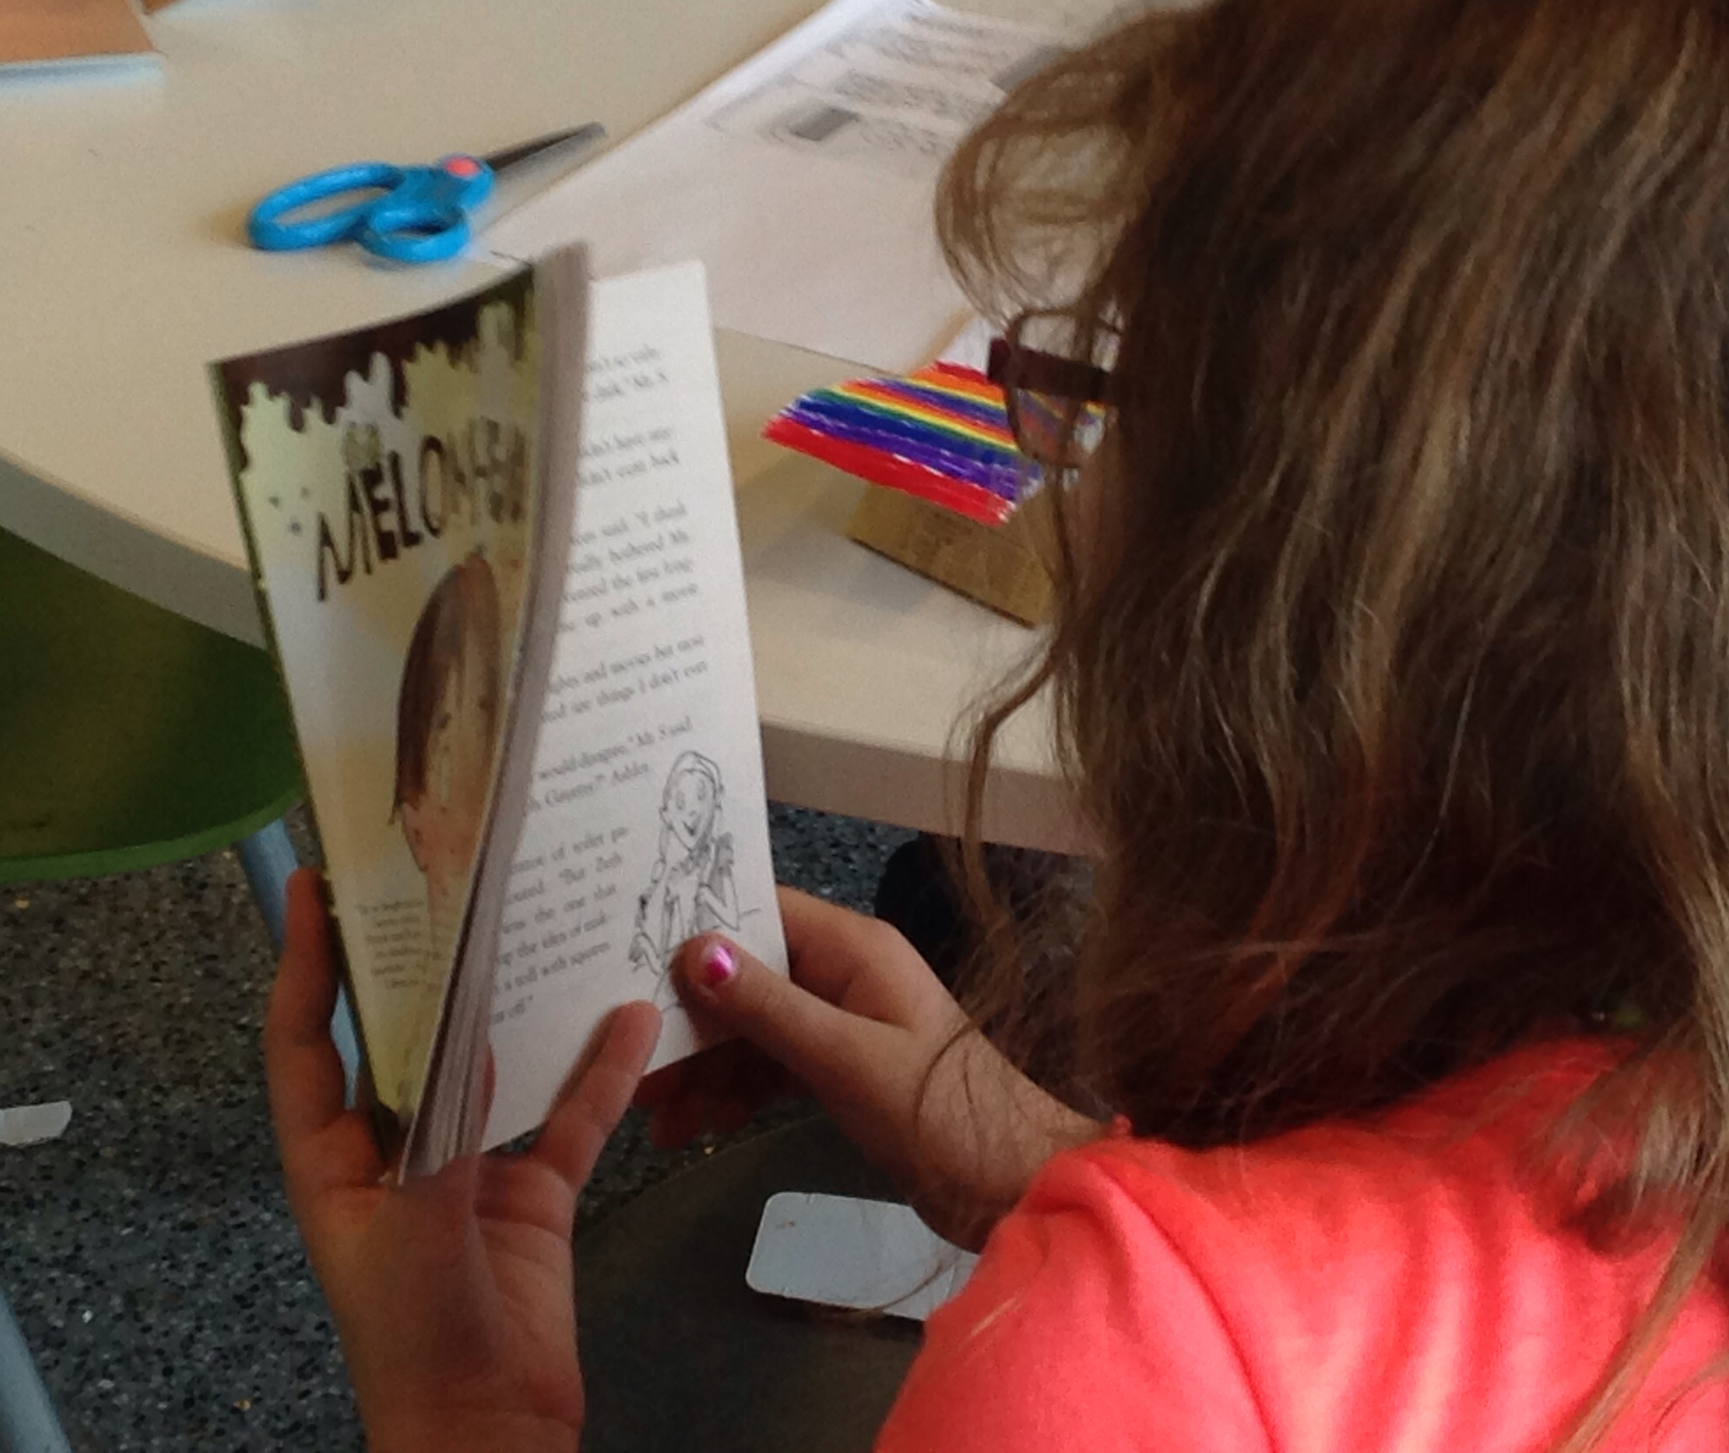
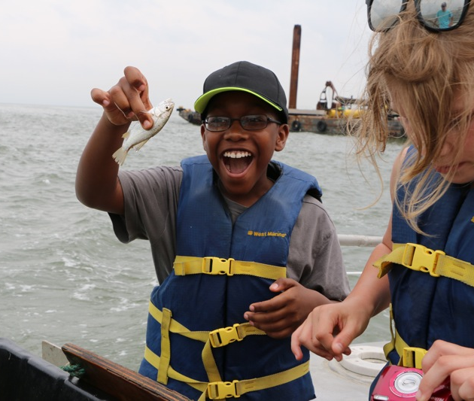
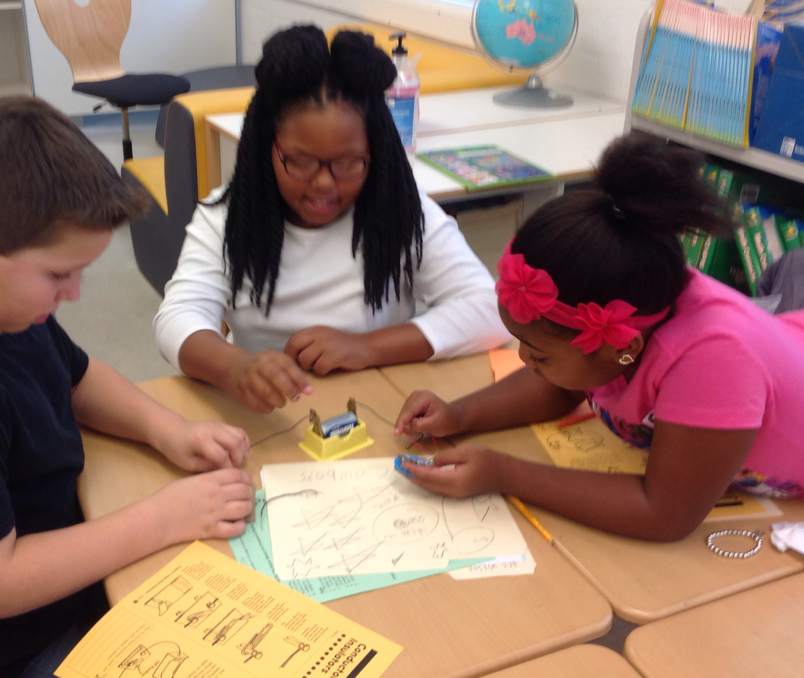
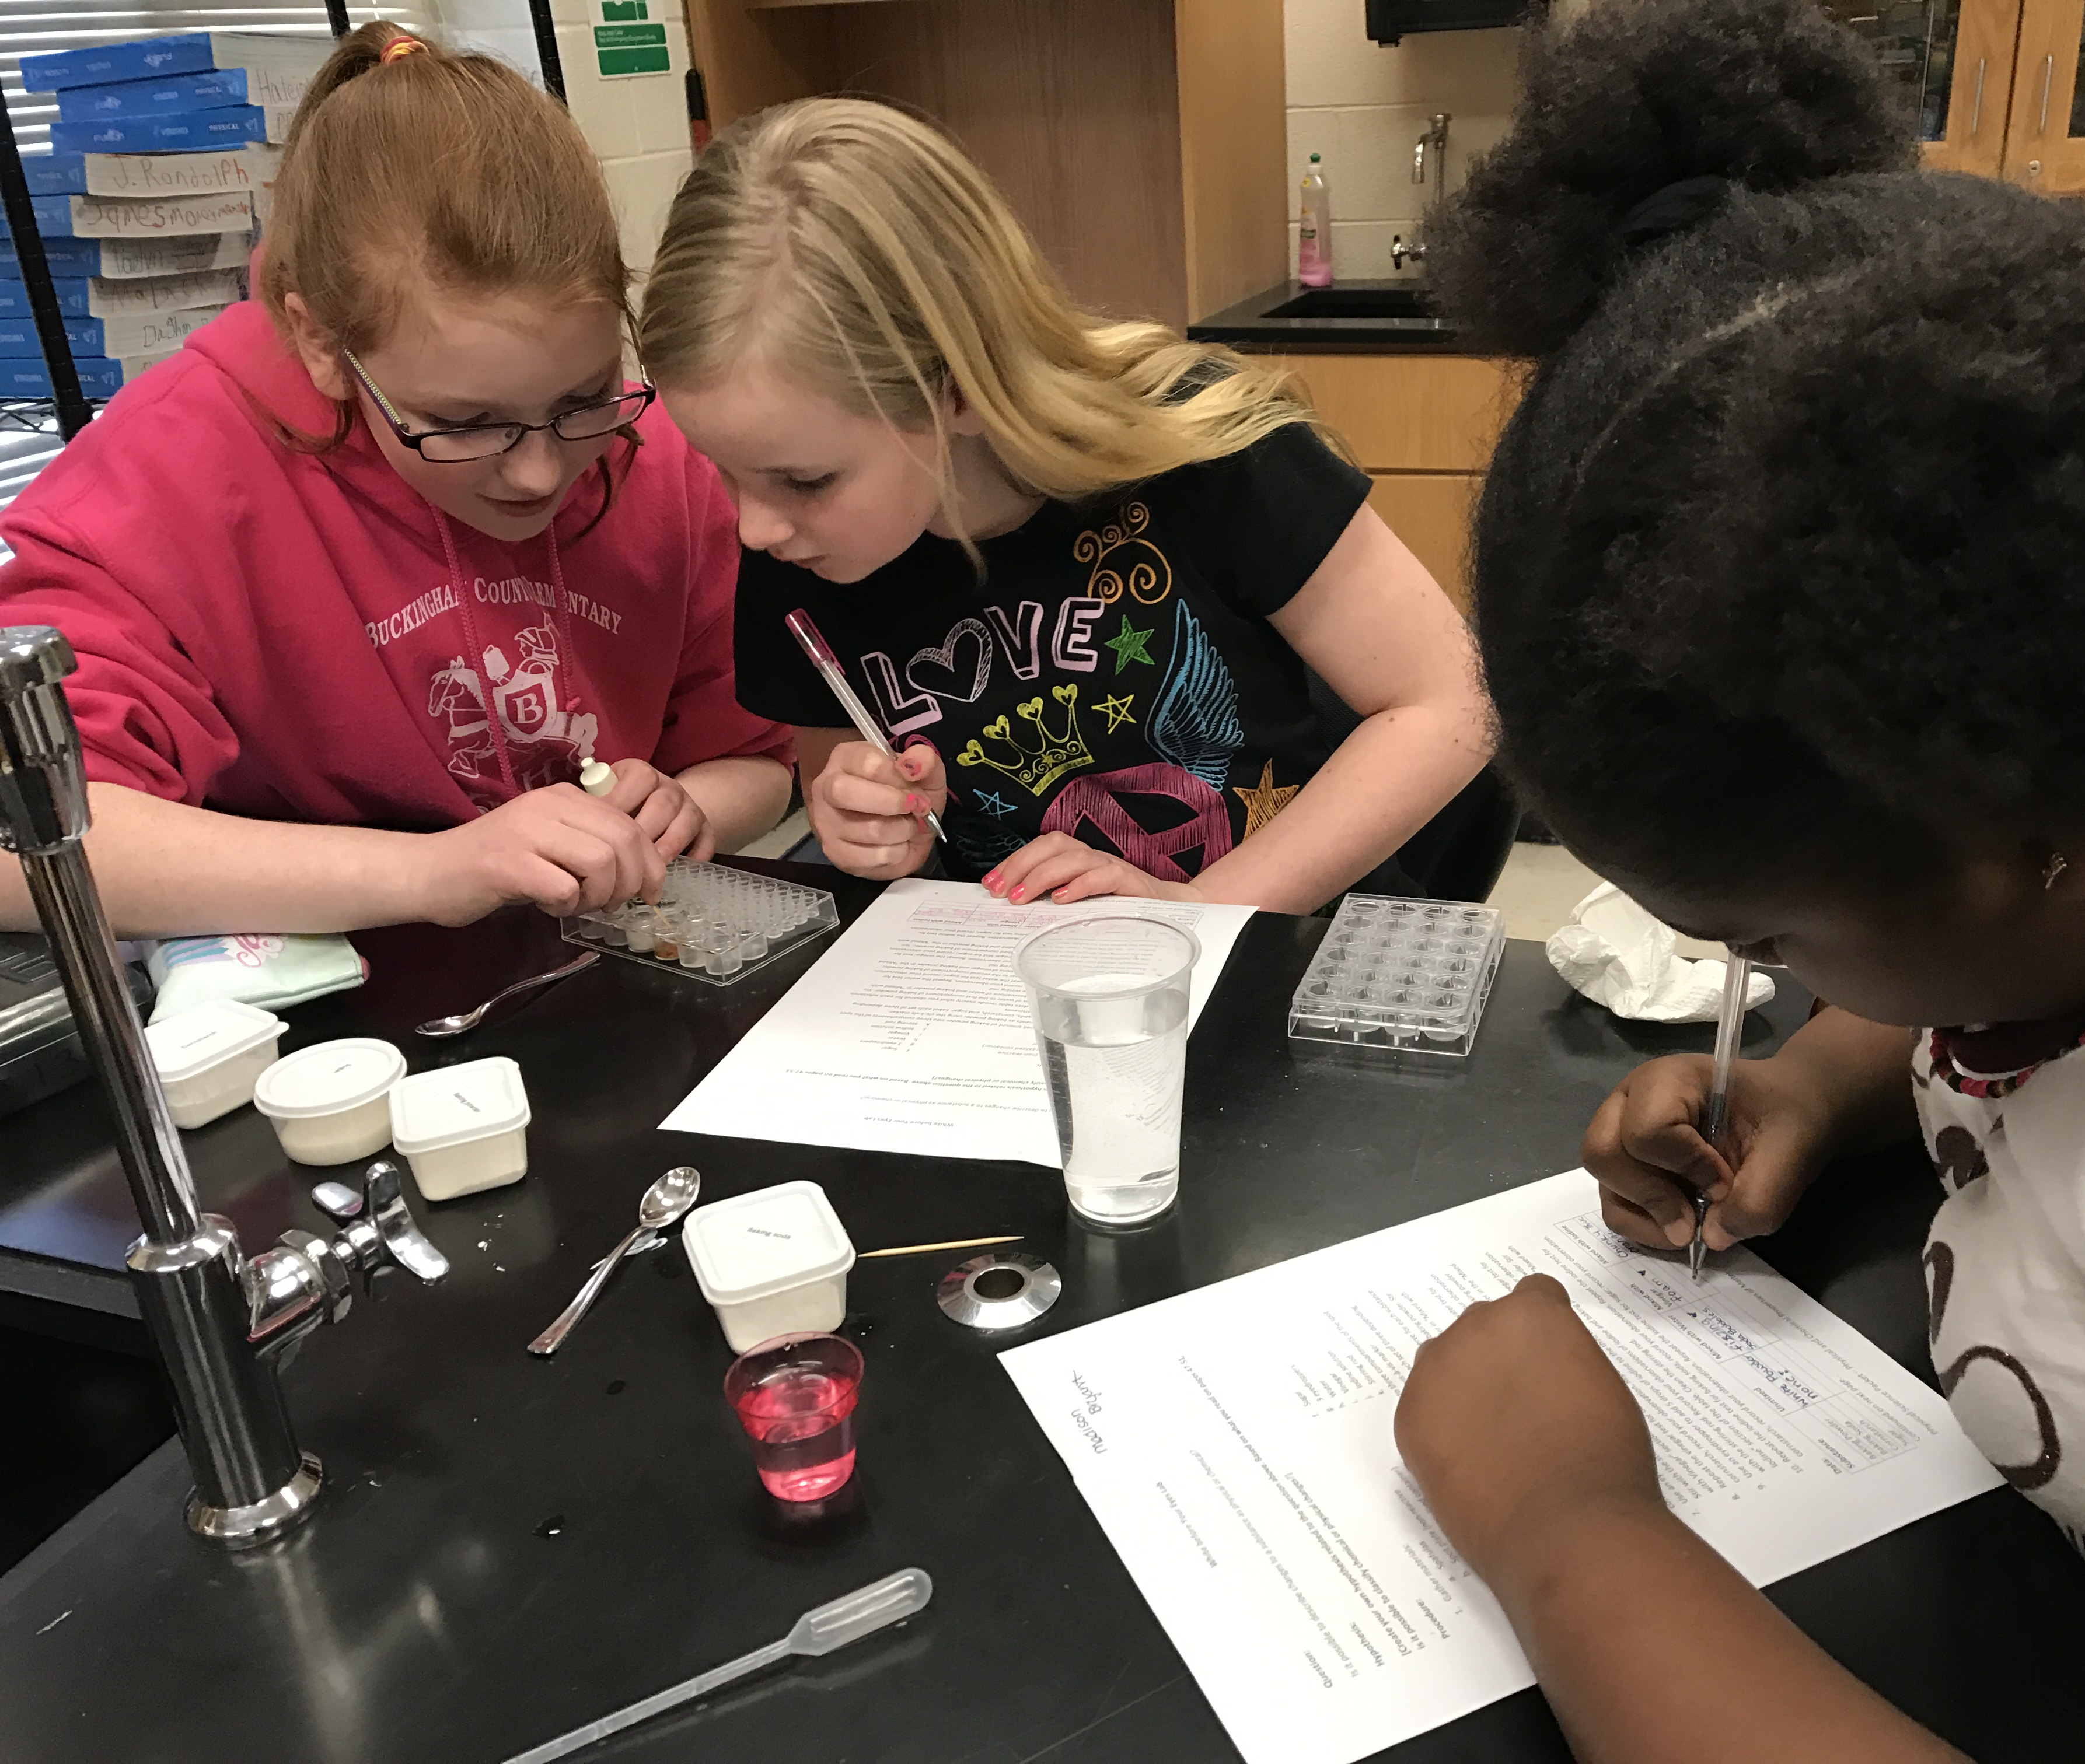
What is Positive Youth Development?
Notes:
Positive Youth Development is really a new catchphrase for something that people have been doing for centuries. Today, it means an intentional approach to working with youth in a way that
is productive and constructive
Enhances young people’s strengths
Promotes positive outcomes
And it does this by
Providing opportunities for youth
Fostering positive relationships
Providing support they need to build on their strengths.
https://youth.gov/youth-topics/positive-youth-development

Slide 3
Where Does PYD Occur?
It MAY occur in …
Schools
Community Organizations (4-H,
Scouts, Recreation Departments, etc.)
Sports Programs
Homes
Religious Institutions
And more
Notes:
Positive youth development has the potential to occur anywhere. But does it?
PYD must be intentional, and research has shown that to be a quality PYD program or atmosphere, certain things must be present.
http://www.cypq.org/

Slide 4
Youth Program Quality
Plan
Reflect
Make Choices
Lead and Mentor
Be in small groups
Partner with Adults
Experience Belonging
Psychological and Emotional Safety
Program Space Emergency Procedures
Physically Safe Environment Healthy Snacks
Welcoming Atmosphere
Encouragement Reframing Conflict
Skill Building Active Engagement
Session Flow
Engagement
Interaction
Supportive
Environment
Safe
Environment
Notes:
Youth Program Quality (YPQ) describes the context for guiding and achieving positive youth development (PYD)
Lets think about this in terms of the school context….
Safety is the foundation of the program. It includes physical safety and emotional safety. Making sure that everyone is included. This also plays into the school climate. Is it positive? How are situations with misbehavior, bullying or violence handled?
The supportive environment is how we as adults (teachers, staff, administration) structure our classrooms and common space (playground, cafeteria, library, gym, etc.). Do we welcome youth? Do we work with them to address undesirable behaviors? Do we actively involve them in learning, providing encouragement and an opportunity for them to build skills?
The interaction tier of the pyramid relates to how the youth connect with each other and with their peers. Are we providing them opportunities to work together in small groups? Do we provide all youth a chance to share their experiences (even those who struggle)? Do we provide them opportunities to develop leadership skills?
The tip of the pyramid is where the most opportunity for growth can be found, but you cannot get to it without a firm foundation and solid layering to get to this point. This is higher level youth engagement where they are making choices, planning, and reflecting on what happens and what they are learning. This is often perceived as more challenging in a school environment because it involves youth in making important decisions and that takes time. However, when youth can give input on the projects to be done, or how the class will go about learning a certain topic, they have more buy-in and learn more skills along the way. Of course, the choices and plans must be age-appropriate, too.
Engagement is not complete without the reflection piece. Reflection is a review of what has happened, how youth felt, and what they have learned from the experience. This helps them to scaffold the learning – connecting it to previous experiences and internalizing it. It enables youth to use their critical thinking skills and helps them to deepen their understanding. It also gives them the opportunity to connect their experiences to real world applications. Reflection needs to be built into each session you have with the youth.
Reflection should be fun.
It should be integrated into the activity.
We as adults help youth reflect by asking open-ended questions.

Slide 5
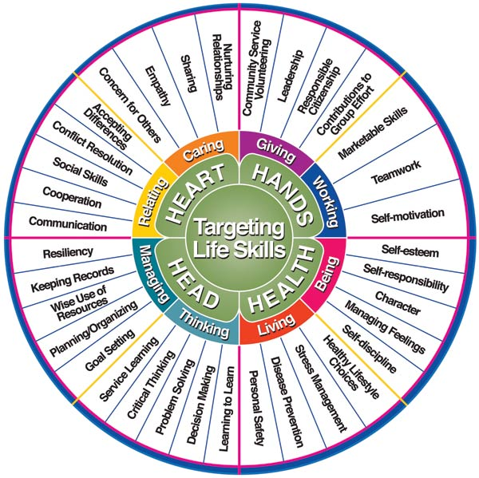
Targeting Life Skills – a 4-H model
Hendricks, P. (1998) “Developing Youth Curriculum Using the Targeting Life Skills Model” http://www.extension.iastate.edu/4H/skls.eval.htm
Notes:
Life skills help a person function in their day-to-day activities.
4-H focuses on developing skills that are healthy and productive for both youth and their communities.
Mastery of any skill requires opportunities to try, make mistakes, and try again.
Skills are learned in sequential steps related to the age and stage of development of the young person.
Norman, M. N., Jordan, J. C. (n.d.). Targeting life skills in 4-H. University of Florida, Institute of Food and Agricultural Sciences.
In the classroom, our purpose is teach students needed information so that – well let’s face it – so that they can pass their SOL tests and so that they gain a subject knowledge that will help them progress into adulthood and be able to function in society (reading directions, understanding basic math to make sure they can do their shopping, etc.). But we know that learning does not happen in a vacuum. There are many life skills at play, too – learning to get along with others, to communicate effectively, to think critically about a problem and to manage stress for example.
For positive youth development to occur, we cannot get so caught up in the academics that we forget about providing opportunities for interaction and engagement in a supportive and safe environment. In addition to questions about the subject matter we need to ask students why that information is important to them. How does learning about ancient Egypt for instance help them navigate the world today? Question the students and guide them to the realization that studying the past helps us understand change and understand the influences on our civilization today – things like art and architecture.
Think about this example:
If we are studying the scientific method, we learn the content knowledge about the steps involved, what a hypothesis is, how to control the variables in an experiment so that we have many things that are constant and just one independent variable. We also learn life skills of planning and organizing, critical thinking, problem solving, keeping records, personal safety, and maybe even stress management. When we focus on the content-based skills and ignore the life skills, we miss a great opportunity. But when we spend a few minutes intentionally pointing out the life skills learned and asking questions about those life skills, we have added a whole new dimension to the learning – one that is a major part of positive youth development.

Slide 6
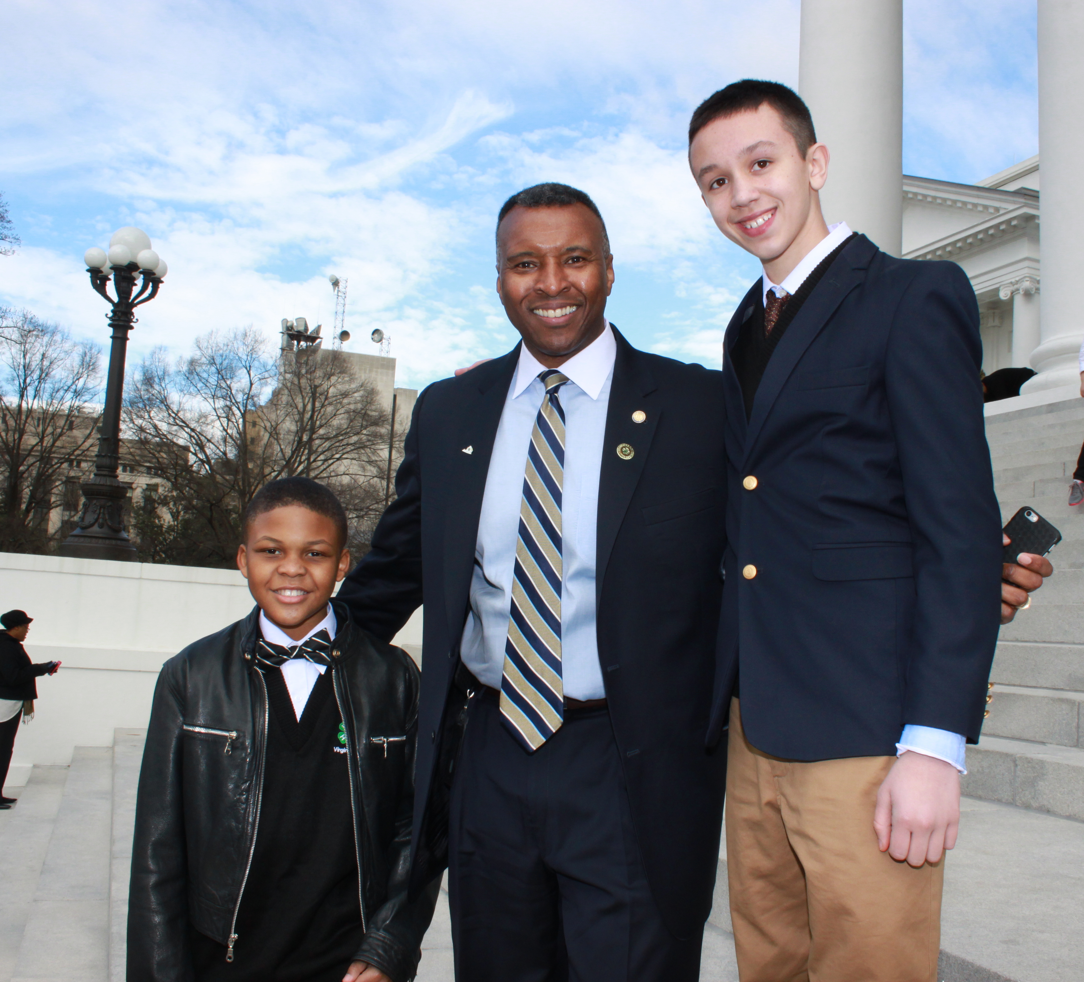




Positive Youth Development
Why invest in youth?
Notes:
Asking the question, “Why are we focusing on positive youth development” is like asking, “Why should we invest in our youth?”
We do it because our youth can make positive contributions to our communities and to society as a whole now, and to a larger extent in the future. We would like to emphasize the positive and the productive and to enable our youth with the confidence and skills they need to be good citizens.
There are many opportunities for positive youth development to occur as long as the organizations and entities are making an intentional effort to have quality programs that enhance positive youth development. PYD doesn’t typically just happen by accident.
Let’s make sure that our schools are places where positive youth development occurs in tandem with the academic skills and content.

Slide 7
Thank you!

