Slide 1

Final Deliverable:
Website Mockups and Improvements
By Mia Hagood

Slide 2

Deliverable Overview
Goal: Help students make informed decisions choosing majors by improving the organization and access of information about majors
All proposed designs are meant to help VT Admissions faculty improve VT's current website
  User experience
  Information organization/access
Recommended improvements
  Wireframes: layout, skeleton
  Mockups: images, text, fonts, visual details

Slide 3
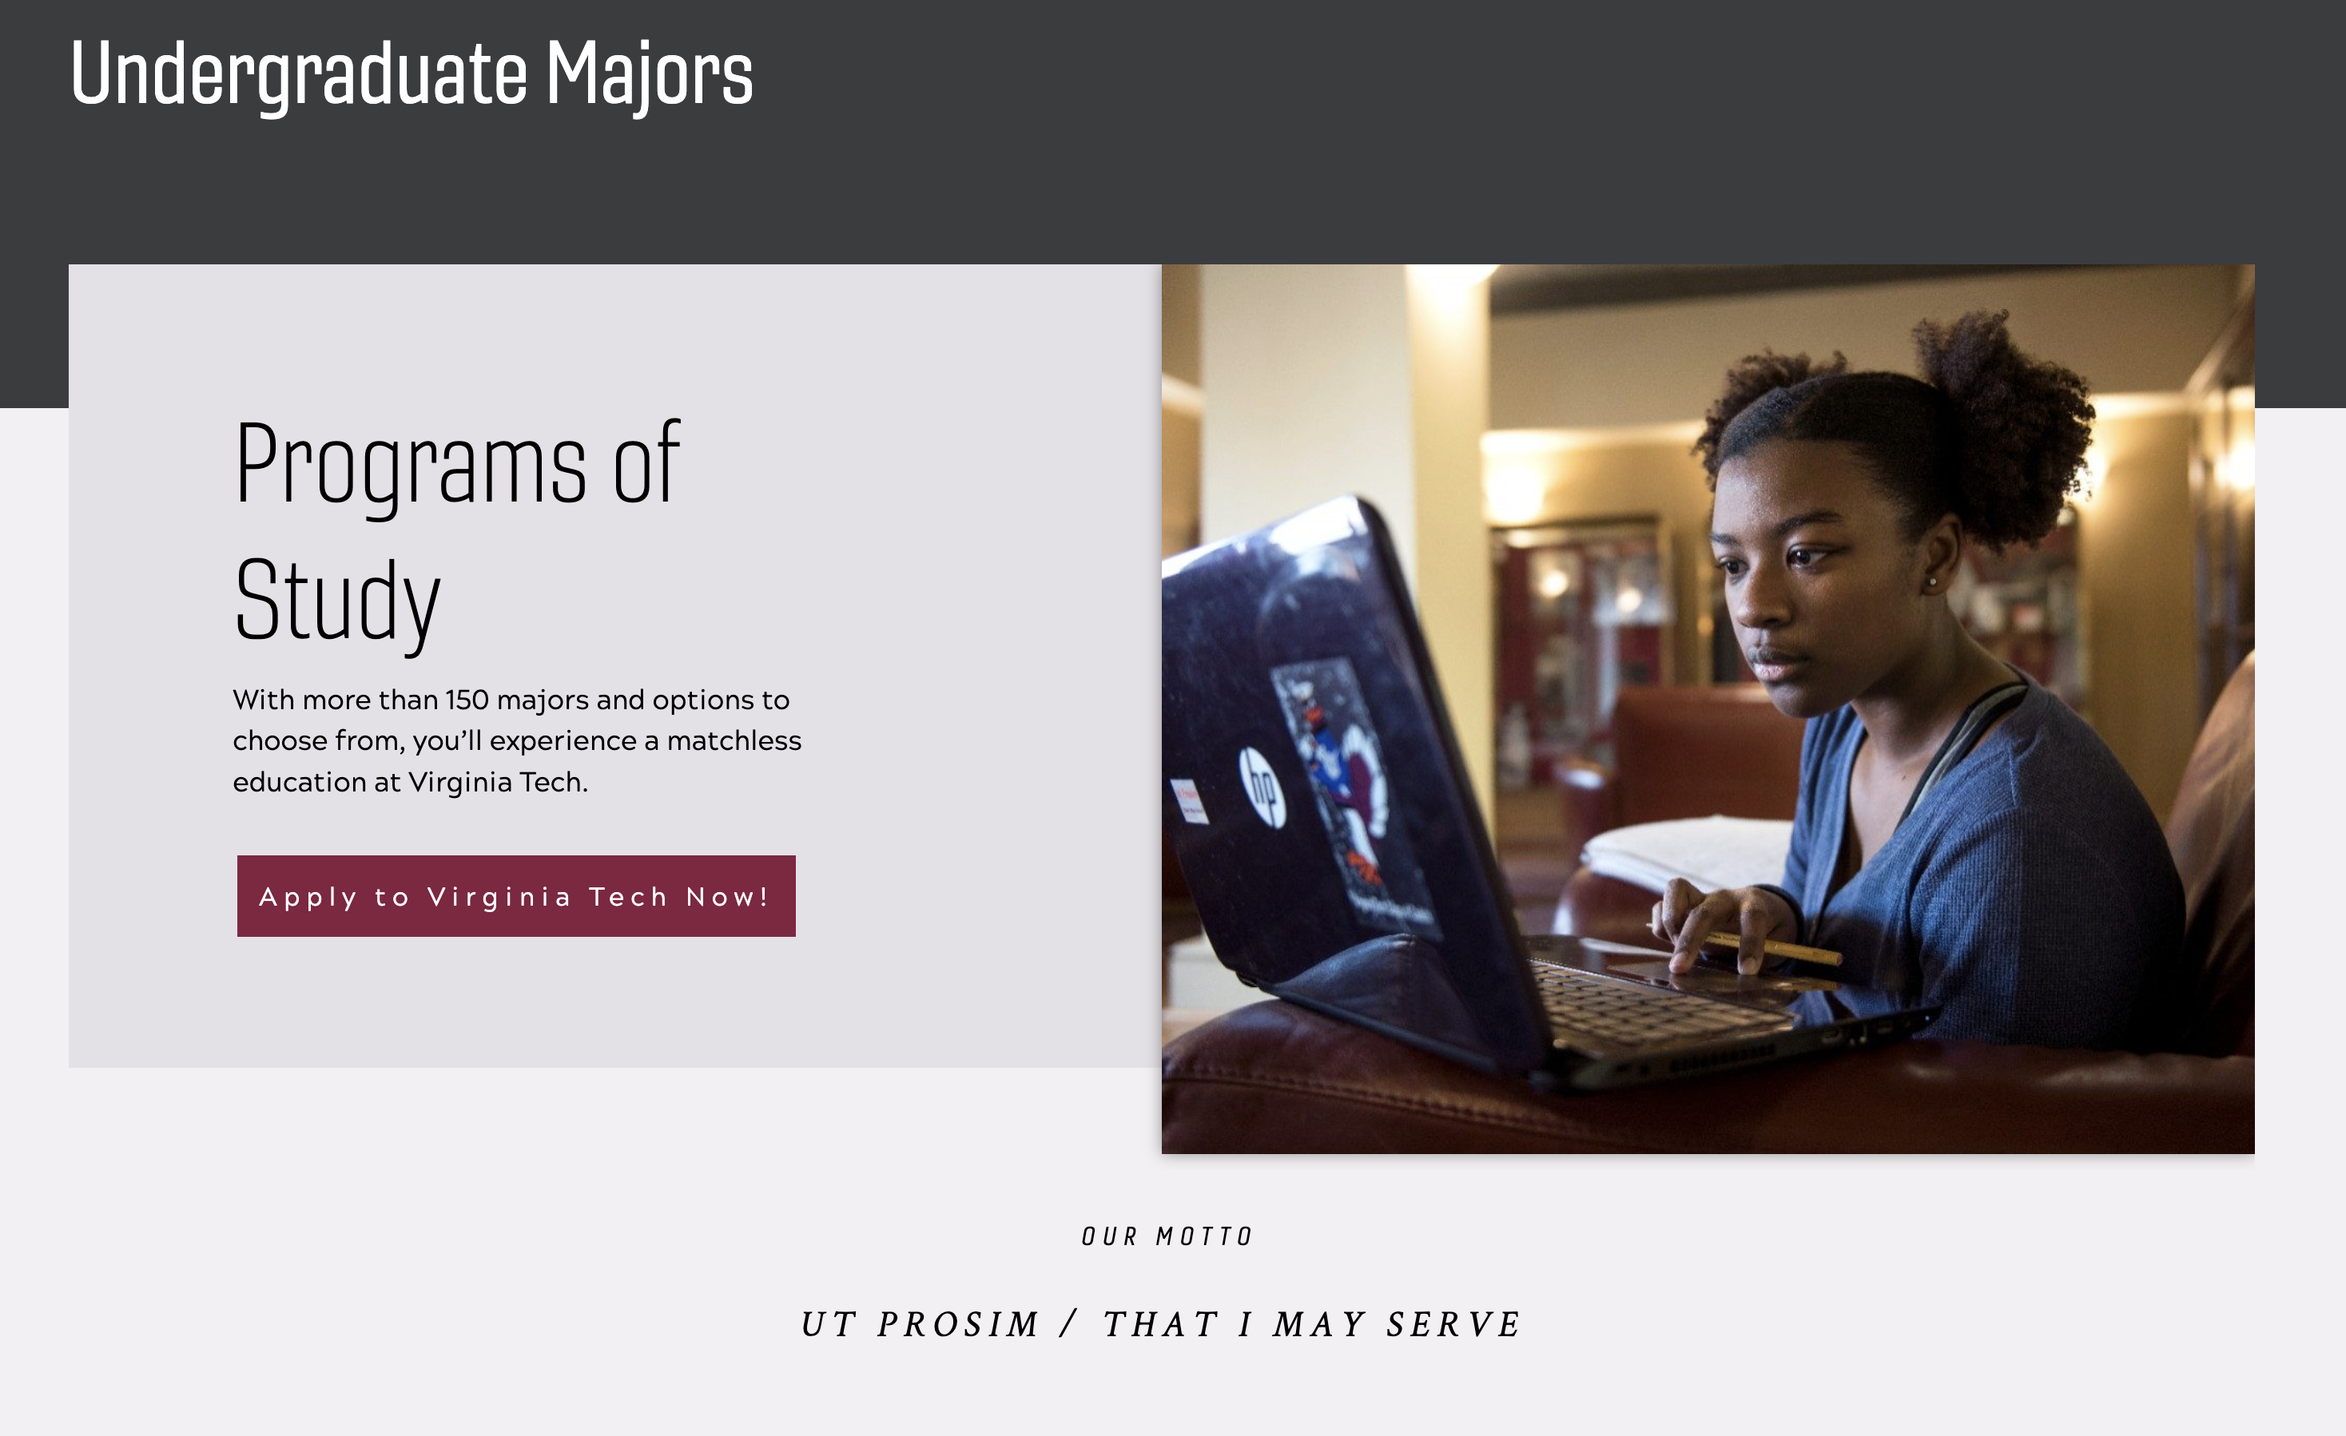
Home/Landing

Slide 4
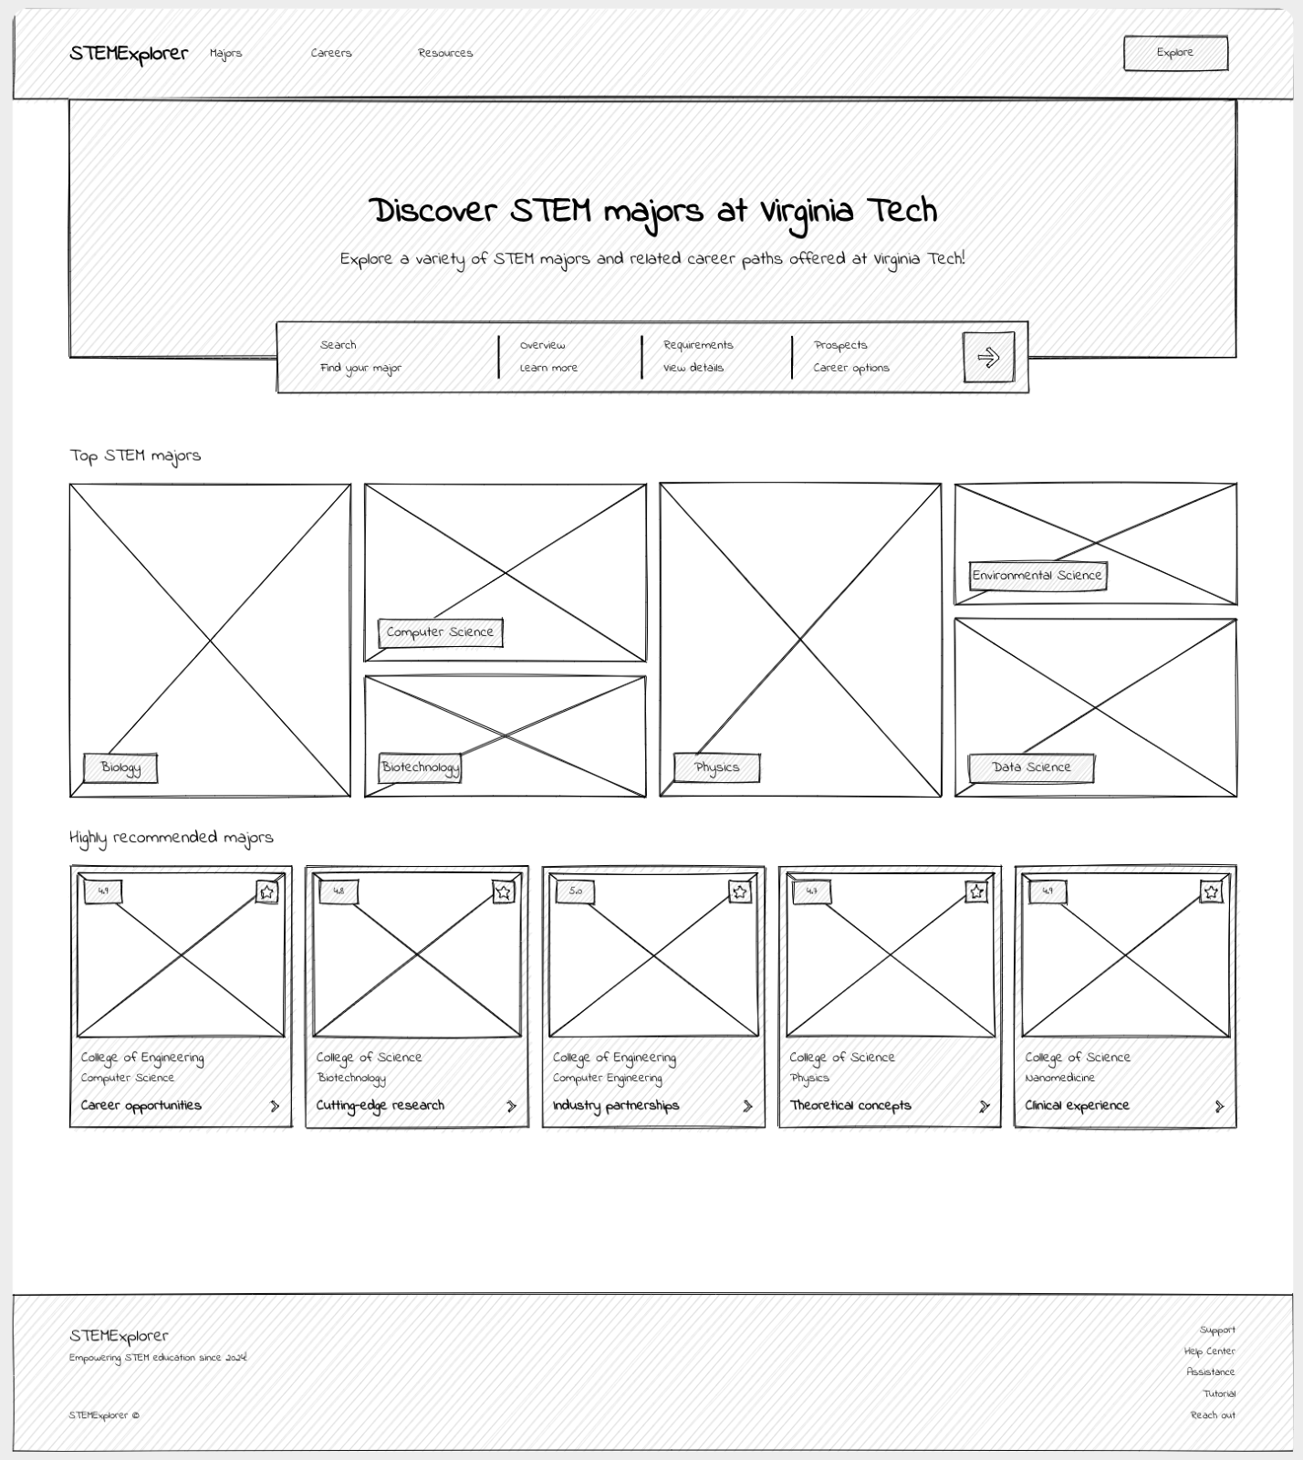
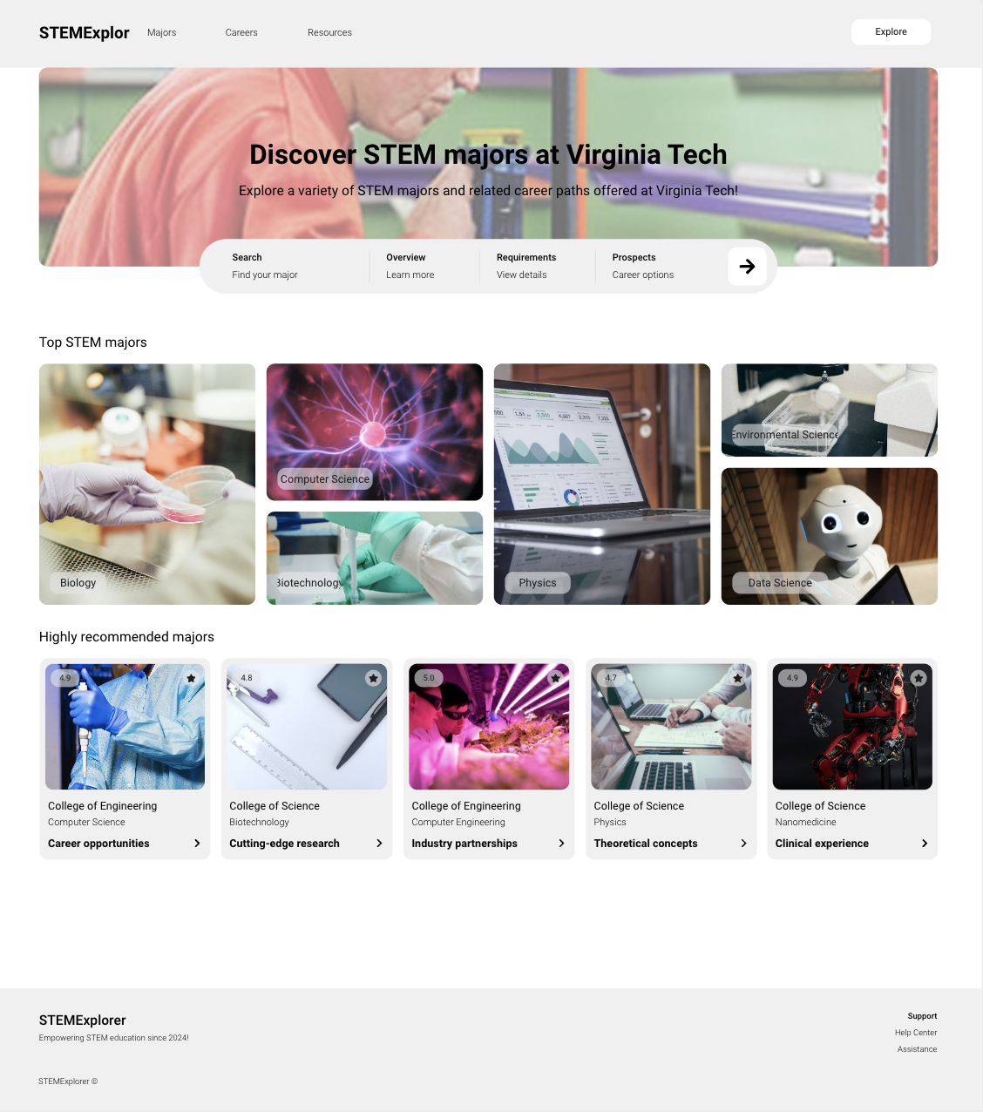
Home/Landing

Slide 5
Summary of Landing
Incorporate more visuals
More ways to explore majors
  Top majors
  Top recommended

Slide 6
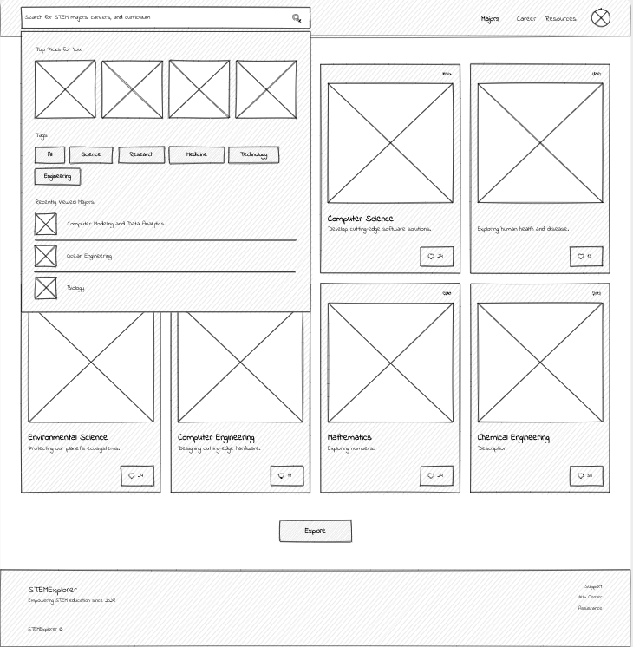
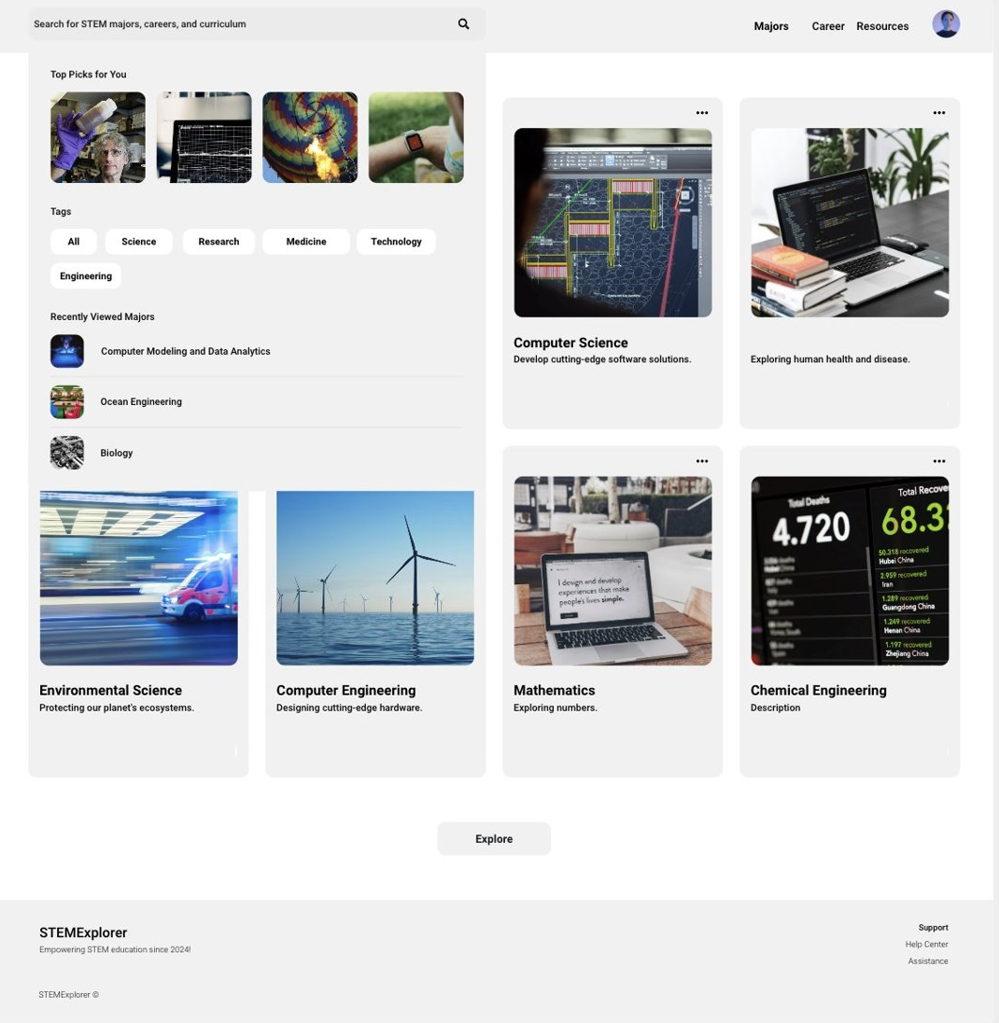
Search Bar

Slide 7
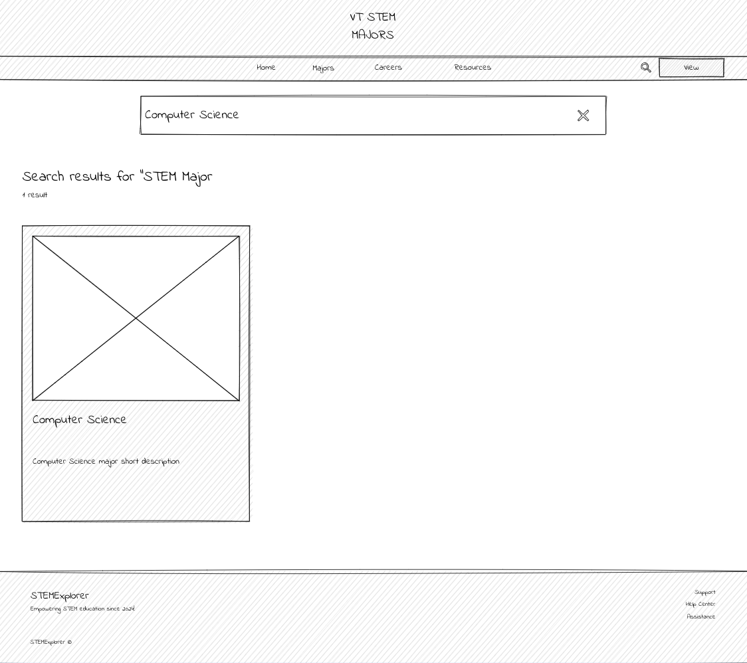
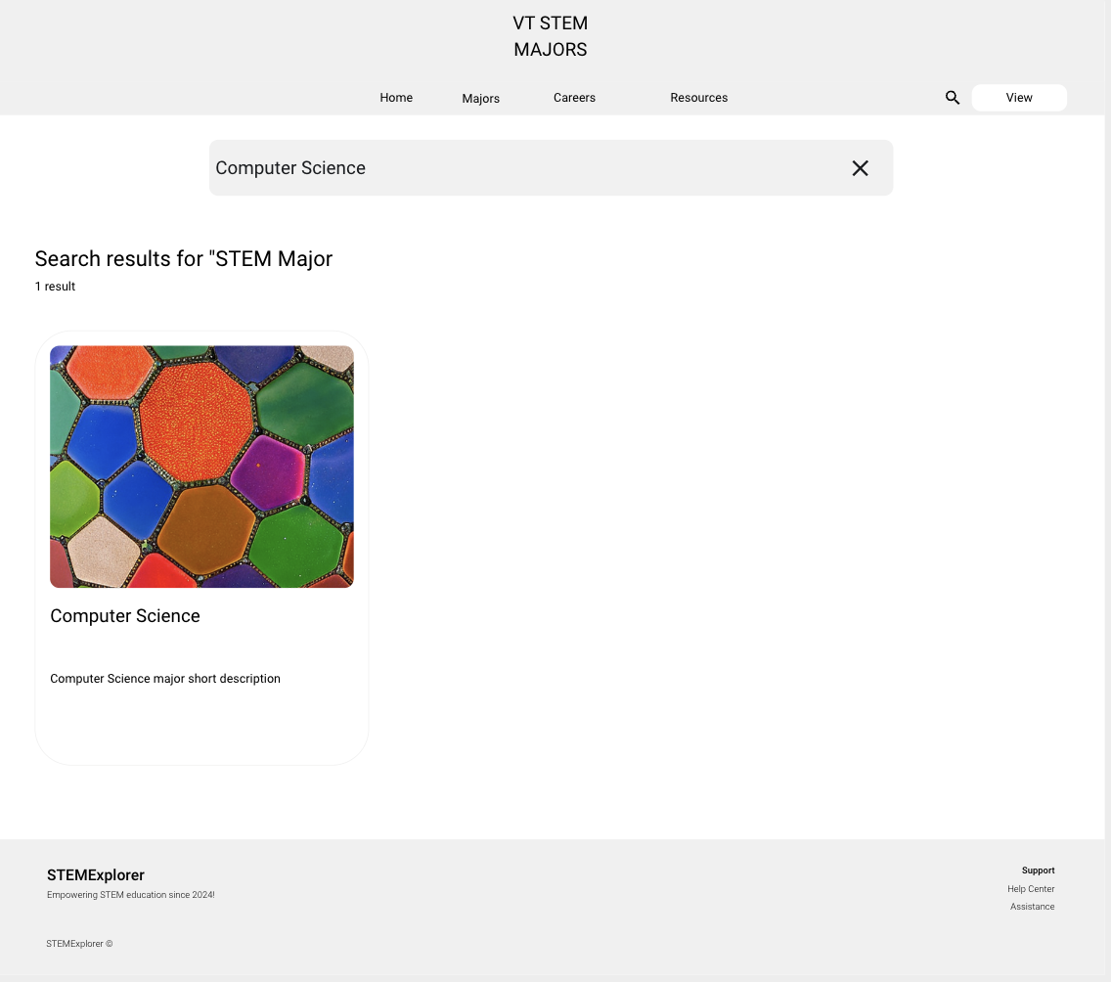
Search Results

Slide 8
Summary of Searching
Implement a searching feature
Search by tags
History/recent searches
Visual results

Slide 9
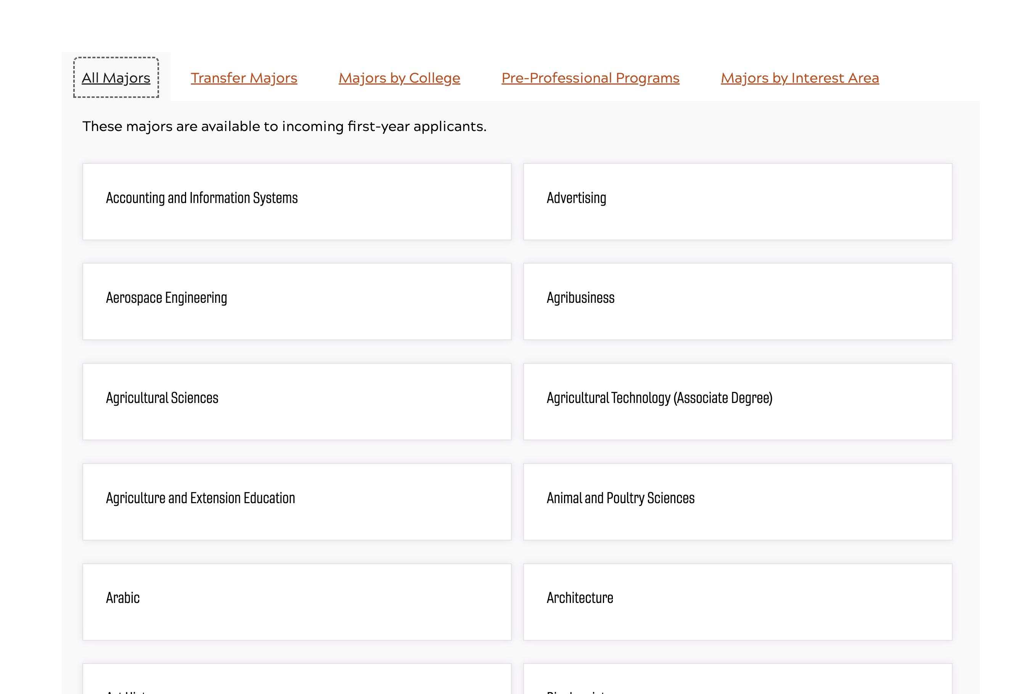
Overview

Slide 10
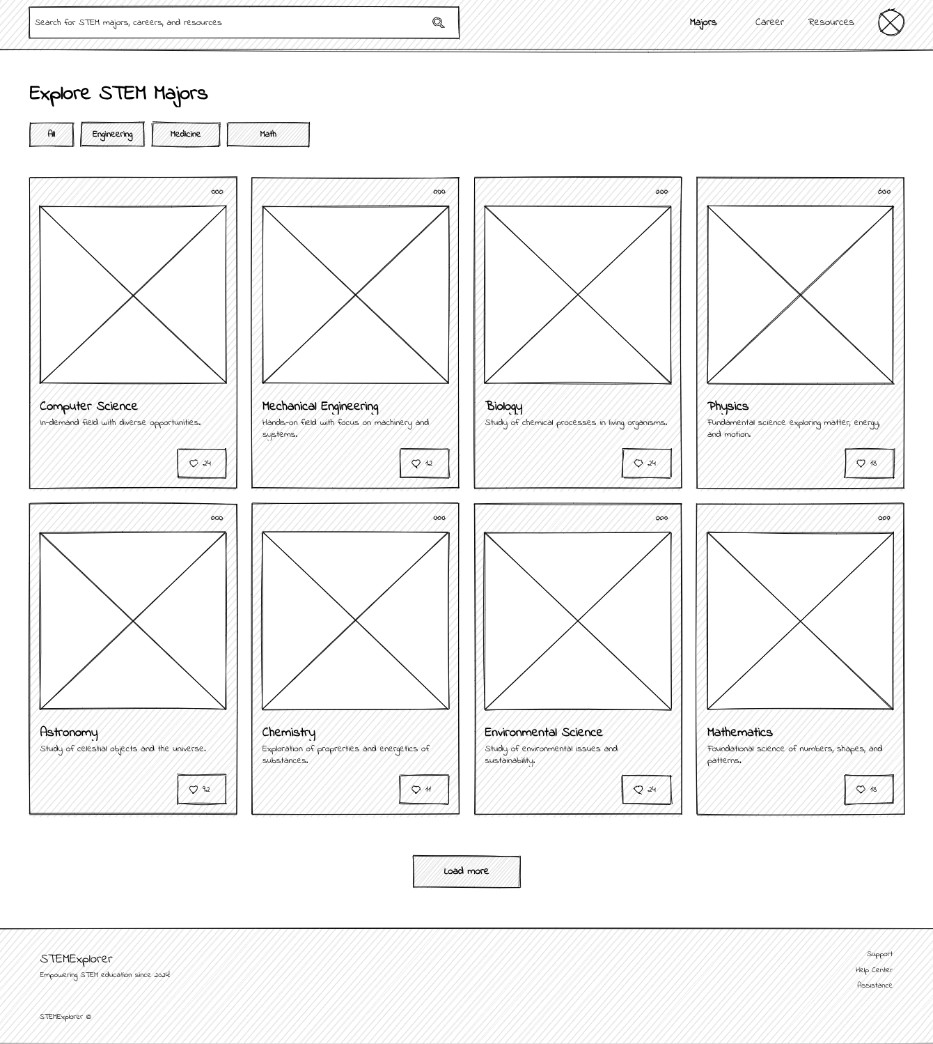
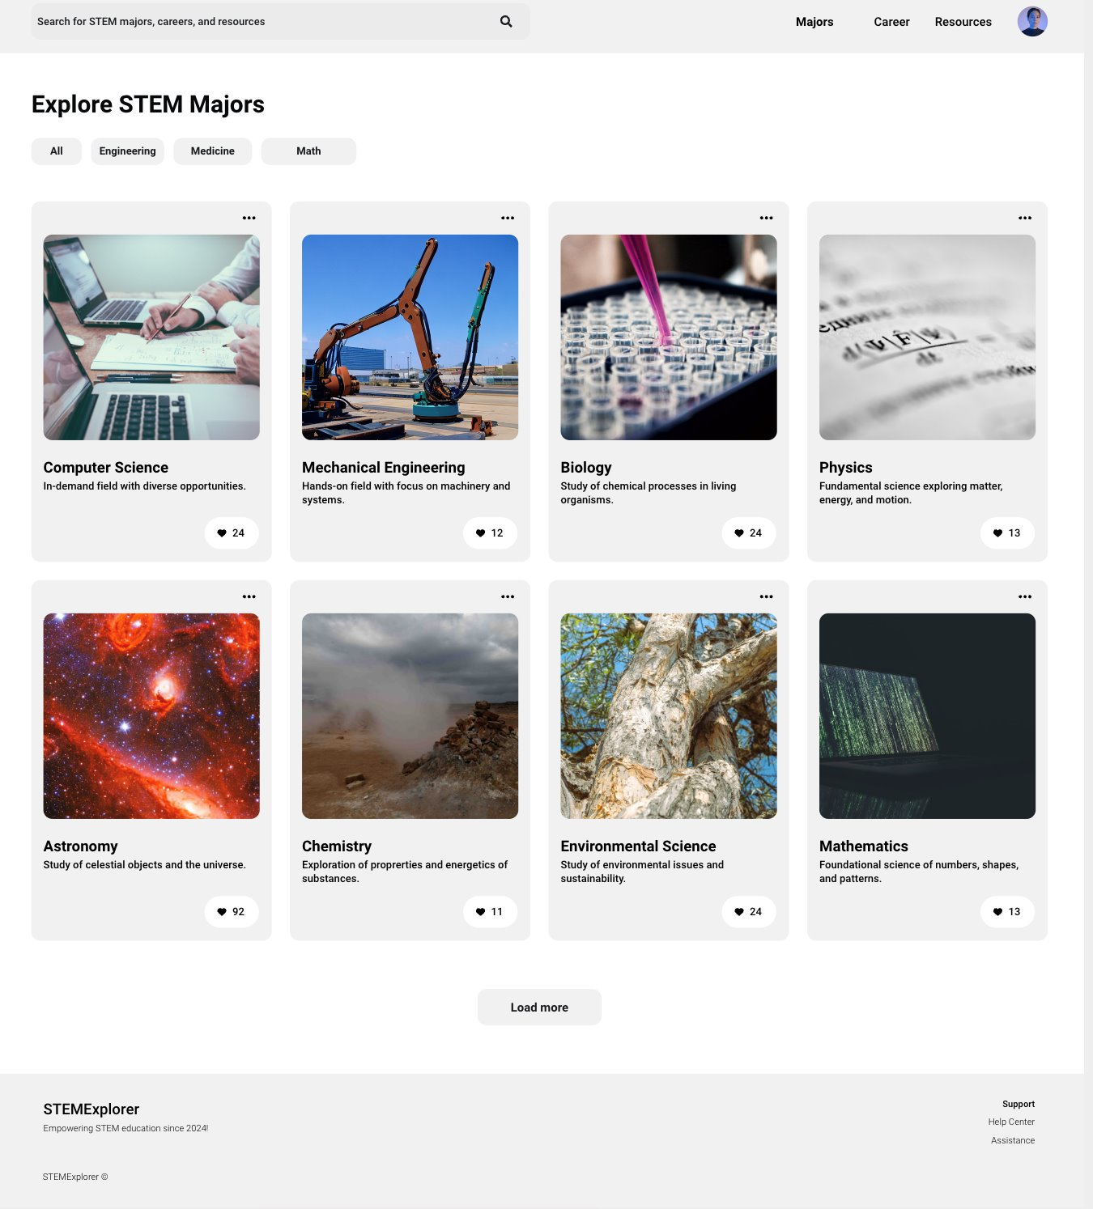

Overview List View [edited title and replaced right image]

Slide 11
Summary of List View
Cards with image and explanation
Sort/filter by keywords and tags

Slide 12
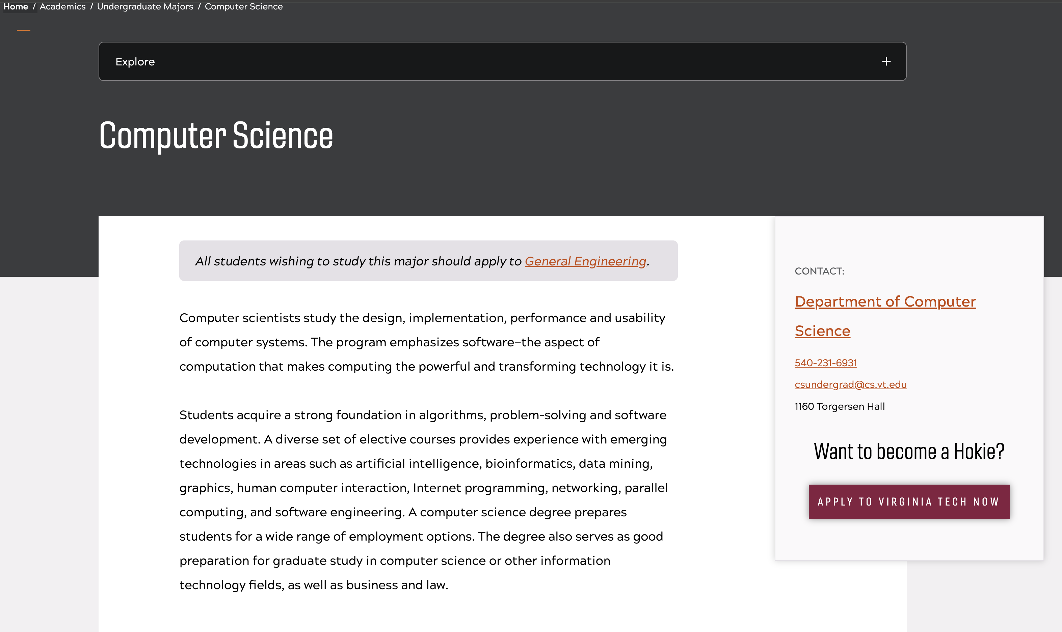
Major Details

Slide 13
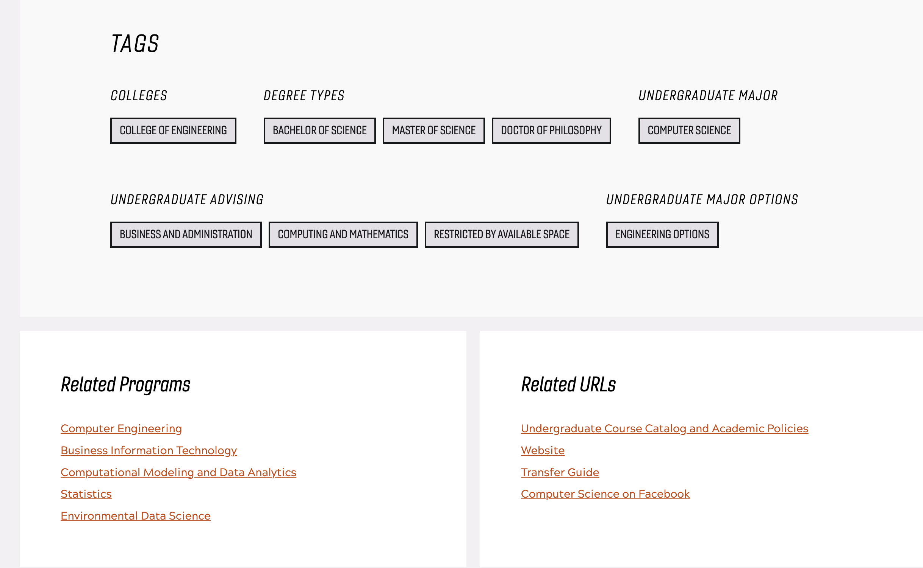
Major Details

Slide 14
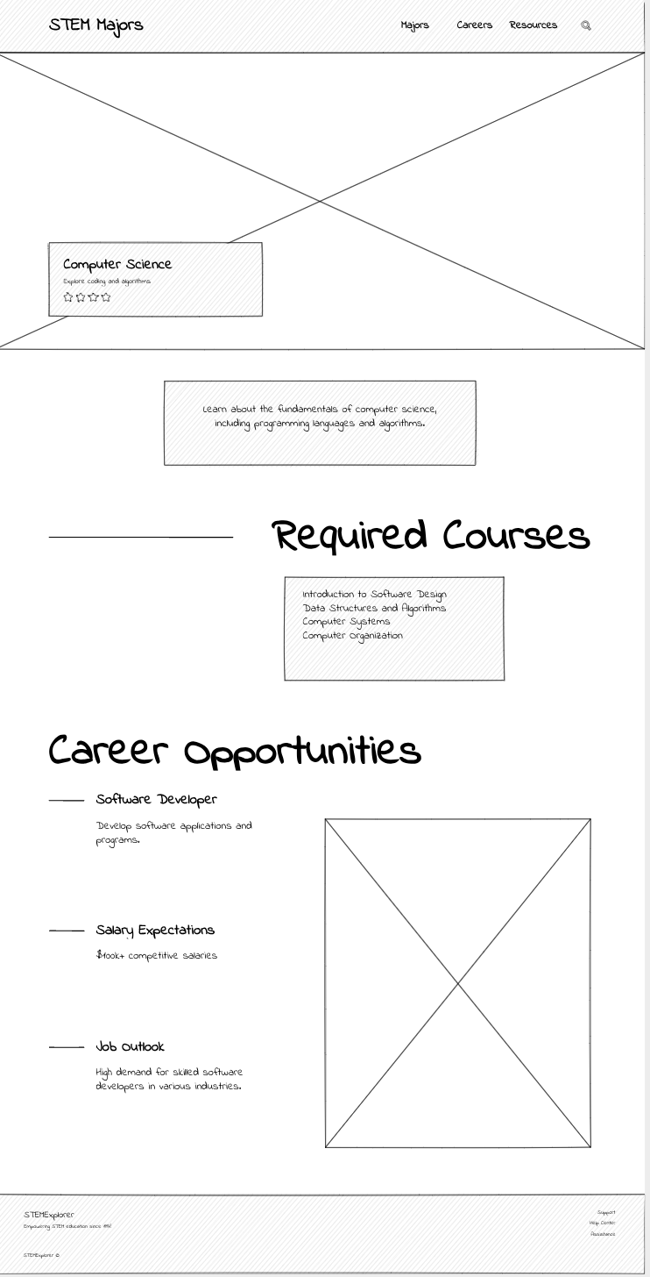
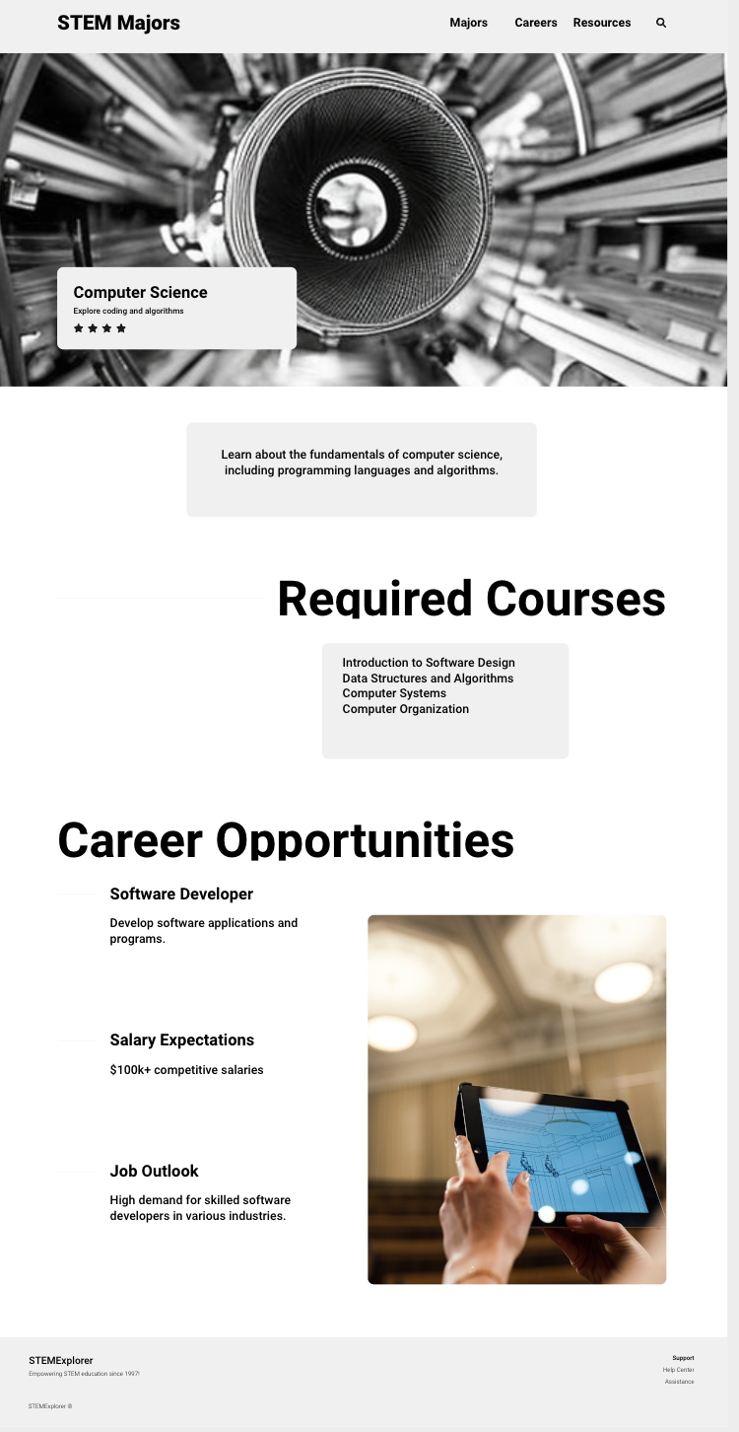
Major Details

Slide 15
Summary of Details Page
Include information in one page to make it convenient and direct
  Detailed explanation
  Courses
  Career paths
  Research and extracurriculars

