Slide 1

TEXAS TECH UNIVERSITY
National Wind Institute
NAWEA Presentation
by
Dr. Andy Swift and Dr. Chris Pattison
Texas Tech University
Wind Science & Engineering
Integrating Real-World Case Studies into Wind Energy Graduate Education

Slide 2
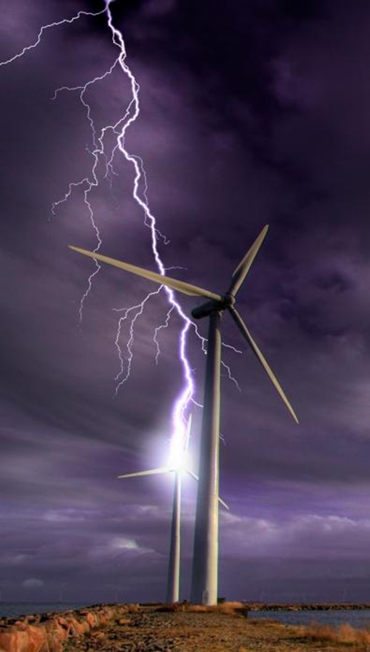
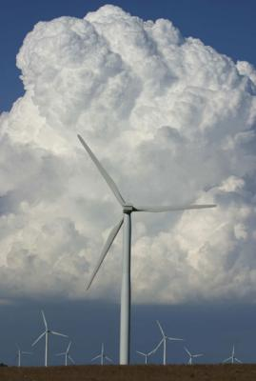
TEXAS TECH UNIVERSITY
National Wind Institute
Questions?
Thank You

Slide 3
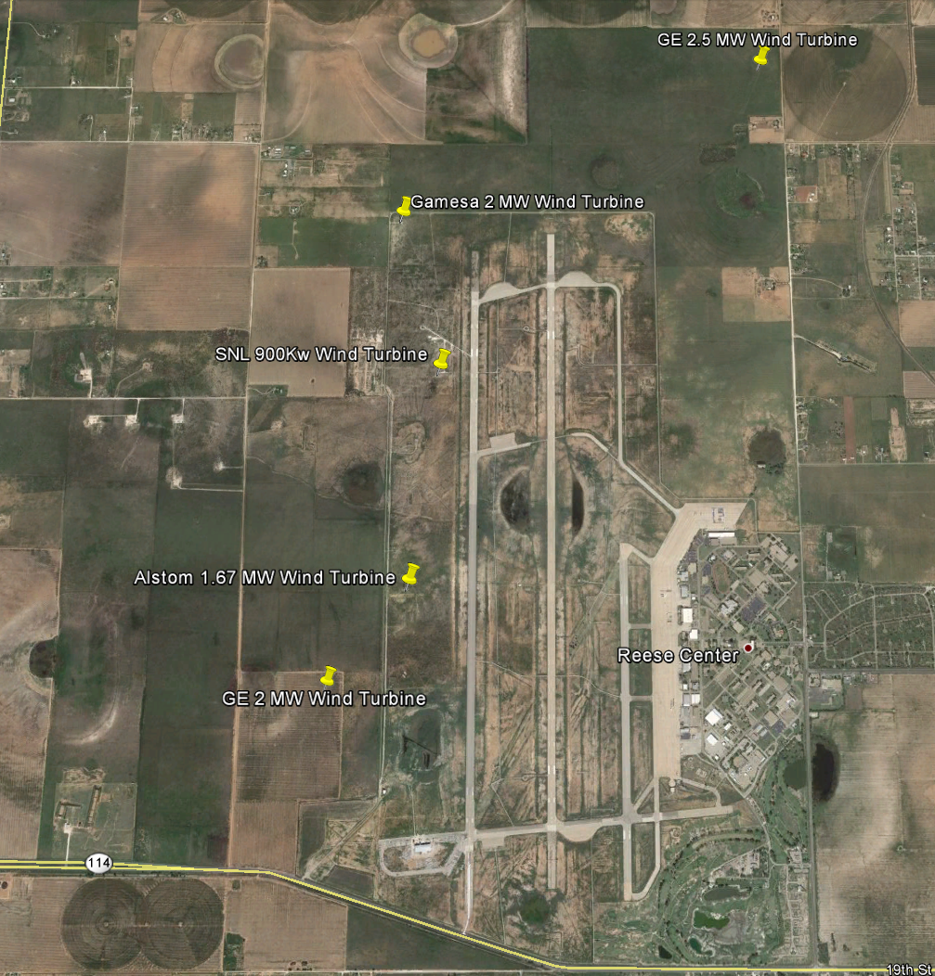
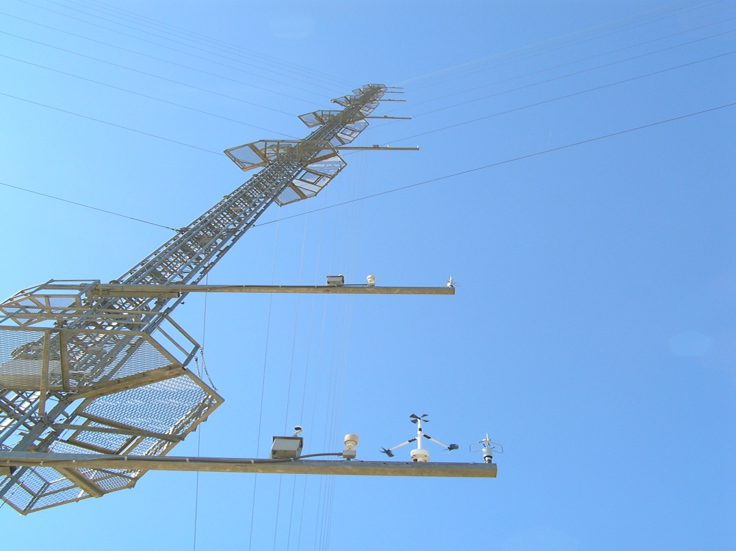
33° 36’ N
102 2’ W
TEXAS TECH UNIVERSITY
National Wind Institute
200 meter tower
Research and Education
NWI over-view
Aerial image
Mission statement

Slide 4
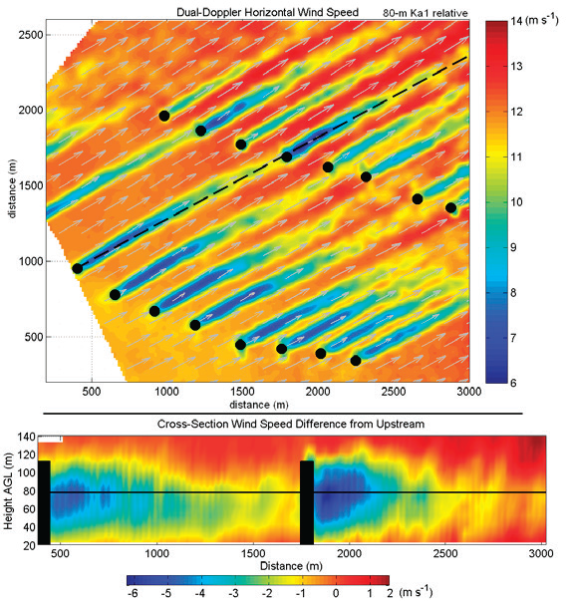
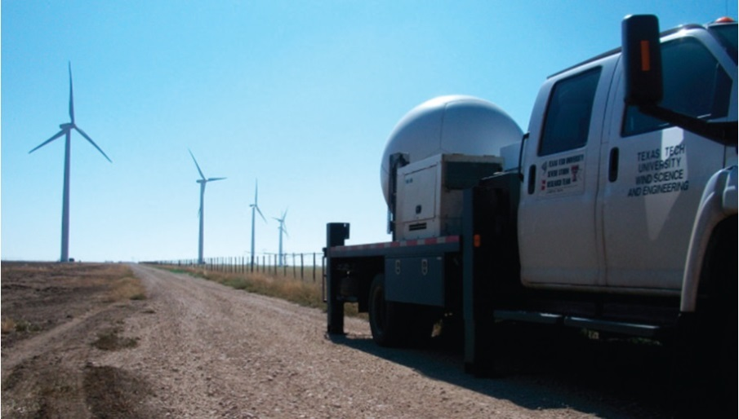
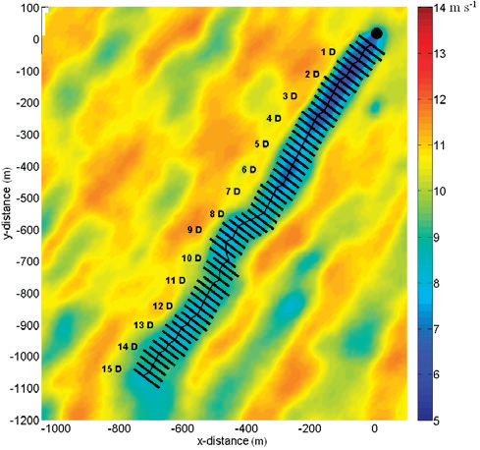
Education Program
TEXAS TECH UNIVERSITY
National Wind Institute
Radar and wake studies
2 of 86

Slide 5
TEXAS TECH UNIVERSITY
Education Program
National Wind Institute
Vision
  The NWI Educational Programs provide a comprehensive suite of high quality, multi-disciplinary educational opportunities that support the workforce needs of the wind energy industry.
Opportunity
  Wind energy along with other renewable electric technologies is a rapidly growing global industry
  Last year (2013) approximately 45% of the new electric capacity installed globally was a renewable technology
  TTU / NWI Educational Programs are one of only a few in the nation to support a US workforce of approximately 80,000.

Slide 6
Education Program
TEXAS TECH UNIVERSITY
National Wind Institute
Undergraduate Programs
  Bachelor of Science in Wind Energy
  Minor in Wind Energy
  Undergraduate Certificate
Graduate Programs
  Graduate Certificate Programs
    Advanced Technical Wind Energy (for engineers and scientists)
    Advanced Managerial Wind Energy (for managers, business and legal professionals)
Outreach Programs
  Global Component, BSWE, Study Abroad in Germany
  Partnership with TTU WCOE and Jade University-summer 2014
528 enrollments
(20 graduated)
30 Graduate enrollments

Slide 7
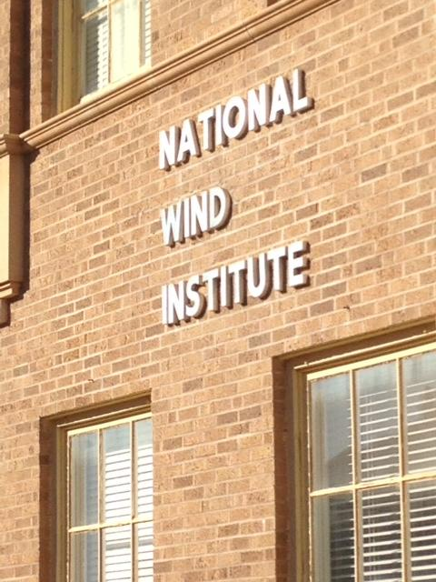
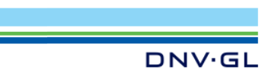

Graduate Education
TEXAS TECH UNIVERSITY
National Wind Institute
Partners:
TTU’s NWI
DNV-GL

Slide 8
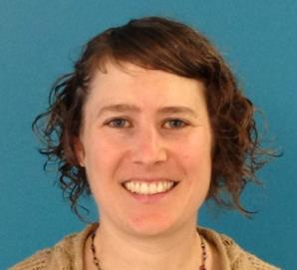
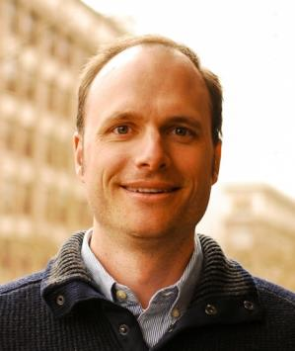
TEXAS TECH UNIVERSITY
National Wind Institute
Graduate Education Partners
Case studies presented by Dr. Kim Mortstock in Seattle, with DNV-GL
Case studies presented by Dr. Chris Elkinton in Portland, with DNV-GL

Slide 9
TEXAS TECH UNIVERSITY
Partnership details
National Wind Institute
Multi-Year Contract agreement between TTU/DNV-GL
Student course fees cover cost to deliver case studies
Face-to-face and on-line delivery
Lync and MediaSite
Lecture-capture mode (videos)
Blackboard (education platform)
Distance Education (e-learning) Group

Slide 10
Graduate Education
TEXAS TECH UNIVERSITY
National Wind Institute
Graduate classes working with DNV-GL
1. Advanced Technical Wind Energy 1 & 2
2. Advanced Managerial Wind Energy 1 & 2
Additional Graduate Courses:
Power Systems Engineering, Wind Power Meteorology, Renewable Energy Policy, Energy Options and Futures, Finance, or Risk Modeling and Assessment

Slide 11
TEXAS TECH UNIVERSITY
Case Study Topics
National Wind Institute
Fall Classes
1. Off shore
2. Community impact
Turbine Technology
Site suitability
DNV-supplied high-level homework
New Case Studies each fall semester
Spring Classes
5. Site suitability (part 2)
6. Finance & Sensitivity analysis
7. Turbine under-performance
8. Off-Shore Construction & O&M logistics

Slide 12
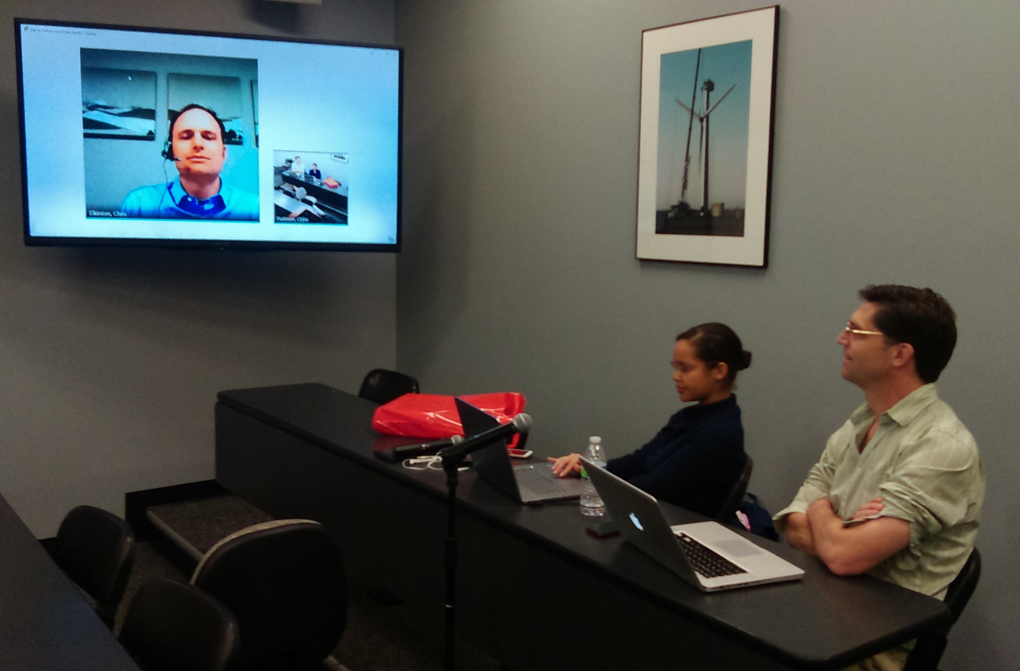
WE Classroom
TEXAS TECH UNIVERSITY
National Wind Institute

Slide 13
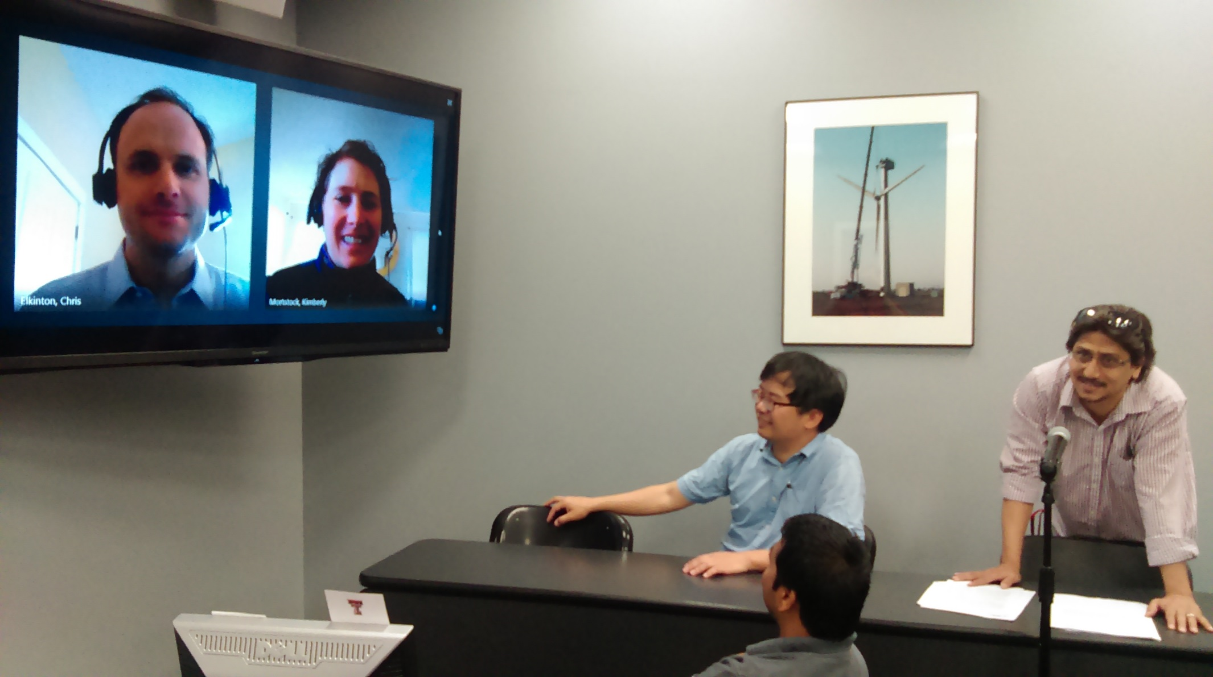
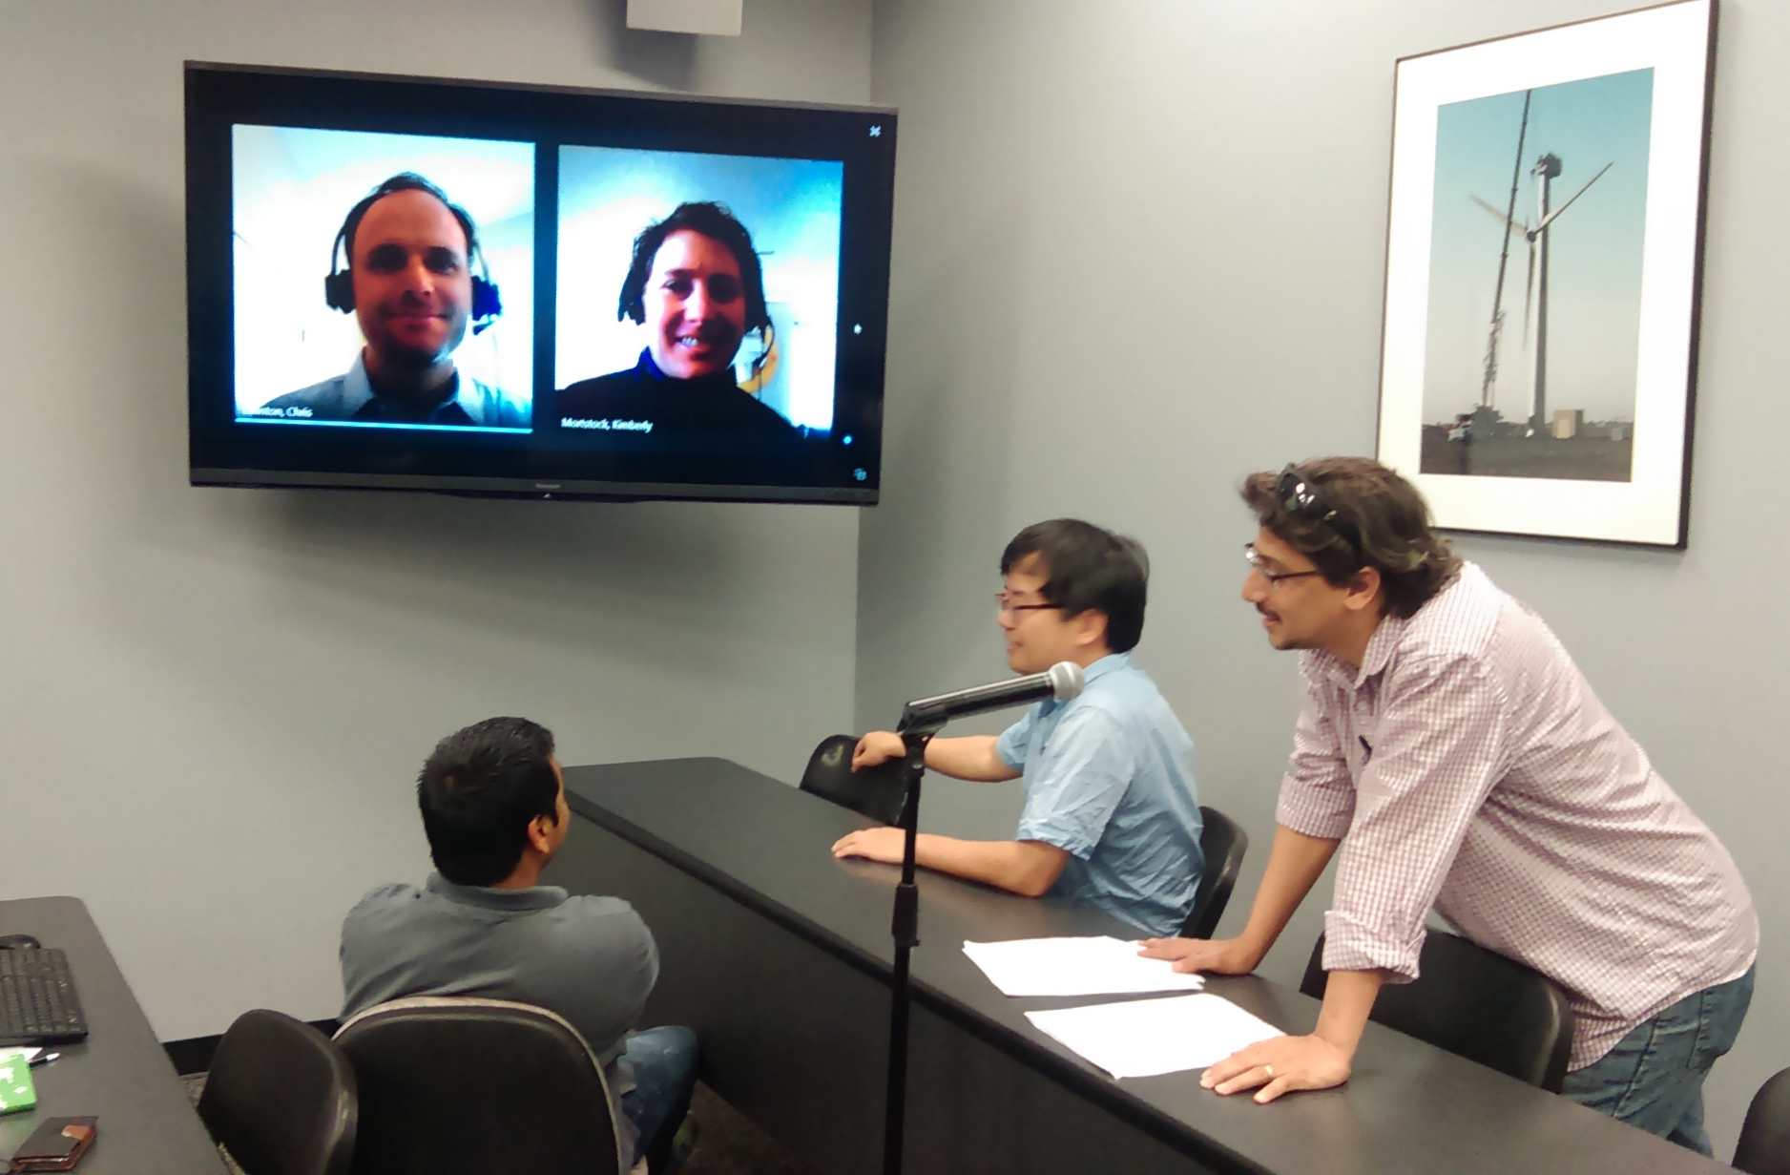
WE Classes
TEXAS TECH UNIVERSITY
National Wind Institute

Slide 14
TEXAS TECH UNIVERSITY
National Wind Institute
Results
What did the students get out of the experience?
Student feed-back
Very positive experience
Very enriching
Greater understanding
Stretch their knowledge
Pushed them into areas of unfamiliarity
Pushed the limits of individual knowledge
Example: Tanzania

Slide 15



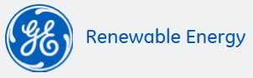


TEXAS TECH UNIVERSITY
National Wind Institute
STEM/MBA
Other Graduate Program
Renewable Industry Work Force

Slide 16
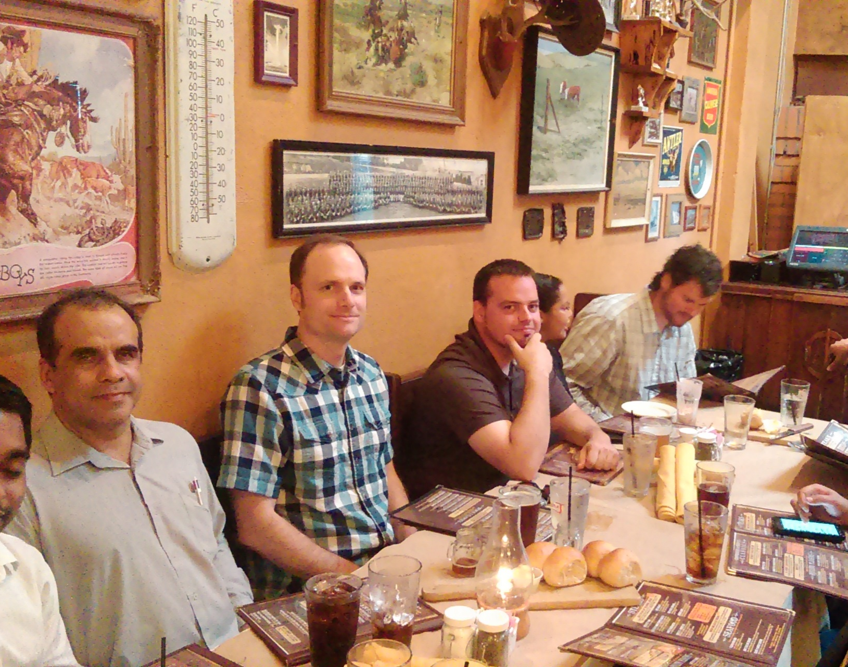
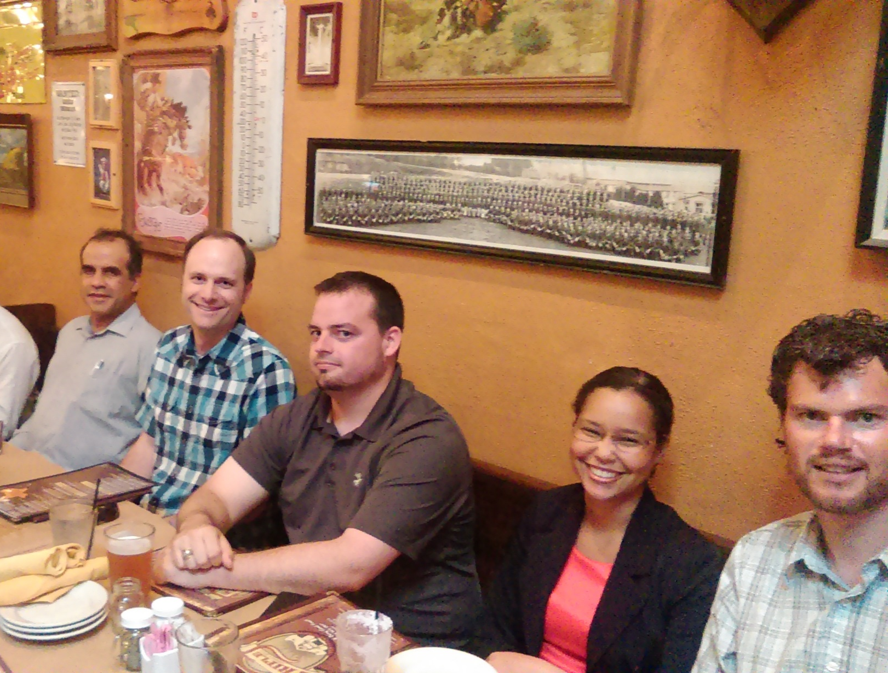
TEXAS TECH UNIVERSITY
National Wind Institute
Post-class relationship

Slide 17
TEXAS TECH UNIVERSITY
National Wind Institute
Questions?
Thank You

