Slide 1
A Discovery Portal for CS 4624 Projects
Mark Fuentes, Maddie Gonzalez, Adam Kanaan, Faizan Mohsin, Shayne Perryman
CS 4624 Multimedia/Hypertext - Mohamed Farag
Virginia Tech, Blacksburg, VA 24061
April 25th, 2024

Slide 2
Outline
Project Problem
Changes in Design
Features
Deliverables
Demo
Issues and Solutions
Future Works
Acknowledgements
References

Slide 3

Problem Overview
Formatting
  Excessive/Unnecessary information
  No visible search bar
Functionality
  Filtering is extremely strict and dysfunctional
  Overpopulated/Unused categories
  Missing functions and features
User Interface
  Not so user friendly
  Limited features
  Unrestricted project view

Slide 4
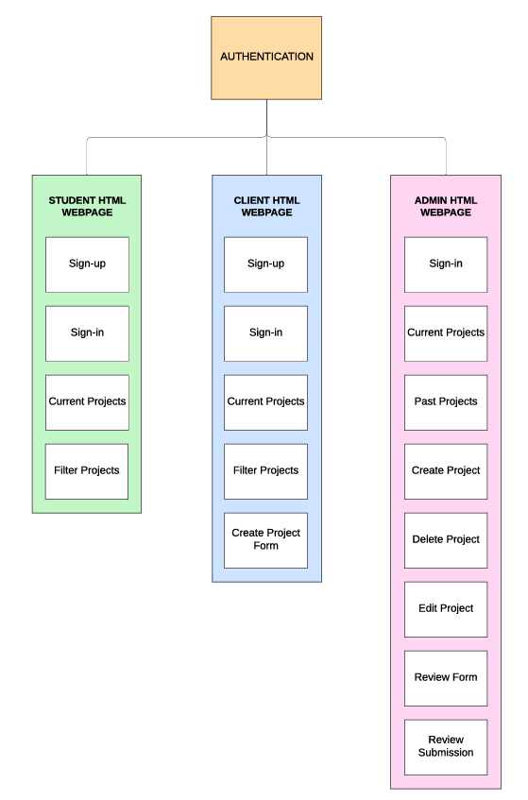
Final Design (Front End)

Slide 5
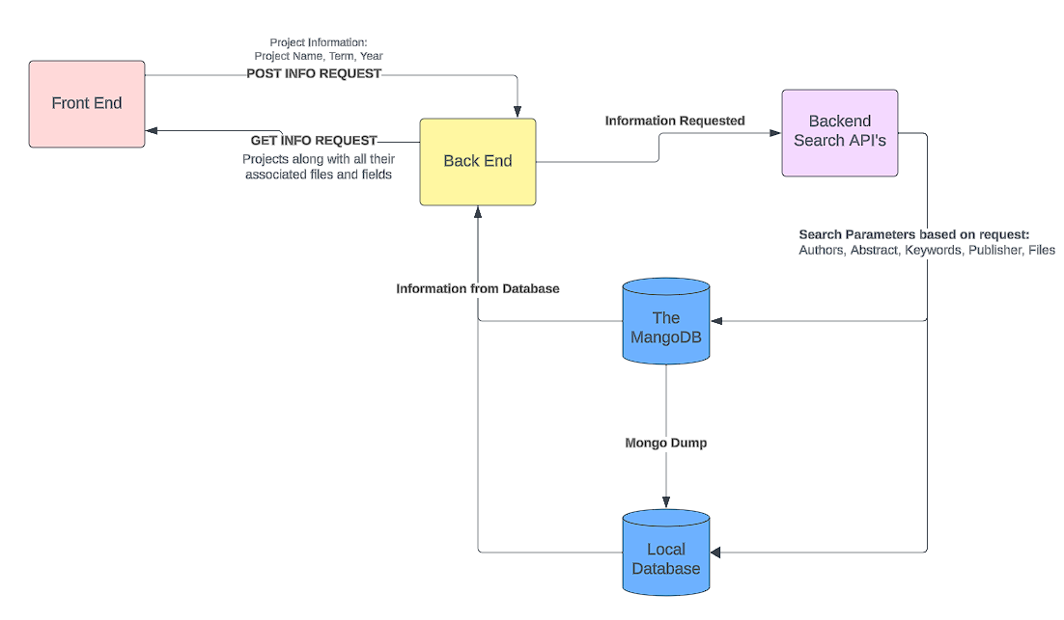
Final Design (Back End)

Slide 6
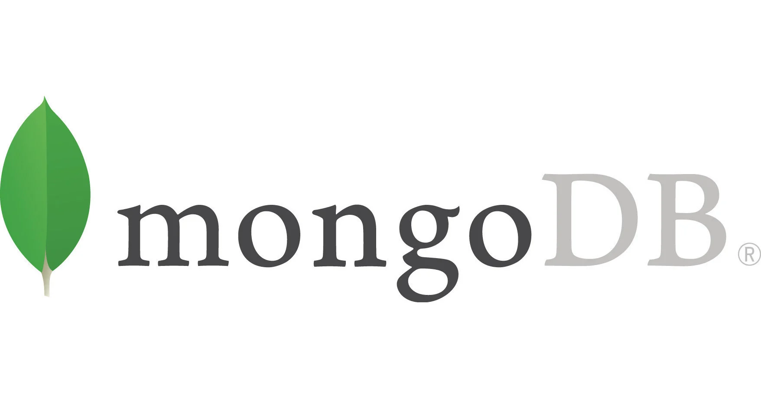
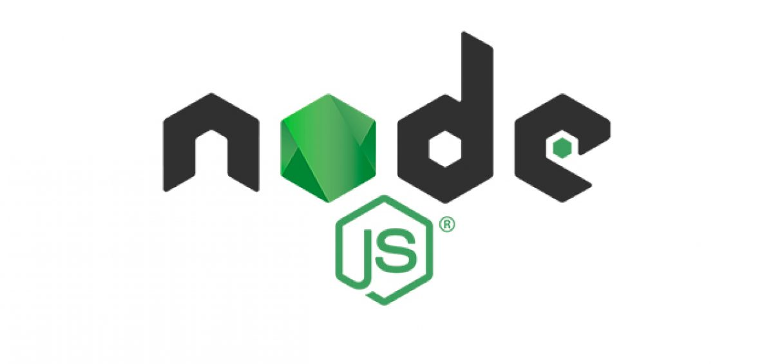
Deliverables
Project Webpage Portal
Frontend (HTML, CSS, React)
Backend (Node.js, Axios)
Search Functionality API
JavaScript Search APIs
Project File Database
MongoDB & Local Database

Slide 7
Features Exclusive to Admin Role
View projects from previous/current semesters
Delete Projects
Create new projects
Create new users or clients
Upload files to existing projects
Sort projects A-Z, Z-A, by semester + year
Search projects by name or by author

Slide 8
Features Exclusive to Client Role
View projects they’ve created
Delete projects they’ve created
Create new projects
Upload files to their existing projects

Slide 9
Features Exclusive to Student Role
View projects from current semester
Join a max of one project
Leave project

Slide 10
Live Demo

Slide 11
Past Issues and Solutions
Project creation/form/join
  Additional features
Failed to run through rlogin
  Run locally
Accessing database separate from MongoDB Atlas
  MongoDB dump to local
Clarification of role permissions/access
  Extensive communication
Displaying and allowing file downloads
  Mapping dictionary
New projects requiring a differing schema
  non-existent fields to ‘null’
Solr implementation requiring extensive time
  Temporary API

Slide 12
Future Improvements
Adding in Solr
Dockerization of the Project
Additional security measures
Formatting options
Allow for final submissions of current projects when completed (source code, report, presentation, etc.)

Slide 13

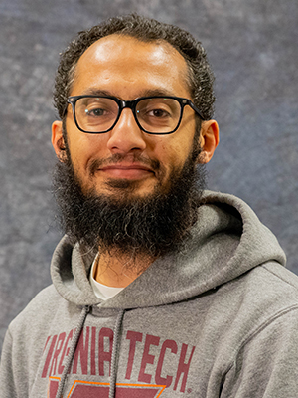
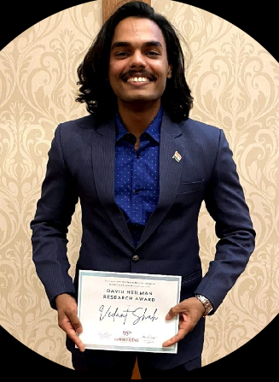

Acknowledgements
We would like to thank Dr. Farag and Vedant for working closely with us on this project that will be used by current and future students at Virginia Tech.

Slide 14
References
URLs to follow for additional information:
CS4624: Multimedia, Hypertext, and Information Access (vt.edu)
API’s:
Search Functionality:https://solr.apache.org/guide/7_6/searching.html
Authentication: https://www.freecodecamp.org/news/how-to-secure-your-mern-stack-application/
Mongo Documentation:
Mongo Shell: https://www.mongodb.com/docs/mongodb-shell/install/
Local Install: https://www.mongodb.com/docs/manual/tutorial/install-mongodb-on-windows/#std-label-install-mdb-community-windows

Slide 15
Thank you for your time.

