Slide 1
Twitter Equity Firm Value
Nathan Guinn, Rohan Rane, Christian Wiskur, Jacob Smith, and Erik Agren
CS 4624 Multimedia, Hypertext, and Information Access
Instructor: Dr. Fox
Virginia Tech, Blacksburg VA 24061
May 2, 2018

Slide 2
Outline
Project Overview
Data Scraping and Gathering
Twitter and Stock
Data Analysis
Company Guide
Limitations
Acknowledgements

Slide 3
Our Goal
Analyze the ways companies can mitigate stock failure following a data breach using Twitter
Research the role of users
Provide a company guide
Guidelines following a data breach using social media

Slide 4
Data Scraping
Gather firm tweet data for 707 Data Breaches
120 days before and 30 days after
Gather user tweet data
10 days before and 30 days after
Keywords: security breach, hacker, theft, fraud, steal
Gather stock price of the companies
3 days before and after the breach
Notes:
2 weeks ago we spoke with our client, Ziqian Song
We sat down together and figured out the main requirements for the project
First, we’ll use tools to gather information about firms responses on twitter
We’ll analyze this data for interaction with users as well as importance of tweets based on likes and retweets
Next, we’ll gather user twitter data by querying the tweets dataset with keywords like “security”, “breach”, or a given “company’s name”
Within this data set we’ll identify important users who may have more influence because of their position or having a large number of followers
After we gather all the relevant twitter data, we’ll use different tools to analyze the breach effect on the company by analyzing their stock price
We’ll combine all this information and determine whether or not a company’s response was successful
Finally, we’ll propose an ideal response for companies based upon our findings

Slide 5
Tweet Collection Method
CSV File
Tweet CSV File
Event ID
Date
Company Name
Tweet
Python Script:
GetOldTweets API
Event Date
Retweets
Twitter Account
Favorites
Mentions
Keywords File
Hashtags

Slide 6
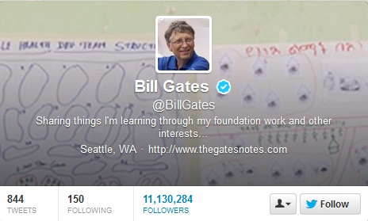
Additional Tweet Data Collection
Announcements vs. Replies
Hyperlinks
User biography, followers, following, verified
http://www.londonlovesbusiness.com/londons-best/twillionaires-the-7-richest-people-on-twitter/5441.article

Slide 7
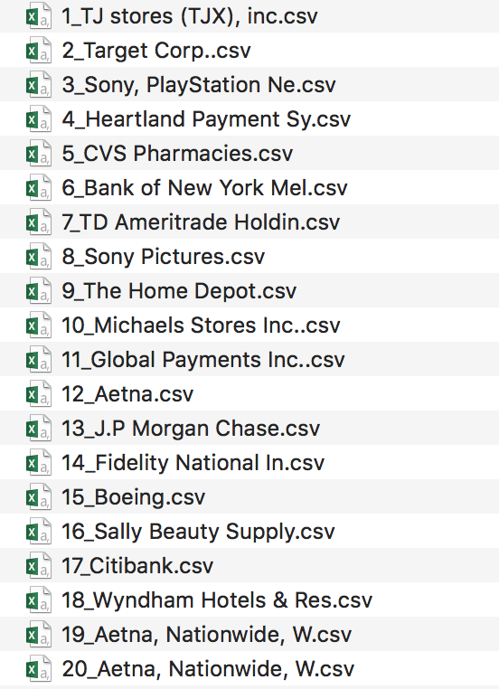
Stock Data
Client provided stock data
Raw stock data - unusable
Over one million rows
Scrub and clean
Join with breach information
Create new CSV for each event

Slide 8
Stock Data
Event Stock CSVs
Stock Return CSV
EventID
Date
Python Script:
stockManipulation.py
Formatted Date
Ticker
Ticker
Price
Company Name
Price

Slide 9
Data Analysis
Use Fama French Model to analyze stock data
Expected stock price vs actual stock price
3 days before and after
Compute sentiment analysis
Specifically the user tweets
Analyze abnormally good and abnormally bad stock performance
2.5 standard deviations above and below
Many didn’t have tweet data

Slide 10
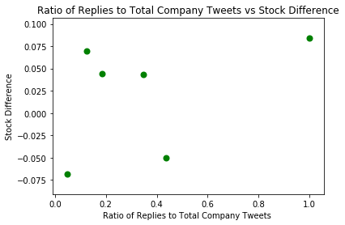
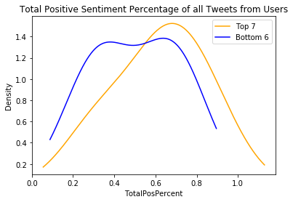
Plotting Our Data

Slide 11
Company Guide
Focus on replying to customers instead of making announcements
This will help fight against tweets of Negative Sentiment
Always reply to influential users
Verified
High Follower Count
Try to keep tweet count down
The breaches most tweeted about had the largest drops

Slide 12
Limitations
Twitter data on breaches before 2010
Some breaches had an excessive amount of tweets to analyze
Equifax breach had 90,000 tweets
This limited how many abnormal companies to include in analysis
Scope of project wasn’t well defined initially
New requirements added to project throughout
Underestimation of machine learning difficulty
Data collection was delayed

Slide 13
Possible Improvements
Add parallelization to several scripts
Have a different data sharing platform than Google Drive
Dedicate more time towards data analysis

Slide 14
Acknowledgements
We would like to thank the following people:
Our client Ziqian Song
Our professor Dr. Fox
Our TA Jin

Slide 15
References
Hendricks, Kevin, et al. “Article Tools.” Management Science, Institute for Operations Research and the Management Sciences, 14 Oct. 2015, pubsonline.informs.org/doi/abs/10.1287/mnsc.2014.1987.
Lee, Lian Fen, et al. “The Role of Social Media in the Capital Market: Evidence from Consumer Product Recalls.” Journal of Accounting Research, 27 Mar. 2015, onlinelibrary.wiley.com/doi/10.1111/1475-679X.12074/abstract.

