Slide 1
Collection Management
Presenters: Yufeng Ma & Dong Nan
May 3, 2016
CS5604, Information Storage and Retrieval, Spring 2016
Virginia Polytechnic Institute and State University Blacksburg VA
Professor: Dr. Edward A. Fox
Notes:
Good afternoon, everyone. We’re collection management team. It’s kind of funny that along the whole semester, we are always the first to present results, but now we are the last one to conclude. Anyway in the next 15 minutes or so, we will present our results regarding collection management.

Slide 2
Outline
Goals & Data Flow
Incremental update
Tweet cleaning
Webpage cleaning
Notes:
Here is the outline of our final presentation. First we will go over the top level functions of our team, and our connections to the other teams. Then we will look at the three main parts – Incremental update, cleaning tweets and webpages.

Slide 3
Goals
Keep data in HBase current
Providing “quality” data
  Identify and remove “noisy” data
  Process and clean “sound” data
  Extract and organize data
Notes:
Now let’s first look at the main goal of our team. For incremental update, we are supposed to import only new tweet records from mySQL to HDFS and finally into HBase. While for the cleaning part, our responsibility is to extract useful metadata or features , and then store them into HBase.

Slide 4
Data Flow Diagram
Image credit: Sunshin Lee
Notes:
Here is the graph, the three ovals indicate where we are, and you can also find out our collaborations/relationships with other teams in this figure. Actually all the other teams’ work will sit on the shoulder of ours.

Slide 5
Incremental Update
Notes:
Now Dong will introduce the incremental update and tweet cleaning part, after that I will go over the whole process of webpage cleaning.

Slide 6
Incremental Update: MySQL → HDFS
Previous bash script importing 700+ tables, without incremental feature.
Incremental import new rows in the relational database (MySQL) to HDFS.
Use incremental append mode of Sqoop to import data incrementally.
Code credit: Kathleen Ting and Jarek Jarcec Cecho. Apache Sqoop Cookbook. Sebastopol: O'Reilly Media, Inc., 2013. Print.

Slide 7
Incremental Update: HDFS → HBase
Keep HBase in sync with imported data on Hadoop.
Write Pig script to import new data from HDFS to HBase.
Use job scheduler Cron on Linux (by creating crontab file), periodically run the Pig script.
Image credit: http://itekblog.com/wp-content/uploads/2013/03/crontab.png

Slide 8
Tweet Cleaning

Slide 9
Tweet: Text Cleaning and Info Extraction
  Remove URLs, profanities, and non-characters from raw tweets.
  Extract short URLs from raw tweets, expand, and map to corresponding web pages.
  Extract hash tags (#) and mentions (@) out from raw tweets.
  Store cleaned text, extracted hash tags and mentions from HDFS node to HBase.
  All the cleaning, extracting and storing process done by Pig Latin.
rowkey | clean_tweet
collection # - tweet id | clean_text | urls | hashtags | mentions | mappings | empty | collection | doctype

Slide 10
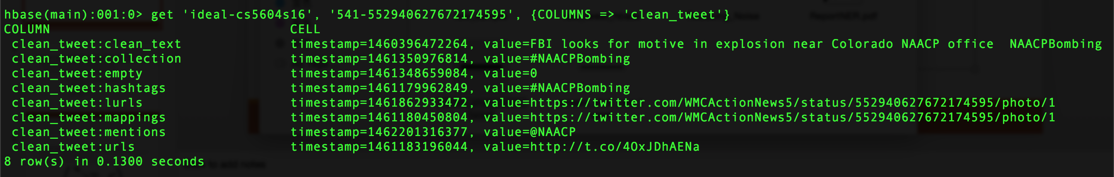
Tweet: Text Cleaning and Info Extraction (Example)
Raw tweet on HDFS
Cleaned tweet and extracted info in HBase

Slide 11
Webpage Cleaning
Notes:
Thanks for Dong's detailed explanation of tweet cleaning.

Slide 12
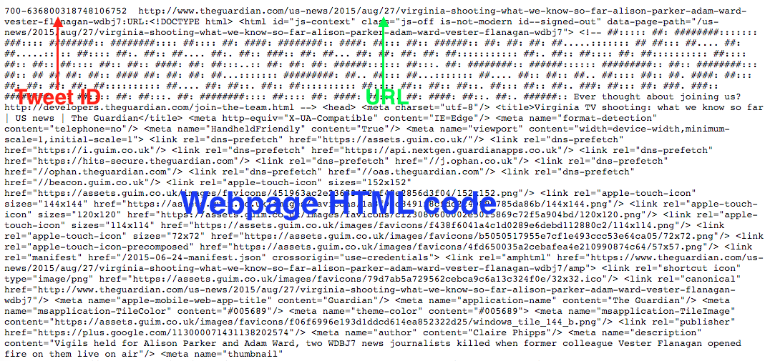
Raw Data
Notes:
Before we step into technical details of webpage cleaning, let’s look at the raw data we got from two GRAs. All the webpage records we got are Tab Separated Value files with fixed formats like in this picture. The first field is collection number dash tweet ID, then comes the urls for this webpage. After this we will come across colon URL colon which separates URL and the corresponding webpage’s HTML code.

Slide 13
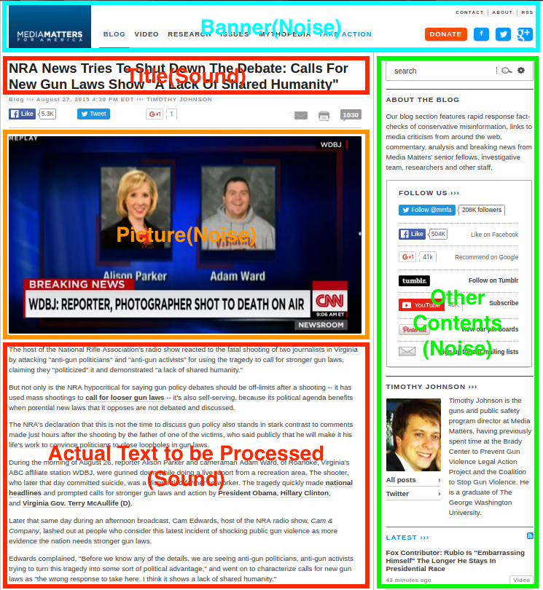
Webpage Sample
Notes:
We can visualize this webpage in any browser to get a more direct intuition. The only useful features here for our further processing like classification or LDA are the title and the body of texts in red boxes. Therefore, our main purpose is to extract these features.

Slide 14
Webpage Cleaning Rules
Remove Non-ASCII characters
Keep English text only
Extract URLs
Remove profane words
Notes:
Now comes the rules for webpage cleaning. One requirement for us is to remove Non-ASCII characters. Also only the English texts should be kept. Since most NLP processings are based on English corpus. Based on this, we can extract the URLs, and then replace the profane words with some special strings.

Slide 15
Libraries/Packages
BeautifulSoup4
  Parse text out of HTML and XML files
Readability
  Pull out the title and main body text from a webpage
Langdetect
  Detect language of a text using naive Bayesian filter
Re
  Provide regular expression matching operations
Notes:
With these rules being clarified, we introduced several libraries and packages in python for our purpose here. The first is beautifulsoup, which is very powerful for parsing and extracting HTML tags. After this, we can apply the readability package to identify readable titles and contents in the webpage. Thereafter, langdetect is imposed to detect the main language code of the text. Finally regular expressions to extract URLs, remove profane words.

Slide 16
Raw consolidated files &
metadata in Text format
Webpage cleaning pipeline
RE
Readability
Titles & “Useful” HTML
HTML only (raw)
Identified tweet ID, URL and original webpage code
BeautifulSoup
Content only
English only Text
ASCII only Text
Langdetect
RE
Clean web pages in TSV format with preset schema
Clean Text, Replace profanity and extract URLs
Notes:
Here is the whole pipeline for the webpage cleaning. First we use regular expression to identify the three key fields. Then BeautifulSoup and Readabilitiy together helps to filter out unnecessary tags and only keep the readable title and contents. After this we detect the language and use regular expression again to extract urls and remove profane words.

Slide 17
Cleaned Webpage Schema
Rowkey | clean_web
URL | collection | lang | domain | doc_id | title | text_clean | text_clean_profanity
Rowkey | clean_web
URL | urls | empty | mappings | doctype | web_original
Notes:
Finally, we will upload the whole stuff into HBase using Pig script. Here is the detailed schema for clean_web. We provide both the original HTML code and useful information with it.

Slide 18
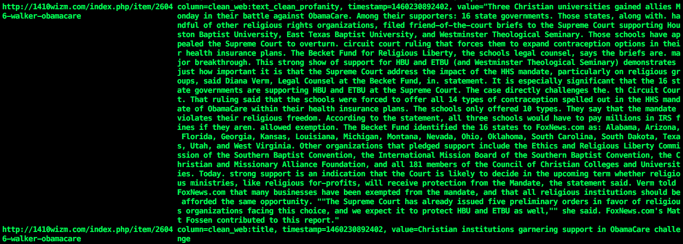
Cleaned Webpages
Notes:
Here is a sampled cleaned webpage, which shows the readable title and content in the webpage.

Slide 19
Future work
Clean big collection
Clean documents with multiple languages
Automating webpage crawling and cleanup
Notes:
Now for the future work, right now we only do processing on small collections, we will focus on big collection cleaning. What's more, it’s also quite necessary for us to deal with documents in languages other than English. Finally, I will also work with Mohamed to figure out automating webpage crawling and cleanup. As as soon as incremental update is done, we have new tweets, then we can extract urls in it, and crawl the correspond webpages.

Slide 20
Acknowledgements
Integrated Digital Event Archiving and Library (IDEAL) NSF IIS – 1319578
Digital Library Research Laboratory (DLRL)
Dr. Fox, IDEAL GRA’s (Sunshin & Mohamed)
All of the teams in the class
Notes:
Finally, we would greatly appreciate the help from Dr. Fox for his edits on our reports and general suggestions for the project, and two GRAs Sunshin and Mohamed, especially Sunshin. He did sacrifice lots of his research time for helping us. Last but not least，we would also thank all the other teams in the class for your collaborations and feedbacks.

Slide 21
Thank You!
Notes:
Thank you guys. Any questions?

