Slide 1
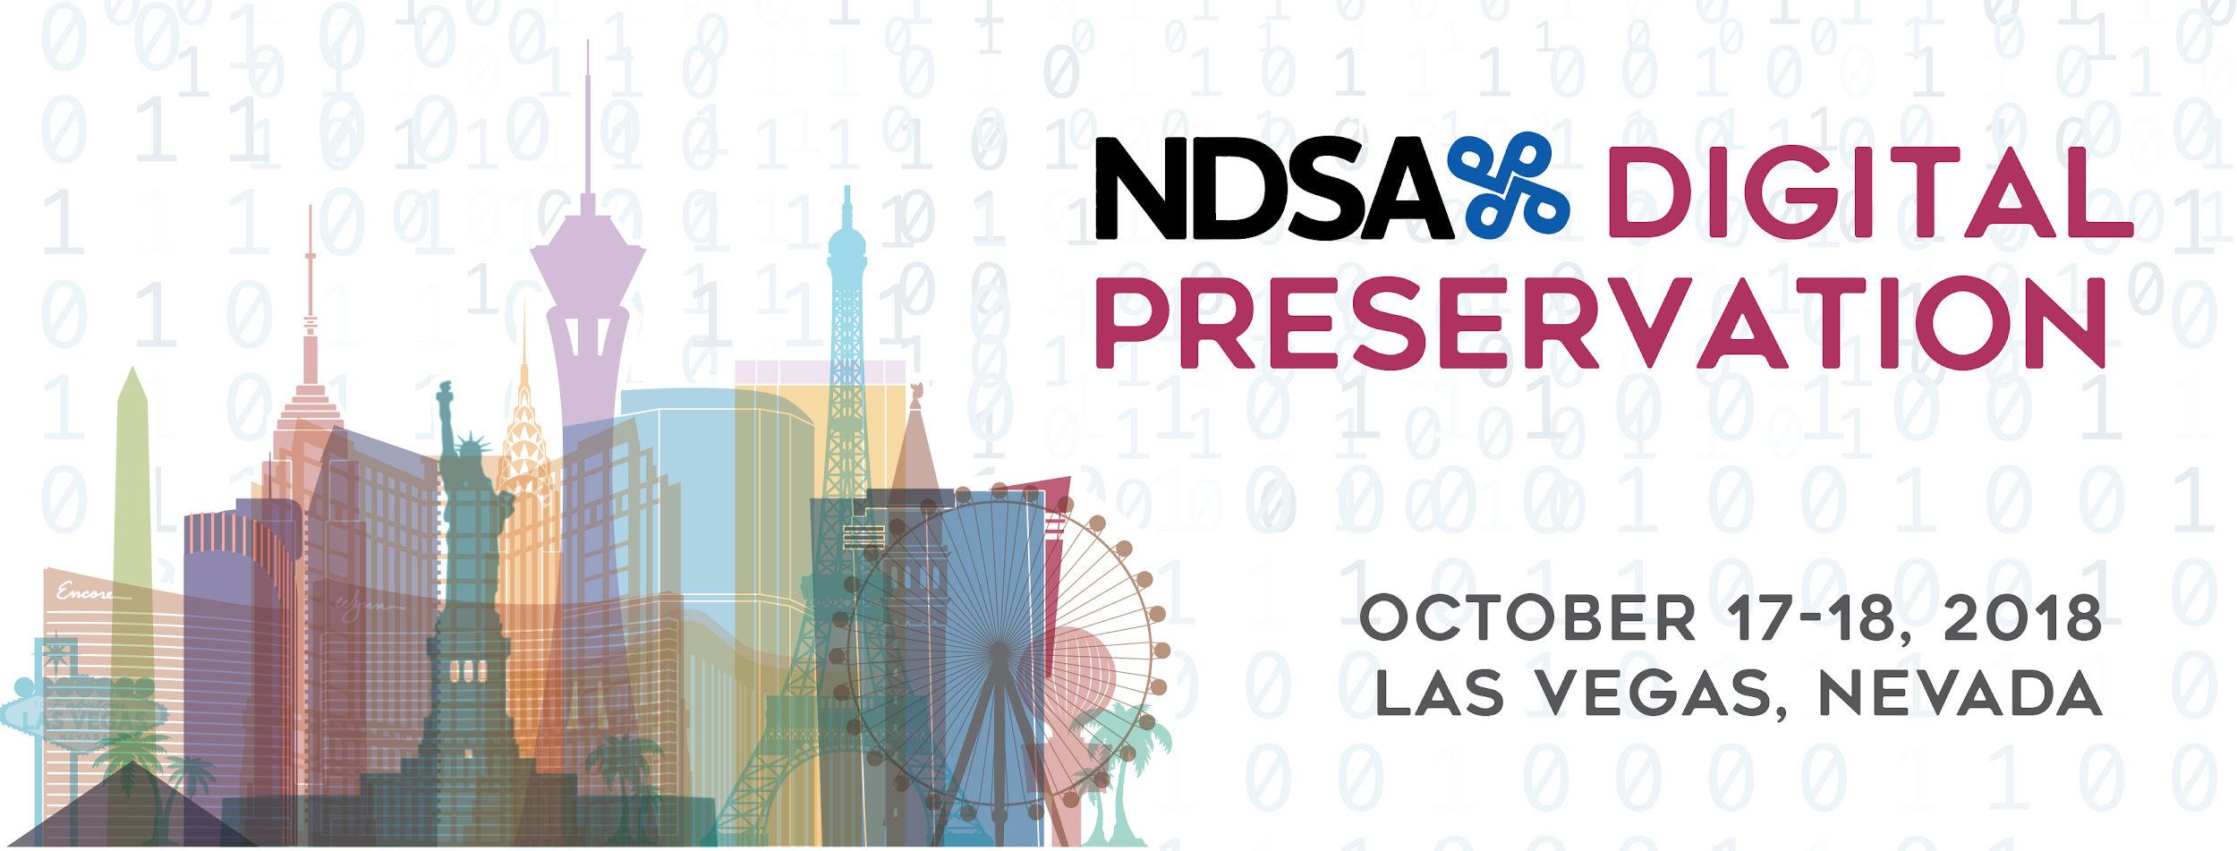
Make IT Work:
Collaborating with IT to Create Sustainable Preservation Systems
Alex Kinnaman, Luke Menzies, Shira Peltzman, Mary Leverance, Elena Colón-Marrero
October 18th, 2018
#r1a
Notes:
DLF Guide to Accessible Presentations: https://www.diglib.org/dlf-events/2016forum/guide-to-creating-accessible-presentations/
Good morning everyone. Thank you for attending our panel Make It Work. First we would like to introduce ourselves. My name is Alex Kinnaman and I am the Digital Preservation Coordinator at Virginia Tech.

Slide 2
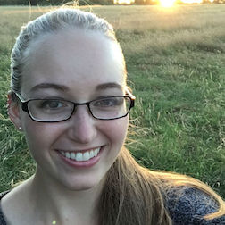
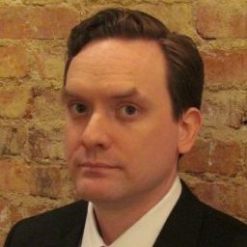
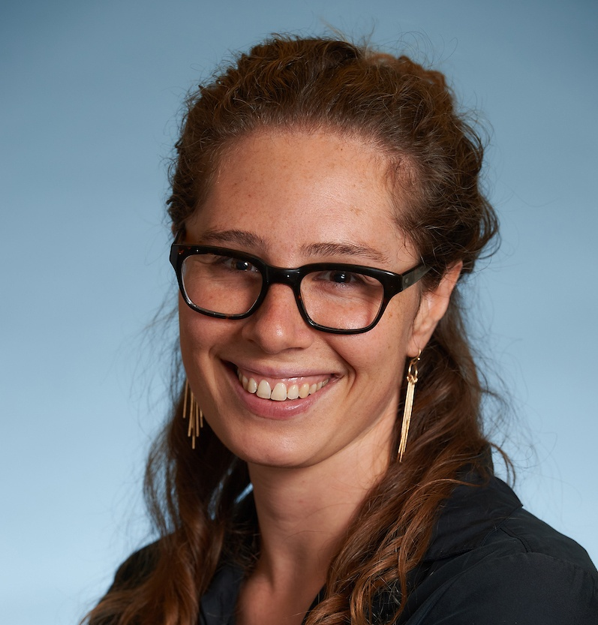
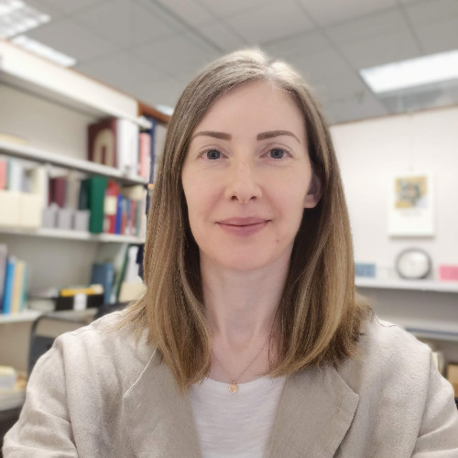
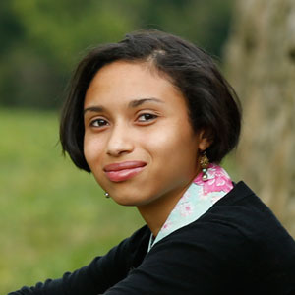
Panelists
Alex Kinnaman Virginia Tech alexk93@vt.edu
Luke Menzies Virginia Tech
limen@vt.edu
Shira Peltzman
UCLA
speltzman@library.ucla.edu
Mary Leverance
University of Arkansas mleveran@uark.edu
Elena Colón-Marrero
Computer History Museum ecolon-marrero@computerhistory.org
Notes:
Alex Kinnaman (moderator), Digital Preservation Coordinator at Virginia Tech, alexk93@vt.edu
Luke Menzies, Digital Preservation Technologist at Virginia Tech, limen@vt.edu
Shira Peltzman, Digital Archivist at UCLA, speltzman@library.ucla.edu
Mary Leverance, Preservation $ Conservation Coordinator for Libraries and Center for Advanced Spatial Technologies at the University of Arkansas, mliverance@uark.edu
Elena Colón-Marrero, Digital Processing Archivist at the Computer History Museum, ecolon-marrero@computerhistory.org

Slide 3
Panel Overview & Goals
To discuss and provide practical strategies for the challenges surrounding IT collaboration, including:
Translation
Advocacy and outreach
Time, resources, and responsibility
Compromise
Hardware & software
Notes:
Overview/Goals
Digital Preservation is still a relatively new field with quickly-evolving standards and technologies. We often sit in the middle between library work and information technologies, and as is often the case, digital preservation is not always a priority. It’s expensive, it usually requires everyone to change their workflows, and it requires the expertise and time of our IT personnel to set up and maintain. We rely on IT to get our systems up and running but we often have difficulty communicating our needs effectively and we hit roadblocks that slow our progress. This panel is meant to discuss various elements of IT collaboration and, more importantly, to provide practical strategies for addressing these challenges. We will be touching on themes such as translating terminology and needs; advocating for our expertise and outreach; the balance of time, resources, and responsibility for our technologies between archivists and IT; the importance of compromise; and hardware and software.
For the first half of this session each of us will present on a case study or project, and then for the second half we will move into a guided discussion with plenty of time for Q&A.

Slide 4

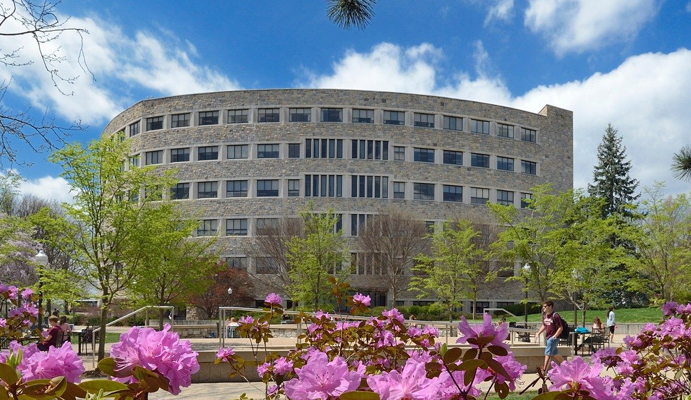
Virginia Tech University Libraries
Located in Blacksburg, VA
Approx. 91 faculty
Large IT unit for entire Library
5 major repositories
Administrative support for digital preservation
Preservation technologies
chosen before our hiring
Notes:
Virginia Tech University Libraries is located in Blacksburg, VA. We have approximately 91 Library faculty (and growing) and five major repositories that are supported by a large IT unit. We’re very fortunate that we have high administrative support for digital preservation. They invested in two digital preservation faculty, myself and my colleague Luke, in the last year to join a new team called Digital Imaging and Preservation Services, or DIPS. Before our hire they generated an interest in the Library Faculty, set funding aside, and chose technologies that worked with our repository platforms. So this meant two things. One, people were excited and thought that we would swoop in and save all of the content, and two, that we had no say in what technologies and tools were chosen or who managed them.
Our job is to customize these technologies to create a robust preservation system for five fairly siloed repositories, so we jumped right in starting with our Archivematica instance and starting having conversations with our IT Services, and we pretty much got shut out for months. Every conversation was, “Can we do this?” “No.” And because we had no input on what tools were chosen and weren’t in our positions when they were set up and tested, we have had to completely rely on the ITS personnel to work with these technologies at all. The main example is that we as the preservation team do not have any back-end access to our Archivematica instance, and we work with our IT unit regularly to make even small changes.
Total Academic staff at VT: 1,395
Students: 32,304

Slide 5


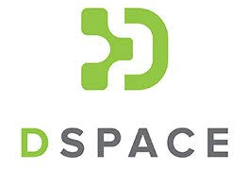

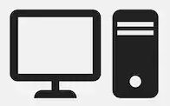


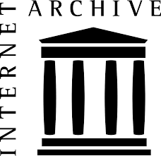
VTUL Technologies
Managed
Externally
Managed by University IT
Managed by Library IT
VT Archive
NAS
Notes:
Just to give you an idea of how much IT affects our daily work, this is an overview of our technology management. Our external tools and services have their own IT, specifically APTrust, MetaArchive, and the Internet Archive, that we communicate with remotely as needed. We have two internal IT units that we interact with regularly at Virginia Tech. Central IT, which is the University-wide group of IT units, handles most of our major software choices, our local long-term storage VT Archive, and our documentation wiki software Confluence. They are very difficult to get in touch with -- even the library ITS team has trouble communicating with Central IT. And finally, our LIbrary ITS handles everything else, including DSpace, Fedora, Archivematica, and our Network Attached Storage, which are the software that we use the most. With that, I will hand it over to my colleague Luke.

Slide 6
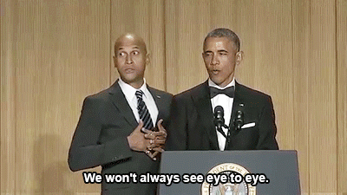

VTUL Challenge: Lost in Translation
How do we communicate our vision and needs to IT
and
How do we understand their vision and needs?
Notes:
Our work to unify our digital curation storage, preservation, and access is inherently a collaborative one, not only with our Library Information Technology unit, IT Services but with at least five other Library units. We have found the concept of translation to be an especially productive model for strategizing to improve our relationships with ITS and other units. In this regard, two essential functions of translation are most salient: One, the need to communicate our preservation goals, standards, and needs to IT; and Two, the need to understand their goals, constraints, and needs.

Slide 7
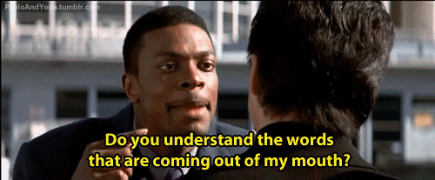
VTUL Challenge: Translation
Terminological & conceptual barriers
Competition with other units for IT equipment and services
Need to establish preservation as a top priority
'Getting things done' and 'making things happen' closely tied with the organizational hierarchy and the authority of persons or units
Notes:
The work of translation and negotiation between digital preservation and Library IT at Virginia Tech involves four main challenges:
1 - Terminological and conceptual barriers
2 - The need to establish preservation as a top priority
3 - Competition with other units for IT equipment and services
4 - The fact that 'getting things done' or 'making things happen' is closely tied to the organizational hierarchy and the authority of particular persons or units
As far as terminology and concepts, we discovered that we needed to translate terms, such as Archival Information Packages (AIPs), Submission Information Packages (SIPs), and Distribution Information Packages (DIPs). We found ourselves explaining the difference between having several backup copies and imposing preservation processes and standards. At the same time, we needed to understand basic IT concepts and terminology, such as "infrastructure as code", data serialization, relational versus non-relational databases, etc.
As one unit among many, the Digital Imaging and Preservation Services team is in competition with other units for IT equipment and services. We experienced long delays in getting the equipment and software we needed to perform some of the basic functions of our jobs. Although our Library's switching to a whole new Integrated Library System (ILS) was a perfectly legitimate reason for these delays, it meant that we would need to be flexible and find new ways to express the importance of digital preservation. For example, using terms from agile software development or from the business world enabled us to demonstrate that digital preservation is absolutely essential for the Library and the university.
Finally, we came to realize that getting things done and making things happen is closely tied to our organizational hierarchy and how much authority certain units or persons hold. In practical terms this means that we very often need to engage with collaborators as entire units rather than individuals. We held several meetings early on just for the sake of introducing ourselves and our unit, and approached these meetings with the attitude of "What can we do for you?" and "What are your group's needs?" With IT Services, it was necessary to meet with both groups and individuals in order to translate IT requirements and needs and to figure out what avenues to take in order to move forward together.

Slide 8
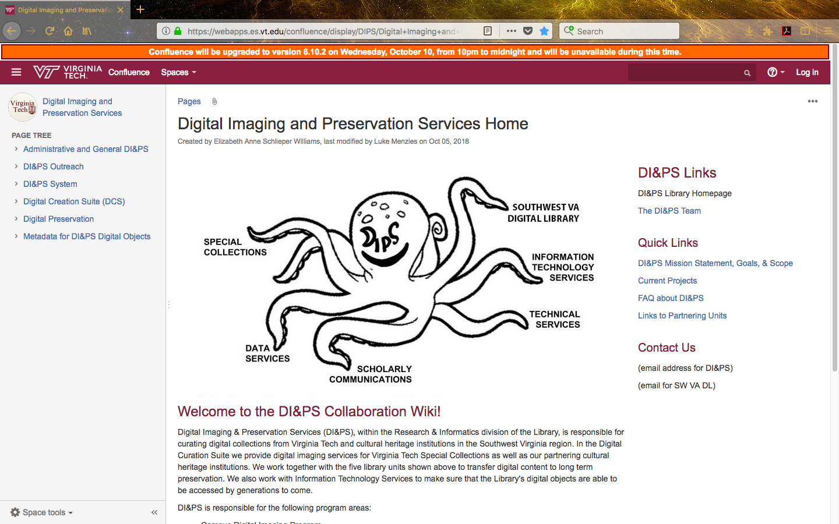
VTUL Translation Strategies
Conduct extensive research
Centralize & unify documentation
Make policy explicit
Meet face-to-face
Unify the message (DI&PS 'branding')
Notes:
We used five overall strategies to overcome our communication barriers and develop a positive, productive relationship with IT.
1 - Conduct extensive research
2 - Centralize and unify documentation
3 - Make policy explicit
4 - Meet face-to-face
5 - Unify the message (i.e. DI&PS 'branding')
First, we conducted extensive research on both sides of the translation gap. This meant researching preservation standards and concepts in order to translate them into concrete procedures and to better express them to non-specialists. It also meant researching IT concepts, terminology, and tools.
Next, we established a wiki for our team, Digital Imaging and Preservation Services. Using Atlassian's Confluence software, we created this site as a resource where stakeholders and partnering units could go to find unified documentation, information about our work, preservation policies, and detailed workflow procedures. By making our preservation standards, requirements, and policies explicit on this site, we fortified our communication bridge with IT.
Probably the most useful strategy we used, though, was formal and informal face-to-face meetings. When we wanted to better understand our Archivematica instance we sat down with our systems administrator. Although this was intimidating at first, our research paid off. He was able to walk us through some of the technical issues, and we were able to ask specific, informed questions about the software and our particular setup. Informally, we created a weekly off-site meet-up, "Drinks with DI&PS", where collaborators and stakeholders could chat with us or blow off steam in a casual atmosphere.
The last strategy we employed was a kind of "branding" for our team. We used our collaboration wiki website to unify our team's message and "get on the same page," literally. We also created a kind of mascot for our team, the DI&PS octopus, in order to visually demonstrate our group's desire to build bridges between the different units who create, store, and manage digital objects.

Slide 9
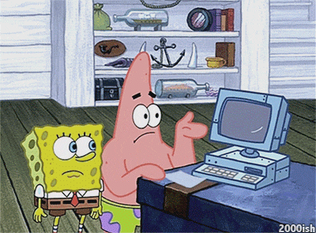
VTUL: Tips for Building Bridges with IT
Unify the message
Be prepared to advocate for your work
Know your own terminology, and be able to translate it to IT
Keep in mind that there are external factors at play
Compromise!
Notes:
When things with IT do not go your way, it's important to keep a cool head. Hopefully, keeping in mind the following five tips will help:
1 - Unify the message
2 - Be prepared to advocate for your work
3 - Know your own terminology and be able to translate it into IT terminology
4 - Keep in mind that there are external factors at play
5 - Compromise!
Rather than explain these tips, which are pretty self-explanatory, we would like to share our experiences in connection with them.
1 - Our team consists of five full-time faculty and staff, previously six, including digital imaging, digital collections management, and preservation specialists. In our interactions with IT it is essential that we work out any internal disagreements and give IT a unified message about our requests and needs. They can more easily meet a unified request coming from the whole group than different requests coming from individuals.
2 - As a preservation specialist it is sometimes difficult to unpack, examine, and explain our assumptions about preservation. Many of our IT faculty and staff in IT Services have extensive knowledge and experience with digital preservation. We still need to advocate for our work with IT, though. For example, our IT unit is increasingly looking toward cloud-based services, storage, and applications as a way to shift their time and resources away from hardware maintenance and more toward serving our end users. The burden is on preservation personnel to evaluate the preservation functionalities of cloud technologies and services and to advise IT personnel on best practices for secure digital preservation.
3 - In order to advise IT about standards and best practices for preservation, it goes without saying that we need to know our own terms and concepts and be familiar with their corresponding terms and concepts in the realm of information technology. For example, when we talk about information packages or BagIt Bags, how many actual files are we talking about? How do we translate the archival concept of provenance into digital terms?
4 - Keep in mind that there are external factors at play. For example, our team experienced a surprisingly long waiting period for equipment and software licenses. What we didn't realize at first was that university-wide restrictions were holding up our orders, not our IT team.
5 - Last but not least, compromise! The best approach to compromise is to begin with a thorough knowledge of which preservation needs are necessary and which ones are more flexible. Do you absolutely need a FRED machine, or can you make do by cobbling together more 'cost efficient' components? We initially had some tension with IT Services because we were prohibited from accessing the backend of our Archivematica instance. After we met with our systems administrator and came to understand his perspective we compromised. We are responsible for researching Archivematica features and using the Dashboard interfaces, and he does the backend implementation.

Slide 10
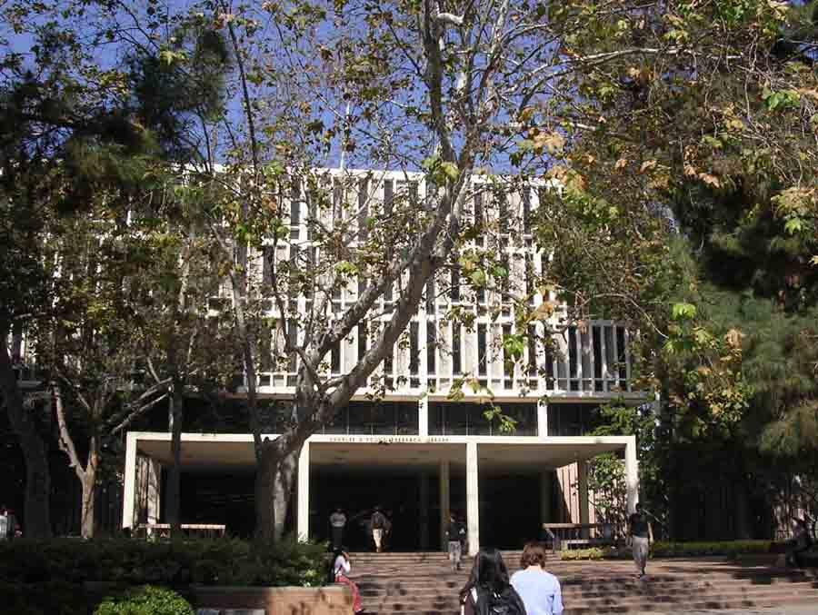
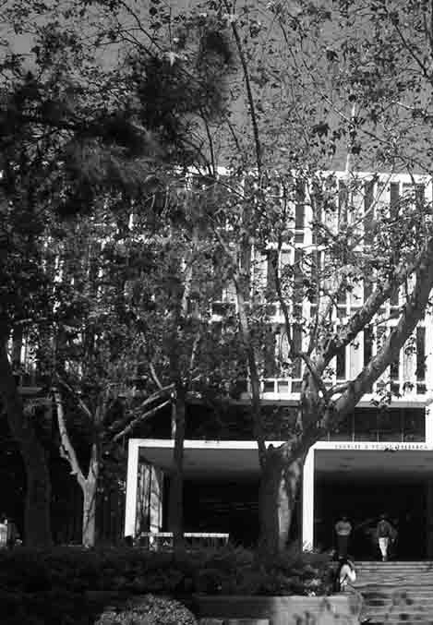
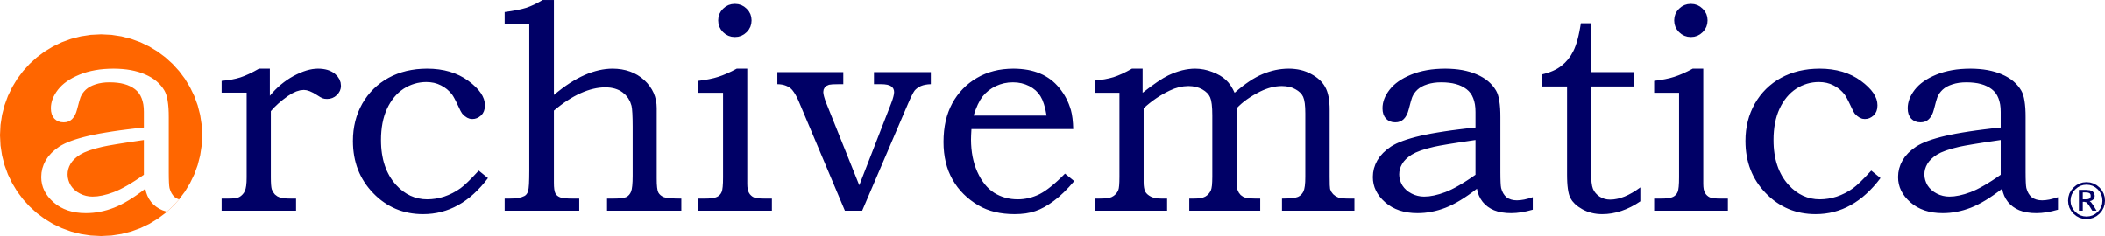
UCLA Library
Collaborating with
DIIT to implement
a study in contrasts
  2016-17
  2017-
Notes:
SHIRA
I’ll be talking about UCLA Library’s project to implement Archivematica, which, for those of you who aren’t already familiar with this software, is the free and open source too we use to package and prepare our born-digital archival material for long-term preservation.
This talk will be a study in contrasts
UCLA Library first implemented Archivematica in 2016-17
We relied heavily on our Digital Initiatives and Information Technology (DIIT) department to carry out this work, but ultimately -- for reasons that I’ll get into in just a minute -- the approach we took to supporting this software proved unsustainable.
When we renewed our annual maintenance agreement in 2017-18 we re-evaluated our approach, re-scoped the project, and were able to collaborate with DIIT to successfully implement this software in a significantly more sustainable and impactful manner
I’ll talk about both iterations of this project, including both the challenges that ultimately led us to rethink the project, as well as the solutions that we came up with to ensure the project’s success

Slide 11
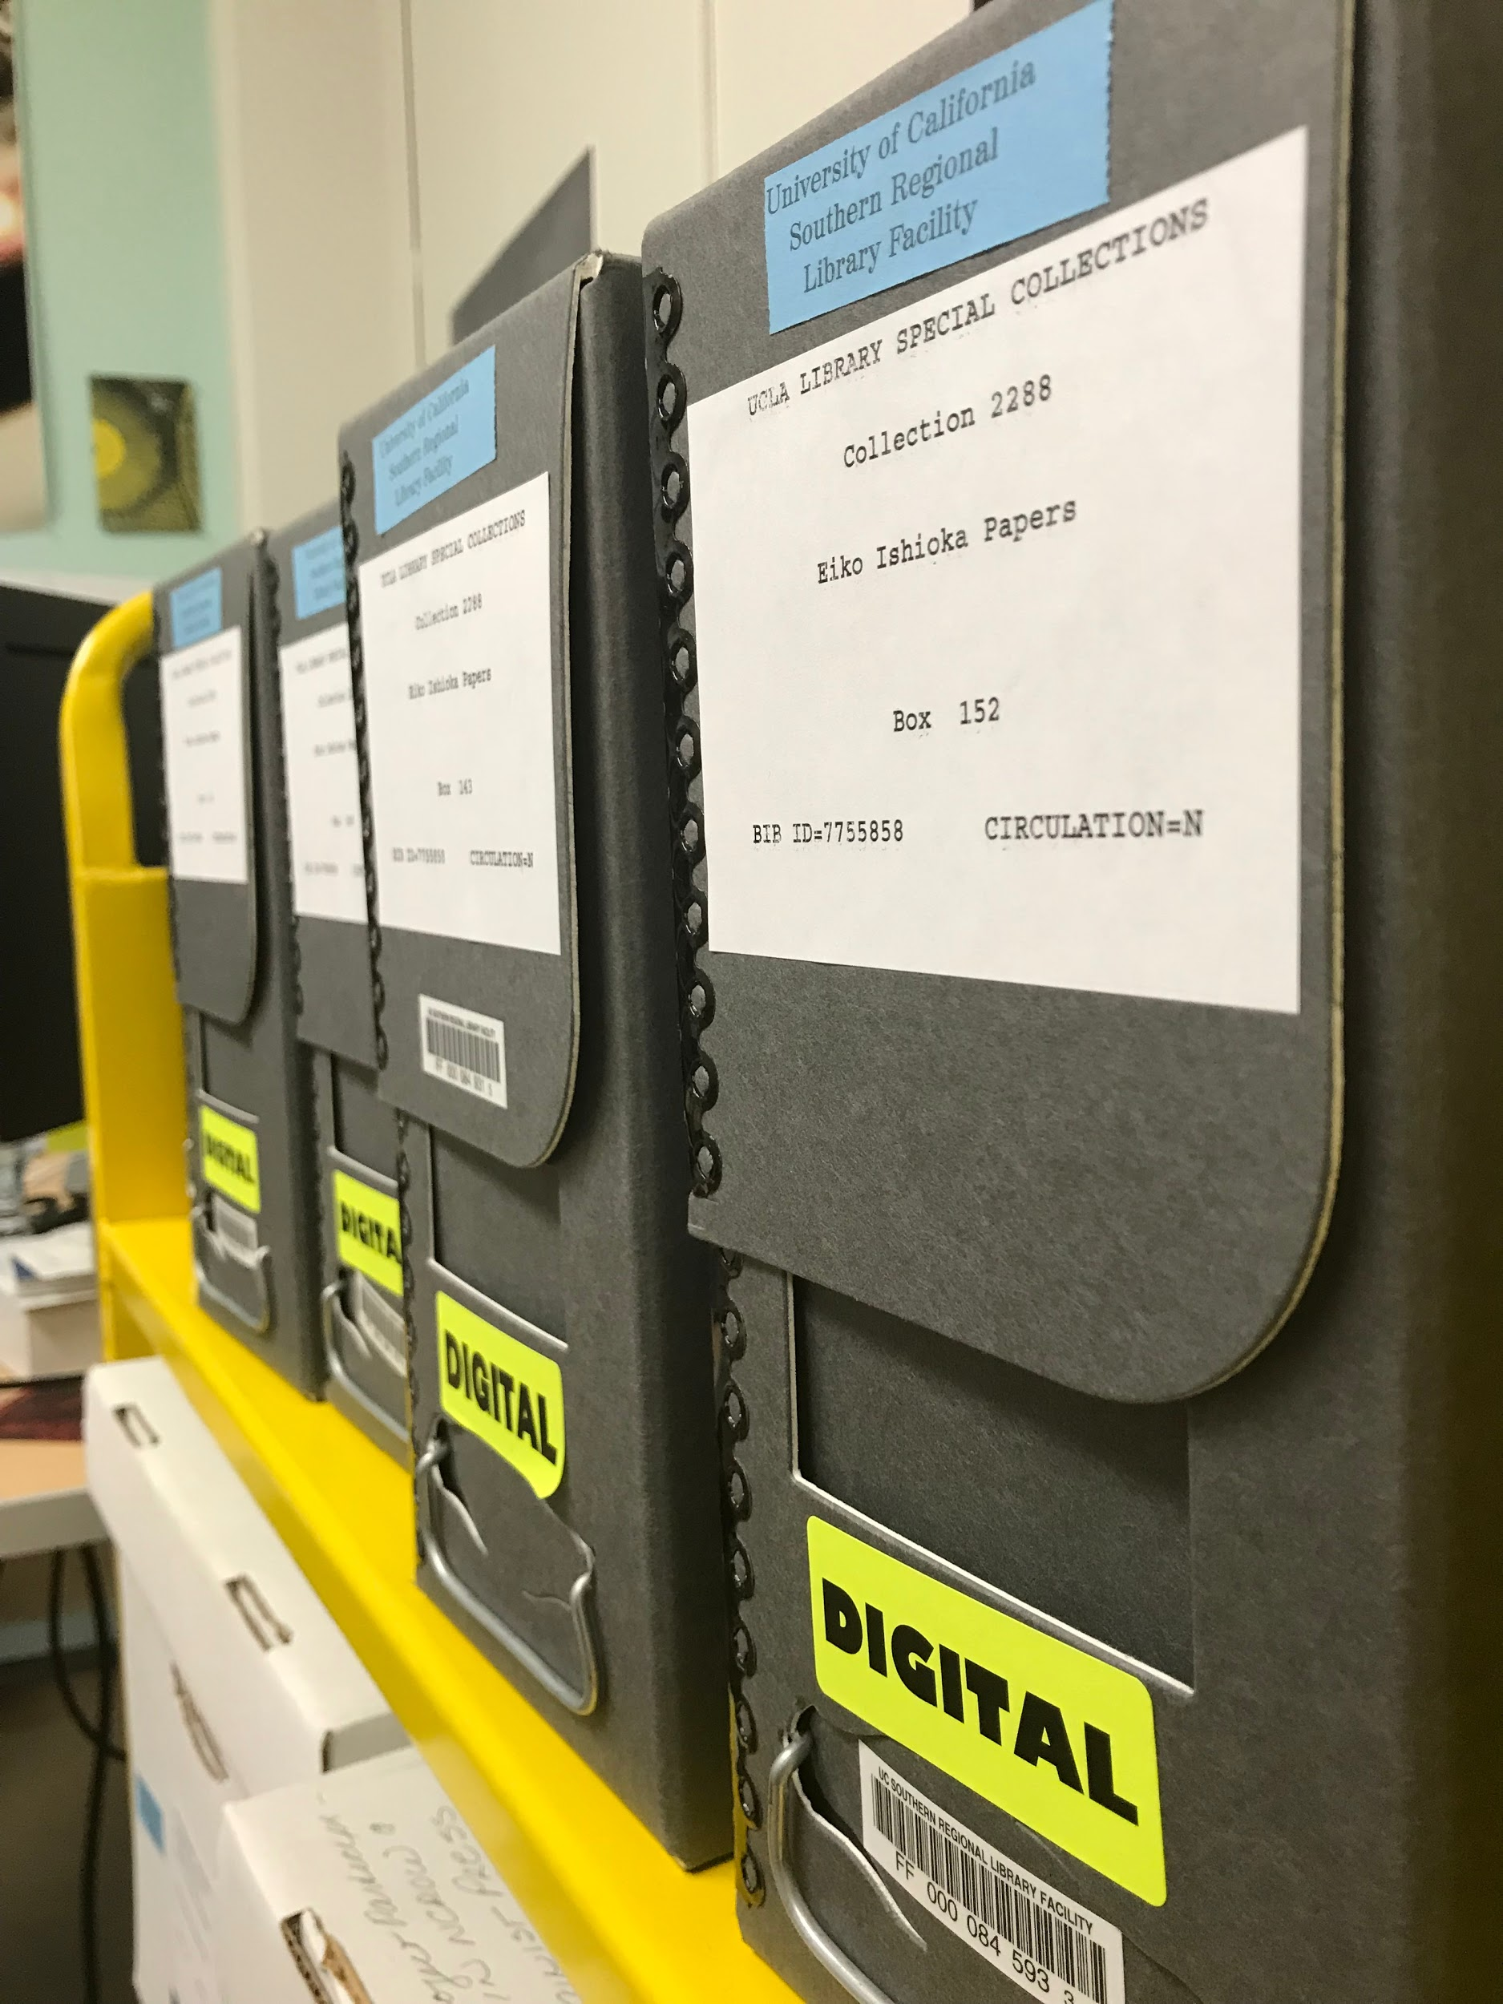
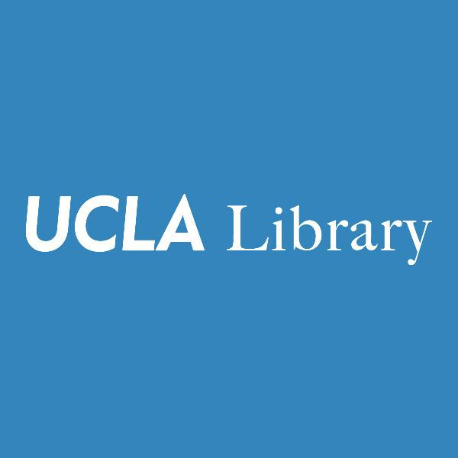

UCLA Library Special Collections
Located in sunny L.A., CA
LSC includes: Center for Oral
History and Research,
Biomedical Library, and UCLA’s
University Archives
Approx 33 LTEs
Notes:
SHIRA
I work in UCLA LSC, which is one of largest Spec Coll’s in country
Approx 33 FTEs
But many staff, including most of our archivists, are temporary
Although we have been collecting born-digital materials for decades, we did not have the appropriate tools, policies, or systems to systematically process and preserve this material at scale
When I was hired in 2015, my job was to change this

Slide 12
UCLA LSC Digital Archives Program
LSC’s Digital Archives
Program, 2015-
Proposal for funding
  Submitted Feb 2016
  Approved* Feb 2016
Notes:
SHIRA
To do this I wrote a funding proposal for a project to implement a robust and sustainable digital archives program.
This proposal included everything from equipment to staffing to securing server storage space for our collections
But the most critical and most costly part of my ask was for a year-long Annual Maintenance Agreement with Artefactual to install Archivematica
I submitted this proposal in February 2016, and it was approved 10 days later by the library’s administration
I added the asterisk beside “approved” because in reality it was approved save for the Archivematica AMA, which took several additional months of advocacy on my part to get the library on board
Advocacy = lots of outreach
Meetings with AULs
Reports summarizing why we needed this tool
Emails detailing how it would benefit the library as a whole

Slide 13
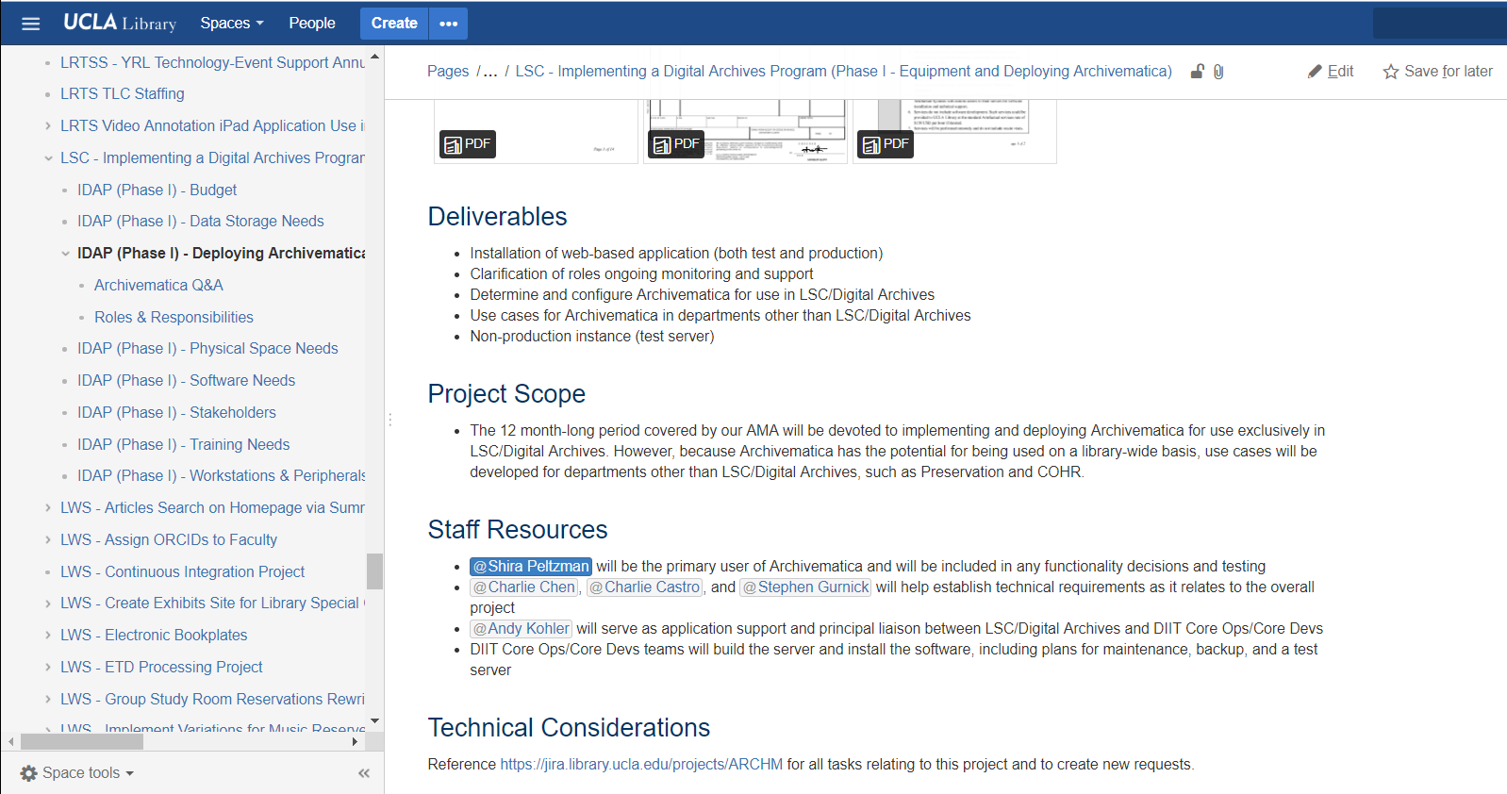
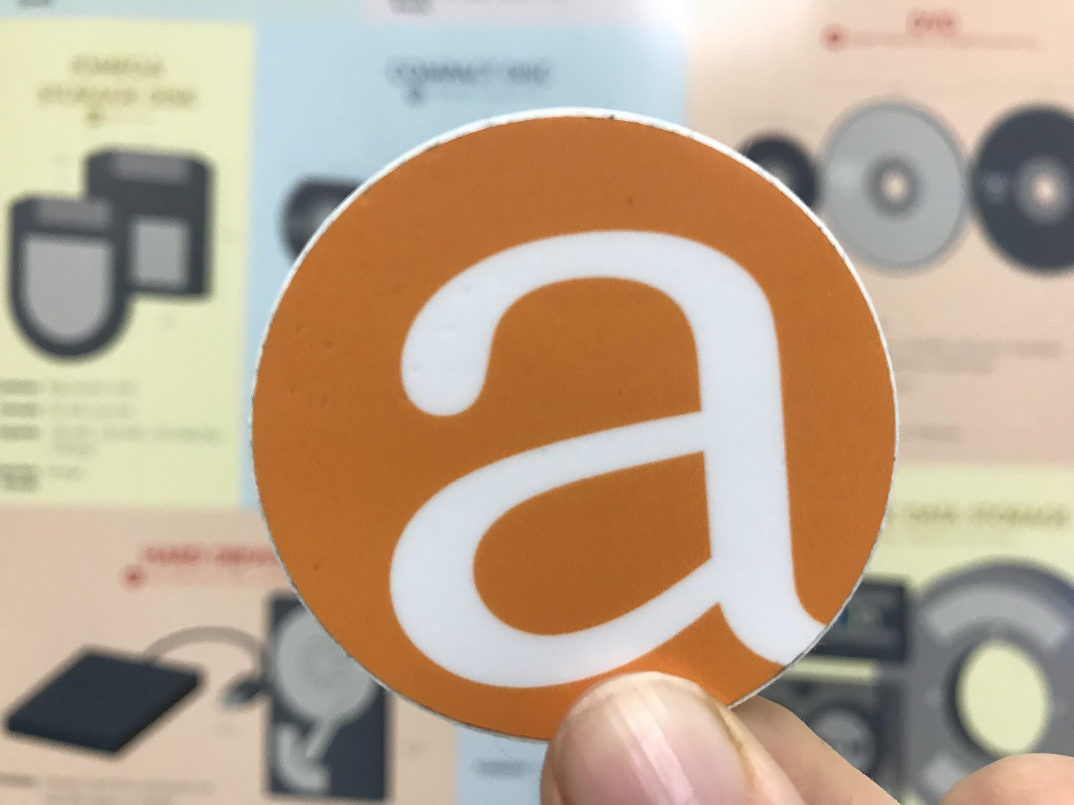
UCLA Library: Archivematica (2016-17)
Notes:
SHIRA
After 3 months of back-and-forth, UCLA finally agreed to purchase a year-long AMA in May 2016
By that point in time I had already begun working with staff in DIIT to draft a project charter and documentation, which (or some of which) is what you see onscreen
I’ll return to this in a moment but
first I want to give just a tiny bit of background about DIIT

Slide 14
UCLA Digital Initiatives and I.T. (DIIT)
Partners with units in other areas of the library to
Centrally supports much of the software used in LSC’s digital archives program
  ePADD, KryoFlux, FTK, BitCurator, etc.
Approx 40 LTEs
They have a lot (!) on their plates
Notes:
SHIRA
DIIT is responsible for centrally supporting much of the software used throughout UCLA library
To do this work they partner with units in other areas of the library to collaboratively provide technology support on everything from our library catalog, to our paging system, to all of the software used in LSC’s digital archives program
Including ePADD, KryoFlux, FTK, BitCurator, etc.
Although they have roughly 40 FTEs,
They have a LOT on their plates

Slide 15
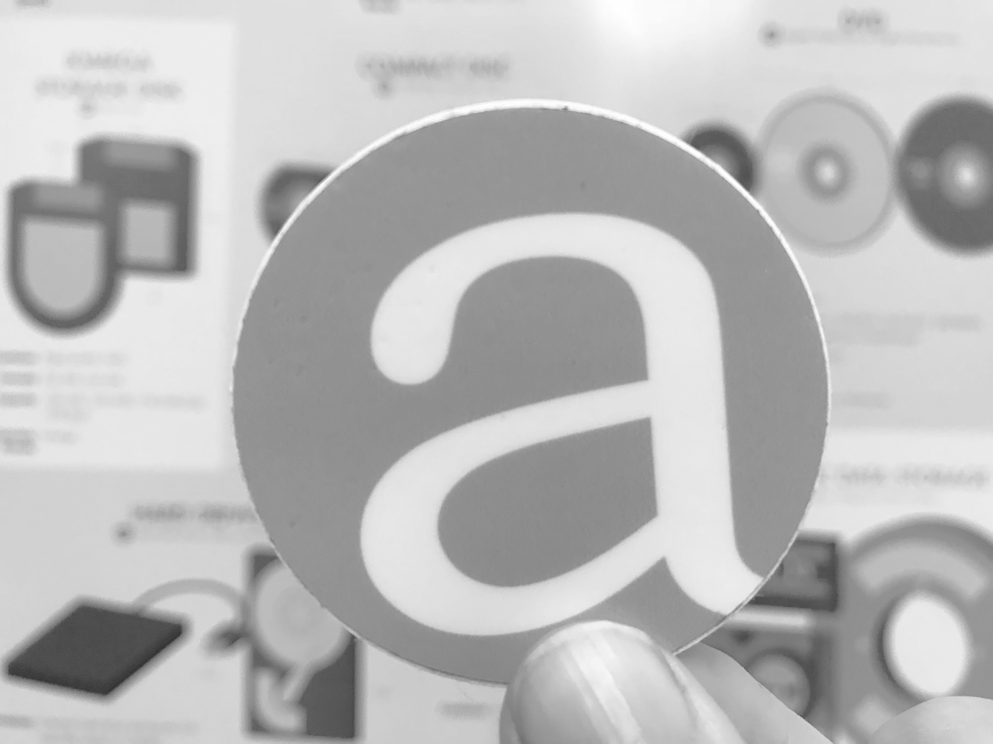
Archivematica roles & responsibilities
DIIT DEV OPS
Archivematica storage management
Software management for patches and upgrades
Oversight for interaction with other tools
Manage general software support issues
LSC DIGITAL ARCHIVES
Create and manage user accounts
Create and manage pipelines
Respond to user needs offer solutions to issues as they arise
Train others in department
Serve as designated coordinator between departments
Notes:
SHIRA
With that in mind, I want to take a minute to review the roles and responsibilities for implementing Archivematica as they had been assigned back in the fall of 2016 when this project first got off the ground:
DEV OPS
Archivematica storage management; handle storage management capacity on the backend
Software management for patches and upgrades
Have oversight for interaction with other tools for preservation
Manage general software support issues
LSC DIGITAL ARCHIVES
Create and manage user accounts
Create and manage pipelines
Serve as software expert who is a bridge between user and tech support; respond to new user needs offer solutions to issues as they arise
Train others in department
Serve as designated coordinator between departments
In short, DIIT was supposedly going to be responsible for pretty much all aspects of software support

Slide 16
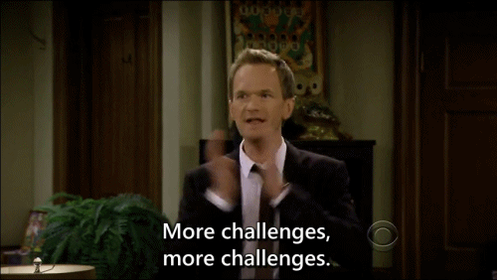
UCLA Library Challenges
Project required a significant commitment
of resources and time from DIIT
Application is complex;
supporting it requires
a degree of expertise
DIIT had no background
in archives or digi pres
Notes:
SHIRA
The approach to we took to this project created quite a few challenges
1) first and foremost the project as it had been conceived originally involved quite a hefty commitment of time and resources from a department that was already stretched thin
2) The second challenge was the complexity of the software
Anyone who has worked with Archivematica can attest to the fact that the application is complex, and--like most free and open source tools--suffers from documentation that isn't always up-to-date or complete, which raised the bar to entry for DIIT in terms of getting to know it or being able to diagnose things when they went wrong.
The software's inherent complexity is compounded by the fact that Archivematica is an open source tool that packages together a number of other open source tools.
Although this is one of its greatest strengths, it also means that there are a number of dependencies that makes administering this application quite a challenge.
It is essential to take the time to gain some understanding of what each of these tools do and the role they play in the processing pipeline.
This feeds into the third problem I’ll mention here, which is that my DIIT collaborators had little-to-no archives background, and were unfamiliar with the basic concepts of OAIS, let alone the intricacies of processing born-digital material or an understanding of the overall purpose or function that each microservice played in our pipeline
In short, without this baseline knowledge, it was difficult for DIIT to effectively troubleshoot and provide the level of support that we needed.
Since my time up here today is limited I won’t go into too much detail about how each one of these challenges manifested itself in the real world
I think it will suffice to say that, as you might imagine, it quickly became apparent that DIIT would be unable to take on the work that supporting this application would entail
Although we were able to install Test and Production servers, by the end of our year-long annual maintenance agreement it was clear that the support model as we had originally conceived it was quite unrealistic given that this was just one of a number of projects for which DIIT was responsible

Slide 17
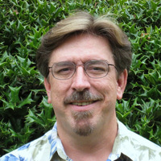
UCLA Library: Solutions
Regular coffee meetings with a key
DIIT collaborator
  This helped me better
  understand DIIT (and vice versa)
  It also led to a closer and more
  Productive partnership between LSC and DIIT
Edson Smith
DIIT, UCLA Library
Notes:
SHIRA
Throughout this process, I began having monthly coffee meetings with Edson Smith, who oversees our Dev Ops team in DIIT
We both recognized that it was important for us to have a better understanding of what we were each working on, what was going on in our respective departments, etc.
I can’t emphasize how critical these chats were because they armed me with much clearer insight into how things worked and how decisions were made in DIIT
For instance, I learned that during the first iteration of the project, Archivematica had not been a departmental priority for DIIT. To explain this briefly,
Departmental priorities are set by DIIT’s AUL
When a project is officially designated as a departmental priority, a project manager is assigned to ensure that the work is completed on time and meets its goals.
Another thing that our conversations brought to light was that I realized Archivematica could actually help Edson with aspects of his work -- specifically, preparing digital objects for deposit into DPN for long-term storage.
In short, Edson had been doing by hand what Archivematica could automate
When I realized this, I set up a few training sessions for the two of us to sit down together and take the assets he was working with through the pipeline
These training sessions were essential, because I think they helped Edson understand what an important role this tool played in our workflow, and how much it did for our collections
After months of direct and indirect advocacy, Edson was able to advocate not only for our AMA to be renewed, but for the project to be listed as a departmental priority

Slide 18
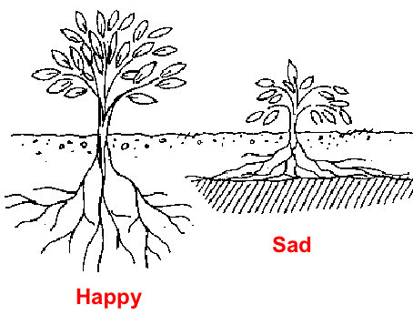
UCLA Library: Strategies
2nd AMA began fall 2017
Project was re-scaled and
re-scoped
The burden of
application support shifted
from DIIT to Artefactual
Notes:
SHIRA
The way that Edson put it, was that he compared the first iteration of our Archivematica implementation to the second was, “we potted the plant the first time around, but then just left it to wilt inside. Let’s see what happens if we try giving it sunlight and water”
So that’s what we did
Our second AMA began in the fall of 2017
The second time around we re-scaled and re-scoped the project so that DIIT’s role would be pared back significantly
The biggest difference was that we shifted the burden of application support from DIIT back to Artefactual

Slide 19
Archivematica deliverables
DIIT DEV OPS
Provide a hosting environment
Perform load testing
Provide documentation
ARTEFACTUAL
Deploy Archivematica
Deliver MySQL and SQLite backups on the VMs (Production and Test)
Upgrade settings on the new servers (UCLA DIIT can review for policy adherence if required.)
Provide relevant training
Notes:
SHIRA
You can see this shift reflected here in the updated deliverables
This time around DIIT’s main responsibility was to simply provide a hosting environment for Archivematica, which is a significant step back from what they were on the line for previously.
UCLA deliverables
Provide a hosting environment into which Artefactual can deploy an Archivematica instance
Perform load testing
Provide documentation about the process
Artefactual deliverables
Deployment Archivematica
Deliver MySQL and SQLite backups on the VMs (Production and Test)
Upgrade settings on the new servers (UCLA DIIT can review for policy adherence if required.)
Provide relevant training

Slide 20
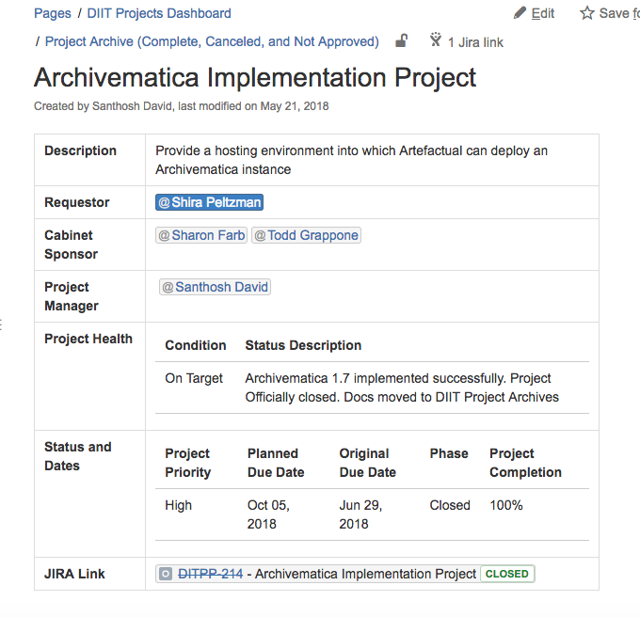
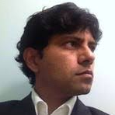
UCLA Library:
Outcome
Santhosh Kundukulangara
DIIT Project Manager, UCLA Library
Notes:
SHIRA
This was thanks in very large part to my colleague Santhosh Kundukalangara, who served as project manager
His support was critical
He developed communication plan, a project workplan, and helped push the work forward
I’m happy to report that this time around the project was a success
You can (maybe?) see that reflected in the screenshot of the STATUS section of our project charter on the screen

Slide 21
UCLA Library: Tips
Make connections
Understand how decisions are made
Help colleagues understand how this work will benefit them or make their jobs better/easier/faster
Advocacy and outreach are everything
Accept that change will not happen overnight
Notes:
SHIRA
So what made the second iteration more successful and sustainable than the first? A few things.
Make connections
The regular coffee meeting I set up with Edson provided a forum for the kind of soft advocacy that’s required for affecting change
Understand how decisions are made
I would also say that another major factor was that the first time around I simply assumed that because the library had paid a lot of money for an AMA, it would automatically be a priority
I didn’t know that this was not necessarily the case; once I did, I concentrated my efforts on winning over Edson to the cause since I knew that he would be an effective advocate
Help colleagues understand how this work will benefit them or make their jobs better/easier/faster
One of the ways I ultimately did this was to convince him that he had a stake in making this work.
Advocacy and outreach are everything
And in that vein, I think the biggest piece of advice I can give is never underestimate the power of advocacy, whether soft, hard, direct, or indirect.
Accept that change will not happen overnight
On that point though, it’s also important to recognize that this won’t happen overnight.
Affecting change is hard, and without persistent advocacy it simply will not happen
That’s about all I have for today, but before I hand off the mic …

Slide 22
Shout out and thanks to my team!
Santhosh Kundukulangara
Charlie Chen
Stephen Gurnick
Edson Smith
Josh Gomez
Jasmine Jones
Notes:
SHIRA
I just want to thank and acknowledge the whole Archivematica team at UCLA who has worked alongside me to see this project to completion
Santhosh Kundukulangara
Charlie Chen
Stephen Gurnick
Edson Smith
Josh Gomez
Jasmine Jones
I’d be nowhere without all of them
And with that, I’ll hand it off to Mary

Slide 23
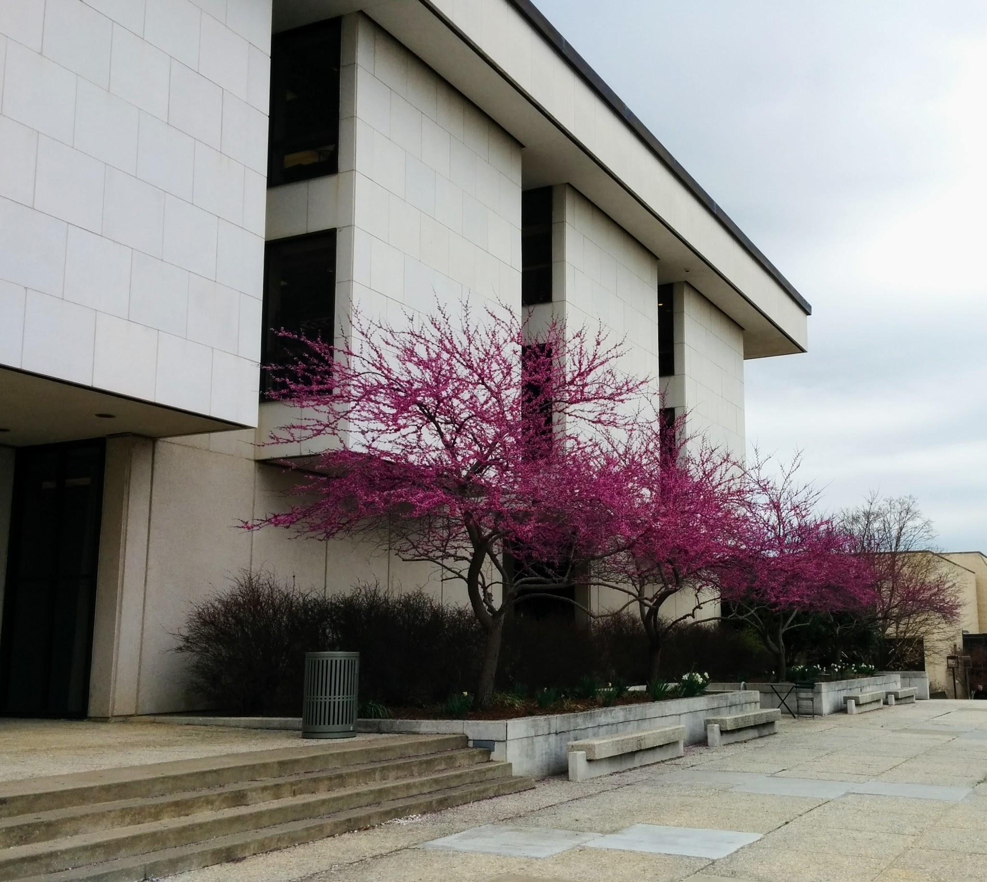
Univ. of Arkansas Libraries & CAST
Libraries
  2 IT workers / 160+ workers
  No digital preservation staff
CAST
  1 IT worker / 14 research staff
  Preserve data per grant req.
Notes:
Good morning! My name is Mary Leverance, and my job title at the University of Arkansas is Preservation Coordinator. My duties are split between the University Libraries and the Center for Advanced Spatial Technologies (aka CAST), a grant-funded multi-disciplinary research center. In the Libraries, I focus on physical preservation of library items, and was also on a committee to recommend a digital preservation system. With CAST, my role is to make research data objects findable and accessible, and preserve them for the long-term.
Here’s a bit of background on the IT and digital preservation setup for each group.
Libraries
The two IT workers handle any technology-related need or problem, and they also work on special projects. Needless to say, they’re busy.
The Libraries do not have anyone solely dedicated to digital preservation, and although we made a recommendation for a digital preservation system, SPOILER ALERT: the recommendation doesn’t involve IT, and we aren’t fully up and running with a system.
CAST
There is one IT worker for 14 researchers. CAST research projects include geospatial research in archaeology, image analysis, 3D reconstruction, reality capture, and GIS & mapping. Researchers collect and generate large data sets.
Per National Science Foundation (NSF) grant requirements, research data must be preserved for the long-term.

Slide 24
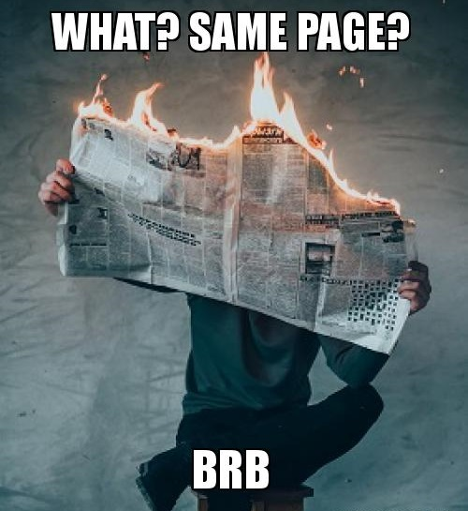
U of A: Challenges
Libraries
So, what IS digi pres?
“Wandered lonely as a cloud” storage
New leadership
The great unknown
CAST
So, what IS digi pres?
Files: size and type
$$$$$ / no system
Notes:
Both groups are dealing with challenges, and while they’re listed on the slide singularly, they really all play off of and impact one another.
Libraries
Challenge #1
Staff and administration recognize digital preservation as important - this is good!
However, leadership, librarians, and IT have different understanding of what digital preservation is, and are not unified on what it isn’t
Challenge #2
Our saga with IT
With apologies to William Wordsworth, we started out wandering lonely as a cloud: the university archivist spearheaded the initial implementation of open source software
Libraries IT was a bit resistant to digital preservation and not able to provide support staff-wise, so collaboration was shifted to university IT
This worked, but a restructuring meant losing their support, and then access to the open source system altogether
To bring it back to the cloud, a recent allocation of cloud storage space prompted IT to say, Hey, there’s cloud storage you can use for preservation! Which brings us back to the first issue of knowing what digital preservation is.
Challenge #3
In early 2017, a proprietary system was recommended
Not long after, new administrative leadership was hired
Someone new brings their own ideas of how to do things, and when a system is not already fully implemented, these ideas may be cause for pause
Challenge #4
There are unknowns
It remains to be seen whether this leadership change will bring Libraries IT back into the picture
We don’t know the level of commitment or budget for digital preservation
Due to the unknowns, we’re not up and running with a system
CAST
Challenge #1
Current “long-term preservation” is data backups on office servers and data stored in cloud
Challenge #2
Large files from 3D scanning and geospatial work means more storage space is needed, which IT person has to come up with
Storage space is not free, no matter what kind of system you’ve implemented
Challenge #3
Although funding for preservation could be written into grants, it’s generally something not seen as priority
Even if there is collaboration with the Libraries on a system, money will remain a challenge

Slide 25
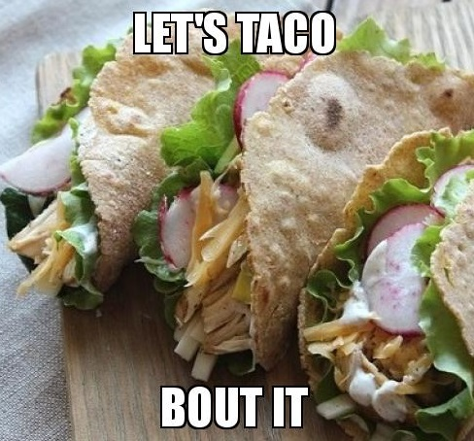
U of A: Strategies
Libraries
Keep interest levels elevated
Continued education
New position
CAST
Terminology
NSF requirements
Open access repository options
Notes:
At this point in time, both groups need to spend more time discussing objectives, goals, initiatives, and desired outcomes in order to move us into a project execution phase. In thinking about ways to facilitate this, I’m focusing on the following strategies. Unlike the other presenters, these are strategies to do, and not ones that have already been done.
Libraries
Strategy #1
Work with colleagues (the university archivist and the head of Digital Services) to keep administrators interested in digital preservation
We will continue to promote reasons for digital preservation system with leadership and with Libraries IT, even though they aren’t currently involved
We will keep our perspectives open for implementing a system that perhaps wasn’t the one recommended by committee
Strategy #2
We will continue educational outreach with presentations and in individual discussions
Strategy #3
We will advocate for a permanent digital preservation position within the Libraries
CAST
Strategy #1
Establish common point of reference regarding digital preservation terminology
Strategy #2
Explore further: with NSF requirements for digital preservation, is the group meeting requirements with present setup?
Strategy #3
Collaborate with IT worker to find an open access repository so projects are stored in a separate location, in order to expand on the current setup

Slide 26
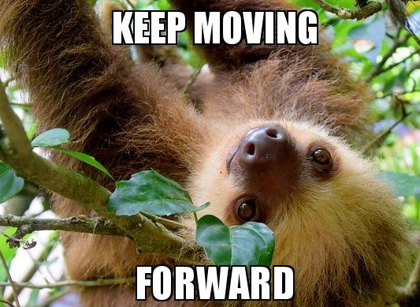
U of A: Tips
Know your role
Value institutional knowledge
But… what works now and going forward?
Hands-on experience with YOUR system
Notes:
Although I don’t have a success story to report, my library colleagues (who I mentioned earlier) and I have learned some basic things along the way.
Tip #1
Know your role
When collaborating with IT, know who is doing what, and when work needs to be done, give proper instructions to your collaborators so they can create the output you need AND meet your expectations
For example, IT handles the back-end of the digital preservation system, and the Libraries handle the front-end
This communication fosters accountability and trust between collaborators
Tip #2
Value institutional knowledge
Are things always done a certain way? Is there one person who’s worked at the university for 15+ years and knows the history of everything institutional? Are you new and playing detective to figure out what’s really behind-the-scenes?
LISTEN and investigate to fill your knowledge gaps
Tip #3
But, don’t let “this is the way we do things” be the sole factor in the choices you make or the direction you propose
As has already been mentioned, change can be difficult, but often necessary
Tip #4
Don’t set it and forget it
Are you just starting out with a new system that was set up by IT? Set up a time to run through it together so you can learn about it as a team. The people who set it up will most likely have tips to share that will keep you from searching for answers on your own.
Now I’ll pass the mic over to Elena.

Slide 27
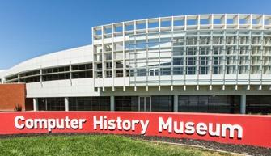
Computer History Museum
Located in Mountain View, CA.
Archive is off site in Fremont, CA .
Approximately 70 person staff.
IT Department of 5 for whole museum.
Budget: Small.
Notes:
Good morning everyone. My name is Elena Colon-Marrero and I am the Digital Processing Archivist at the Computer History Museum. As my colleagues did, I want to give you a little context about the museum. The Computer History Museum is located in Mountain View, California, with the archives located off site in Fremont, CA about 20-30 minutes away. The museum has a staff of approximately 70 people, with a single IT department of 5 people responsible for the IT needs of the whole museum. A majority of the employees work on site, but I work at the off-site facility in Fremont. I only go to the museum for our all staff meetings or as needed. I can't give you exact figures as to our budget, but it is small.

Slide 28
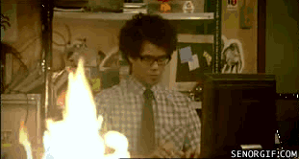
CHM: Challenges
Goal: Build two digital workstations to image software and process other born-digital materials.
Obstacles:
Not a Priority
Avoiding being short-changed
Notes:
On the day-to-day basis I do not work with IT. Most of my interactions come when an IT rep stops every few weeks or when something breaks. A major part of my job is imaging the software that is in our collection. When I started at the museum in July 2016 I did not have any machines to do digital preservation work on. In order to start on this aspect of my job I needed a workstation with all the tools needed for imaging floppy disks, CDs, and DVDs, as well as a workstation to process non-software related digital materials. We had two choices, build the workstations ourselves or have IT build them for us. Myself, my supervisor, and the Senior Digital Archivist, Andrew Berger, decided it would be preferable to have IT help us build the two workstations that we wanted. We wanted IT to have buy-in with the workstations in case we needed to fix something that no one on our team could fix. Our major challenges with IT was
Being a priority. The IT team was in the final stretches of building a new permanent exhibit, Make Software Change the World. This exhibit had a lot of audio-visual and interactive components that took a major portion of IT's time.
Getting them to not short-change us. Due to the amount of work that they had the department wanted to do the least amount of work possible on the workstations, which would have meant getting a very stripped down version of what we wanted.

Slide 29
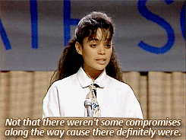
CHM: Tips
Consistent follow ups.
Set your goals higher.
You will HAVE to compromise
Pick your battles.
Notes:
How did we make it work?
The first thing was consistent follow ups.
We met with IT once a month to discuss progress and updates for the stations. At the start of the process in July, I presented IT with a list of all the things I wanted in two workstations: one a linux based computer with BitCurator installed and another that was Windows based.
The second tip: Set your goals higher.
In preparing my list I only included my "dream" items. My supervisor and co-worker told me it would be best to present the top of the line items I wanted in the stations, because we would have to make concessions. This way through all the wheeling and dealing we would get a machine that was closest to what we really needed rather than what we aspirationally wanted.
You Will have to compromise
The whole process took 9 months to get every workstation. There were a lot of disagreements as to what would go into the stations, how security would be handled, and what digital preservation even means. Not surprisingly the head of IT and the rest of us were not on the same page. Instead of getting the two workstations that we wanted, we got three. One Windows based machine, where we do the majority of our disk imaging, a Linux machine with Bitcurator installed, but no ability to image floppy disks, and a second Windows machine with numerous virus and malware scanning programs.
4. Lastly, Pick your battles
It became a pick your battles type of situation and eventually our interactions shifted from the head of IT to the staff members that were actually building the machines. Those individuals were more willing to provide us with the things we needed, because they didn’t take that long to accomplish. It turned out that what we were discussing in our meetings were not getting communicated properly to the IT staff members that were building our machines. On two machines we were able to get general log-ins, and admin privileges on all of the machines, but this meant that our workflows would need to be segmented between three sometimes four computers.
We didn't get exactly what we wanted. Throughout the 9 months, we had to fight with IT to be considered a priority and to make sure they didn’t short change us. We accomplished this through consistent follow-ups, setting our goals higher, making compromises where we could, and choosing our battles carefully. Instead of two machines we got three. This resulted in a clunky workflow process, but hey, I have machines and I have the power to install new programs and tools without IT approval! Thank you!

Slide 30
Guided Discussion and Q&A
What would you say is your greatest success in applying particular strategies or techniques to dealing with IT? Your biggest blooper?
Is there an aspect of your project/case study that was unexpected or surprising?
What resources did you find to be helpful in overcoming barriers (e.g. books or articles, websites, tools, people, departments, etc.)?
What tools or strategies can you recommend, based on your experience?
Notes:
Thank you to all of our panelists.
At this point we are going to transition into discussion. We have a few questions that we wanted to discuss with one another, but please feel free to jump in with questions. I’ll go ahead and ask the first question for the group: What would you say is your greatest success in applying particular strategies or techniques to dealing with IT? What about your biggest blooper? And I would just like to say that when we discussed these questions ahead of time, we really liked the use of the word “blooper” because it doesn’t imply failure, but it shows the ups and downs of this work. So, panelists, greatest successes and bloopers?
Back up questions:
Mary mentioned “Know your role” which is sometimes a difficult thing to put into words. I’m wondering if someone could define what you think your role is in collaborating with IT?

