Slide 1
Paleontology Topic Trends
May 01, 2018
CS4624: Multimedia, Hypertext, and Information Access
Instructor: Edward A. Fox
Virginia Tech, Blacksburg, VA 24061
James Wilson, Joseph Martin, Eric Weiler, Rudy Cruz

Slide 2
Outline
What We’re Doing
Stacked Bar Graphs
Our Experience
Future Work
Acknowledgements

Slide 3
What We’re Doing
Task: Determine trends in paleontology
Resources: PDFs containing abstracts for new paleontology publications presented at international paleontology conference (1987-2017)
Work: Text mining the abstracts and building word counts to perform analysis on.

Slide 4
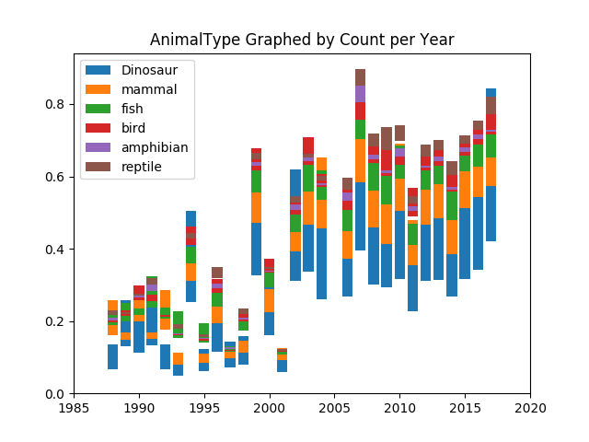
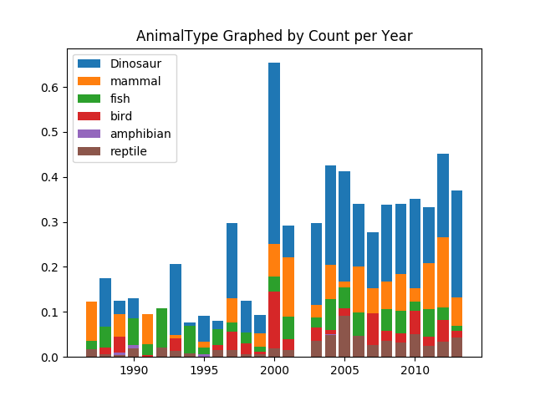
Stacked Bar Graphs

Slide 5
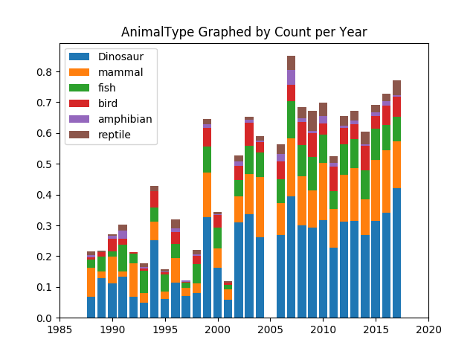
Stacked Bar Graph Cont.

Slide 6
Our Experience
Learned to be client centric
Learned over 5 new Python frameworks
Fostered a better understanding of automated textual analysis

Slide 7
Future Work
Extract, analyze, and present data relating to the authors of the publications
  How authors relate to each other
  How authors relate to a particular subject
  Show demographics of the authors
  Can be represented as a graph data structure
Integrate the code into a web application
  Users submit their abstracts to the app
  Users can do it all themselves instead of submitting to devs and waiting for a result
  Users can customize report parameters and stop words

Slide 8
Acknowledgements
Client: Our client is Professor Sterling Nesbitt, a professor in the geosciences college, with a focus in Paleobiology. Our project is focused around abstracts created by the Society of Vertebrate Paleontology, and the information within them.

Slide 9
References
http://vertpaleo.org/Annual-Meeting/Abstracts.aspx
http://www.jmlr.org/papers/volume3/blei03a/blei03a.pdf
http://www.simonlindgren.com/stuff/2017/4/14/topic-modelling-with-mallet
https://en.wikipedia.org/wiki/Stemming

Slide 10
Questions?

