Slide 1


An Open Textbook Approach to OER: VIVA & the Open Textbook Network
Virginia Library Association Annual Conference
Friday, October 28, 2016
Hot Springs, Virginia
© Hea Poh Lin “Book” CC BY 3.0
This presentation is licensed with a
Creative Commons Attribution 4.0 license

Slide 2




Presenters
Olivia Reinauer
Anita Walz
Genya O’Gara
Anne Osterman
Claudia Holland
© Hea Poh Lin “Book” CC BY 3.0
Notes:
OLIVIA: Reference Librarian at Tidewater Community College
Anita: Open Education, Copyright & Scholarly Communication Librarian (for full disclosure, Anita is also an Open Textbook Network Advisory Board Member)
Genya: Associate Director
Anne: VIVA Director
Claudia: Head of Scholarly Communication & Copyright Office

Slide 3
Roadmap
What is the Open Textbook Network?
Why did VIVA join?
What have we done (and learned) so far?
How can you be involved?
And where do we go from here?
© Hea Poh Lin “Book” CC BY 3.0

Slide 4
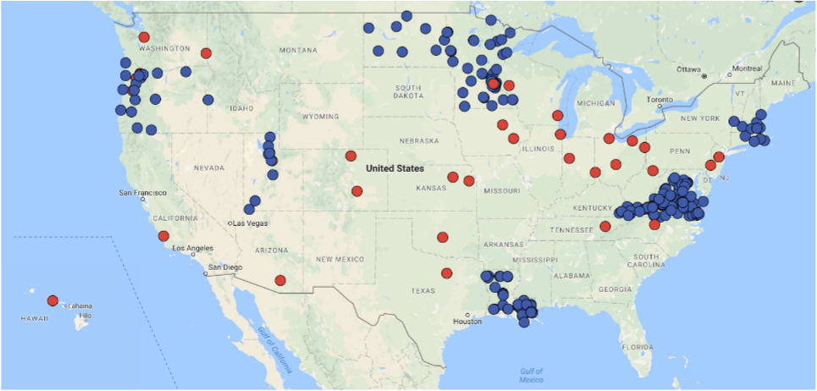

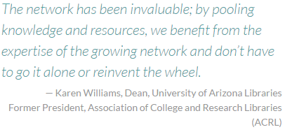
The Open Textbook Network
(and Open Textbook Library)
Open Textbook Network
http://research.cehd.umn.edu/otn
Created in 2014
Open Textbook Library
https://open.umn.edu/opentextbooks
Created in April 2012
© Hea Poh Lin “Book” CC BY 3.0
Babson Reports on OER (2012, 2014, 2016): http://www.onlinelearningsurvey.com/oer.html
Notes:
Anita
What is the Open Textbook Network (and what’s an open textbook)? (a brief history) (Anita)(5:00)
Babson report findings (OTN addresses the problem of where to find content)
Open Textbook Library walkthrough/overview
Workshops for faculty
Training for librarians

Slide 5
Open Textbooks
Gratis ($no cost) + Libre (freedom)
© Hea Poh Lin “Book” CC BY 3.0
For more information, see “Unpacking Creative Commons Licenses” or https://creativecommons.org/licenses
Notes:
Anita
What is the Open Textbook Network (and what’s an open textbook)? (a brief history) (Anita)(5:00)
Babson report findings (OTN addresses the problem of where to find content)
Open Textbook Library walkthrough/overview
Workshops for faculty
Training for librarians

Slide 6
Open Textbooks
Gratis ($no cost) + Libre (freedom)
© Hea Poh Lin “Book” CC BY 3.0
For more information, see “Unpacking Creative Commons Licenses” or https://creativecommons.org/licenses
Notes:
Anita
What is the Open Textbook Network (and what’s an open textbook)? (a brief history) (Anita)(5:00)
Babson report findings (OTN addresses the problem of where to find content)
Open Textbook Library walkthrough/overview
Workshops for faculty
Training for librarians

Slide 7




Open Textbooks
Gratis ($no cost) + Libre (freedom)
© Hea Poh Lin “Book” CC BY 3.0
For more information, see “Unpacking Creative Commons Licenses” or https://creativecommons.org/licenses
Notes:
Anita
What is the Open Textbook Network (and what’s an open textbook)? (a brief history) (Anita)(5:00)
Babson report findings (OTN addresses the problem of where to find content)
Open Textbook Library walkthrough/overview
Workshops for faculty
Training for librarians

Slide 8
Open Textbooks
Gratis ($no cost) + Libre (freedom)
Free to:
Remix Copy/Share
Translate Edit/Adapt/revise
Redistribute Keep/retain
Repurpose
© Hea Poh Lin “Book” CC BY 3.0
For more information, see “Unpacking Creative Commons Licenses” or https://creativecommons.org/licenses
Notes:
Anita
What is the Open Textbook Network (and what’s an open textbook)? (a brief history) (Anita)(5:00)
Babson report findings (OTN addresses the problem of where to find content)
Open Textbook Library walkthrough/overview
Workshops for faculty
Training for librarians

Slide 9
Dipping our toes in Open Initiatives
VIVA & the Open Textbook Network
© Hea Poh Lin “Book” CC BY 3.0
Notes:
Genya

Slide 10
2015 OER Task Force
  Surveyed VIVA members
  Identified ongoing OER initiatives in VA
  Made recommendations for next steps
Findings & reports
© Hea Poh Lin “Book” CC BY 3.0
Notes:
Genya

Slide 11
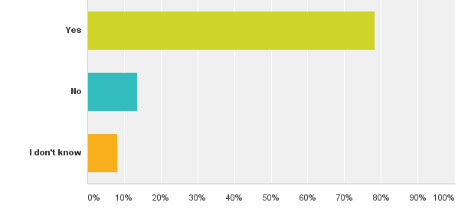
Survey Results
  39 institutions participated
  78% were exploring or using OER
Findings & reports
© Hea Poh Lin “Book” CC BY 3.0
Notes:
Genya

Slide 12
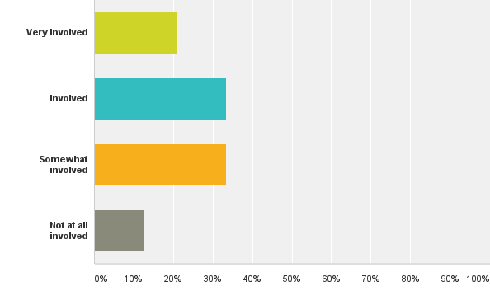
Survey Results
  Library levels of involvement varied
  However 84% of respondents thought the libraries should be playing an active role
Findings & reports
© Hea Poh Lin “Book” CC BY 3.0
Notes:
Genya

Slide 13
Findings & Recommendations
2015 Survey Findings:
  OER textbooks and shareable course projects
  OER in instruction sessions and online resources
  Grant funding supporting faculty incorporating OER
2015 Key recommendations:
  Educate on statewide efforts & coordinate with SCHEV Open VA
  Centralize information on OER resources
© Hea Poh Lin “Book” CC BY 3.0
Notes:
Genya

Slide 14
Open Initiatives Expansion
Library Advisory Committee
  Presentation by Anita Walz, Tara Cassidy, and Kathleen DeLaurenti
Exploration of Open Initiatives as a consortium
  Interests of the Library Advisory Committee and VIVA Steering Committee
  Current institutional efforts
  Implementable recommendations
© Hea Poh Lin “Book” CC BY 3.0
Notes:
Genya

Slide 15
Benefits/Goals
VIVA’s goal to deliver equitable and cost-effective access to academic resources for Virginia students fits with SCHEV’s focus on higher education affordability.
The OTN program is devoted to access, affordability, and student success, and therefore meets both these priorities.
Joining as a consortium allows VIVA to bring this opportunity, and these student savings, to academic libraries across the Commonwealth.
© Hea Poh Lin “Book” CC BY 3.0
Notes:
Genya

Slide 16
OTNSI WISDOM
Points Learned
Notes:
Olivia

Slide 17
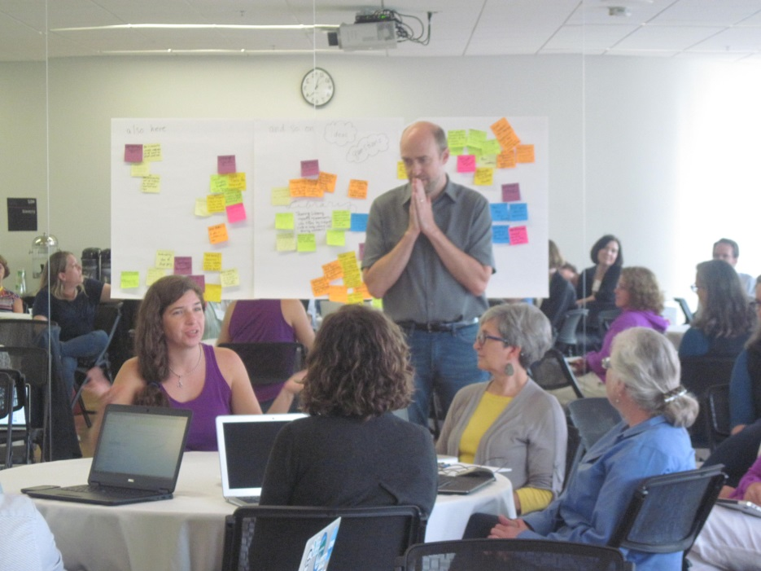
Open Textbook Network Summer Institute
VIVA’s membership announced April 2016
August 8-12, 2016 University of Minnesota
4 VIVA System Leaders attended
© Anita Walz “OTNSI 2016” CC BY 4.0
© Hea Poh Lin “Book” CC BY 3.0
Notes:
Olivia
Approx 20 members for the OTNSI and 46 for the summit

Slide 18
Objectives
OTNSI (for new members)
OTN Summit
OTN workshop
Strategies for overcoming barriers and engaging campus partners
Creating actionable steps to use on your campus
Enhancing open textbook program development across OTN members
Envisioning the future of OTN
Sharing research on open textbook efficacy
Network-wide discussion of common themes and hurdles
© Hea Poh Lin “Book” CC BY 3.0
Notes:
Olivia

Slide 19
Why Educators Care
Social justice
Student learning, retention, degree completion
Increased pedagogical control
© Hea Poh Lin “Book” CC BY 3.0
Notes:
Opens doors to attend college; provides students with affordable course options otherwise unavailable to them. Preliminary research indicates student learning is no different if not better than traditional textbooks.
Can’t control tuition increases; no or low-cost textbooks one area we can help.
Greater academic freedom and flexibility.

Slide 20

Building Faculty Awareness, Education and (ultimately) Engagement
Why focus only on textbooks?
Where are open textbooks found? Open Textbook Library!
How to recognize quality content?
What is the point of textbook reviews?
Public Domain (1909) http://www.loc.gov/pictures/item/2007683268
© Hea Poh Lin “Book” CC BY 3.0
Notes:
Claudia
Complete open textbooks easier to adopt & potentially modify than starting off with searching for disparate open materials ; student learning increases with availability of txtbk at the outset of a course; OTL is great place to start. Currently includes
As the disciplinary expert,the instructor is the best judge of quality materials. Textbook reviews may or may not be available.
Reviews invite more in-depth critique/education about specific OT; stipend incentivizes & rewards engagement. Also, dedication of funds to a cause reflects the value the library/institution places on this initiative.

Slide 21
Some Tips
Do not judge or demonize
Acknowledge skepticism, concerns & uncertainty
No selling; Respect academic freedom
Stay focused on the open textbook option
Invite partnerships
© Hea Poh Lin “Book” CC BY 3.0
Notes:
Claudia
Do not be negative about lack of interest, critical comments, bookstore or publisher role in textbook problems. Embrace all questions.
You are not “selling” an idea, you are offering education about other options to consider in lieu of expensive, perhaps restrictive textbooks.
You may want to acknowledge the availability of library provided materials, but don’t get bogged down. The point is too many options dilute the primary reason for a workshop (if holding one) or consideration to adopt an open textbook (primary message).
Offer to work with interested faculty to facilitate the process and streamline the discovery process.

Slide 22
Adapting & Creating
OTN Advisory Board – Editing Working Group
Member presentations on authoring and publishing open textbooks
Publishing partnerships underway with U. Washington, U. Arizona, U. Mass-Amherst, Cleveland State
© Hea Poh Lin “Book” CC BY 3.0
Notes:
Olivia
Although the workshop is focused on adoption, 16% of faculty responding to the post-workshop survey say that they plan to author an open textbook

Slide 23
Hearing From the Experts
Open Education Research fellow – Rajiv Jhangiani, Kwantlen Polytechnic University
  COUP Framework
OER Research Toolkit - OTN & the Open Education Group
Creative Commons workshop - Nancy Simms, UMN Copyright Program Librarian
© Hea Poh Lin “Book” CC BY 3.0
Notes:
Olivia
COUP = Cost, Outcomes, Use, Perceptions

Slide 24
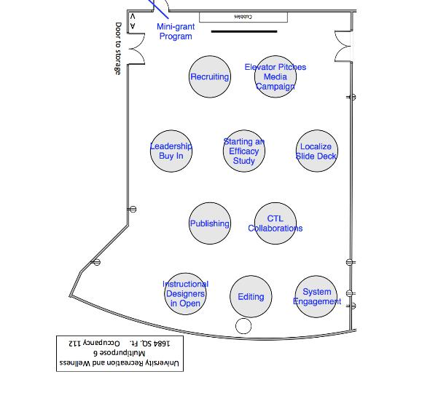
Engaging with the OTN Community
Experts in our Midst
Roundtables
OTN Advisory Board
Creating Open Textbooks
Recruitment
© Hea Poh Lin “Book” CC BY 3.0
Notes:
Olivia

Slide 25
Implementation in Virginia
A Consortial Approach

Slide 26
Campus Level Implementation
Tidewater Community College
Virginia Tech
George Mason University
Virginia Commonwealth University
© Hea Poh Lin “Book” CC BY 3.0
Notes:
Claudia/Olivia

Slide 27
Campus Leader Training
October 6, 2016 - 35 Campus & System Leaders @JMU
Open Textbook Library: Past & Present
Affordability, student academic success, and open
Identifying obstacles to open textbook adoptions
Strategies for addressing common challenges and
building local programming
© Hea Poh Lin “Book” CC BY 3.0
Notes:
Anita

Slide 28
The VIVA Program
VIVA System Leaders
  Anita Walz, Virginia Tech
  Claudia Holland, George Mason University
  Jimmy Ghaphery, Virginia Commonwealth University
  Olivia Reinauer, Tidewater Community College
© Hea Poh Lin “Book” CC BY 3.0
Notes:
Anne

Slide 29
The VIVA Program
VIVA Campus Leaders
Bridgewater College: Vickie Einselen | Randolph-Macon College: Laurie Preston
College of William & Mary: Kathleen Delaurenti | Richard Bland College : Bianca Spurlock
Dabney S. Lancaster Community College: Nova Wright | Roanoke College : Piper Cumbo
Eastern Mennonite University: Jennifer Ulrich | Shenandoah University : Andrew Kulp
Germanna Community College: Matthew Pierce | Sweet Briar College: Katie Glaeser
Hampden-Sydney College: Brian Burns | Thomas Nelson Community College: Joslyn Allison
J. Sargeant Reynolds Community College: Lynn Riggs | Union Presbyterian Seminary : Ann Knox
James Madison University : Liz Thompson | University of Mary Washington: Erin Wysong
Liberty University: Hannah Lowder | University of Richmond: Lucretia McCulley
Marymount University : Mason Yang | University of Virginia: Dave Ghamandi
New River Community College : Yvonne Maute | Virginia Commonwealth University: Hillary Miller
Norfolk State University : Lynne Harrison | Virginia State University: Arthur Fridrich
Northern Virginia Community College : Heather Blicher | Virginia Tech: Inga Haugen
Old Dominion University : Lucy Rush | Virginia Wesleyan College: Robin Takacs
Piedmont Virginia Community College : Crystal Newell | Virginia Western Community College: Dale Dulaney
Radford University: Jackie DeLong
© Hea Poh Lin “Book” CC BY 3.0
Notes:
Anne

Slide 30
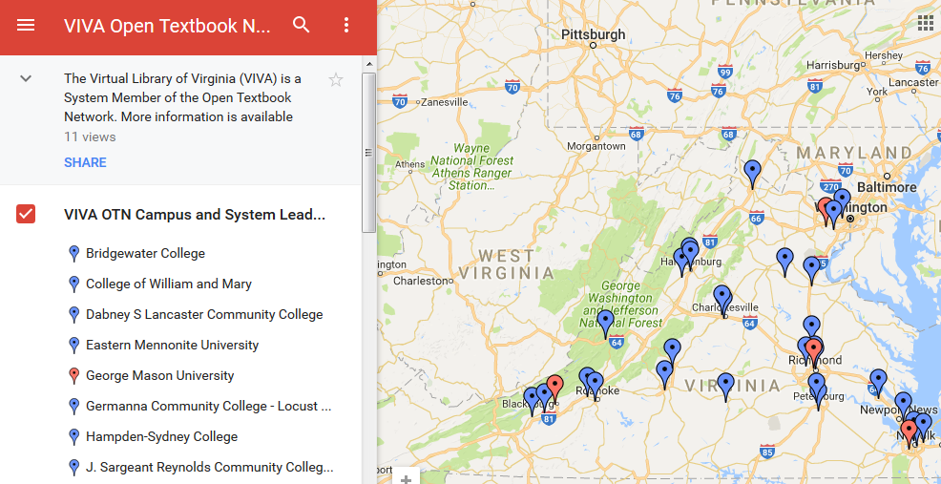
The VIVA Program
© Hea Poh Lin “Book” CC BY 3.0
Notes:
Anne

Slide 31
The VIVA Program
The VIVAOER-L Listserv is the key communication tool (http://www.vivalib.org/aboutviva/listservs.html)
  Discussion about OTN topics and statewide approach
  Announcement of workshops
© Hea Poh Lin “Book” CC BY 3.0
Notes:
Anne

Slide 32
The VIVA Program
$20,000 of VIVA Central Funds are available to support faculty reviews of OTN materials following Campus and System Leader workshops.
These funds will be distributed on a first come/first served basis.
© Hea Poh Lin “Book” CC BY 3.0
Notes:
Anne

Slide 33
The VIVA Program
If you are a school without a Campus or System Leader:
  You or your faculty may be able to attend a workshop at a neighboring institution.
  A Campus or System Leader may be able to provide a workshop for your faculty.
  VIVA may host another Train the Trainer workshop next year.
© Hea Poh Lin “Book” CC BY 3.0
Notes:
Anne

Slide 34

Next Steps: Consortium Level
Building bridges
Learning
Community
Planning
Leading Mentoring
Connecting
Sharing
© Hea Poh Lin “Book” CC BY 3.0
Notes:
Anita / All

Slide 35
Discussion (and Thank You!)
Olivia Reinauer oreinauer@tcc.edu
Anita Walz arwalz@vt.edu
Genya O’Gara gogara@gmu.edu
Anne Osterman aelguind@gmu.edu
Claudia Holland chollan@gmu.edu
© Hea Poh Lin “Book” CC BY 3.0

