Slide 1
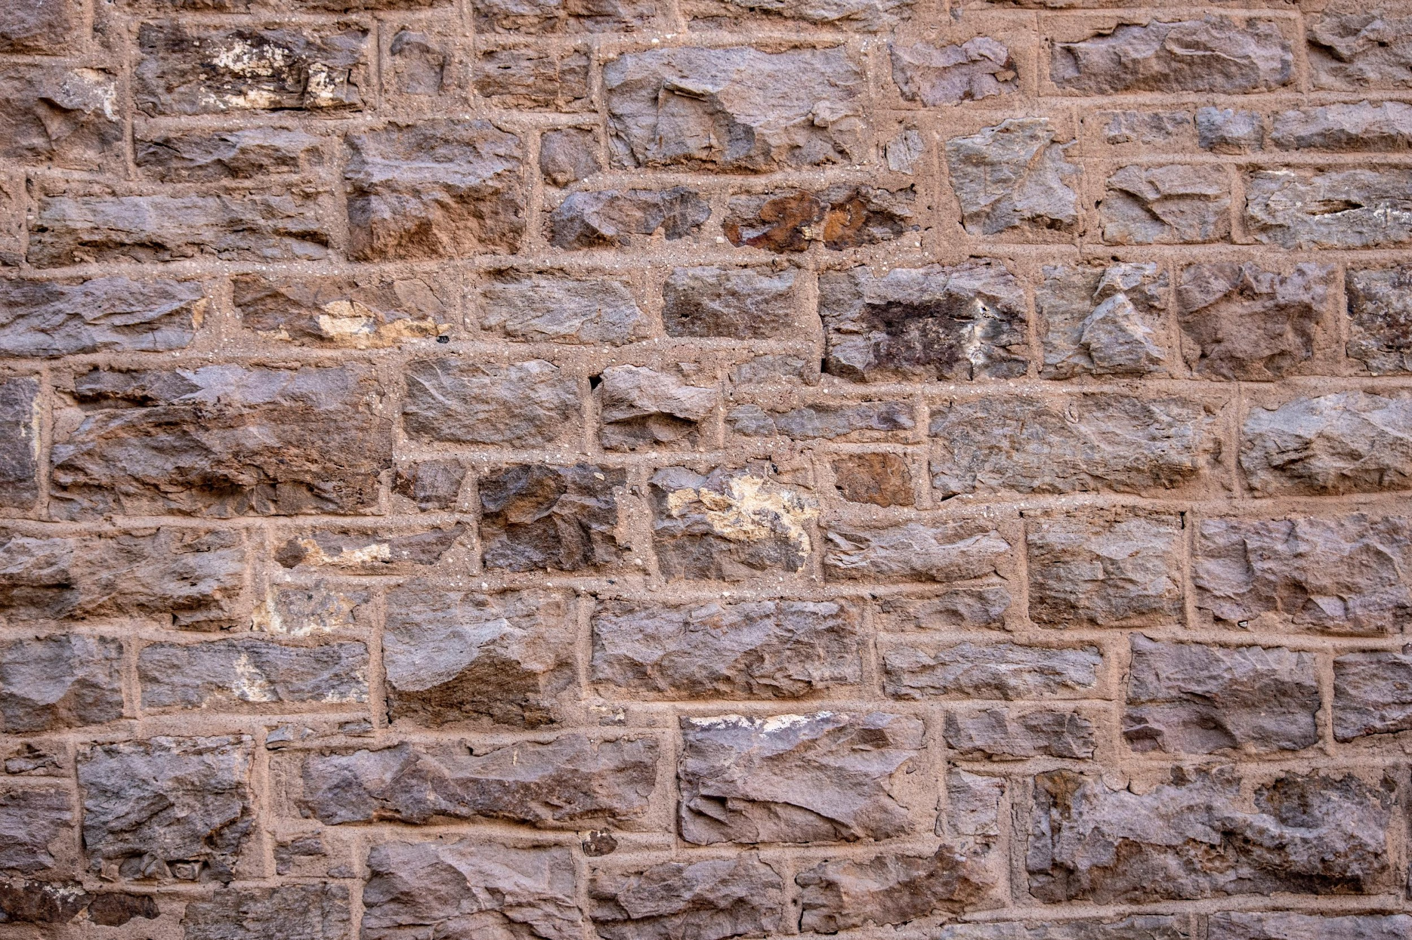

Strategic Management
Innovation and Entrepreneurship:
Tinkering with Strategy
Unless otherwise noted, this slide deck is (c) Virginia Polytechnic Institute and State University. It is released under a Creative Commons Attribution NonCommercial ShareAlike 3.0 license (CC BY NC-SA 3.0)
Instructor Name | Name of Institution
http://hdl.handle.net/10919/102735
Photo by Jon Sailer on Unsplash

Slide 2
Tinkering with Strategy
Aim of the game:
  In order to win your team needs to build the highest freestanding tower using Tinkertoy construction set.
Rules of the game:
  All groups will be given 10 minutes to plan how to build a Tinker Toy tower.
  All pieces of the Tinker Toys must be separated before your group can build.
  However you may position the pieces as you wish.
  The tower must be freestanding, i.e. it may not touch anything or anyone.
http://hdl.handle.net/10919/102735

Slide 3
More Rules
The groups’ order of building will be randomly determined.
Each subsequent group will immediately follow the previous group, after the previous group has taken apart their tower—fully separating each Tinker Toy.
Each group will have 40 seconds to build their tower. They must cease when time is called.
http://hdl.handle.net/10919/102735

Slide 4
Even More Rules
Breaking a Tinker Toy part will result in disqualification.
All groups may watch the building group.
The winning group will be determined by having the tallest Tinker Toy tower.
Please, no betting.
http://hdl.handle.net/10919/102735

Slide 5
Discussion – Take 5 Minutes to Think About the following
Why has the winning team won?
  Was there any unique strategy employed by the winning group?
  What could the other groups learn from the success of the winning group?
Why did the non-winning groups “fail”?
  Was it bad strategy, poor implementation, or bad luck?
If the teams were companies and Tinker Toys were new products, what does your game experience tell you about competitors and their strategy?
http://hdl.handle.net/10919/102735

Slide 6
Tinkering and first-mover advantage/disadvantage
What’s a first-mover advantage?
  Initial occupant of a strategic position or niche gains access to resources and capabilities that a follower cannot match
  Advantages that come to firms that make important strategic and technological decisions early in the development of an industry
http://hdl.handle.net/10919/102735

Slide 7
Some First Mover Advantages
Technological Leadership
  Experience or learning curve
  Success in patent or R&D
Switching Costs
  Supplier-specific learning and investment
  Contractual switching costs
Preemption of scarce assets
  Controlling assets that already exist
  Positioning in ‘space’
At a time when using most personal computers required memorizing obscure commands, Apple pioneered a user-friendly interface. The firm gained a reputation as an innovator that persists today.
Following World War II, Japan’s economy laid in ruin. Ibuka Masaru used this backdrop to build a company that would be the first in Japan to create tape recorders and transistors radios. The company he pioneered—Sony—has now been a fierce electronics competitor for over a half century.
http://hdl.handle.net/10919/102735

Slide 8
Some First Mover Disadvantages
Free-rider Effects
  Gaining from the experiences of early pioneers (the pioneers are the ones with the arrows in their backs)
Shifts in Technology or Customer Needs
  What would have happened if I switch the rules of the game? What if there was a bonus “height” added if certain colors were used, but only the later groups knew which color was to be given the bonus?
High risk and costs
http://hdl.handle.net/10919/102735
Notes:
Barriers to imitation (making it difficult to imitate).
Social Complexity: Deep interpersonal relationships within an organization and with suppliers or customers. Unique organizational cultures.
Causal Ambiguity: Causes of success are obscure and difficult to determine.
Path dependency: The keys to success are from years of learning and iterating processes, or historical circumstances. This could maybe be shown with GE’s culture and HR practices that reward only the highest performers, which may cause a self-selection bias for the people that apply and are willing to work in high pressure situations.

Slide 9
Factors that Determine the Extent of First-mover Advantages/Disadvantages
The extent to which innovation can be protected by property rights or lead-time advantages
The importance of complementary resources
The potential to establish a standard
http://hdl.handle.net/10919/102735
Notes:
Barriers to imitation (making it difficult to imitate).
Social Complexity: Deep interpersonal relationships within an organization and with suppliers or customers. Unique organizational cultures.
Causal Ambiguity: Causes of success are obscure and difficult to determine.
Path dependency: The keys to success are from years of learning and iterating processes, or historical circumstances. This could maybe be shown with GE’s culture and HR practices that reward only the highest performers, which may cause a self-selection bias for the people that apply and are willing to work in high pressure situations.

Slide 10
Back-up Slides
http://hdl.handle.net/10919/102735
Notes:
Barriers to imitation (making it difficult to imitate).
Social Complexity: Deep interpersonal relationships within an organization and with suppliers or customers. Unique organizational cultures.
Causal Ambiguity: Causes of success are obscure and difficult to determine.
Path dependency: The keys to success are from years of learning and iterating processes, or historical circumstances. This could maybe be shown with GE’s culture and HR practices that reward only the highest performers, which may cause a self-selection bias for the people that apply and are willing to work in high pressure situations.

Slide 11
Example of First Mover Disadvantages
Netscape’s web browser was a first mover that was popular in the 1990s, but nearly extinct by 2002 with the advent of Microsoft’s competitive offering—Internet Explorer.
Not all of Apple’s first moves were triumphs. The firm’s disastrous attempt to pioneer the personal digital assistant market through its “Newton” created a loss of around one-hundred million dollars.
Strategic windows are periods in time when firms’ resources and capabilities are aligned with the opportunities available on the market.
http://hdl.handle.net/10919/102735
Notes:
Barriers to imitation (making it difficult to imitate).
Social Complexity: Deep interpersonal relationships within an organization and with suppliers or customers. Unique organizational cultures.
Causal Ambiguity: Causes of success are obscure and difficult to determine.
Path dependency: The keys to success are from years of learning and iterating processes, or historical circumstances. This could maybe be shown with GE’s culture and HR practices that reward only the highest performers, which may cause a self-selection bias for the people that apply and are willing to work in high pressure situations.

Slide 12
More Discussion
Was there a “first mover advantage”?
  What is a “first mover advantage” and what causes it?
  How might a first mover advantage be created in the Tinker Toy tower Industry?
What resources give an advantage to Tinker Toy tower building?
  Can these be “protected” from imitation?
http://hdl.handle.net/10919/102735
Notes:
Barriers to imitation (making it difficult to imitate).
Social Complexity: Deep interpersonal relationships within an organization and with suppliers or customers. Unique organizational cultures.
Causal Ambiguity: Causes of success are obscure and difficult to determine.
Path dependency: The keys to success are from years of learning and iterating processes, or historical circumstances. This could maybe be shown with GE’s culture and HR practices that reward only the highest performers, which may cause a self-selection bias for the people that apply and are willing to work in high pressure situations.

Slide 13
Even More Discussion
How might this exercise be changed so that later groups do not “learn” from the earlier groups?
  Can you enforce “patents”? Why do patents exist?
What “resources” allowed the winning group to be successful?
  What types are these?
  Are they easily identified?
  Can you imitate “unobserved” resources?
http://hdl.handle.net/10919/102735
Notes:
Barriers to imitation (making it difficult to imitate).
Social Complexity: Deep interpersonal relationships within an organization and with suppliers or customers. Unique organizational cultures.
Causal Ambiguity: Causes of success are obscure and difficult to determine.
Path dependency: The keys to success are from years of learning and iterating processes, or historical circumstances. This could maybe be shown with GE’s culture and HR practices that reward only the highest performers, which may cause a self-selection bias for the people that apply and are willing to work in high pressure situations.

Slide 14
Sustaining Competitive Advantage
PRICE-BASED STRATEGIES
Accepted reduced margin
Win a price war
Reduce costs
Focus on specific segments
DIFFERENTIATION
Create difficulties of imitation
Achieve imperfect mobility of resources and competences
Reinvest margin
Sustainable Competitive
Advantage
LOCK IN
Achieve size/market dominance
First-mover advantage
Reinforcement
Rigorous enforcement
http://hdl.handle.net/10919/102735

