Slide 1


Chapter 1
Introduction to Strategic Management
Strategic Management
MGT 4394
Notes:
These slides serve as a study guide for “Chapter 1: Introduction to Strategic Management” in Strategic Management and Case Analysis: An Integrated Approach ©Lori Anderson, Dirk Buengel, and Joseph J. Simpson, which is provided at https://doi.org/10.21061/strategicmanagementandcaseanalysis under an open license, Creative Commons BY NC-SA 4.0. The slides are also provided at https://hdl.handle.net/10919/138831 under the same open license, Creative Commons BY NC-SA 4.0.
Note to Instructors: These study guides are intended to be a concise and comprehensive accompaniment that follows the logic of the textbook. Our intention is to support you in your instruction and is based on our experience that it can be easier and quicker to remove slides you do not want to include than to create additional slides.

Slide 2
Study Guide
These slides serve as a study guide for “Chapter 1: Introduction to Strategic Management” in Strategic Management and Case Analysis: An Integrated Approach by Lori Anderson, Dirk Buengel, and Joseph J. Simpson, which is provided under an open license, Creative Commons BY NC-SA 4.0. The slides are also provided under the same open license, Creative Commons BY NC-SA 4.0.
Notes:
Note to students: These study guides are intended to be a concise and comprehensive accompaniment that follows the logic of the textbook and may support your learning, mastery, and application of these concepts. They are are intended to supplement, not replace, your review of the textbook and any other sound study strategies you have made, such as taking notes to support your most effective learning.

Slide 3
Learning Objectives
After you have engaged with the concepts in this chapter, you will understand and be able to apply the following key strategic management concepts.
How the terms organization, business, company, firm, and industry are used in the textbook.
How the terms strategic management concepts and theories, and analytical frameworks and tools are used in the textbook.
What strategic management is.
The analysis, formulation, implementation (AFI) framework.
Intended, deliberate, emergent, realized, and unrealized strategies.
Why strategic management is important.
The history of strategic management.
The contemporary critique of strategic management.
Why strategic management is valuable to you in all career settings and at all career stages.

Slide 4
Organization, Business, Company, Firm
Organization: Broadest term for any structured entity in all sectors; private, public, and not-for-profit
Business/Company/Firm: Used interchangeably in private sector
All four terms can be correctly applied to entities in the private sector that engage in commerce and aim to make a profit.
Notes:
It is important to understand how the terms organization, business, company, firm, and industry are used in the book.
Organization is the broadest term used to describe a specific entity and applies to entities in all sectors: private (for-profit), governmental (public), and not-for-profit (including nonprofit, nongovernmental organizations [NGOs], and voluntary organizations).
Organizations in the private sector are also referred to as businesses, companies, and firms. Therefore, all four terms can be correctly applied to entities in the private sector that engage in commerce and aim to make a profit.

Slide 5
Industry
An industry is a group of organizations, businesses, companies, or firms that offer similar products and services while competing in the marketplace for profit.
Strategic management helps organizations understand their position within an industry and how to stay competitive.
Notes:
Industry is a group of organizations, businesses, companies, or firms that offer similar products and services while competing in the marketplace for profit. The term industry is used to indicate this group of competing organizations, businesses, companies, or firms.

Slide 6
Concepts, Theories, Analytical Frameworks and Tools
Concepts are ideas.
Theories are a collection of concepts explaining something.
Analytical frameworks provide a structured format for analyzing data.
Strategic management frameworks/tools provide a structured format to analyze company data as it relates to a major area of strategic management.
Notes:
As a multidisciplinary field of study, strategic management incorporates concepts and theories from many disciplines.
Concepts are ideas.
Theories are collections of concepts that explain something. Common examples include the concept of gravity, which is an idea that is part of the theory of relativity; likewise, the concept of genetic mutation is a part of the theory of evolution. In business, theories are collections of concepts that explain something that occurs in the business world. For example, the concept of power is a part of leadership theories, such as shared leadership theory.
An analytical framework provides a structured format for analyzing data. Continuing with the example of the concept of power as an essential building block of leadership theories, there are multiple analytical frameworks that support analyzing power dynamics, such as French and Raven’s five bases of power—legitimate, reward, expert, referent, coercive power—that can be used to evaluate how leaders influence others.
Strategic management frameworks provide a structured format to analyze company data as it relates to a major area of strategic management. Strategic management analytical frameworks may also be referred to as strategic management tools.

Slide 7
Strategic Management, 1 of 3
Strategic management is a multidisciplinary business practice and field of study
Notes:
From the textbook:
Strategic management is an area of business that is research-grounded in nature. Like most areas of business, strategic management is both a focused area of business practice and a field of study supported by robust research. In this introductory chapter to strategic management, you first learn about strategic management in the context of business practice, and then you learn about strategic management as a field of study.
Strategic management is a multidisciplinary subject, relying on and synthesizing all areas of business expertise, such as accounting and information systems, business information technology and cybersecurity, finance, insurance and business law, hospitality and tourism management, human resource management, business management, management consulting and analytics, entrepreneurship, innovation and technology management, marketing, and real estate. The primary aim of strategic management is to continuously apply evidenced-based analysis to formulating and implementing strategies that allow a firm to differentiate itself in the market. Strategic management uses many frameworks and tools that are based on many interrelated concepts and theories.
From the Syllabus:
What is Strategic Management?
Firm success depends not only on the soundness of a well-formulated strategy, but also on the congruence and alignment of all its strategies. The field of strategic management focuses both on the content of strategic decisions and the implementation of processes to position a firm for competitive advantage under conditions of both uncertainty and competition.
Specifically, strategic management engages tools for analysis and decision-making that affect a firm’s strategic positioning, reflecting its resources, capabilities, and core competencies, so that it results in the creation, capture, and sustainability of competitive advantage. As a result, the field is inherently interdisciplinary and draws directly from theory from disciplines of strategy, accounting, economics, finance, international business, marketing, political science, and organization and management.
Strategic management deals with the world of experience. Management involves making sense with others and is a creative and subjective process. Conjectures and knowledge based on personal experiences are highly valued in firms, and therefore, in the conversations in this class. Ultimately, an effective strategist makes decisions about which data and analysis, from multiple perspectives, is most relevant to a given situation. Therefore, this course requires you to work across disciplines to integrate perspectives from beyond your own major and experiences to make sound, strategic judgements.

Slide 8
Strategic Management, 2 of 3
Strategic management synthesizes all areas of business expertise
accounting and information systems
business information technology and cybersecurity
finance
insurance and business law
hospitality and tourism management
human resource management
business management
management consulting and analytics,
entrepreneurship
innovation and technology management
marketing
real estate

Slide 9
Strategic Management, 3 of 3
The primary aim of strategic management is to continuously apply evidenced-based analysis to formulating and implementing strategies that allow a firm to differentiate itself in the market.

Slide 10
Key Components of Strategic Management
Strategic leadership
Strategic management
Strategy
Strategic analysis
Strategy formulation
Strategy implementation
Notes:
Strategic leadership includes the responsibility, talent, capacity, power, and actions necessary to steer an organization strategically though a dynamic market to create and sustain a competitive advantage and to become and remain an industry leader. Strategic leaders direct the strategic management process.
Strategic management is the dynamic and ongoing process of managing a firm’s approach to strategy. Strategic management follows a structured process to methodically and thoroughly analyze the environment, industry, and firm as well as to formulate and implement strategy.
Strategy is a collection of organizational plans and processes that focus on creating and sustaining superior firm performance relative to a company’s competitors, which creates a sustainable competitive advantage. Strategies are broad and long range, with few specifics. They do not typically address actions.
Strategic analysis is the process of applying strategic management concepts and theories with analytical frameworks and tools to conduct a thorough 360-degree analysis of a firm. This enables strategy managers to make evidenced-based decisions about strategy formulation and strategy implementation in all areas of the company’s operations.
Strategy formulation is the process of designing strategies throughout all levels and areas of an organization. Successful strategy formulation relies on evidenced-based decisions that are grounded in strategic analysis.
Strategy implementation is the process of executing the strategies that a company has formulated.

Slide 11
Strategic Leadership
Strategic leadership includes the responsibility, talent, capacity, power, and actions necessary to steer an organization strategically through a dynamic market to create and sustain a competitive advantage and to become and remain an industry leader.
Strategic leaders direct the strategic management process.
Notes:
Strategic leadership includes the responsibility, talent, capacity, power, and actions necessary to steer an organization strategically though a dynamic market to create and sustain a competitive advantage and to become and remain an industry leader. Strategic leaders direct the strategic management process.

Slide 12
Strategic Management
Strategic management is the dynamic and ongoing process of managing a firm’s approach to strategy.
Strategic management follows a structured process to methodically and thoroughly analyze the environment, industry, and firm as well as to formulate and implement strategy.
Notes:
Strategic management is the dynamic and ongoing process of managing a firm’s approach to strategy. Strategic management follows a structured process to methodically and thoroughly analyze the environment, industry, and firm as well as to formulate and implement strategy.

Slide 13
Strategy
Strategy is a collection of organizational plans and processes that focus on creating and sustaining superior firm performance relative to a company’s competitors, which creates a sustainable competitive advantage.
Strategies are broad and long range, with few specifics.
They do not typically address actions.
Notes:
Strategy is a collection of organizational plans and processes that focus on creating and sustaining superior firm performance relative to a company’s competitors, which creates a sustainable competitive advantage. Strategies are broad and long range, with few specifics. They do not typically address actions.

Slide 14
Strategic Analysis, 1 of 2
In firms, Strategic analysis is the process of applying strategic management concepts and theories by using analytical frameworks and tools to conduct a thorough 360-degree analysis of a firm.
This enables strategy managers to make evidenced-based decisions about strategy formulation and strategy implementation in all areas of the company’s operations.
You conduct strategic analysis of a company by conducting a case analysis.
Notes:
In firms, strategic analysis is the process of applying strategic management concepts and theories with analytical frameworks and tools to conduct a thorough 360-degree analysis of a firm. This enables strategy managers to make evidenced-based decisions about strategy formulation and strategy implementation in all areas of the company’s operations.

Slide 15
Strategic Analysis, 2 of 2
When you graduate, you will be involved in strategic analysis either immediately or very early in your career, depending on the size company you join and its management style, whether you serve as an internal or external consultant or you begin an entrepreneurial venture of your own.
Competency in strategic analysis is essential to both navigating a career and to starting your own business

Slide 16
Strategy Formulation, 1 of 2
Strategy formulation is the process of designing strategies throughout all levels and areas of an organization. Successful strategy formulation relies on evidenced-based decisions that are grounded in strategic analysis.

Slide 17
Strategy Implementation
Strategy implementation is the process of executing the strategies that a company has formulated.
Notes:
Once strategic analysis is complete, strategy formulation begins. This process addresses the broad question “Where are we going?”
There are three levels of strategy in an organization: corporate-level strategy, business-level strategy, and functional-level strategy. Strategy is formulated at all levels of a company.
Corporate-Level Strategy
The corporate level of a company consists of senior executives in the C-suite, and if the company is large enough, it includes the board of directors. Corporate-level strategy is a companywide strategy that focuses on creating and maintaining a firm’s competitive advantage by creating synergy within and between multiple industries, markets, market segments, and businesses, across multiple industry value chains, and in different geographical locations. Corporate-level strategy is the responsibility of senior executives and the board of directors.
Business-Level Strategy
Business-level strategy focuses on how to compete within an organization’s chosen market and market segments to create and sustain competitive advantage. Business-level strategy addresses a firm’s strategic market position, cost leadership and differentiation, and strategic market size (whether it competes in a focused market segment or a broad market).
Business-level strategy is the strategy of a strategic business unit. A strategic business unit is a fully functional unit of a business that has its own vision and direction and may be part of a larger organizational unit like a division. The unit’s focus and structure may be based on factors such as markets served, products offered, or regions served. Smaller firms may have only one strategic business unit, and large corporations may have more than one strategic business unit.
Strategic business units focus on one business-level strategy. Smaller firms that have only one strategic business unit have only one business-level strategy. In large companies with more than one strategic business unit, different strategic business units may have different business-level strategies. Therefore, large corporations that have more than one strategic business unit potentially have multiple business-level strategies.
All strategy should be specific and differentiating. Though business-level strategies include a finite number of strategies that are common to all companies, companies implement them in ways that reflect their specific company conditions.
In addition to each strategic business unit’s business-level strategy, there are additional strategies that are embedded into business-level strategies at the strategic business unit level. The four embedded strategies that are covered in this text are innovation, sustainability and ethics, technology, and multinational strategy.

Slide 18

Alignment
Strategic leaders and managers align strategic analysis, strategy formulation, and strategy implementation, much like fitting puzzle pieces together correctly.
Figure 1.2: Strategic leaders align strategic analysis, strategy formulation, and strategy implementation, much like being sure all the puzzle pieces fit into the correct place. [Kindred Grey. 2025. CC BY-NC-SA. Adapted from "Brain with a head outline and grey and blue puzzle pieces" by Raquel Mela (2019). Brain with a head outline]

Slide 19
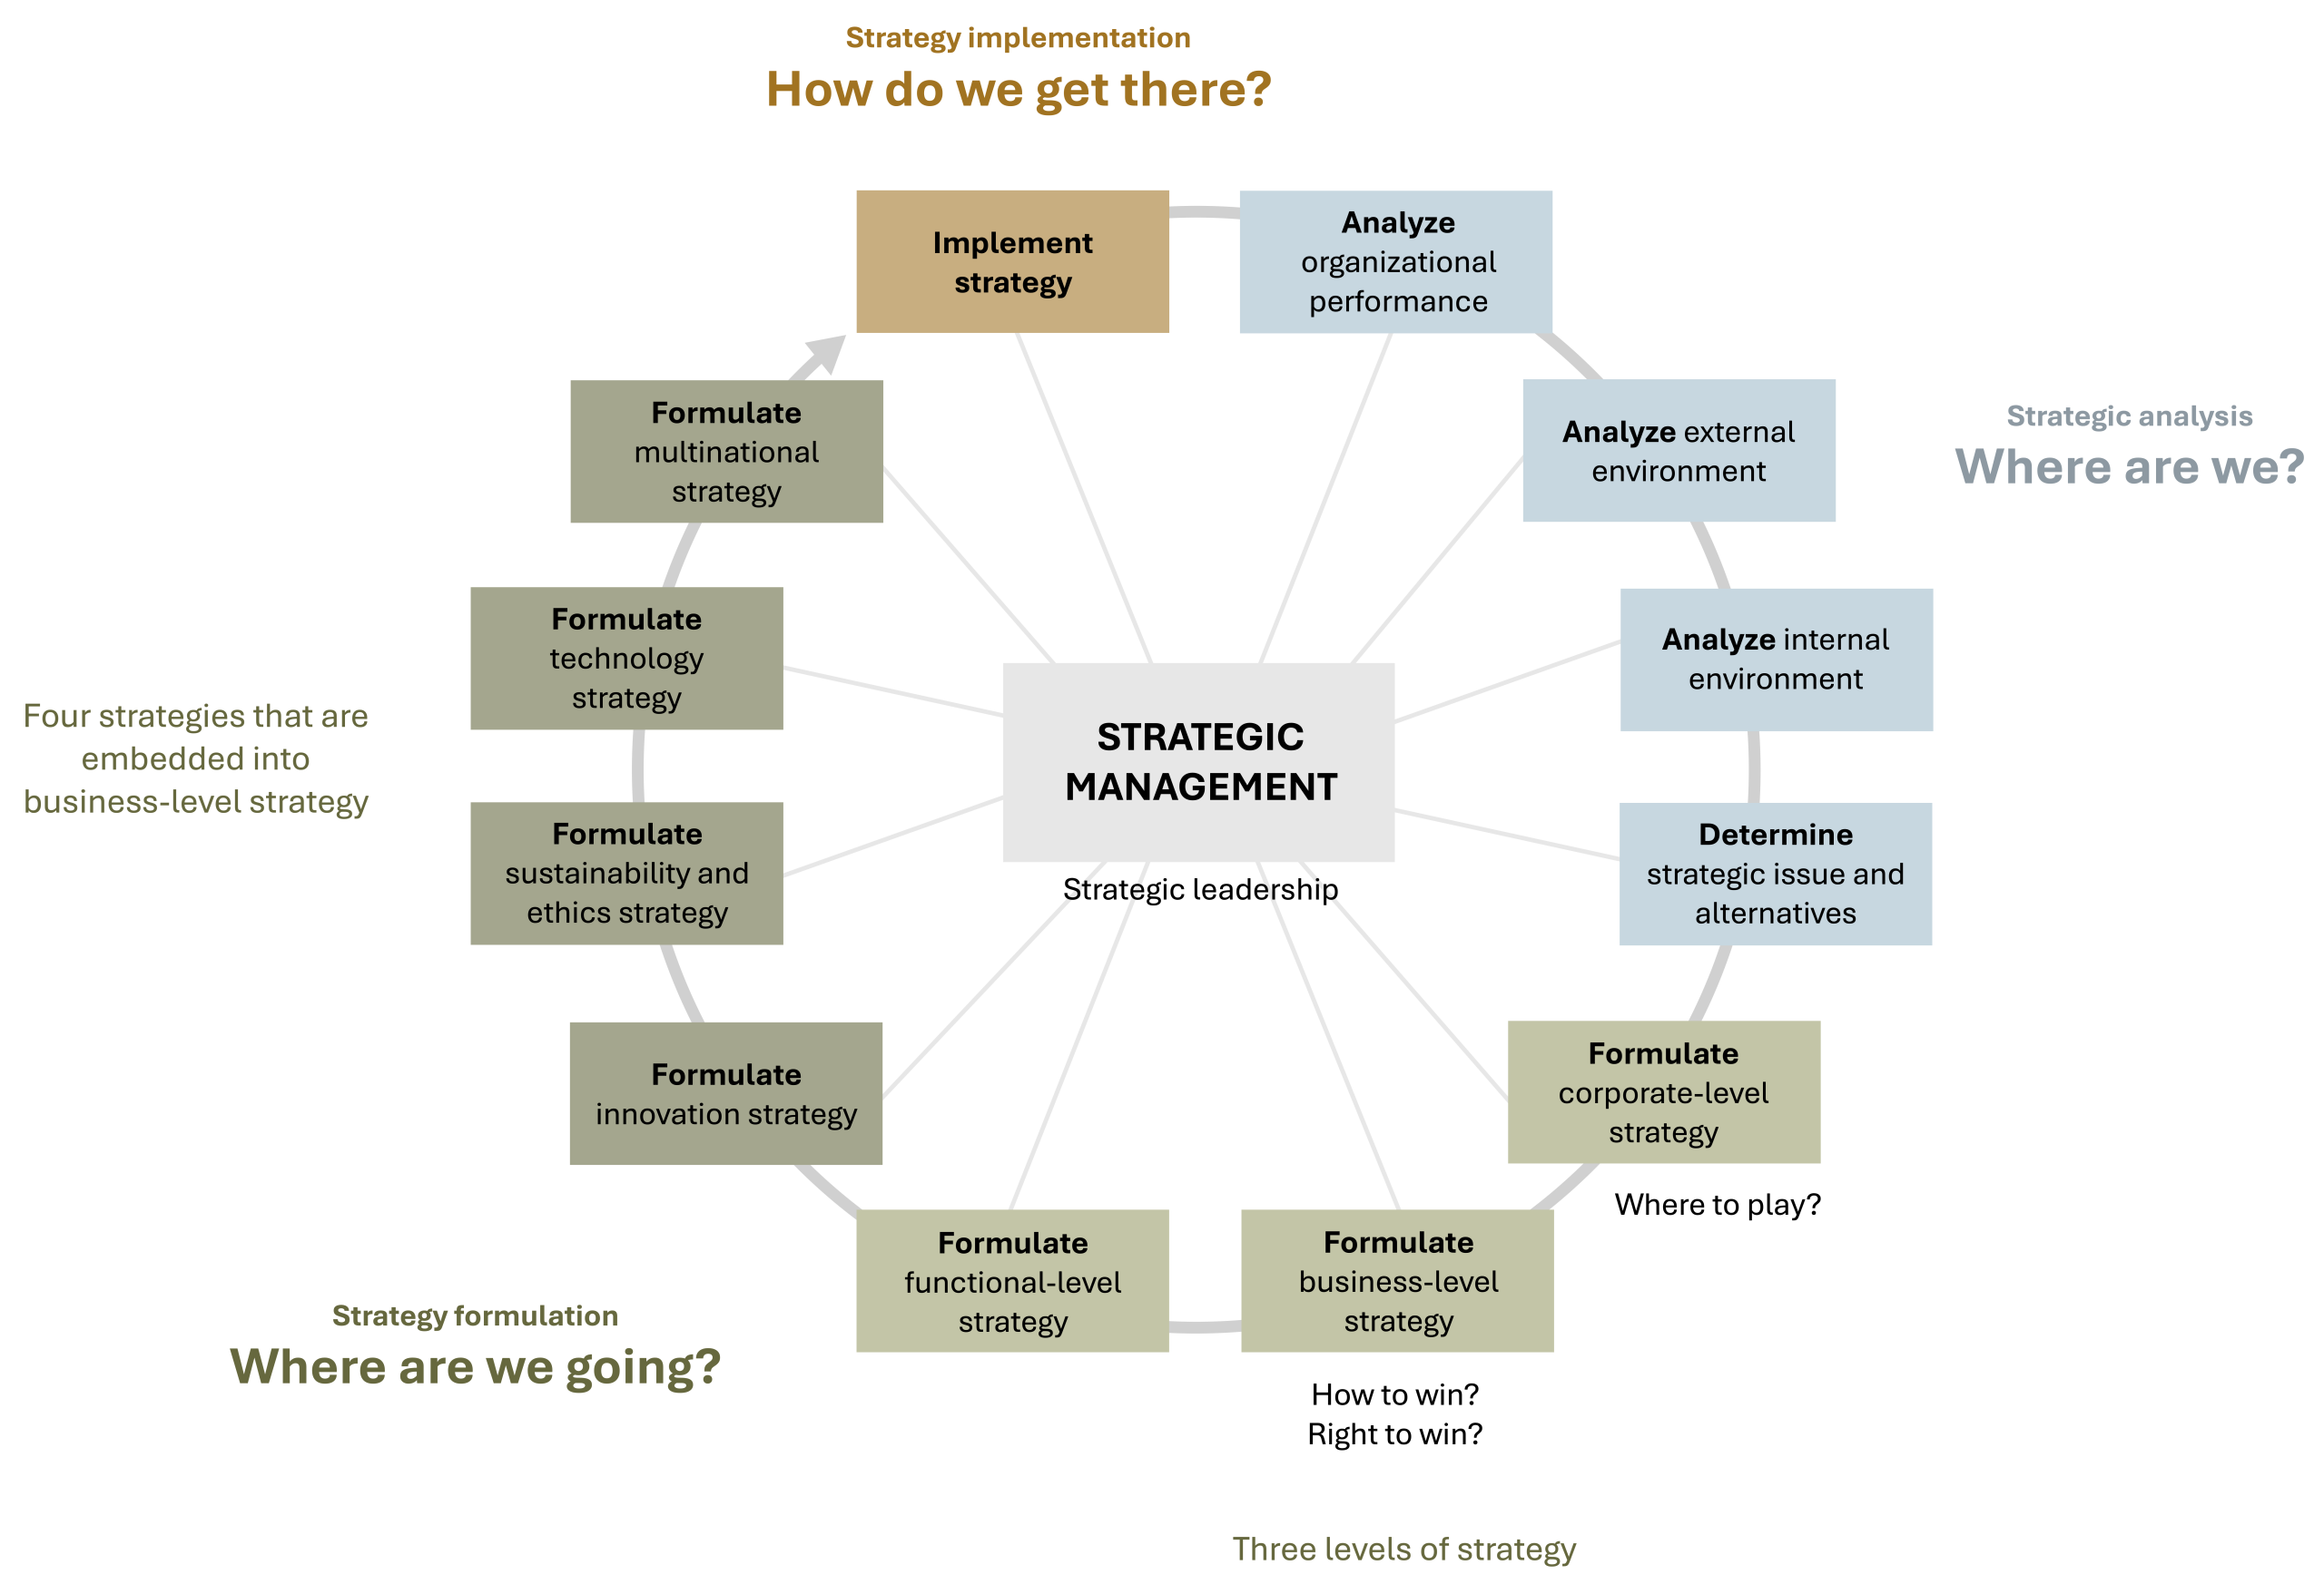
Analysis, Formulation, Implementation (AFI) Framework
Figure 1.3: The analysis, formulation, implementation (AFI) framework [Kindred Grey. 2025. CC BY-NC-SA.]
Notes:
The practice and research of strategic management includes the three pillars of strategic analysis, strategy formulation, and strategy implementation. These are represented in the analysis, formulation, implementation (AFI) framework that guides the focus and structure of this book.

Slide 20
3 Essential Questions
Strategic management’s foundations rest in three essential questions that align with the three stages of strategic management:
Strategic analysis: Where are we?
Strategy formulation: Where are we going?
Strategy Implementation: How are we going to get there?

Slide 21
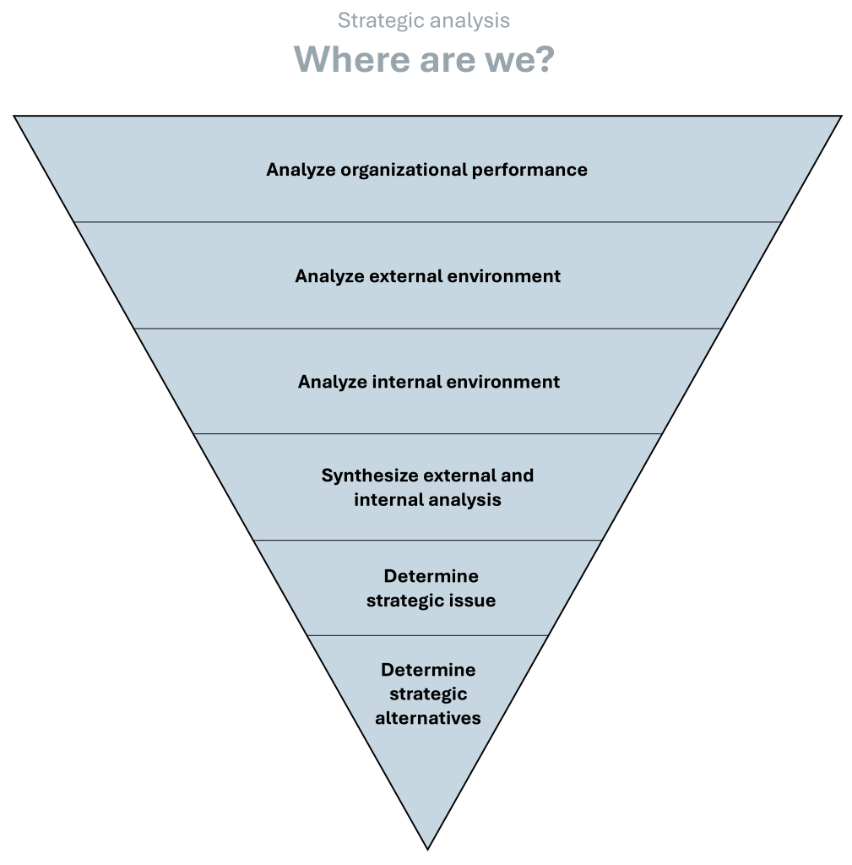
Strategic Analysis Process
Where are we going?
Analyze:
      Organizational performance
External environment
Internal environment
Conduct a SWOT analysis to synthesize external and internal analysis
Identify a strategic issue
Determine strategic alternatives
Figure 1.4: Strategic analysis [Kindred Grey. 2025. CC BY-NC-SA.]
Notes:
Strategic analysis addresses the broad question “Where are we?” and includes multiple steps. In this section, we review the steps to strategic analysis so that you can see the overall approach to strategic analysis. Later chapters discuss what is involved in each step of strategic analysis and how to conduct a strategic analysis of your own using these strategic management tools.
The order of the steps is important. First, analyze organizational performance, which assesses the robustness and congruence of a firm’s mission, purpose, vision, values, and goals as well as its financial position, its market position, and other relevant quantitative data. This step also includes a review of the firm’s balanced scorecard. Next, review the external environment of the firm, which considers the general environment, the industry environment, and strategic groups, then analyze the internal environment of the firm, which assesses a firm’s resources, capabilities, and core competencies. Organizational performance also considers a firm’s value chain. Once you have analyzed an organization’s organizational performance and its external and internal environments, synthesize the analysis using a strengths, weaknesses, opportunities, and threats (SWOT) analysis. Finally, identify a strategic issue and strategic alternatives.
Organizational Performance: Mission, vision, values, goals, financials, market position, and balanced scorecard.
External Environment: Includes general, industry, and competitive environments.
Internal Environment: Focuses on resources, capabilities, core competencies and a firm’s value chain

Slide 22
Strategic Issue
A strategic issue is the most important, urgent, broad, long-term matter that the company is facing. Strategic issues are the result of multiple causes in multiples areas of a business and require significant organizational talent and resources to resolve. Addressing a strategic issue moves a firm toward its mission, purpose, and vision, and it should therefore be congruent with the firm’s values and goals. A strategic issue focuses on the present and specific organizational context, addressing what is happening with this firm at this time, in this place, and under these circumstances.
Notes:
A firm’s strategic issue is the most important, urgent, broad, long-term matter that the company is facing. Strategic issues are the result of multiple causes in multiples areas of a business and require significant organizational talent and resources to resolve. Addressing a strategic issue moves a firm toward its mission, purpose, and vision, and it should therefore be congruent with the firm’s values and goals. A strategic issue focuses on the present and specific organizational context, addressing what is happening with this firm at this time, in this place, and under these circumstances.

Slide 23
Strategic Alternative
A strategic alternative is an action that addresses and has the potential
to resolve every aspect of a strategic issue.
Notes:
A firm’s strategic issue is the most important, urgent, broad, long-term matter that the company is facing. Strategic issues are the result of multiple causes in multiples areas of a business and require significant organizational talent and resources to resolve. Addressing a strategic issue moves a firm toward its mission, purpose, and vision, and it should therefore be congruent with the firm’s values and goals. A strategic issue focuses on the present and specific organizational context, addressing what is happening with this firm at this time, in this place, and under these circumstances.

Slide 24
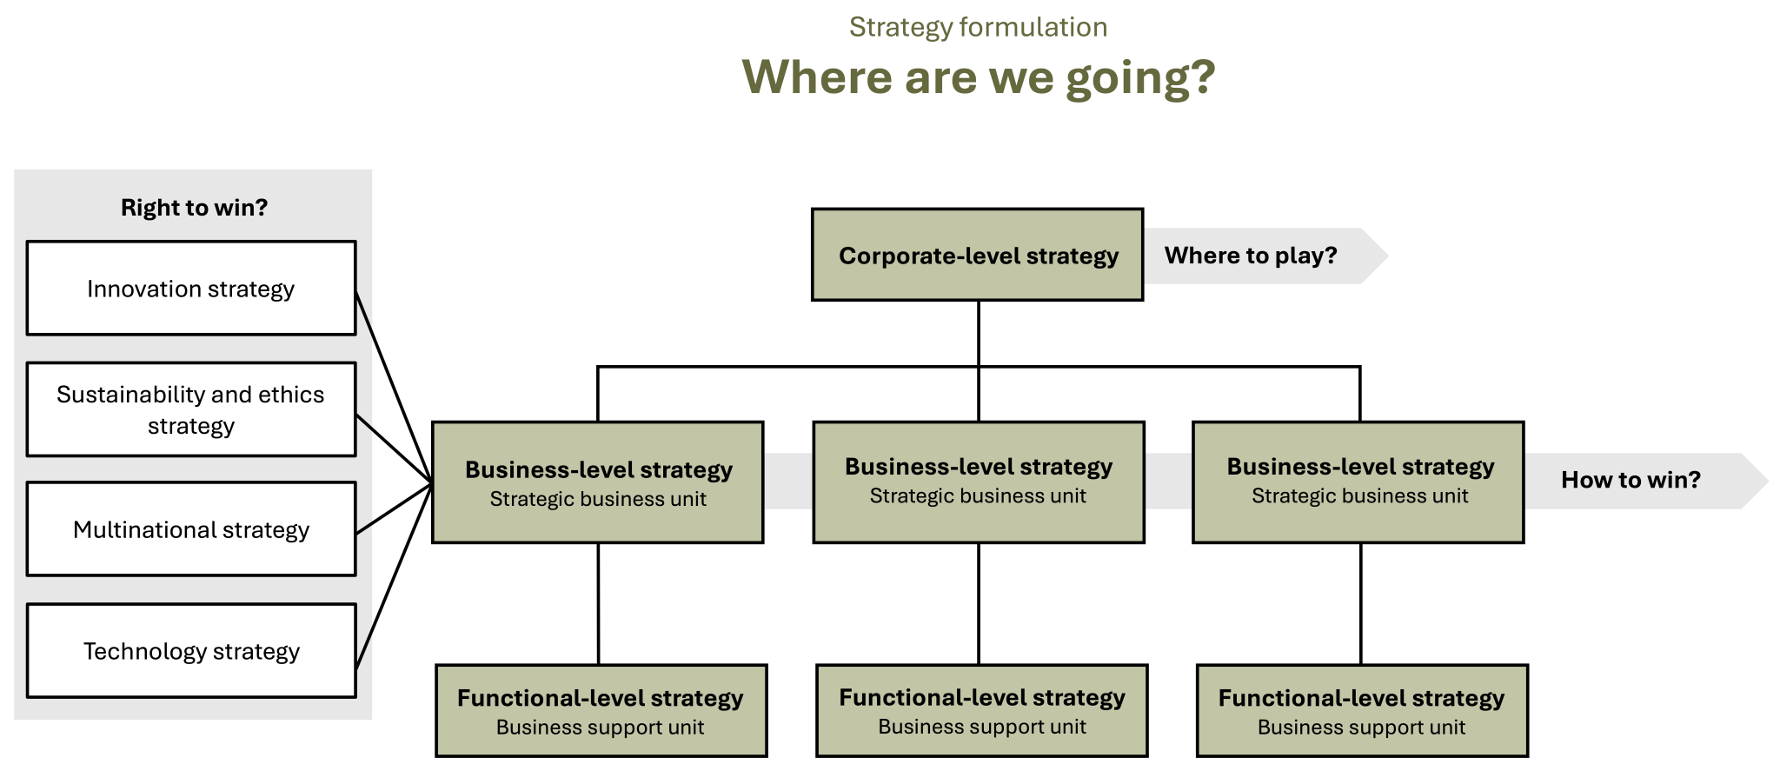
Strategy Formulation, 2 of 2
Figure 1.5: Strategy formulation [Kindred Grey. 2025. CC BY-NC-SA.]
Notes:
Once strategic analysis is complete, strategy formulation begins. This process addresses the broad question “Where are we going?”
There are three levels of strategy in an organization: corporate-level strategy, business-level strategy, and functional-level strategy. Strategy is formulated at all levels of a company.
Business-Level Strategy
Business-level strategy focuses on how to compete within an organization’s chosen market and market segments to create and sustain competitive advantage. Business-level strategy addresses a firm’s strategic market position, cost leadership and differentiation, and strategic market size (whether it competes in a focused market segment or a broad market).
Business-level strategy is the strategy of a strategic business unit. A strategic business unit is a fully functional unit of a business that has its own vision and direction and may be part of a larger organizational unit like a division. The unit’s focus and structure may be based on factors such as markets served, products offered, or regions served. Smaller firms may have only one strategic business unit, and large corporations may have more than one strategic business unit.
Strategic business units focus on one business-level strategy. Smaller firms that have only one strategic business unit have only one business-level strategy. In large companies with more than one strategic business unit, different strategic business units may have different business-level strategies. Therefore, large corporations that have more than one strategic business unit potentially have multiple business-level strategies.
All strategy should be specific and differentiating. Though business-level strategies include a finite number of strategies that are common to all companies, companies implement them in ways that reflect their specific company conditions.
In addition to each strategic business unit’s business-level strategy, there are additional strategies that are embedded into business-level strategies at the strategic business unit level. The four embedded strategies that are covered in this text are innovation, sustainability and ethics, technology, and multinational strategy.

Slide 25
Corporate-Level Strategy
Corporate-level strategy is a companywide strategy that focuses on synergy across industries, markets, market segments, locations, and businesses.
The corporate level of a company consists of senior executives in the C-suite, and if the company is large enough, it includes the board of directors.
Notes:
Corporate-Level Strategy
The corporate level of a company consists of senior executives in the C-suite, and if the company is large enough, it includes the board of directors. Corporate-level strategy is a companywide strategy that focuses on creating and maintaining a firm’s competitive advantage by creating synergy within and between multiple industries, markets, market segments, and businesses, across multiple industry value chains, and in different geographical locations. Corporate-level strategy is the responsibility of senior executives and the board of directors.

Slide 26
Business-Level Strategy
Business-level strategy is the strategy of a strategic business unit.
Notes:
Business-Level Strategy
Business-level strategy focuses on how to compete within an organization’s chosen market and market segments to create and sustain competitive advantage. Business-level strategy addresses a firm’s strategic market position, cost leadership and differentiation, and strategic market size (whether it competes in a focused market segment or a broad market).
Business-level strategy is the strategy of a strategic business unit. A strategic business unit is a fully functional unit of a business that has its own vision and direction and may be part of a larger organizational unit like a division. The unit’s focus and structure may be based on factors such as markets served, products offered, or regions served. Smaller firms may have only one strategic business unit, and large corporations may have more than one strategic business unit.
Strategic business units focus on one business-level strategy. Smaller firms that have only one strategic business unit have only one business-level strategy. In large companies with more than one strategic business unit, different strategic business units may have different business-level strategies. Therefore, large corporations that have more than one strategic business unit potentially have multiple business-level strategies.
All strategy should be specific and differentiating. Though business-level strategies include a finite number of strategies that are common to all companies, companies implement them in ways that reflect their specific company conditions.
In addition to each strategic business unit’s business-level strategy, there are additional strategies that are embedded into business-level strategies at the strategic business unit level. The four embedded strategies that are covered in this text are innovation, sustainability and ethics, technology, and multinational strategy.

Slide 27
Strategic Business Unit
A strategic business unit is a fully functional unit of a business that has its own vision and direction and may be part of a larger organizational unit like a division.
The unit’s focus and structure may be based on factors such as markets served, products offered, or regions served. Smaller firms may have only one strategic business unit, and large corporations may have more than one strategic business unit.
Notes:
Business-level strategy is the strategy of a strategic business unit. A strategic business unit is a fully functional unit of a business that has its own vision and direction and may be part of a larger organizational unit like a division. The unit’s focus and structure may be based on factors such as markets served, products offered, or regions served. Smaller firms may have only one strategic business unit, and large corporations may have more than one strategic business unit.
Strategic business units focus on one business-level strategy. Smaller firms that have only one strategic business unit have only one business-level strategy. In large companies with more than one strategic business unit, different strategic business units may have different business-level strategies. Therefore, large corporations that have more than one strategic business unit potentially have multiple business-level strategies.
All strategy should be specific and differentiating. Though business-level strategies include a finite number of strategies that are common to all companies, companies implement them in ways that reflect their specific company conditions.
In addition to each strategic business unit’s business-level strategy, there are additional strategies that are embedded into business-level strategies at the strategic business unit level. The four embedded strategies that are covered in this text are innovation, sustainability and ethics, technology, and multinational strategy.

Slide 28
Strategies Embedded into Business-Level Strategies
Innovation strategy
Sustainability and ethics strategy
Technology strategy
Multinational strategy
Notes:
In addition to each strategic business unit’s business-level strategy, there are additional strategies that are embedded into business-level strategies at the strategic business unit level. The four embedded strategies that are covered in this text are innovation, sustainability and ethics, technology, and multinational strategy.

Slide 29
Innovation Strategy
A strategy embedded into a business-level strategy at the strategic business unit (SBU) level. It shapes how a company approaches innovation to create and sustain competitive advantage.
🎯 Purpose & Impact:
Drives the creation of new products, services, and business models
Supports long-term differentiation and market leadership
Encourages a culture of continuous improvement and creativity
Aligns innovation efforts with the firm’s strategic goals and vision
💡Key Takeaway:
All companies regardless of size or growth stage; must define and implement an innovation strategy to remain competitive in a dynamic market.
Notes:
Innovation Strategy
All companies of all sizes and stages of development and growth must address innovation and formulate innovation strategies. Innovation strategies are embedded into business-level strategies at the strategic business unit level that focus on a firm’s approach to innovation so that it can create and sustain a competitive advantage.

Slide 30
Sustainability & Ethics Strategy
Embedded into a business-level strategy at the SBU level. It guides the firm in reducing its environmental and social impact, while improving ethical behavior and aligning with ESG standards.
🎯 Purpose & Impact:
Focuses the company on reducing harm and enhancing positive impact
Strengthens reputation and trust with stakeholders
Aligns operations with Environmental, Social, and Governance (ESG) metrics
Encourages legal compliance and ethical decision-making
🌍 Key Takeaway:
Companies that lead in sustainability and ethics gain long-term value through brand loyalty, stakeholder confidence, and regulatory alignment.
Notes:
Sustainability and Ethics Strategy
Sustainability strategies are embedded into business-level strategies at the strategic business unit level that focus on a company’s approach to reducing its adverse environmental and social impacts while establishing competitive differentiation through the firm’s positive environment and social performance (usually measured against environmental, social, and governance [ESG] metrics).
Business ethics strategies are strategies that are embedded into business-level strategies at the strategic business unit level that focus on a company’s approach to increasing ethical behavior and remaining legally compliant.

Slide 31
Technology Strategy
A business-level strategy embedded at the SBU level that outlines how a company uses technology to gain competitive advantage and align with its overall business vision.
🎯 Purpose & Impact:
Directs investment in emerging technologies (ex: AI, automation, & digital platforms)
Aligns tech use with the firm’s goals and roadmap
Supports operational efficiency, innovation, and differentiation
Helps firms stay agile in fast-changing industries
⚙️ Key Takeaway:
A strong tech strategy ensures that technology isn’t just a tool; it’s a driver of transformation and strategic success.
Notes:
Technology Strategy
Technology strategies are strategies that are embedded into business-level strategies at the strategic business unit level that focus on a company’s approach to using technology as a source of competitive differentiation and that align the firm’s use of new and emerging technologies with the firm’s roadmap to reach its vision and overall business objectives.

Slide 32
Multinational Strategy
Embedded into the business-level strategy at the SBU level for firms operating in more than one country (multinational corporations/MNC). It guides how companies position themselves in global markets.
🎯 Purpose & Impact:
Helps firms choose between international, multidomestic, global, or transnational strategies
Aligns marketing, operations, and products across diverse cultural and economic contexts
Balances local responsiveness with global efficiency
Addresses regulatory, logistical, and competitive differences across regions
🌎 Key Takeaway:
Only multinational corporations need a multinational strategy but for them, it is essential to global success.
Notes:
Multinational Strategy
Multinational corporations (MNCs) are firms that have operations in more than one country.
Though all successful companies formulate innovation, sustainability and ethics, and technology strategies, not all businesses are MNCs and therefore not all companies formulate multinational strategies. Multinational corporations formulate multinational strategies, which are embedded into business-level strategies at the strategic business unit level that address different ways to position the company in multinational markets. They include international, multidomestic, global, and transnational strategies.

Slide 33
Strategic Coherence Through Embedded Strategies
Why They Matter Together:
🔄 Innovation Strategy helps firms adapt and grow through new ideas and offerings
🌱 Sustainability & Ethics Strategy ensures responsible, values-based operations
🖥️ Technology Strategy positions the firm to leverage emerging tools and platforms
🌐 Multinational Strategy allows global firms to effectively operate across borders
Key Takeaway: These strategies must work in harmony to support the firm’s long-term success, ensure strategic alignment, and deliver sustained competitive advantage.

Slide 34
3 Critical Strategic Questions
Strategy can be described as a firm’s answer to three critical strategic questions that every organization needs to answer.
Corporate-level strategy: Where to play?
Business-level strategy: How to win?
Strategies embedded into business-level strategies: Right to win?
    Innovation strategy
    Sustainability and ethics strategy
    Technology strategy
    Multinational strategy
Notes:
Strategy can be described as a firm’s answer to three strategic questions that are critical for every organization:
Where to play?
How to win?
Right to win?
The first two questions (“Where to play?” and “How to win?”) are addressed at the two broad levels of strategy. “Where to play?” is answered at the corporate level with corporate-level strategy. “How to win?” is addressed through business-level strategy at the strategic business unit level. The third question (“Right to win?”) is addressed by the specific strategies that are embedded into business-level strategies at the strategic business unit level: innovation strategy, sustainability and ethics strategy, technology strategy, and multinational strategy. All three questions drive the firm’s formulation of a roadmap and action plan toward sustained superior performance.

Slide 35
Where to Play?
The answers to the question are largely determined by the firm’s assessment of the attractiveness and profit potential of alternative markets, market segments, businesses, and synergies between them.
The answers also provide important solutions to the allocation of limited company resources to different businesses. In this sense, it is also important for every organization to decide where not to play.
Notes:
This first question is addressed at the corporate level of a company and considers which industries, markets, market segments, businesses, and regions in which the firm wants to operate (play). The answers to the question are largely determined by the firm’s assessment of the attractiveness and profit potential of alternative markets, market segments, businesses, and synergies between them. The answers also provide important solutions to the allocation of limited company resources to different businesses. In this sense, it is also important for every organization to decide where not to play. Overall, the strategy that focuses on where to “play” can be described as the firm’s search for markets and market segments that are attractive today and in the future.

Slide 36
How to Win?
Answers to this question are largely determined by the firm’s ability to develop a winning strategy around its resources, capabilities, and core competencies that are superior to those of its competitors and that will create value for the firm’s customers.
Notes:
After the first question has been addressed, the firm needs to decide how it will win in its chosen markets, and this is approached through business-level strategy at the strategic business unit level of a company. Answers to this question are largely determined by the firm’s ability to develop a winning strategy around its resources, capabilities, and core competencies that are superior to those of its competitors and that will create value for the firm’s customers. There are various drivers of how a firm can win in its chosen markets, like differentiation and cost leadership or whether the firm chooses to operate in a focused or broad market. Overall, the “How to win?” question addresses the firm’s search for a sustainable competitive advantage.

Slide 37
Right to Win?
An organization needs a clear right to win in its chosen markets.
This right is supported by truly differentiating and valuable resources, capabilities, and core competencies that are unique for the specific organization.
Notes:
Once the question of where to play has been resolved at the strategic business unit level through business-level strategy, the question “Right to win?” can be considered. All companies have the ambition to win in their chosen markets. They want to gain market share, increase revenue and profit, and enter new markets and regions. However, strategy is more than a wish list of what a company would ideally want to do and achieve. Strategy is a company-specific roadmap for navigating its industry, directing how a firm moves from its current state toward the firm’s vision.
With this conception of strategy in mind, the company’s right to win is addressed by the specific strategies that are embedded into business-level strategies at the strategic business unit level: innovation strategy, sustainability and ethics strategy, technology strategy, and multinational strategy. An organization needs a clear right to win in its chosen markets. This right is supported by truly differentiating and valuable resources, capabilities, and core competencies that are unique for the specific organization.
Let’s take the example of your university’s volleyball team. The team surely has the ambition to do well, win as many games as possible, and maybe even win the conference title. Going beyond just the hope to win requires a clear right to win. This right (or reason or justification) to win could be that the team has the best coach, the best training conditions, the best infrastructure, the best team captain, or outstanding individual players. Maybe it is not the superior quality of individual players but the superior chemistry and teamwork that makes the team win. Whatever it may be, without a true right to win, strategy just becomes wishful thinking— an exercise written on paper.
On a business level, the right to win needs to be clearly anchored in business-level strategy because it is in strategic business units where a firm decides how it wants to win in its chosen markets.

Slide 38
The 3 Critical Strategic Questions:
Check Your Knowledge So Far
Strategy can be defined as a firm’s answer to three critical strategic questions that guide its decision-making and shape its competitive path:
🏆 2. How to Win?
Focuses on how to compete successfully in chosen markets
Driven by the firm’s resources, capabilities, and core competencies
Involves choosing a competitive advantage (ex: cost leadership & differentiation)
Goal: Deliver superior value to customers and outperform competitors
🔓 3. Right to Win?
Ensures the firm has the capabilities and credibility to win in its markets
Achieved through embedded strategies:
  Innovation
  Sustainability & Ethics
  Technology
  Multinational Strategy
Goal: Turn ambition into actionable strategy
🧩 1. Where to Play?
Determines which industries, markets, and regions the firm should compete in
Based on market attractiveness, synergies, and resource allocation
Helps define where the firm should and should not compete
Goal: Find profitable, strategically aligned markets
🧠 Key Takeaway:
These 3 questions form the foundation of a company’s strategic roadmap guiding its vision, resource allocation, competitive approach, and long-term success.
Notes:
The first two questions (“Where to play?” and “How to win?”) are addressed at the two broad levels of strategy. “Where to play?” is answered at the corporate level with corporate-level strategy. “How to win?” is addressed through business-level strategy at the strategic business unit level. The third question (“Right to win?”) is addressed by the specific strategies that are embedded into business-level strategies at the strategic business unit level: innovation strategy, sustainability and ethics strategy, technology strategy, and multinational strategy. All three questions drive the firm’s formulation of a roadmap and action plan toward sustained superior performance.

Slide 39
Functional-Level Strategy
Functional-Level Strategy focuses on implementing strategy in business support units.
Notes:
Functional-Level Strategy
The third level of strategy formulation is functional-level strategy. Functional-level strategy, or just functional strategy, focuses on implementing strategy in business support units. Business support units focus on single business functions, such as accounting, business information technology, business law, finance, human resource management, marketing and sales, supply chain management, operations, and procurement.
Many of you will join firms in business support units in your first professional positions after graduation. All types of strategy cascade down to business support units, influencing strategy implementation at each level. Because functional-level strategy is the focus of most courses in your major, it is not addressed in detail in this book.

Slide 40
Business Support Units
Business support units focus on single business functions, such as accounting, business information technology, business law, finance, human resource management, marketing and sales, supply chain management, operations, and procurement.
Notes:
Functional-Level Strategy
The third level of strategy formulation is functional-level strategy. Functional-level strategy, or just functional strategy, focuses on implementing strategy in business support units. Business support units focus on single business functions, such as accounting, business information technology, business law, finance, human resource management, marketing and sales, supply chain management, operations, and procurement.
Many of you will join firms in business support units in your first professional positions after graduation. All types of strategy cascade down to business support units, influencing strategy implementation at each level. Because functional-level strategy is the focus of most courses in your major, it is not addressed in detail in this book.

Slide 41
Functional-Level Strategy & Business Units:
Check Your Knowledge So Far
Functional-Level Strategy
Focuses on how each department (or business support unit) executes the business-level strategy. It translates high-level goals into day-to-day operations.
Business Support Units
The organizational departments that focus on a single functional area and support overall business success.
Examples:
Accounting
Business Information Technology
Business Law
Finance
Human Resource Management
Marketing & Sales
Supply Chain Management
Operations
Procurement
Business Functions
the core activities that every business must perform to operate and compete.
They are carried out by the business support units listed above.
Notes:
Functional-Level Strategy
The third level of strategy formulation is functional-level strategy. Functional-level strategy, or just functional strategy, focuses on implementing strategy in business support units. Business support units focus on single business functions, such as accounting, business information technology, business law, finance, human resource management, marketing and sales, supply chain management, operations, and procurement.
Many of you will join firms in business support units in your first professional positions after graduation. All types of strategy cascade down to business support units, influencing strategy implementation at each level. Because functional-level strategy is the focus of most courses in your major, it is not addressed in detail in this book.

Slide 42
3 Levels of Strategy: Check Your Knowledge So Far
Corporate-Level Strategy
Business-Level Strategy
Functional-Level Strategy
Led by C-Suite and board of directors
Companywide strategy that focuses on synergy across industries, markets, market segments, locations, and businesses
Strategy of strategic business units (SBUs) that can each have their own strategy
Focuses on how to compete within a chosen market or market segment
Focuses on how departments support business strategy
Examples: HR, Marketing, Finance, Operations
Ensures alignment of day-to-day operations with broader strategic goals
Notes:
Once strategic analysis is complete, strategy formulation begins. This process addresses the broad question “Where are we going?”
There are three levels of strategy in an organization: corporate-level strategy, business-level strategy, and functional-level strategy. Strategy is formulated at all levels of a company.
Corporate-Level Strategy
The corporate level of a company consists of senior executives in the C-suite, and if the company is large enough, it includes the board of directors. Corporate-level strategy is a companywide strategy that focuses on creating and maintaining a firm’s competitive advantage by creating synergy within and between multiple industries, markets, market segments, and businesses, across multiple industry value chains, and in different geographical locations. Corporate-level strategy is the responsibility of senior executives and the board of directors.
Business-Level Strategy
Business-level strategy focuses on how to compete within an organization’s chosen market and market segments to create and sustain competitive advantage. Business-level strategy addresses a firm’s strategic market position, cost leadership and differentiation, and strategic market size (whether it competes in a focused market segment or a broad market).
Business-level strategy is the strategy of a strategic business unit. A strategic business unit is a fully functional unit of a business that has its own vision and direction and may be part of a larger organizational unit like a division. The unit’s focus and structure may be based on factors such as markets served, products offered, or regions served. Smaller firms may have only one strategic business unit, and large corporations may have more than one strategic business unit.
Strategic business units focus on one business-level strategy. Smaller firms that have only one strategic business unit have only one business-level strategy. In large companies with more than one strategic business unit, different strategic business units may have different business-level strategies. Therefore, large corporations that have more than one strategic business unit potentially have multiple business-level strategies.
All strategy should be specific and differentiating. Though business-level strategies include a finite number of strategies that are common to all companies, companies implement them in ways that reflect their specific company conditions.
In addition to each strategic business unit’s business-level strategy, there are additional strategies that are embedded into business-level strategies at the strategic business unit level. The four embedded strategies that are covered in this text are innovation, sustainability and ethics, technology, and multinational strategy.

Slide 43

Mintzberg & Waters, 1 of 2
Figure 1.6 Intended, deliberate, emergent, realized, and unrealized strategy [Kindred Grey. 2025. CC BY-NC-SA.]
Notes:
The AFI framework is a popular and useful model of strategic management. It is a top-down, rational model that is driven by managers focused on managing the strategic management process and by strategic leaders steering a firm strategically. It is planned and methodical.
There are other approaches to strategy, such as Mintzberg and Waters’s (1985) model that considers intended, deliberate, emergent, realized, and unrealized strategies. This view considers how strategies evolve over time.
The AFI framework and Mintzberg and Waters’s approach are two schools of strategic thought that business leaders often find complementary.

Slide 44
Mintzberg & Waters, 2 of 2
5 types of strategy:
Intended: What is planned
Deliberate: A planned response to alter, but not completely change, an intended strategy in the face of dynamic conditions.
Emergent: a completely new and unplanned strategy that is formulated in response to an unexpected circumstance,
Realized: What is ultimately followed
Unrealized: What is abandoned
Notes:
Intended Strategy
An intended strategy is the strategy that an organization plans to implement. The structured strategic management process described above produces intended strategies.
Deliberate Strategy
Many things can happen between planning a strategy and implementing it, potentially requiring changes to the intended strategy. A deliberate strategy is the strategy that a firm implements in such a situation. It is a planned response to alter, but not completely change, an intended strategy in the face of dynamic conditions. Sometimes the factors that lead to the difference between an intended and deliberate strategy are internal to the organization, such as talent and managerial capacity. Often these differences can come from sources external to the organization, like the COVID-19 global pandemic, climate change, and changing competition.
Emergent Strategy
An emergent strategy is a completely new and unplanned strategy that is formulated in response to an unexpected circumstance, which most often originates from a firm’s external environment (such as the emergence of a new technology). Emergent strategies are as important to a firm’s success as intended and deliberate strategies. Firms that are skilled at horizon scanning for new opportunities and are nimble in response to changing conditions are better positioned to take advantage of these dynamic conditions and formulate effective and profitable emergent strategies.
Companies formulate emergent strategies and deliberate strategies in response to changing circumstances. The distinction is that deliberate strategies alter, but do not completely change, the intended strategy. They tend to be dynamic tweaks to the intended strategy. Emergent strategies, on the other hand, are completely new strategies that are formulated in response to surprising and unforeseen conditions. An emergent strategy is completely different than the intended strategy and requires a change of strategic direction.
Realized Strategy
A realized strategy is the strategy that an organization follows over time. Realized strategies include a firm’s intended strategy and deliberate strategy if the company has altered but not completely changed the intended strategy in the face of dynamic conditions. Realized strategies may also include an emergent strategy if an unanticipated and completely new opportunity has arisen and the firm has been nimble and quick enough to capitalized on it by formulating an emergent strategy.
One way to think about intended, deliberate, and realized strategies is as an evolution of strategy over time. The company initially plans an intended strategy. A deliberate strategy is the part of the intended strategy a firm implements after taking into account dynamic conditions either in the company’s external environment, such as a new competitor, or in the firms’ internal environment, like a change in CEO. The deliberate strategy alters, but does not completely change, the intended strategy. A firm’s realized strategy is the strategy that an organization follows over time that includes the intended and deliberate strategies and also incorporates any emergent strategies that have been formulated in response to conditions that were unforeseen when the intended and deliberate strategies were formulated. A firm’s realized strategy can be different than the intended and deliberate strategy if the company has formulated an emergent strategy.
Unrealized Strategy
An unrealized strategy is an abandoned part of the intended strategy. There are many reasons why parts of strategies are abandoned, creating a gap between strategy formulation and implementation. These are elaborated on in detail in Chapter 13.

Slide 45
Why Strategic Management Is Important
Strategic management is a dynamic, ongoing process that includes:
Strategic analysis
Strategy formulation
Strategy implementation
It answers the fundamental question:
How can a firm create and sustain a competitive advantage?
Strategic management positions a company for superior performance relative to its competitors.
Strategic Leadership:
Ensures the company has the talent and capacity to execute strategy
Guides evidence-based decisions across all levels
Is essential to effective and adaptive strategy
Why it matters:
Determines whether a company survives, grows, and leads
Business success depends on sound strategy, execution, and leadership
Notes:
Strategic management is a dynamic and ongoing process consisting of strategic analysis, strategy formulation, and strategy implementation. Strategic management is a critical business activity.
Strategy addresses the fundamental business question of how to create and sustain a competitive advantage by positioning a firm for superior performance relative to its competitors. This is a question all firms must ask throughout each step of the strategic management process.
Strategic leaders are responsible for ensuring their company has the human talent and organizational capacity to carry out robust and dynamic strategic management. They have the power to direct actions to ensure a sound, evidence-based strategy is formulated and implemented throughout all levels of the firm and in all areas of strategy. Strategic leadership is essential to successful strategic management.
Strategic management and strategic leadership are central to whether a company survives, grows, is successful, adapts to changing conditions, and becomes a market leader. Business success rests on strategy and its successful management and leadership.

Slide 46
The History of Strategic Management
Strategy in Human History:
Indigenous nations used strategic alliances pre-colonization
Classic texts like The Art of War, The Aeneid, and The Prince reflect strategic thinking
Military lessons from Waterloo, the U.S. Civil War, and WWII still inform modern strategy
Foundational Milestones in Strategic Management:
1911: Frederick Taylor’s Scientific Management → focus on performance
1959: Ford Foundation pushed for strategic “capstone” business courses
1962: Walmart founded → strategy adapts to cost leadership at scale
1980: Porter’s Competitive Strategy & launch of Strategic Management Journal
1995: Amazon’s founding revolutionized e-commerce strategy
2000s: Corporate scandals (e.g., Enron) shifted focus to ethics
2005: Friedman’s The World Is Flat → global competition becomes core issue
2006: An Inconvenient Truth → climate change drives rise of sustainability
2018–Present: Apple & NVIDIA reshape strategy around tech & AI megatrends
Key Takeaway:
Understanding the evolution of strategic management from ancient tactics to AI-era tech firms; helps explain how strategy adapts to societal, ethical, and technological shifts.

Slide 47
Contemporary Critique of Strategic Management
Strategic management is a dynamic and evolving field. Alongside historical milestones, criticism plays a key role in shaping how the field grows and improves.
🔍 Common Critiques:
Resource-Intensive: Some leaders question the time and cost required for thorough strategic management.
Skepticism Toward Impact: Critics doubt whether strategy processes consistently deliver evidence-based outcomes.
Inflexibility: Some argue strategic frameworks can slow a firm’s ability to adapt to rapid market changes.
🧠 Why Criticism Matters:
Encourages critical thinking from scholars, practitioners, and students
Drives continuous improvement in strategic tools and methods
Reflects confidence in the field — not weakness — by fostering open discussion
📌 Key Takeaway:
Strategic management thrives on reflection and adaptation. Just like other business disciplines, it evolves through feedback, challenge, and a commitment to ongoing improvement.

Slide 48
Why Strategic Management Matters in Every Career
🧭 Strategic Management Applies to All Careers and Stages
Whether you start in a large company, small firm, consulting role, or as an entrepreneur, strategic management plays a vital role from Day 1.
👩‍💼 In Your First Job:
You'll implement strategies in your functional area (ex: marketing, finance, HR, or IT)
You might contribute to broader strategic analyses
You’ll need to understand:
  Corporate, business, and functional-level strategy
  Innovation, technology, and sustainability strategies
  Possibly even multinational strategy
📈 As You Advance in Your Career:
Strategic responsibilities increase over time
Promotions often depend on your strategic thinking skills
The ability to formulate and implement strategy becomes more central to leadership
🎯 Key Takeaway:
Strategic management isn’t just for executives — it’s for you.
Mastering it early helps you stand out, advance, and lead — in any role, in any industry, at any stage.
🔁 Across All Paths:
Large Firms: Strategy is formal and layered — you grow into it
Small Firms: Strategy is immediate — you wear many hats
Consulting: Requires fluency in strategy, regardless of focus
Entrepreneurship: You own and execute every stage of strategy

Slide 49
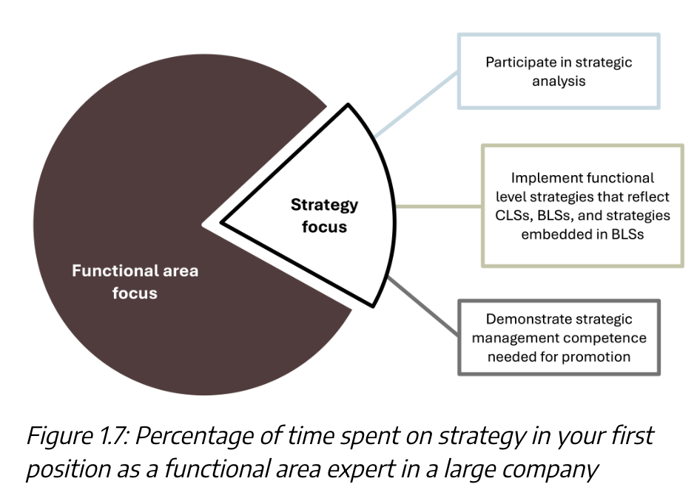
Your First Job in a Large Company
These visuals show how strategic responsibilities increase from early roles to executive leadership, reinforcing the need to build strategic skills from the start.
Kindred Grey. 2025. CC BY-NC-SA.

Slide 50
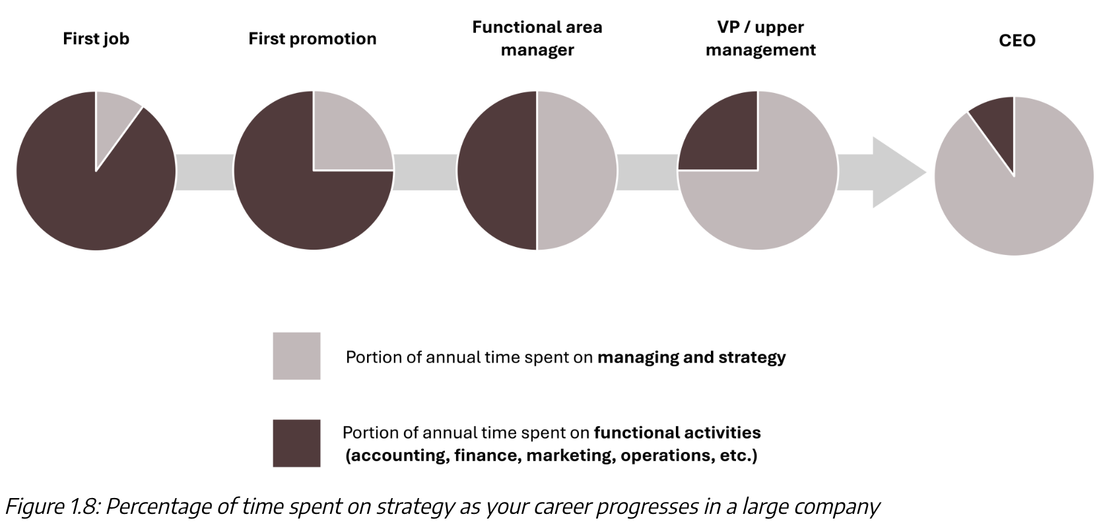
Over Your Career
These visuals show how strategic responsibilities increase from early roles to executive leadership, reinforcing the need to build strategic skills from the start.
Kindred Grey. 2025. CC BY-NC-SA.

Slide 51
Demonstrate Your Knowledge, Skills & Competence, 1 of 3
Describe organization, business, company, firm, and industry and their relationships to each other. Give examples, and explain how your examples illustrate each.
Explain concepts, theories, and analytical frameworks and tools and their relationships to each other. Give examples, and explain how your examples illustrate each.
Define strategic management. How does this compare to what you expected strategic management to be before you began this course?
Describe strategic leadership, strategic management, and strategy and their relationships to each other.
Explain strategic analysis, strategy formulation, and strategy implementation and their relationships to each other.
📝 Tip: Use these prompts for exam prep or in-class discussions.

Slide 52
Demonstrate Your Knowledge, Skills & Competence, 2 of 3
Describe the analysis, formulation, implementation (AFI) framework. How much of the framework can you recall without referring to the diagram? Now return to figure 1.3 and be sure you understand each element in the figure and their relationships.
Explain the concepts of strategic issue and strategic alternative, giving an example of each. These are essential throughout the course, so understanding them now is important.
Describe the three levels of strategy. Which level of strategy are you most likely to directly analyze, formulate, and implement in your first position after graduation?
Explain Mintzberg and Waters’s (1985) model of strategy. How does this compare and contrast with the strategy in the AFI framework?
Discuss why strategic management is important to businesses. What are the risks when firms do not manage strategy well?
📝 Tip: Use these prompts for exam prep or in-class discussions.

Slide 53
Demonstrate Your Knowledge, Skills & Competence, 3 of 3
Describe several key events in the history of strategic management. Which events were familiar to you? Were there any that surprised you? Discuss why knowing the history of a subject important.
Discuss a few of the critiques of strategic management. Why is a critiquing a field important?
Describe how strategic management is relevant to you and your career.
By answering these questions robustly, you have demonstrated your thorough knowledge of this overview of strategic management. Well done!
📝 Tip: Use these prompts for exam prep or in-class discussions.

