Slide 1

Scholarly Publishing
Architecture and Design Research: PhD Colloquium
Gail McMillan: gailmac@vt.edu
Professor, Virginia Tech Libraries: 421 Newman Library
Director, Scholarly Communication
Notes:
I’m happy to share my thoughts on scholarly communication or scholarly publishing. I tend to use these terms interchangeably. “The only aim of scholarly communication should be the widest possible distribution of knowledge and scholarly results” [Peter Suber] An important fact of scholarly research is that the work is not complete until the results have been fully communicated and openly available for others to build upon. (Heather Joseph re Berlin Open Access Convergence, C&RL News, Feb. 2012, . 84)

Slide 2
Virginia Tech: Land grant mission
“The discovery and dissemination of new knowledge are central to its mission. “
https://www.president.vt.edu/about-the-office/mission-vision/index.html

Slide 3
Goals of theses and dissertations
Original research
Original contribution to scholarship
Continuing contribution to scholarship
Writing ability
Goals of ETDs
Discoverable
Integrity of content: readable/viewable in future; non-proprietary formats
Data behind illustrations, data, and conclusions

Slide 4
Traditional ETD or not
Notes:
Freedom to present your ETD, Have you thought about what your ETD will look like, not just what it will contain?
Supplemental files in each of these ETDs
Schaffler (Engi): videos
Walker (Arch): webpages, images, audio, video, code
Rees: (Ag econ): data in spreadsheets (Excel; csv would have been better—nonproprietary formats/preservation)
Another creative example: https://vtechworks.lib.vt.edu/handle/10919/74396 ; http://www.matthewyourshaw.com/orbital-a-graduate-thesis/
Manuscript style ETD
Articles, chapters, conference papers: published or prepared for submission
At least 1: Master’s, 2: Doctorate
Research conducted @ VT
Sole author or major contributor
Copyright

Slide 5
Copyright
Copyright Law: U.S. Code, Title 17
Section 102: original works of authorship fixed in any tangible medium of expression,
now known or later developed, from which they can be communicated
Copyright is automatic (no © required)
Copyright registration is not required
Payment is not required
Notes:
What cannot be copyrighted?
Ideas, procedures, and methods
Titles, names, slogans
Facts (common information)
Data (e.g., phone numbers)
Works in the public domain
Unrecorded, unwritten, i.e., un“fixed” works
Copyright holders control
Reproduction
Modification
Distribution
Public performance
Public display

Slide 6
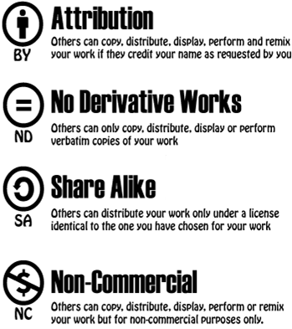
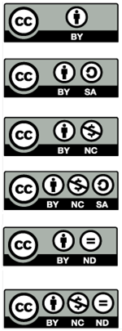
Creative Commons Licenses
Notes:
How many of your have heard of Creative Commons licenses or seen the CC on publications?
International not-for-profit organization
Improve clarity about what people can do with copyrighted content
Legal/social framework in the form of licenses
https://www.youtube.com/watch?v=io3BrAQl3so 6 minute video
Finding CC licensed works
http://search.creativecommons.org
Google Advanced search
https://www.google.com/advanced_search (scroll down to “usage rights”)
Put a CC license on your ETD-–title page and supplemental files.

Slide 7
ETD License
I hereby grant to Virginia Tech the non-exclusive license to archive and make accessible, under the conditions specified above, my thesis, or dissertation, in whole or in part in all forms of media, now or hereafter known.
I retain all other ownership rights to the copyright of the thesis or dissertation including the right to use all or part of this thesis or dissertation in future works (such as articles or books).

Slide 8
Choose what Happens to Your Approved ETD
Worldwide Access
Publicly available through vtechworks.lib.vt.edu
VT mission: discovery and dissemination of new knowledge
VT-only
Available to current university community for 1 year
Secured (withheld, embargoed)
No access for 1 year
Then publicly available in VTechWorks
Notes:
As the Copyright Holder, you decide how your ETD will be distributed. Worldwide Access: ALL will move to public access eventually.
Limitations of VT-only: when you leave the university, you won’t have access
Use SECURED wisely:
Sensitive materials, e.g., ethical obligations to human subjects
Commercial ramifications: patents
Research is underdeveloped
Most publishers will consider publicly available ETDs.
Make an informed decision: Plan or at least consider the transformation of your ETD into a publication well in advance.
Which journals do you want to publish your articles?
Select a book-friendly topic, but write your ETD as an ETD.

Slide 9
The case for making ETDs immediately accessible
Scholarship on a particular topic is easily findable and accessible
Early career scholars are visible.
Cultivate a significant scholarly profile
Garner additional readers, feedback
Professional opportunities
Networking
Publishing prospects: Harvard Press acquisitions editor: “If you can’t find it, you can’t sign it.”
Invited lectures
Inherent value in openly sharing scholarly work
Scholars working outside the Western academy
Notes:
Truschke
To Embargo or Not to Embargo? Strategically Disseminating The Dissertation http://dissertationreviews.org/archives/11995

Slide 10
Public Access is NOT a Red Flag for Publishers
Open Access and Dissertation Embargoes
Published yet Unpublished: The Dual Rise of Open Access and Dissertation Embargoes /11861
Publishing a Revised Dissertation
Defusing the Fear: Publishing A Book Based on a Non-Embargoed Dissertation /11904
To Embargo Your Dissertation, or Not?
To Embargo or Not to Embargo? Strategically Disseminating The Dissertation /11995
http://dissertationreviews.org/archives/
Audrey Truschke: audrey.truschke@gmail.com Andrew W. Mellon Postdoctoral Fellow, Stanford University
Notes:
April 2015.
In two of the 3 articles he sites our surveys and publications
#2 “The core claim of this article is [that]: not embargoing one’s dissertation immediately upon deposit is unlikely to harm an early career scholar’s chances of landing a book contract. …five scholars conducted a survey of journal and university press editors in 2011 and found that a mere seven percent of university press editors said they would refuse to consider a book based on a thesis that had been made previously available in an electronic repository. Based on my conversations with acquisitions and senior editors at numerous university …there is good reason to question whether even that seven percent actually act as they claim.”

Slide 11
Public Access is NOT a Red Flag for Publishers
“Do Open Access ETDs Diminish Publishing Opportunities in the Sciences?” Marisa L. Ramirez, Gail McMillan, Joan T. Dalton, Ann Hanlon, Heather S. Smith, Chelsea Kern. College & Research Libraries 75/6 (Nov. 2014): 808-821. doi: 10.5860/crl.75.6.808
“Do Open Access ETDs Diminish Publishing Opportunities in the Social Sciences and Humanities? Findings from a 2011 Survey of Academic Publishers.” Marisa L. Ramirez, Joan T. Dalton, Gail McMillan, Max Read, and Nancy H. Seamans. College & Research Libraries, 74/4 (July 2013): 368-380. doi: 10.5860/crl-356
Earlier (2000-2003) publications about publishers attitudes towards ETDs http://scholar.lib.vt.edu/copyright/cprtetd.html

Slide 12
Based on the data from 2011-2012 editors’/publishers’ surveys
Most publishers will consider them.
89% SoSci/Humanities; 80% Sciences
Harvard Press acquisitions editor: “If you can’t find it, you can’t sign it.”
Quality is the publishers’ main concern.
Adapted for new readership
Peer review is radically different.
http://crl.acrl.org/content/74/4/368.abstract?sid=bedcf9ba-1490-4b70-80af-deb7bfb40214
http://crl.acrl.org/content/early/2013/10/29/crl13-524.full.pdf+html
Notes:
Most of the media coverage publishers’ attitudes about ETDs reports perceptions of publishers’ attitudes and anecdotes.
I’m very disappointed in the American History Association and the Association of Writers and Writing Programs because they do not provide any data to substantiate their embargo recommendations. I think it is very harmful for them to make embargo recommendations based only on anecdotes and perceptions of publishing policies. The contemporary data as well as that from a decade ago clearly contradict these perceptions.
It is important that our students are informed about actual policies and practices at a variety of levels from the institution’s ETDs to the publishers’. Let’s encourage them not to wait until late in the ETD process to select several potential publishers and investigate their copyright and OA policies.

Slide 13
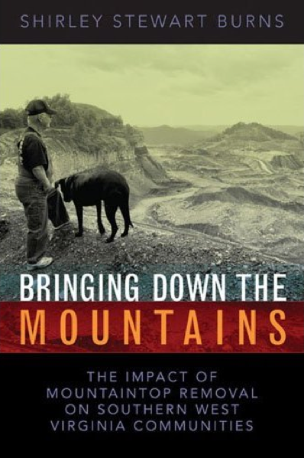
University press editors are invested in the book as an entity unto itself
Evaluating a revised ETD is identical with methods for assessing subsequent books by more senior scholars
Substantial revisions
Structurally significantly different from the dissertation
Notes:
University press editors are generally invested in the book as an entity unto itself Just as theses covers are radically different, the content of these two works is radically different. It began as a publicly available but very traditional traditional WVU ETD that became a popular book available on Amazon and from the author’s website.
Bringing Down the Mountains by Shirley Stewart Burns
“None of the university press editors with whom I spoke actually compare book manuscripts to the dissertations on which they are based when assessing book manuscripts. On the contrary, when I asked editors who said they demanded revisions how they knew if a thesis had been revised, nearly all professed to rely exclusively on the book proposal and their own judgment.”
Audrey Truschke, Mellon Postdoctoral Fellow http://dissertationreviews.org/archives/11904

Slide 14

Open Access
Open-access (OA) literature is digital, online, free of charge, and free of most copyright and licensing restrictions.
http://guides.lib.vt.edu/oa/journals
Notes:
There is support for publishing your article in an open access journal: VT’s O[en Access Subvention Fund

Slide 15
Where to publish
Think.Check.Submit
What journal has the articles you read?
Who is the publisher?
What are the editorial policies?
Peer reviewed?
APC: article processing charge?
Editorial Board: names/reputations
Where is the journal indexed?
Notes:
Avoiding predatory publishers:
Assess website, articles, editorial board
Red flags: multiple journals launched at once, irregular publishing, lack of focus, few articles published, high fees
Vanished website: Jan. 2017: Criteria for Determining Predatory Open-Access Publishers For more information on predatory publishers, including lists of publishers and standalone journals that meet these criteria, please visit http://scholarlyoa.com By Jeffrey Beall
The criteria are intended to provide a framework for analyzing scholarly open-access publishers and journals. The criteria recognize two documents published by the Committee on Publication Ethics (COPE):
Code of Conduct for Journal Publishers
Principles of Transparency and Best Practice in Scholarly Publishing

Slide 16
Choosing Where to Publish
DOAJ
Sherpa/Romeo
JIF: Journal Impact Factor
https://blogs.lt.vt.edu/openvt/2015/01/29/removing-the-journal-impact-factor-from-faculty-evaluation/
http://sciencewatch.com/sites/sw/files/sw-article/media/sw-journal-selection-white-paper.pdf
JournalToCs: http://www.journaltocs.hw.ac.uk/
Notes:
~11,600 Journal Impact factors
ThomsonReuters Journal Citation Report (proprietary)
Citations to a journal in one year and divided by the number of articles published in the two years prior
https://jcr.incites.thomsonreuters.com/

Slide 17
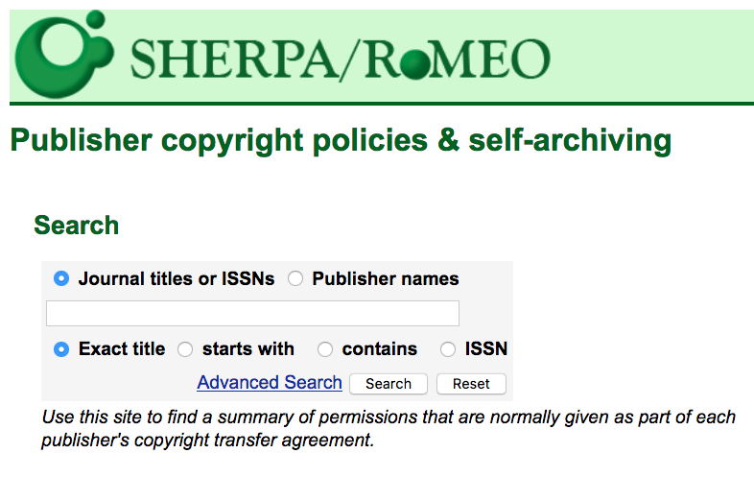
Notes:
Searchable database of publishers’ copyright and self-archiving policies
Searchable by: publisher name, journal title, ISSN
http://www.sherpa.ac.uk/romeo/

Slide 18


Finding Journal Publishers
Directory of Open Access Journals
9,499 OA, peer-reviewed journals
17 “built environment,” 142 “architecture,” 139 “design”
http://ulrichsweb.serialssolutions.com.ezproxy.lib.vt.edu/
77,655 peer reviewed, active journals (10,472 OA)
85 OA “built environment”
OA, online, academic/scholarly, peer reviewed
Notes:
According to Steven Harnad About 25,000 peer-reviewed journals are published worldwide, in all disciplines and all languages=2.5 mil articles/annually
Ulrichsweb http://www.ulrichsweb.com/

Slide 19
Beware of bogus journals
Common scam-journal red flags: archiving policies, indexing policies, and article count
http://gavialib.com/2014/07/common-scam-journal-red-flags-archiving-policies-indexing-policies-and-article-count/
Some journals say they are indexed in DOAJ but they are not
https://doajournals.wordpress.com/2014/08/28/some-journals-say-they-are-in-doaj-when-they-are-not/

Slide 20

Changing Business Models
APCs: Article Processing Charges
DOAJ
32% APC 2015
26% APC 2014: $964 (avg.)
61% commercial publishers; 11% university presses
VT Open Access Subvention Fund
Open monographs
Open Educational Resources (OER)
Notes:
Here are some new and evolving models: A business model that is gaining traction is shifting from demand-side to supply side, from user pays to author or institution pays
“average cost per article for an open access publishing system were $188 as reported by Edgar and Willinsky (2010) in a survey of
over 900 journals using Open Journal Systems,”
“high average OA APC, for example the $5,000 charged by Elsevier’s Cell Press” [Nature (per VT OASF FY 16)]
Sustaining Knowledge Commons: http://sustainingknowledgecommons.org/?attachment_id=257
OA APCs article 2014 October 17, Heather Morrison [et al.?]
APC can be handled in a variety of ways
DOAJ APCs: https://doajournals.wordpress.com/tag/apcs/

Slide 21
VT Open Access Subvention Fund
$1500.00 per article; $3000.00 per author per year
Prorated among multiple VT authors
No other sources of funding
Reputable journals and publishers
http://www.lib.vt.edu/oafund/ >>> https://aqua.lib.vt.edu/oa-subvention.php
Notes:
There is support for publishing your article in an open access journal

Slide 22
Virginia Tech Open Access Subvention Fund
Open to everyone at VT
For peer-reviewed articles accepted by open access or hybrid OA journals
Publishers of hybrid OA journals must reduce institutional subscription prices
Limited to $1500 per article and $3000 per author per year
Authors have no other funding sources available
Publisher complies with OASPA Code of Conduct
Journals must be registered in an open access directory
Funding limited; disbursed in the order in which requests received
Notes:
2 year pilot project Fy13 and FY14: $8,000 from Provost, VP Research, Lib Dean
FY2015 added to annual budget allocation: $20,000 Provost, $30,000 Lib Dean
FY2016: $60,000 >>> $86,000; FY2017: $100,000 less than 30% remaining as of Feb. 1, 2017
open access (OA) subvention fund to subsidize article processing fees for scholarly peer-reviewed articles accepted for publication in open access or hybrid OA journals.
A primary goal of the program is to enable authors to engage in new transformational open publishing environments. We hope to raise awareness among Virginia Tech authors of the benefits of open publishing and to encourage new ways of thinking about digital scholarship and information access.
The program aligns with the University Libraries strategic direction to support the research endeavors of our faculty and students, including the process of providing unrestricted access to digital research and scholarship.
OA fees are often reduced through discounts offered by University Libraries' memberships and subscriptions.

Slide 23
Balanced Approach to Copyright
Authors: retain some rights
Use and develop your work without restrictions
Deposit in your institutional repository (VTechWorks)
Increase access for education/research
Receive proper attribution when your work is used
SPARC Author Addendum
Publishers: give them non-exclusive rights
Publish/distribute and receive financial return
Receive proper attribution/citation
Migrate works to future formats; include in collections
Notes:
Balance means a model like this where publishing and copyright = scholarly communication in the 21st Century
Sometimes necessary to negotiate with the publisher. At least try; I’ve always been successful.
Help is available from SPARC (the Scholarly Publishing and Academic Resources Coalition) http://www.sparc.arl.org/resources/authors/addendum
When you retain copyright, then you have options.

Slide 24
Measuring Scholarship
Tenure/Promotion
Research performance assessment
Journal Impact factors
ThomsonReuters Journal Citation Report (proprietary)
Citations to a journal in one year and divided by the number of articles published in the two years prior
https://jcr.incites.thomsonreuters.com/
Article-level metrics
Citation advantage w/OA
80% studies say, “Yes.”
http://sparceurope.org/oaca/
Altmetrics: alternative scholarly barometers
Notes:
http://sustainingknowledgecommons.org/2015/06/01/doaj-impact-factor-and-apcs/
Publishers (such as PLOS, BioMed Central, and SageOne) are already displaying Article-Level metrics.

Slide 25
Altmetrics
Use of scholarly impact measures based on activity in web-based environments (faster communication)
Quantifiable and valuable methods to assess impact of a researcher’s work
Leverage technologies to extend the reach and impact of scholarship
Reach a wider audience beyond academia (i.e., funded subscribers)
How has this particular article been received?
Across all publications, how often has this researcher’s work been accessed?
Notes:
Example: CURATING THE CAMPUS, CURATING CHANGE: A collection of eight vignettes https://vtechworks.lib.vt.edu/handle/10919/73191
ALTMETRICS phrase first coined by Jason Priem in a tweet on Sept. 28, 2010. He is one of a growing number who advocate building a reward system that values and encourages new forms of web-native scholarship.Both more granular and more research-based information
Feb. 25, 2016 announced Best Practices coming out of its NISO Alternative Assessment Metrics (Altmetrics) Initiative http://www.niso.org/topics/tl/altmetrics_initiative/
Document Details - NISO RP-25-201x-3, Altmetrics Data Quality Code of Conduct - draft for public comment: http://www.niso.org/apps/group_public/document.php?document_id=16121&wg_abbrev=altmetrics-quality
Rather than using journals and journal-focused measures of quality (such as the Impact Factor), the altmetrics community sought to de-tether assessments of quality from the venues in which authors chose to publish their results. https://scholarlykitchen.sspnet.org/2017/02/02/plum-goes-orange-elsevier-acquires-plum-analytics/

Slide 26
Some Sources of Altmetrics
Usage
HTML views, PDF downloads (e.g., journal, PubMed Central, FigShare, Dryad, etc.)
Captures
CiteULike bookmarks, Mendeley readers/groups, Delicio.us
Mentions
Blog posts, news stories, Wikipedia articles, comments, reviews
Social Media
Tweets, Google+, Facebook likes, shares, ratings
Citations
Web of Science, Scopus, CrossRef, PubMed Central, Microsoft Academic Search
Notes:
By looking at some of the computer mediated social networks, we can begin to categorize Altmetrics into these sources [Richard Cave, IT Director at PLOS]

Slide 27
Scholarly Publishing
Gail McMillan: gailmac@vt.edu
Professor, Virginia Tech Libraries: 421 Newman Library
Director, Scholarly Communication
Notes:
Thank you!
Architecture and Design Research: PhD Colloquium
Discussion: Feb. 1, 2017. 20 students plus Dr. Patrick Miller (Landscape Arch) and Dr. Jim Jones (arch+design)
These slides were created to facilitate a discussion about many aspects of scholarly communication at the request of Dr. Patrick Miller for the PhD colloquium in the Architecture and Design Research Program.

