Slide 1
Prion Database
Seth Helm, Aaron Isele, Mike Kenyon, & Steven Warren
CS 4624 Multimedia, Hypertext, and Information Access
CRN: 13179, Edward A. Fox
Virginia Tech, Blacksburg, VA 24061
4/27/2021

Slide 2
Outline
Project Introduction
Data Collection
Implementation and Design
Walkthrough Video
Timeline
Lessons Learned
Future Studies
Acknowledgements and References

Slide 3
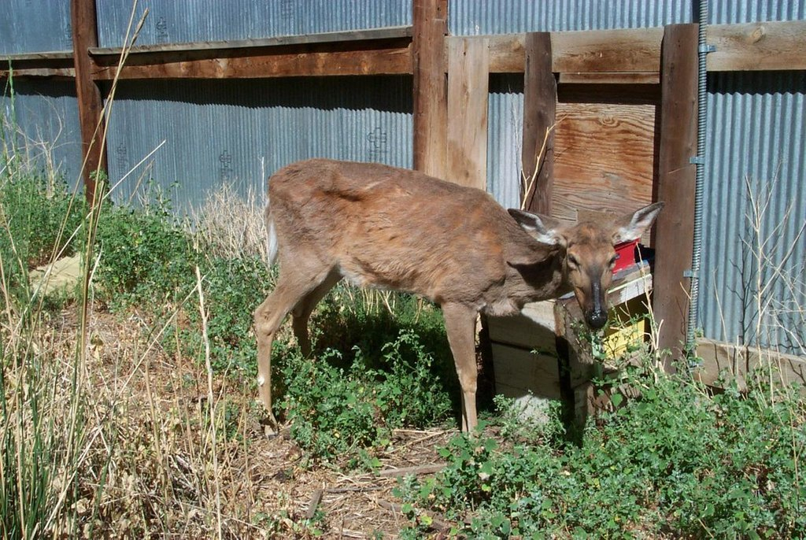
Introduction
Found in over 25 States and 3 other countries
Ultimately fatal
No known cure
Symptoms often do not show until 18-24 months
Not shown to be infective to humans
Weight Loss
Loss of Fear & Awareness
Excessive Salivation

Slide 4
Why Make The Database?
States do not communicate openly
No national interactive database currently exists
Encourage transparency
Provide better map of the spread

Slide 5
Project Summary
Goals
  Develop a first of its kind map of the past and present distribution of chronic wasting disease
Requirements
  A table of chronic wasting disease reports fed by verified user input datasets and official repositories.

Slide 6
Data Collection
Emails to State Department of Natural Resources (DNR)
Processing
  Cumulative vs. Individual testing reporting
Deciding on the most important data points

Slide 7
Design/Implementation
R Shiny
  Maps
  Graphs
Google Sheets database

Slide 8
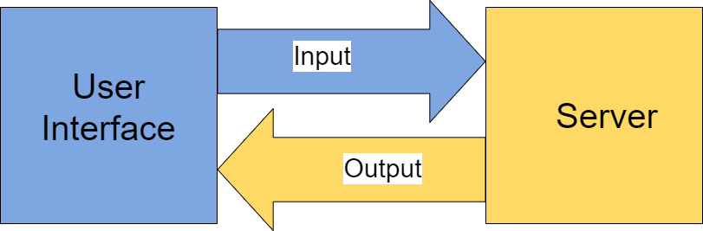
R Shiny

Slide 9
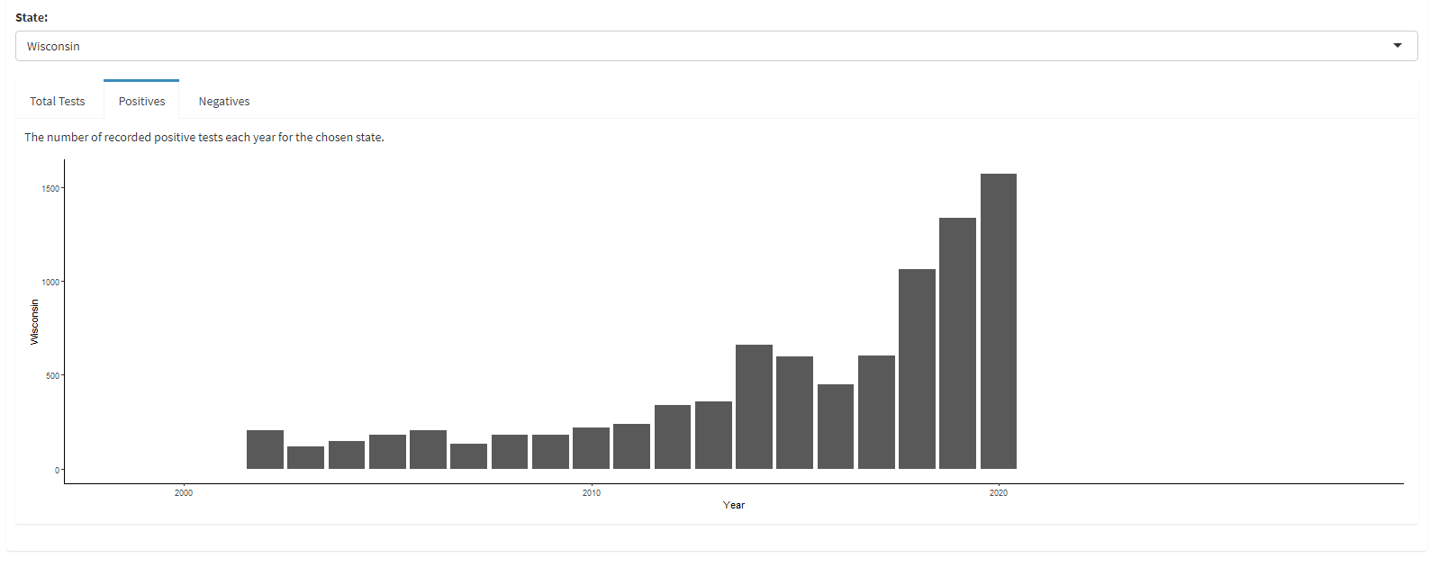
R Shiny Graphs

Slide 10
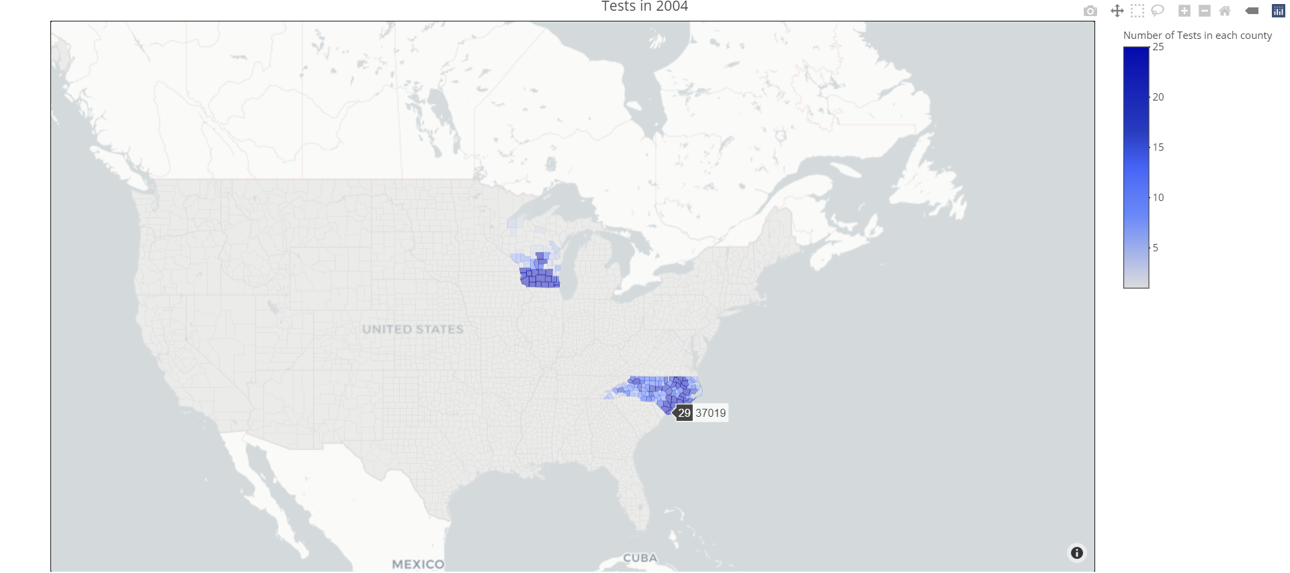
R Shiny Maps

Slide 11
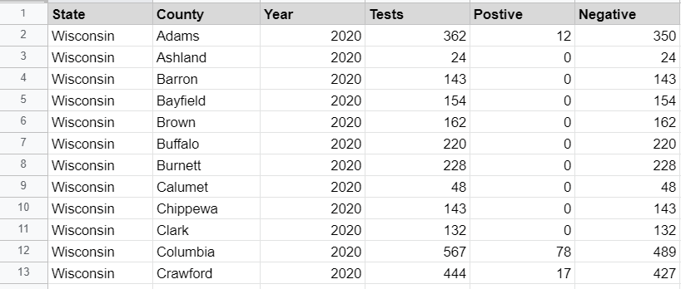
Google Sheets: Input Data (Sheet 1)

Slide 12
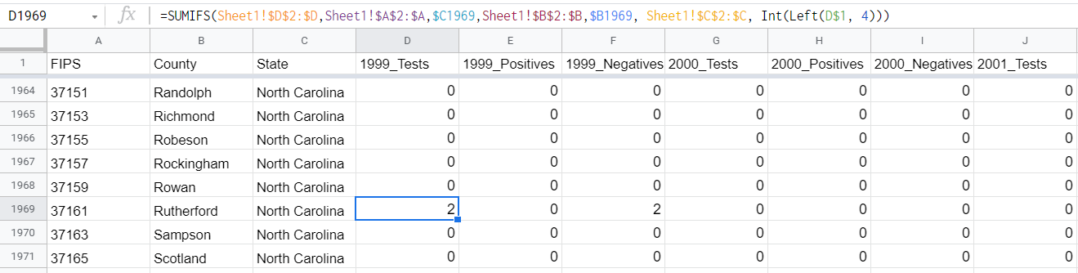
Google Sheets: Mapmaking Data (Sheet 2)

Slide 13
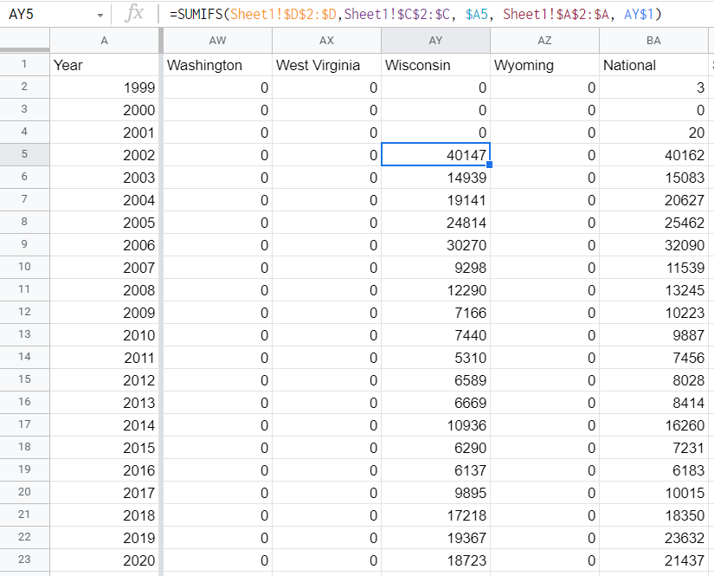
Google Sheets: Cumulative Tests (Sheet 3)

Slide 14
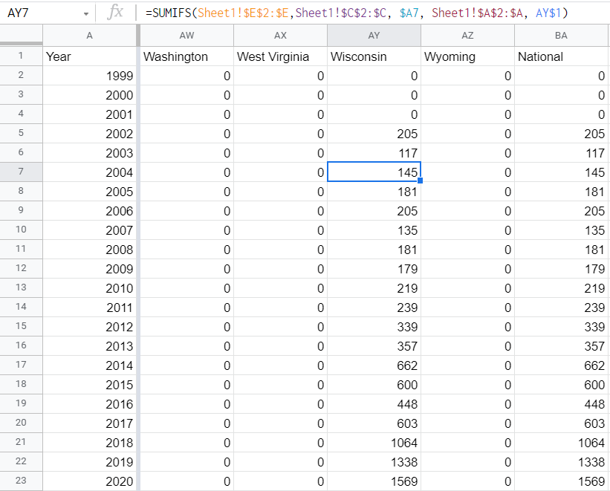
Google Sheets: Cumulative Positive (Sheet 4)

Slide 15
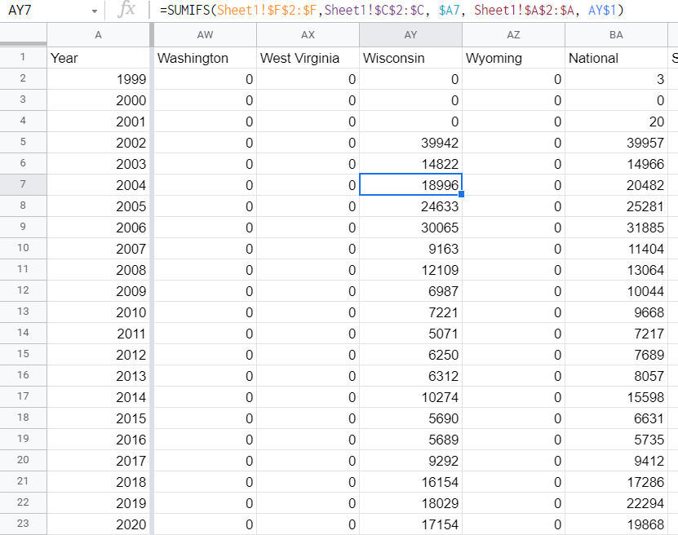
Google Sheets: Cumulative Negative (Sheet 5)

Slide 16
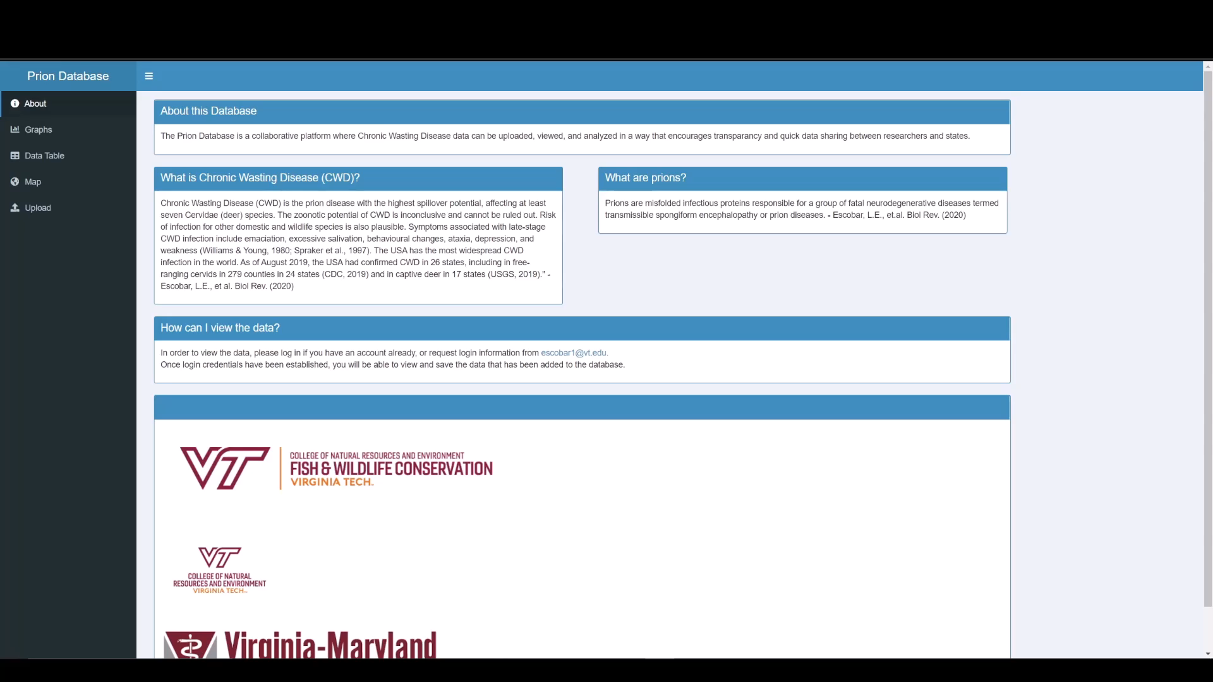
Walkthrough Video

Slide 17
Timeline
1/21: Initial client contact via email
2/10: First client meeting and finalized project proposal
2/16: Presentation 1 - Initial project designs and client expectations
2/19: Established weekly meeting with client
2/22: Began sending emails for data requests
2/28: Forwarded emails requesting more information to client
3/02: Connected R Shiny database with Google Sheets backend data storage
3/12: Added the data obtained from emails into Google Sheets
3/24: Met with client to show MVP
3/30: Presentation 2
4/08: Interim report and methodology completed
4/22: Map design and final additional graphs finished
4/27: Final Presentation

Slide 18
Lessons Learned
Gathering Data is difficult
Anticipating Data formats is difficult
Learning new libraries takes time

Slide 19
Future Ideas
Login/Authentication
Embedded Maps
More dynamic graphs
Graphs with extra data
Further data collection

Slide 20
Acknowledgements
Client: Dr. Luis Escobar, Assistant Professor in the Department of Fish and Wildlife Conservation at Virginia Tech, escobar1@vt.edu
Mariana Castaneda-Guzman, M.Sc. Student Department of Fish and Wildlife Conservation at Virginia Tech, marianacg@vt.edu
Daniel Skinner, Illinois Department of Natural Resources
J Caudell, Indiana Department of Natural Resources
Nicole Lewis, New Jersey Department of Natural Resources and Wildlife
Merril Cook, North Carolina Wildlife Resources Commission
Dr. Amy Horn-Delzer and Karen Torvell, Wisconsin Department of Agriculture, Trade and Consumer Protection
Tamara Ryan, Wisconsin Department of Natural Resources

Slide 21
References
[1] CWD Alliance. CWD-Info.org - Chronic Wasting Disease Alliance. Retrieved April 7, 2021 from http://cwd-info.org/
[2] R Studio.Retrieved April 7, 2021 from https://shiny.rstudio.com/

Slide 22
Questions?

