Slide 1
OPENNESS:
CONTRIBUTE, ACCESS, USE
Joy Kirchner
University of British Columbia
Scholarly Communications
Workshop
Jan. 17-18, 2012
Virginia Tech Libraries

Slide 2
What do we mean by open?
Open to contributions and participation
Open and free to access
Open to use & reuse w/few or no restrictions
Open to indexing and machine readable

Slide 3

Open movements
Open access
  Public access
Open source
Open education
Open data
Open science
Open books
Open peer review….

Slide 4
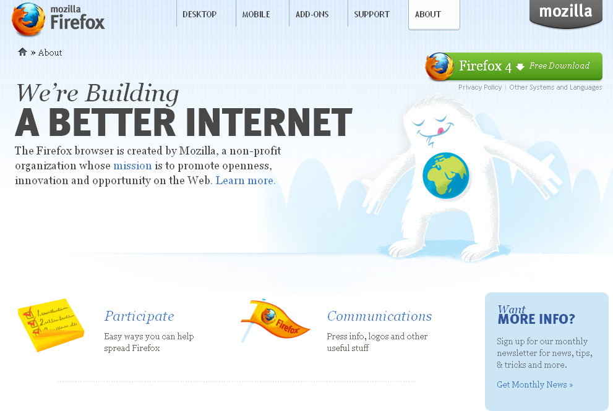
PARTICIPATE
in
BUILDING
and
CONTRIBUTE
EXPERTISE

Slide 5
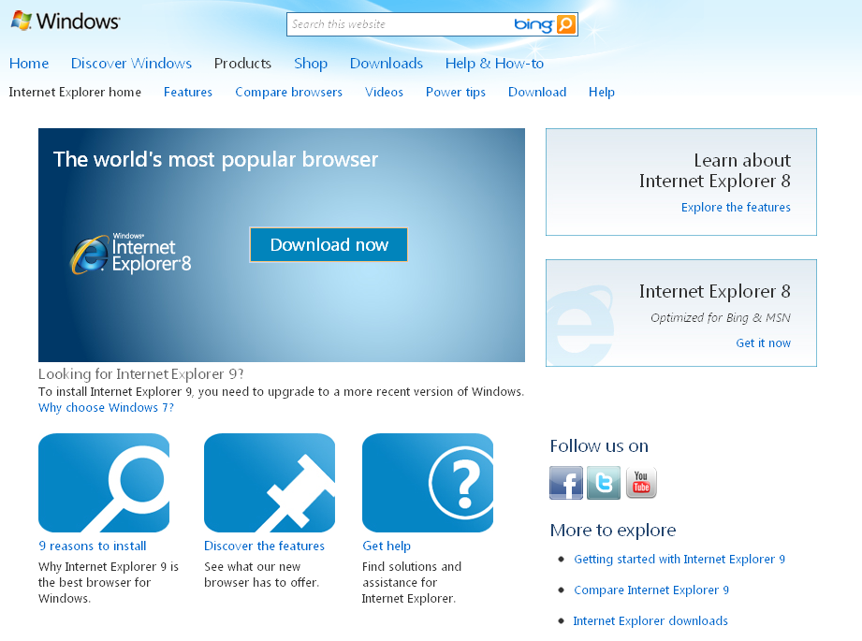
AS OPPOSED TO…

Slide 6
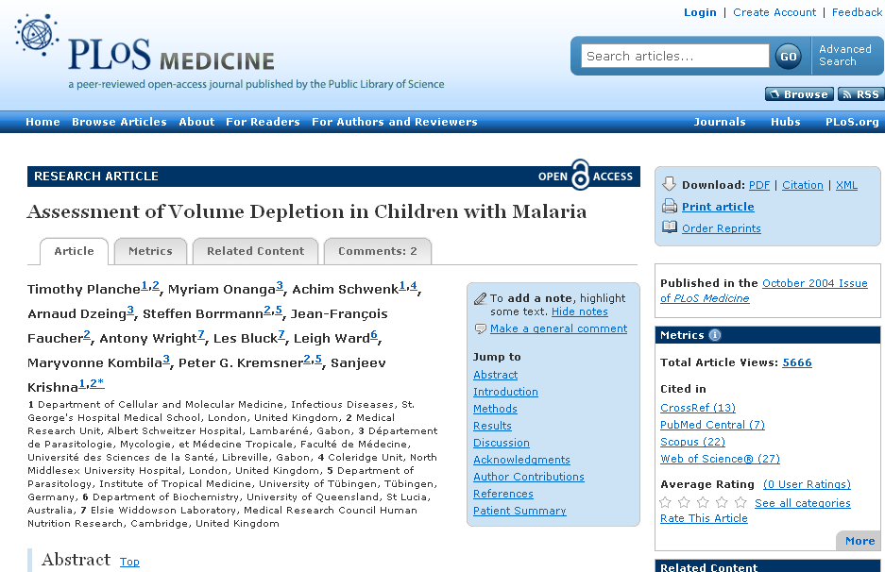
OPEN and FREE TO ACCESS

Slide 7
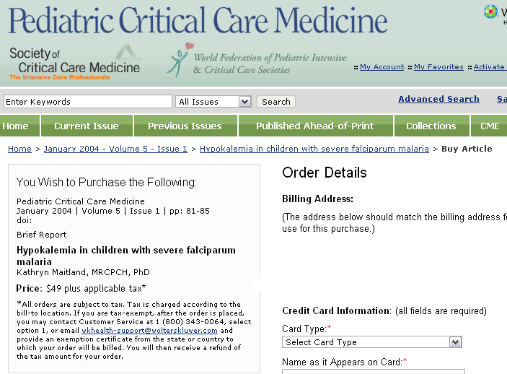
AS OPPOSED TO…

Slide 8
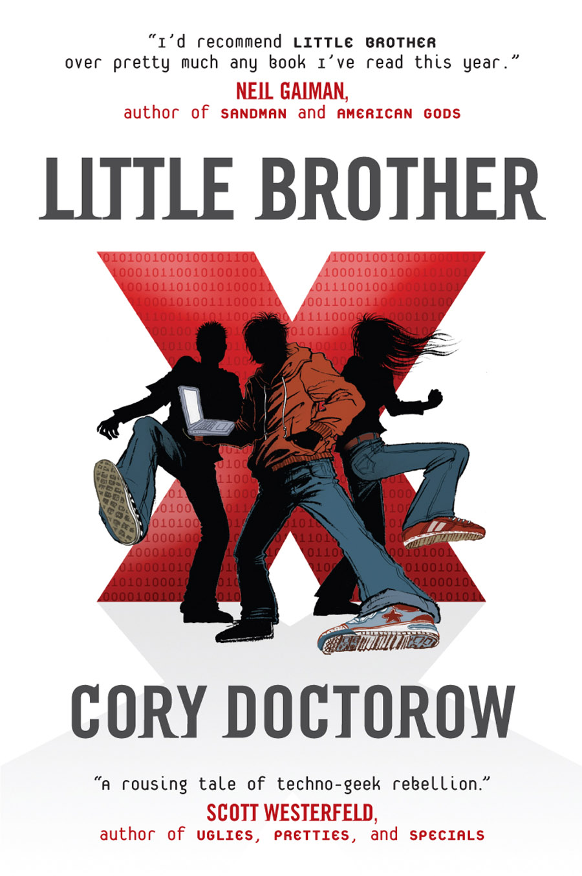
OPEN TO USE and
REUSE WITH FEW or NO RESTRICTIONS
Notes:
Cory Doctorow releases all of his books under a Creative Commons license, allowing for adaptation and remixing. People release translations of his work, fan videos, and alternate covers. All without asking.

Slide 9

AS OPPOSED TO…
Notes:
Stephen Joyce, a nephew of the author and representative of the estate, is notorious for pursuing lawsuits against scholars who so much as quote from Joyce’s works, even in situations that are clearly fair use.

Slide 10
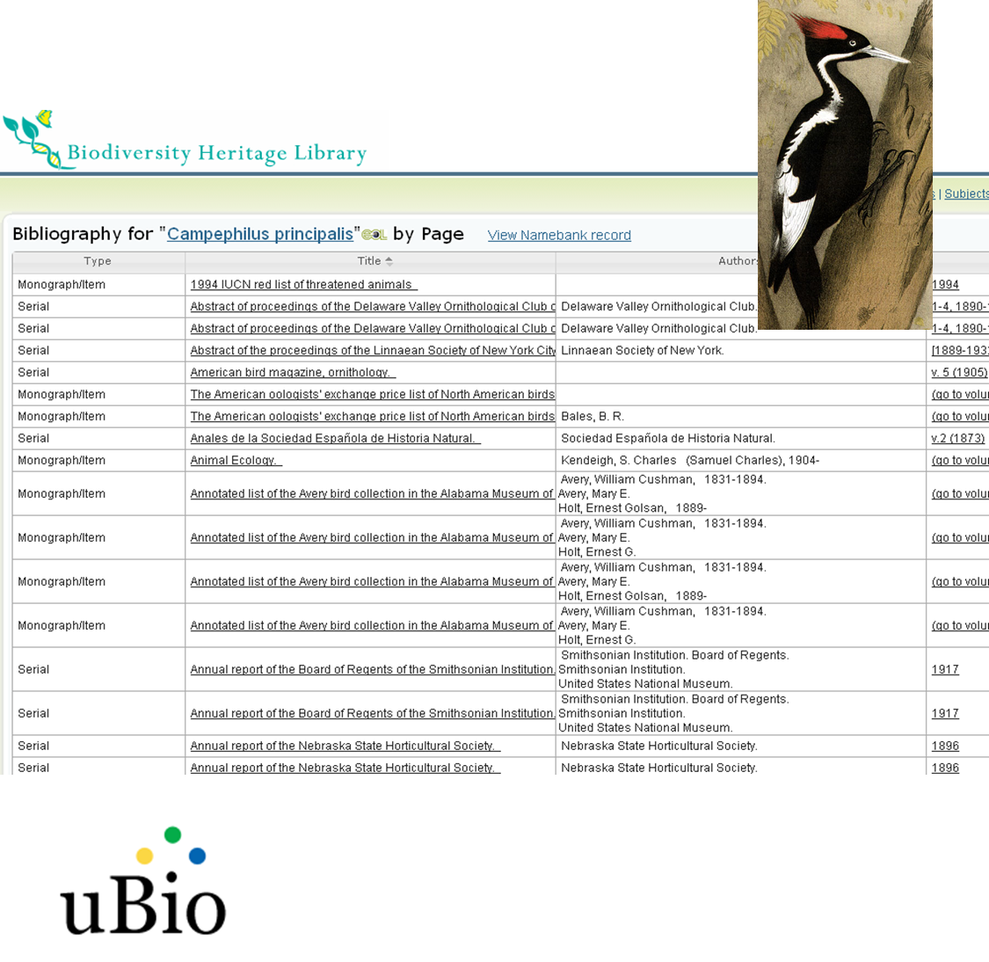
OPEN TO MACHINE READING, INDEXING, and PROCESSING
Notes:
Increasing it has become important to think not only about openness in terms of how humans can interact with something, but also in terms of how computers can interact with items. The Biodiversity Heritage Library has opened their digital library to others to mine and index so that scientists can pull out useful information in a machine automated way. They’ve also taken open tools to apply to their corpus; in this example, they’ve used a tool called TaxonFinder from the uBio project to mine their over 90,000 volumes for mentions of taxonomic name. This is an example of a search for the taxonomic name fo the ivory billed woodpecker – now likely extinct.

Slide 11
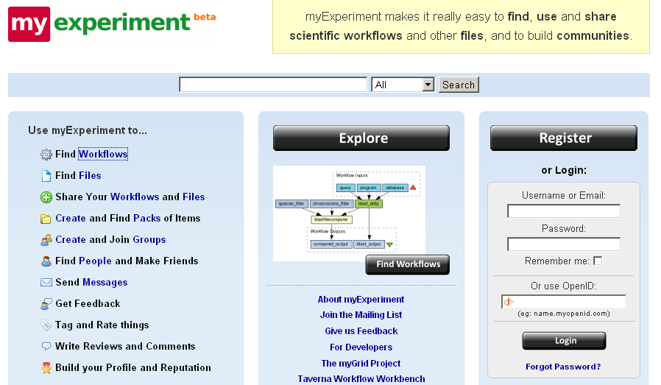
Transparency

Slide 12
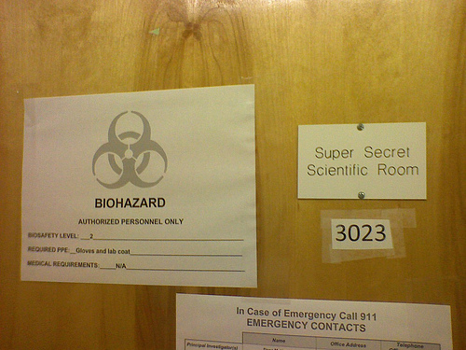
As opposed to…

Slide 13

AS OPPOSED TO…
Notes:
As opposed to systems that prohibit machine indexing or mining. This image refers to the ‘no robot’ text that is included in the headers of websites that do not want to be indexed by sites like google. Many materials that have copyright restrictions on use or reuse would prohibit the type of mining that the BHL does, or are in formats (like PDF) that make it very difficult for users to program against.

Slide 14
Commonalities
Generally enabled by technology
Works both inside and outside of traditional models
Supported by a variety of business models

Slide 15
Open Access
Open access literature is digital, online, free of charge, and free of most copyright and licensing restrictions.
- Peter Suber

Slide 16
Gratis vs. Libre
Gratis: You can read it for free. Anything else, you better ask permission.
Libre: With credit given, OK to text-mine, re-catalog, mirror for preservation, quote, remix, whatever.
Most OA is gratis. You get to “libre” via Creative Commons licensing, usually.
(text from Dorothea Salo)

Slide 17
2 Paths to Open Access manuscript ….
Traditional subscription
access journals
Open Access journal
(PLOS Medicine; BioMedCentral, DOAJ)
Open access copy
in online archive
(IR; Pubmed Central)
gold
green
Articles can be made OA by publishing in
an OA journal or self archiving OA copies from
a traditional publication
New Models of Scholarly Publishing

Slide 18
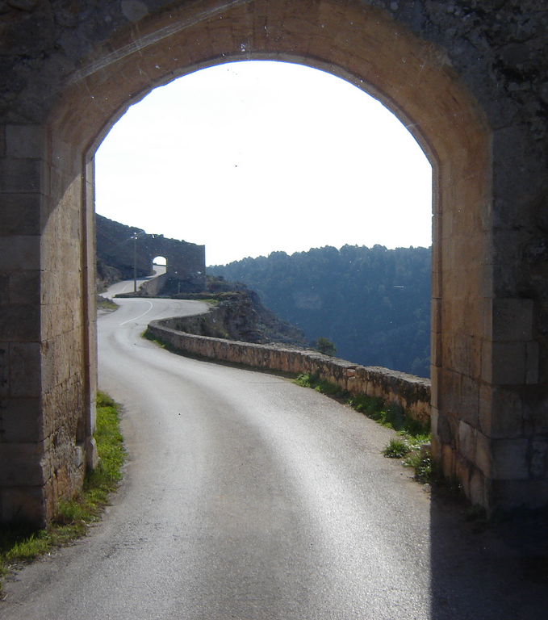
Two (and a Half) Roads to Open Access
1) Open Access publishing
2) Author self-archiving
2.5) Hybrid: Commercial journals allow authors to pay to make articles freely available
Notes:
“The winding roads of Spain” by SKI Tripper, CC-BY, http://www.flickr.com/photos/nzer/2640367659/

Slide 19
OPEN ACCESS PUBLISHING (‘GOLD’)
Publication that is free & open for anyone to access on internet
Journals or books!
  6355 OA journals according to Directory of Open Access Journals (as of April 2011)
  Journals across all disciplines
  Share common features with toll access journals
Supported by variety of models
  Institution / funder supported OR author-supported (2006 – 47% author supported)
Generally allow authors to retain copyright and/or license under creative commons

Slide 20
Issues and questions
Has taken time for impact factors and reputation to build
Business models still emerging
Author-pays model has better traction in the STM community

Slide 21
OPEN ACCESS VIA ARCHIVING/REPOSITORIES (‘GREEN’)
Literature published through traditional channels that is made openly available through deposit in a repository or placing on web site
Institutional, departmental, or discipline based repository
Supported by wide range of business models
Range of publisher policies on deposit

Slide 22
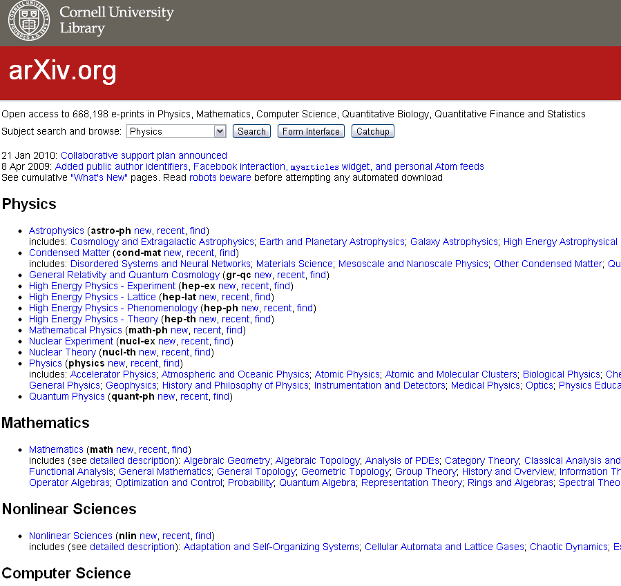
DISCIPLINARY
REPOSITORY

Slide 23
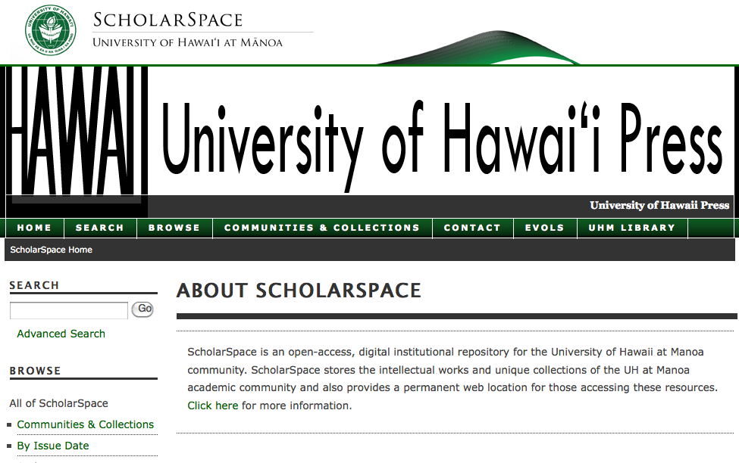
INSTITUTIONAL REPOSITORY
Notes:
Recommend including the IR of the local institution if possible

Slide 24
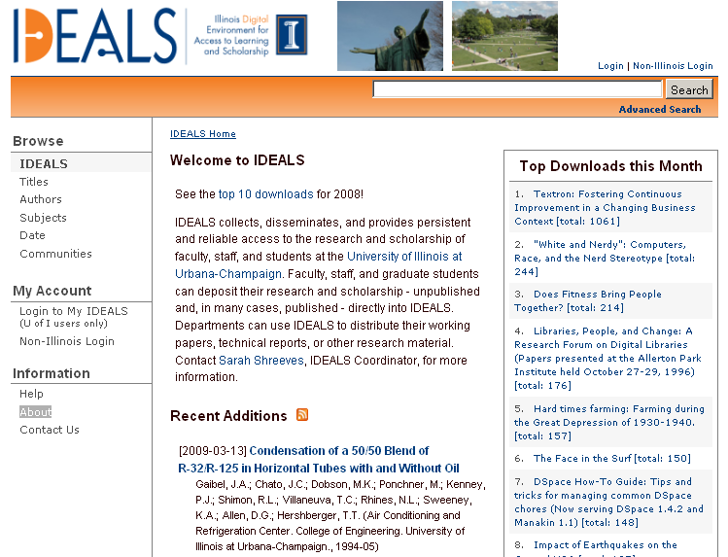
Institutional Repository

Slide 25
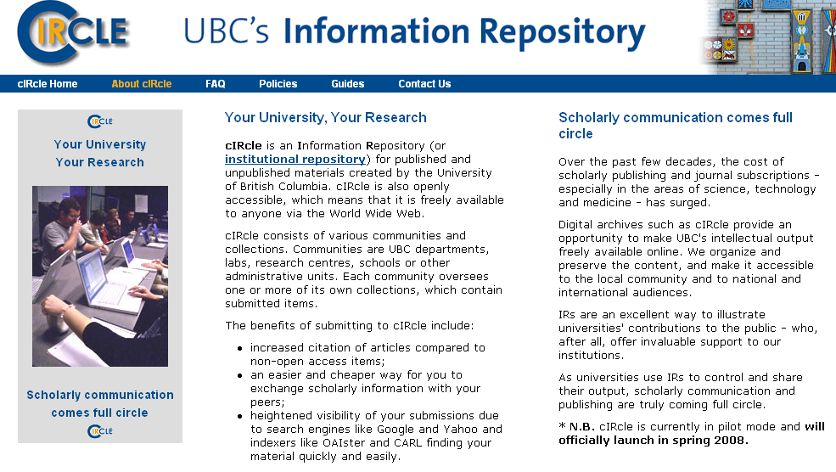

Slide 26
Issues and questions
Sustainability sometimes an issue
Participation of faculty (particularly for institutional)
  Discipline based repositories often rooted in cultures used to sharing
Often include a range of material including student work, grey literature, theses and dissertations, etc.
For published literature, what can be deposited confusing (post print, pre print, published version?)
Copyright issues murky and (often) frustrating

Slide 27
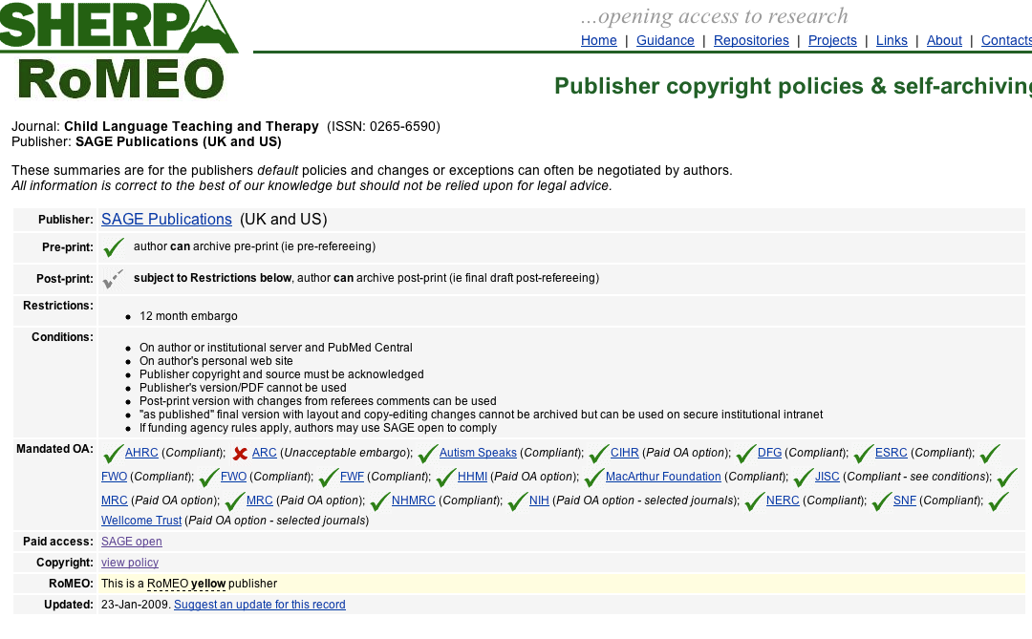
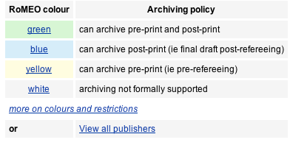

Child Language Teaching and Therapy
Mandated open access

Slide 28

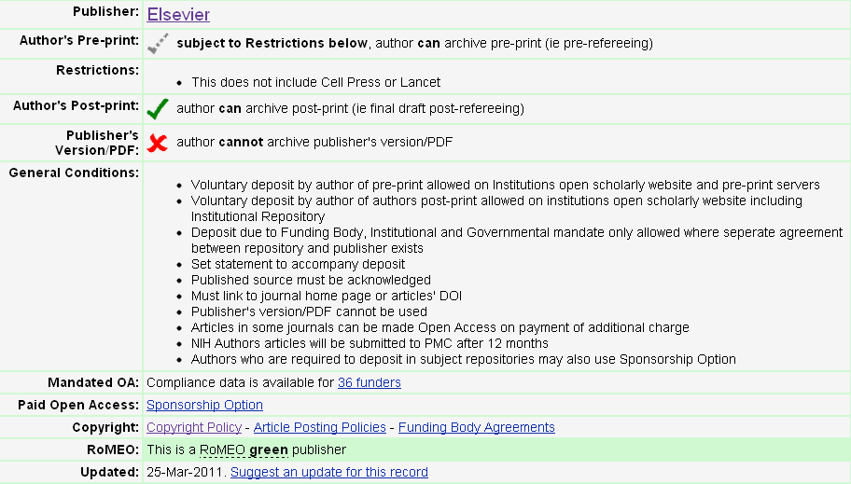

Slide 29
Hybrid models
Publisher | Price | Notes
Elsevier Sponsored Article | $3,000 | Some journals
Oxford Open | $3,000 | Some journals; lower price if author is from a developing country
Springer Open Choice | $3,000 | All journals
Wiley OnlineOpen | $3,000 | Some journals; fees vary
American Chemical Society AuthorChoice | $1,000 – 3,000 | Lowest price if institution subscribes & have personal membership
Plant Physiology | $1,500/ $500 / Free | OA free for members of ASPB; Discount if non-member but institution subscribes

Slide 30
ISSUES AND QUESTIONS
Mixed business model – subscriptions and author pays on an article by article basis – uncomfortable for many
Relatively low adoption (generally around 1-2%)
What impact on subscription prices?
Many libraries with funds for faculty to publish in OA journals will not fund these articles
Notes:
The 1-2% is what we heard from publishers at the ALCTS Scholarly Communications Interest Group meeting on Hybrid journal models at ALA Midwinter in 2011 – see http://connect.ala.org/node/128235

Slide 31
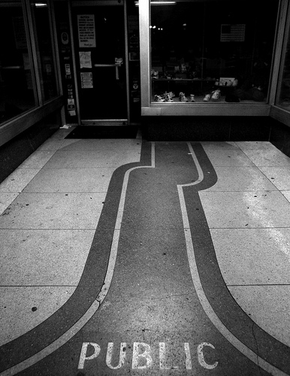
Public Access Mandates
  Public should have ready and
  easy access
  to taxpayer funded research
  Many legislative efforts in US to halt and expand this.
Notes:
NIH Mandate – All research funded by National Institutes for Health must be made freely available in PubMedCentral 12 months after publication;
Legislative efforts to restrict NIH mandate (HR 801: Fair Copyright in Research Works Act) – 2009/2010
Legislative efforts to expand it (Federal Research Public Access Act S.1373 and Federal Research Public Access Act HR5037) 2009/2010
White House Office of Science and Technology Policy: http://www.whitehouse.gov/blog/2010/03/08/public-access-policy-update
COMPETE act

Slide 32
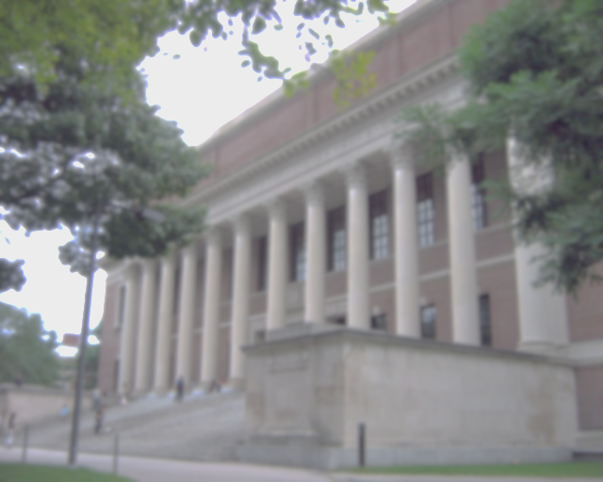
Institutional Open Access Policies
  Harvard
  (Faculty of Arts and Sciences, College of Law)
  MIT
  Kansas
  Oberlin
  Duke
  University of Hawaii!
  And others…
  http://roarmap.eprints.org
Notes:
Update, talk about the process, lessons learned; also note use of word policy and not mandate.

Slide 33
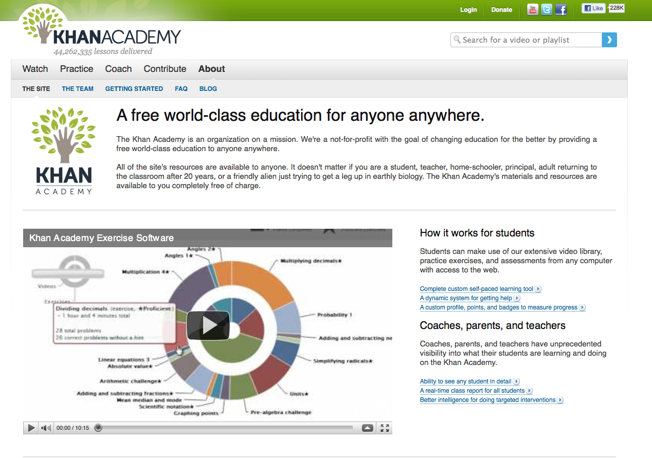
Open Education

Slide 34
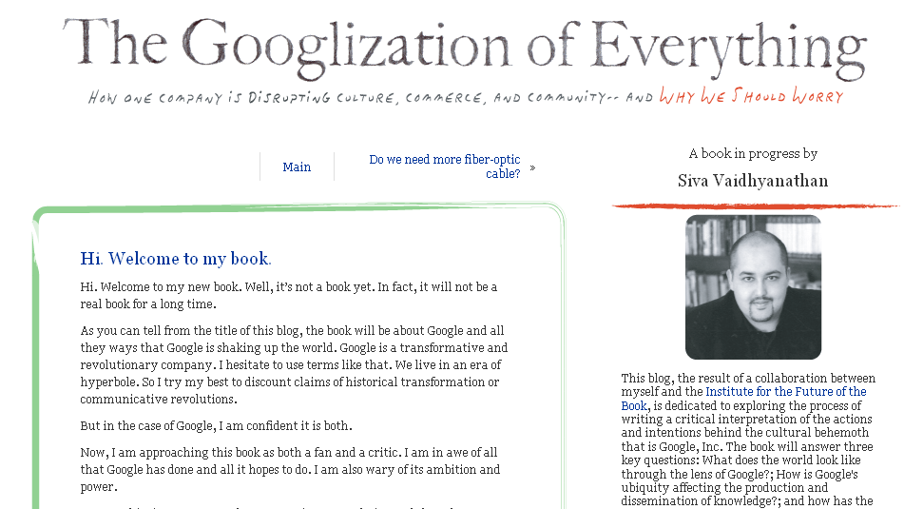
Open Books
Notes:
Note that this book has been published as a ‘real’ book as well

Slide 35
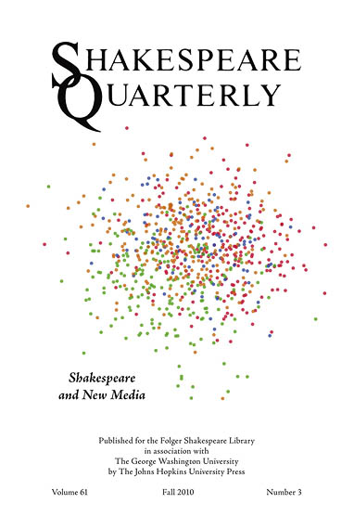
Open Peer Review
Notes:
Shakespeare Quarterly under Katherine Rowe’s direction conducted an experiment in ‘partially open peer review’. Steps were: Editorial team screens submissions for appropriate quality and topicality; if authors agree, article posted for expert commentary; experts review each others commentary as well as the submission; editor makes final publication decision; entire process made open in a commentpress installation at http://mediacommons.futureofthebook.org/mcpress/ShakespeareQuarterly_NewMedia/

Slide 36
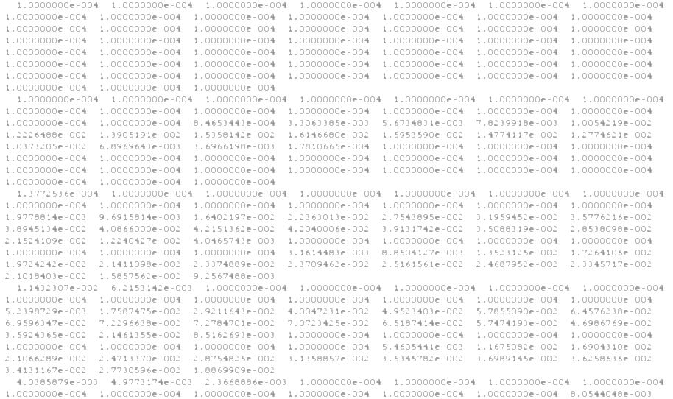
Open Data
Open access to data not just papers
The rate of discovery is accelerated by better access to data
Actionable data
Funder mandates around management and sharing of data (in some cases)

Slide 37
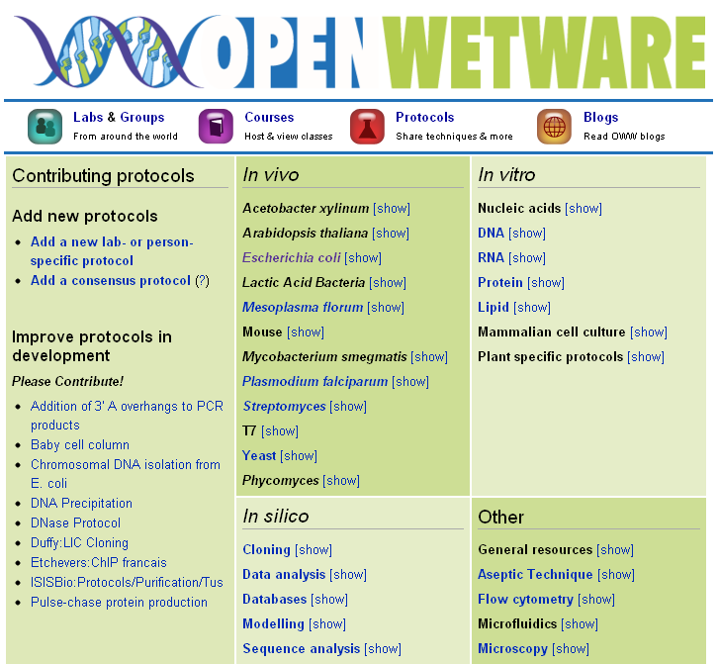
OPEN SCIENCE
Notes:
Open Science is: Transparency in experimental methodology, observation, and collection of data, Public availability and reusability of scientific data, Public accessibility and transparency of scientific communication, Using web-based tools to facilitate scientific collaboration.
Important question for libraries is how should we be involved in not just end product (data, publications) but also process of scholarly communication?

Slide 38

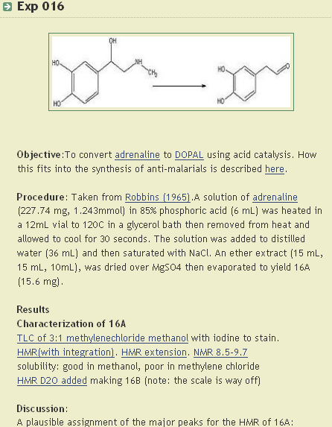
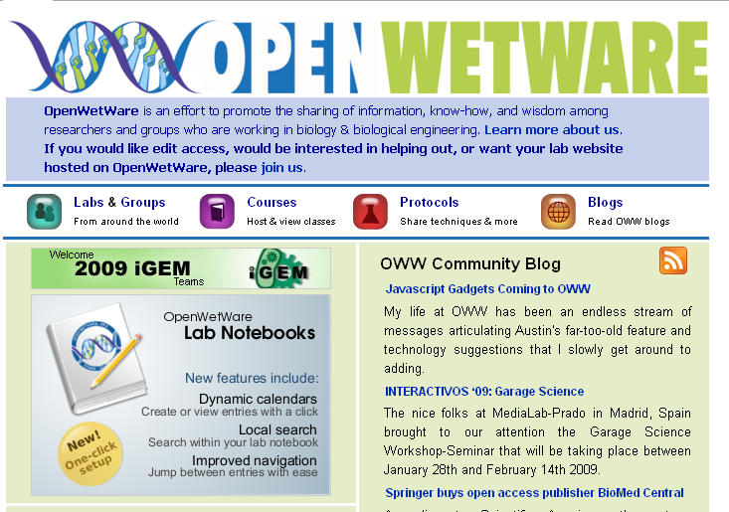
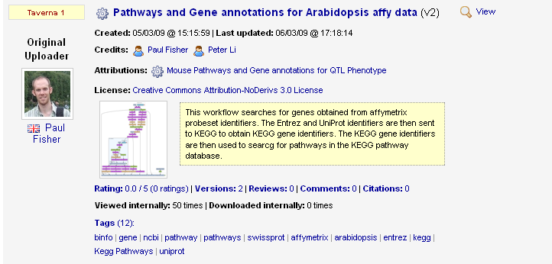
Open Science

Slide 39
Resources
Peter Suber - Open Access Overview: http://www.earlham.edu/~peters/fos/overview.htm
Directory of Open Access Journals:
http://www.doaj.org/
Registry of Open Access Repositories: http://roar.eprints.org/
Sherpa/Romeo Publisher Copyright Policies and Self-Archiving: http://www.sherpa.ac.uk/romeo.php

Slide 40
Attribution
Slide 3: Door http://www.flickr.com/photos/crystalina/6327766/
Slide 14: Text used from Dorothea Salo’s “Open Sesame” Presentation at http://www.slideshare.net/cavlec/open-sesame-and-other-open-movements
Slide 15: “The winding roads of Spain” by SKI Tripper, CC-BY,
http://www.flickr.com/photos/nzer/2640367659/
Slide 25: Public http://www.flickr.com/photos/aaronw79/5575652125/
Slide 26: Harvard Widener Library http://www.flickr.com/photos/mak506/2771080083/
Except noted all photos used under a Creative Commons 3.0 Attribution-Share Alike 3.0 license.
This work was created by Sarah L. Shreeves and Molly Kleinman and last updated on April 6, 2011. This work is licensed under the Creative Commons Attribution-NonCommercial-ShareAlike 3.0 United States License. To view a copy of this license, visit http://creativecommons.org/licenses/by-nc-sa/3.0/us/ or send a letter to Creative Commons, 171 Second Street, Suite 300, San Francisco, California, 94105, USA.

