Slide 1
CS 5604 Spring 2015
Classification
Xuewen Cui
Rongrong Tao
Ruide Zhang
May 5th, 2015

Slide 2
Overview
Background
Algorithm
Implementation
Result and Evaluation
Future Work
Conclusion

Slide 3
Background
Feature Extraction
Words extracted as features
Feature Selection
Feature vectors generated from Apache Mahout
Classification – enforce Solr search engine
Naive Bayes

Slide 4
Algorithm
Text Mining
Naïve Bayes
Random Forest
Support Vector Machine (SVM)
Only serial implementation provided by Mahout

Slide 5
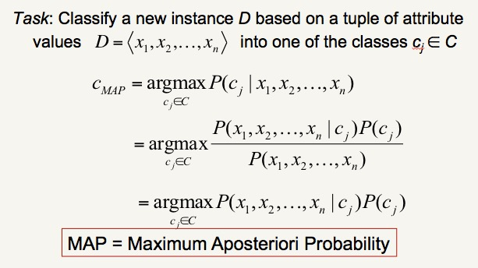
Algorithm - Naive Bayes

Slide 6
Implementation
Data labeling
Data source: cleaned data from reducing noise team.
Collection: small collection, large collection.
Each collection has tweets and webpages.
Each has 8 topics(come from 8 teams).
Each topics: 100 positive,100 negative
Train set: 80% samples
Measurement of Accuracy: 5-fold Cross-Validation

Slide 7
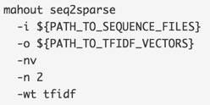
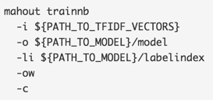

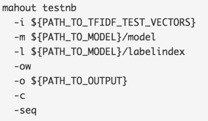
Implementation
Apache Mahout Naive Bayes
Class label prediction for new data is not supported

Slide 8
Implementation
Apache Mahout Naive Bayes
Learning Apache Mahout Classification
work for Hadoop 1.x

Slide 9
Implementation
pangool: 100% compatible with different versions of Hadoop
Naive Bayes classification with MapReduce
Jose Cadena from Hadoop Team
made our program able to read in .avro file and write to .avro file

Slide 10
Example
POSITIVE content of tweets or webpages
NEGATIVE content of tweets or webpages
Training: .txt file
New data file stored in HDFS
All results (labeled new data) loaded into HBase by Hadoop team

Slide 11
Result and Evaluation
Tweets: Small Collection
Team | Collection Topic | Average Accuracy | Filesize | Runtime
Classification | Plane Crash | 92% | 90M | 13s
LDA | Suicide Bomb Attack | 89% | 13M | 8.6s
Hadoop | Jan. 25 | 73% | 214M | 18.6s
Solr | Election | 86% | 298M | 34s
Reducing Noise | Charlie Hebdo | 85% | 64M | 8.4s
NER | Storm | 100%
Arabic
negative tweets come from other collections

Slide 12
Result and Evaluation
Tweets: Large Collection
Team | Collection Topic | Average Accuracy | Filesize | Runtime
Classification | Malaysia Airlines | 78% | 270M | 32s
Hadoop | Egypt | 81% | 3.1G | 136s
Reducing Noise | Shooting | 73% | 7.4G | 112s
LDA | Bomb | 75% | 5.8G | 110s

Slide 13
Result and Evaluation
Webpages: Small Collection
Team | Collection Topic | Average Accuracy | Filesize | Runtime
NER | storm | 83% | 65M | 4.7s
Classification | Plane Crash | 87% | 24M | 9s

Slide 14
Result and Evaluation
Webpages: Large Collection
Team | Collection Topic | Average Accuracy | Filesize | Runtime
Hadoop | Egypt | 79% | 140M | 36s
Clustering | Diabetes | 77% | 305M | 40s

Slide 15
Future Work
For performance improvement
Use larger training set
Try using tf-idf value instead of word count in NaiveBayesGenerate.java
Use more representative features

Slide 16
Conclusion
Learned feature selection and classification algorithm on Apache Mahout
Found a package to predict class label using Naive Bayes classifier generated from Apache Mahout
Make it compatible with higher versions of Hadoop, instead of just 1.1.1
Found a package for M/R Naive Bayes classifier
Can be updated later for performance improvement

Slide 17
Thanks
We give our thanks to
Instructor: Dr. Fox
TA: Mohamed Magdy and Sunshin Lee
Classmates
Jose Cadena from Hadoop Team
Reducing Noise Team

Slide 18
Acknowledgements
We would like to thank our instructor Dr. Edward A. Fox, who brought us into this interesting project. We would like to thank our TAs, Mohamed Magdy and Sunshin Lee, for their continued support and valuable suggestions throughout the project. We would also give special thanks to Jose Cadena from the Hadoop team, who helped us with input and output formatting problems. Further, we thank the Reducing Noise team, which provided cleaned tweets and webpages for us to work on. Finally, thanks go to the support of NSF grant IIS - 1319578, III: Small: Integrated Digital Event Archiving and Library (IDEAL).

Slide 19

Questions

