Slide 1
KidDataViz Project
Andrew Ahn, Joshua Yang, Heechan Lim, Sasha Holt, Timothy Kelley, Jack Homer
CS4624 Multimedia, Hypertext, and Information Access, Dr. Fox
Virginia Tech, Blacksburg VA 24061
11/29/2022

Slide 2
Outline
Project Overview
Timeline/Milestones
Work Completed
Website Implementation
Game Implementations
Lessons Learned
Future Work
Acknowledgements
References

Slide 3



Project Overview
Client: Dr. Sally Hamouda
Games for helping with data visualization concepts for kids
Kids will be able to access our website and navigate to games
Games will consist of varying designs aimed at different groups
Categories are split into 1st and 2nd grade; 3rd and 4th grade; and 5th grade

Slide 4
Timeline/Milestones
September
October
November
December
Phase 1
Phase 2
Phase 3
Phase 4
Research data visualization tools, brainstorm simple game ideas, website/game design
Begin website and game development and implement data visualization components
Testing and surveys conducted, feedback received
Revise and re-implement design and finalize website

Slide 5
Work Completed
Website Implementation
React application for front end
Hosted on Vercel
Collapsable for mobile use in the future
Game Implementations
6 games fully implemented for testing
Playable from the website
Testing Preparation + Deployment
Google form with detailed questions and prompts created
Sent out to users on 11/29

Slide 6
Website Implementation

Slide 7
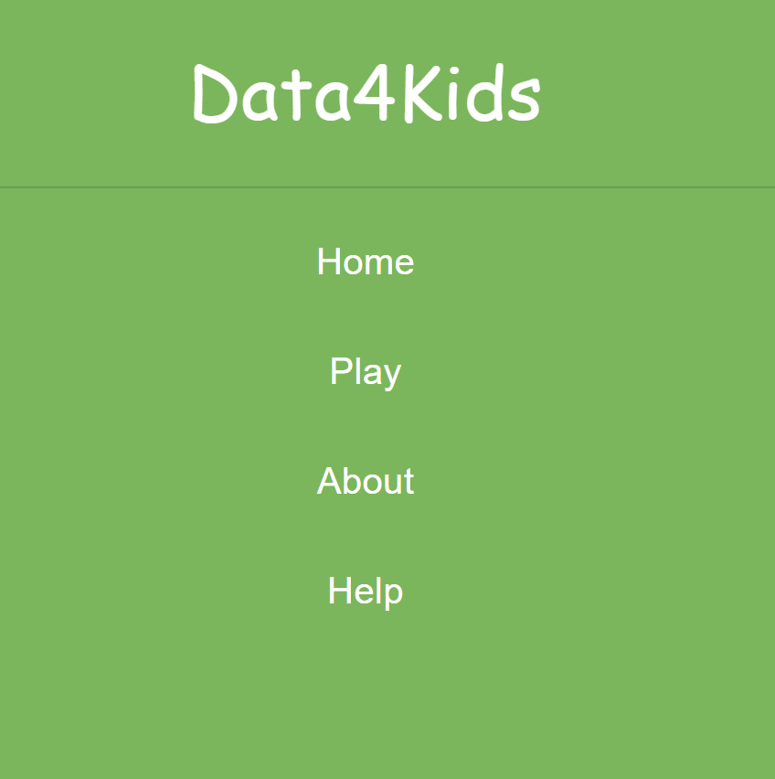
Changes in Implementation
Design was changed to be more accommodating to mobile users
Menu/Taskbar now collapses into dropdown menu
Changed to be scrollable
Scales better on mobile
Less static menus on the side or top of the screen

Slide 8
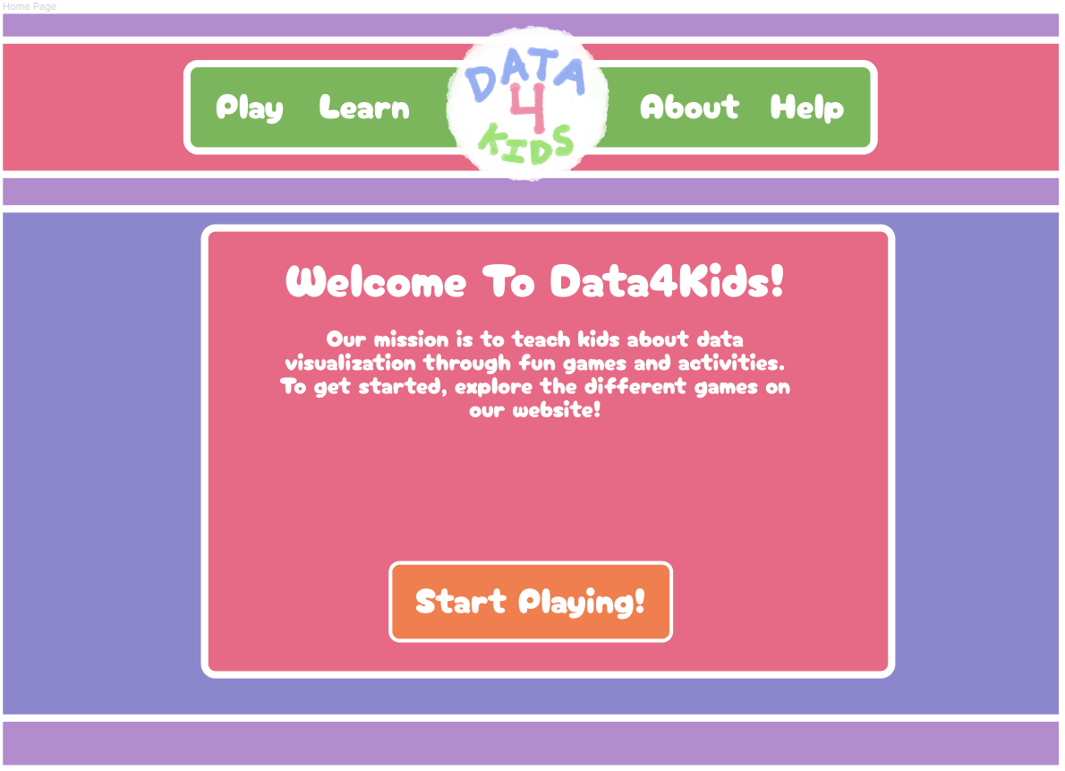
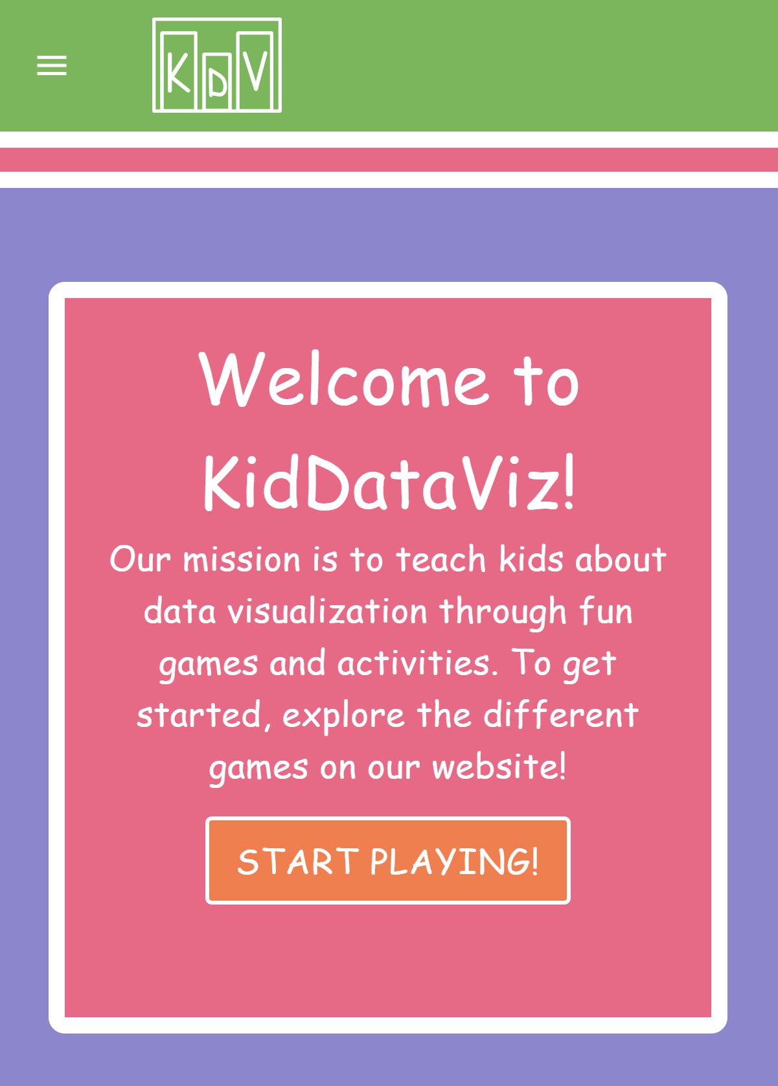
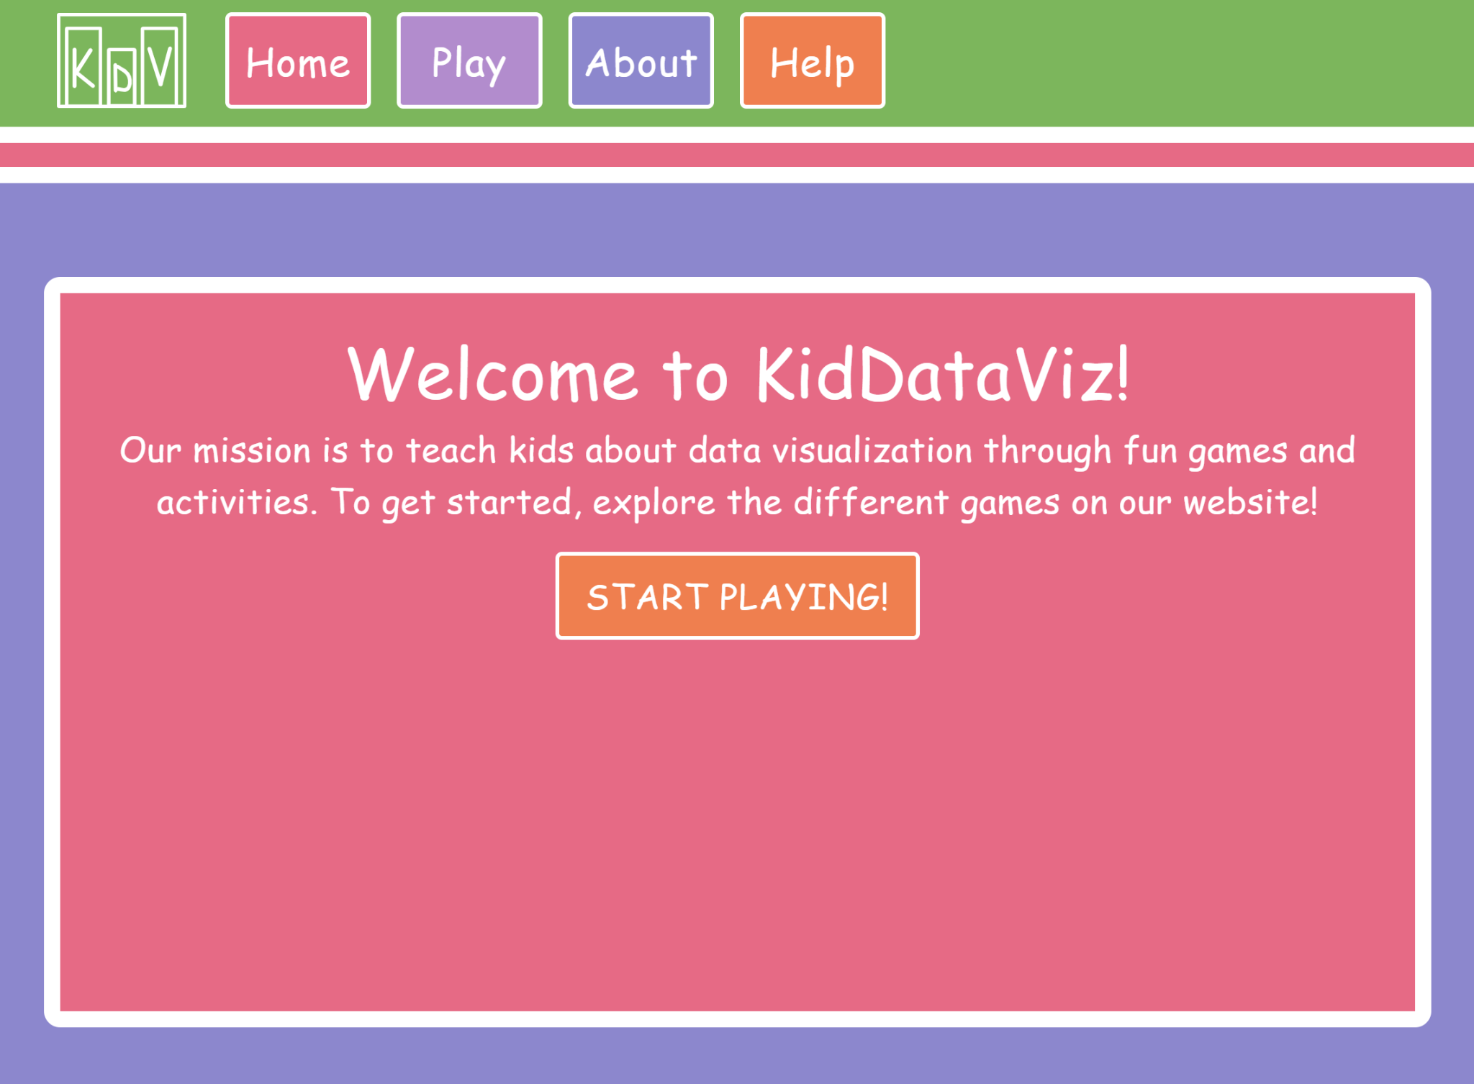
Website Design vs. Development - Home
Wireframe
Application (Desktop)
Application (Mobile)

Slide 9
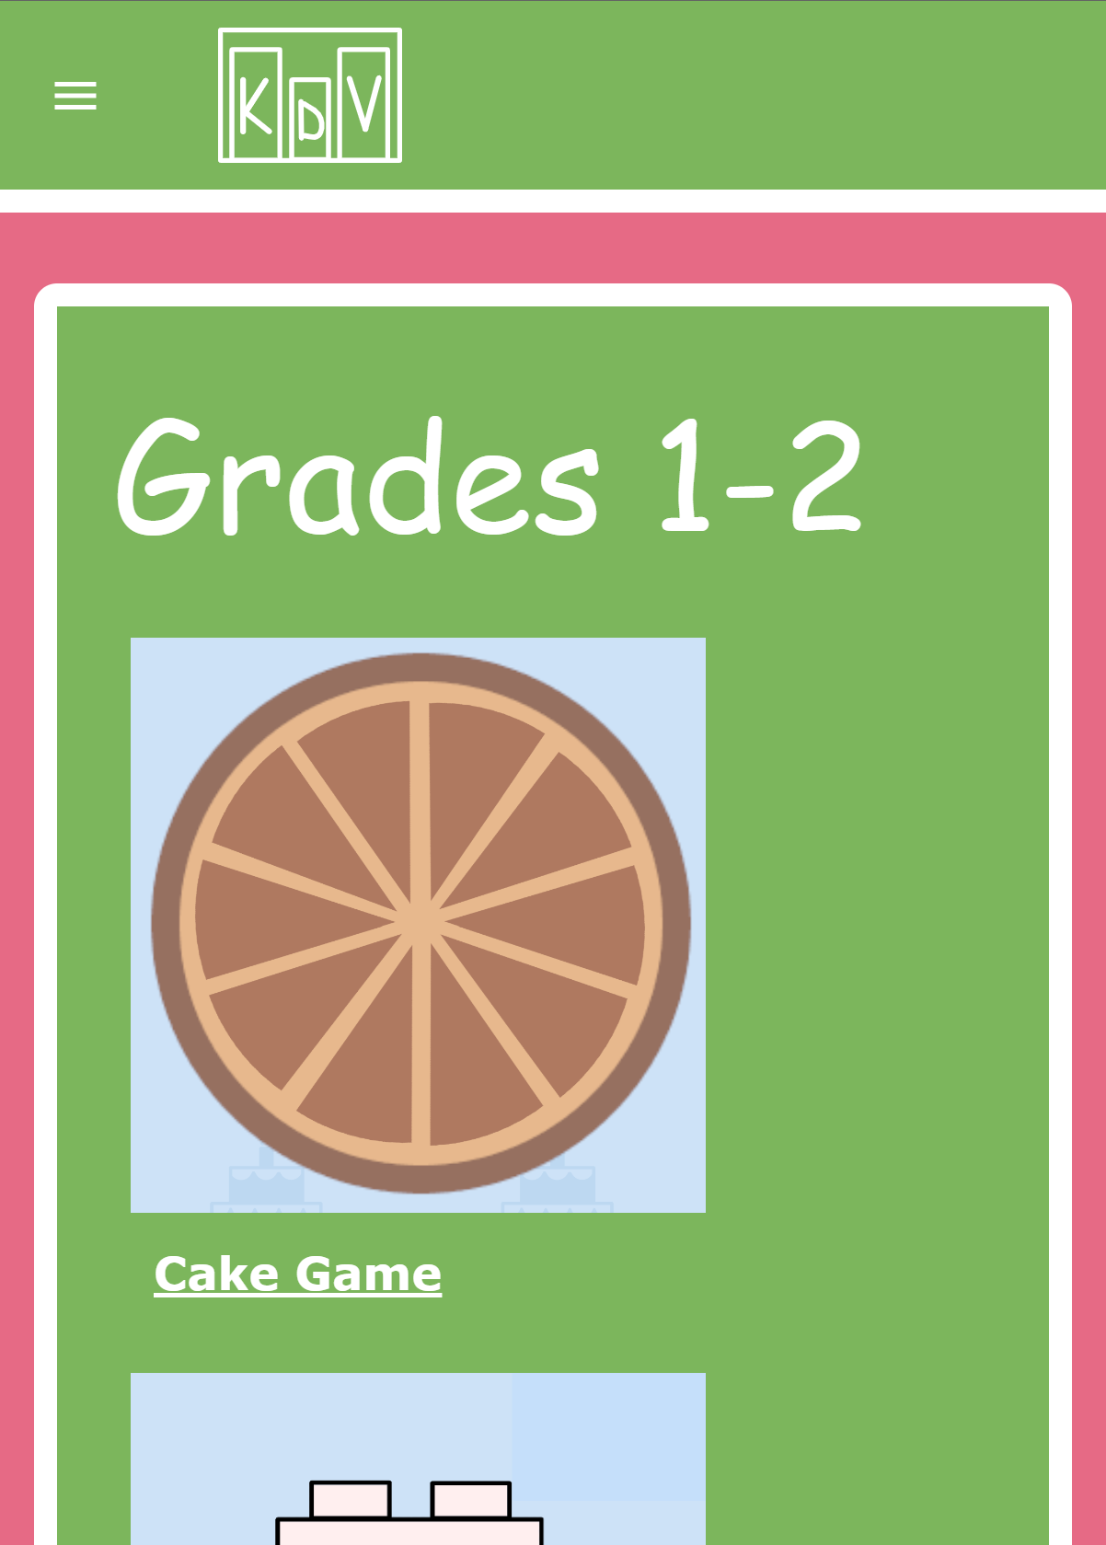
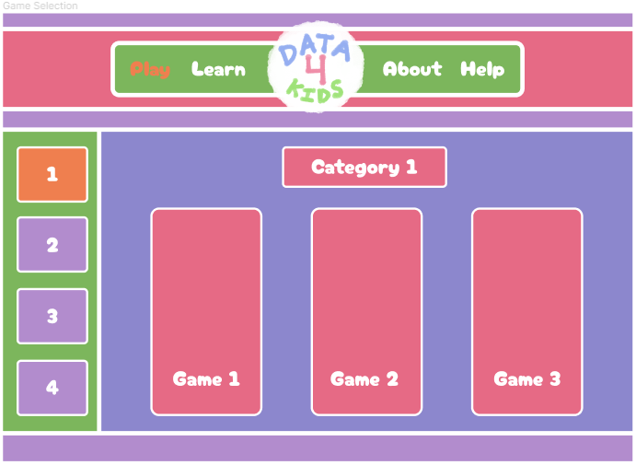
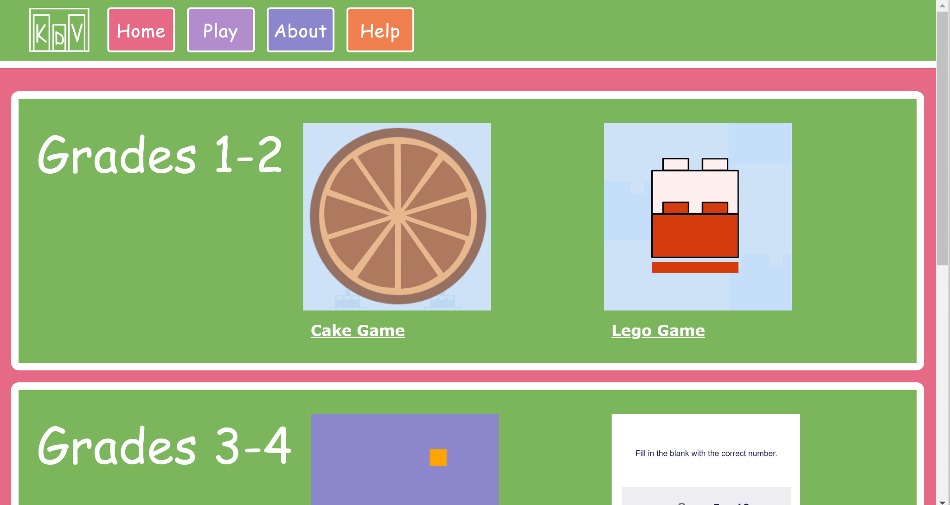
Website Design vs. Development - Play
Wireframe
Application (Desktop)
Application (Mobile)

Slide 10


Hosting Changes
Application was initially hosted on AWS Amplify but was moved to Vercel for better integration with the Unity games
Front end is still built directly from the project GitHub, allowing for continuous deployment
Whenever a change is pushed to main it rebuilds the application
Allows for integration with backend tools like MongoDB

Slide 11
Game Implementations

Slide 12
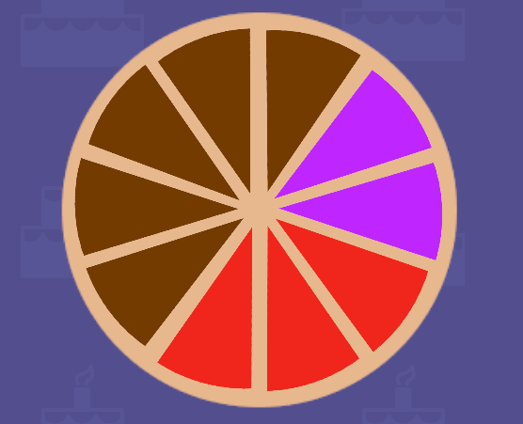
Game 1 - Cake Bake
Basic Idea: The user will be creating a pie chart based on different cake flavors they put into place.
After the game the user will:
Be familiar enough with the data to answer percentage/fraction questions about it.
Actively use the pie chart to answer those questions.

Slide 13
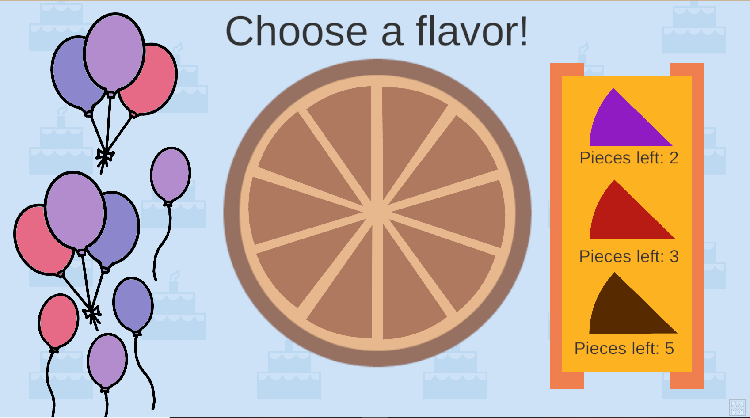
Game 1 (continued)
Players will choose flavors from the table.
Will then place them on the tray.
Once finished, their custom cake will be used to answer questions.

Slide 14
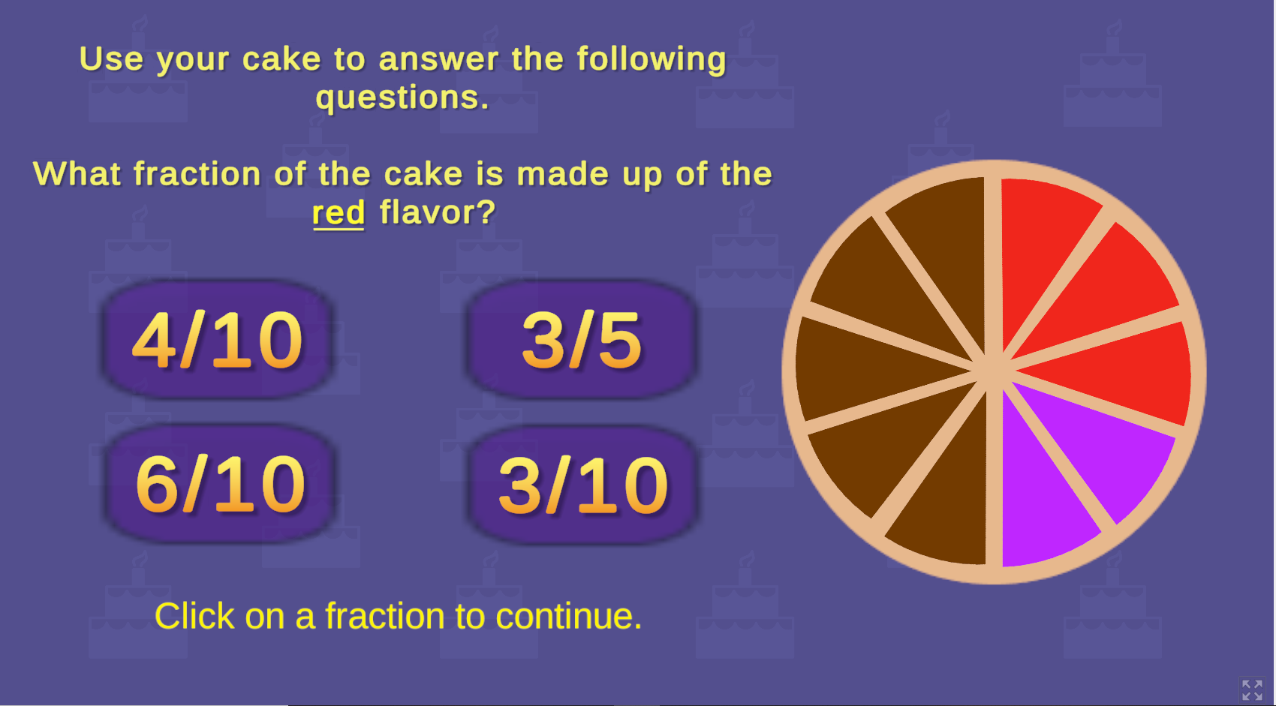
Game 1 (continued)
Basic fraction questions for 1st and 2nd graders.
Goal is for players to already be familiar with the data set, and be able to evaluate it.

Slide 15
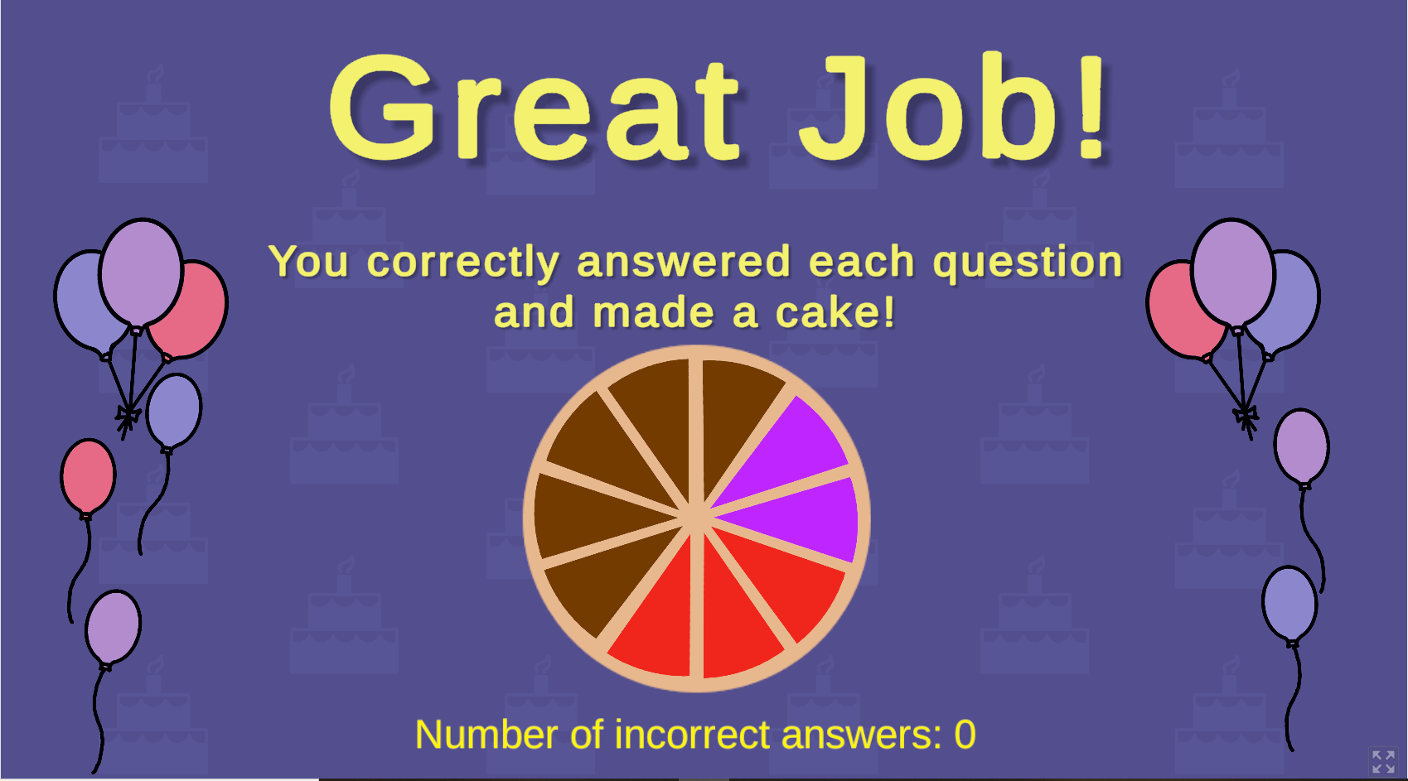
Game 1 (continued)

Slide 16
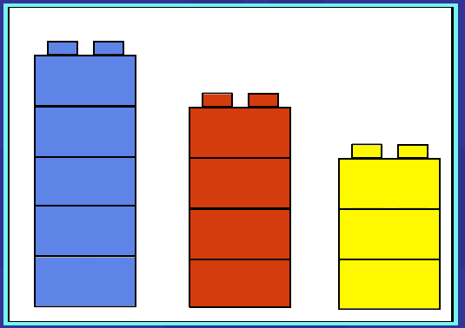
Game 2 - Lego Game
Basic Idea: The user will be creating a bar chart based on different colored Legos.
After the game the user will:
Be familiar enough with the data to answer percentage/fraction questions about it.
Actively use the bar chart to answer those questions.

Slide 17
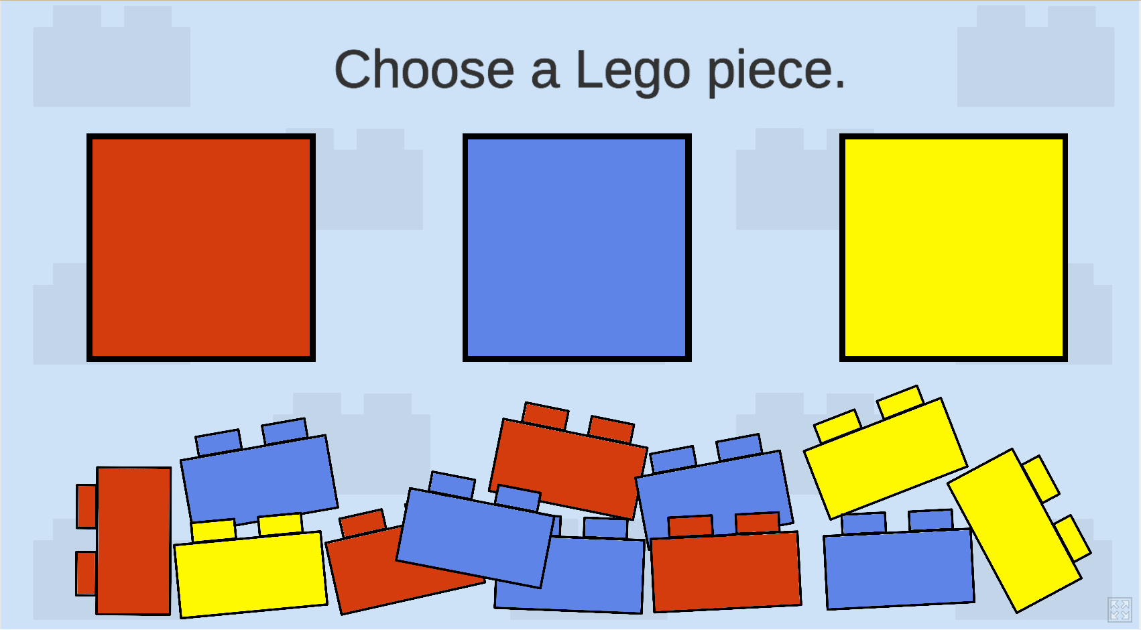
Game 2 (continued)
Players will pick each piece which binds it to the mouse.
Will then sort the pieces into the correct colored bins.

Slide 18
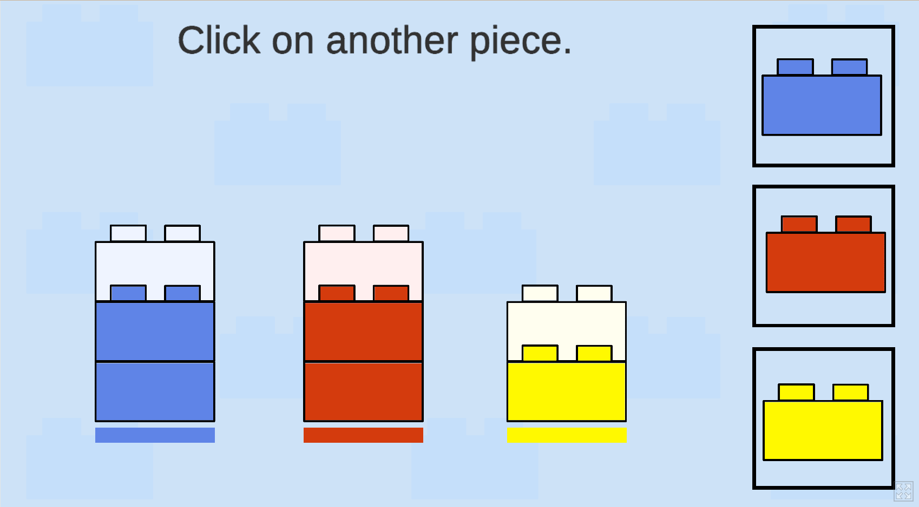
Game 2 (continued)
After they have sorted the pieces, they will then make the bar chart themselves.
The bar chart will be used to answer simple questions.

Slide 19
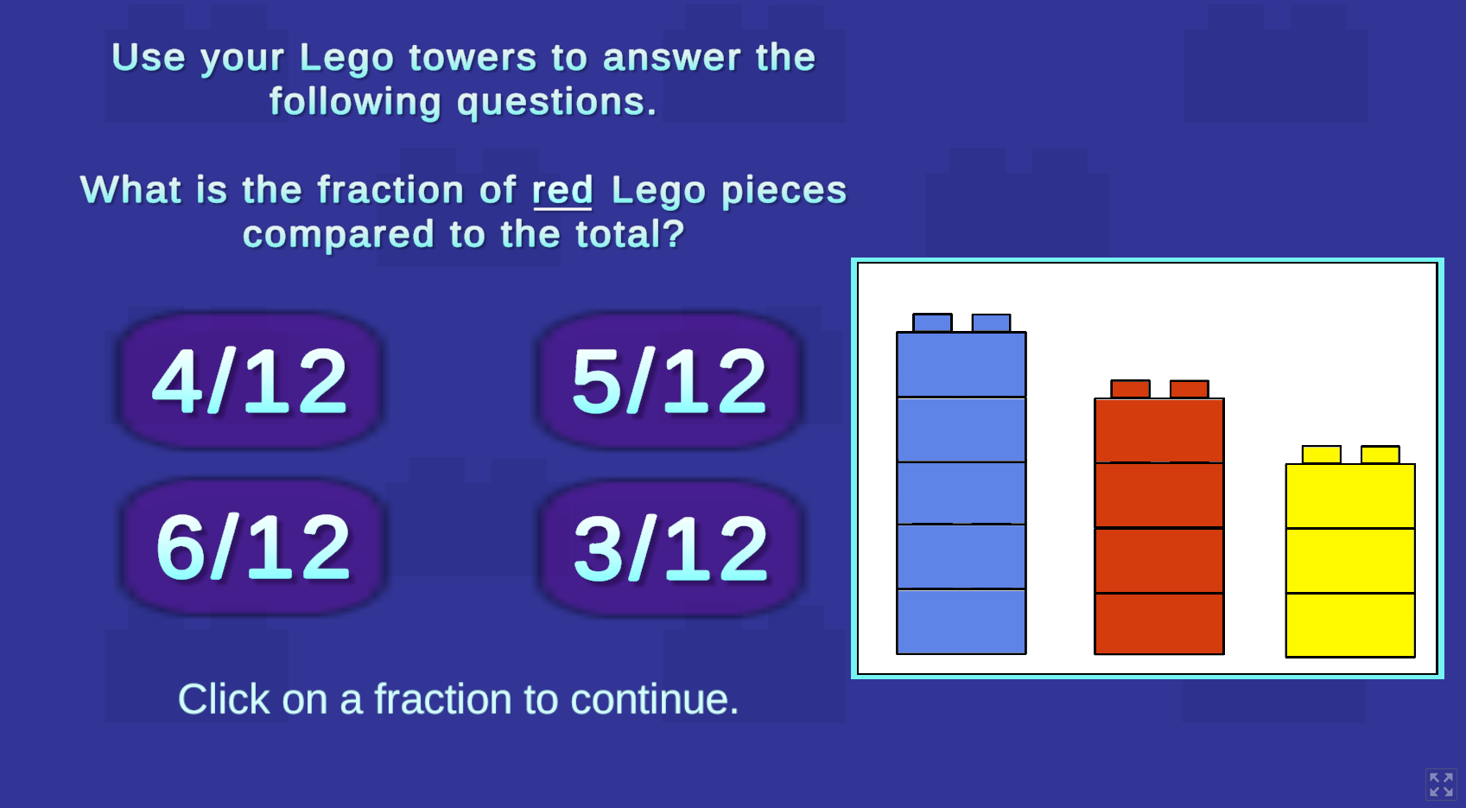
Game 2 (continued)
Basic fraction questions for 1st and 2nd graders.
Goal is for players to already be familiar with the data set, and be able to evaluate it.

Slide 20
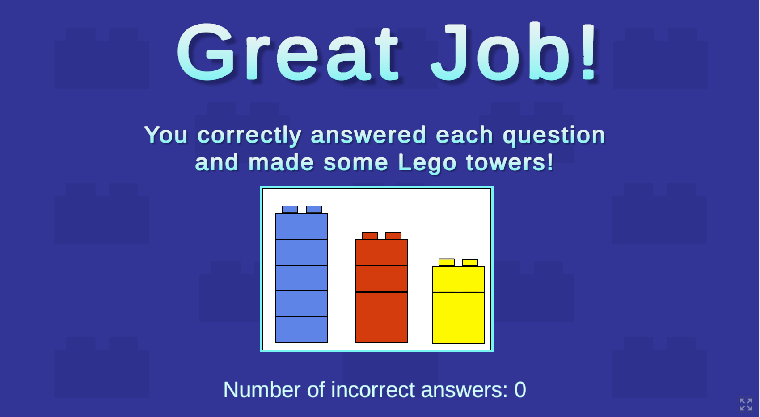
Game 2 (continued)

Slide 21
Game 3 - Math Game
Basic Idea: The user will be solving simple math problems. It will keep track of data such as correct and incorrect answers and number of questions.
After the game the user will:
Produce a dataset from playing the game.
Be able to visualize the data collected from the game in different ways.
Be able to understand concepts such as bar charts.
Demonstrate their knowledge through simple addition and subtraction problems.

Slide 22
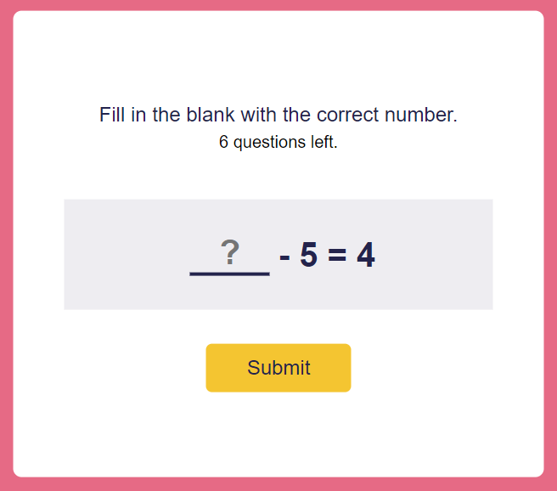
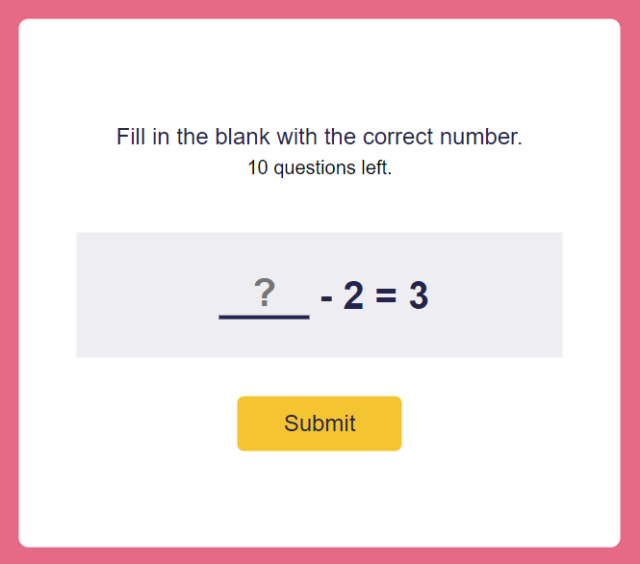
Game 3 (continued)

Slide 23
Game 4 - Math Game Hard
Basic Idea: The user will be solving simple math problems. It will keep track of data such as correct and incorrect answers and number of questions.
Harder Version of the Math Game for Higher Grades
Includes Multiplication and Operators, Addition and Subtraction
Correct and Incorrect Answers
Data Visualization

Slide 24
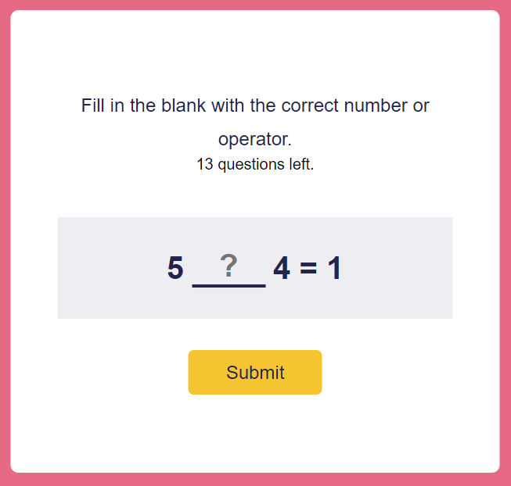
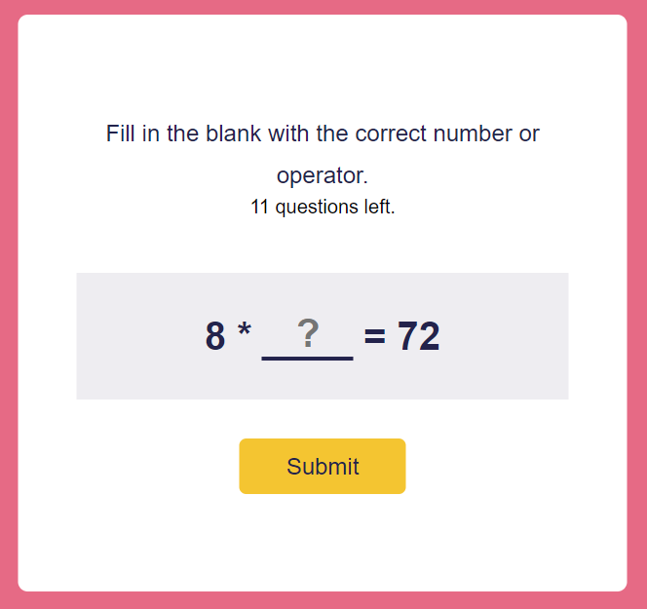
Game 4 (continued)

Slide 25
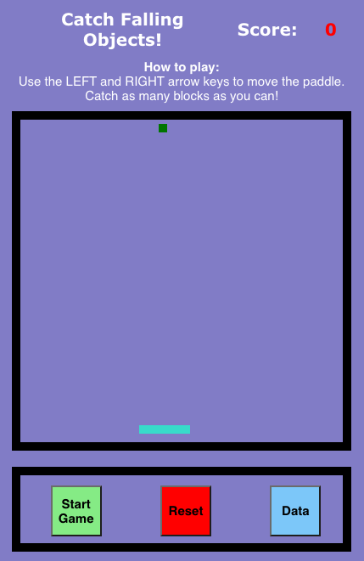
Game 5 - Catch Game
Basic Idea: The user will control a paddle using arrow keys to catch the falling colors. The user will be able to visually see the number of each color block caught in a bar chart.
After the game the user will:
Be familiar with bar charts
Be familiar with randomization

Slide 26
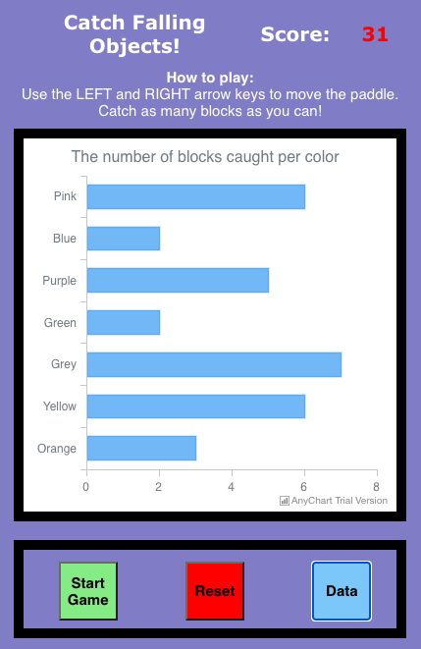
Game 5 (continued)
Added functionality for data visualization
Utilized AnyChart Javascript library to visualize data

Slide 27
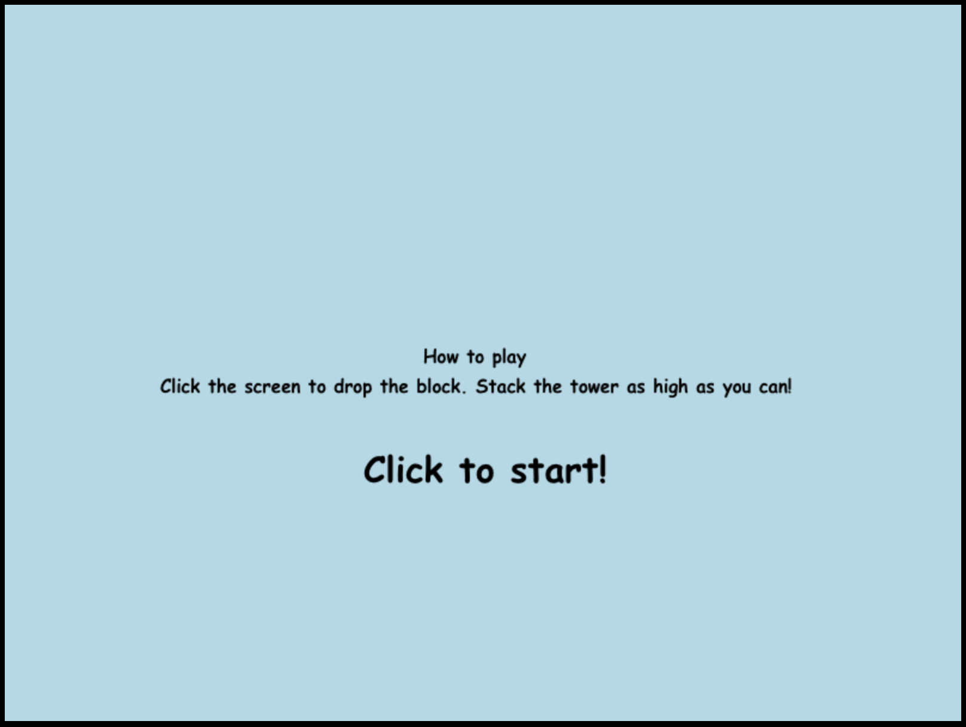
Game 6 - Tower Game
Basic Idea: The user will click to drop the moving block to create a tower. There will be three rounds with increasing difficulty.
After the game the user will:
Learn about line charts and how to interpret them.
Understand change over time graphs.

Slide 28
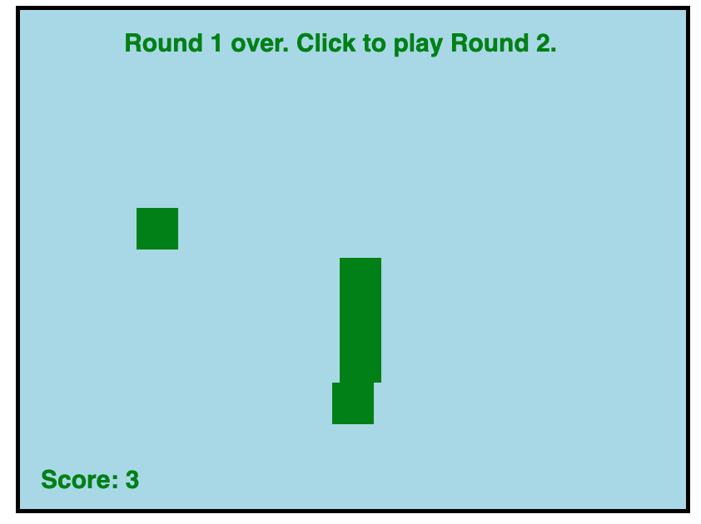
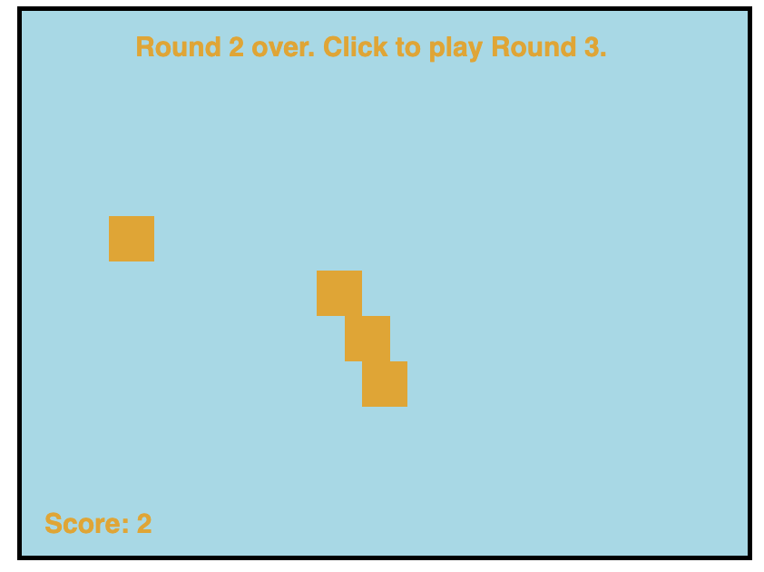
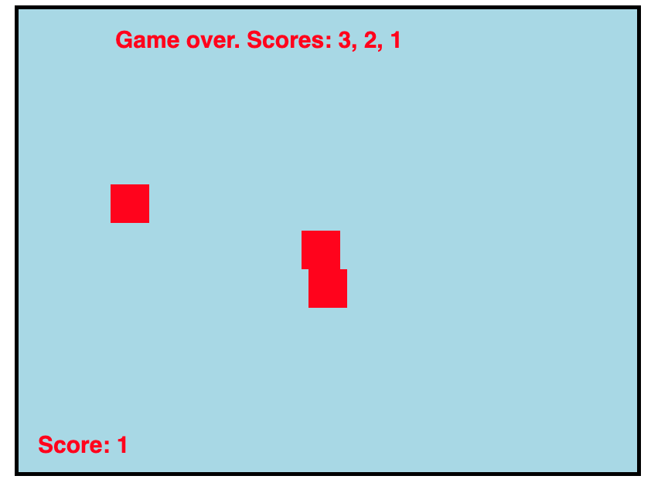
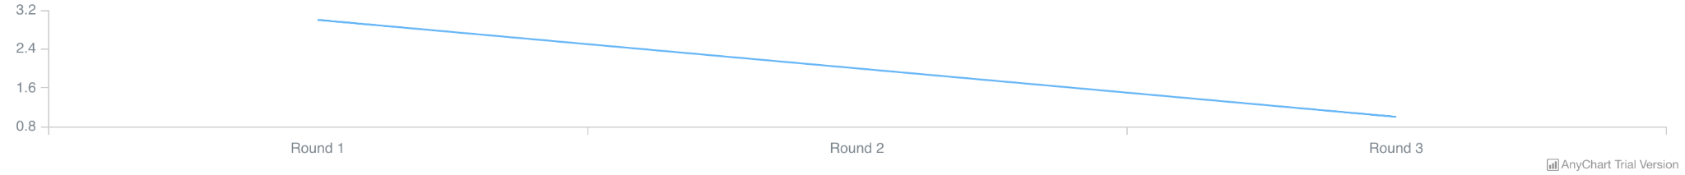
Game 6 (continued)
Utilized AnyChart Javascript library to visualize data

Slide 29
Lessons Learned
Problems | Solutions
User Interface | React
Game Development | Learn Unity, Build in JS
Game Integration with Website | WebGL
Coordination | Communicate When Working
Timeline | Plan Extra Week

Slide 30
Future Work
Addition of more games
Data visualization and analytics lessons
Backend and database integration

Slide 31
Acknowledgements
Client:
Professor Sally Hamouda, Department of Computer Science
Professor:
Dr. Edward Fox, Ph.D, Department of Computer Science

Slide 32
References
https://www.anychart.com/products/anychart/docs/
https://reactjs.org/docs/getting-started.html
https://docs.unity3d.com/Manual/UnityManual.html
https://docs.unity3d.com/Manual/webgl-gettingstarted.html

