Slide 1

TEAM 4 : Language models, Classification and Summarization
CS5604: Information Storage and Retrieval
Under the guidance of Dr. Edward Fox
SMEs: Bipasha Banerjee, Sara Ahmadi
Team:
Kanad Naleshwarkar, Gayatri Bhatambarekar, Zeel Desai, Aishwarya Kumaran, Adithya Harish Srinivasan Manikandan, Shadab Haque
5 December 2023, Blacksburg, VA, 24061, USA

Slide 2
Classification - Summary of tasks
Evaluation of previous implementation.
Fine-tuned the SciBERT^{[1]} model on the 50k abstract-label dataset.
Addressed label imbalance problem by assigning weightage to each label.
Classifier model now provides output in accordance with ProQuest level-2 subject categories.
Implemented batch processing to speed up the inference from new model.

Slide 3
SciBERT Classification - Results
Average F1 score on test set using SciBERT^{[1]}: 0.74
Average loss (BCEWithLogitsLoss^{[2]}): 0.72

Slide 4
Classification - Sample Output
Sample ETD ID: 75199
Title: “Faith and politics: The socio-political discourses engaged by Mexican ex-voto paintings from the nineteenth-century and beyond.”
Abstract: “The Universalis Ecclesiae of 1508 authorized Spanish colonization of the Americas in return for the conversion of native populations to Christianity. From its inception therefore, the Mexican nation lived an alliance between Church and State. This alliance promoted the transfer of Castilian Catholicism to American shores. Catholic practices, specifically the ex-voto tradition, visualize this intermingling of religion and politics. The ex-voto is a devotional painting that expresses…”
Model output: {'History': '0.63', 'Fine and performing arts': '0.44'}

Slide 5
SciBERT Classification Statistics
Time taken to fetch 1000 title-abstract pairs from the APIs: 73.7 sec
Time taken for inference on 1000 title-abstract pairs: 2.4 sec

Slide 6
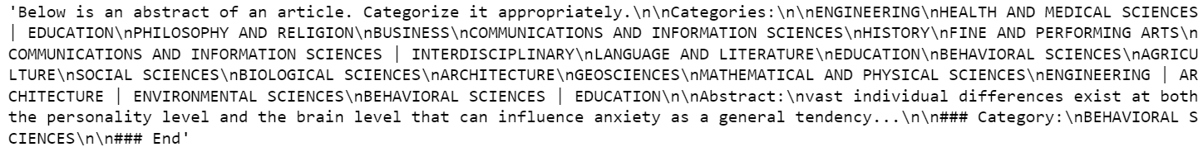
Classification using LLaMA 2
Approach to overcome class imbalance:
  Oversampling
Removed all the rows having no abstracts.
The structure of the prompts is as follows:

Slide 7
Classification using LLaMA 2
Fine-tuned Llama-2-7b-chat-hf.
Trained it on 150000 oversampled data for a total of 1 epoch.
Metric | Value (%)
Accuracy | 48.31
Precision | 68.74
Recall | 48.31
F1 Score | 52.85
Table 1: LLaMA 2 classification evaluation metrics.

Slide 8
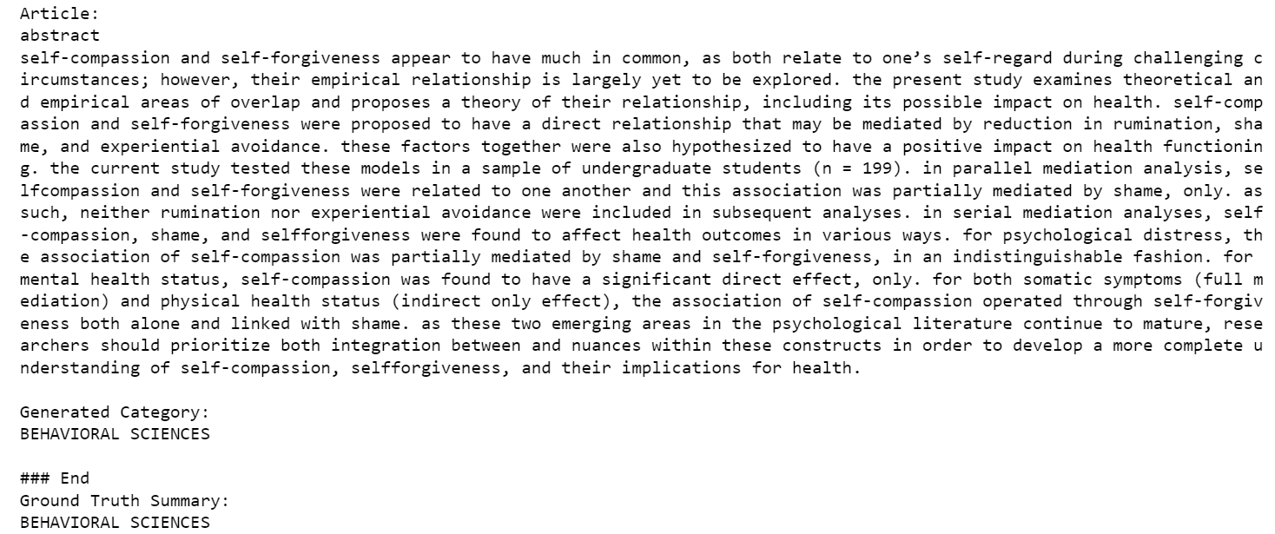
LLaMA 2 Classification Sample Output

Slide 9
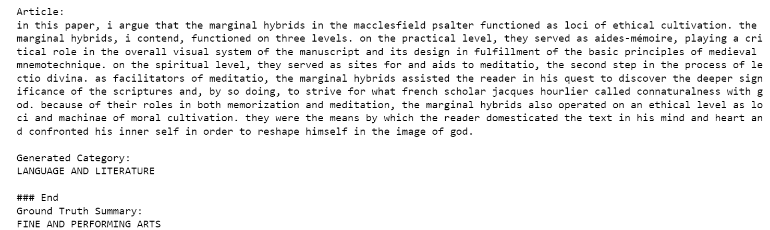
LLaMA 2 Classification Sample Output

Slide 10
Classification - Evaluation
SciBERT model for classification outperformed LLaMA 2 (F1 score 0.74 for SciBERT vs. 0.52 for LLaMA 2).
SciBERT was significantly faster to get inference on title-abstract pairs than LLaMA 2.

Slide 11
Classification - Future Work
Speeding up inference process using Kafka.
Running classification on chapter summaries.

Slide 12
Summarization - Summary of tasks
We have used 5 models to evaluate generated summaries:
TextRank (Non-transformer model)
LexRank (Non-transformer model)
LSA (Non-transformer model)
BigbirdPegasus (Transformer model)
LLaMA 2 7B
We have used multiple ETDs as input and we are able to successfully generate summaries of each ETD.

Slide 13
Summarization - summary of tasks
Analysed the previous year team’s code and improved the models.
Worked on 5 models to generate summaries from input PDFs.
Made summaries cleaner by removing unnecessary words (stopwords) for all models.
Checked all the model performance using ROUGE score for precision, recall, and F1 metrics^{[4]}.

Slide 14
Instruction Tuning for LLaMA 2
The arXiv and Booksum datasets were used for fine-tuning.
The model used was LLaMA-2-7B.
The maximum sequence used was 4096.
For removing noise from the arXiv dataset:
  Removed citations @xcite or @xmath.
  Removed LaTeX notations.
  Removed references starting with arXiv or DOI.
The text field contains a prompt, article and the abstract.
Text field is given as input to the model for fine-tuning.

Slide 15
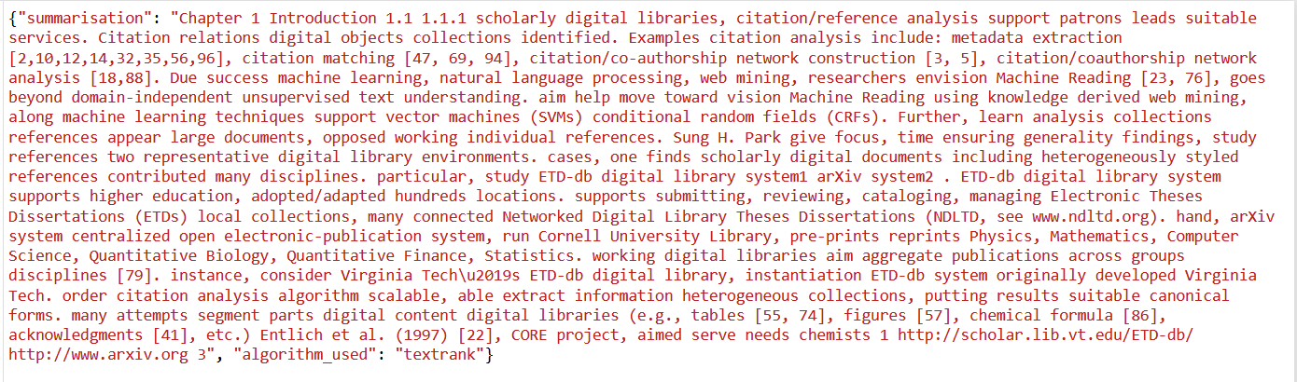
Summarization - TextRank
TextRank^{[3]} is an algorithm used in Natural Language Processing (NLP) for extractive summarization and keyword extraction. It's based on the PageRank algorithm, which was originally used by Google to rank web pages in search results. We used the chapter titled “Discipline-Independent Text Information Extraction from Heterogeneous Styled References Using Knowledge from the Web”. The summarized output is shown in Fig. 1.
Fig. 1: Summary using TextRank

Slide 16
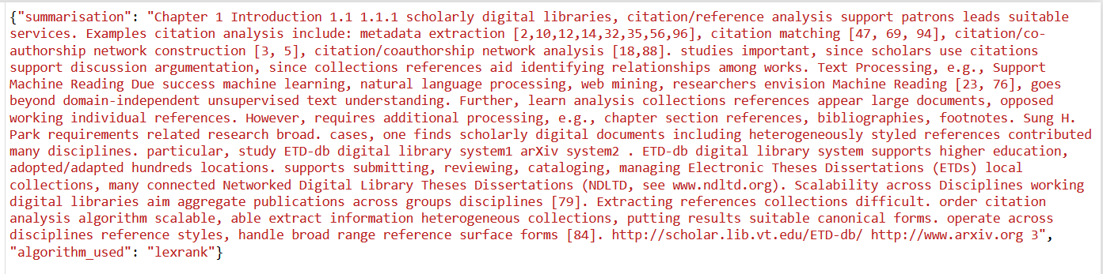
Summarization - LexRank
LexRank is a graph-based algorithm used in text summarization to identify and extract key sentences from a document. It's an extractive summarization technique, meaning it selects important sentences from the input text to create a summary. The summarized output is shown in Fig. 2.
Fig. 2: Summary using LexRank

Slide 17
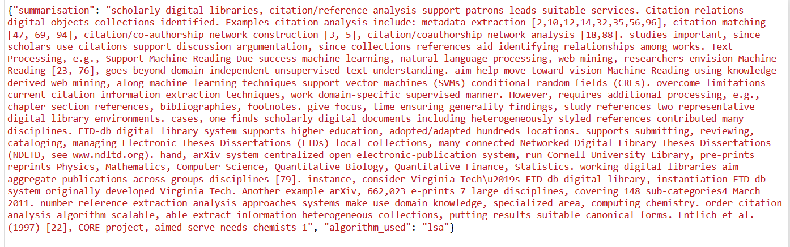
Summarization - LSA
Latent Semantic Analysis (LSA) can be used for text summarization, particularly for extractive summarization, where the goal is to select a subset of sentences from a document to create a summary. The summarized output is shown in Fig. 3.
Fig. 3: Summary using LSA

Slide 18
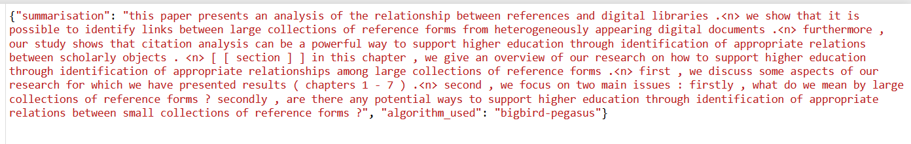
Summarization - BigBirdPegasus
BigBird^{[5]} is designed to handle long sequences, making it well-suited for tasks that involve lengthy documents and text summarization. It is particularly useful for extractive summarization tasks where the goal is to select important sentences or passages from a document to create a summary.The summarized output is shown in Fig. 4.
Fig. 4: Summary using BigbirdPegasus

Slide 19
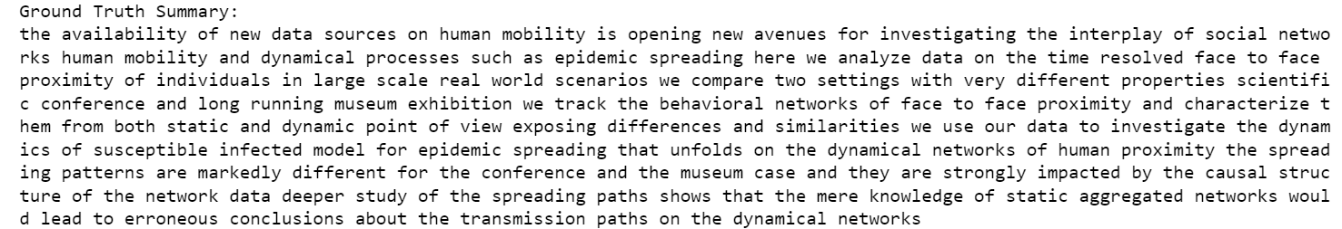
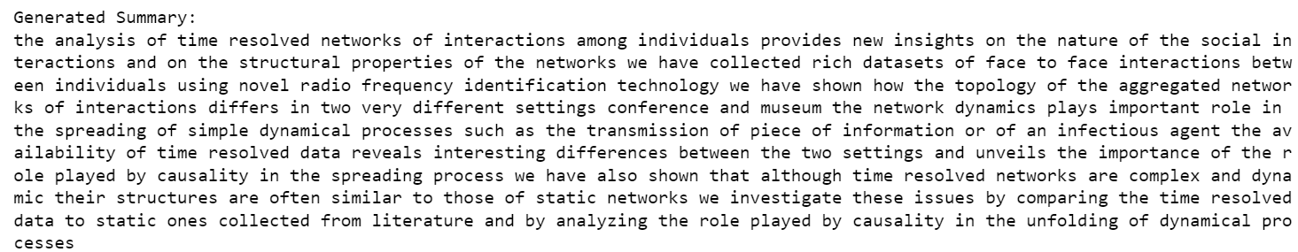
Instruction Tuning for Summarization

Slide 20
Evaluation Metrics - ROUGE-1 score
We used the ROUGE score method to assess the quality of the summaries generated by our models. The results of this evaluation are presented in Table 2.
Model Name | F1 | Recall | Precision
Text Rank | 0.28 | 0.31 | 0.25
Lex Rank | 0.26 | 0.34 | 0.22
LSA | 0.29 | 0.38 | 0.23
Big Bird Pegasus | 0.235 | 0.206 | 0.73
Table 2: Evaluating models using ROUGE-1 scores

Slide 21
Evaluation Metrics - ROUGE-2 score
Table 3 depicts ROUGE-2 scores. The reference summary is manually generated summary.
Model Name | F1 | Recall | Precision
Text Rank | 0.092 | 0.103 | 0.083
Lex Rank | 0.081 | 0.103 | 0.067
LSA | 0.08 | 0.10 | 0.60
Big Bird Pegasus | 0.029 | 0.25 | 0.34
Table 3: Evaluating models using ROUGE-2 scores

Slide 22
Evaluation Metrics - ROUGE-L score
Table 4 depicts ROUGE-L scores. The reference summary is manually generated summary.
Model Name | F1 | Recall | Precision
Text Rank | 0.156 | 0.175 | 0.141
Lex Rank | 0.141 | 0.180 | 0.117
LSA | 0.14 | 0.18 | 0.11
Big Bird Pegasus | 0.141 | 0.123 | 0.164
Table 4: Evaluating models using ROUGE-L scores

Slide 23
Evaluation - ROUGE-1 score (abstract as reference summary)
Table 5 depicts ROUGE-1 scores. The reference summary is abstract of the chapter.
Model Name | F1 | Recall | Precision
Text Rank | 0.56 | 0.45 | 0.76
Lex Rank | 0.51 | 0.39 | 0.74
LSA | 0.46 | 0.56 | 0.70
Big Bird Pegasus | 0.10 | 0.08 | 0.55
Table 5: Evaluating models with respect to abstract using ROUGE-1 scores

Slide 24
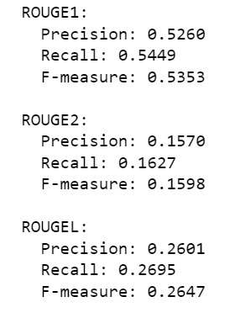
Instruction-tuning for Summarization
ROUGE scores for the previous summary:
Train with more maximum sequence tokens for improvement in evaluation score.

Slide 25
Evaluation Results
We used ROUGE (Recall-Oriented Understudy for Gisting Evaluation) metrics to check how good our text summaries are. These metrics helped us to see if the summaries are good or not based on ROUGE-1, ROUGE-2 and ROUGE-L scores indicating precision, recall and F1 score. TextRank model outperformed other methods and gave the best results.
When we compared generated summaries to manually generated summaries we found that BigBirdPegasus model outperformed all the other models followed by the TextRank.
When we compared generated summaries with the abstract of the chapter we found that TextRank performed a lot better than other models.
Apart from using ROUGE, we manually reviewed the summaries, and summaries generated by TextRank were more appealing. Its summaries looked better to us, and it was also the quickest to generate summaries.
Currently we have decided to use TextRank as our main model for summarizing ETDs.

Slide 26
Summarization - Future Work
1. Model Improvements:
BigBirdPegasus: We did preprocessing, tokenization to remove stop words, but one could improve the accuracy further to generate more comprehensive and informative summaries.
LongFormer Model: It could be utilized and better fine-tuning can be done in order to increase the accuracy of the summaries. It could generate summaries that are not only informative but also meaningful and fluent.
LLaMA 2 Model: There could be more experimentation done with the structure of the input text while fine-tuning. It can also be run for a larger number of epochs.
2. Furthermore, to improve the model performance, the dataset size can be increased and extensive model tuning can be performed.
3. There can be an improvement to refine and develop evaluation metrics that provide a comprehensive assessment of summarization quality. Metrics like coherence, informativeness, and coverage could be utilized beyond traditional ROUGE scores.

Slide 27
References
[1] I. Beltagy, K. Lo, and A. Cohan. SciBERT: A Pretrained Language Model for Scientific Text. arXiv preprint arXiv:1903.10676, 2019. URL https://ar5iv.org/abs/1903.10676. (Accessed Dec 13, 2023).
[2] S. Imambi, K. B. Prakash, and G. R. Kanagachidambaresan. Pytorch. In K. B. Prakash and G. R. Kanagachidambaresan, editors, Programming with TensorFlow: Solution for Edge Computing Applications, pages 87–104. Springer International Publishing, Cham, 2021. URL https://doi.org/10.1007/978-3-030-57077-4_10. (Accessed Dec 13, 2023)
[3] R. Mihalcea and P. Tarau. TextRank: Bringing Order into Text. In D. Lin and D. Wu, editors, Proceedings of the 2004 Conference on Empirical Methods in Natural Language Processing, pages 404–411, Barcelona, Spain, 2004. Association for Computational Linguistics. URL https://aclanthology.org/W04-3252. (Accessed Dec 17, 2023).
[4] R. Nallapati, B. Zhou, C. Gulcehre, and B. Xiang. Abstractive text summarization using sequence-to-sequence RNNs and beyond. arXiv:1602.06023, 2016. URL https://arxiv.org/abs/1602.06023. (Accessed Dec 13, 2023).
[5] M. Zaheer, G. Guruganesh, K. A. Dubey, J. Ainslie, C. Alberti, S. Ontanon, P. Pham, A. Ravula, Q. Wang, L. Yang, and A. Ahmed. Big Bird: Transformers for Longer Sequences. In H. Larochelle, M. Ranzato, R. Hadsell, M. Balcan, and H. Lin, editors, Advances in Neural Information Processing Systems, volume 33, pages 17283–17297. Curran Associates, Inc., 2020. URL https://proceedings.neurips.cc/paper_files/paper/2020/file/c8512d142a2d849725f31a9a7a361ab9-Paper.pdf. (Accessed Dec 17, 2023).

Slide 28
THANK YOU

