Slide 1
Traffic Visualization Dashboard
By: Team 7:
Noneman, Brett | Borghese, Matt | Gabriel Worsley | Liao, Xinchen | Chen, Xi
Course: CS 4624 HyperText/Multimedia
Instructor: Mohamed Farag
Address: Virginia Tech, Blacksburg VA 24061
Date: Dec 4, 2024

Slide 2

Outline
Client
Problem
Motivation
Deliverables
Tech Stack
Scope Growth
Accomplishments
Demo
Challenges
Deployment
Lessons Learned
Contribution
Future Work
Questions

Slide 3

Client : Mohamed Farag
Dr. Farag is a research associate in the Center for Sustainable Mobility (CSM).
His research interests include intelligent transportation systems, connected/automated vehicles, C-V2X, machine learning, large-scale data analysis, large-scale system analysis and design, big data, and information retrieval.

Slide 4
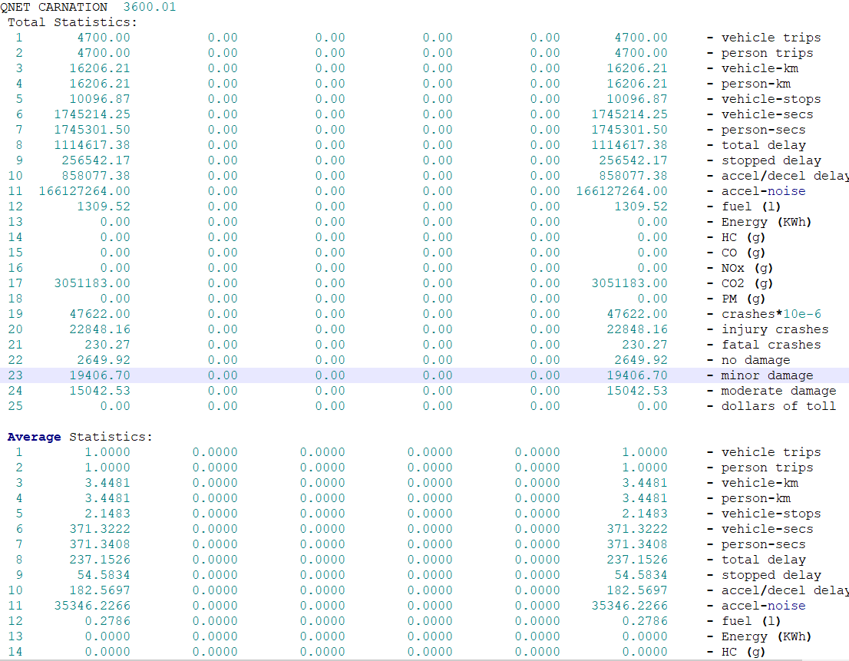

Problem
The Virginia Tech Transportation Institute has developed a Traffic Simulation Tool: https://sites.google.com/a/vt.edu/hrakha/software
It is hard to visualize input data for a traffic environment, from raw data.
It is harder to make meaningful observations from the raw output data.

Slide 5

Motivation
The goal is to build a visualization dashboard to creatively visualize the data of the Integration Traffic Simulator
The dashboard contains different charts that allow the end users to gain insights from the output data.

Slide 6
Deliverables
User Login and Token System
Back End Endpoint to Database Server Storage
Collection Uploads
Collection Selection
Parsing of Uploaded Files
Visualization Selection
Customizable Visualizations

Slide 7
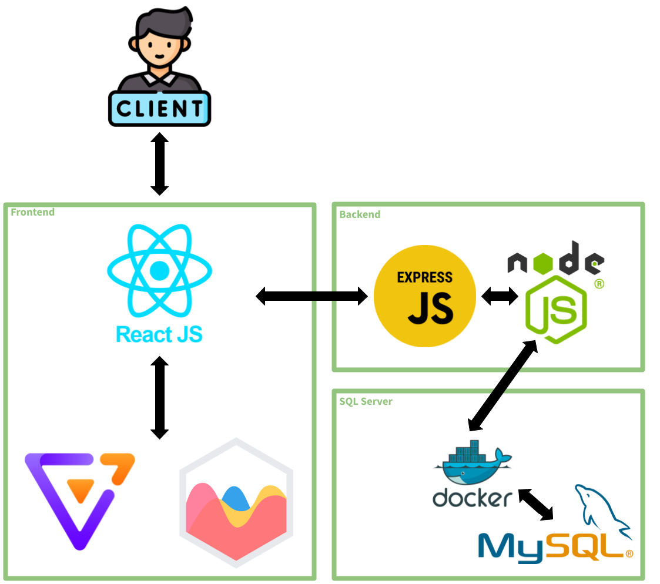
Technology Stack
React is our base for the front end. It uses Antv/Charts for help with visuals.
Node.js is our primary backend. Express js is the middle man communicating with React.
MySQL Server stores our data and is stored in a docker container for simple deployment.

Slide 8
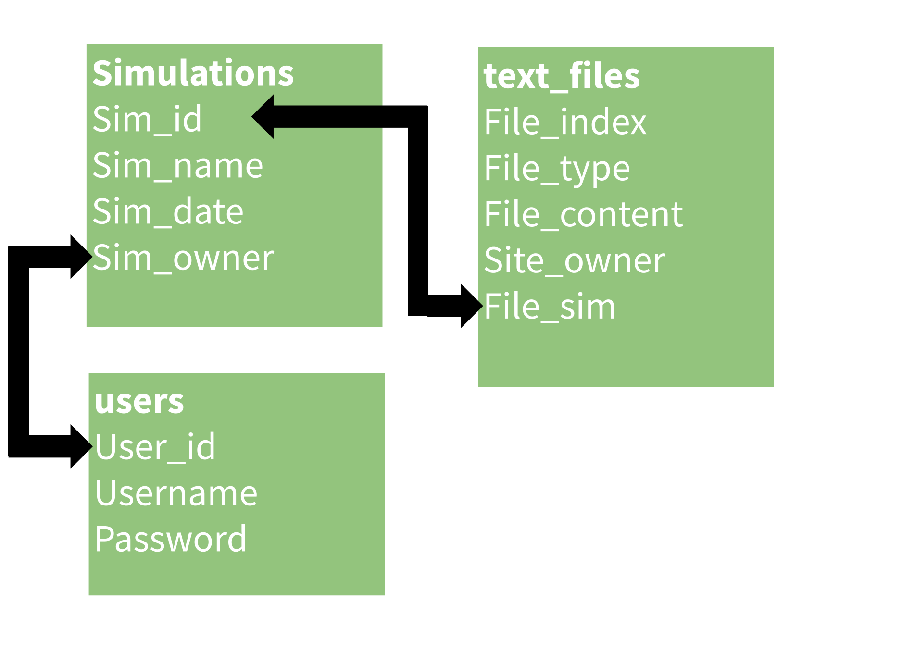
DB Schema

Slide 9

Scope Growth
Starting the group was using unfamiliar technologies, so completion seemed out of grasp.
The Goal was to set up a workable frontend and backend, which would allow visuals to be plugged in.
After the first month, goal was within sight, so the scope grew to make as many visuals as possible.
We were also asked to change from single file uploads, to zip uploads.

Slide 10

Accomplishments
Deliverables have been achieved!
There is a functioning user sign up/login interface, with tokening operations that span the front and backend. It looks good!
A protected route protects the home page from trespassers and a loading screen in between.
You can name and upload a zip file of the simulation data, where it is parsed in the backend, stored, and shown/reflected in the front end. There is even a cool loading animation for it.

Slide 11

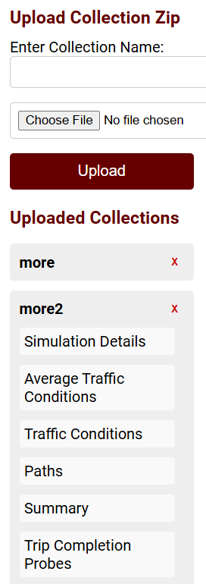
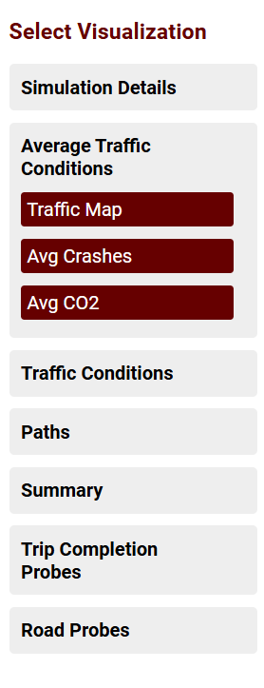
MORE Accomplishments
There is an interactive collection selection interface, that highlights the data types within.
A dynamic visualization window appear on collection selection, allowing for easy visualization choice. It only show visualizations you have data for.

Slide 12


Is the project done.
*Client Meetings*

Slide 13
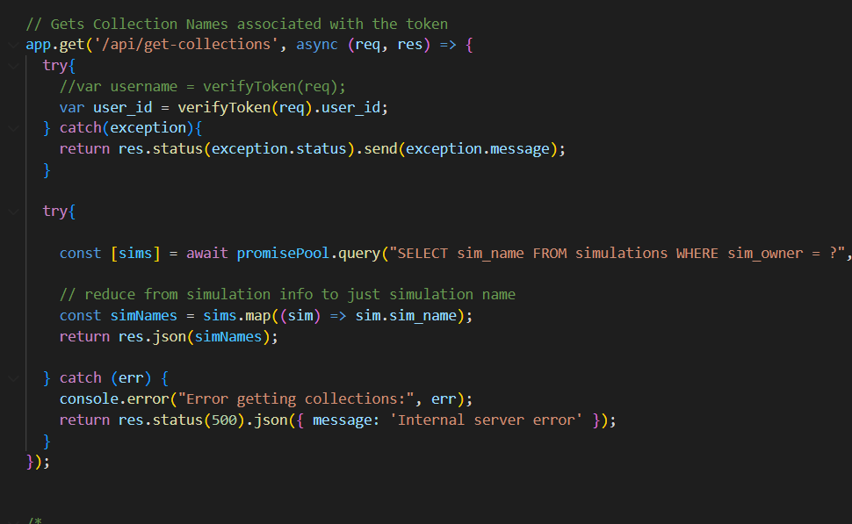
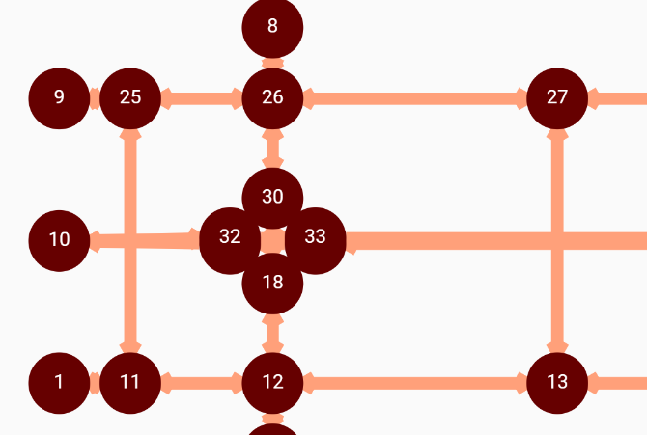
Yes Uhm… Wait, There’s More
There is at least one visualization for each file type : 10, 11, 12, 13, 15, 16, summary
We even designed a new graph to show the traffic mapped out, some visualizations build on this. Many are highly interactive, allowing interesting insights, and easy to query info.
Having a slide for each one is boring when we can demo and explain.

Slide 14


Demo Time!
Demo Video Given In Attached File Named : traffic_visual_demo.mkv

Slide 15

Challenges
We as a group for the most part were unfamiliar with Node js at first, so there was a time of learning at first that slowed our progress.
There were also much time messing with newer undocumented versions of Antv that also wasted much of our time.
Occasionally there were pushes that destroyed progress with Github, making paranoia checking commits, before pulling.

Slide 16

Challenges Cont.
We also only had one set of corresponding IO files from the simulator and some, single files unrelated to the rest.

Slide 17

Deployment
This was also a challenge.
First attempt was to move it as is, there were problems: Installing node js. Installing MySQL Server exclusively for my account.
After much trouble shooting and getting everything on docker locally it worked, but not on the server.
Peer/Farag help, enabled me to get Node js installed with
an older version of Node js. Luckily MySQL Server was best
in the docker and worked.

Slide 18
Lessons Learned
Docker is amazing for MySQL Server Deployment
Using older versions of libraries is always worth looking into, for installation issue and documentation if there are significant changes.
Leading a team looks different depending on your members.
Importance of planning

Slide 19

Contribution
Brett Noneman : Lead Front End Developer, Visualization Designer, and some Back End Assistance.
Matt Borghese : Strong Back End Development, especially Parsing, and Optimizing some systems.
Xinchen Liao : Visualization Designer of 12, 11, and the initial trenches of AntV learning.
Gabriel Worsley : Back End Developer, Front End Developer, Project Lead/Coordinator, Presentation Coordinator, Visualization Designer
Xi Chen : Visualization Designer of 10 and 13

Slide 20

Future Work
Make visualization dependant on not just output files, but also input files.
Read and Parse file 14 (We were not provided 14, mostly due to time and scope)
Read and Parse other input file to make/invent more meaningful kinds of graphs.
More unified visualizations
Notes:
-
-which visualization can be made
-

Slide 21

Future Work Part 2
Break up server.js into multiple logical files
Make Front End File Type names more flexible, currently tied to the backend naming scheme.
Force user logout, on token expiration, or refresh token, currently fine since nothing can happen on token expiration.
Database password encryption.

Slide 22
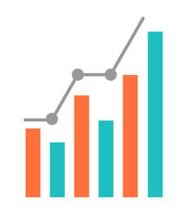
Summary File Improvement
Improving the graph to make it more intuitive
Comparison of summary files between collections
  Reworking the custom summary chart to display data from more than one collection for direct comparison of values

Slide 23
File 10 Improvement
Add bar chart to compare the Arrival Flow to the Saturation Flow
  Understand the level of traffic congestion by comparing actual flow to maximum capacity
Add pie chart and bar chart to show the percentages of Y-critical lane(%), Y-critical approach(%), and Y-critical sum(%)
  Highlight how critical lanes contribute to overall intersection efficiency.
Add line chart to illustrate the progression of phase over time, such as Phase Start (sec) to Phase End (sec), and highlight Green Phase (sec) and Intern Green (sec)
  Show how signal phases are sequenced and the duration of each phase

Slide 24
File 11 Improvement
Animation on the traffic map
  Add two way road icon on the edge
  Add cars on it, using number of cars showing traffic flow
Give pop information page more meaningful mini charts, which can show this value in this edge is low or high or the same compare to the one in the other edges

Slide 25
File 13 Improvements
Make tooltip and popup data more meaningful for users analyzing the minimum path tree.
Replace or supplement current edge information with number of crashes per edge to aid in path selection.
Highlighting crash statistics helps users prioritize safer routes while finding the minimum path tree.
Provides actionable insights for informed decision-making.

Slide 26
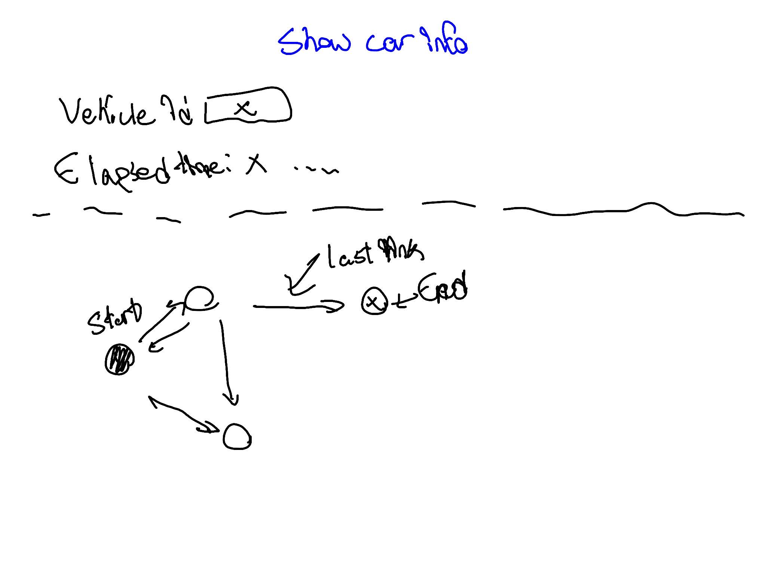
File 15 Improvement
Car Information Filter Ideally should be able to show the id of every vehicle ID, used. This is so it could be used in the second planned graph
It would comparisons on a smaller scope of cars showing their entire routes and perhaps contrasting to another car.
May require a backend update to query for vehicle ID.

Slide 27
File 16 Improvement
Additional, more detailed visualizations to provide deeper insight into:
  Fuel use
  Greenhouse gas emissions
  Crash rates, and injury rates/fatalities for those crashes
  Speed
Speed heatmaps, safety maps, speed maps, emission maps, etc.

Slide 28

Questions?

Slide 29



Acknowledgements
To Professor Farag for all his help and support throughout the semester!

