Slide 1
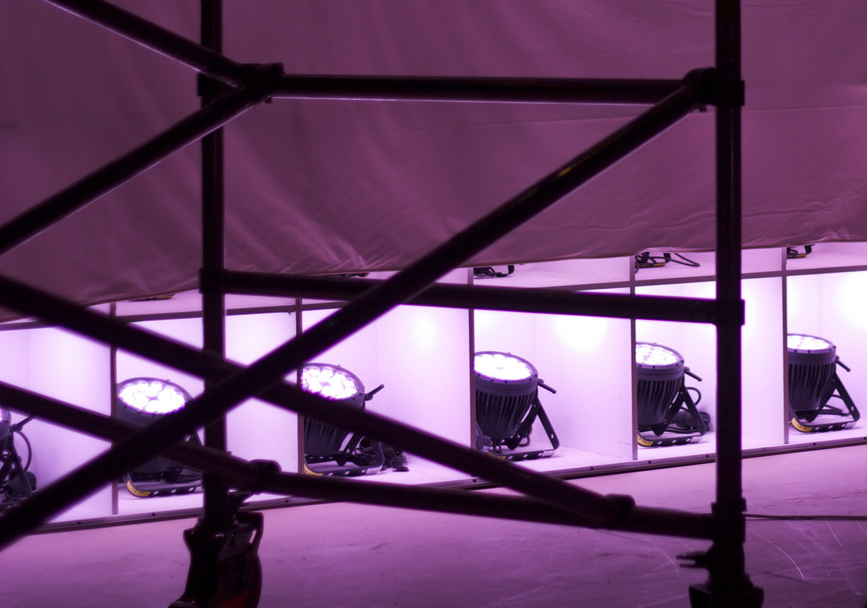
Behind the Scenes of the Fair Use Week Exhibit
How We Made Our
Copyright Decisions
Authors: Virginia Pannabecker, Robert Sebek, Anita Walz, Scott Fralin, Keith Gilbertson
Unless otherwise noted, content in this presentation is licensed for use as CC BY 4.0
“Backstage” image by Pierluigi Dalla Rosa, via Flickr, CC BY-SA 2.0 license.

Slide 2
Presentation Plan
Examples of copyright decisions from the Fair Use Exhibit Team, Virginia Tech, 2016
Discussion
Questions about exhibit decisions
Participant experiences in using copyrighted materials
Visit exhibit on the 2nd floor

Slide 3
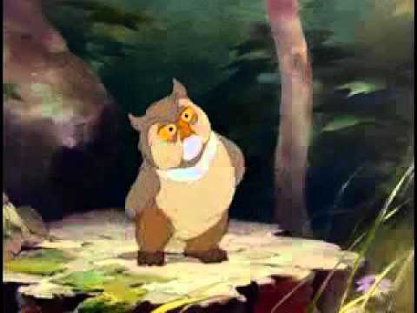
Example 1 - Re-Upload of Video to Add Captions / Transcription
Re-Upload of “Fair(y) Use Tale” video by Professor Eric Faden to add captions / transcription

Slide 4
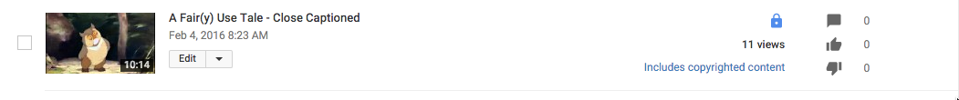
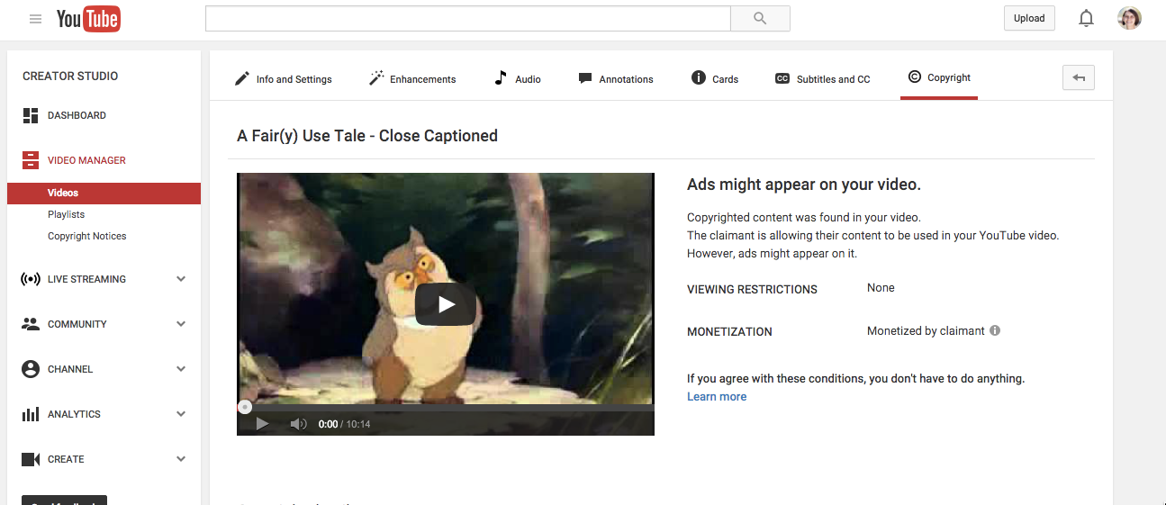
YouTube Copyright Notice
Received a notice of copyrighted content from YouTube and a request to approve ads.

Slide 5
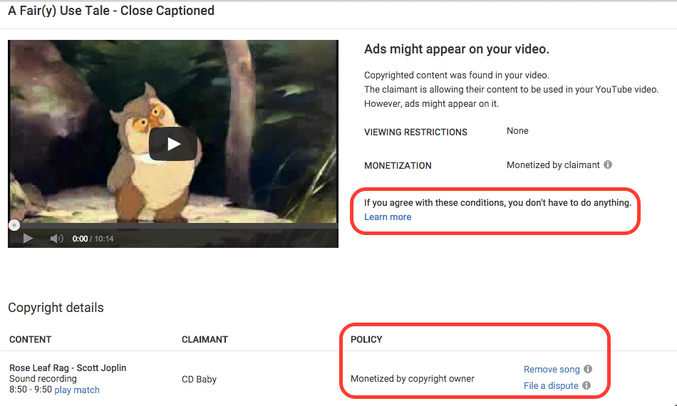
YouTube Copyright Notice - Options
Notes:
YouTube

Slide 6
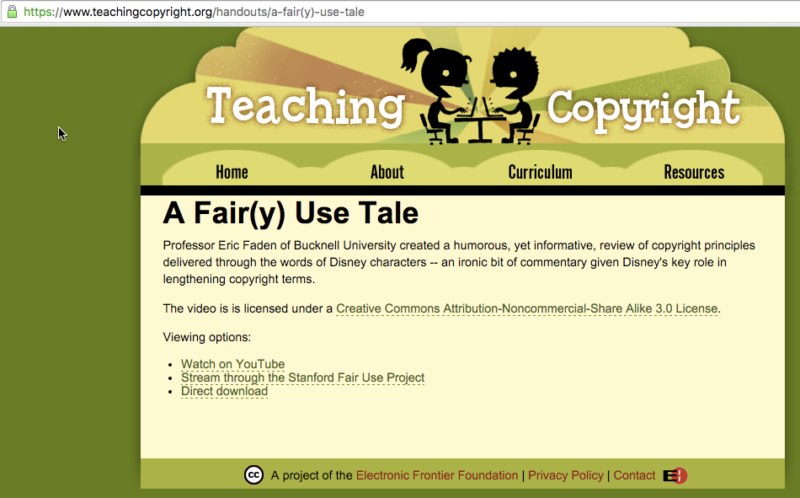
YouTube Copyright Notice - Decision
Research
Notes:
Reviewed the terms of the original video file

Slide 7
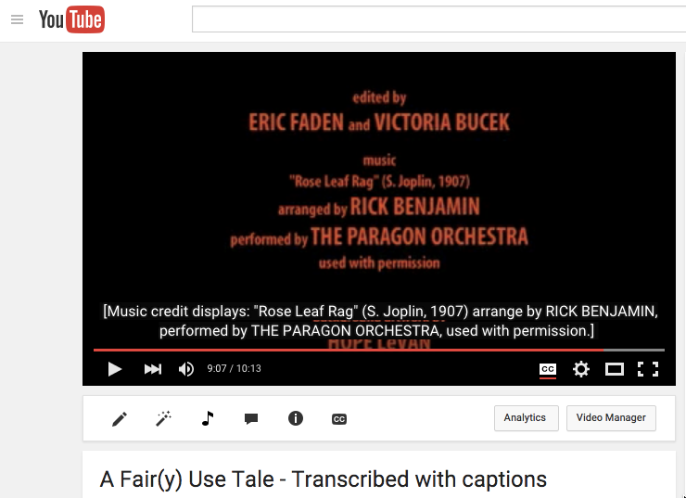
YouTube Copyright Notice - Decision
Research
Notes:
Reviewed the permission statement in the video
Considered the length of the song in the video (short portion, only during credits)

Slide 8
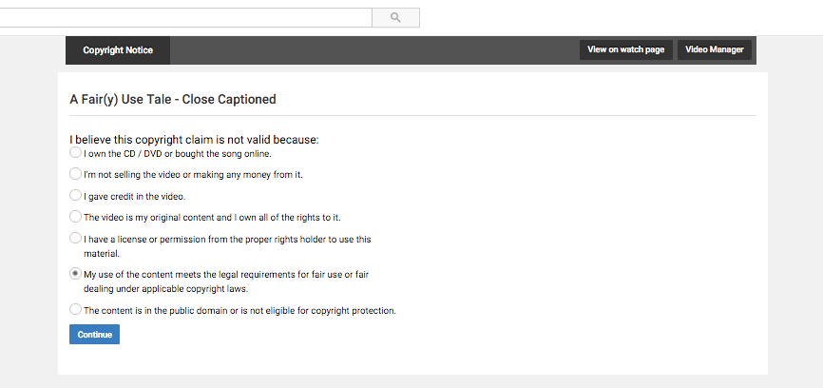
YouTube Copyright Notice - Decision
File a Dispute
Notes:
Chose to dispute the claim and state the reason as being that the use was a fair use

Slide 9
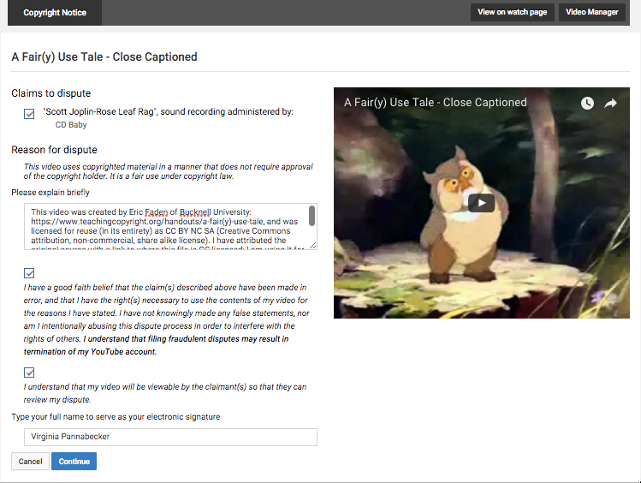
YouTube Copyright Notice - Decision
File a Dispute
Notes:
Provided a description and analysis of how the use was a fair use

Slide 10
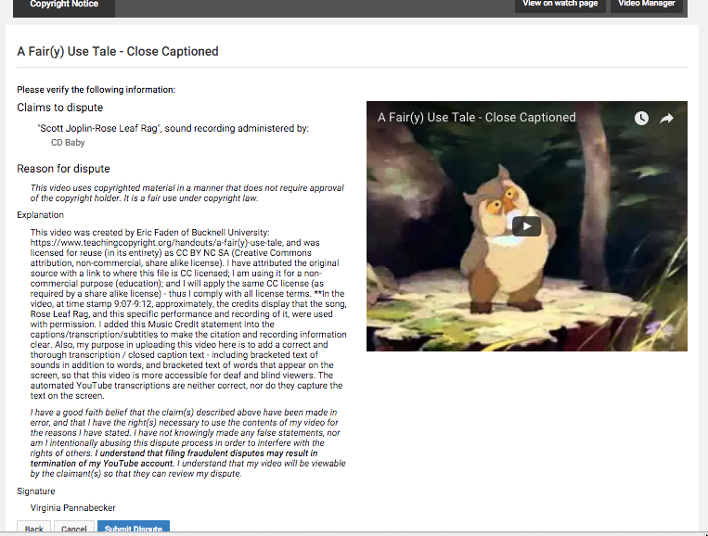
YouTube Copyright Notice - Decision
File a Dispute
Notes:
Provided a description and analysis of how the use was a fair use

Slide 11
Additional Examples
Screenshots
Book cover image
CC License of Exhibit content

Slide 12
References
“Celebrate Fair Use Week at VT,” interactive exhibit. Created and designed by: Virginia (Ginny) Pannabecker, Anita Walz, Robert Sebek, Keith Gilbertson, and Scott Fralin; Panel Design by: Robert Sebek; Exhibit Implementation by: Scott Fralin
A Fair(y) Use Tale by Professor Eric Faden, CC Licensed CC BY-NC-SA 3.0 license
A Fair(y) Use Tale by Professor Eric Faden, reuploaded to YouTube and transcriptions and captions added by Virginia Pannabecker, CC Licensed CC BY-NC-SA 3.0 license
Images:
“Backstage” image by Pierluigi Dalla Rosa, via Flickr, CC BY-SA 2.0 license.
Screenshots taken by Virginia Pannabecker using the Mac Grab utility
application

Slide 13
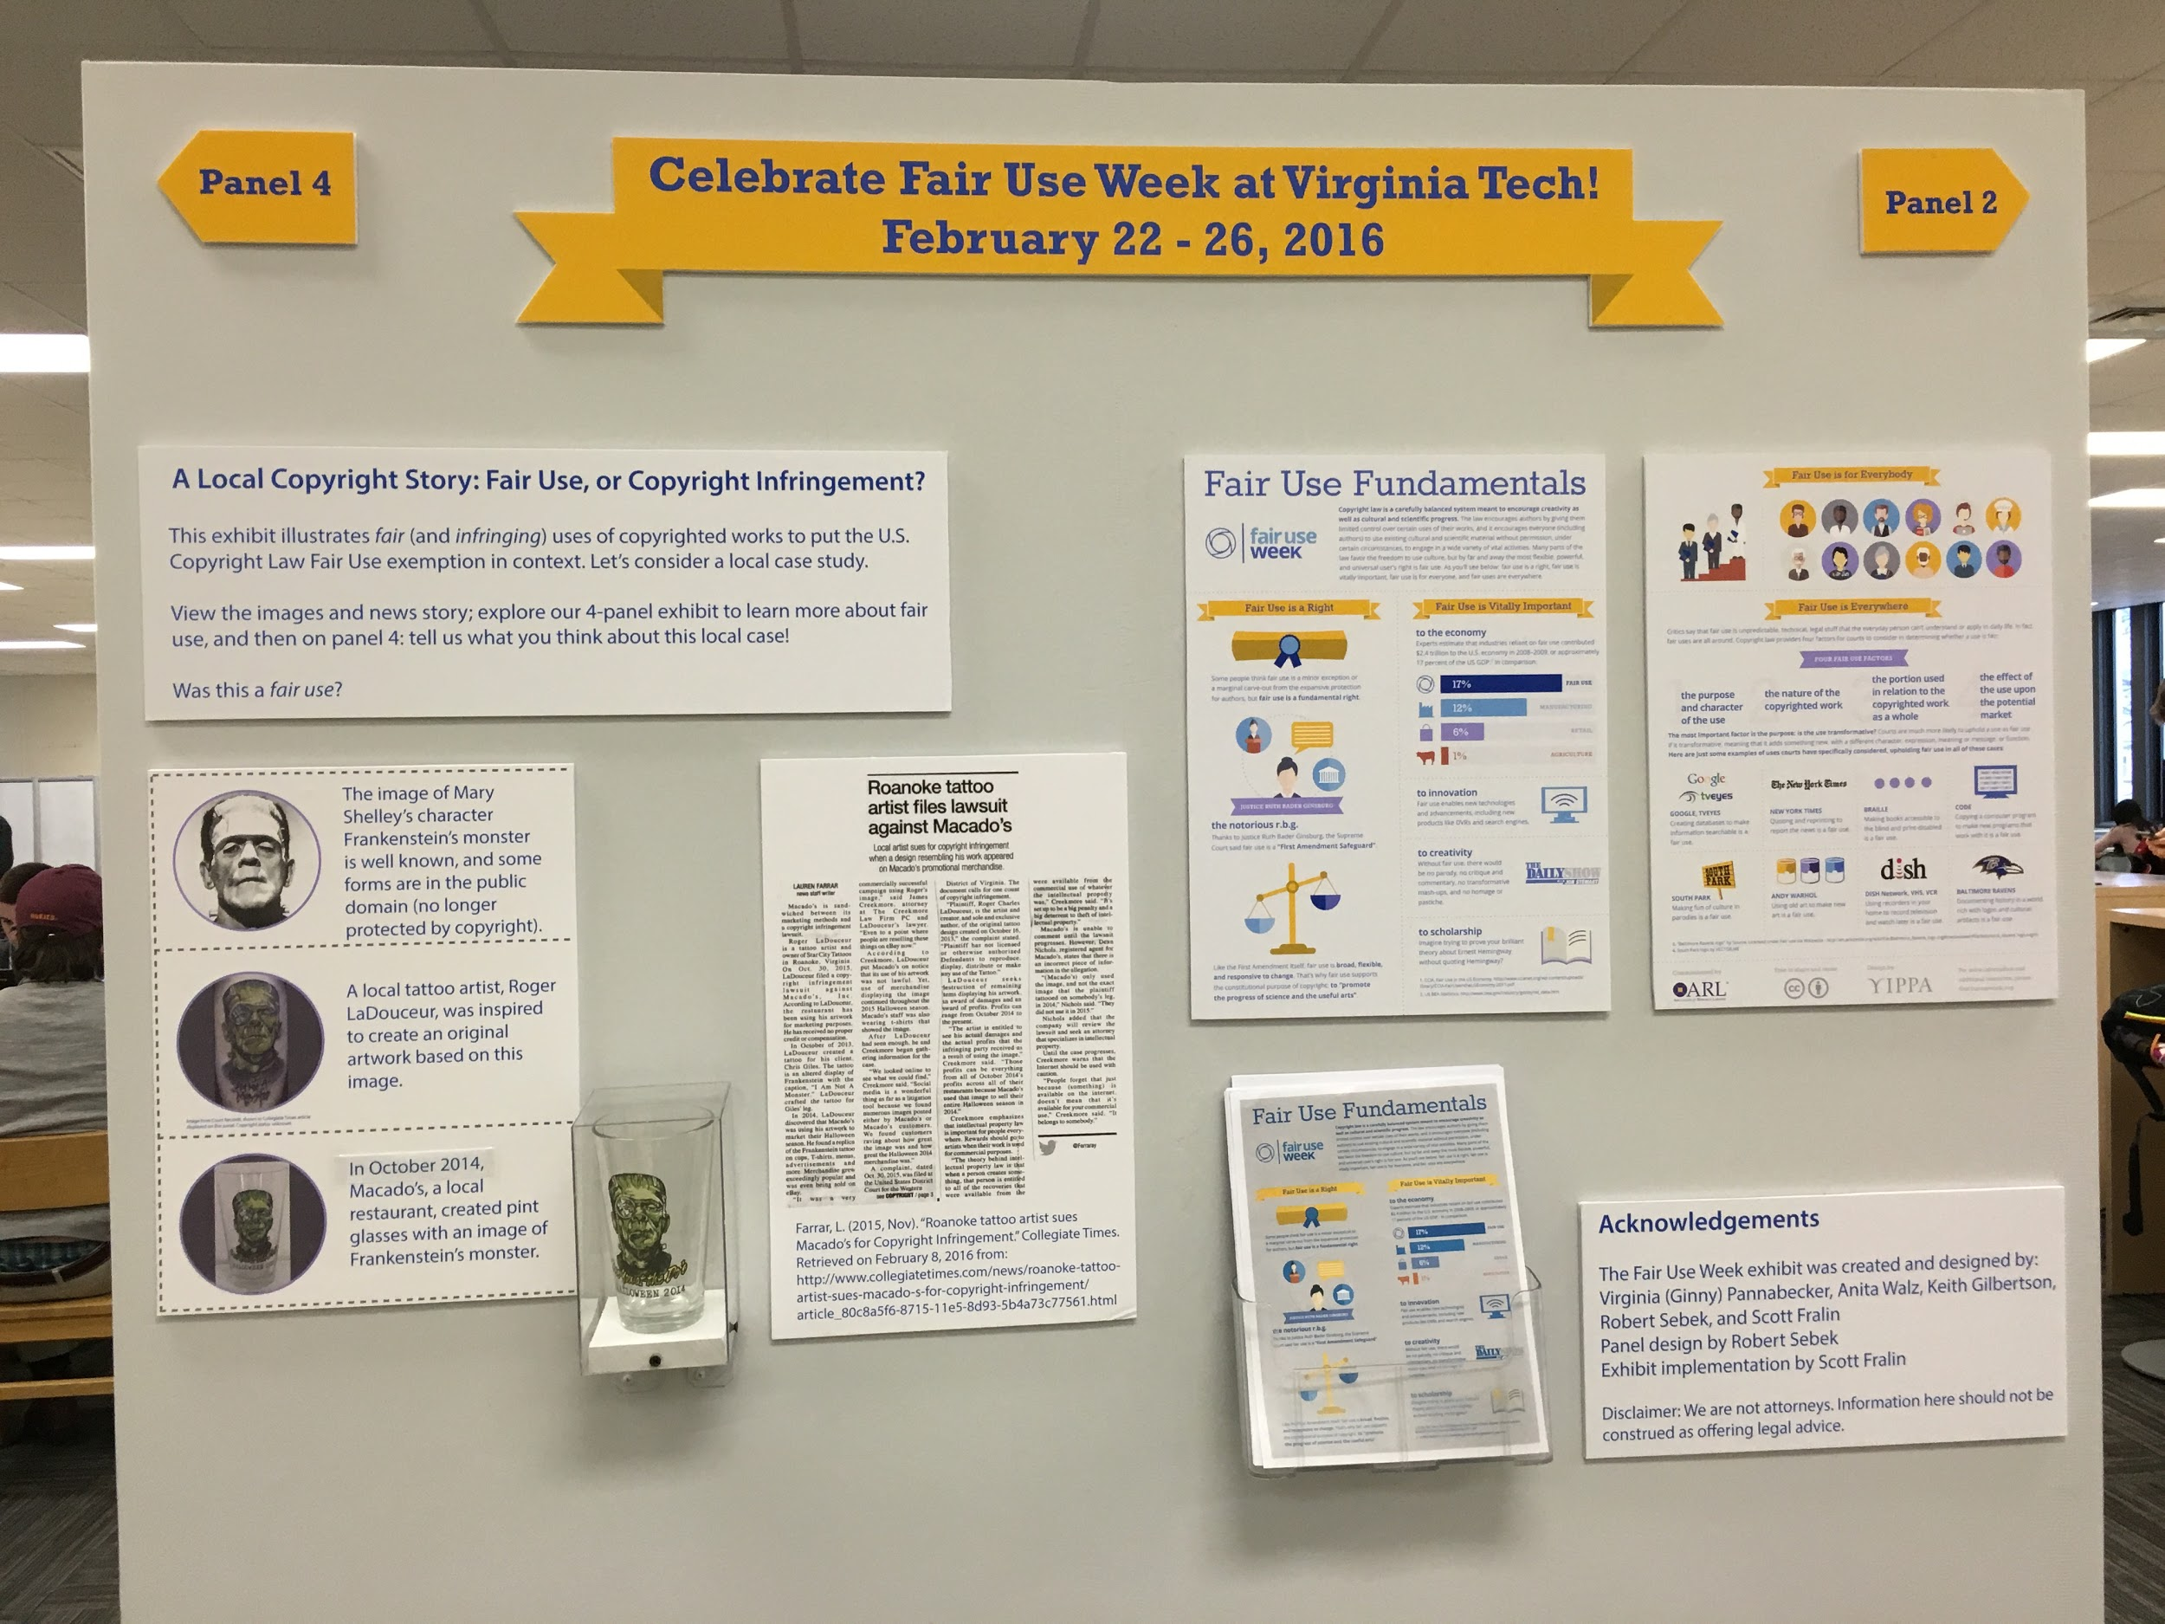
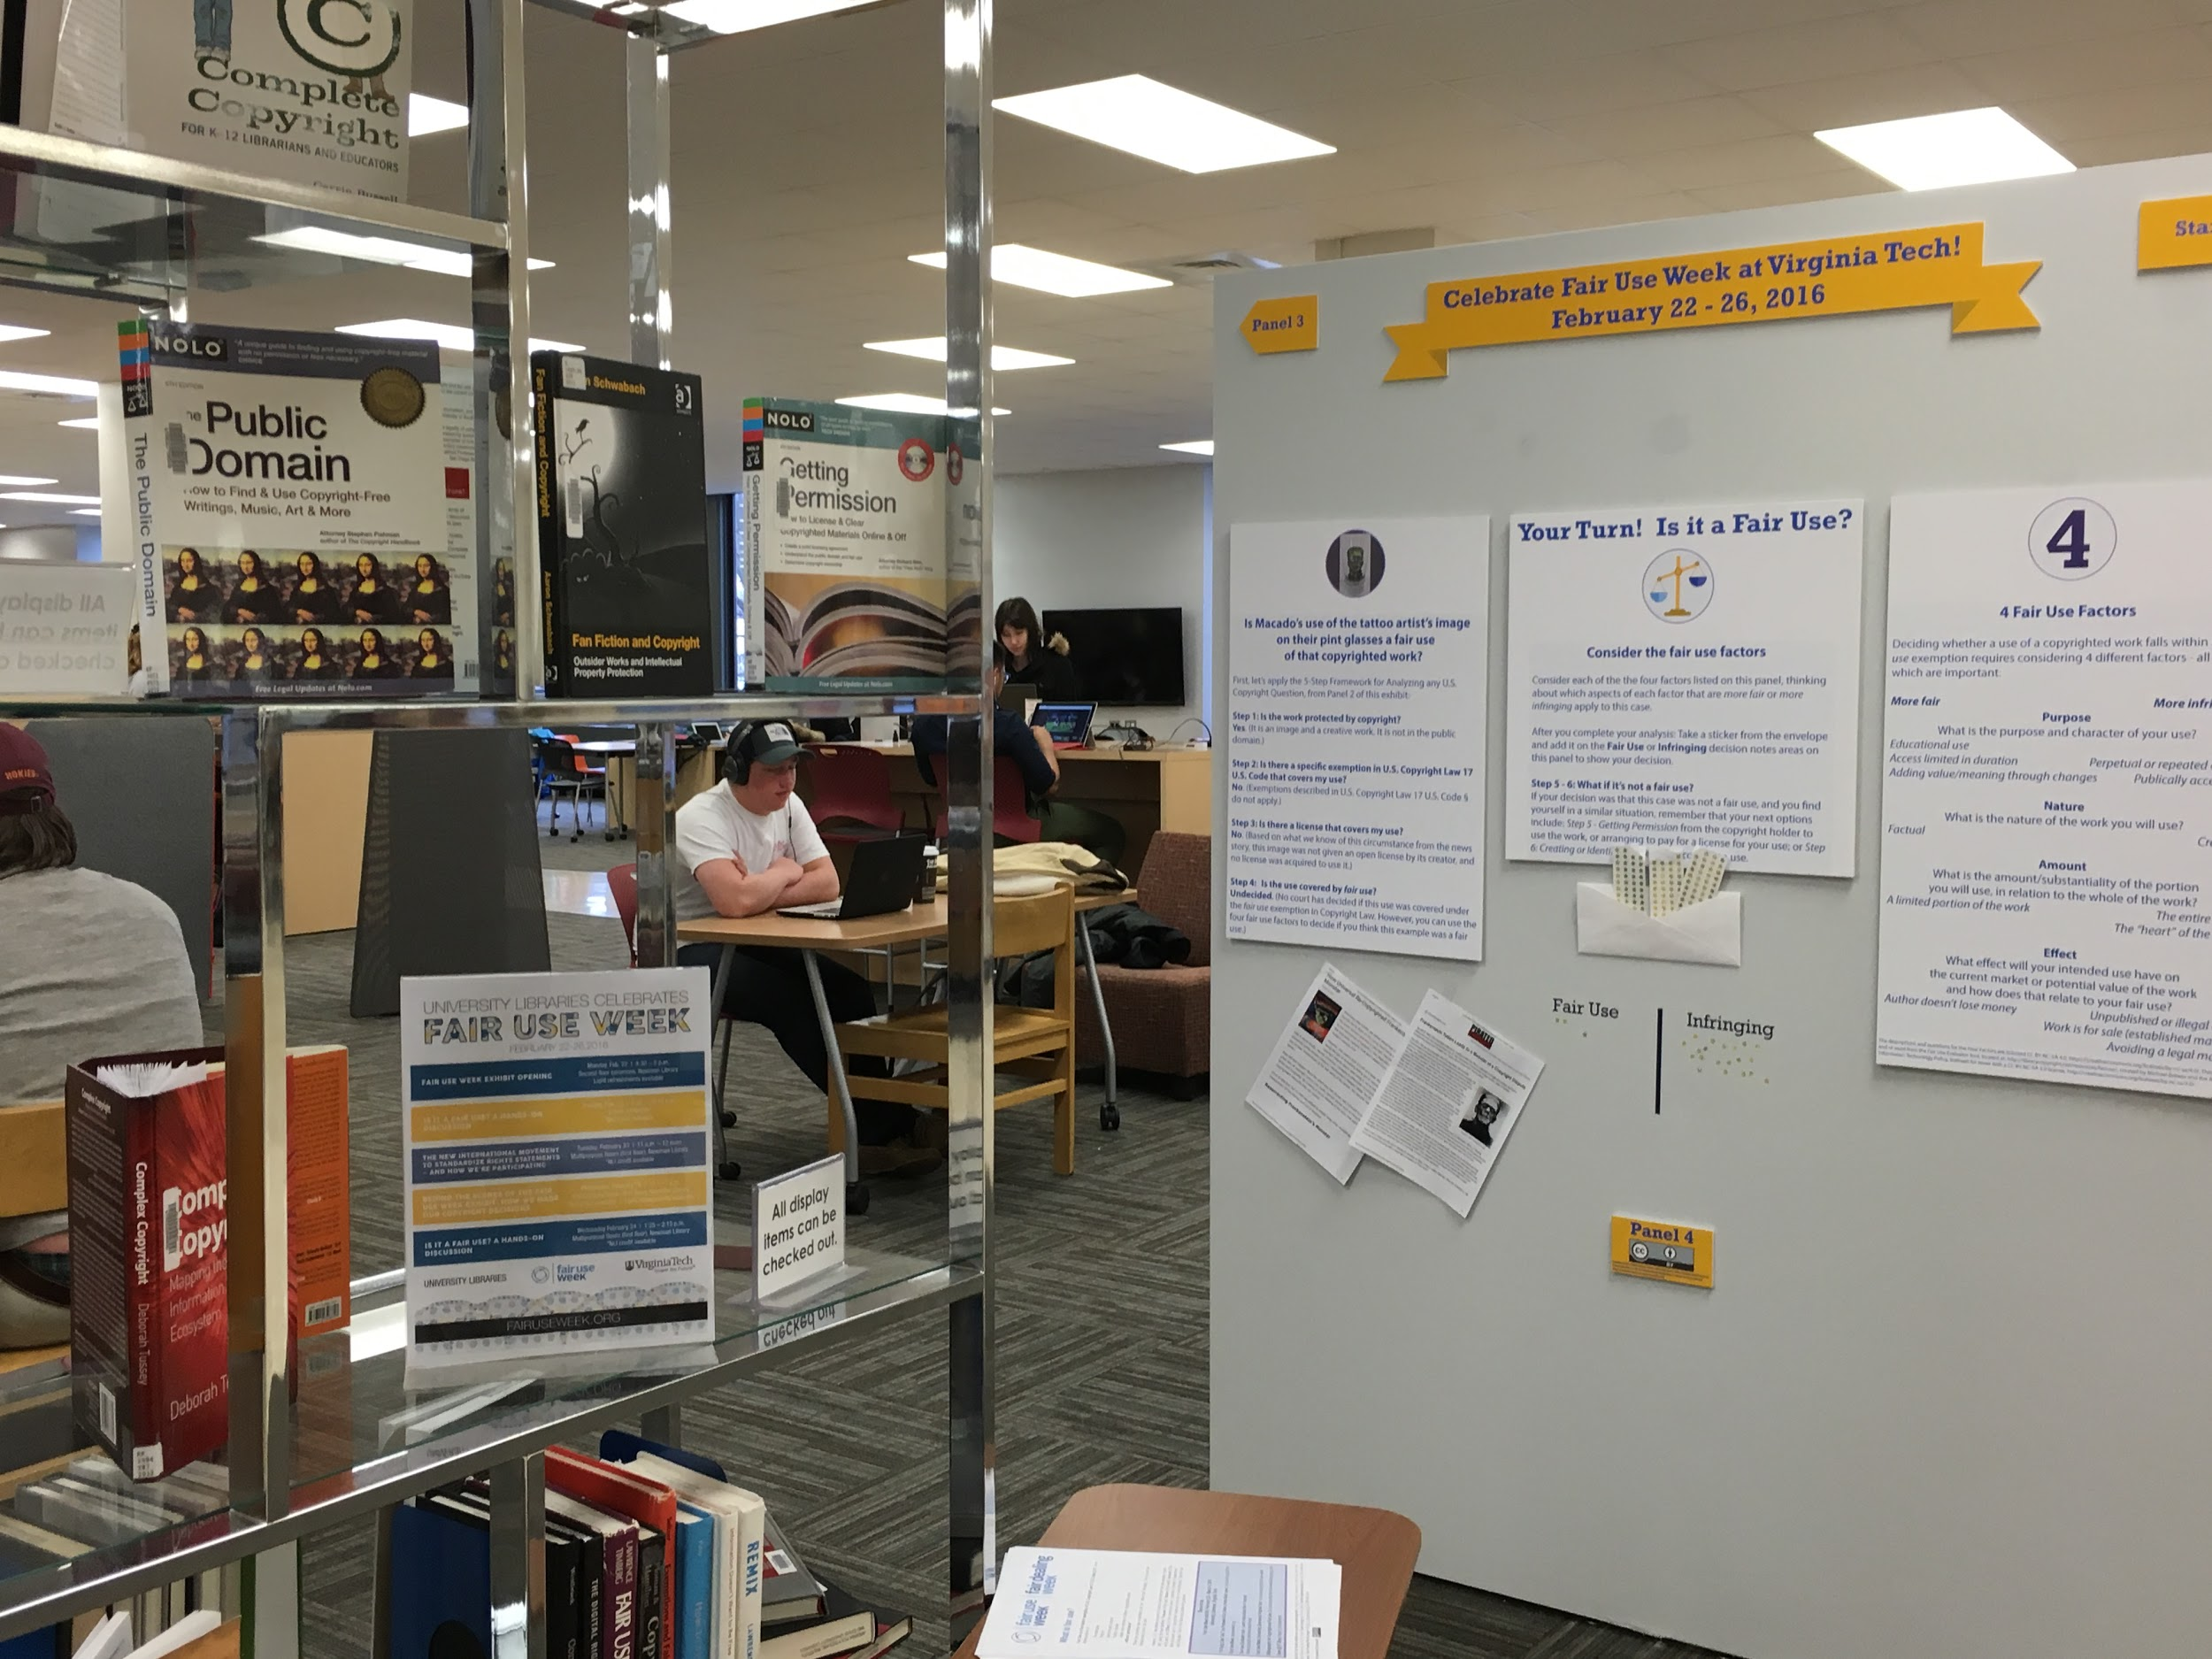
Exhibit Tour!

