Slide 1


Chapter 3
Analyze Organizational Performance
Strategic Management
MGT 4394
Notes:
These slides serve as a study guide for “Chapter 3: Analyze Organizational Performance” in Strategic Management and Case Analysis: An Integrated Approach ©Lori Anderson, Dirk Buengel, and Joseph J. Simpson, which is provided at https://doi.org/10.21061/strategicmanagementandcaseanalysis under an open license, Creative Commons BY NC-SA 4.0. The slides are also provided at https://hdl.handle.net/10919/138831 under the same open license, Creative Commons BY NC-SA 4.0.
Note to Instructors: These study guides are intended to be a concise and comprehensive accompaniment that follows the logic of the textbook. Our intention is to support you in your instruction and is based on our experience that it can be easier and quicker to remove slides you do not want to include than to create additional slides.

Slide 2

Study Guide
These slides serve as a study guide for “Chapter 3: Analyze Organizational Performance” ” in Strategic Management and Case Analysis: An Integrated Approach by Lori Anderson, Dirk Buengel, and Joseph J. Simpson, which is provided under an open license, Creative Commons BY NC-SA 4.0. The slides are also provided under the same open license, Creative Commons BY NC-SA 4.0.
Notes:
Note to students: These study guides are intended to be a concise and comprehensive accompaniment that follows the logic of the textbook and may support your learning, mastery, and application of these concepts. They are are intended to supplement, not replace, your review of the textbook and any other sound study strategies you have made, such as taking notes to support your most effective learning.

Slide 3
Learning Objectives, 1 of 2
After engaging with this chapter, you will understand and be able to apply the following concepts.
Mission, purpose, vision, and values
Performance measures and benchmark measures
Various organizational performance metrics
Balanced Scorecard analysis
Competitive advantage

Slide 4
Learning Objectives, 2 of 2
You will be equipped to analyze a firm’s:
Mission, purpose, vision, and values
Financial position
Market position
Other relevant quantitative data
Balanced scorecard

Slide 5
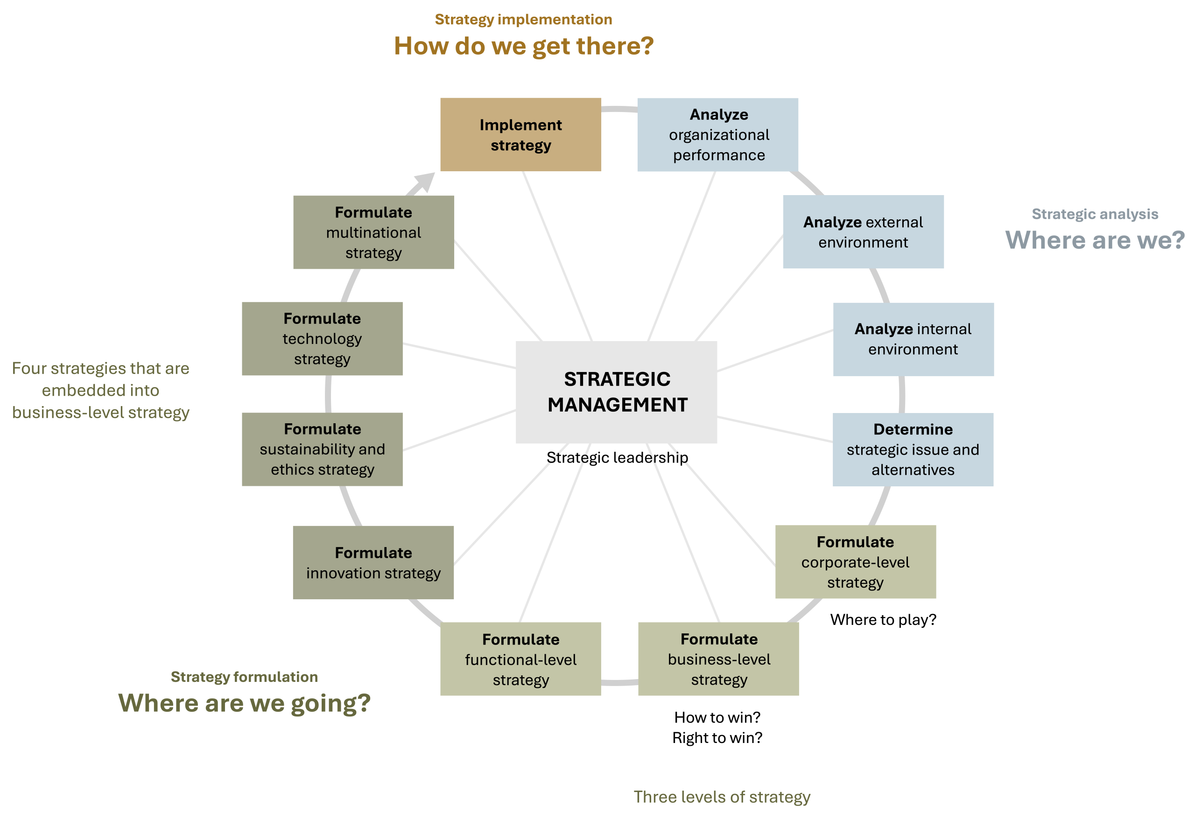
Analyze Organizational Performance in the AFI Framework
Figure 1.3: The analysis, formulation, implementation (AFI) framework [Kindred Grey. 2025. CC BY-NC-SA]

Slide 6
Key Topics
Organizational performance overview
Mission, purpose, vision, and values
Performance and benchmark measures
Financial and market position analysis
Balanced Scorecard framework
Competitive advantage and Economic Value Creation (EVC)

Slide 7
Strategic Analysis: Where Are We?
Strategic management’s foundations rest in three essential questions that align with the three stages of strategic management:
Strategic analysis: Where are we?
Strategy formulation: Where are we going?
Strategy Implementation: How are we going to get there?
Like all strategic analysis, analyzing organizational performance addresses the question of where a firm is.

Slide 8
Step 1 in Case Analysis
1. Analyze a firm’s organizational performance.
Use the organizational performance analysis instrument to analyze a firm’s organizational performance.
Analyze, interpret, and evaluate the firm’s mission, purpose, vision, values, and goals.
Evaluate line of sight and congruence among the firm’s mission, purpose, vision, and values.
Analyze, interpret, and evaluate the firm’s financial position.
Analyze, interpret, and evaluate the firm’s market position.
Analyze, interpret, and evaluate additional relevant quantitative measures of organizational performance.
Analyze, interpret, and evaluate a firm’s balanced scorecard.
Evaluate line of sight and congruence among the measures in the balanced scorecard.
Common-size data and present trends to ensure the analysis is
meaningful.

Slide 9
Organizational Performance Analysis
Organizational Performance Analysis
Combines internal and external insights to evaluate where a firm currently stands.
Critical first step in the AFI framework.
Step 1 in the Case Analysis Process.

Slide 10
Organizational Performance Analysis Instrument
Complete the organizational performance analysis instrument.
See link in textbook.

Slide 11
Analyze Mission, Purpose, Vision, and Values, 1 of 3
Collectively, a firm’s mission, purpose, vision, and values set clear organizational direction that guides all firm decisions and strategies.
Organizational leaders define these factors for the firm and then express them in statements for their stakeholders.
It is important that there is a clear line of sight and congruence among these essential organizational elements.
If there is no congruence or weak congruence between any or all of these, the organization will not have clear direction, and this can lead to poor decisions, weak strategies, and overall poor organizational performance.
Notes:
Collectively, a firm’s mission, purpose, vision, and values set clear organizational direction that guides all firm decisions and strategies. Organizational leaders define these factors for the firm and then express them in statements for their stakeholders. It is important that there is a clear line of sight and congruence among these essential organizational elements. If there is no congruence or weak congruence between any or all of these, the organization will not have clear direction, and this can lead to poor decisions, weak strategies, and overall poor organizational performance. Of course, strong guiding statements do not guarantee superior firm performance. A company may have excellent mission, purpose, vision, and values and still make misguided strategic leadership decisions. However, this does not make it any less important for those four elements to be strong, clear, and congruent.
It is not enough for strategic leaders to just ensure that an organization’s mission, purpose, vision, and values are aligned; they also need to align their leadership approach with these factors. Strategic leadership that is aligned to a company’s mission, purpose, vision, and values has the potential to inspire employees, who feel the firm’s leadership is authentic and that they are empowered to contribute meaningfully to the firm’s performance. This powerful authenticity has the potential to lead an organization toward excellent performance.
Collectively, an organization’s mission, purpose, vision, and values serve as the foundation for all strategic decisions. They inform every aspect of a business, both external and internal. For example, among other things, they inform marketing approaches, asset management approaches, and decisions to cooperate with other organizations. They also influence organizational structure, human resource policies, and organizational culture.
The primary emphasis for a firm defining and expressing these guiding factors is to capture the organization’s distinctiveness. Missions, purposes, visions, and values that are both distinct and authentic have the potential to drive excellent performance.
The first step in analyzing a firm’s organizational performance is to assess its mission, purpose, vision, and values. In analyzing them, the first important question to ask is whether they are effective. Then consider whether there is a clear line of sight among them and whether they are congruent. If the answer to either is no, recommend that the company revisit these and bring them into alignment.
Not only does there need to be a clear line of sight and congruence among the mission, purpose, vision, and values, strategies must align with them as well. If strategies do not align, they either need to be adjusted or dropped, or in some cases, the mission, purpose, vision, and values should be revised to stay relevant.
It is important to understand how mission, purpose, vision, and values relate and how they are distinct. It is most important to understand the concepts behind each and what each aims to accomplish because not all organizations consider and communicate through all four of the guiding statements. Some companies combine the ideas behind two of the factors, and sometimes companies use different names for the same ideas. When analyzing a company, it is more important to assess whether each broad concept is dealt with and communicated than whether a company uses each of these exact terms.

Slide 12
Analyze Mission, Purpose, Vision, and Values, 2 of 3
When analyzing a company, it is more important to assess whether each broad concept is dealt with and communicated than whether a company uses each of these exact terms.
Notes:
It is important to understand how mission, purpose, vision, and values relate and how they are distinct. It is most important to understand the concepts behind each and what each aims to accomplish because not all organizations consider and communicate through all four of the guiding statements. Some companies combine the ideas behind two of the factors, and sometimes companies use different names for the same ideas. When analyzing a company, it is more important to assess whether each broad concept is dealt with and communicated than whether a company uses each of these exact terms.

Slide 13
Analyze Mission
Mission:
Explains why the organization exists and its societal role.
Guides stakeholder engagement (employees, customers, partners).
Example: Google – "Organize the world’s information and make it universally accessible and useful."
Notes:
Missions and mission statements are important for all firms. They are essential for industry leaders who seek to maintain their positions and drive continued success. When working to revitalize an organization, leaders often focus on reaffirming its commitment to a clear mission.
A mission statement explains why an organization exists. A well-crafted mission statement captures the essence of the organization and answers the questions “Why do we exist?” and “What is our purpose?” For example, a nonprofit might have a mission “to provide access to clean water in underserved communities,” which clearly expresses why it exists. The mission defines the organization’s role within society. Just as important as the firm’s purpose is its identity, addressed in questions like “What defines us?” and “Who are we?” A mission is rooted in the firm’s past foundation and current identity. Since a mission statement captures the essential elements of the company’s identity from its founding to its reason to exist in the present, mission statements are often written in the present tense.
In practice, a mission statement also serves to inform key stakeholders why they should invest their trust, resources, and support in the organization. For an organization to succeed, it must gain the support of key stakeholders such as employees, owners, suppliers, partners, and customers.
When you analyze a firm’s mission statement, consider to what degree it addresses the criteria of a strong mission statement. It is not necessary that the mission statement meets every one of these criteria. After all, strong mission statements are short. Use this list as a guide to make your own assessment:
Does the mission statement explain why the organization exists?
Does the mission statement define the organization’s role within society?
Is the mission statement rooted in the firm’s past foundation and current identity?
Does the mission statement capture the essential elements of the company’s identity?
Is the mission statement written in the present tense?
Does the mission statement inform key stakeholders, such as employees, owners, suppliers, partners, and customers, why they should invest their trust, resources, and support in the organization?
The mission of an organization serves as a foundation for its purpose, vision, and values.

Slide 14
Analyze Purpose
Purpose:
Focuses on societal or industry-wide impact beyond profits.
Inspires and unifies stakeholders.
Example: PwC – "Build trust in society and solve important problems."
Notes:
In recent years, many organizations have increasingly embraced the concept of using a purpose statement to articulate their reason for existence beyond just profit-making, which differentiates them from mission statements.
Purpose statements are designed to inspire and unite stakeholders, ranging from employees to customers, around a central purpose. Unlike mission statements, purpose statements often focus on the broader impact an organization seeks to have on society or its industry. By highlighting the company’s contributions beyond its products or services, purpose statements can help organizations foster trust, loyalty, and a sense of shared responsibility. Purpose statements often reflect a company’s stance toward sustainability. Sometimes a company will publish a separate sustainability statement. Sustainability is reviewed in detail in Chapter 10.
A well-crafted purpose statement also serves as a strategic guide, helping organizations navigate complex decisions by providing a clear framework for evaluating opportunities and challenges. When a company’s actions and initiatives are aligned with its stated purpose, it ensures consistency in decision-making. This alignment fosters long-term success, as organizations are more likely to prioritize initiatives that resonate with their purpose and contribute to their broader goals. In turn, this can enhance the firm’s reputation and attract not only customers but also partners and talent who share a similar vision for the future. With this focus on the current actions the company is taking, purpose statements are usually written in the present tense.
Not every company defines a purpose separate from its mission. Some companies address their purpose beyond profit-making in their mission statements. When analyzing a firm’s broad guidance as it is communicated through its missions, purpose, vision, and values, it is most important to assess whether the company defines and articulates its purpose in addition to profit-making, whether this is expressed separately in a purpose statement, presented as part of the mission, or even included in another statement.
When you analyze a firm’s purpose statement, consider to what degree it addresses the criteria of a strong purpose statement. As with your analysis of the firm’s mission statement, it is not necessary that the purpose statement meets every one of these criteria. Use this list as a guide to make your own assessment:
Does the purpose statement articulate a firm’s reason for existence beyond just profit-making?
Does the purpose statement focus on the broader impact an organization seeks to have on society or its industry?
Is the purpose statement written in the present tense?
Does the purpose statement inspire and unite stakeholders?
Does the purpose statement foster trust, loyalty, and a sense of shared responsibility?
If a company has not articulated a separate purpose statement, has it addressed the criteria above somewhere else?
With mission and purpose defined, company leaders define their vision and communicate this through a vision statement.

Slide 15
Analyze Vision
Vision:
Aspirational future-focused direction.
Motivates and aligns organizational actions.
Example: LinkedIn – "Create economic opportunity for every member of the global workforce."
Notes:
An organizational vision statement is a forward-looking or aspirational statement that captures what a company wants to achieve in the long run. It’s meant to inspire and guide the organization, offering a clear sense of direction. A good vision paints a picture of a hopeful future, helping to align everyone around the same vision. Vision statements are usually concise, easy to understand, and motivate people by showing them what they’re working toward. Unlike mission and purpose statements, they are usually written in the future tense.
A compelling vision statement can be a powerful tool that leaders can use to energize and align the organization toward where it wants to be. A clear vision defines what the company aspires to become and helps to shape its strategies. For instance, LinkedIn’s vision is to “[c]reate economic opportunity for every member of the global workforce” (LinkedIn.com). This succinct yet ambitious vision highlights the company’s aspirations to reach every member of the global workforce and assist them by creating economic opportunities. Consequently, one might expect LinkedIn to feverishly pursue expansion of its offerings around the globe.
When you analyze a firm’s vision statement, consider to what degree it addresses the criteria of a strong vision statement. As with your analysis of the firm’s mission and purpose statements, it is not necessary that the purpose statement meets every one of these criteria. Use this list as a guide to make your own assessment:
Is the vision statement a forward-looking or aspirational statement that captures what a company wants to achieve in the long run?
Does the vision statement inspire and offer a clear sense of direction?
Does the vision statement paint a picture of a hopeful future?
Is the vision statement concise and easy to understand, with the potential to motivate people by showing them what they’re working toward?
Is the vision statement written in the future tense?
Is the vision statement aligned with the mission statement?
Once a company has confirmed their current position with strong mission and purpose statements and articulated their aspirations for the future through their vision, they can then consider their values. A company’s vision serves as the foundation for its values and goals, which in turn guide the organization toward achieving that vision.

Slide 16
Analyze Values
Values:
Core guiding principles for decision-making and behavior.
Influences organizational culture and stakeholder perception.
Example: KPMG – "Integrity, Excellence, Courage, Together, For Better.
Notes:
In addition to crafting mission, purpose, and vision statements, companies also create corporate value statements that define the core principles they stand by and expect their employees to uphold. These values are often showcased on company websites to communicate what the organization believes in and strives for.
Value statements are important because they not only guide internal culture but also influence how the company is perceived by stakeholders. Employees are expected to align with these values, and those who don’t may find their tenure short-lived. Customers often choose companies whose values resonate with their own and firms that clearly communicate their principles. When Nike faced backlash over labor practices, the company revised its value system to emphasize fair labor conditions, showing how values impact both internal policies and public image. Likewise, Ben & Jerry’s commitment to social justice can build strong brand loyalty. Values statements are usually written in the present tense.
Values are also tightly intertwined with strategic management. When formulating strategies and goals, companies must ensure alignment with their value statements. For example, if a strategy conflicts with a core value like sustainability, it must be reconsidered or adjusted. Companies like Tesla, which prioritizes environmental sustainability (Tesla.com), would likely reject strategies that compromise that value, even if profitable in the short term. Adhering to corporate values ensures that companies maintain their integrity while progressing toward their long-term goals.
When you analyze a firm’s values statement, consider to what degree it addresses the criteria of a strong values statement. As with your analysis of the firm’s mission, purpose, and vision statements, it is not necessary that the values statements meet every one of these criteria. Use this list as a guide to make your own assessment:
Does the values statement define the core principles the firm stands by and expects its employees to uphold?
Does the values statement have the potential to guide organizational culture and also influence how the company is perceived by stakeholders?
Does the company articulate a separate sustainability statement?
Is the purpose statement written in the present tense?
A company’s values reflect their current commitment to a set of guiding principles. Values focus on where the company is headed by setting the parameters for the firm’s goals. The company defines and executes its goals by remaining true to its values.

Slide 17
Values
Company | Values statement
KPMG | Integrity: We do what is right. Excellence: We never stop learning and improving. Courage: We think and act boldly. Together: We respect each other and draw strength from our differences. For Better: We do what matters.
Wells Fargo | We want to satisfy our customers’ financial needs and help them succeed financially.
RSM | Respect and uncompromising integrity Succeeding together Excellence Impactful innovation Acting responsibly
Figure 3.2: Values and values statements

Slide 18
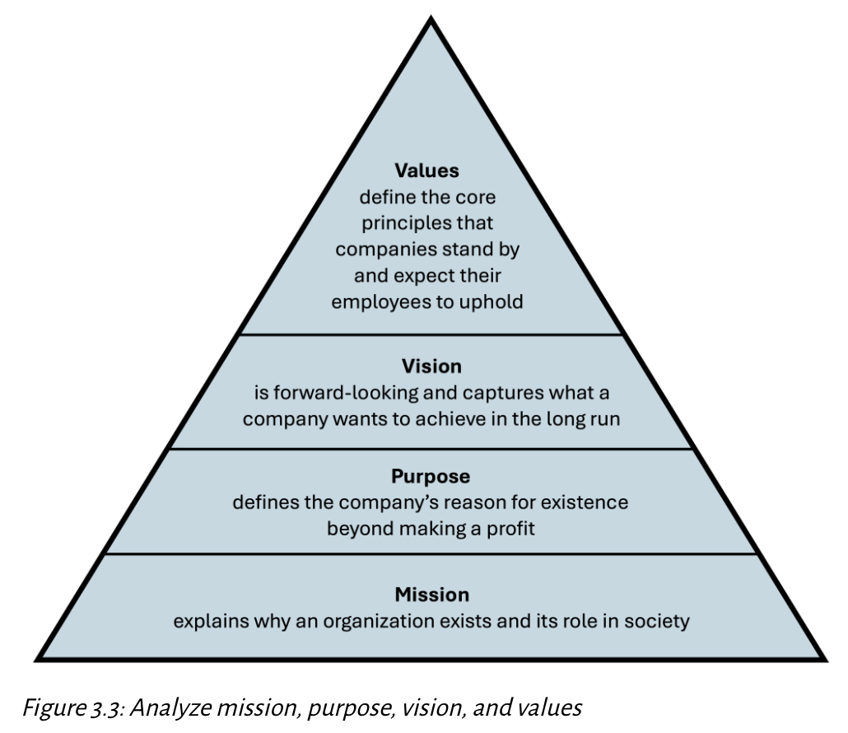
Analyze Mission, Purpose, Vision, and Values
Kindred Grey. 2025. CC BY-NC-SA.

Slide 19
Analyze Mission, Purpose, Vision, and Values: Check Your Knowledge So Far
These four statements shape a company’s identity, strategic direction, and culture
💡 Purpose Statement
Articulates a firm’s deeper reason for being beyond profit as how it contributes to society Ex (Patagonia): “We’re in business to save our home planet.”
🎯 Mission Statement
Explains why an organization exists; its core function and who it serves
Ex (KPMG): “To turn knowledge into value for the benefit of our clients, our people, and the capital markets.”
🤝 Value Statements
Define the core principles and ethical standards that guide employee behavior and company culture
Ex (RSM): “Respect and uncompromising integrity. Succeeding together. Excellence. Impactful innovation. Acting responsibly.”
🌅 Vision Statement
A forward-looking, aspirational statement describing what the company hopes to become
Ex (Microsoft): “To help every person and every organization on the planet achieve more.”
“Where there is no vision, there is no hope” - George Washington Carver

Slide 20
Performance Measures and Performance Benchmarks, 1 of 2
Performance measures are metrics used to track an organization’s progress, such as profits, stock prices, or sales figures. These metrics provide insights but only offer a partial view of overall performance.
Performance benchmarks provide context by comparing an organization’s metrics to its previous results or to those of competitors. For example, a company showing a profit margin of 20 percent in 2024, might seem like a strong performance. However, if that same company had a profit margin of 35 percent in the previous year, and the industry average for 2024 was 40 percent, this new result would indicate a decline.

Slide 21
Performance Measures and Performance Benchmarks, 2 of 2
📊 Performance Measures
Metrics that track an organization’s progress
Examples:
Profit margin
Revenue
Stock price
Market share
Sales volume
❗ These show how well a firm is doing, but not why or compared to what
📏 Performance Benchmarks
Standards or reference points used to evaluate performance
Compare a firm’s metrics to:
Historical data
Industry standards
Competitors’ performance
Help answer: “Is this result good, bad, or getting worse?”
💡 Example:
A 20% profit margin might look strong... But:
2023 profit margin = 35%
2024 industry average = 40% → Reveals decline in performance
✅ Key Takeaway
Performance measures track outcomes, while benchmarks provide the comparison needed to interpret them.

Slide 22
Analyze a Firm’s Financial and Market Positions and Other Relevant Quantitative Data
Once you have analyzed a firm’s mission, purpose, vision, and values, the next step is to analyze a firm’s financial and market positions and other relevant quantitative data.

Slide 23
Key Financial Ratios: Liquidity and Leverages Measures
Types of measures | Ratio | Formula | Purpose | Examples
Liquidity measures | Current ratio (CR) | Current assets / Current liabilities | Indicates ability to pay short-term obligations | Target uses CR to assess its ability to cover short-term obligations with its available assets.
Leverages measures | Debt ratio (DR) | Total liabilities / Total assets | Shows the proportion of assets financed through debt | Apple evaluates its DB to understand how much its assets are financed through debt.
Figure 3.4: Finance ratios (bolded items indicate glossary terms)

Slide 24
Key Financial Ratios: Profitability Ratios
Types of measures | Ratio | Formula | Purpose | Examples
Profitability ratios | Gross margin (GM) | Gross profit / Total revenue | Percentage of revenue remaining after direct costs | Starbucks uses GM to see the percentage of revenue left after covering direct costs like coffee beans and milk.
Blank | Net profit margin (NPM) | Net profit / Net revenue | Shows profit earned per dollar of revenue | Netflix examines its NPM to determine profit per dollar after all expenses.
Blank | Return on equity (ROE) | Net profit / Shareholder equity | Measures profitability relative to equity financing | Goldman Sachs reviews ROE to gauge how effectively it uses shareholders’ equity to generate profits.
Blank | Return on assets (ROA) | Net profit / Total assets | Assesses efficiency in using assets to generate profit | Tesla checks ROA to measure how efficiently it uses assets like factories to produce profits.
Blank | Return on investments (ROI) | (Net profit / Investment cost) x 100 | Assesses profitability relative to the cost of investment | Apple measures ROI for evaluating the success of new products.
Figure 3.4: Finance ratios (bolded items indicate glossary terms)

Slide 25
Key Financial Ratios: Efficiency and Market Value
Types of measures | Ratio | Formula | Purpose | Examples
Efficiency ratios | Inventory turnover (IT) | Cost of goods sold (COGS) / Average inventory | Indicates how efficiently inventory is managed | Walmart tracks IT to understand how quickly it sells and restocks products.
 | Accounts receivable turnover (ART) | Net credit sales / Average accounts receivable | Assesses efficiency of accounts receivable management | Microsoft tracks ART to evaluate how quickly it collects payments from customers.
Market value | Market capitalization (MC) | Shares outstanding × Share price | Reflects the overall market value of the company | Amazon uses MC to understand its overall market value based on stock prices and shares.
 | Earnings per share (EPS) | Net income / Number of outstanding shares | Shows the profitability attributed to each share of stock | Amazon tracks EPS to evaluate its profitability per shareholder.
 | Net profit | Total revenue – Total expenses | Reflects the overall profit a company generates | Netflix analyzes net profits to evaluate a company’s financial health.
 | Stock price | The market valuation of one share of the company | Indicates how investors perceive the company’s future performance | Microsoft monitors its stock price to track shareholder sentiment.
Figure 3.4: Finance ratios (bolded items indicate glossary terms)

Slide 26
Analyze a Firm’s Market Position
Analyzing a firm’s market position assesses how a firm compares to its competitors within the market. Two common measures for evaluating a company’s market position are market share and price–earnings (PE) ratio.
Market Share
Formula: Firm’s Total Product Revenue / Total Revenue in the Industry
Market share reflects the percentage of the market controlled by a company. For example, if Netflix generates 35 percent of the total revenue in the global streaming industry, then its market share in that sector is 35 percent.

Slide 27
Analyze a Firm’s Market Position, 3 of 3
Analyzing a firm’s market position assesses how a firm compares to its competitors within the market. Two common measures for evaluating a company’s market position are market share and price–earnings (PE) ratio.
Price–Earnings (PE) Ratio
Formula: Stock Price / Earnings per Share (EPS)
The PE ratio shows how much investors are willing to pay for $1 in earnings. If a company’s stock is priced at $50 per share and generates $5 in annual earnings per share, the PE ratio is 10. A lower PE ratio suggests better value, while a higher PE ratio might indicate strong market confidence in the company’s future growth prospects. For instance, a company like Tesla often has a high PE ratio due to market optimism about future earnings growth.
Complete the section titled “Market Position” in the organizational performance analysis instrument.

Slide 28
Analyze Financial & Market Position; Check Your Knowledge So Far
📊 Why Analyze Financial and Market Data? Understanding a firm’s performance requires a deep dive into financial reports, market comparisons, and quantitative data. Financial strength, market share, and other performance metrics help assess a company’s success and strategy alignment.
💰 Analyze Financial Position
Financial health reflects a firm’s ability to generate profits, manage assets, and create value for shareholders
Examples of financial statements used:
Income Statements
Balance Sheets
Cash Flow Statements
💡 Pro Tips & Common Pitfalls
Don’t analyze ratios in isolation; always compare to industry benchmarks or past years
Earnings per Share (EPS) isn't everything – check if it's rising due to real growth or cost-cutting/debt
Short-term success ≠ long-term health → check trends, not just one period
Be industry-aware – High Return on Equity (ROE) in tech ≠ same meaning in retail
Interpret, don’t just report; Say what the numbers mean for strategy
Notes:
An essential measure of organizational performance is a firm’s financial landscape, which is visualized through analysis of financial data from the industry, competitors, and the firm.
Conducting a financial analysis of a firm is not always straightforward. The method and calculations are simple enough, and the key measures are reviewed below. The complexity lies in finding useful data, deciding which data is meaningful in this context, and presenting the data in an easily digestible format.
Technology companies often have a higher Return on Equity (ROE) than retail companies. Tech firms achieve high ROE through large profit margins. Retailers compensate for thin margins with high asset turnover - they generate more sales per dollar of asset.

Slide 29
Market Position: Check Your Understanding So Far
📍 Market Position Metrics
Market Share = Firm Revenue / Industry Revenue Example: Netflix holding 35% of global streaming revenue
PE Ratio = Stock Price / EPS High PE → optimism about growth
Tesla trades at a high PE ratio because investors believe in its future dominance in EVs, energy storage, and AI-driven autonomous vehicles—even if current earnings are modest.
Low PE → undervaluation or poor growth outlook
Ford often trades at a lower PE ratio compared to tech-forward automakers like Tesla. Because Investors see Ford as a mature company with slower growth potential.

Slide 30
Analyze a Firm’s Other Quantitative Data
🌐 Other Quantitative Measures
Used to gain broader insights beyond finance:
📈 Trend Analysis: Year-over-year shifts in sales, production, etc. 😊 Customer Satisfaction: example: Net Promoter Score
🧠 Innovation Strength: Patents, new products launched
👩‍💼 Employee Satisfaction: Internal surveys, Glassdoor ratings
🌍 Demographic & Industry Data: example: Gen Z consumer trends, aging population impact

Slide 31
Non-Financial Quantitative Data
Customer Satisfaction
Employee Engagement and Retention
Brand Strength and Market Recognition
Innovation Rate (Patents, New Products)
Demographic Trends and Forecasts
Example: Netflix tracks Monthly Active Users (MAU) to gauge customer engagement levels.

Slide 32
Use a Range of Measures to Evaluate Organizational Performance, 1 of 2
Metric | Formula/Definition | Purpose | Example use
Monthly active users (MAU) | Total individual users engaging with the service in a month | Tracks customer engagement and product stickiness | Netflix monitors MAU to gauge customer activity.
Customer acquisition cost (CAC) | Total cost of acquiring new customers / Number of new customers | Measures the efficiency of customer acquisition | Steam evaluates CAC to optimize marketing spending.
Churn rate | (Customers lost during a period / Total customers at the start) × 100 | Identifies customer retention issues | Spotify analyzes churn to improve customer retention.
Lifetime value (LTV) | Average revenue per user (ARPU) × Average customer lifetime | Assesses the total value a customer brings | Slack uses LTV to understand long-term profitability.
Recurring revenue | Revenue from subscription services | Tracks stable, recurring income | Dropbox measures monthly recurring revenue (MRR).
Retention rate | (1 – Churn Rate) × 100 | Measures customer loyalty over time | Zoom focuses on retention to maintain a steady user base.
Figure 3.5: Key measures for organizational performance
Notes:
Leaders analyze their firm by evaluating their current position, focusing on trend examination, and comparing themselves with industry benchmarks or competitors. For example, return on assets (ROA) measures how effectively a company turns its assets into profit. A high ROA suggests efficient asset use, while a low or negative ROA signals inefficiency. This analysis goes beyond financial metrics, incorporating other performance indicators like product quality, employee satisfaction, retention, productivity, and customer satisfaction. For instance, Software as a Service (Saas) is a cloud-based software delivery model where applications are hosted by a service provider and made available to users over the internet. Instead of purchasing and installing software on individual computers or servers, users subscribe to the software on a pay-as-you-go basis, often through monthly or annual plans. In SaaS companies like Netflix or Steam, monthly active users (MAU) is a crucial metric. Assessing various factors from multiple angles enables companies to gauge their overall performance.

Slide 33
Use a Range of Measures to Evaluate Organizational Performance, 2 of 2
📈 Why Multiple Measures Matter Leaders can’t rely on just one metric; real performance is multidimensional.
Good decisions can still lead to poor results
ex: COVID-19 disruption
Using multiple perspectives such as financial, customer, internal, market to avoid blind spots
Ex: In one year, 788 unique metric combos were used across the restaurant industry!
🧠 Strategic Thinking Tip
A high ROA may mean efficient operations... but what if customer satisfaction is dropping? Relying on one number won’t tell the whole story.
🏁 Key Takeaway
Measuring performance = more than just finance. It’s about selecting the right mix of metrics based on your company, strategy, and industry.

Slide 34
Analyze a Firm’s Balanced Scorecard
Scorecard dimension | Definition | Example
Financial measures | How a firm is performing financially | Return on assets (ROA) Return on equity (ROE) Return on investment (ROI) Stock price Profits
Customer measures | How well a company attracts, satisfies, and retains customers | Number of new customers Number of repeat customers Percentage of repeat customers
Internal business process measures | How efficient the organization is | Production times Delivery efficiency New product development speed Speed serving a customer
Learning and growth measures | How a business can continue to innovate and create future value | Average number of new skills learned by each employee every year
Figure 3.6: Analyzing organizational performance using the balanced scorecard
Notes:
Customer measures reflect how well a company attracts, satisfies, and retains customers. These measures answer the question “How do customers view us?” Examples include metrics like new customer acquisition rates, customer satisfaction scores, and repeat customer percentages.
For instance, Amazon emphasizes customer retention by offering services like Amazon Prime, which encourages loyalty through faster shipping, exclusive content, and personalized shopping experiences. Additionally, Amazon gathers extensive customer data to anticipate consumer needs and adapt its offerings accordingl
Internal business process measures focus on organizational efficiency and answer the question “What must we excel at?” Internal business process measures include production times, delivery efficiency, and new product development speed.
For example, Toyota’s commitment to lean manufacturing focuses on reducing waste in its production processes. By streamlining assembly lines and improving supply chain coordination, Toyota continuously works to reduce the time it takes to manufacture vehicles while maintaining quality standards.
Learning and growth measures provide insights into how an organization can continue to innovate and create future value. These metrics answer the question “Can we keep improving and adding value?” They often focus on employee development, innovation capabilities, and adapting to changing market conditions.
A company like Google, for example, prioritizes learning and growth by offering employees continuous opportunities for training and skill development. This not only keeps the workforce agile and innovative but also ensures that the company remains competitive in a fast-evolving tech landscape. Metrics in this category might include the number of new technologies introduced or the percentage of employees who undergo skill upgrades annually.

Slide 35
Analyze a Firm’s Balanced Scorecard: Customer Measures
Customer measures reflect how well a company attracts, satisfies, and retains customers.
These measures answer the question “How do customers view us?”
Examples include metrics like new customer acquisition rates, customer satisfaction scores, and repeat customer percentages.
For instance, Amazon emphasizes customer retention by offering services like Amazon Prime, which encourages loyalty through faster shipping, exclusive content, and personalized shopping experiences. Additionally, Amazon gathers extensive customer data to anticipate consumer needs and adapt its offerings accordingly.
Notes:
Customer measures reflect how well a company attracts, satisfies, and retains customers. These measures answer the question “How do customers view us?” Examples include metrics like new customer acquisition rates, customer satisfaction scores, and repeat customer percentages.
For instance, Amazon emphasizes customer retention by offering services like Amazon Prime, which encourages loyalty through faster shipping, exclusive content, and personalized shopping experiences. Additionally, Amazon gathers extensive customer data to anticipate consumer needs and adapt its offerings accordingl
Internal business process measures focus on organizational efficiency and answer the question “What must we excel at?” Internal business process measures include production times, delivery efficiency, and new product development speed.
For example, Toyota’s commitment to lean manufacturing focuses on reducing waste in its production processes. By streamlining assembly lines and improving supply chain coordination, Toyota continuously works to reduce the time it takes to manufacture vehicles while maintaining quality standards.
Learning and growth measures provide insights into how an organization can continue to innovate and create future value. These metrics answer the question “Can we keep improving and adding value?” They often focus on employee development, innovation capabilities, and adapting to changing market conditions.
A company like Google, for example, prioritizes learning and growth by offering employees continuous opportunities for training and skill development. This not only keeps the workforce agile and innovative but also ensures that the company remains competitive in a fast-evolving tech landscape. Metrics in this category might include the number of new technologies introduced or the percentage of employees who undergo skill upgrades annually.

Slide 36
Analyze a Firm’s Balanced Scorecard: Internal Business Process Measures
Internal business process measures focus on organizational efficiency and answer the question “What must we excel at?”
Internal business process measures include production times, delivery efficiency, and new product development speed.
For example, Toyota’s commitment to lean manufacturing focuses on reducing waste in its production processes. By streamlining assembly lines and improving supply chain coordination, Toyota continuously works to reduce the time it takes to manufacture vehicles while maintaining quality standards.
Notes:
Customer measures reflect how well a company attracts, satisfies, and retains customers. These measures answer the question “How do customers view us?” Examples include metrics like new customer acquisition rates, customer satisfaction scores, and repeat customer percentages.
For instance, Amazon emphasizes customer retention by offering services like Amazon Prime, which encourages loyalty through faster shipping, exclusive content, and personalized shopping experiences. Additionally, Amazon gathers extensive customer data to anticipate consumer needs and adapt its offerings accordingl
Internal business process measures focus on organizational efficiency and answer the question “What must we excel at?” Internal business process measures include production times, delivery efficiency, and new product development speed.
For example, Toyota’s commitment to lean manufacturing focuses on reducing waste in its production processes. By streamlining assembly lines and improving supply chain coordination, Toyota continuously works to reduce the time it takes to manufacture vehicles while maintaining quality standards.
Learning and growth measures provide insights into how an organization can continue to innovate and create future value. These metrics answer the question “Can we keep improving and adding value?” They often focus on employee development, innovation capabilities, and adapting to changing market conditions.
A company like Google, for example, prioritizes learning and growth by offering employees continuous opportunities for training and skill development. This not only keeps the workforce agile and innovative but also ensures that the company remains competitive in a fast-evolving tech landscape. Metrics in this category might include the number of new technologies introduced or the percentage of employees who undergo skill upgrades annually.

Slide 37
Analyze a Firm’s Balanced Scorecard: Learning and Growth Measures
Learning and growth measures provide insights into how an organization can continue to innovate and create future value.
These metrics answer the question “Can we keep improving and adding value?”
They often focus on employee development, innovation capabilities, and adapting to changing market conditions.
A company like Google, for example, prioritizes learning and growth by offering employees continuous opportunities for training and skill development. This not only keeps the workforce agile and innovative but also ensures that the company remains competitive in a fast-evolving tech landscape.
Metrics in this category might include the number of new technologies introduced or the percentage of employees who undergo skill upgrades annually.
Notes:
Customer measures reflect how well a company attracts, satisfies, and retains customers. These measures answer the question “How do customers view us?” Examples include metrics like new customer acquisition rates, customer satisfaction scores, and repeat customer percentages.
For instance, Amazon emphasizes customer retention by offering services like Amazon Prime, which encourages loyalty through faster shipping, exclusive content, and personalized shopping experiences. Additionally, Amazon gathers extensive customer data to anticipate consumer needs and adapt its offerings accordingl
Internal business process measures focus on organizational efficiency and answer the question “What must we excel at?” Internal business process measures include production times, delivery efficiency, and new product development speed.
For example, Toyota’s commitment to lean manufacturing focuses on reducing waste in its production processes. By streamlining assembly lines and improving supply chain coordination, Toyota continuously works to reduce the time it takes to manufacture vehicles while maintaining quality standards.
Learning and growth measures provide insights into how an organization can continue to innovate and create future value. These metrics answer the question “Can we keep improving and adding value?” They often focus on employee development, innovation capabilities, and adapting to changing market conditions.
A company like Google, for example, prioritizes learning and growth by offering employees continuous opportunities for training and skill development. This not only keeps the workforce agile and innovative but also ensures that the company remains competitive in a fast-evolving tech landscape. Metrics in this category might include the number of new technologies introduced or the percentage of employees who undergo skill upgrades annually.

Slide 38
Analyze a Firm’s Balanced Scorecard: Check Your Knowledge So Far
📕 Balanced Scorecard: Framework evaluating financial, customer, internal, and growth measures.
🔹 Why Use a Balanced Scorecard? Understanding performance is like flying a plane—you need more than one gauge. The balanced scorecard expands focus beyond financials to include:
Customer success
Internal processes
Employee learning & growth
Developed by Kaplan & Norton, this system ensures long-term strategic alignment and sustainable success
Balanced Scorecard covers:
💰 Financial success 📈 Customer satisfaction & retention
⚙️ Operational efficiency 🎯 Innovation & employee development
Used by companies like Apple, Google, and Amazon to align teams around strategy
Notes:
Understanding organizational performance requires a multidimensional approach. Just as a pilot must monitor multiple gauges, such as altitude, airspeed, and fuel level, managers must track various performance metrics to ensure their organizations stay on course. While various financial performance measures are essential indicators, they are only one component of the bigger picture.
To help managers assess performance beyond just financial measures, Harvard professors Robert Kaplan and David Norton developed the balanced scorecard. This tool encourages a broader evaluation of an organization’s performance by focusing on multiple key areas. The balanced scorecard framework emphasizes a balance between financial indicators and other critical measures that influence long-term success.
The balanced scorecard suggests that managers track performance across four perspectives: financial, customer, internal business processes, and employee learning and growth. We reviewed the financial measures in section 3.4. Here we focus on the additional measures in the balanced scorecard: customer measures, internal business processes measures, and employee learning and growth measures.

Slide 39
Balanced Scorecard Examples in Action, 1 of 2
📈 Customer Focus
Amazon uses Prime to boost loyalty and repeat purchases
Tracks satisfaction via reviews and custom-tailored offerings
⚙️ Internal Efficiency
Toyota applies lean manufacturing to minimize waste and increase speed
Focus on consistent delivery and quality improvement
🎧 Learning & Innovation
Google promotes continuous upskilling, encouraging creativity and adaptability
Measures success by tech launches and employee development

Slide 40
Balanced Scorecard Examples in Action, 2 of 2
Scorecard Dimension -> Reflective Questions
💸 Financial
What are my goals for financial stability post-grad? Student debt? Savings? Credit readiness?
📈 Customer Network
Who is in my network? How can I grow and engage my LinkedIn, mentors, or peers?
⚙️ Internal Processes
How efficiently do I work/study? How has that improved? What habits improve my output or collaboration?
🎧 Learning & Growth
What skills or credentials am I building? How do my lifestyle choices support future success?
📣 Key Takeaway The balanced scorecard offers a strategic, multi-lens view of performance for vital for organizations and individuals alike.

Slide 41
Competitive Advantage
In strategic management, the focus often shifts from these financial measures to the concept of competitive advantage.
A company is said to have a competitive advantage when its economic value creation (EVC) exceeds that of its competitors.

Slide 42

Competitive Advantage, 1 of 2
Competitive Advantage =
Firm’s EVC $>{Competitors}^{′}EVC$

Slide 43
Economic Value Creation (EVC )
Economic Value Creation (EVC ) =
Customer Willingness to Pay (WTP) − Cost of Production

Slide 44
Competitive Advantage, 2 of 2
Reflects long-term strategic strength
Indicates deeper organizational dynamics beyond temporary financial metrics
Example: Firms like Tesla invest heavily in innovation, maintaining competitive advantage through unique technological capabilities.

Slide 45
Competitive Advantage in Action
💸 EVC Breakdown Example:
Firm A: WTP = $150, Cost = $80 → EVC = $70
Firm B: WTP = $140, Cost = $90 → EVC = $50 ✅ Firm A has the competitive advantage
🎯 Sources of Competitive Advantage
Lower production costs
Higher perceived value by customers
Innovation & reinvestment strategy
🧠 Strategic Tip:
Don’t just chase profits; build value that customers want and competitors can’t replicate
📘 Key Takeaway
Competitive advantage is a more stable and reliable measure of long-term performance than profits or stock price
It captures true strategic progress, not just temporary financial outcomes

Slide 46
Competitive Advantage: Check Your Knowledge So Far
📈 What is Competitive Advantage?
Competitive advantage refers to a firm’s unique traits or capabilities that allow it to outperform competitors over the long term.
💡 Why Financials Alone Fall Short
Short-term profits can be misleading
Market fluctuations distort real performance
Some firms re-invest heavily (ex: R&D), showing lower profits but building future strength
📊 True Strategic Strength = Competitive Advantage Measured using: EVC (Economic Value Creation) Formula: EVC = Willingness to Pay (WTP) – Cost
🛠️ If EVC is higher than competitors, the firm has a strategic edge.
🧠 Strategic Takeaway
EVC helps identify true long-term winners; not just profitable firms, but strategically superior ones

Slide 47
Key Takeaways
🔍 Mission, Vision, Purpose, Values: These foundational statements define why a firm exists, what it aims to achieve, and the principles it stands for
📊 Performance Measures vs. Benchmarks: Measures track progress (ex: revenue & ROA); benchmarks compare it over time or against competitors
💵 Financial & Market Data: Use ratios like ROA, ROE, and market share to understand profitability, efficiency, and competitive standing
📐 Balanced Scorecard: Assesses performance across four key areas; Financial, Customer, Internal Processes, and Learning & Growth
📈 Multiple Metrics = Better Insight: No single measure tells the whole story—use a range of metrics for a full performance picture
🏆 Competitive Advantage: Long-term success comes from creating more economic value than competitors (EVC = WTP – Cost), not just short-term profits

Slide 48
Demonstrate Your Knowledge, Skills, and Competence, 1 of 2
Use these questions to test your knowledge of the chapter.
Describe mission, purpose, vision, and values and how they are similar and distinct. Do companies always define each one? Discuss the most useful way to approach these when you conduct a case analysis.
Explain performance measures and performance benchmarks. Give an example of each, and explain how your examples illustrate each.
Review figure 3.4 to ensure you understand how to use each measure in case analysis. Test your knowledge by writing down each ratio and filling in the type of measure, the formula, and its purpose without referring to the figure. If there are any areas you need to study further, we encourage you to do this now, as they will be highly useful throughout the rest of the course.
Describe market share and PE ratio. Explain how they are used to analyze a firm’s market position.
What other types of relevant quantitative data may be useful when you conduct a case analysis? Explain their roles in case analysis.

Slide 49
Demonstrate Your Knowledge, Skills, and Competence, 2 of 2
Use these questions to test your knowledge of the chapter.
Discuss why using a range of measures is important when you analyze a case.
Review figure 3.5 to ensure you understand how to use each organizational performance measure in case analysis.
Test your knowledge by writing down each metric and filling in the formula and its purpose without referring to the figure. If there are any areas you need to study further, we encourage you to do so now.
Review figure 3.5 to ensure you understand how to use each organizational performance measure in case analysis.
Test your knowledge by writing down each metric and filling in the formula and its purpose without referring to the figure. If there are any areas you need to study further, we encourage you to do so now.
Describe what a company’s balanced scorecard measures and why this is a useful tool. Explain how considering alternative measures in addition to financial measures is useful and how this gives a broader measure of an organization’s performance.
Discuss competitive advantage. Explain the concept, the formula, and its role in strategic management.
You are now competent at analyzing a firm’s organizational performance. Congratulations!

