Slide 1
Arabic News Summarization
Julia Freeman and Souleiman Ayoub

Slide 2
Overview
Customizing a filled out template provided by Fusion.
Summarize news articles with attributes that are extracted
Named entities especially for organizations and persons
Topic extraction using LDA algorithms
Predefined news articles categories
Dates
The data set are news articles extracted from PDF newspapers.

Slide 3
Fusion
Fusion extends any Solr deployment with the enterprise-grade capabilities.
Shipped with many available OOB tools such as connectors.
Fusion is a full information retrieval system and supports building collections by
Crawling (collecting) the data
Indexing
Searching

Slide 4
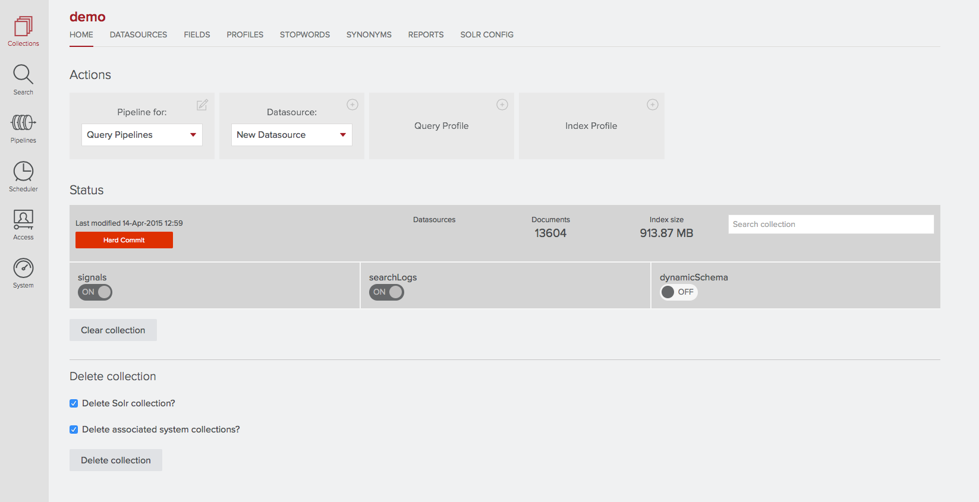

Slide 5
Schema
We modified the schema file by removing the unnecessary fields and adding an extra field.
This supports our special collection.

Slide 6
Template Summarization
Fusion provides a template where each field contains an arbitrary descriptor.
Title Author Name
Organization Publication date
People Category
Topics

Slide 7
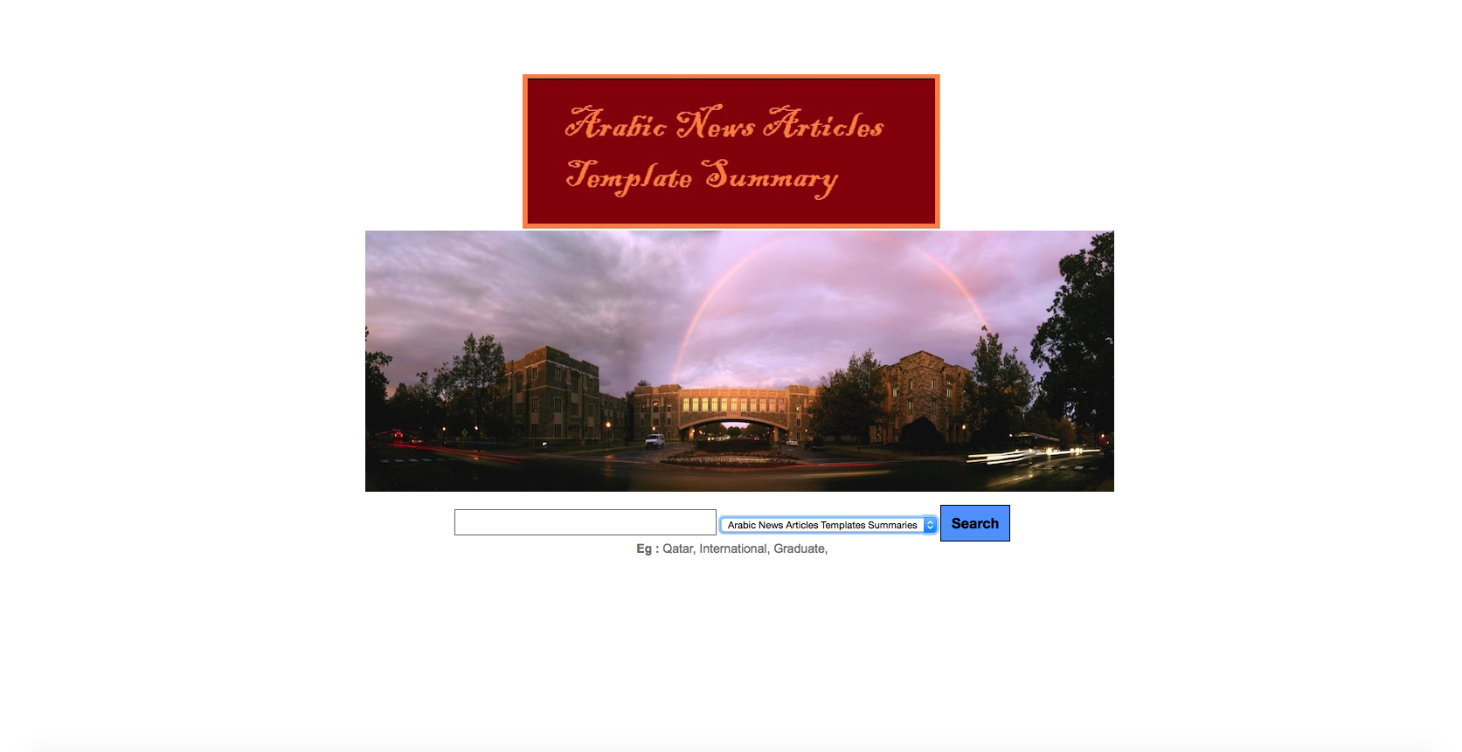
Interface

Slide 8
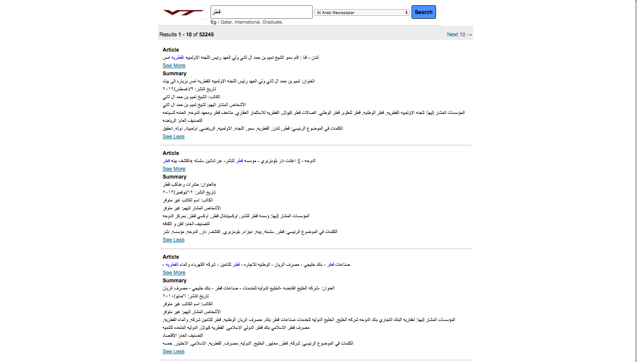

Slide 9
Acknowledgements
Professor: Dr. Edward Fox
Client: Tarek Kanan
QNRF – NPRP Grant #: 4-029-1-007

