Slide 1
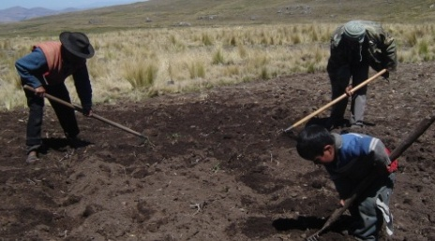
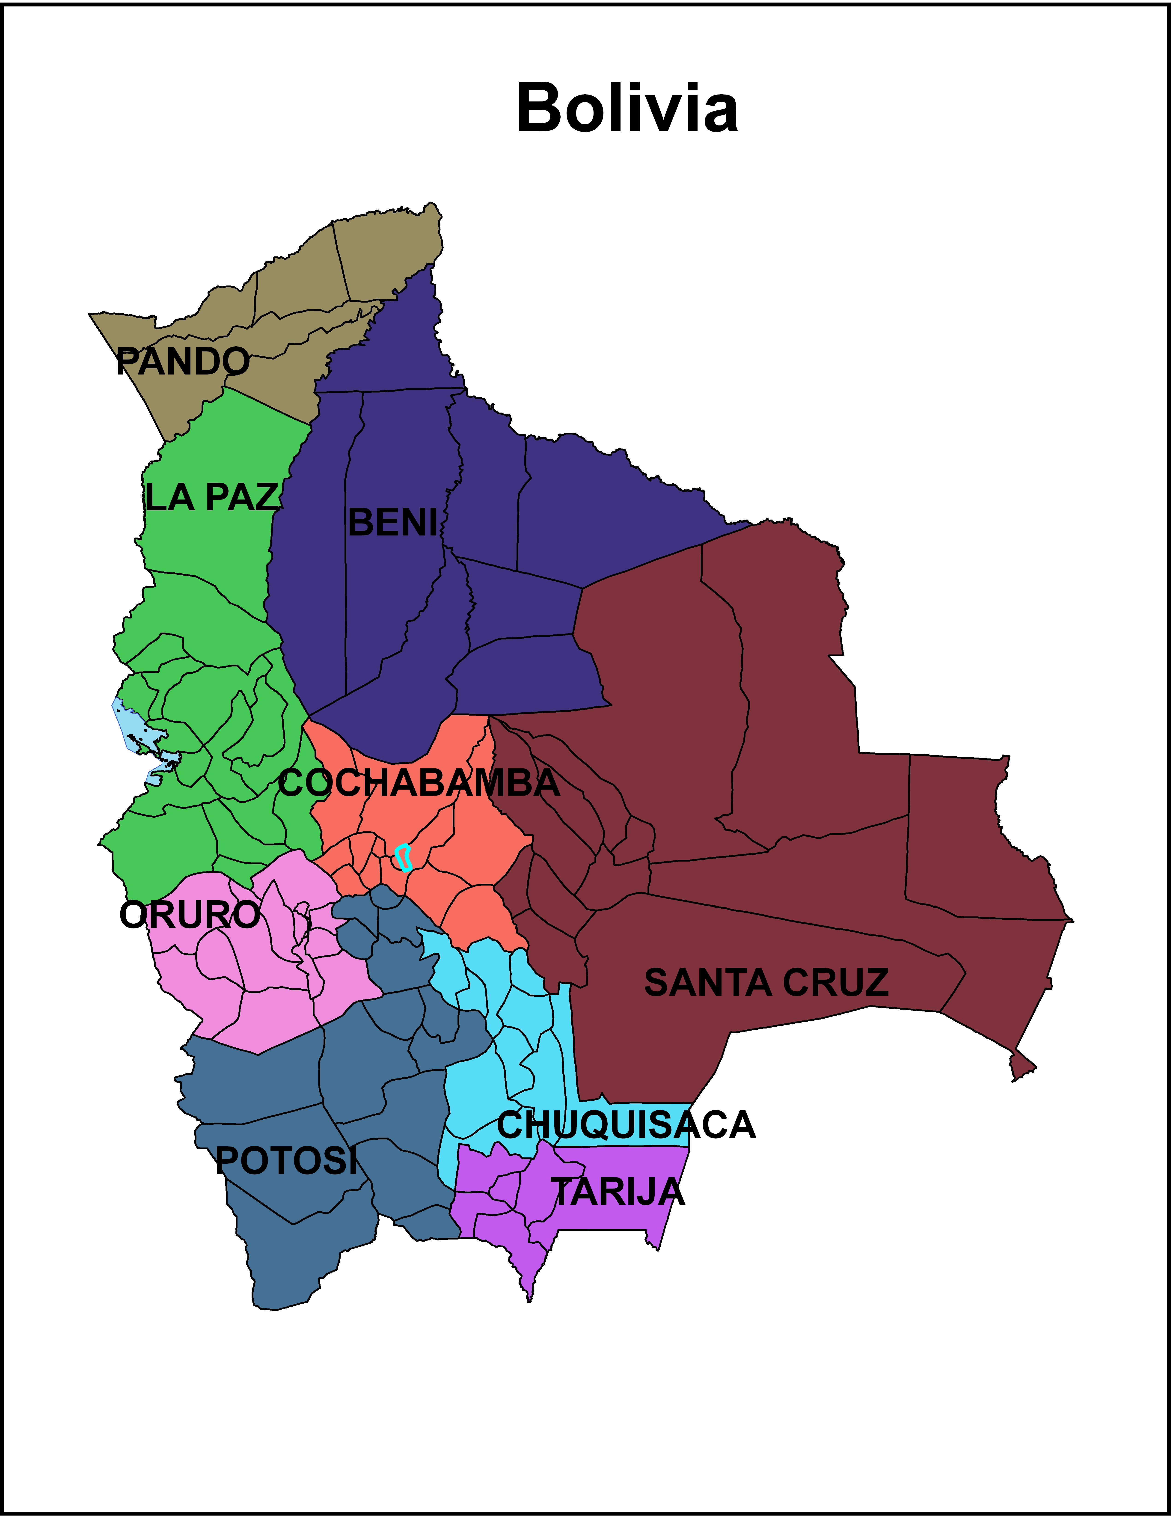
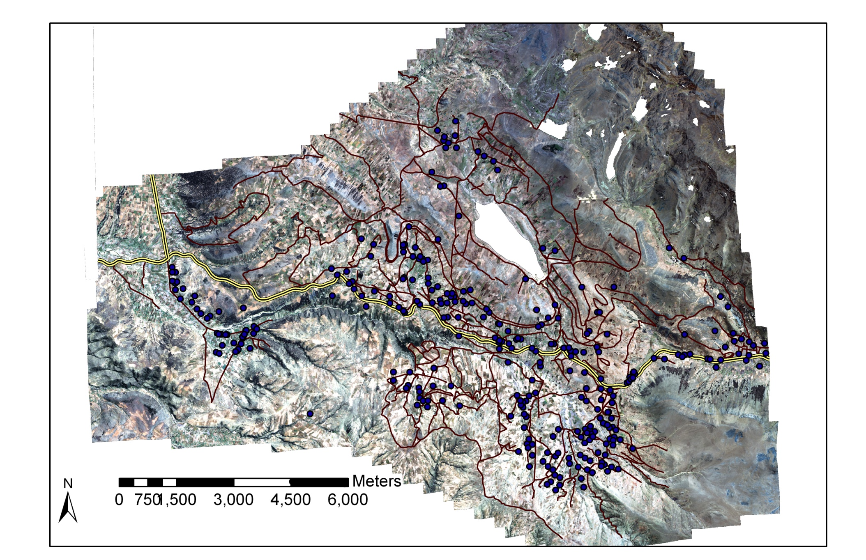
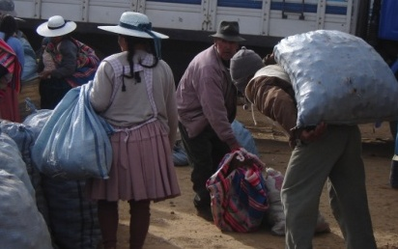
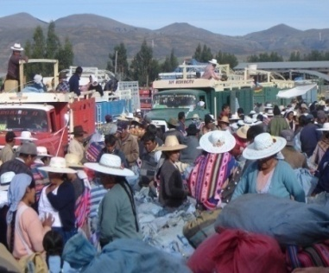


Market participation decisions and market choices: A case study of Bolivian potato farmers
Catherine Larochelle and Jeffrey Alwang, Department of agricultural and applied economics, Virginia Tech
International Association of Agricultural Economists (IAAE) Triennial Conference, Foz do Iguacu, Brazil, 18-24 August, 2012.
Introduction
Conceptual framework
Results
Conceptual framework
Potato production is vital for impoverished households in the Bolivian Andes.
Market participation can be an useful tool to lift small-scale farmers out of semi- subsistence farming and escape poverty¹.
Identifying obstacles to market participation and factors to promote participation in higher-valued markets is necessary to increase farmers’ income and welfare.
Y₁ = Market participation
Market participation | Quantity sold | Optimal market choice
Fixed transaction costs
-Radio ownership increases the probability of market participation by 6.5%. -An one unit increase in population density increases (population/0.8 km²) the probability of joining the market by 0.6 percent. | NA | -Radio ownership increases the probability of selecting an optimal marketing strategy by 3%.
Proportional transaction costs
-Living 1 km further away from Tiraque and Santa Cruz markets decreases market participation by 1.1% and 0.02% respectively. | -Living 1 km further away from Tiraque and Santa Cruz markets decreases quantity sold by 280kg and 5kg respectively. | -Living 1 km further away from the Tiraque and Santa Cruz markets decreases the likelihood of selecting an optimal marketing strategy by 13.9% and 0.2% respectively.
Determinants of household supply of potato |  | Supply
Insignificant | -An additional hectare in farm size increases quantity sold by 872 kg. | Selling an additional 1,000kg of potato increases the likelihood of selecting an optimal marketing strategy by 2.2%.
Determinants of household demand for potato
-An additional child decreases the probability of market participation by 1.3%. | Insignificant | NA
Household characteristics
-Households whose head attended secondary school are 11.9% more likely to participation in the market compared to households whose head has no formal education. | -Being a female household head reduces the quantity sold by 919 kg. -Primary education of the household head increases quantity sold by 574 kg compared to no education. | -Primary education of the household head increases the probability of selecting an optimal marketing strategy by 4.6% compared to no education. -An one-year increase in the age of the household head reduces the probability of selecting an optimal marketing strategy by 1.1%
Access to liquidity
NA | NA | -An additional 1,000 Bs in livestock ownership value increases the likelihood of selecting an optimal marketing strategy by 1.3%.
✓Potato is the main food crop and cash crop followed by beans, cereal, and livestock.
✓Potato sales represent 79.5% of crop revenue and 49.5% of total household revenue.
No
Yes
Y₂ = Quantity sold
100 kg
37,500 kg
Market choice
Household and Market Location
Cochabamba
Santa Cruz
Tiraque
Punata
Tiraque
4 Km
Marketing strategy:
Any combination of these markets
Cochabamba
60 Km
Stochastic Dominance analysis
To identify the marketing strategies (i.e. those that lead to higher prices)
Punata
16 Km
Y₃ = Optimal market choice
Santa Cruz
400 km
No
Yes
x₁ = Fixed transaction costs
x₂ = Proportional transaction costs
x₃ = Determinants of household supply of potato
x₄ = Determinants of household demand for potato
x₅ = Household characteristics
x₆ = Access to liquidity
Research questions
Research questions
What is needed to simulate small-scale farmers market participation and volume sold?
What is needed to improve marketing performance?
Conclusions
Data
-Reducing the costs of obtaining price information (additional price broadcasting, cellular use, training) could raise producers welfare.
-Improving transportation alternatives and road quality in the study area could increase quantity sold and facilitate sales in more lucrative markets.
-Policies aimed at increasing market surplus, such as technical assistance, could generate additional sales and provide better market opportunities to farmers, increasing their income.
Credit programs, easing liquidity constraints, could help farmers adopt more profitable marketing strategies.
Data
Survey data:
  354 potato farmers
  Data on agricultural activities, market participation, household characteristics, etc.
  Geo-referenced household location
  GIS data for road network, elevation, soil, etc.
Market participation and quantity sold
  317 households sold an average of 4914 kg (5881) of potato
Optimal market choice:
  Optimal marketing strategies are: 1) Santa Cruz, 2) Cochabamba, 3) Punata/Tiraque/Cochabamba, and 4) Punata/Tiraque/Santa Cruz.
  36 households selected an optimal marketing strategy
Methods
Simultaneous system of 3 equations with selectivity and a recursive equation²
Acknowledgment:
We acknowledge funding support from Sustainable Agricultural and Natural Resource Management Collaborative Research Support
Program (SANREM CRSP).
Reference:
[1]: Barrett, C.B. (2008), Smallholder market participation: Concepts and evidence from eastern and southern Africa, Food Policy 33(4): 299-317.
[2]:Roodman, D. 2011. Fitting fully observed recursive mixed-process models with cmp. Stata Journal 11: 159-206

