Slide 1
Team 1: Knowledge Graphs
Final Presentation, Fall’23, CS-5604, Information Storage and Retrieval
Presented On - 11/30/2023
Students
Daniel Gaugler (danielg19@vt.edu)
Ashish Aggarwal (ashish1702@vt.edu)
SME
Satvik Chekuri (satvikchekuri@vt.edu)
Virginia Tech, Blacksburg, VA 24061

Slide 2
Introduction
Within an ETD, there are many data elements such as:
  Document metadata
  Chapters
  Tables
  Figures
  etc.
Currently even with these objects stored in the database there is no effective way to determine the relationships between them.
  There is not process to iterate through these elements even if they are closely related.
  For example: the caption of a given figure, the chapter the figure and caption are located in, or even the ETD the elements originated from
Our team will be creating knowledge graphs to help build these relationships

Slide 3
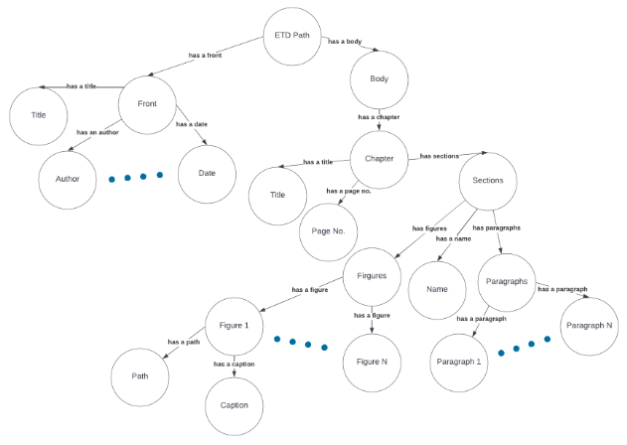
What are Knowledge Graphs
Knowledge graphs are structured data representations for computer processing.
Knowledge graphs are composed of nodes (entities) and edges (relationships).
  Nodes and edges have unique identifiers (e.g., URIs).
Knowledge graphs utilize RDF (Resource Description Framework) for interconnected data representation.
Notes:
Scalable for handling extensive interconnected data.
Flexible, allowing for easy addition or modification of information.

Slide 4
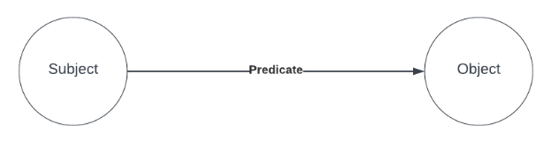
RDF triple
RDF (Resource Description Framework) triples are the basic building blocks of data in the Semantic Web.
Each RDF triple consists of three parts:
  Subject: This represents the resource being described. In other words the subject is what the information is about.
  Predicate: This represents the property or relationship between the subject and the object. Like the subject, it is represented by a URI within our system. The predicate defines the kind of information being expressed such as title of, chapter of, cited by, etc.
  Object: This represents the value of the property or relationship. It can be a URI or a literal value (like a string or a number). The object is what the subject’s property is related to.
Notes:
Knowledge graphs utilize RDF (Resource Description Framework) for interconnected data representation.
RDF assigns URIs to nodes in a graph, structuring information.
RDF statements are used for metadata description and exchange.
RDF imparts semantic meaning to unstructured ETD data.

Slide 5
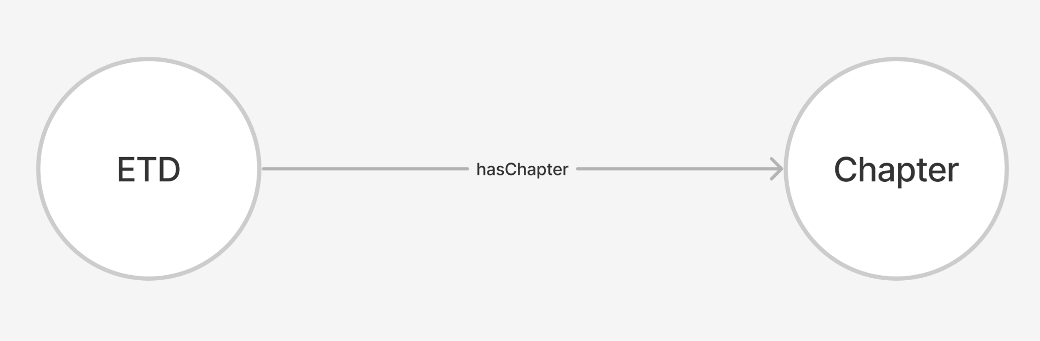
RDF Triple Example

Slide 6
RDF Triple Schema
Total of 49 types of unique RDF triples
  Number of RDF triples per ETD roughly 600 unique entries
Schema can essentially be broken down into 3 types:
  Firstly, the ETD storing metadata (simplified):
Subject | Predicate | Object
ETD | hasTitle | Title
ETD | hasAuthor | Author
ETD | publishedOn | Date
ETD | publishedBy | University
ETD | committeeMember | Committee Member
ETD | degreeType | Degree
ETD | academicDiscipline | Department

Slide 7
RDF Triple Schema (continued)
Secondly, the ETD storing chapters, abstracts, and table of contents
  These values are stored as related to the ETD and contain other elements as well
Thirdly, the chapters, abstracts, and table of contents storing elements that are located within them.
  For the abstract and table of contents this is mostly just storing the text of the abstract and table of contents.
  For the chapter this includes storing:
    Sections
    Paragraphs
    Figures
    Equations
    Tables
    Footnotes
    etc.

Slide 8
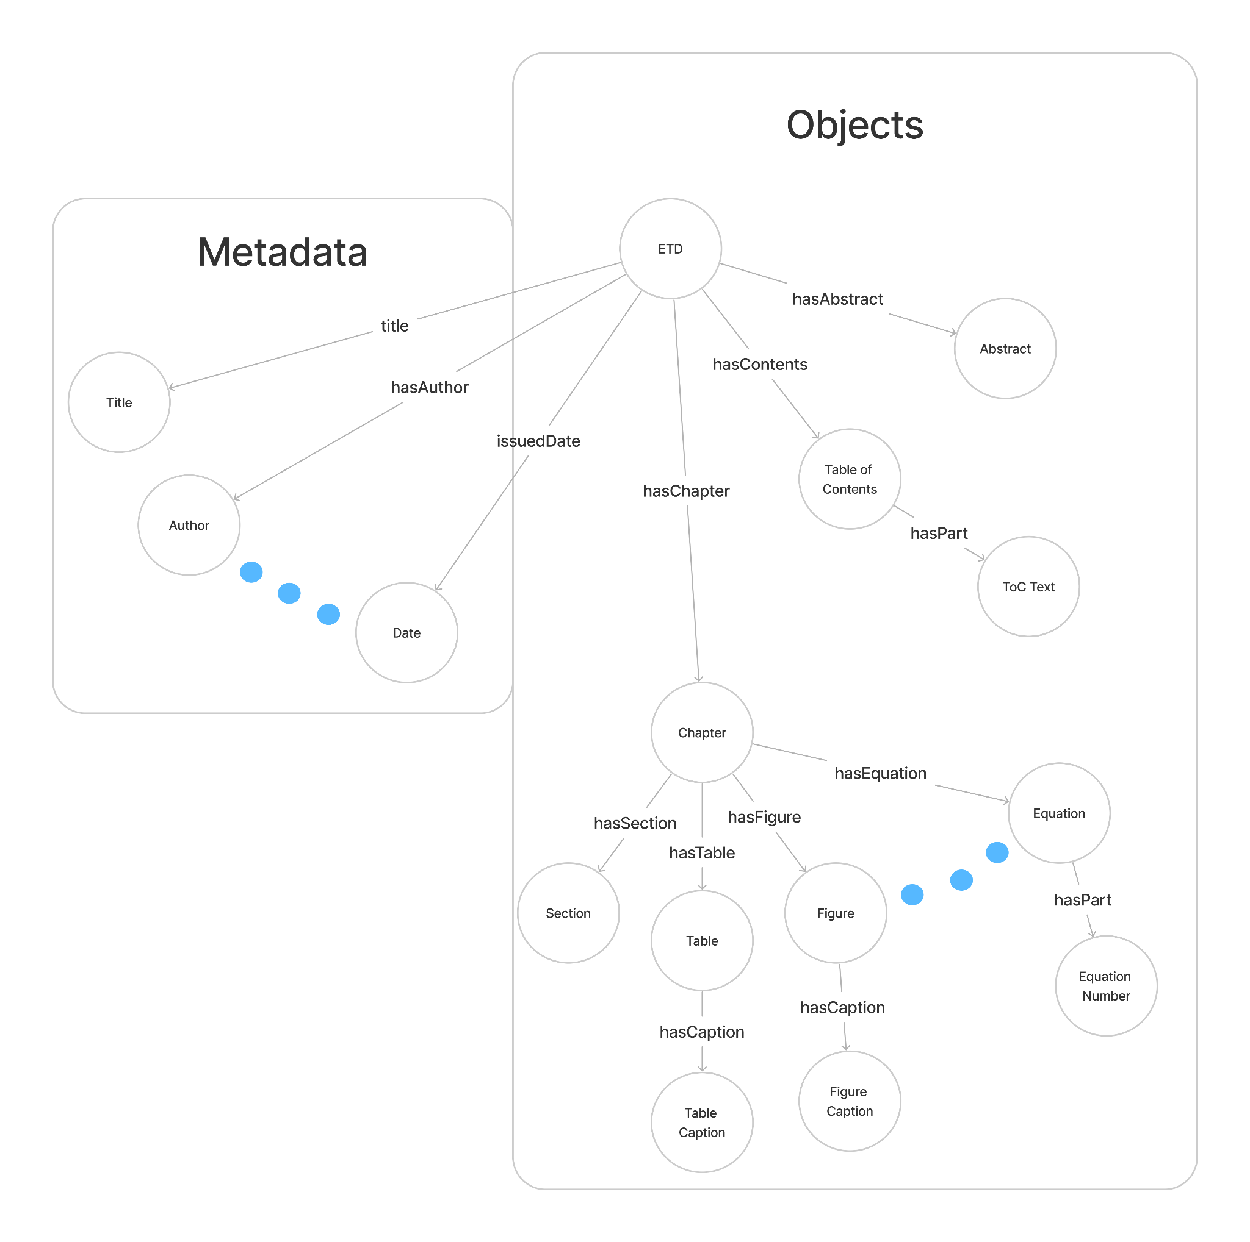
Schema Diagram

Slide 9
ETD to RDF Triples Script
Currently Python script that parses XML file representing the ETD
  Extracts the necessary triples from the file
Used on 200 ETDs provided to us from the object detection of Team 3
Stores objects in the triple as URIs; example of a chapter being stored:
The first box is the URI of the ETD
The second box is the URI of the “hasChapter” predicate
The third box is the URI of the Chapter itself
http://etdkb.endeavour.cs.vt.edu/v1/objects/6384265 | http://etdkb.endeavour.cs.vt.edu/v1/predicate/chapterOf | http://etdkb.endeavour.cs.vt.edu/v1/objects/6384228

Slide 10
Top-down and Bottom-up Triples
The queries we perform can filter for Subject and Predicate but not for the Object.
Example: We want to find the chapters of a specific ETD.
  We could query using the ETD ID as the subject and “hasChapter” as the predicate.
  This would return all triples matching this convention, meaning we could see all the URIs of the chapters in this ETD.
Now say we have a chapter and want to find the entire ETD it belongs to.
  We cannot query based on Object value.
  So we must create an inverse Triple with a “bottom-up” format.
Subject | Predicate | Object
ETD ID | hasChapter | Chapter ID
Chapter ID | chapterOf | ETD ID

Slide 11
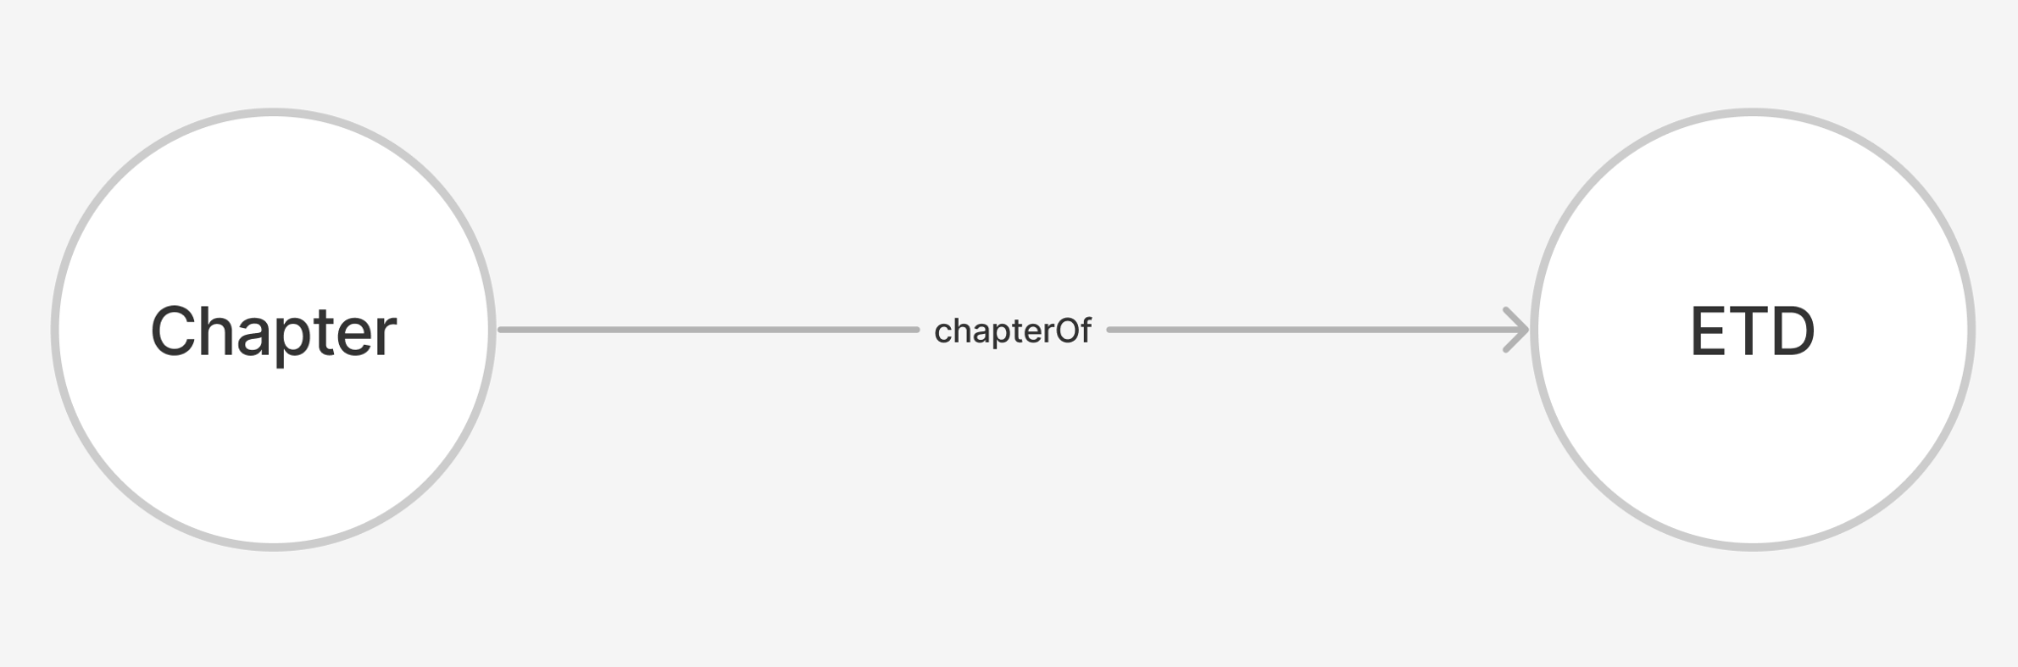
Top-down and Bottom-up Triples
This means for every relationship we must store two sets of triples:

Slide 12
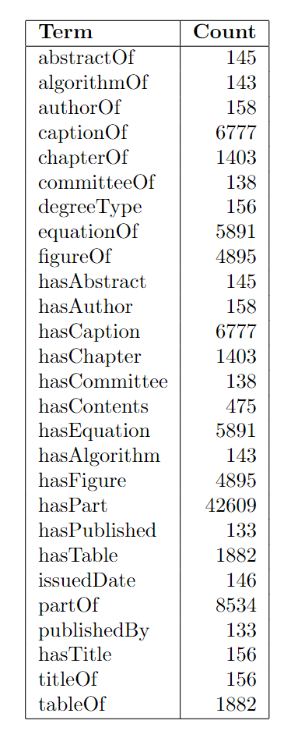
Analysis of Generated Triples
Total of 95k triples generated for ~160 ETDs
These are the counts for each type of predicate that can occur in an ETD.

Slide 13

Virtuoso - Graph Database
Virtuoso is a high-performance, scalable, and extensible triple store and graph database. It's designed to handle large-scale RDF data and is widely used in the context of the Semantic Web and Linked Data.
For our purposes we will use it for RDF Triple Store: Virtuoso is primarily known for its ability to store and query RDF triples, making it a crucial tool for managing Semantic Web data.

Slide 14
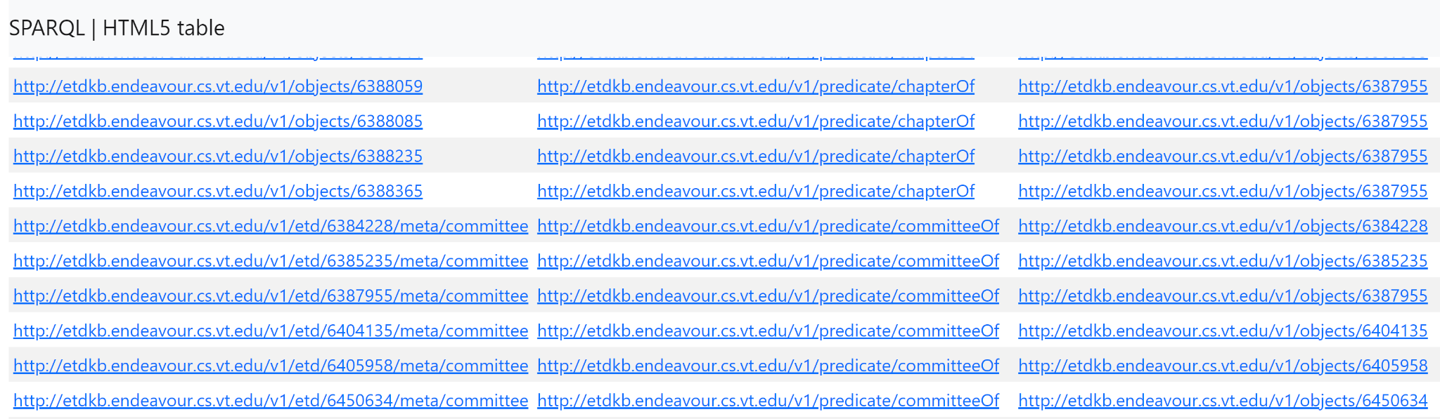
Store Triples in Virtuoso
Virtuoso deployed on Endeavour container
Successfully uploaded RDF triples into Virtuoso
Allows for uploaded triples to be queryable via SPARQL
  We can query by subject, predicate, or object or any combination of them using filters in SPARQL.
Successfully uploaded RDF triples of 200 ETDs into Virtuoso

Slide 15
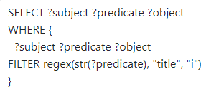
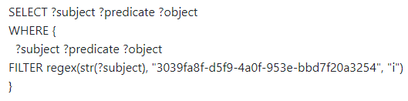
SPARQL Examples
Fetch all relationships for the mentioned ETD ID
Fetch all ETDs that have “title” predicate

Slide 16
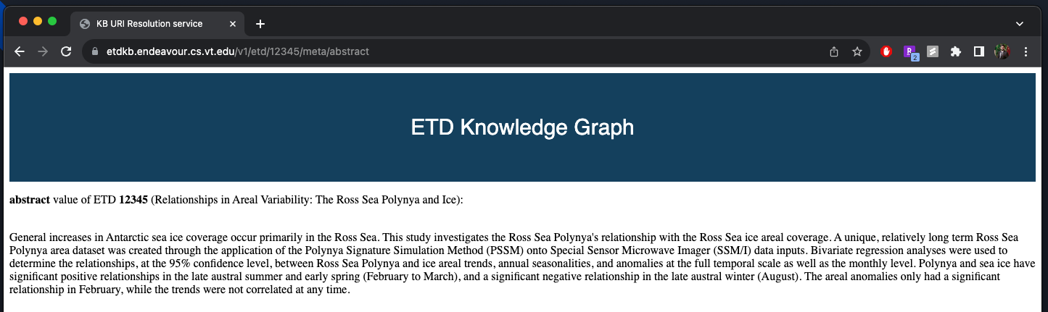
URI Resolution Service
This web service resolves URIs which are returned as part of the SPARQL query. The user can click on the URI and they will be redirected to a webpage that contains supplemental information.
This is a RESTful service with 3 main routes:
  v1/etd/:etdId/meta/:metaProp
    This route fetches data from the “metadata” table of PostgreSQL.
  v1/objects/:objectId
    This route fetches data from the “objects” table of PostgreSQL.
  v1/predicate/:predicateName
    This route fetches data from a JSON stored in server.
The domain of the service is - https://etdkb.endeavour.cs.vt.edu/

Slide 17
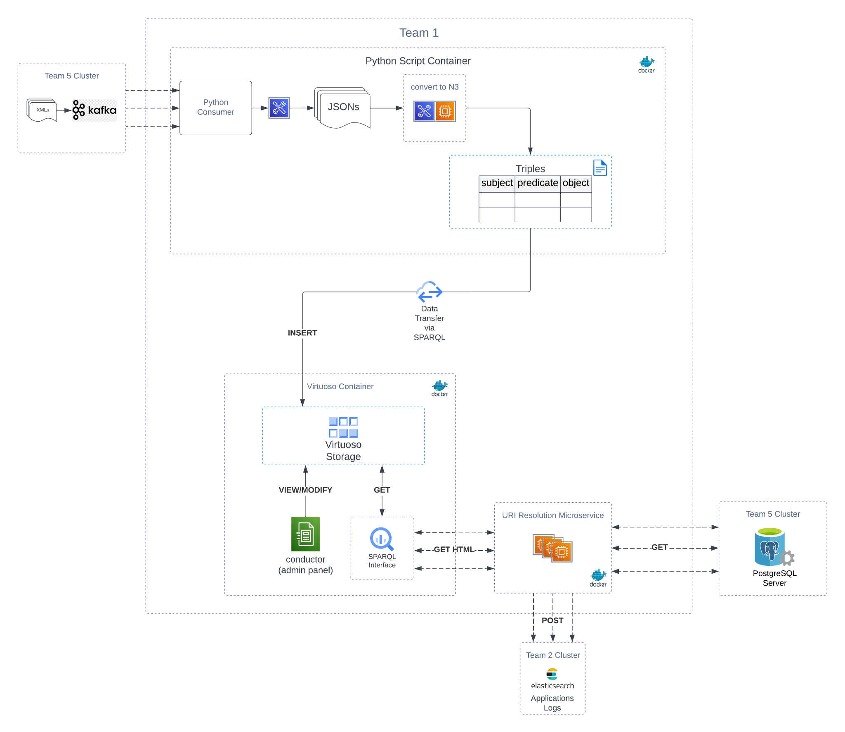
System Architecture

Slide 18
Future Work
Object detection was only completed for a set of 200 ETDs; future researchers shall work on performing OD and generating XML files for all the 500K ETDs.
  To also consider the page images being generated for each ETD by Team3 and later their XML files.
Expand the triple extraction and ingestion process to Virtuoso DB for the remaining ETD XML files in the collection (500K).
Enhance the URI resolution service UI.
Build a custom UI integrated with Search interface to query the ETD RDF graph without the end-user needing to enter SPARQL queries in Virtuoso interface.
Extract entities from the textual objects of ETDs using NER methods to build a finer grained KG.
The Kafka implementation could not be completed due to delays within other teams. We manually utilised a set of dummy 200 ETD XMLs provided to us.
  Automate the pipeline for triple extraction and ingestion into Virtuoso DB.

Slide 19
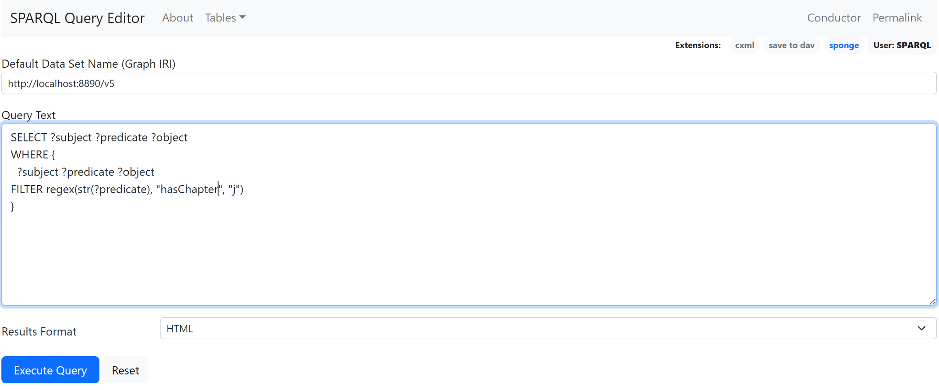
Demo Step 1
Example SPARQL query that queries by predicate

Slide 20
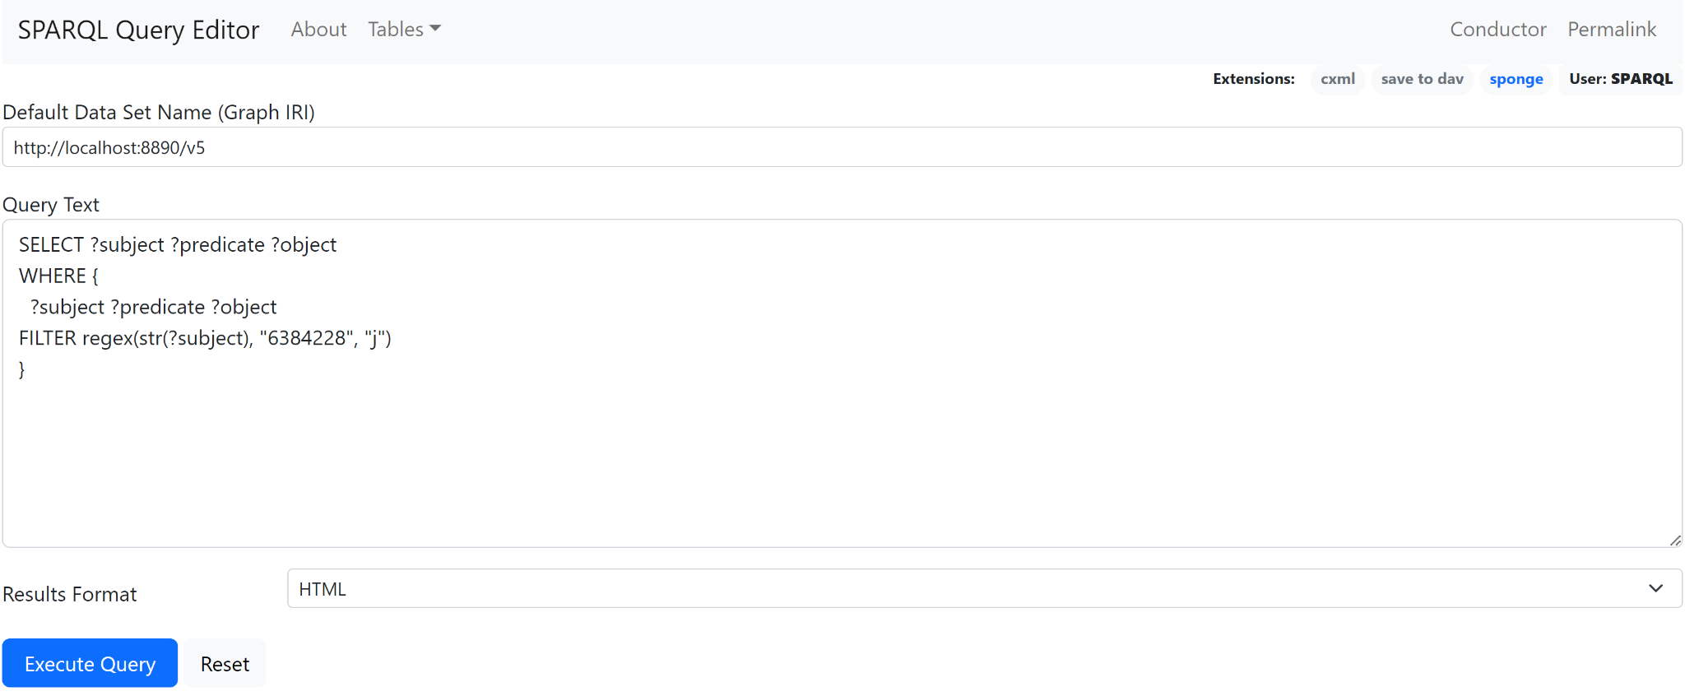
Demo Step 2
Example SPARQL query that queries by subject

Slide 21

Demo Step 3
Example SPARQL query that queries by both predicate and subject

Slide 22
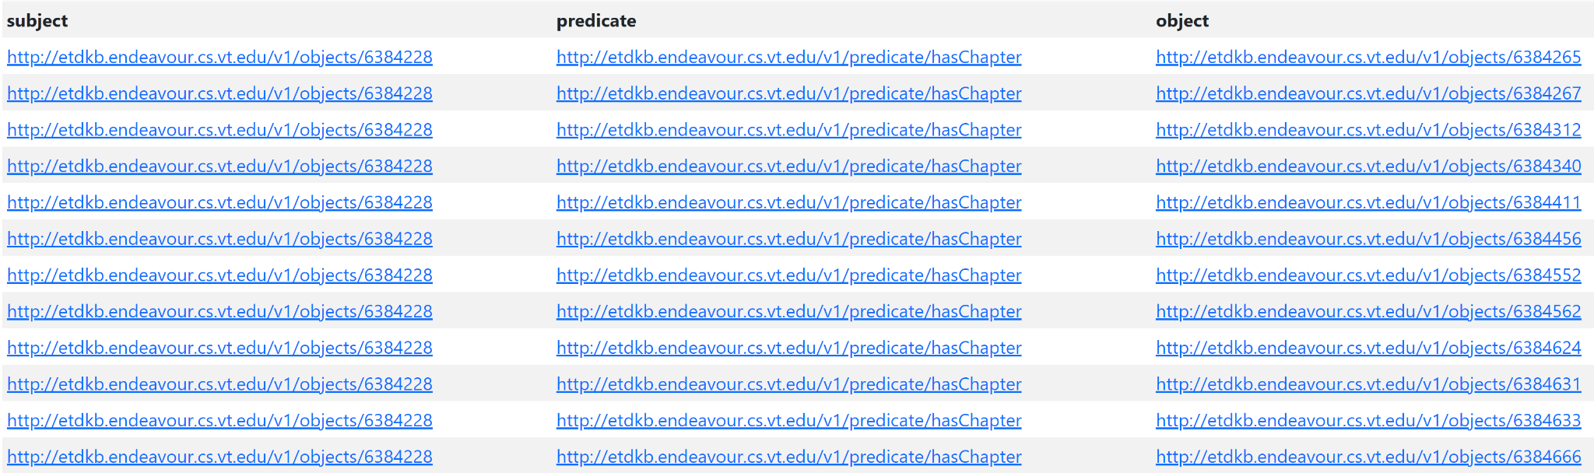
Demo Step 4
Results of the query by both subject and predicate

Slide 23
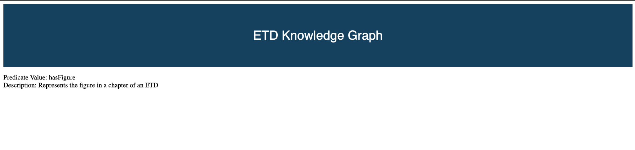
Demo Step 5
URI resolution of an example predicate: “hasFigure”

Slide 24
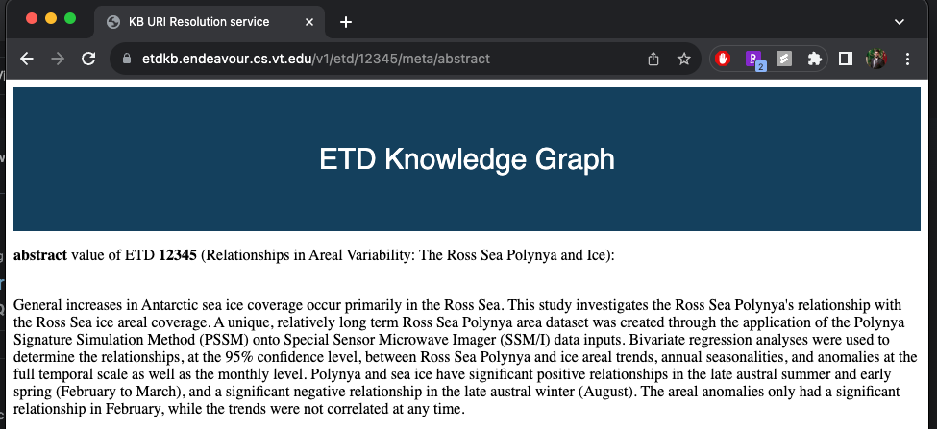
Demo Step 6
URI resolution of an example abstract

Slide 25
Thank you!

