Slide 1
Project Figures
Jonathan Reynosa & Sa Hyun Min
CS 4624 Multimedia, Hypertext, and Information Access
Dr. Edward A. Fox
Virginia Tech, Blacksburg VA, 24061
5/11/2022

Slide 2
Table of Contents
Problem and Motivation
Deliverables and Requirements
Project Timeline
Methodology
Final Design
Lessons Learned
Future Work
Acknowledgements
References

Slide 3
Problem and Motivation
Problem
  Need a way to search through various pdfs and return matching images/graphs within the ETDs.
Motivation
  Electronic theses and dissertations (ETDs) contain a rich amount of figures used for demonstrating scholarly results and observations
  Challenge to effectively search for figures existing in a large number of research documents stored in PDF files

Slide 4
Deliverables and Requirements
Deliverables
  1000 processed ETDs and their respective figures, captions, and document metadata.
  Web-Based Interface built upon ODU's current user interface
Requirements
  Index figure data making use of Elasticsearch
  Allow users to upload PDF files that would be searched
  Build a web-based interface
    Accepts text queries
    Returns the appropriate figures and metadata

Slide 5
Project Timeline
02.15
03.01
03.15
03.29
04.12
05.01
Improve Foundation
Improve Prototype
Debug
Create Foundation
Make Prototype
Finish Project
Front End >>
Get server running
Minor changes to front end
Process one PDF file
Process 1000 PDF files
Troubleshoot and Improve Aesthetics
Finish Project
Back End >>
Explore Framework
Process and Extract Figures
Index figures and data
Combine Front End and Back End
Implement Haystack and improve searching
Finish Project

Slide 6
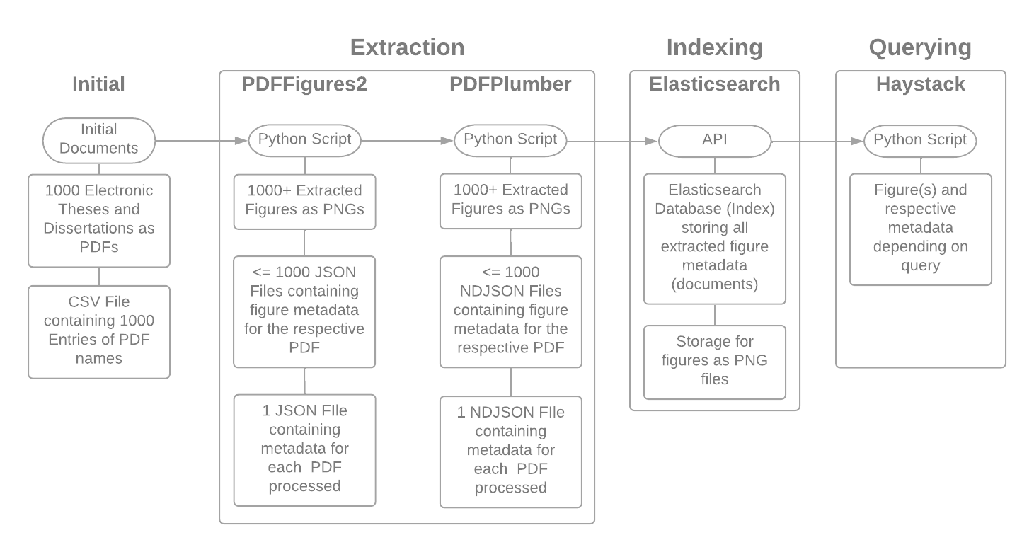
Methodology - Back End

Slide 7
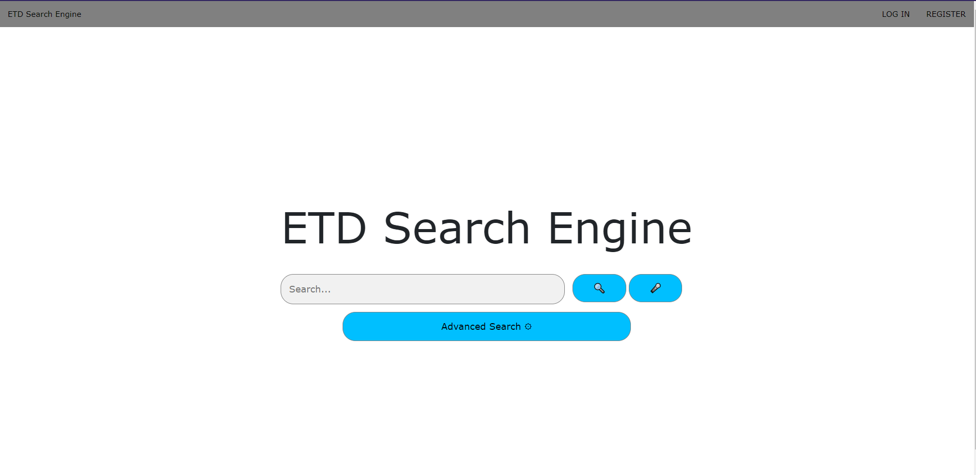
Methodology - Front End
Front End
  Running on localhost.
  Written in PHP, HTML, and Javascript
  Based on ETDUI
  Features
    Allow search for words in figure captions and image text
    Allow users to upload PDFs

Slide 8
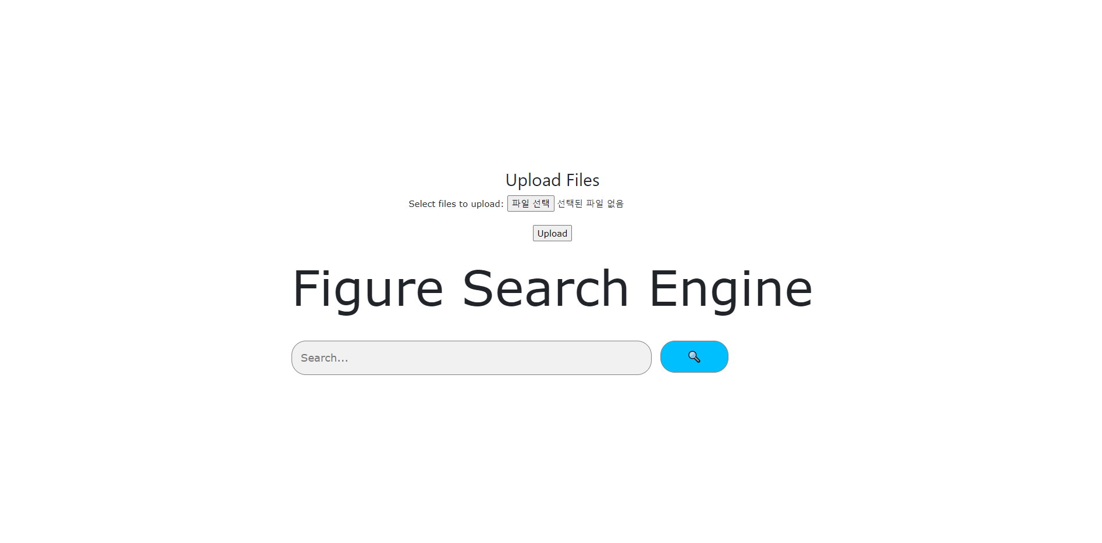
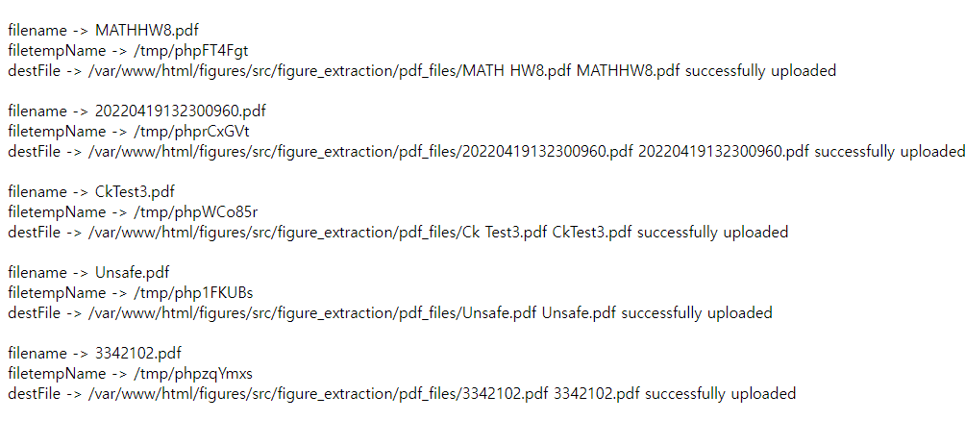
Final Design
Main page
>Allows users to upload PDFs
>uploaded PDFs would be searched
File Upload Page
>Allows users to see what PDFs they uploaded
>Also can see the name of the file and where the file is stored.

Slide 9
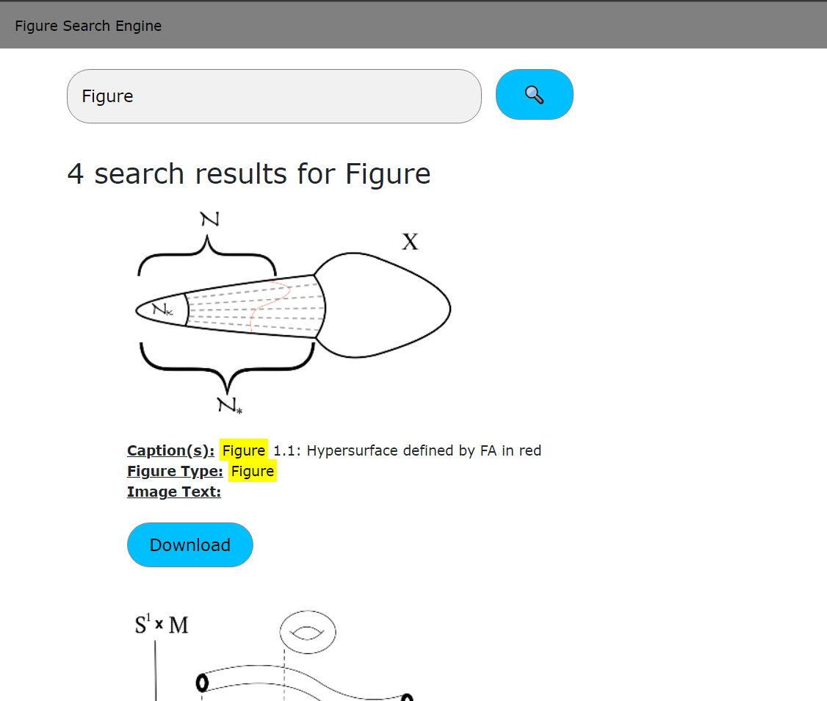
Final Design
Result page
>Figures are shown
>Search for keyword in caption / words within figures.

Slide 10
Lessons Learned
Front End
  Running the base website.
    Readme.txt directions vague.
  Different Front End
    Could have created our own original
Back End
  Project Scale
    Learn various frameworks
    Learn to work with various languages
  Communication
    Reaching out helped us in doing work faster

Slide 11
Future Work
Front End
  Run on actual website, not on localhost.
Back End
  Image Text
    Extract text from images in a better manner
    Add another framework to pipeline
  Haystack
    Increase precision and accuracy of searches

Slide 12
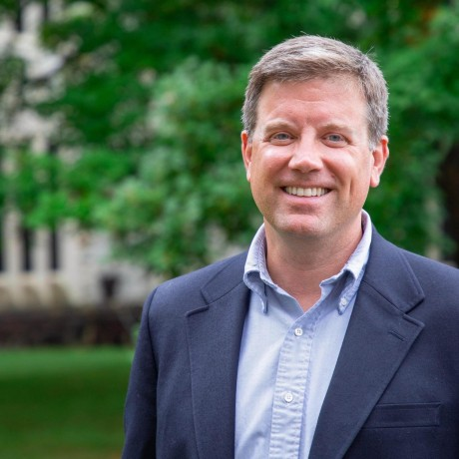
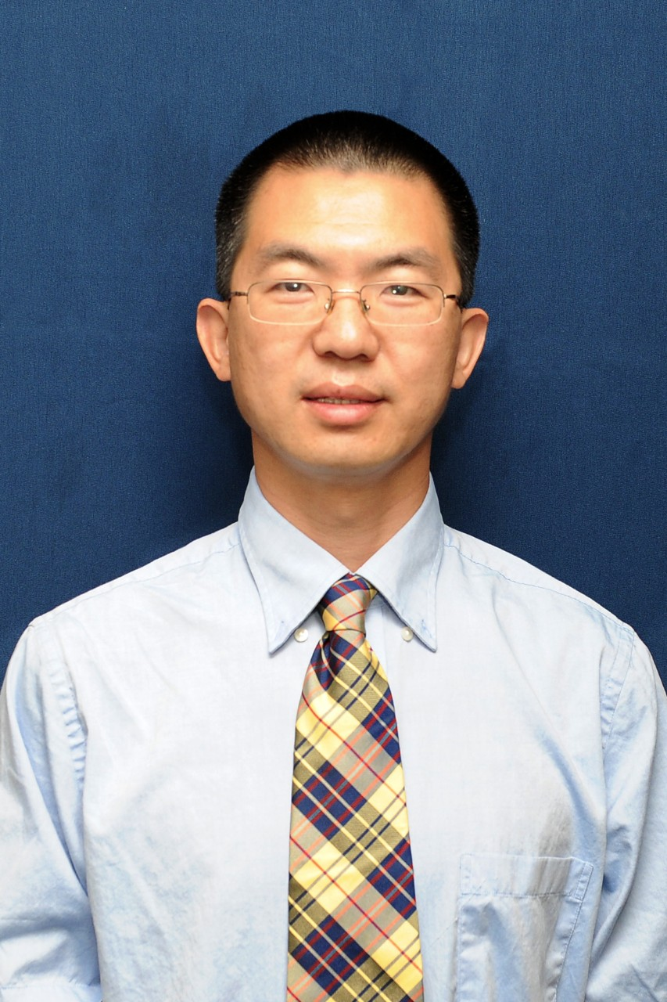
Acknowledgements
William Ingram
Jian Wu
Assistant Dean and IT Services Director
VT University Libraries
Assistant Professor in the CS Department
Old Dominion University

Slide 13
References
https://canvas.vt.edu/courses/145290/pages/s2022project-figureextractionwebservice
https://canvas.vt.edu/courses/145290/pages/s2022project-figureextractionwebservice
https://opening-etds.github.io/
https://github.com/allenai/pdffigures2
https://www.elastic.co/what-is/elasticsearch
https://experts.vt.edu/5675-william-a-ingram
https://www.odu.edu/directory/people/j/j1wu

