Slide 1
Receive $1500 for Publishing Your Next Article
VT’s OPEN ACCESS SUBVENTION FUND
Gail McMillan
Director, Scholarly Communication
University Libraries, Virginia Tech
NLI, Oct. 22, 2014
Notes:
Who am I?
Featured activities in Scholarly Communication
Open Access Week activities: what’s already happened and what’s coming up
How did you learn about this session?
How many of you don’t have tenure yet?

Slide 2
Reputation Economy in Academia
Publishing models need to change
Libraries promoting change
  Hosting
  Publishing
  Subvention funds
Notes:
There are high expectations at academic institutions for faculty to publish in scholarly journals. The more prestigious journals are considered to have a high impact factor, and often have excessively high subscription rates for academic libraries. Library’s collections budget: $9 mil. Library spends on serials: $7 mil
Libraries are balking at this strain on their budgets and responding in a variety of ways.
One way is by expanding library services to include publishing. VT has hosted electronic journals and also hosts open source software that manages the editorial workflow for journals, conference proceedings, and if you’d ask us, monographs.
Publishing models are changing in light of various factors, including the international open access movement and now the expanding federal mandates to make the results of government funded research available to the public.
Virginia Tech’s University Libraries established open access subvention fund to help faculty get their articles published in peer-reviewed scholarly journals that charge article processing fees.

Slide 3
VT’s Open Access Subvention Fund pays Article Processing Charges
Support OA journals
  All articles are publicly available
Support hybrid journals
  Some OA articles
  Some subscription-only articles
Notes:
An increasing number of open access journals are supported through article processing charges. These are rigorously peer reviewed scholarly journals that are in the whole or in part funded by the authors of the articles.

Slide 4
Where do the $$$ come from?
2-year pilot project: $24,00/year
  Dean of University Libraries
  Provost
  Vice President for Research
FY 2015: $50,000
  Dean of University Libraries
  Provost
Notes:
$8,000 from each unit for two years. $24,000 per year. The program is administered by University Libraries

Slide 5
How is the OASF allocated?
For authors that do not have any other source of funding.
$1500.00 per article x 2/yr
  Max $3000.00 per author per year
  Prorated for multiple Virginia Tech co-authors
    $1500 distributed among the Virginia Tech co-authors
    3 authors of one article subsidized at $500 each
Notes:
Yes, but, authors must not have any other sources of funding. OASF is not available for articles resulting from research sponsored by agencies that allow allocations for open access fees like the NIH.
Support is limited to $1500.00 per article and $3000.00 per author per year. For papers with multiple Virginia Tech co-authors, the program would still subsidize the same total amount of up to $1,500 per article but it would be prorated among each of the authors for the purposes of calculating amounts towards the annual limit for individuals, for example, 3 Virginia Tech authors would be allocated $500 each.
Some sources of external funding for publication of research results include: Howard Hughes Medical Institute, Rockefeller Foundation, NIH, NSF

Slide 6
Who can you take advantage of OASF?
The entire Virginia Tech community
  Faculty
  Staff
  Graduate students
  Undergraduate students
Notes:
Everyone in the Virginia Tech community is eligible--all faculty, staff, graduate, and undergraduate students.
Faculty
P&T
AP
Staff
Graduate students and Post docs
Undergraduate students

Slide 7
Who has used the VT OASF?
Notes:
During the Pilot Project (Fy2013-2014)
Other = Institute Director, Lab Specialist (3), Project Associate, Research Associate (3), Research Assistant, Research Engineer, Research Scientist, Research Specialist, Research Technician

Slide 8
Stipulations
Peer-reviewed article accepted for publication in open access or hybrid journal
Open Access Scholarly Publishers Association or similar code of conduct
Journals registered in an OA directory
Hybrid journal publishers reduce institutional subscriptions
Funds allocated in order requests received
Notes:
How to qualify for funding
journal's publisher must be a member of the Open Access Scholarly Publishers Association (OASPA) or comply with OASPA's Code of Conduct.
reputable OA publisher (i.e., not on Beall’s list)
clear contact info
peer-review
editorial or governing board of recognized experts
clear about fees
markets appropriately
clear copyright license
clear instructions
website has high standards
has a means of reporting misconduct
For hybrid OA journals, the publishers must have reduced institutional subscription prices, or plan to reduce prices next year, based on the number of open access publications in the journals.

Slide 9
Request OASF
https://aqua.lib.vt.edu/oa-subvention.php
Name
PID
Department and college
Status (e.g., faculty, graduate student, etc.)
Article: title, journal, publisher
Publisher’s fee
Amount requesting
Link to journal’s OA policy
No alternative sources of article support
Notes:
Status: faculty, undergraduate or graduate student, staff,

Slide 10
Review, vet, prioritize, notify
Applications reviewed by team of librarians
  Gail McMillan, fund manager
Funds
Eligibility
Guidelines
Email notification (10 days)
Notes:
The online application is sent to a team in University Libraries that reviews applications and vets and prioritizes them based on criteria for eligibility, guidelines, and available funding.
Gail McMillan, fund manager
Leslie O’Brien
Julie Speer
Philip Young

Slide 11
Last steps
How are APCs paid?
  Notice to authors includes
    Where to have the invoice sent, or
    Proof of payment for reimbursement
Acknowledge VT OASF in published article
Submit article to VTechWorks
  http://www.vtechworks.lib.vt.edu
Notes:
Payment
After the OASF application is received and the author is sent notification of approval, the author informs the journal to send University Libraries an invoice. Or, the author can send proof of payment and University Libraries will reimburse the department, for example if it paid the Article Processing Charges..

Slide 12
What has the VT OASF supported?
Pilot Project, FY 2013-2014
  55 articles
  117 VT authors
  $58,700 [$48,000 allocated]
FY 2015
  25 requests as of Oct. 19
  13 articles, 43 VT authors
  $16,993.50
Notes:
There’s $33,006.50 OASF available at this time.

Slide 13
VT OASF Pilot Project
Notes:
But how do things look this year?

Slide 14
VT OASF FY2015 as of Oct. 19, 2014

Slide 15
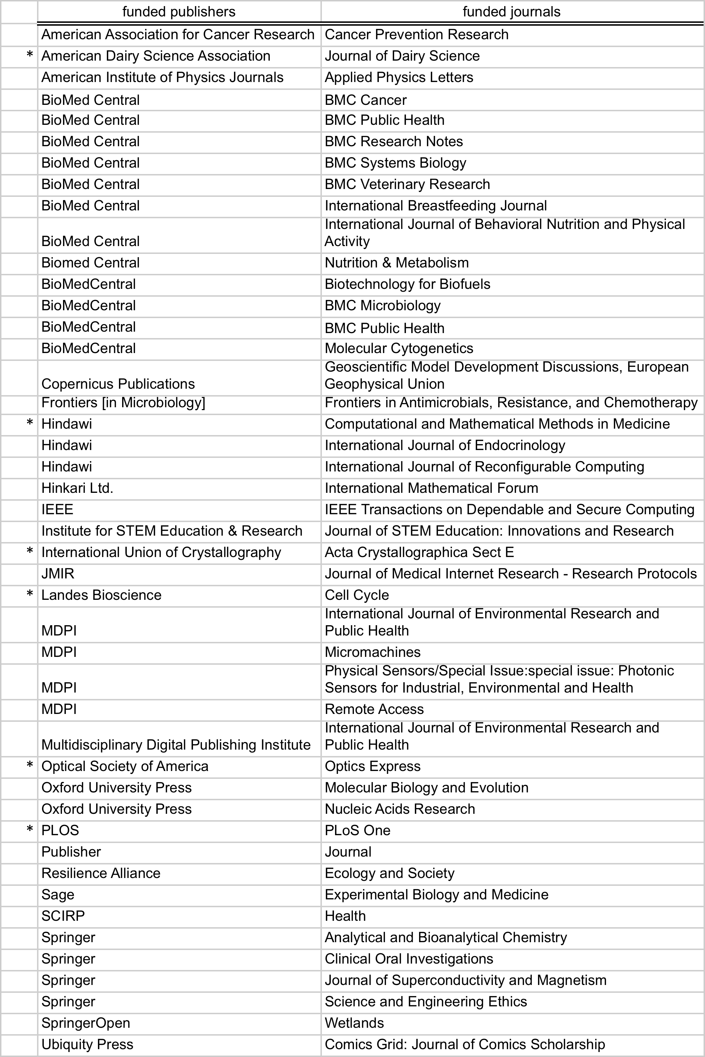

Slide 16
VT Open Access Subvention Fund
https://aqua.lib.vt.edu/oa-subvention.php
Gail McMillan
  gailmac@vt.edu
  540-231-9252
  2036 Newman Library

