Slide 1

Twitter Role Classification
“The Bluebirds”
Gregory Solomon Pickett, Kenneth Worden and Adam Wilborn
CS 4624 - Multimedia, Hypertext, and Information Access Edward A. Fox Virginia Tech, Blacksburg VA 24061
05/8/2019

Slide 2
Outline
Client
Project goals
Development
Results
Testing/User Evaluation
Demo
Acknowledgements

Slide 3

Client
Liuqing Li
PhD candidate working in Digital Library Research Laboratory (DLRL) at Virginia Tech
Wrote a paper on role-related user classification on Twitter

Slide 4
Project goal

Slide 5
Project Goals
Create web interface for TwiRole
Improve accuracy of Twirole

Slide 6
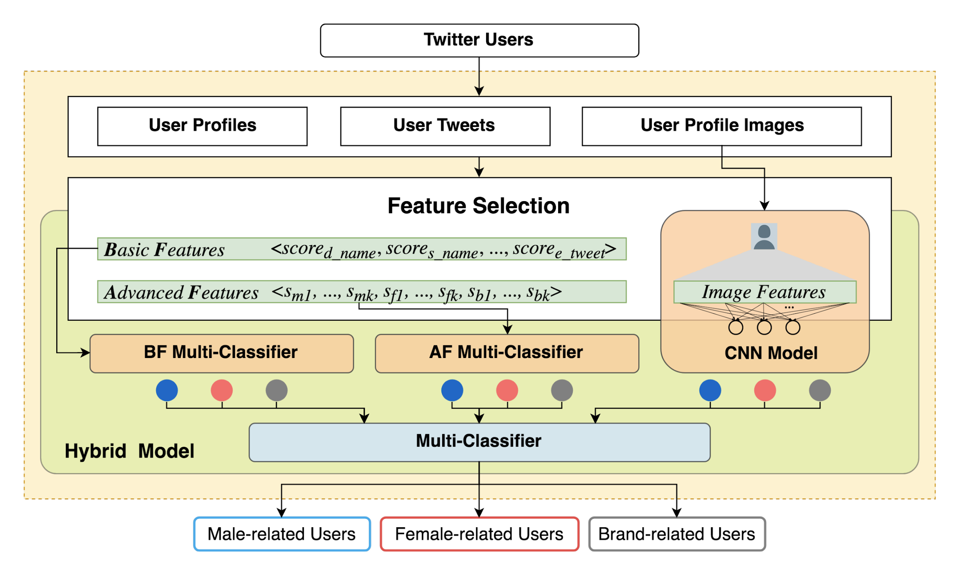
A visualization of the “hybrid” model. From the TwiRole research paper.
Notes:
Adam Wilborn
TWIROLE is a hybrid model consisting of four components. The BF multi-classifier takes the basic features from the user profiles and tweets as an input. The AF multi-classifier focuses on the k-top words in user tweets. CNN works on the user profile images. The final multi-classifier takes the output of the above three modules as an input during training and testing.

Slide 7
Development

Slide 8
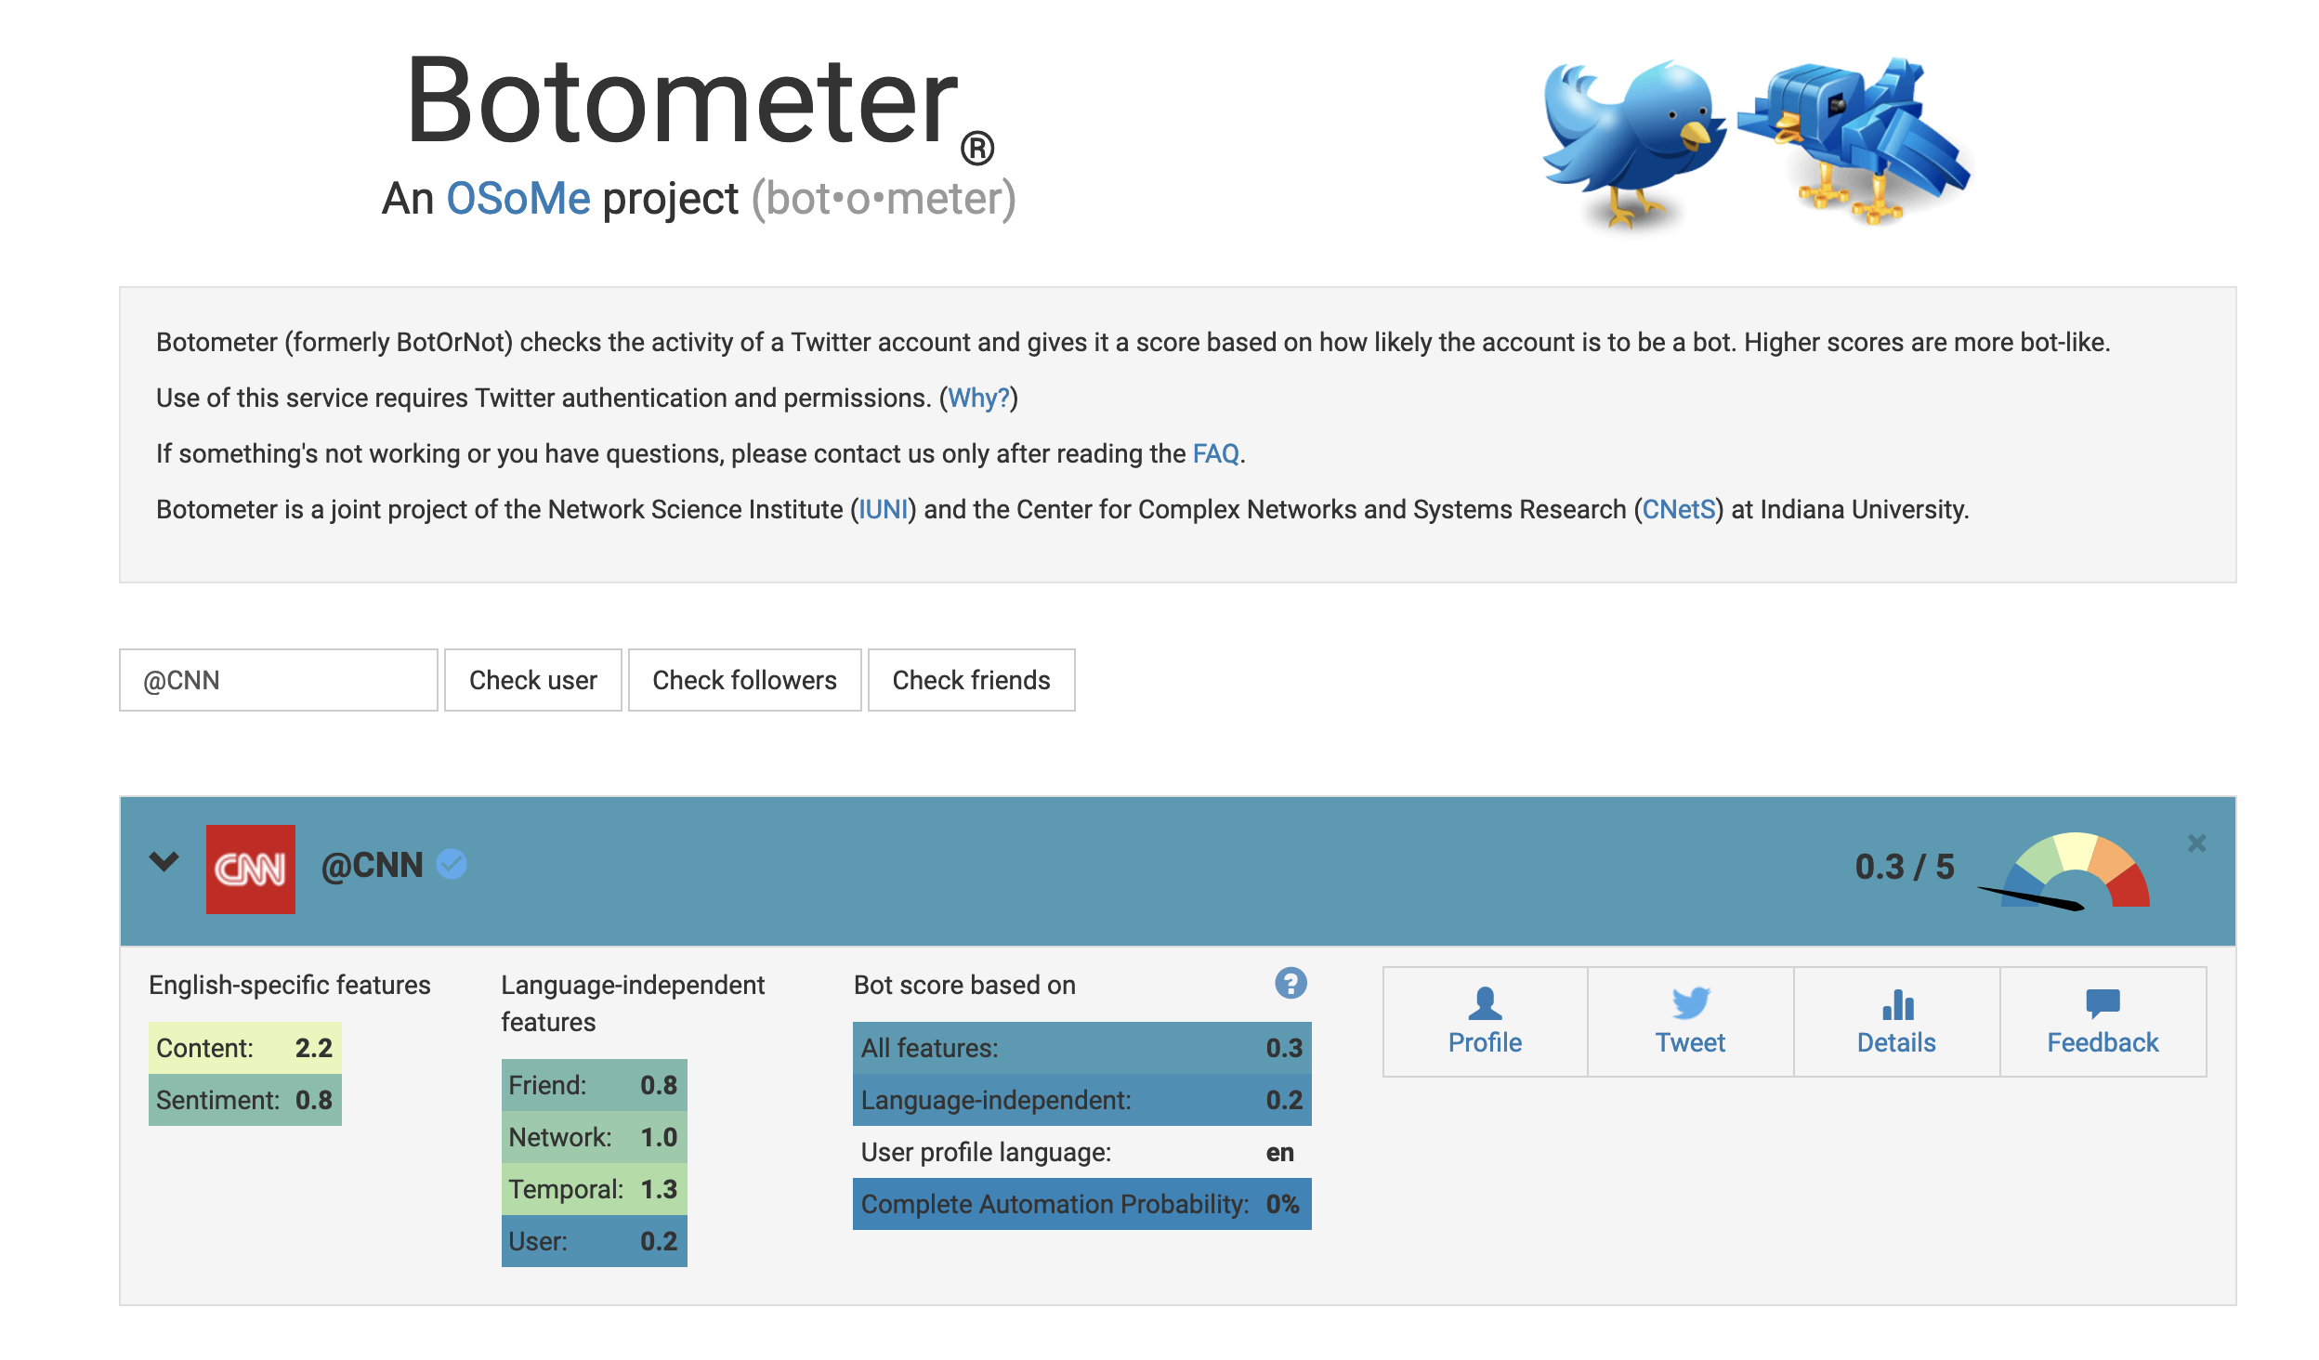
Website
Client wanted something similar to Botometer, a Twitter classification web application.

Slide 9
k -top Emojis
New feature in the advanced classifier
Generates a vector of the most popular emojis for male, female, and brand
Initial results look promising
Notes:
Adam Wilborn

Slide 10
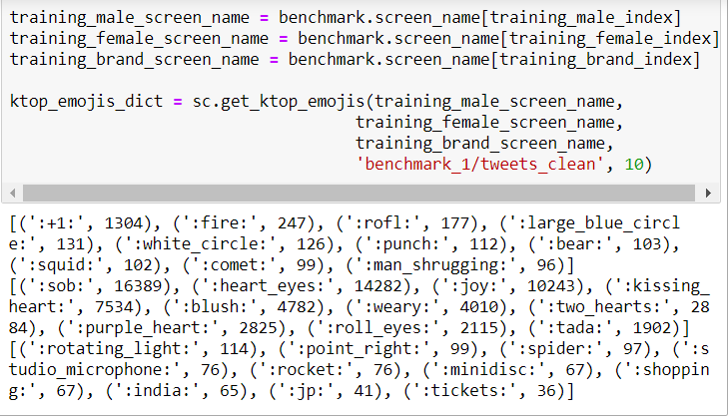
As we can see, each class tends to use unique classes of emojis.

Slide 11
Emoji Frequency
Created to test hypothesis that males, females, and brands use emojis differently
Supported by an empirical observation of emoji usages
Females used 16,000+ of top emoji
Males used 1,200+

Slide 12
Second-person score
Feature in the basic classifier
Calculates a score based on the frequency of second-person terms (e.g. ‘you’, ‘yours’)
Notes:
Adam Wilborn

Slide 13
Third-person score
Feature in the basic classifier
Calculates a score based on the frequency of third-person terms (e.g. ‘he’, ‘she’, ‘it’, ‘they’’)
Notes:
Adam Wilborn

Slide 14
Results

Slide 15
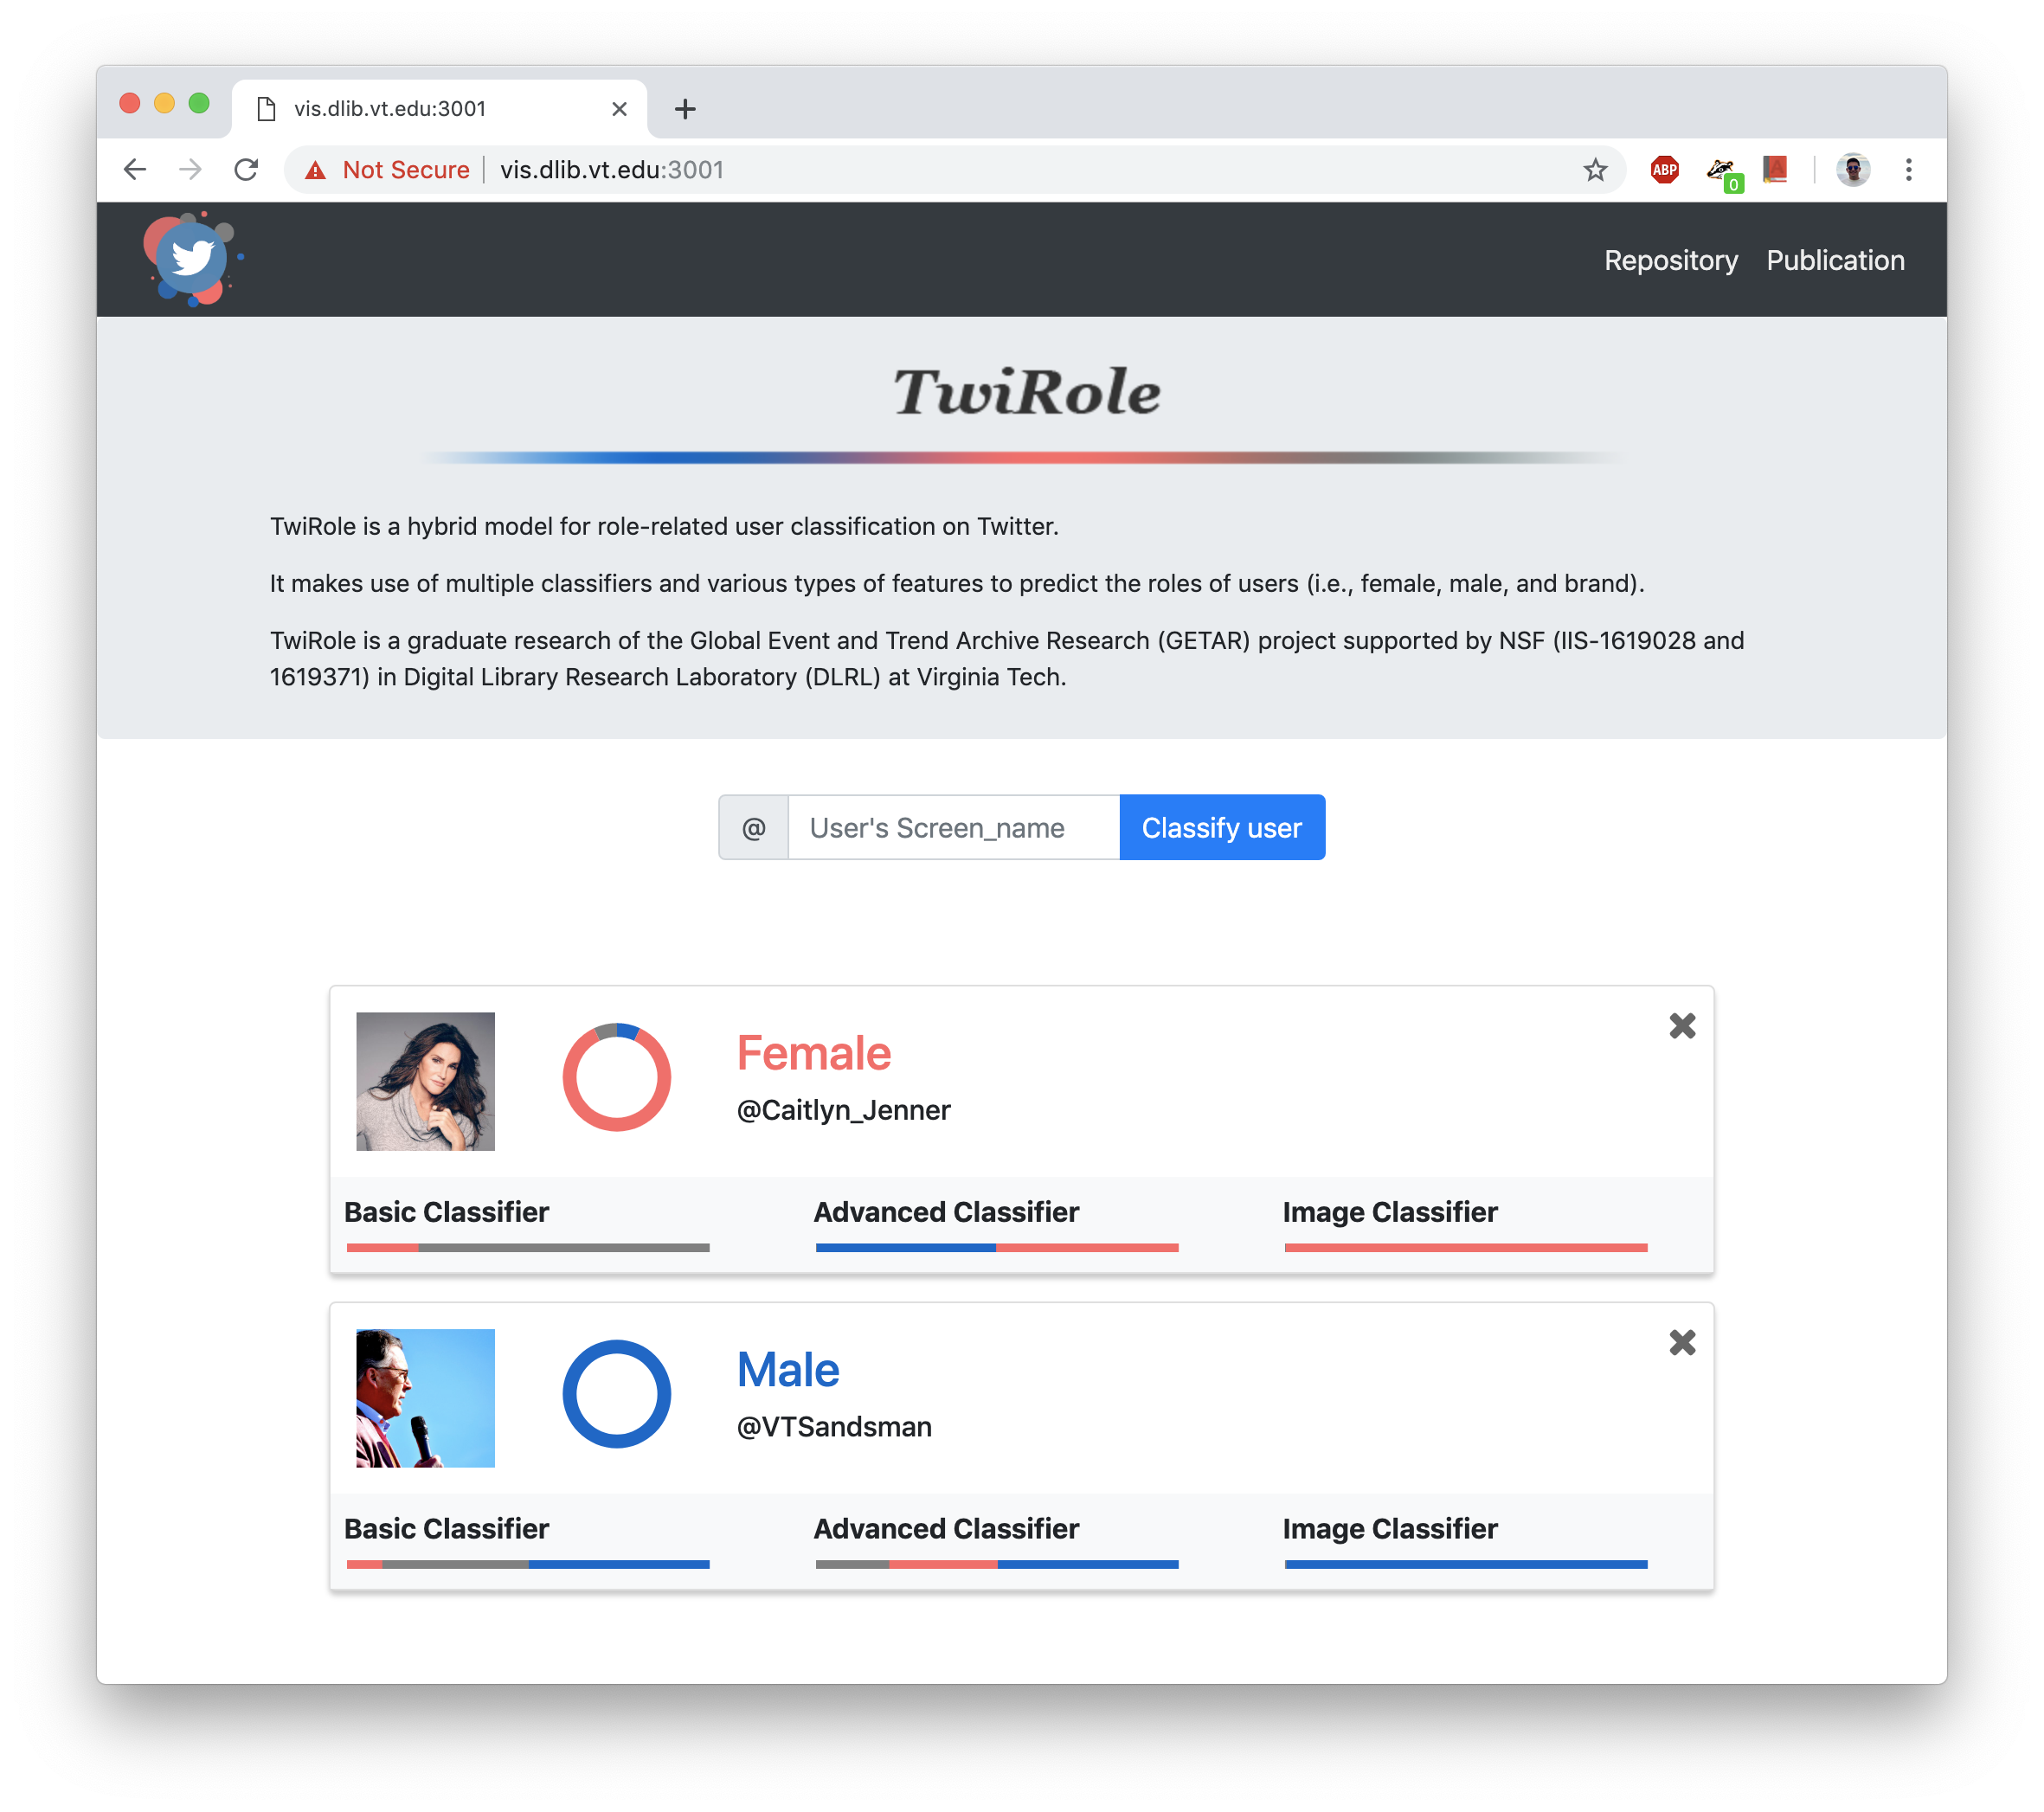
Front end
The final website design. Our client is satisfied with the interface.
Live at https://vis.dlib.vt.edu:3001

Slide 16
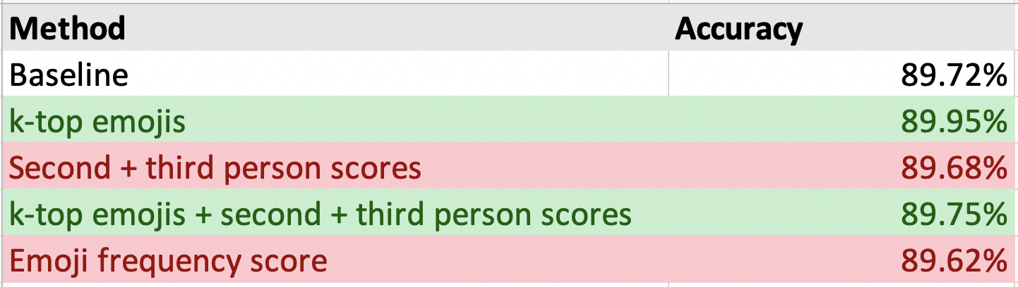
Results from running tests

Slide 17
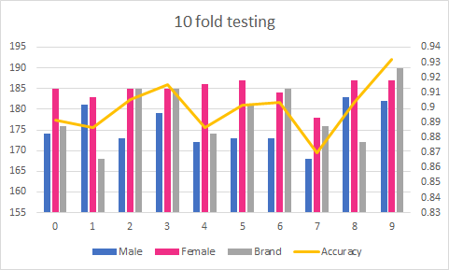
Model w/ k-top emojis

Slide 18
Model improvements
k-top emojis seemed to yield the best improvement
Training takes a long time, maybe some other combination of pre-existing features would result in a more accurate model

Slide 19
Testing/Evaluation

Slide 20
Testing
Running the model and checking accuracy
Cross validation
Failed to classify on tricky cases
Research-heavy tweeters
Transgendered users
Extensive real-user front-end testing

Slide 21
User Evaluation
Gave users task on how to use our website
Users generally liked simplicity
Many comments on how website incorrectly classifies some users
Unavoidable, function of the model accuracy

Slide 22
Demo

Slide 23
https://vis.dlib.vt.edu:3001

Slide 24
Acknowledgements

Slide 25
Acknowledgements
Paper - https://arxiv.org/abs/1811.10202
Github - https://github.com/thebluebirds/TwiRole
We would like to formally thank Liuqing Li, Dr. Edward A. Fox, and the Digital Library Research Laboratory.
We would like to thank the VT CS department and NSF for its support of the Global Event and
Trend Archive Research (GETAR) project through grants IIS-1619028 and 1619371

