Slide 1


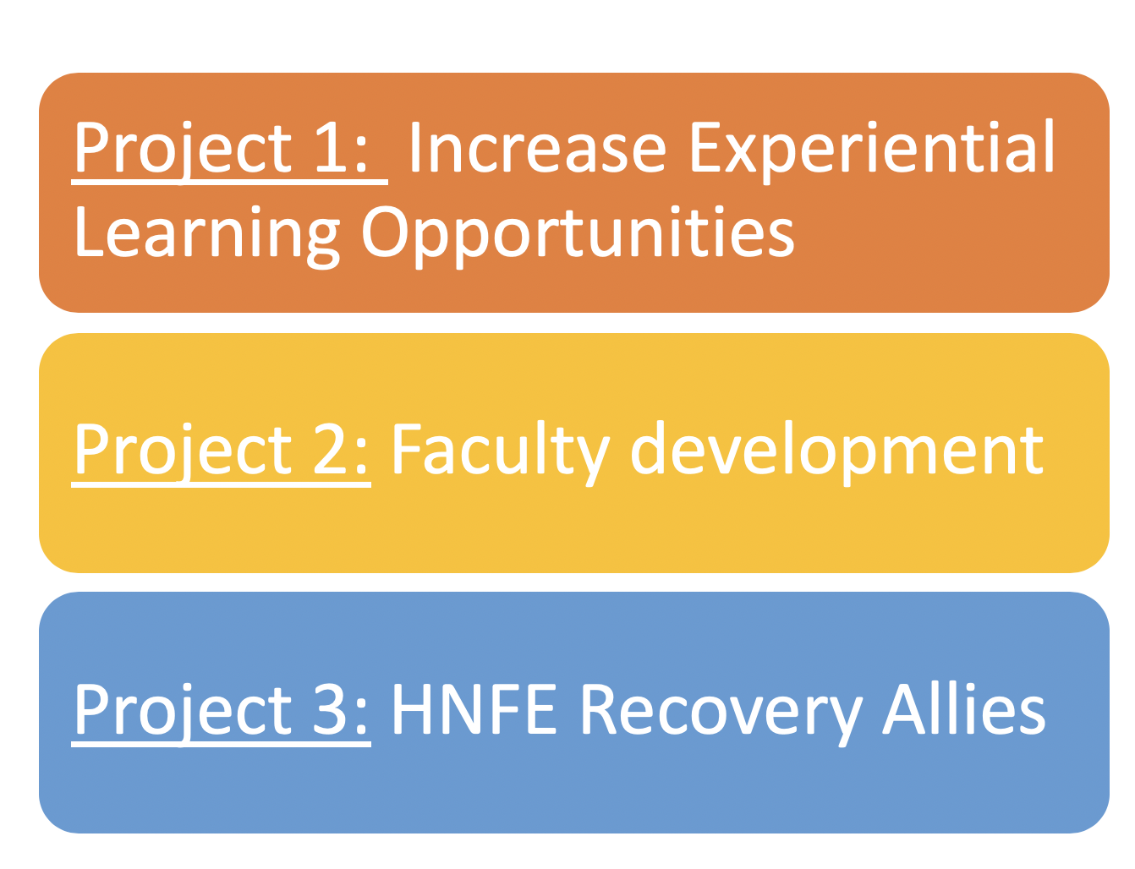
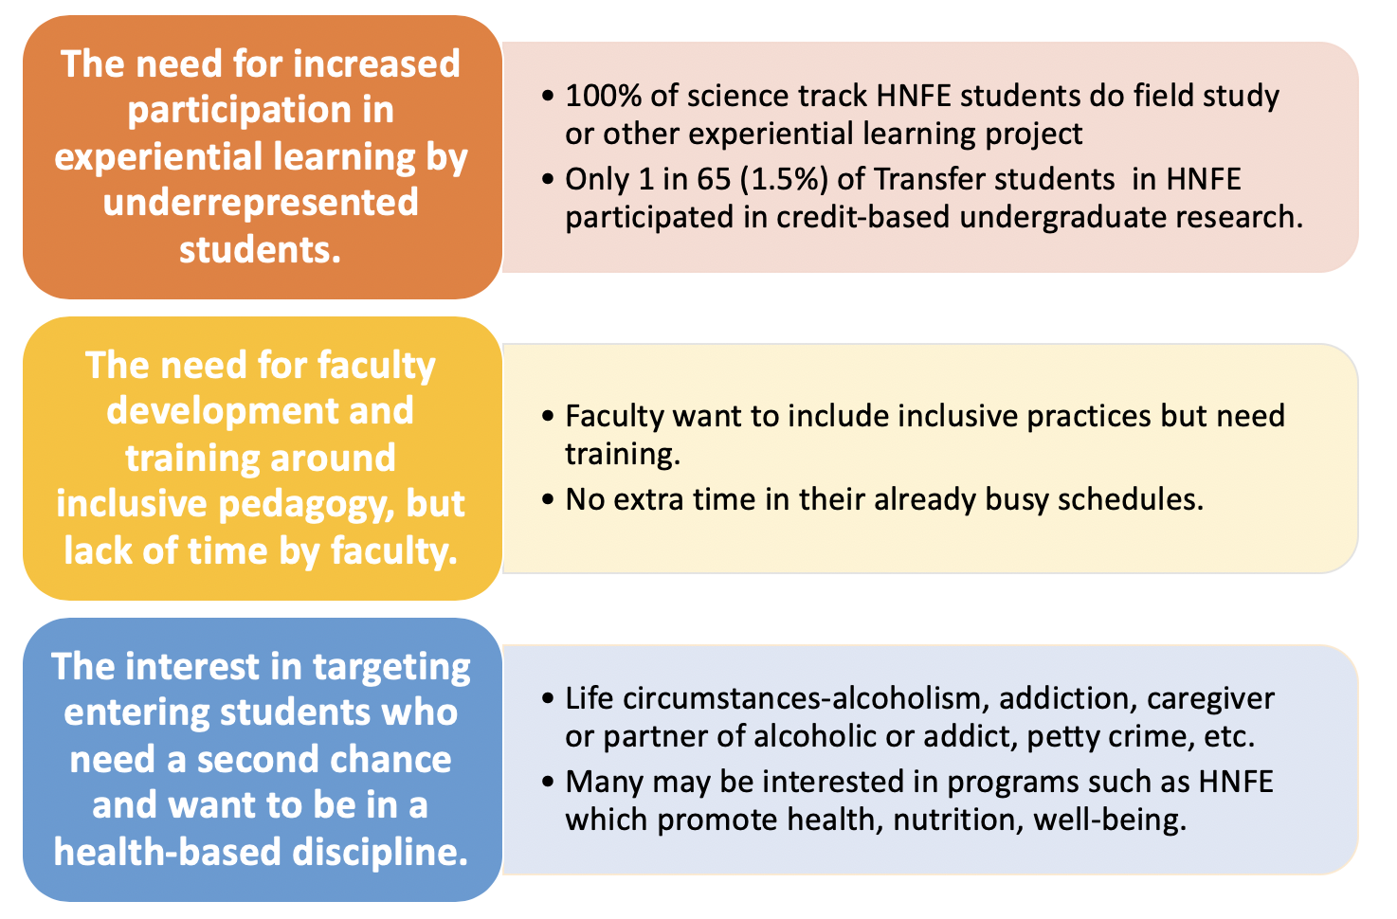
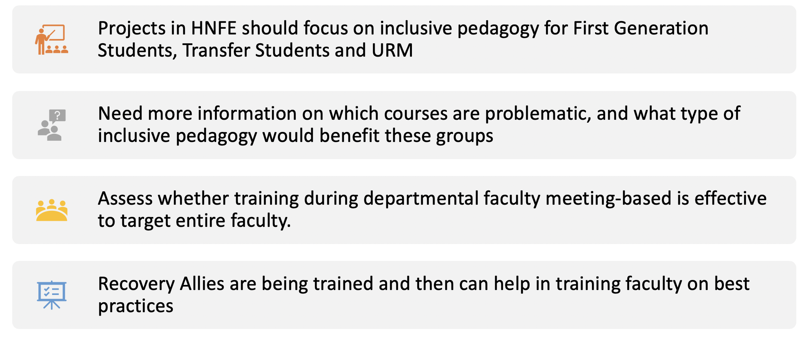
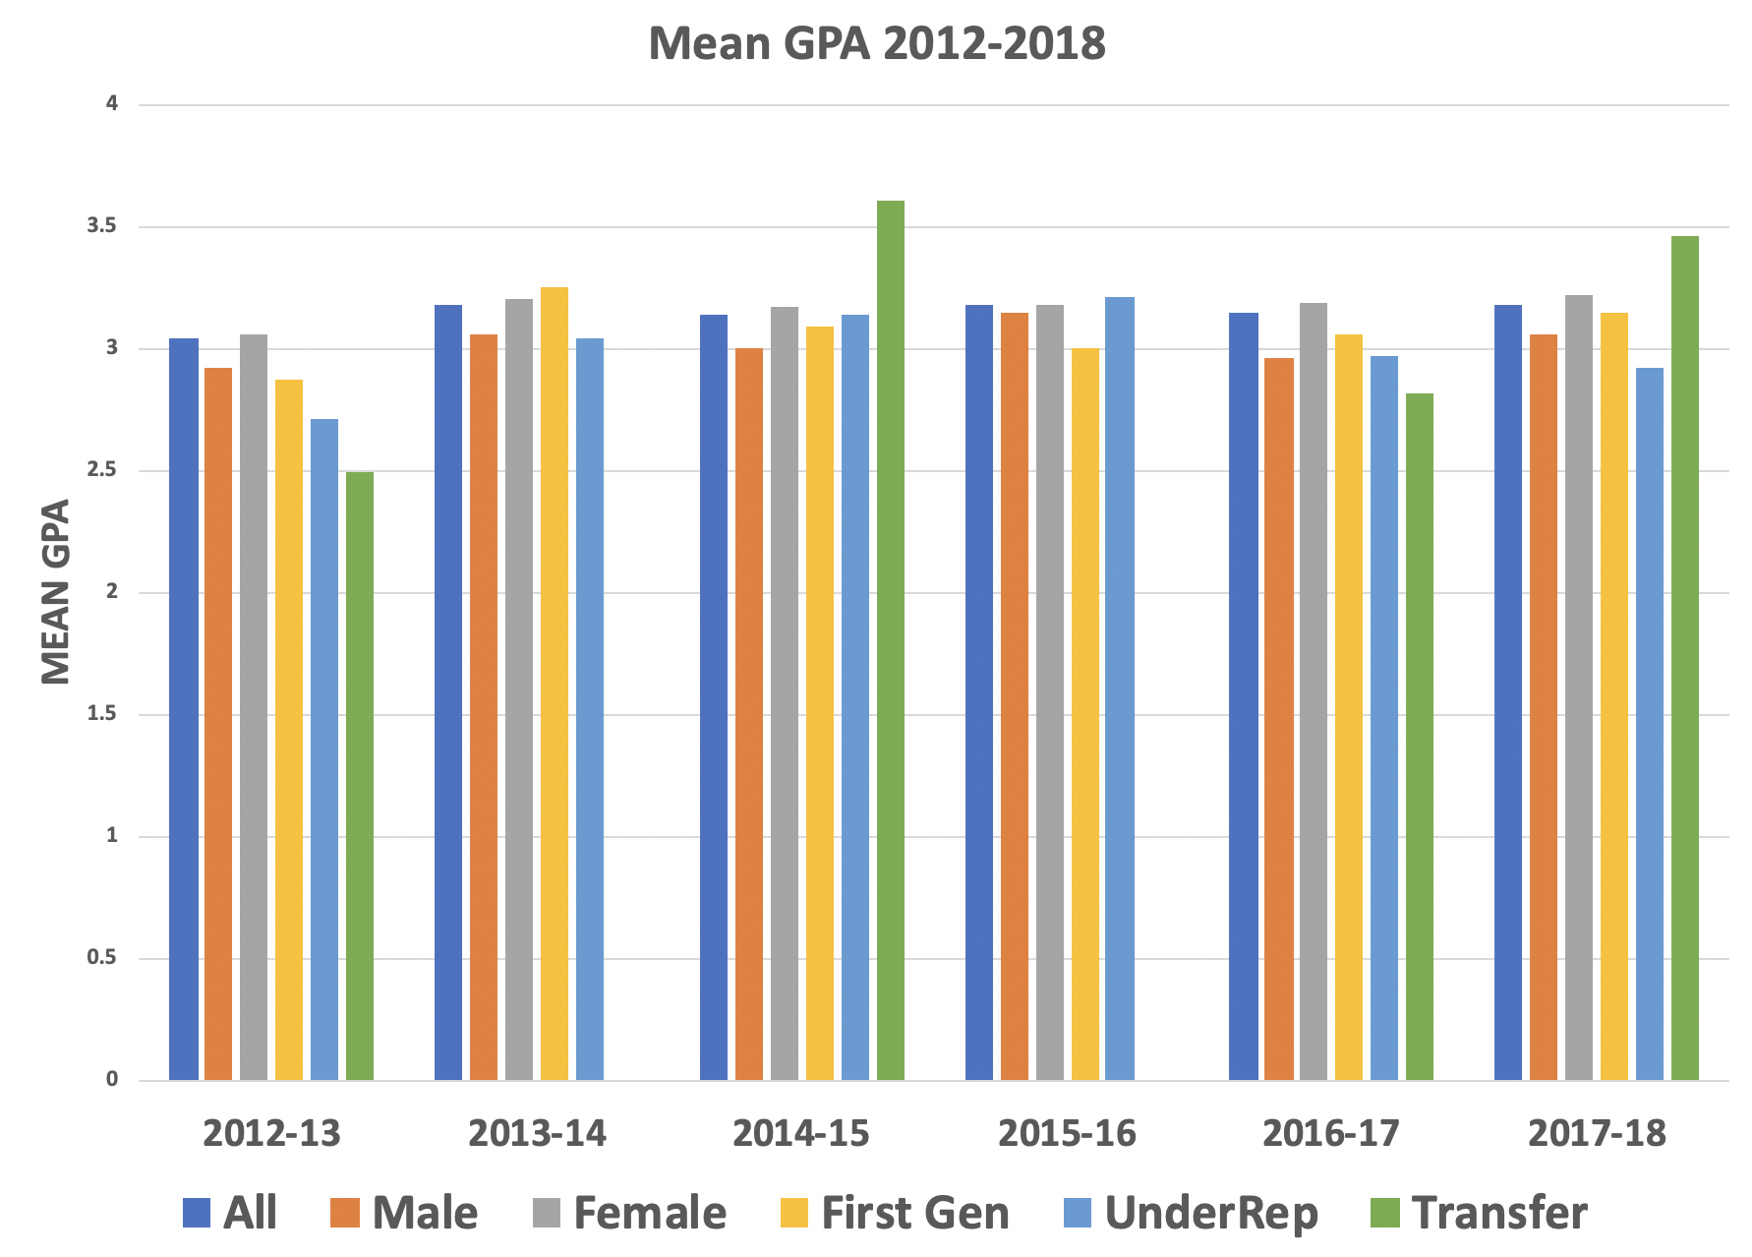
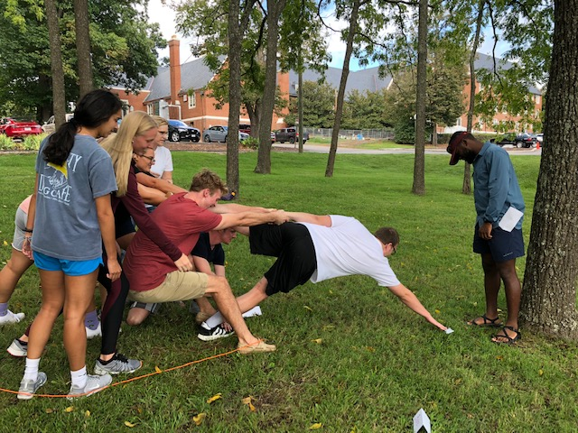
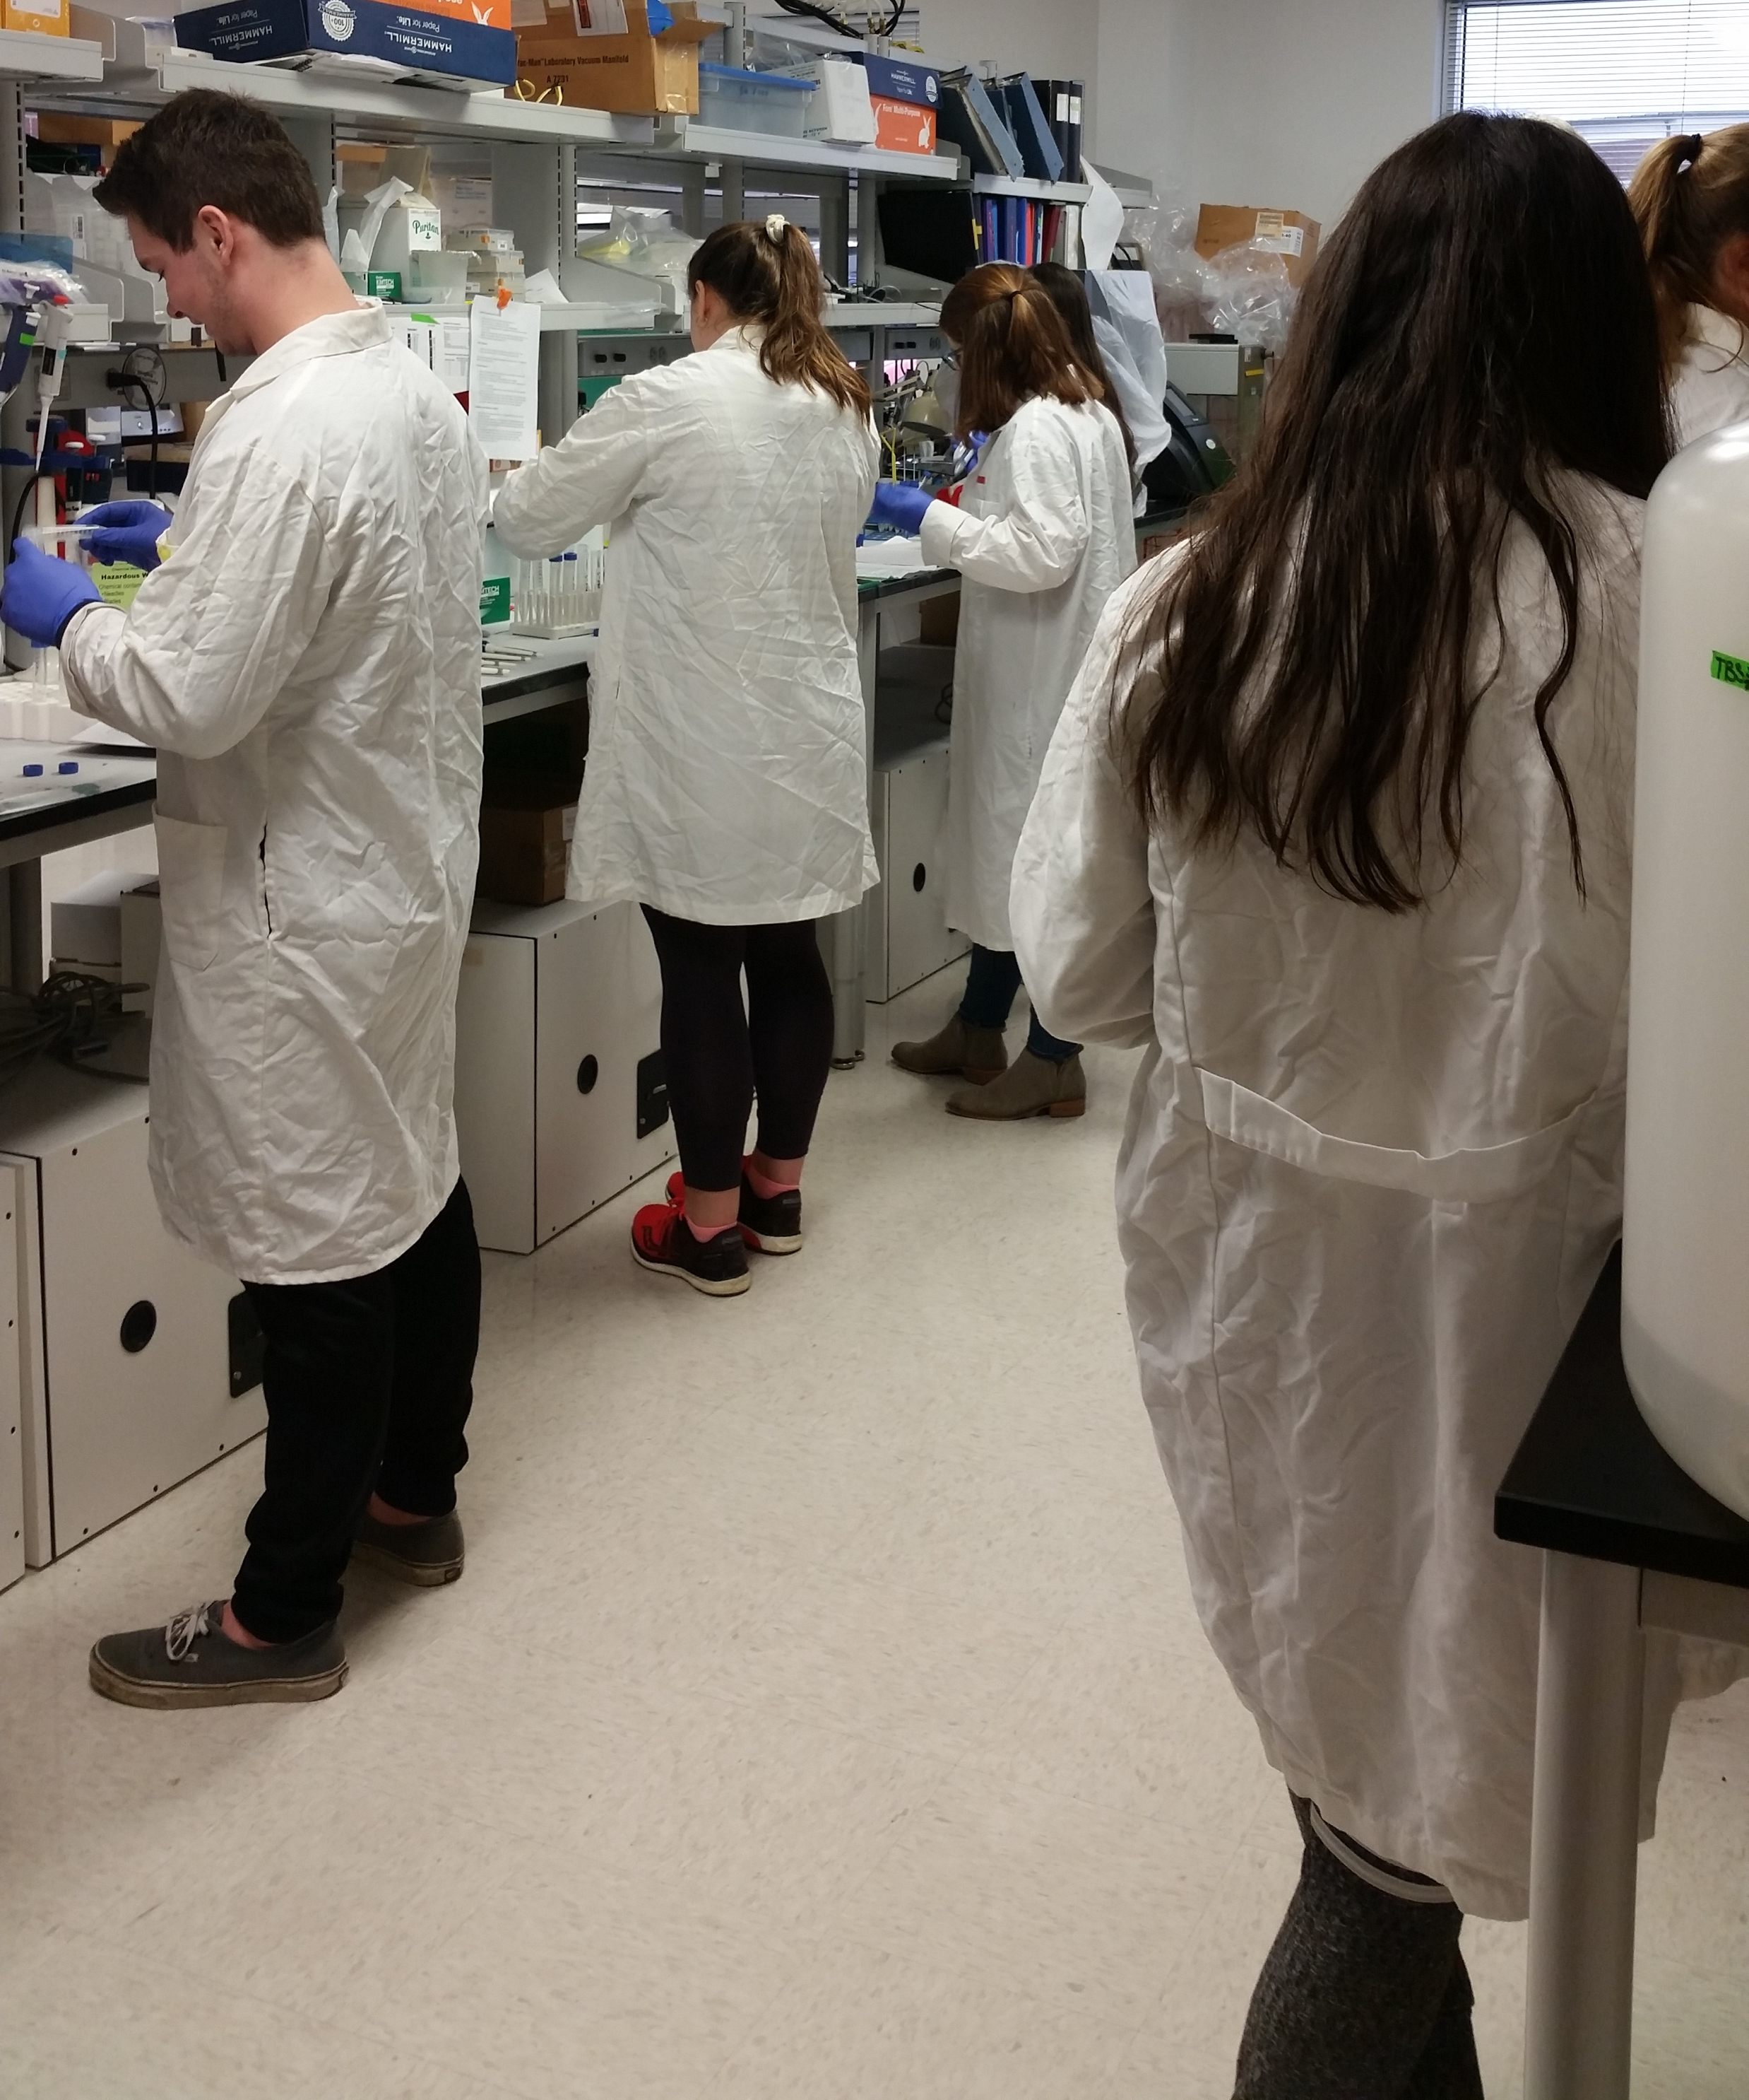
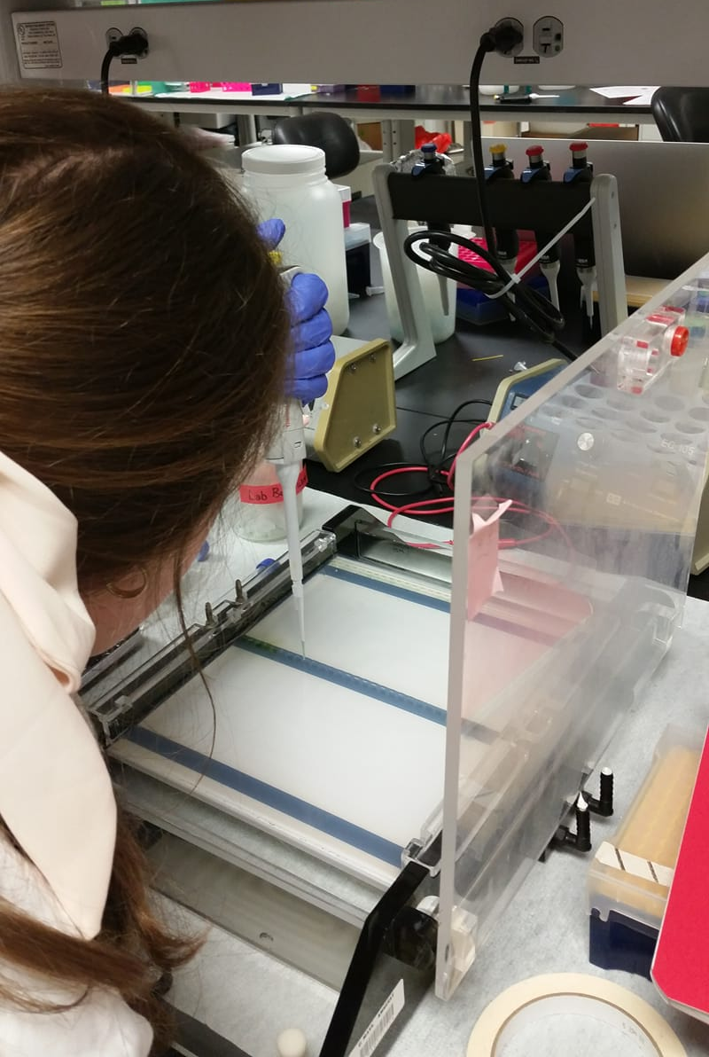
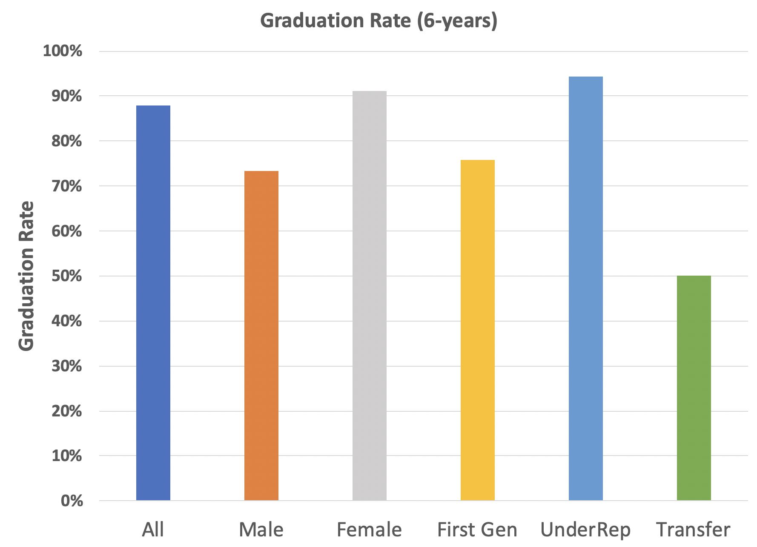
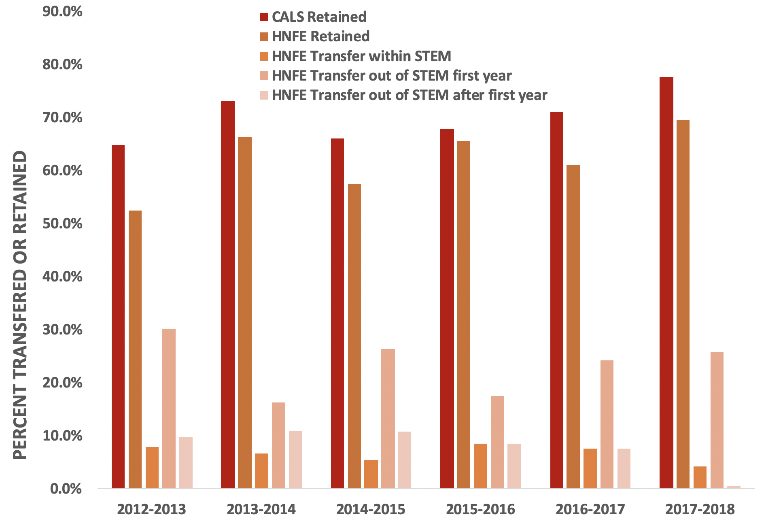
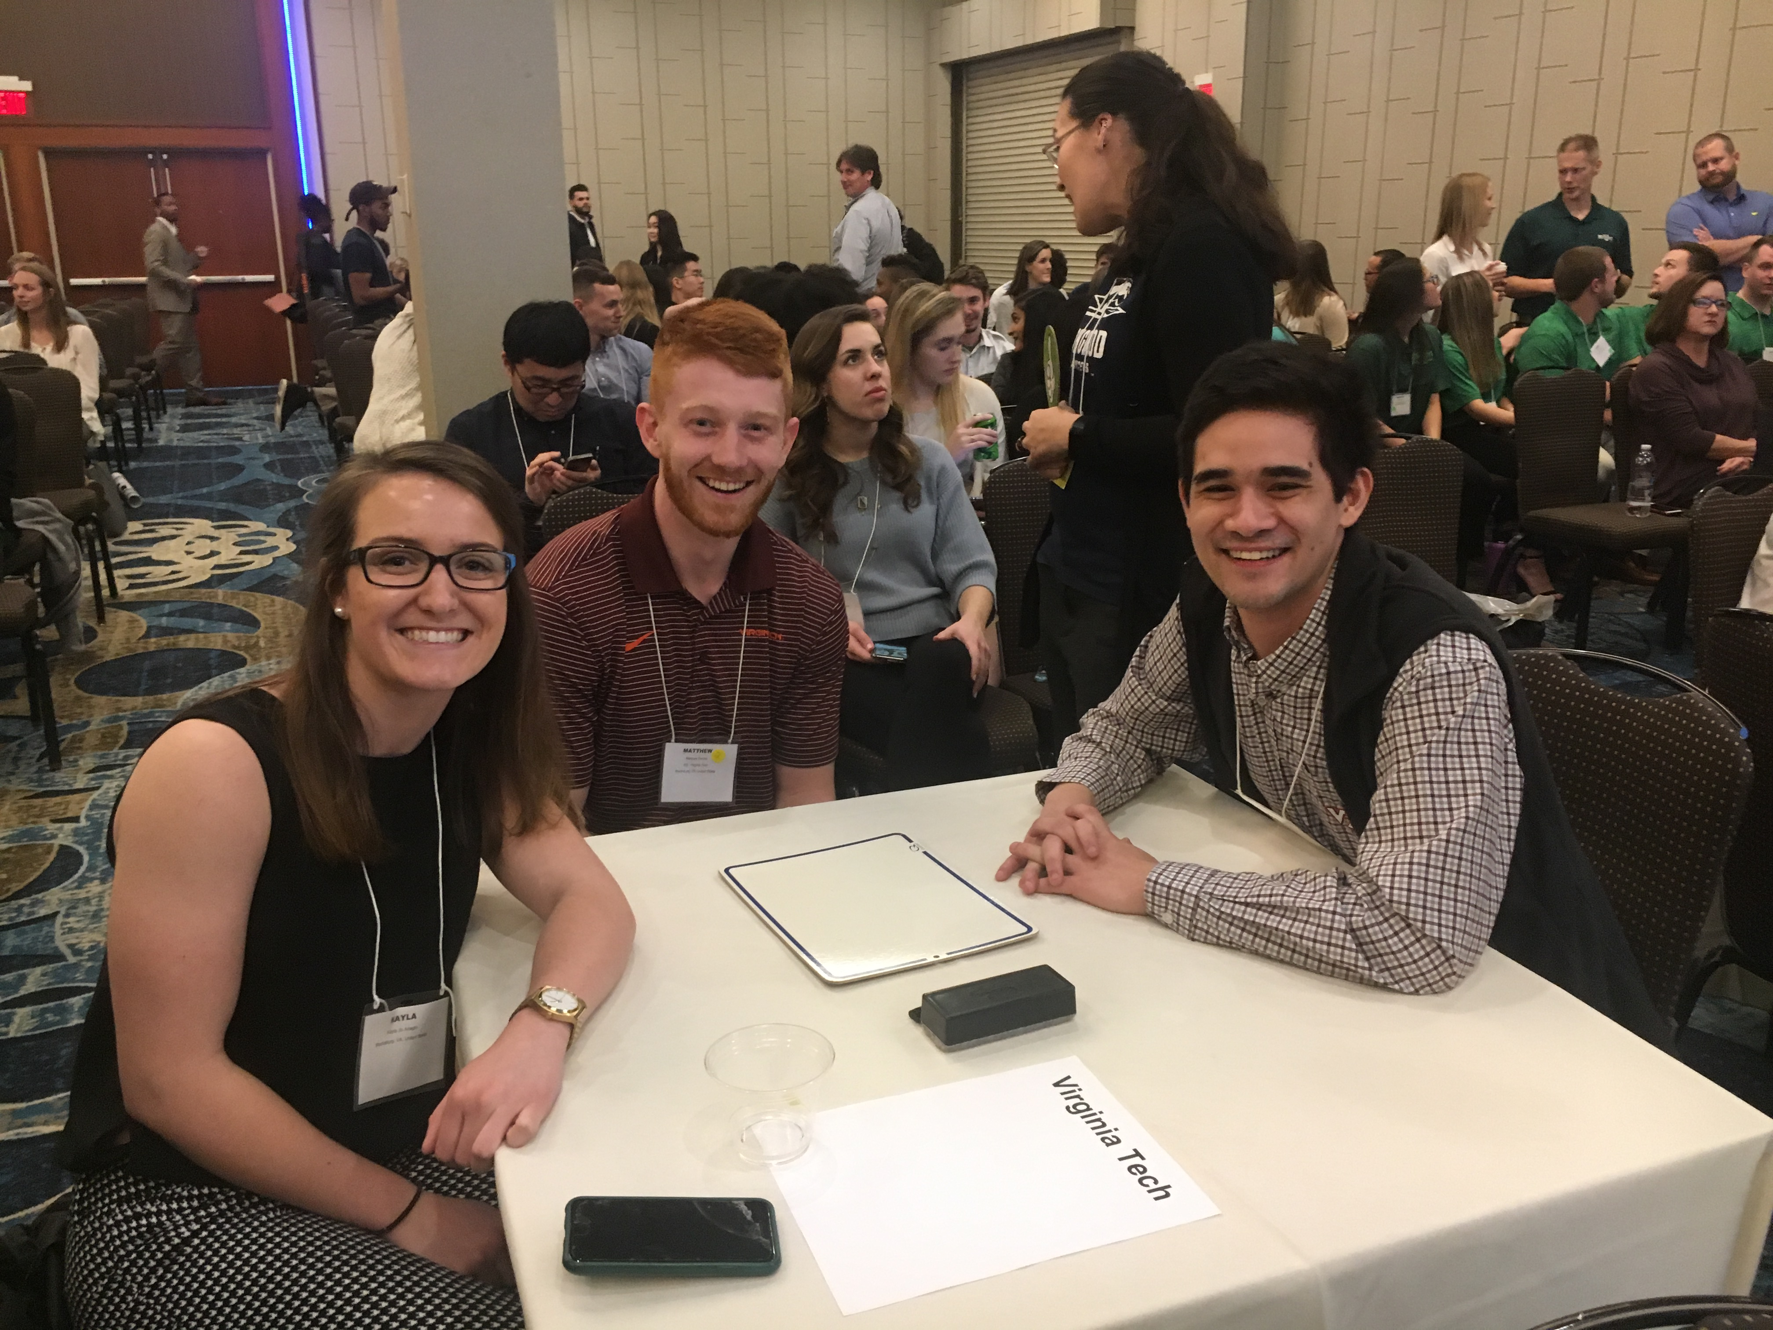


Inclusive Pedagogy in Human Nutrition, Foods, and Exercise: data and ongoing projects
Deborah J. Good, Valisa Hedrick, Renee Eaton, Angela S. Anderson
Human Nutrition, Foods, and Exercise (HNFE), Virginia Tech
Description
Challenges/Opportunities
Outcomes
Ongoing Data Collection and Projects
HNFE DATA
Figure 1
HNFE Projects
Figure 1: Analysis of Education Advisory Board (EAB) “Navigate” platform analytics for Human Nutrition, Foods, and Exercise (HNFE) Department majors as a whole (All), and as subgroups of Male, Female, First-Generation students (First Gen), Underrepresented minorities (UnderRep), and Transfer students. Grade Point Averages (GPA) for HNFE students are higher than CALS average (P <0.01; data not shown), but within HNFE were lowest for First Gen (P < 0.05). Transfer and URM students have high variability year-to-year in GPA (not significant due to low N). Data and statistical analysis by Hao Wang, HHMI graduate fellow.
Figure 2: Using these same groupings, graduation rate for First Gen and Transfer students is lowest compared to All HNFE students (low N, significance not tested).
Figure 3: Retention of HNFE students is lower than CALS, with 30-40% transferring out of STEM majors (P < 0.05).
Renee Eaton modified the content of HNFE 1114 “Transfer Orientation to Human Nutrition, Foods, and Exercise” to include team-building exercises (Figure 4) and laboratory tours. One student began participating in undergraduate research within his first semester.
Deborah Good and Angela Anderson are starting their second year of the Metabolic Nutrition CURE.
Deborah Good, Sasha Marine (Biochemistry) and Hannah Scheer (ALCE) were funded by Center for Excellence in Teaching and Learning to examine possible curricular changes that would improve learning outcomes in the Biochemistry – Metabolic Nutrition course sequence. Angela Anderson has joined the group analyzing HNFE 4025 data. Data on transfer students, and underrepresented populations can be pulled during analysis.
Deborah Good and Donna Westfall-Rudd (Agricultural Leadership and Community Education) started a faculty/staff Lunch and Learn in 2019, and have upcoming workshops scheduled for 2020 in collaboration with Chevon Thorpe, Biochemistry. Plans are to include CALS faculty and beyond in other departments and programs.
Student travel funding to the South East American College of Sports Medicine Conference in Greenville, SC in February 2019. Ten students attended with Dr. Angela Anderson and Renee Eaton.
Figure 4: Team-building exercises in HNFE 1114
Figure 5: Students in the Metabolic Nutrition CURE
Figure 2
Figure 3
Figure 6: Students attending 2019 SE-ACSM conference
This work was supported by HHMI Inclusive Pedagogy Grant awarded to J. Sible, M. Bowers, M. Deramo, D. Good, and S. Karpanty

