Slide 1

Chapter 4
Ethics and Corporate Social Responsibility
(c) Virginia Tech, Department of Management, Pamplin College of Business. CC BY NC SA 4.0.
Available from: http://hdl.handle.net/10919/105157

Slide 2
Objectives
Upon completing the learning activities associated with this lesson, class participants should be able to:
Define business ethics and explain what it means to act ethically in business.
Explain why we study business ethics.
Identify ethical issues that you might face in business, such as insider trading, conflicts of interest, and bribery, and explain rationalizations for unethical behavior
Identify steps you can take to maintain your honesty and integrity in a business environment.
Define corporate social responsibility and explain how organizations are responsible to their stakeholders, including owners, employees, customers, and the community.
Discuss how you can identify an ethical organization, and how organizations can prevent behavior like sexual harassment.
Learn how to avoid an ethical lapse, and why you should not rationalize when making decisions

Slide 3
What are Ethics?
Ethics: To know right from wrong and to know when you’re practicing one instead of the other
Acting ethically in business means more than simply obeying applicable laws and regulations: It also means being:
Honest
Doing no harm to others
Competing fairly
Declining to put your own interests above those of your company, its owners, and its workers
If you're in business, you obviously need a strong sense of what's right and wrong

Slide 4
Ethical Issues and Dilemmas
Ethical issues are the difficult social questions that involve some level of controversy over what is the right thing to do. Environmental protection is an example of a commonly discussed ethical issue, because there can be tradeoffs between environmental and economic factors.
Ethical dilemmas are situations in which it is difficult for an individual to make decisions either because the right course of action is unclear or carries some potential negative consequences for the person or people involved

Slide 5
Conflict of Interest
Individuals must choose between taking actions that promote their personal interests over the interests of others or taking actions that don’t.
Examples:
Can I buy office supplies from my brother-in-law?
My uncle owns a bakery, should I encourage my subordinates to use them for all meetings?

Slide 6
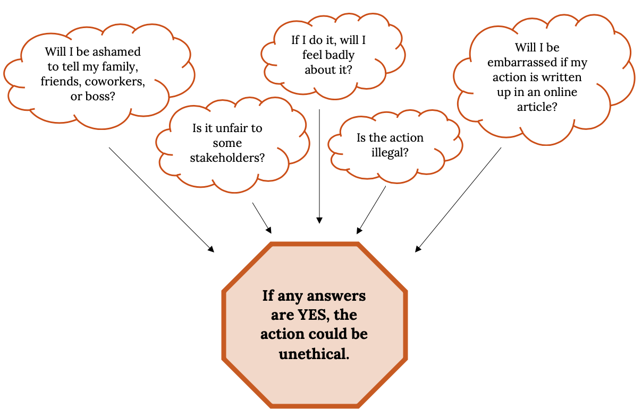
Contemplating an Ethical Decision

Slide 7
Basic Moral Value
Doing things Wrong
Cheating
Cowardice
Cruelty
Doing things RIGHT
Integrity
Respect for human life
Self control
Honesty
Courage
Self-sacrifice

Slide 8
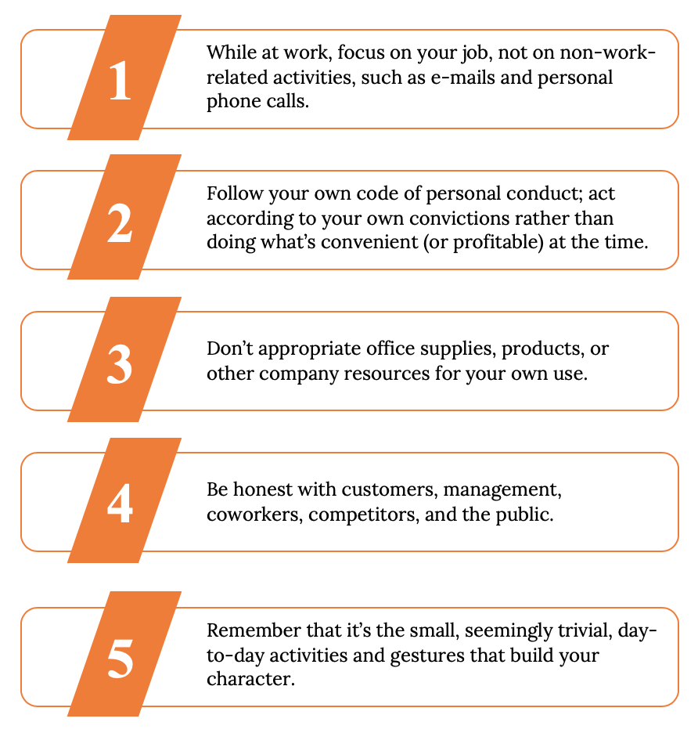
How to Maintain Honesty and Integrity

Slide 9
Facing Ethical Dilemmas
How do I know if an action is unethical?
There's an app for that!
The Golden Rule Test
What if others find out, it becomes public?
Do the right thing, even if no one is looking

Slide 10
Facing Ethical Dilemmas
How, for example, would you answer questions like the following?
1) Is it OK to accept a pair of sports tickets from a supplier?
2) Can I buy office supplies from my brother-in-law?
3) Is it appropriate to donate company funds to a local charity?
4) If I find out that a friend is about to be fired, can I warn her?

Slide 11
Refuse to Rationalize
There are four common rationalizations (excuses) for justifying misconduct:
My behavior isn’t really illegal or immoral. Rationalizers try to convince themselves that an action is OK if it isn’t downright illegal or blatantly immoral. They tend to operate in a gray area where there’s no clear evidence that the action is wrong.
My action is in everyone’s best interests. Some rationalizers tell themselves: “I know I lied to make the deal, but it’ll bring in a lot of business and pay a lot of bills.” They convince themselves that they’re expected to act in a certain way.
No one will find out what I’ve done. Here, the self-questioning comes down to “If I didn’t get caught, did I really do it?” The answer is yes. There’s a simple way to avoid succumbing to this rationalization: Always act as if you’re being watched.
The company will condone my action and protect me. This justification rests on a fallacy. Betty Vinson may honestly have believed that her actions were for the good of the company and that her boss would, therefore, accept full responsibility (as he promised). When she goes to jail, however she’ll go on her own

Slide 12
How to Improve Business Ethics
Top management must adopt and unconditionally support an explicit corporate code of conduct.
Employees must understand that senior management expects all employees to act ethically
Managers and others must be trained to consider the ethical implications of all business decisions

Slide 13
How to Improve Business Ethics
4. An ethics office and/or forum must be set up with which employees can communicate anonymously. Whistleblowers --People who report illegal or unethical behavior.
5.Involve outsiders (other Stakeholders) such as suppliers, subcontractors, distributors and customers.
6.The ethics code must be enforced

Slide 14
Global Business Ethics
Much more gray
More open for abuse
Know the customs
Companies can have great positive influence
Train and role play

Slide 15
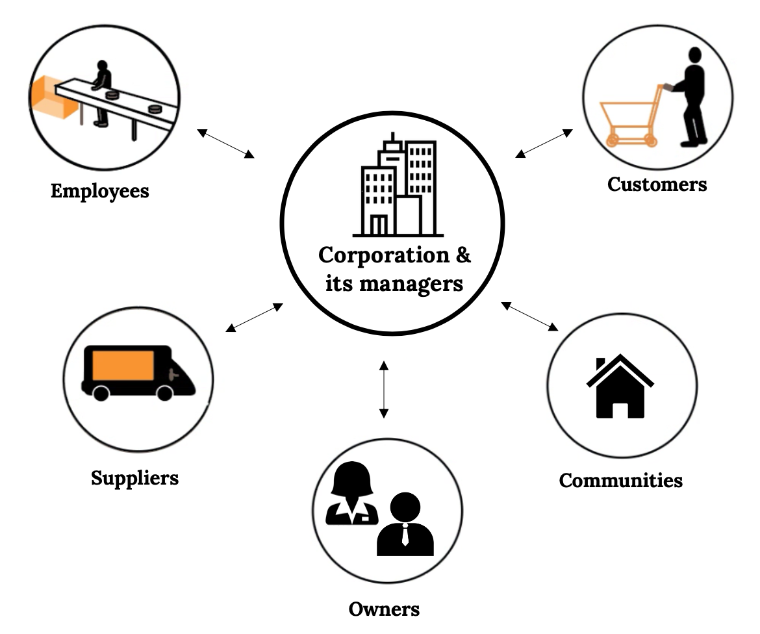
Socially Responsible
Corporate social responsibility refers to the approach that an organization takes in balancing its responsibilities toward different stakeholders when making legal, economic, ethical, and social decisions
Owners
Managers
Employees
  Wages & Benefits
  Health & Safety
Customers
  Consumer Rights
Communities
  Philanthropy

Slide 16
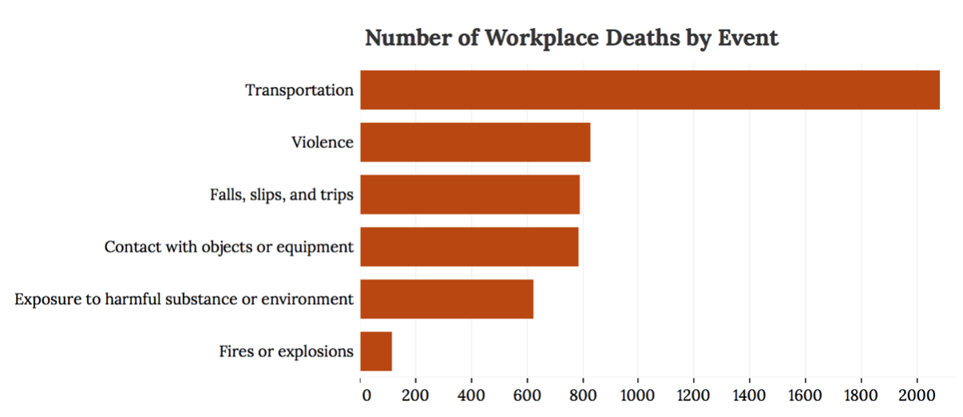
Commitment to Employees
Wages & Benefits
Minimum Wage -$7.25/hr(Federal Rate)
Social Security
Unemployment Insurance
Workers Compensation
Optional –Medical, Dental, Vision Care
Health & Safety
Never Assume
Should be #1 Priority, no exceptions
Have to be reported to Department of Labor

Slide 17
Consumer Rights- Kennedy
(1) The right to safe products. A company should sell no product that it suspects of being unsafe for buyers. Thus, producers have an obligation to safety-test products before releasing them for public consumption.
Ex. Automobile testing, Child Safety Products, UL® -Electrical Products
(2) The right to be informed about a product.Sellers should furnish consumers with the product information that they need to make an informed purchase decision.
Ex. Pillows with tags, Clothing tags, Food labels
(3) The right to choose what to buy. Consumers have a right to decide which products to purchase, and sellers should let them know what their options are.
Ex. Pharmacists, Telephone companies, Purchasing Car/Finance
(4) The right to be heard. Companies must tell customers how to contact them with complaints or concerns. They should also listen and respond

Slide 18
Social Responsibility
Corporate Philanthropy– includes charitable donation
Corporate Social Initiatives– Includes enhanced forms of corporate philanthropy

Slide 19
Social Responsibility - Examples

Slide 20
Takeaways
Business ethics are hugely important and the foundation for both corporate and individual business behavior and decisions.
There are various form of unethical business conduct and you need to detect and avoid such behavior.
Unethical behavior has huge negative consequences and can bring down companies and end individual careers.
Companies protect themselves and they encourage ethical behavior through their code of conduct, business ethics policies, diversity & inclusion programs, anti-harassment policies and being good corporate citizens through the concept of corporate social responsibility. Your choices at college and in the corporate wor

Slide 21
Chapter 4
Q&A
(c) Virginia Tech, Department of Management, Pamplin College of Business. CC BY NC SA 4.0.
Available from: http://hdl.handle.net/10919/105157

