Slide 1



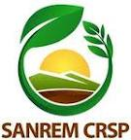
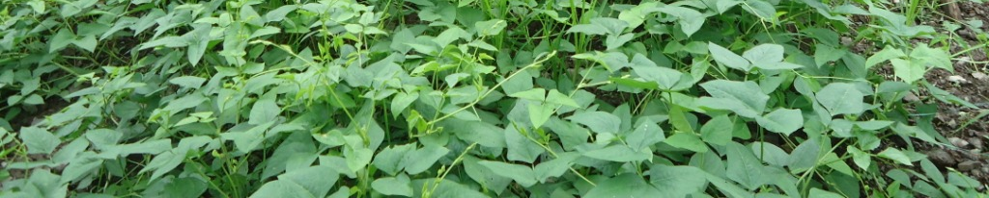
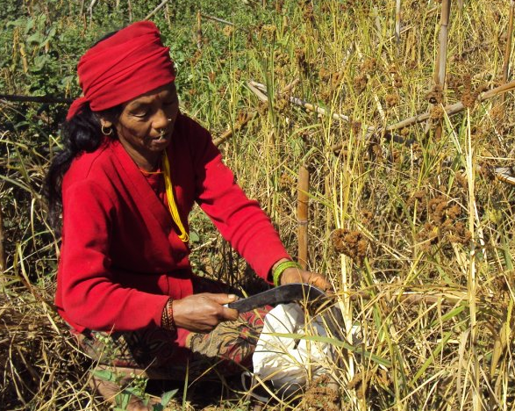
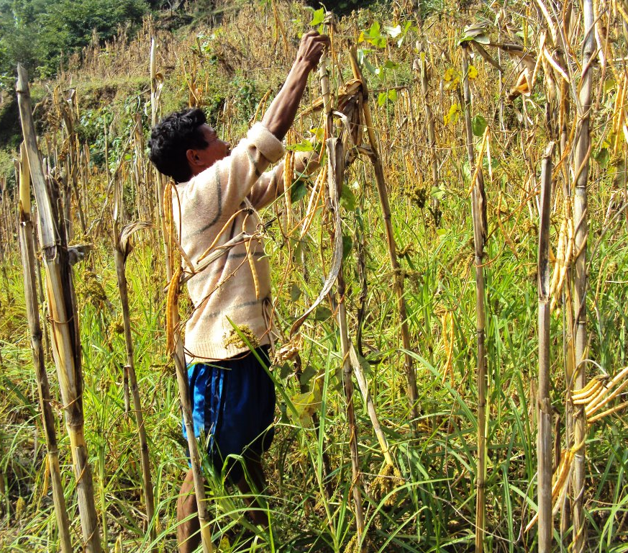
Potential of conservation agriculture practices (CAPs) in enhancing food security of tribal people in central mid-hills of Nepal
B Paudel¹*, T Radovich², J Halbrendt¹, B B Tamang³, S Crow¹ and P Limbu³
¹Dept. of Natural Resources & Environmental Management, ²Dept. Of Civil & Environmental Engineering, ³Local Initiatives for Biodiversity, Research and Development, Nepal
Introduction
Results and Discussion
Traditional agriculture in central mid hills of Nepal is characterized by cultivation of steep sloping lands, resulting lower productivity, degradation of soil health and reduction of livelihood options
Land-use transitions from shifting cultivation to permanence farming have been a problem confronting to sustainable development because of increased erosion
Sustainable Management of Agro-ecological Resources in Tribal Societies (SMARTS) project applied a participatory agro-ecological framework to develop improved conservation practices (CAPs)
CAPs were identified by a multidisciplinary research and extension team in collaboration with farmers.
Yield of maize and millet sole crop was 1.14±0.12 and 0.91± 0.28 tons /ha which was significantly lower than the national averages (2.28 and 1.12) (MoAC, 2011) (p values <0.001 and 0.02), whereas yield of cowpea sole crop 0.87± 0.19 was comparable to national average (0.95 t/ha). Yield significantly differ among villages (p values < 0.01).
Maize-cowpea intercrop farming system with conventional tillage and conservation tillage yielded higher (20% and 11%, respectively) LER indicating their potential to support in food security in communities where almost all harvest used for households consumption.
Cowpea sole crop produced highest protein as well as highest revenue per sq. km. indicating cowpea sole crop is better for market oriented farming.
The effect of strip tillage in the intercrop was observed in term of reduced yield, LER and other parameters, but its positive effects on soil and ecosystem remain to be analyzed.
Objectives
To evaluate the advantage of identified CAPs in food security of Chepang households
Materials & Methods
Selected CAPs which makes up the treatments include:
T1 : Maize – Millet (conventional Tillage) ; T2: Maize – Cowpea (conventional tillage), T3: Maize – Millet + Cowpea (conventional tillage), T4: Maize – Millet + Cowpea (with strip tillage)
Data was collected from 27 farmer’s field trials established in 3 villages of mid-central hills of Nepal
DATA ANALYSIS TOOLS AND FORMULA
Land Equivalent Ratio (LER): is total land area required for single crop to give obtained in intercropping mixture (Osman et al., 2011).
Total Field Protein Yield (FP)
Total Field Carbohydrate yield (FCaH)
Field Revenue (FR)
Protein Advantage Index (PAI) and Carbohydrate Advantage Index (CaHAI) : formula equivalent to MAI
Data analyzed using two-way ANOVA using general linear model for unbalanced data
Conclusions
CAPs showed potential to increase yield and contribute to food security of Chepang ethnic people in short term while sustaining agro-ecosystem function long-term.
Minimum tillage expected to be effective in reducing rate of erosion but they are not viable for farmers in the short-term.
Protein yield (FP) and revenue (FR) were significantly associated with treatments (p values <0.001) but carbohydrate yield was not significantly associated. Cowpea sole crop (Tr2), cowpea-millet intercrop with conventional (Tr3) and strip tillage (Tr4) has significantly higher protein yield (p values, <0.001, 0.002, 0.01), whereas cowpea sole crop has highest protein and revenue (p values, <0.001, 0.002, 0.01) than millet sole crop (T1).
LER millet-cowpea intercrop with full tillage was significantly higher (20%) than sole crops. The major gain is attributed to cowpea, which produced 75 per cent of its sole crop yield even in intercropping
References
Osman, A.N.; Raebild, A., Christiansen, J.L.; Bayala, J. (2011). Performance of cowpea (Vigna ungiculata) and pearl millet (Pennisetum glaucum) intercropped under Parkia biglobosa in an agroforestry system in Burkina Faso. Af. J. Agr. Res. 6(4):882-891.
MoAC (2011). Ministry of Agriculture and Cooperative, Nepal. Statistical information in Nepalese Agriculture, 2010-11. Kathmandu, Nepal.
Project funded by: USAID SANREM-CRSP
Notes:
http://evsglobalchange.files.wordpress.com/2010/03/orissamap.png (map)

