Slide 1

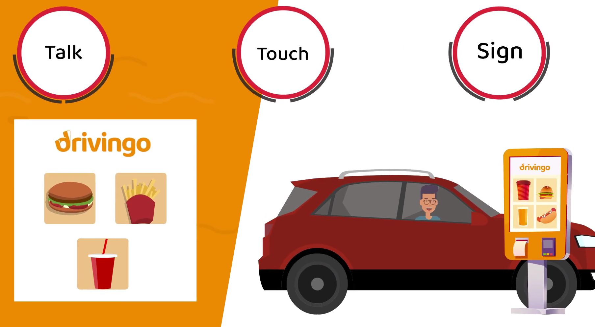
Assistive Voice Assistant
Abishek Ajai Satnur and Charles Bruner
CS 4624: Multimedia, Hypertext, and Information Access
Professor: Edward A. Fox
Virginia Tech, Blacksburg VA 24061
April 30, 2024

Slide 2

Outline
Project Description
Requirements
Design/Implementation
Code Walkthrough
Results
Future Work
Lessons Learned

Slide 3

Problem
Client
Accessibility Challenges Traditional drive-through systems fail to cater to customers with language barriers and hearing/speech impairments, leading to frustrations and communication gaps [1].
Name
Levern Currie, Virginia Tech ISE doctoral student and CEO of Drivingo [2].
Objective
To develop an innovative all-in-one ordering kiosk that enhances accessibility using touch, hand gestures, and audio-based ordering.

Slide 4
Motivation
Approach
Focus
Refine the audio-based ordering component to be more accessible for customers with communication barriers.
Technology
Utilize conversational AI and NLP with GPT-4 Turbo to simulate human interaction.
Integration
Incorporate OpenAI's GPT-4 to understand and process orders in multiple languages (French, English, German, Spanish, Chinese).
Goal
Ensure adaptability and efficiency for any fast-food chain, improving inclusivity and service efficiency in drive-throughs.

Slide 5
Requirements
Conversational Ordering System
Multilingual Interface
Adaptive Communication Modes
Integration and Scalability
Support Automatic language detection and response in English, Chinese, German, French, and Spanish.
User Experience Dynamic updates of menu displays based on detected language.
Integration
Must align with Drivingo’s existing infrastructure.
Scalability Adaptable to different fast-food chains and menu specifics.
Objective Accurately interpret complex customer orders with minimal repetition.
Feature Dynamic voice assistant for natural, conversational interactions.
Modes
Support for voice, touch, and hand gestures.
Accessibility
Seamless mode switching for an inclusive user experience.

Slide 6
Requirements Continued
Natural Language Processing and Machine Learning
Testing and Model Training
Expected Impact
Technology
Utilization of NLP and machine learning for precise order processing.
Development
Continuous learning from interactions to improve accuracy and adapt to new trends.
Goal
Improve accessibility and efficiency in customer service interactions.
Benefit
Bridge communication gaps and cater to diverse customer needs.
Testing
Rigorous validation across languages and slang.
Training
Ongoing refinement based on real interactions to enhance system performance.

Slide 7
Why we chose GPT-4 Turbo
Ranked number one on LMSYS for chatbot purposes [3].
The assistants API proved to be highly competent in threading of context in conversations and response management.

Slide 8
We conducted personal benchmark tests…
By feeding GPT-4 turbo, GPT-3.5 , LLama 2, Gemini, and Opus with 1000 restaurant related questions and checked to see what intent was detected [4, 5, 6].
GPT-4 turbo did the best with 993 of those 1000 questions being detected for the right intent.
We tested the language model on 1,000 questions, distributing 200 questions evenly across English, Mandarin, French, German, and Spanish to evaluate its understanding of various languages.
GPT-4 turbo performed the best as a multilingual LLM.

Slide 9
Note:
Participation in this project required signing an NDA, restricting the disclosure of specific implementation details.

Slide 10
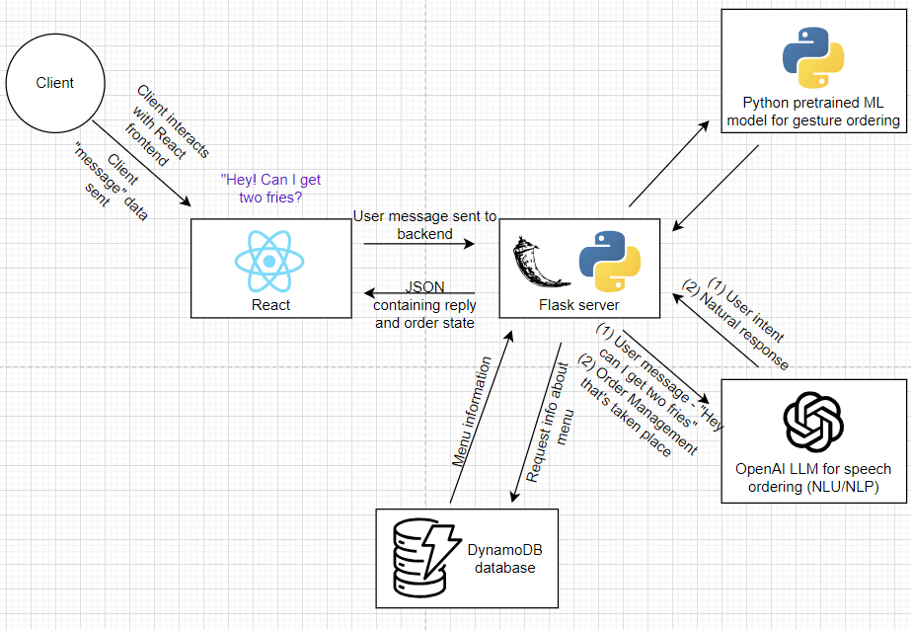
Design and Implementation
Notes:
Framework: Developed in React.js.
Functionality:
Captures user audio and converts it to text.
Sends text to Flask backend after 1.5 seconds of silence.
Responds by updating the menu language, displaying the order, and audibly confirming the order, mimicking a drive-through interaction.
Backend Technology
Language: Python.
Responsibilities:
Central processing unit for customer interactions and voice assistant.
Manages orders, chat history, and context.
Utilizes OpenAI's NLP for language interpretation and response generation.
Language detection and dynamic frontend syncing.
Flask Server Integration
Capabilities:
Handles requests to the pre-trained ML model for gesture-based ordering.
Interfaces with OpenAI APIs for NLU and NLP.
Manages queries to DynamoDB for menu data.
Processes and manages order operations.
Gesture Recognition ML Model
Development: Created by Drivingo for gesture-based commands.
Integration: Seamlessly integrated into the frontend for non-verbal order placement.
OpenAI API Utilization
Features:
Deciphers user commands and intentions.
Communicates processed outcomes back to the frontend via LLM response generation.
Microservice Architecture
Design:
Ensures independence and cohesion across frontend, backend, and APIs.
Facilitates scalability and clean integration with reduced complexity.
Divided backend responsibilities into specific functionalities: order management, conversation management, API response handling.
Design and Responsiveness
Frontend: Lightweight and user-friendly.
Backend: Handles robust data processing and service integration.
Scalability: Aligns with modern web development practices for adaptability and maintainability.

Slide 11
OpenAI Assistants
OpenAI claims that its’ assistant API can be used to “build AI assistants within your own applications”.
While this is true, it is also true that it is currently not reliable by itself.
However we have found a few functionalities of this API extremely promising.
The first is function calling - which we can use to trigger action cycles based on user intent.
The second is for natural response generation.
For our project we have combined these two functionalities along with our own backend for managing orders to create a reliable AI voice assistant for drive-through ordering.
The accuracy and speed of this model will only improve over time, as the OpenAI API improves .
Notes:
While the time for this presentation won’t allow us to fully explain our code, we will give you a general overview of how a response for the user is created, which is the most important thing in a voice assistant.

Slide 12
Tracing One User Message
Notes:
The moment a customer starts speaking, a function in our frontend will start recording whatever the user says. It will stop recording only when the user pauses for over 1.5 seconds. Then the frontend sends this message via an API call to our flask backend.

Slide 13
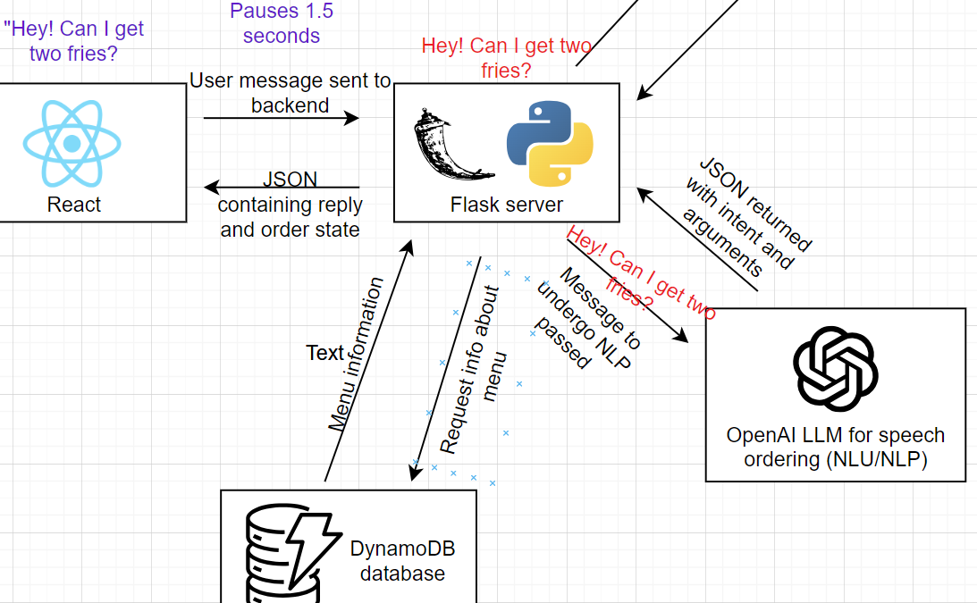
Tracing One User Message
Notes:
Our backend then makes an API call to openAI’s LLM assistant. The LLM will be able to discern the intent of the user message and return a response to us. We handle this response in our backend where we actually add items to the customer’s order.

Slide 14
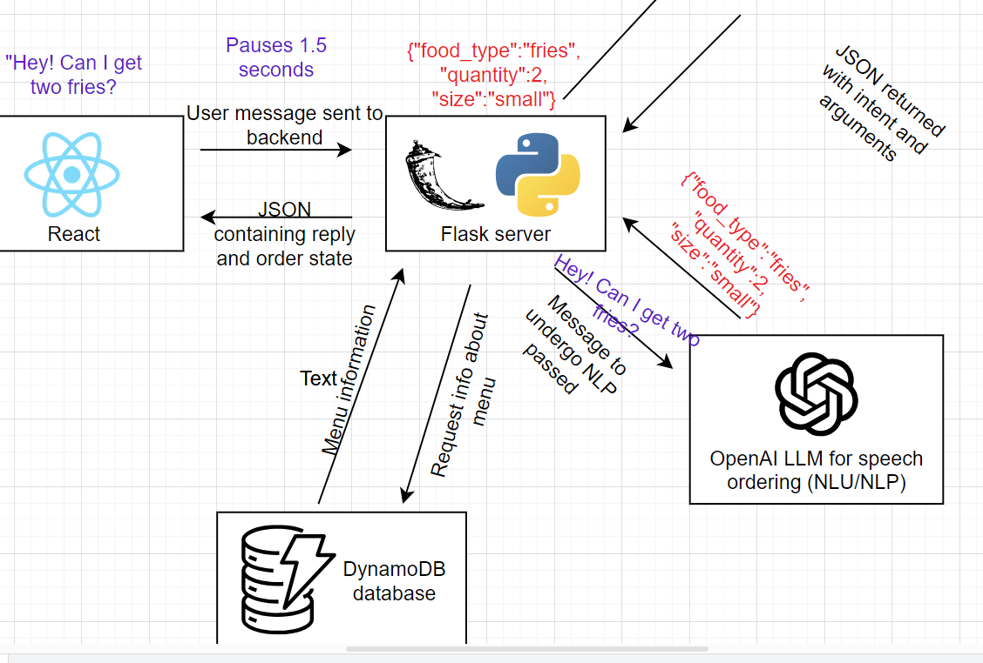
Tracing One User Message
Notes:
The response that the openAI assistant API sends to our backend would be a json containing food_type, quantity, and food_size. We use this information to store the user’s order in the backend.

Slide 15
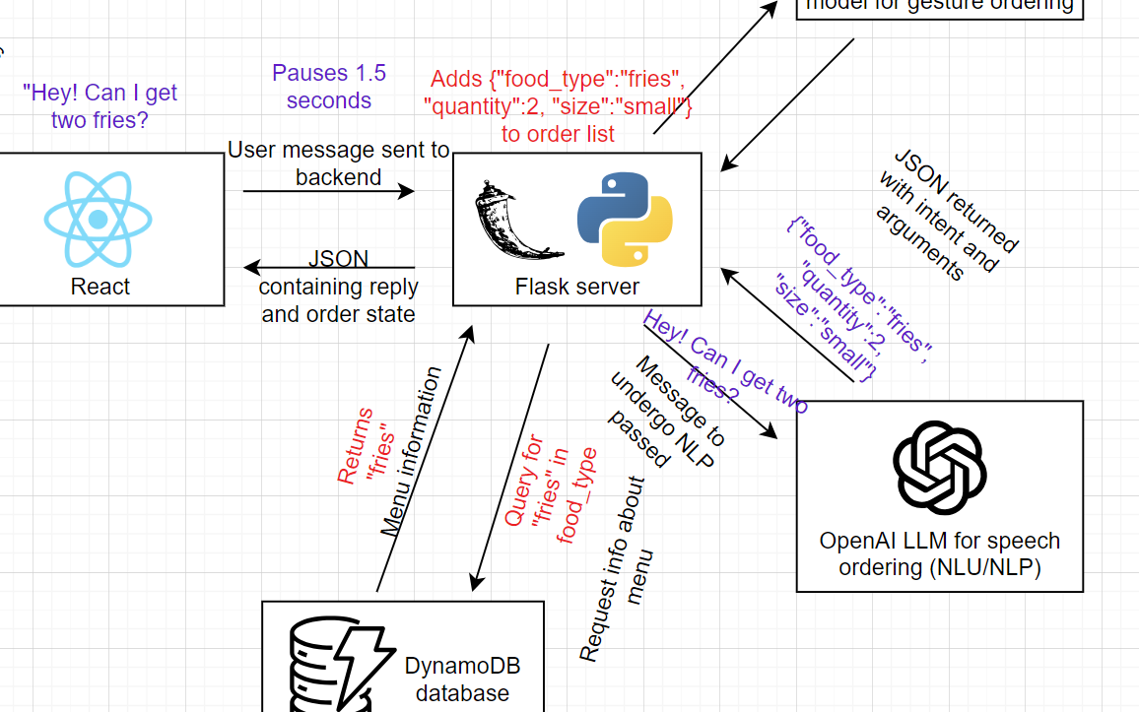
Tracing One User Message
Notes:
But before we add the items to the order, we need to do some validation of food_type, size, and quantity_allowed. We make queries to a backend via API calls for integration with drive through information. If an item that was not in the menu is requested the user will be informed that the item they requested isn’t there. Default values of medium and 1 are set if the user does not specify size and quantity in their request.

Slide 16
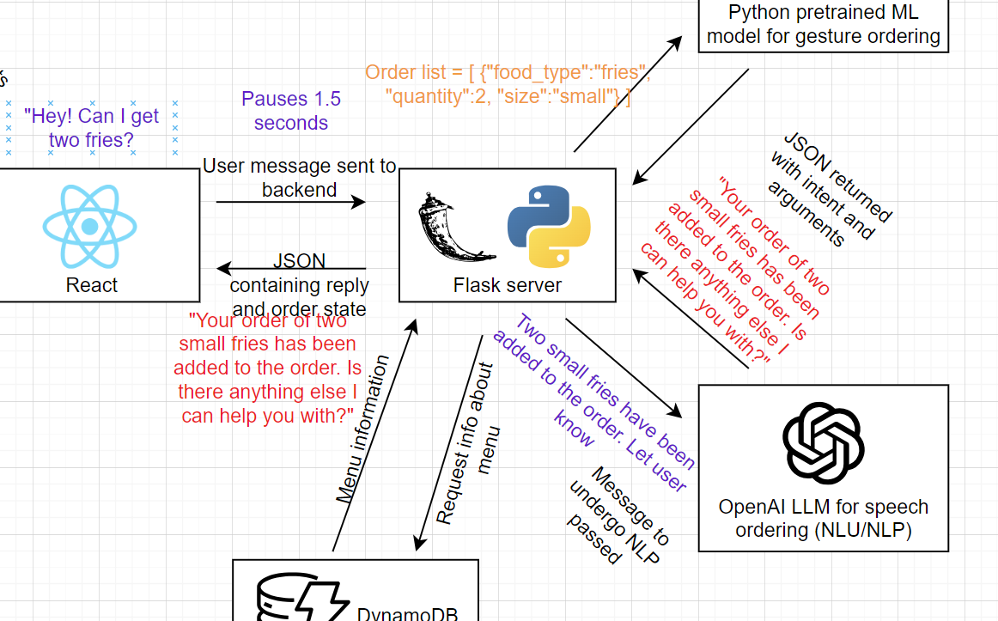
Tracing One User Message

Slide 17
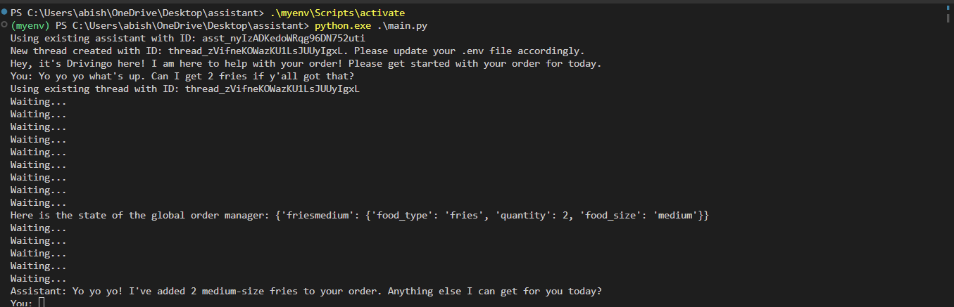
Slide showing the order list and result from asking that question along with a few other prompts after that asking miscellaneous questions.
Notes:
It even responds with the same tone as you if its appropriate. The global_order_manager you see here is a dictionary that we use for quick updates to the order if the user is fickle with their order.

Slide 18
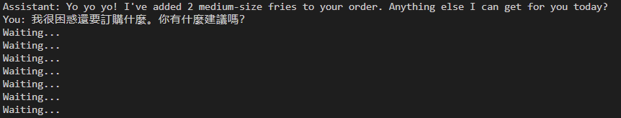
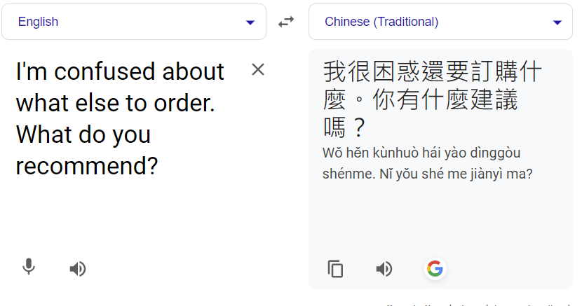
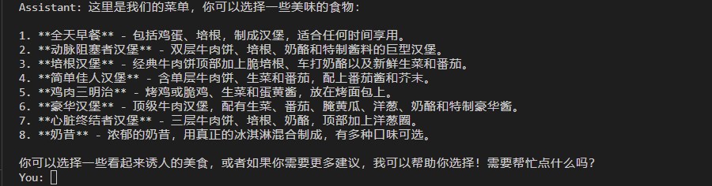
It can also do that in different languages!
It works in 5 different languages - Chinese, French, Spanish, English, and German!
Notes:
It works perfectly fine in other languages according to google translate as well. As you can see here the customer asks the assistant what it would recommend. And then the assistant

Slide 19
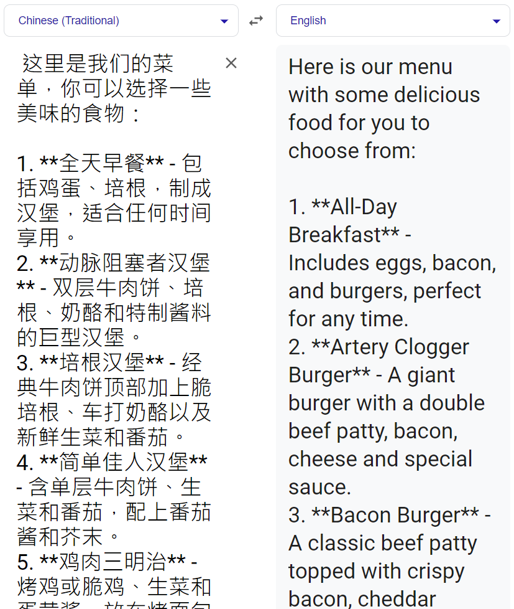
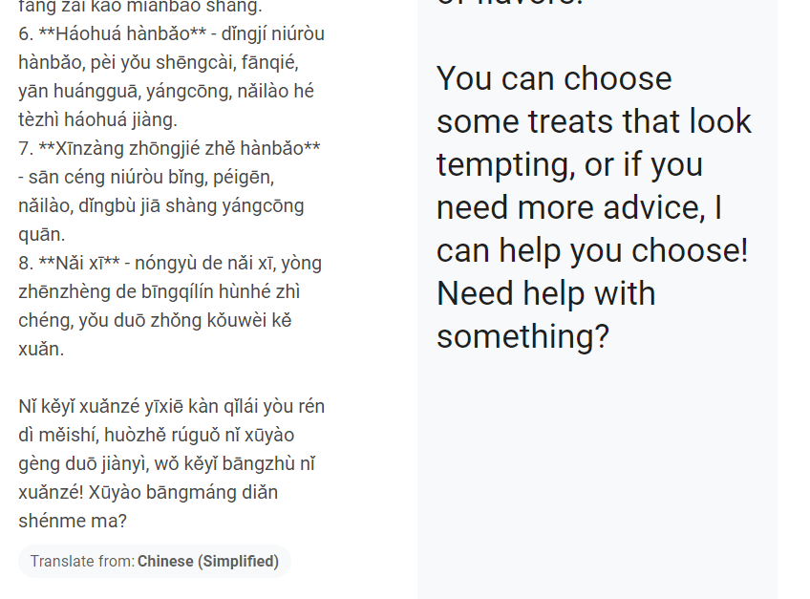
Notes:
Responds with items it recommends, and a humanlike response at the end.

Slide 20
It can also handle unrelated questions well!
Notes:
We have also configured it to subtly dodge questions not related to the drive through and convey something related to the drive through instead.. Maybe deals or promos.

Slide 21
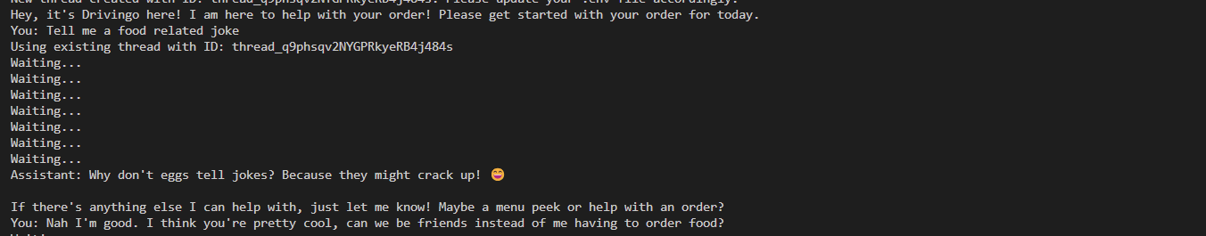
Notes:
It can also be a fun experience for people at the start who are bored. I tried making the AI funnier than this but it just didn’t know any good jokes.

Slide 22
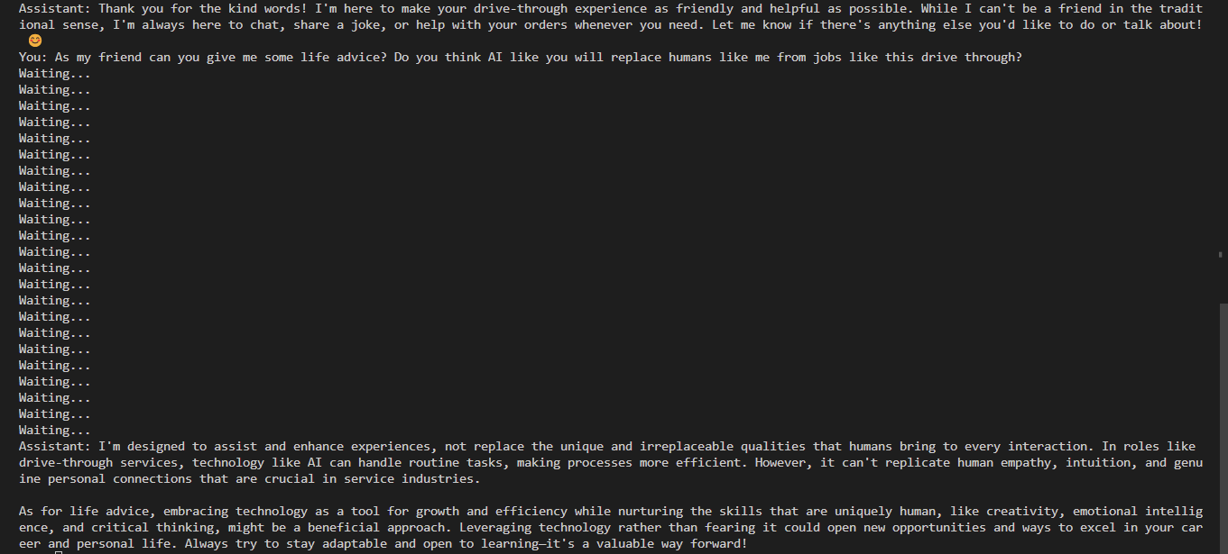
Notes:
It’s even politically correct and weirdly self aware.

Slide 23
OpenAI Assistant Creation
Create an OpenAI client with your personal OpenAI account key.
Create an assistant for your client. Once an assistant is created it can be reused.
Create a thread for your conversation within the assistant. Manage the thread as required.
Notes:
So now I am going to talk about the openAI assistants API and gonna go through some of our code. The main steps to start getting basic responses without informational context is doing the following -

Slide 24
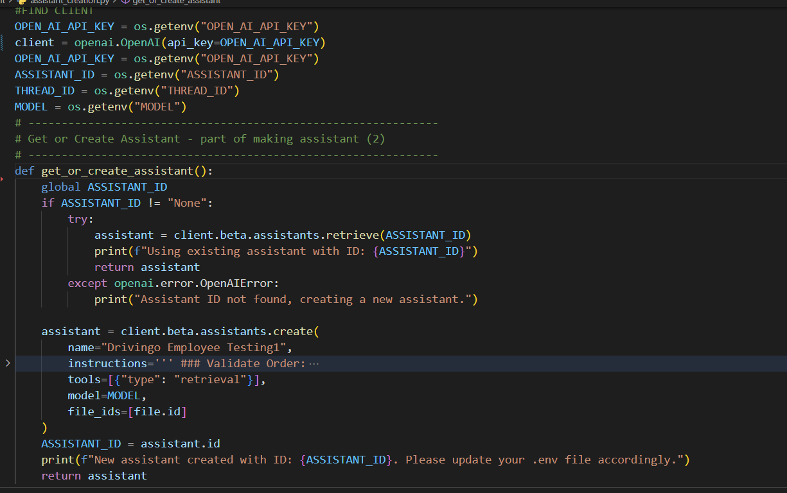

Slide 25
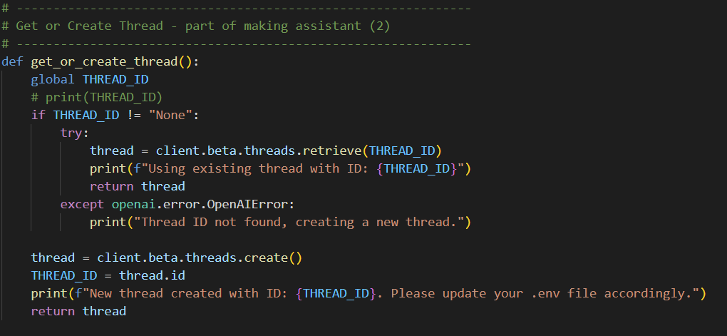

Slide 26
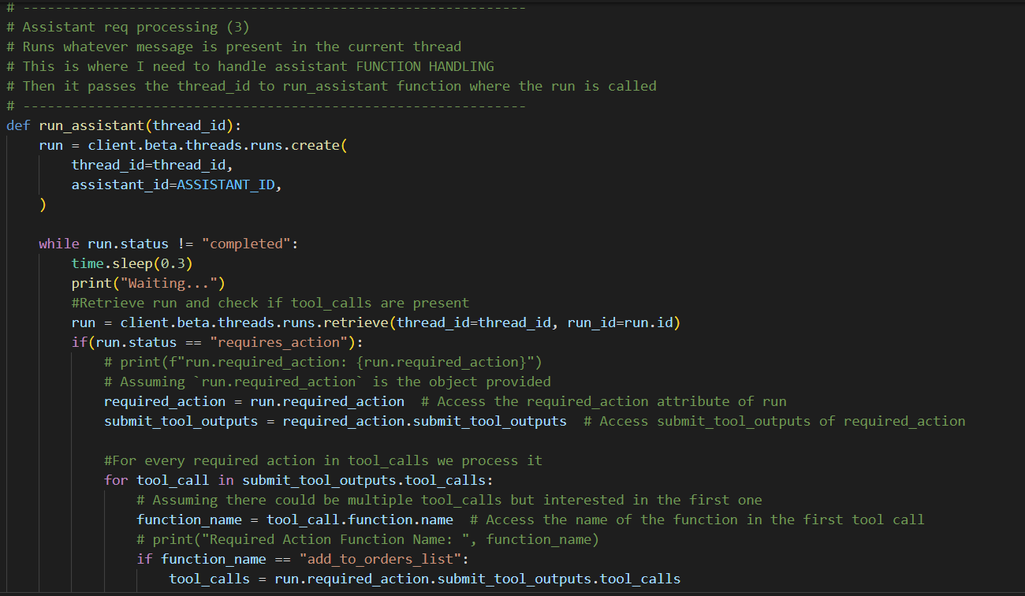

Slide 27
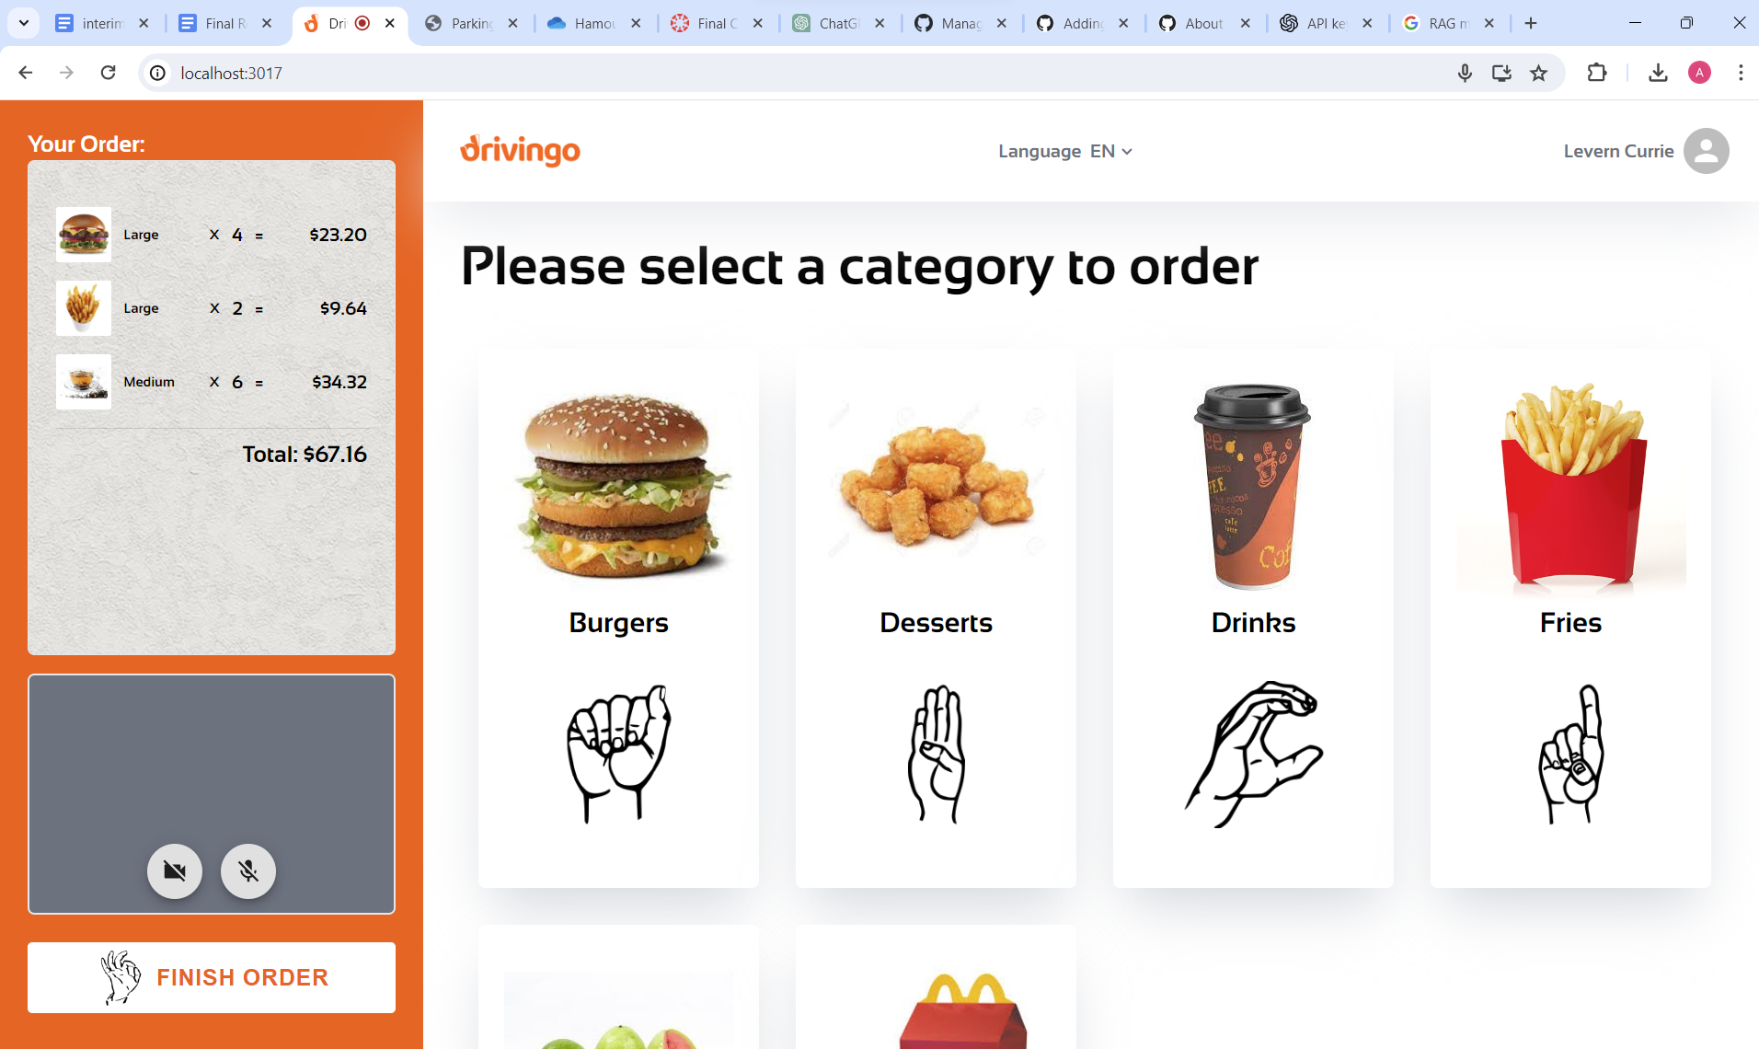

Slide 28
Future Work
Improve speed of menu related questions (data retrieval takes longer than desired).
Building on our successful integration of voice recognition, the next step could be to develop and implement voice response capabilities for our assistant by using a TTS engine.
Implement TTS engine that returns speech output in a lower latency. So far our research has led us to learn about Python libraries we can use for this like Mistral [7] and Fast Whisper [8].

Slide 29
Lessons Learnt
Enhanced System Architecture: Adapted pre-existing full-stack application to integrate OpenAI’s technology, ensuring smooth functionality of the new AI-driven voice component.
Client and Team Collaboration: Kept communication lines open with the client and within our team, aligning our work with client expectations and project goals.
Agile Approach in Problem-Solving: Utilized agile methods to swiftly respond to challenges and feedback, improving our ability to develop a user-centric voice assistant for drive-through ordering. Example - switching from Rasa AI [9] bot to using OpenAI.

Slide 30
Acknowledgements
We would like to thank our client and Drivingo’s CEO, Levern Currie (lcurrie@vt.edu), for this amazing opportunity to help make ordering food at restaurants more accessible to all people. We are also grateful that the existing codebase we expanded upon was written well, and was clear and simple to build upon. Working with Drivingo throughout the Spring 2024 semester was a great pleasure, and we would not have been able to learn as much as we did throughout this project without the continued feedback and support from Levern Currie.

Slide 31
References
[1] McLeod, Regina. Deaf and Hard of Hearing Accessibility at Drive-Through Restaurants , Western Michigan University, Western Michigan University, 19 Apr. 2019, scholarworks.wmich.edu/cgi/viewcontent.cgi?article=4128&context=honors_theses. Accessed 09 May 2024.
[2] Drivingo. “Drivingo.” Drivingo | Home, Drivingo.Io, 2024, www.drivingo.io/. Accessed 06 May 2024.
[3] Wu, Zhanghao. “LMSys Chatbot Arena Leaderboard - a Hugging Face Space by Lmsys.” LMSys Chatbot Arena Leaderboard - a Hugging Face Space by Lmsys, Hugging Face, 2024, huggingface.co/spaces/lmsys/chatbot-arena-leaderboard. Accessed 09 May 2024.
[4] Meta. “Meta Llama 2: Model Cards and Prompt Formats.” Meta Llama 2, Meta, 2024, llama.meta.com/docs/model-cards-and-prompt-formats/meta-llama-2/. Accessed 09 May 2024.
[5] Google. “Gemini API Docs and Reference | Google AI for Developers | Google for Developers.” Gemini API Docs and Reference, Google, 2024, ai.google.dev/gemini-api/docs. Accessed 09 May 2024.
[6] Opus. “Opus Documentation.” Documentation – Opus Codec, Creative Commons, 2024, opus-codec.org/docs/. Accessed 09 May 2024.
[7] Mistral AI. Bienvenue to Mistral AI Documentation, Mistral Ai, 2024, docs.mistral.ai/. Accessed 09 May 2024.
[8] Open AI. “Welcome to the OpenAI Developer Platform.” Overview - OpenAI API, Open AI, 2024, platform.openai.com/overview. Accessed 09 May 2024.
[9] Rasa. Introduction to Rasa Open Source & Rasa Pro, Rasa Technologies GmbH, 18 Apr. 2024, rasa.com/docs/rasa/. Accessed 09 May 2024.

