Slide 1
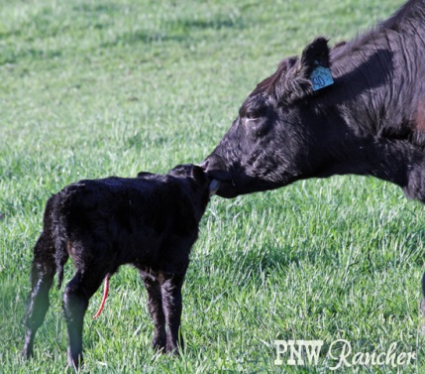
Success in Agriculture
&
In Life
Dr. Andy Overbay
Chilhowie FFA Banquet
May 20, 2016

Slide 2
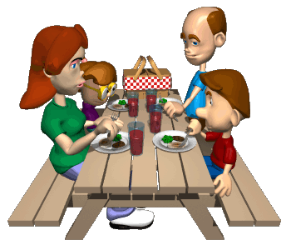
Goal #1
Bring something to the table beside your appetite!

Slide 3

Goal #2
Have a backup plan/exit strategy

Slide 4

Goal #3
Success isn’t always easy or fun.

Slide 5

Goal #4
Build Community.
When good people say good things about you,
good things happen to you.

