Slide 1
Agricultural Literacy
Our Role in the Success
Of Agriculture
Dr. Andy Overbay
December 1, 2016

Slide 2

The Evolution of Our Society
Agrarian
Industrial
Informational
U.S. Farming Population
  1930 25%
  1950 15%
  1975 8.7%
  2000 1-2%
  2010 1%

Slide 3

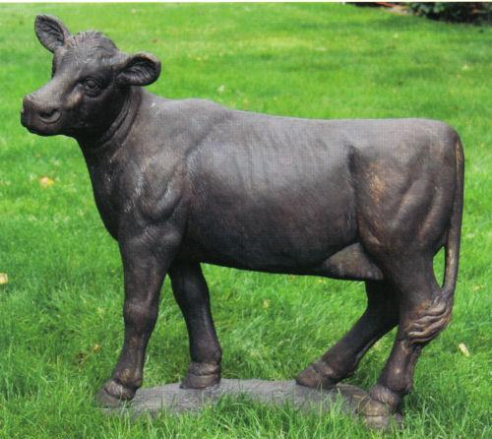

The Power of Words
  Chemical
  Organic
  Homemade
  Religious
  Gay
  Agriculture/Farmer

Slide 4
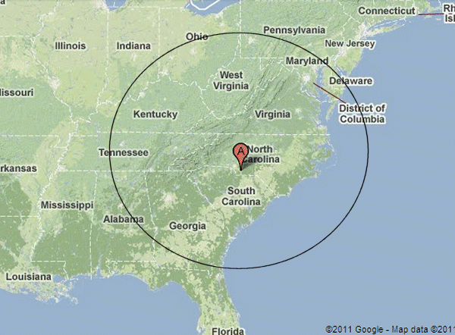
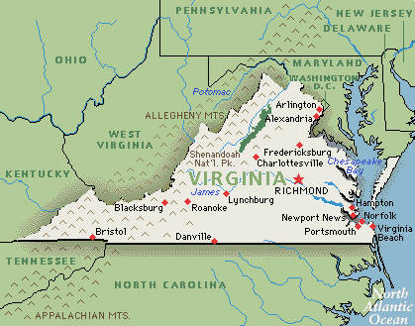

One more…
Local?
Whole Foods
Walmart

Slide 5
Quotes
The prosecution made a real mistake by introducing DNA evidence in this case. These jurors are farmers. They couldn’t possibly understand such sophisticated scientific data!
Savannah Guthrie Court TV Reporter June 17, 2004

Slide 6
Quotes
“Well, we thought about using a cow, but we didn’t want to portray our State as old-fashioned or outdated. Agriculture is old-fashioned and outdated.”
State Quarter Design Committee Member NPR Interview, 2004

Slide 7
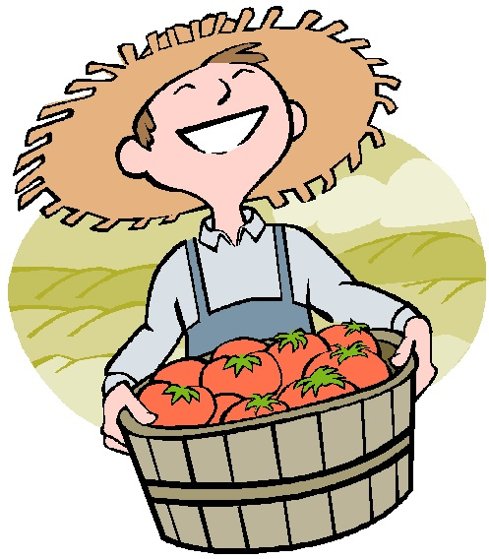
Negative Stereotyping and Perceptions of Fourth Graders
White/Caucasian
Male
Uneducated
Unprofessional
Cruel
Polluters

Slide 8
Witnessing
Verbal….not for every one!
  Actions are more powerful…
“A picture is worth….”

Slide 9
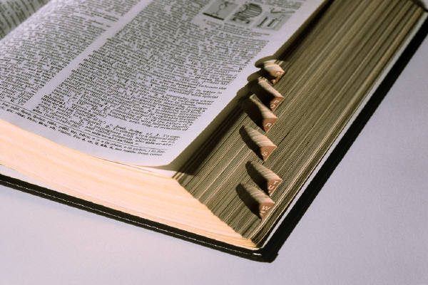
Art Imitating Life
Life at 24 frames per second….

Slide 10
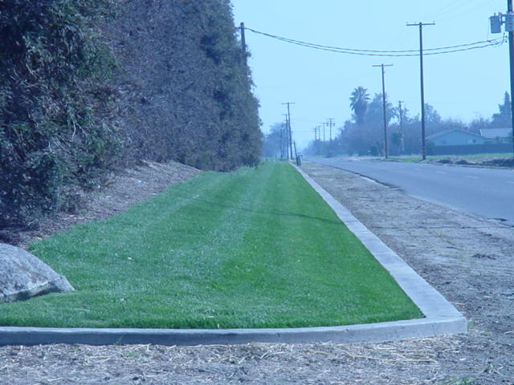
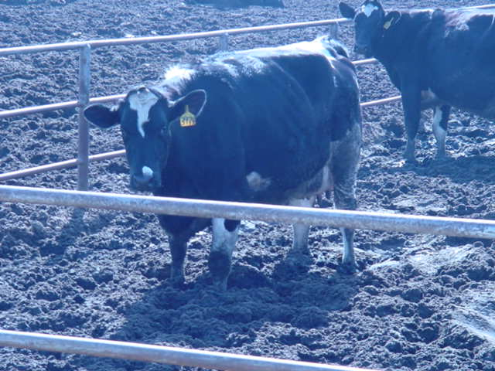
Your Message Here?
got milk?

Slide 11
Quote
“When I got through with those kids, none of them wanted to drink milk!”
Dairy Farm Employee
Smyth County News
1999

Slide 12
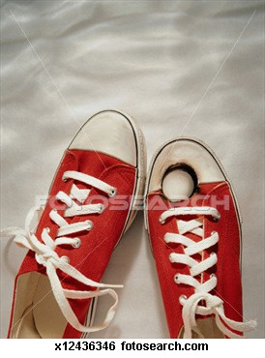
Our Best Weapons
Truth?
Facts backed by research
Knowing our detractors
Minimize self-inflicted damages!

Slide 13
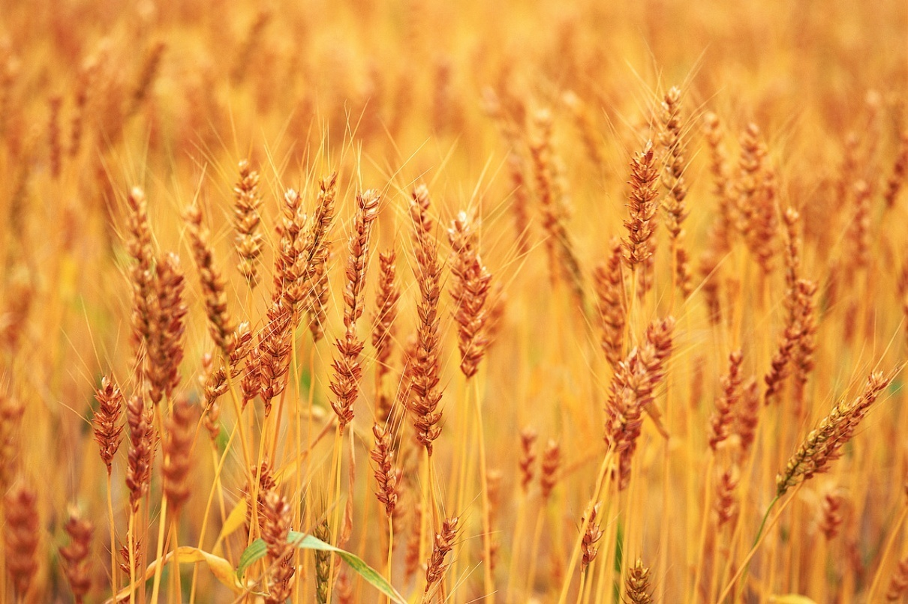

Grain Concentrates
What do you think of when you hear the word “GRAIN”?

Slide 14
Quote
“We ought to be ashamed. While people are starving all over the world, we feed our grain crops to cattle and eat steak.”
Terry Goodman
Pastor, Chilhowie UMC

Slide 15
Cow Feed = Human Food
Most grain fed to cattle (and other animals) is a BY-PRODUCT of human food production
Corn grain used as feed for cows is U.S. Grade #2.
It can contain up to 15% foreign material by law.

Slide 16
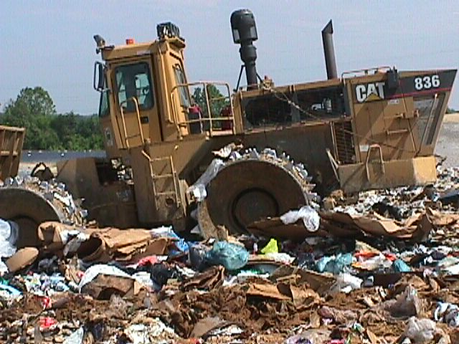
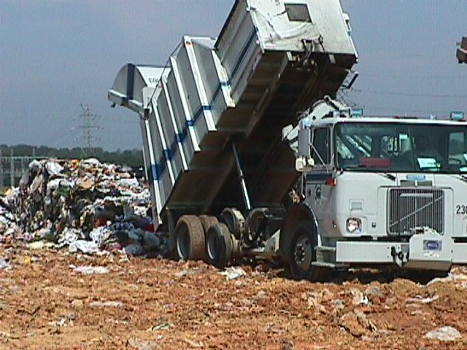
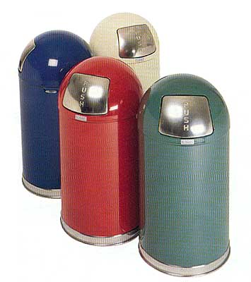
By-products Are Trash!

Slide 17
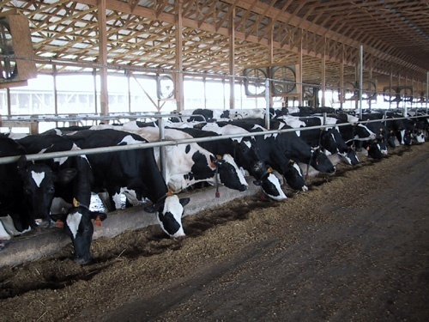

Cows Eat By-Products That Would Otherwise Be Put in Landfills!

Slide 18
Soybean Meal
Soy Oil
Margarine
Diesel Fuel
Ink
Attractants

Slide 19
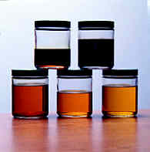
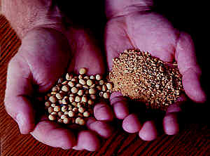
When the Soybean Oil Is Extracted, Soybean Meal Is Left

Slide 20
1,200,000,000 Tons?
14'
400 miles!!!

Slide 21
Other Common By-Product Feeds
Feedstuff
Product
Corn Gluten
Distillers Grain
Brewers Grain
Cottonseeds
Beet Pulp
Citrus Pulp
Soda Pop, Candy Bars, Chocolate Milk
Whiskey, Gasoline
Beer
Blue Jeans, sheets, Q-Tips, bandages
Sugar
Orange Juice

Slide 22
Why is Gluten a protein supplement?

Slide 23
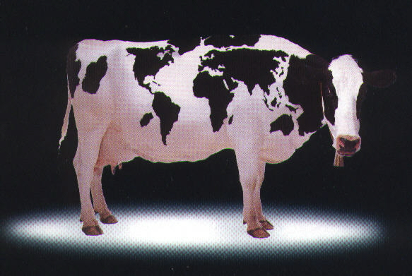
Thanks to Cows For Keeping Our World Cleaner and Greener!

Slide 24
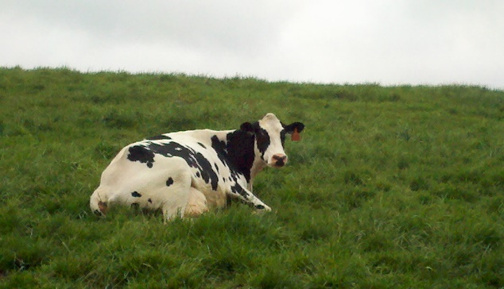
Animal Welfare

Slide 25
What Does Every Cow in the World Have In Common?

Slide 26
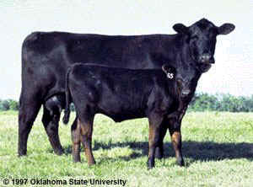
Motherhood

Slide 27
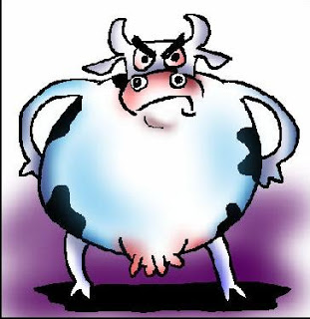
When Mom’s Not Happy…..

Slide 28

The Extension Office
What is that?

Slide 29
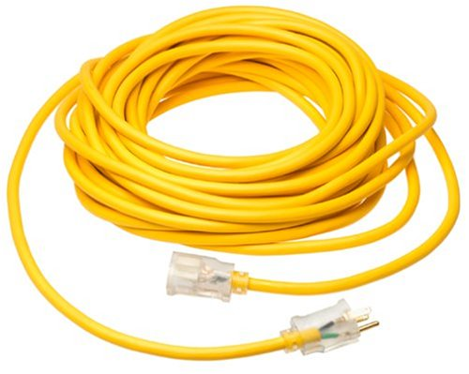

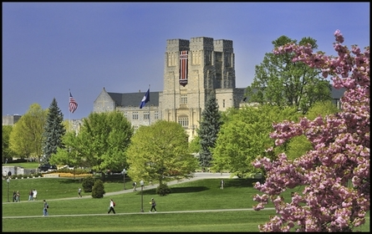

We are an Extension of VA Tech and VSU!

Slide 30
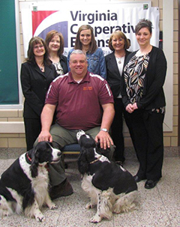
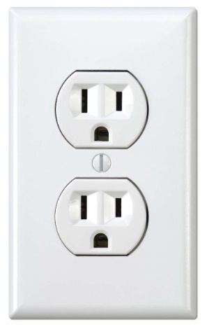

Convenience of Power!

Slide 31



Staff and Faculty of VA Tech

Slide 32
Programs
Agriculture & Natural Resources
Family Nutrition Program
4-H Youth Development
Family and Consumer Sciences

Slide 33
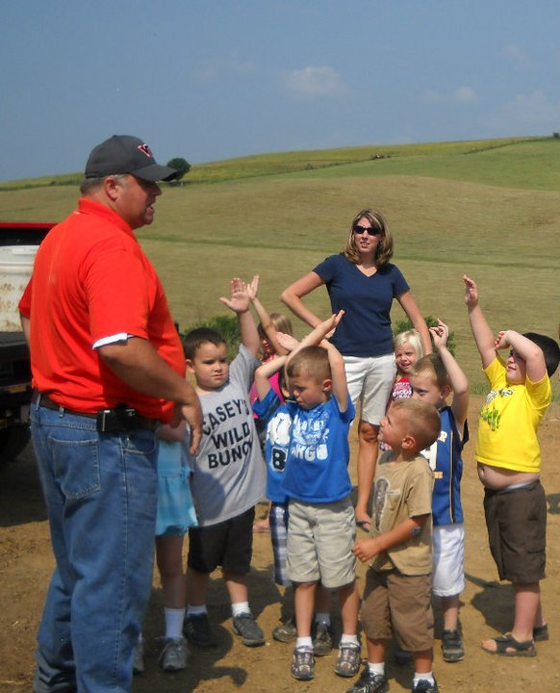
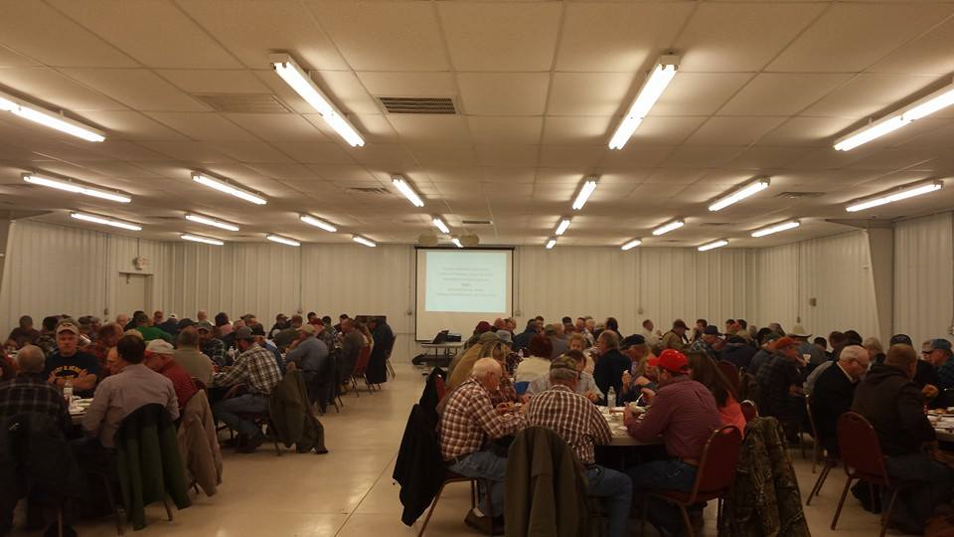
Education

Slide 34
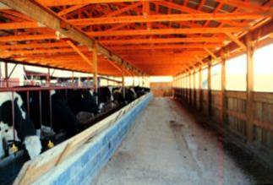
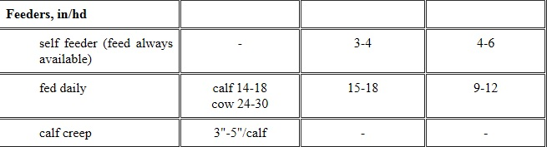
Calves aren’t growing; Cows not Milking?

Slide 35
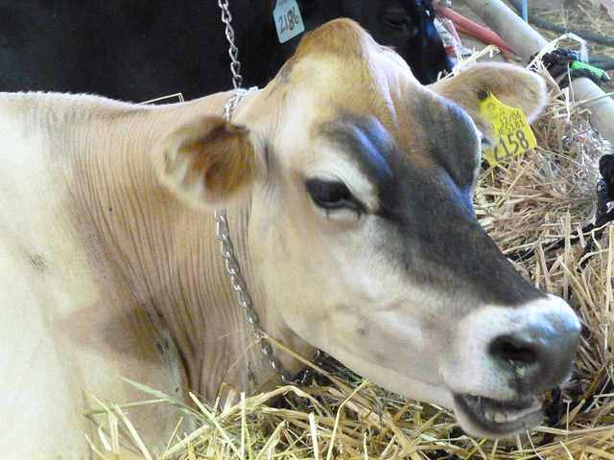
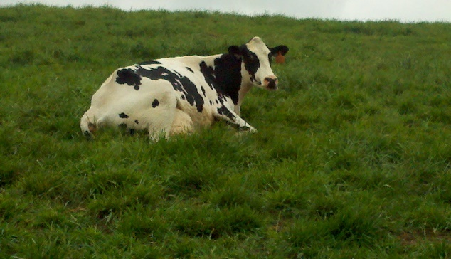
Determining Herd Health with Math
200 cows x 50%= ____________
200 cows x 60% = ___________

Slide 36
Planting Alfalfa….What Does My Field Need?

Slide 37
Agriculture
Over-fertilization?
1600 lbs. of 10:10:10 VS 648 pounds of Custom Blend
(382 DAP+266 Potash)

Slide 38
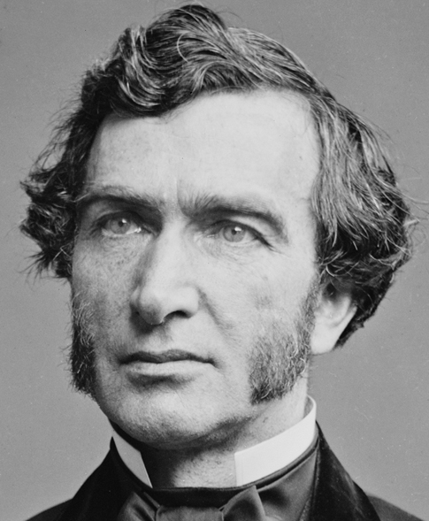
Senator Justin Morrell, Vermont

Slide 39
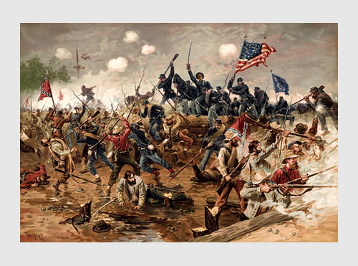

Slide 40

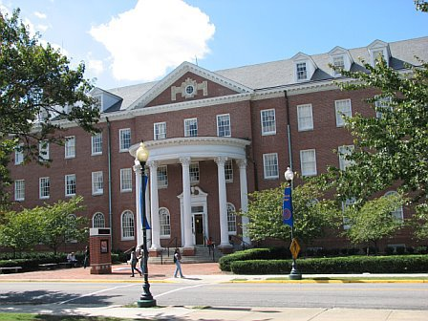

The Land Grant College System

Slide 41
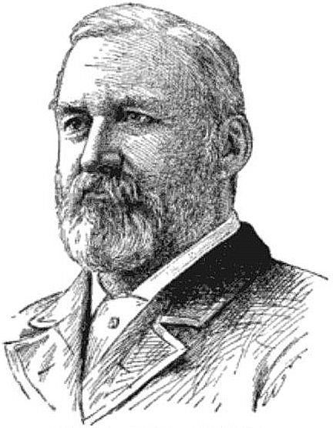
Hatch Act of 1887
William H. Hatch

Slide 42
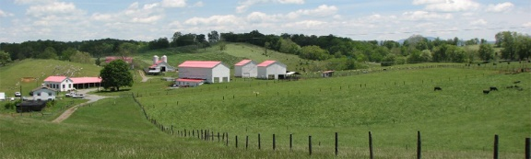
Southwest VA AREC

Slide 43
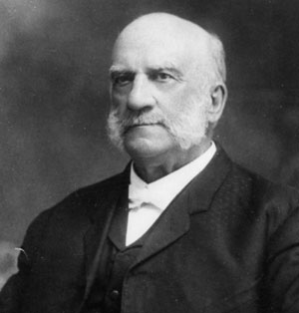
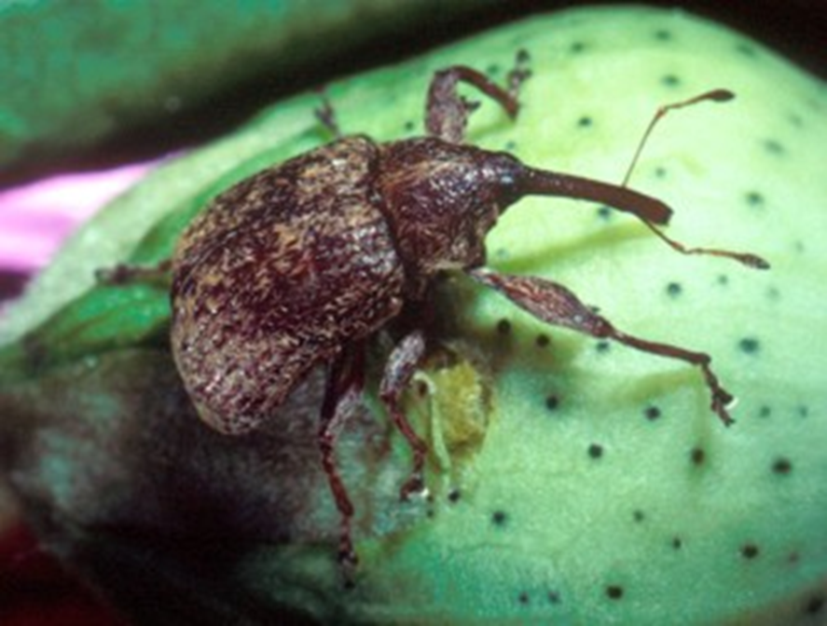
Seaman Knapp

Slide 44
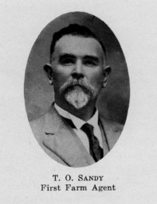
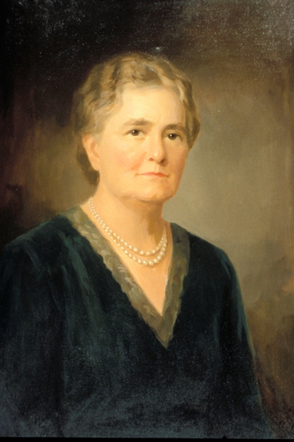
T. O. Sandy & Ella Agnew

Slide 45
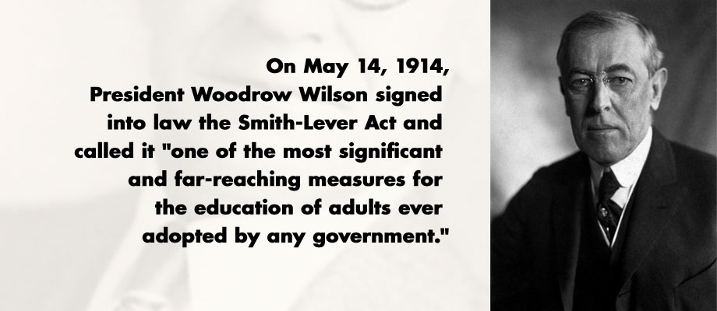
Smith Lever Act 1914

Slide 46
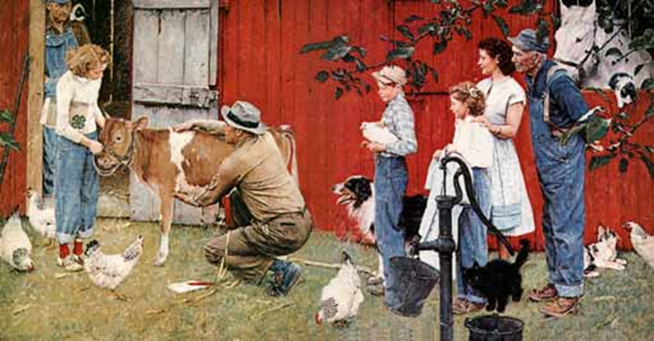
4-H and Youth Focused Agriculture

Slide 47
A Couple of Final Quotes
“In the absence of genuine leadership, people will listen to and follow anyone with a microphone. They are drawn to them like an oasis in the desert. If the oasis turns out to be dry, they’ll drink the sand.”
The American President
1995

Slide 48
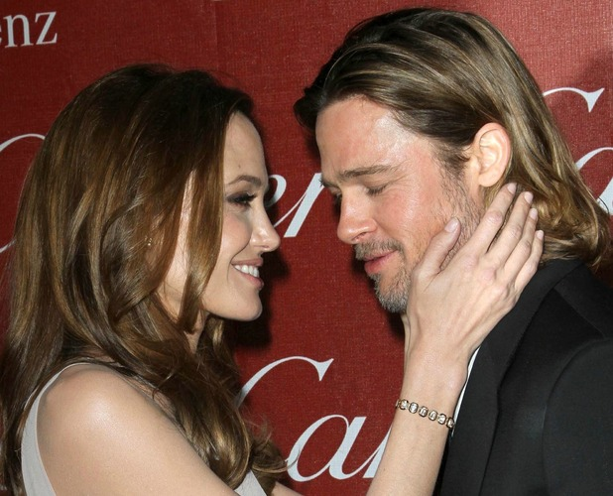
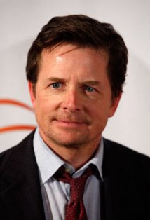
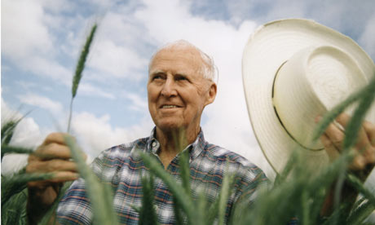
Identify These People
Notes:
"You know, out of all the Lower 9th homes we built, all are producing more energy than they are consuming. They're all pollution-free. This is an amazing story to me.

Slide 49
Actor Defeats Newton’s
Third Law of Thermodynamics
"You know, out of all the Lower 9th homes we built, all are producing more energy than they are consuming. They're all pollution-free. This is an amazing story to me. “
Brad Pitt

Slide 50
One Final Thought
If we don’t tell the story of agriculture….
WHO WILL?

