Slide 1
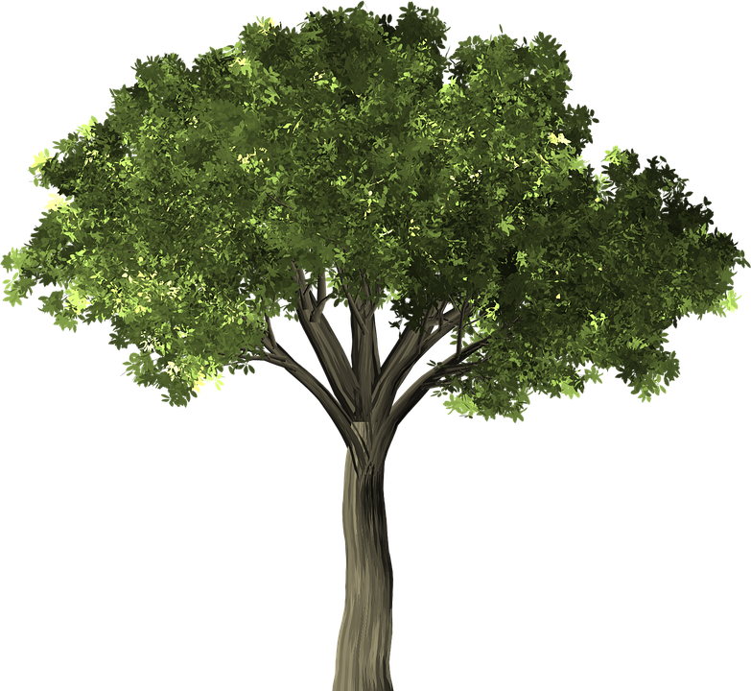

Creative Commons and OER
in 30 minutes
© Anita Walz. Unless otherwise noted, this presentation is licensed with a Creative Commons Attribution 4.0 license. Anyone may modify and redistribute this presentation with attribution. Required attribution: This presentation is adapted from © Anita Walz’s CC BY 4.0 licensed presentation “Creative Commons and OER in 30 minutes” available from: http://hdl.handle.net/10919/78393
Public domain image: https://pixabay.com/en/tree-elm-elm-tree-leaf-green-1484370/

Slide 2

Creative Commons licenses can help you to:
Create & more broadly share your original works
Legally (and easily) incorporate CC-licensed works authored
by others in your own work

Slide 3

Added bonuses:
Using CC-licenses may:
Extend your impact, audience and the reach of your work
Start (and build on) a virtuous cycle of sharing
Save money for your students and other readers

Slide 4

Discussion: Have you heard of OER or CC-licenses?

Slide 5





Slide 6

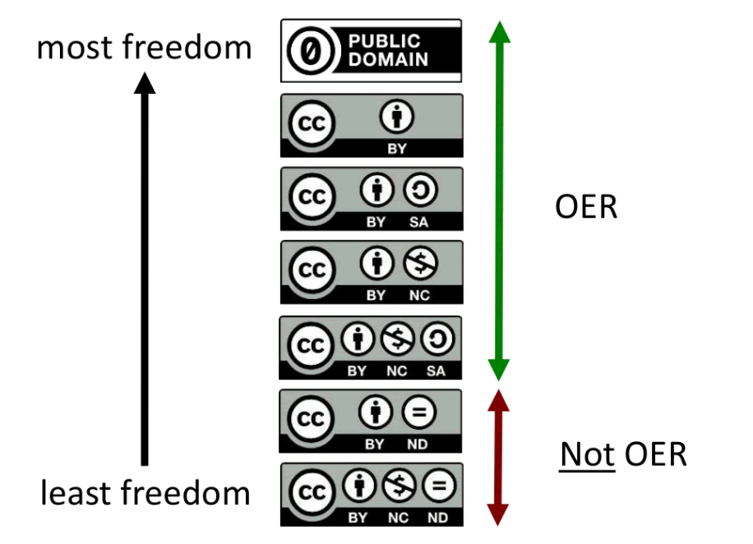

Slide 7


Not all CC-licenses allow derivatives
These licenses (ND) are not “open licenses” as they do not allow derivatives.

Slide 8




Read more here: https://creativecommons.org/licenses
OER definition: http://www.hewlett.org/strategy/open-educational-resources/
No known copyright
Donated to the public domain (and marked as such)
Creative Commons Attribution License (CC BY)
Creative Commons Attribution Share-Alike License (CC BY SA)
Creative Commons Attribution Non-Commerical License (CC BY NC)
Creative Commons Attribution Non-Commercial ShareAlike (CC BY NC SA)
Open Educational Resources
Notes:
Focus on those that ARE OER.

Slide 9
What can I do with OER?
Retain - Make, own, and control copies of the content (store, manage, download, duplicate)
Reuse - Use the content in various ways (in class, study group, extension, journal article, on the radio, in a video, website etc.)
Revise - Adapt, modify, alter the content (reformat or translate)
Remix - Combine revised or original content with other materials to create something new (i.e. mashup)
Redistribute - Share copies of original content, revised content, or remixes with others
Source: This material is based on original writing by David Wiley, which was published freely under a Creative Commons Attribution 4.0 license at http://opencontent.org/definition

Slide 10
Questions?

Slide 11
Best practices for creating & sharing OER
Evaluate
License
Mark
Share
ELMS
© Anita Walz. Unless otherwise noted, this presentation is licensed with a Creative Commons Attribution 4.0 license. Anyone may modify and redistribute this presentation with attribution. Required attribution: This presentation is adapted from © Anita Walz’s CC BY 4.0 licensed presentation “Creative Commons and OER in 30 minutes” available from: http://hdl.handle.net/10919/78393
Public domain image: https://pixabay.com/en/tree-elm-elm-tree-leaf-green-1484370/

Slide 12
Evaluate
Did I create (and still own) all of the content in the item?
If not, do I have permission for my use of third party content?
CC-licensed content - requires attribution
Public domain content (pre-1923, © expired, or U.S. Government content*)
Written permission from the author for your use
Fair use (not recommended if you plan to “share with the world”)
ELMS
* Public Domain in the U.S. Works of a U.S. Government employee within the scope of their official duties
What is the Public Domain? http://fairuse.stanford.edu/overview/public-domain/welcome

Slide 13
License
Example:
© MyName, Publication Year. Unless otherwise noted, licensed with a
Creative Commons Attribution License 4.0
ELMS
Marking CC licensed works to be Machine Readable: https://wiki.creativecommons.org/wiki/Marking_Works_Technical

Slide 14
Mark
Mark 3rd party content within the document
Permission granted by:
Creative Commons license
Public domain (not in copyright)
Author-granted permission (preferably in writing)
Fair Use (not recommended for CC-licensed works shared with the world)
ELMS

Slide 15
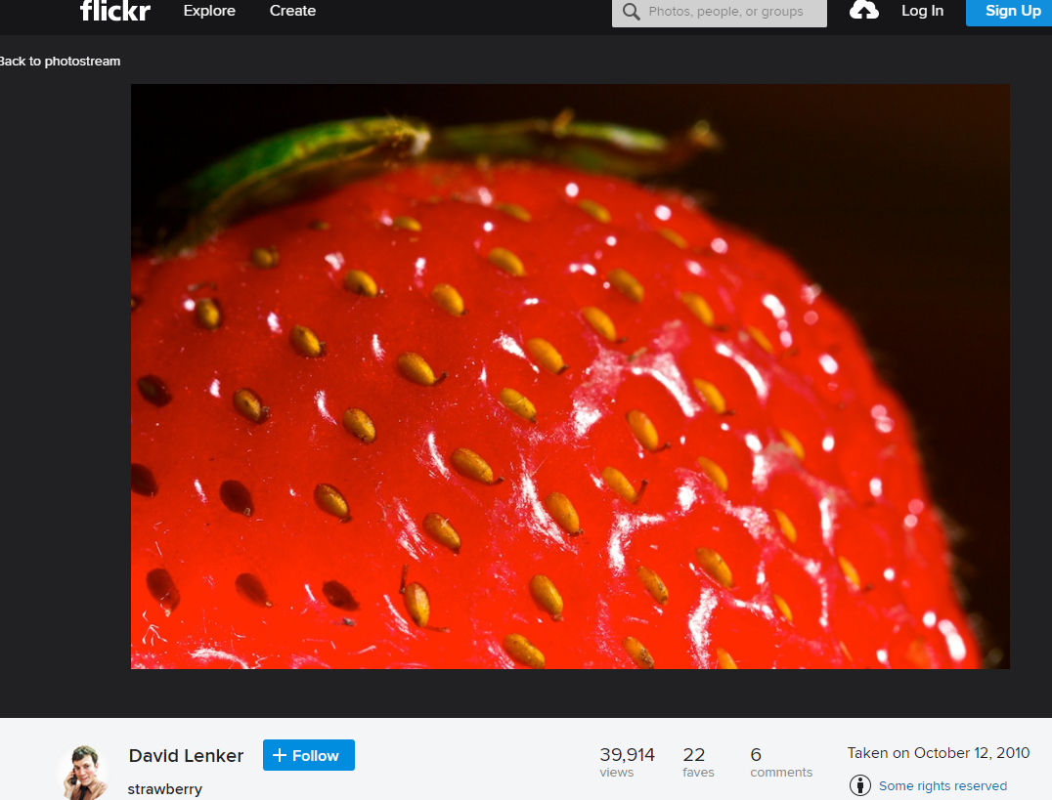
Creative Commons example

Slide 16
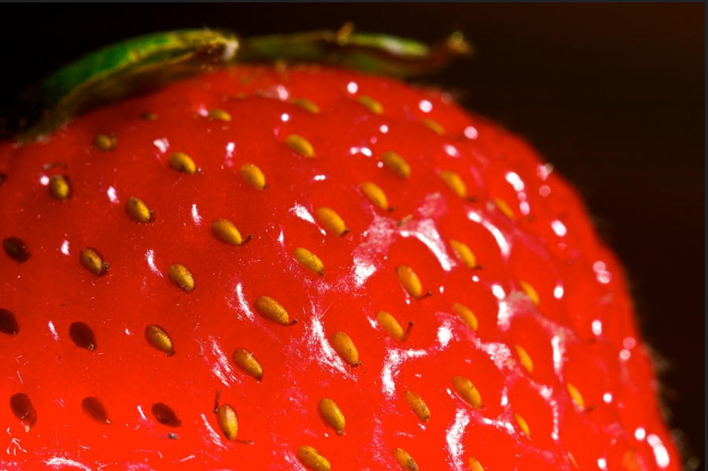
Creative Commons example
Attribution is always required when using CC-licensed materials.
© David Lenker Strawberry CC BY 2.0
ELMS
Best practice for attributing CC-licensed materials: https://wiki.creativecommons.org/wiki/Best_practices_for_attribution

Slide 17
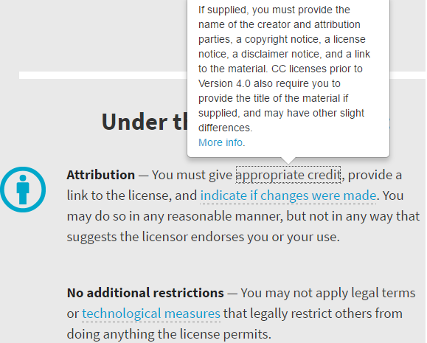
Creative Commons example
© David Lenker Strawberry CC BY 2.0
Attribution is always required when using CC-licensed materials.
© David Lenker Strawberry CC BY 2.0
ELMS
Source: https://creativecommons.org/licenses/by/4.0/
Best practice for attributing CC-licensed materials: https://wiki.creativecommons.org/wiki/Best_practices_for_attribution

Slide 18
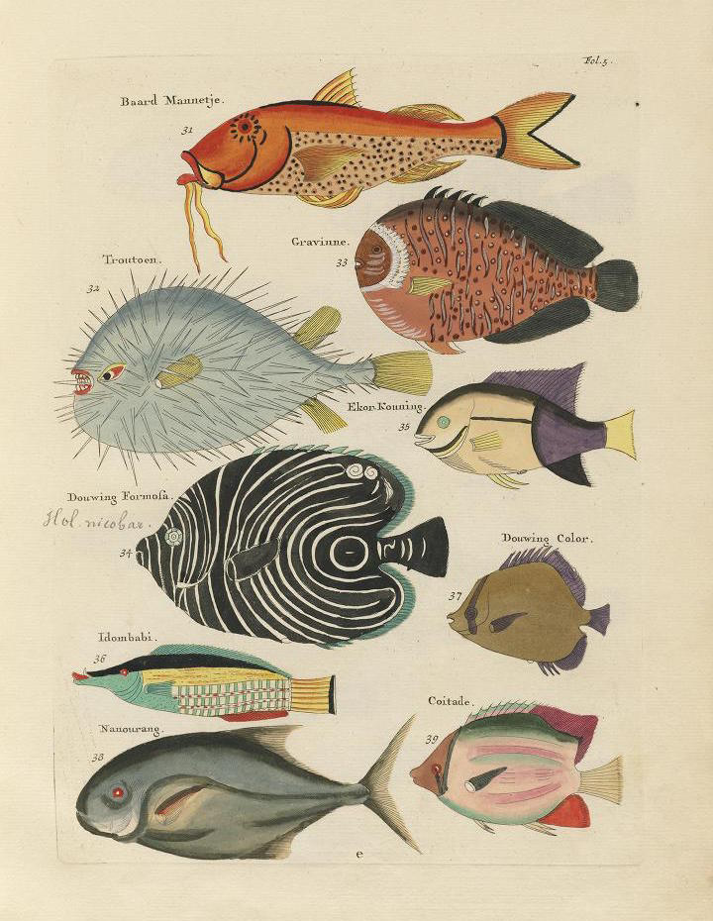
Public domain example
Citations are good scholarly practice.
Attribution of public domain works is not legally required.
Poissons, Ecrevisses et Crabes (1719). Retrieved from: http://publicdomainreview.org/collections/images-from-the-earliest-known-colour-book-on-fish-1754 [Public domain]
ELMS
About the Public Domain: http://guides.lib.vt.edu/oer/PD
More info on finding Public Domain works: http://publicdomainreview.org/guide-to-finding-interesting-public-domain-works-online/

Slide 19
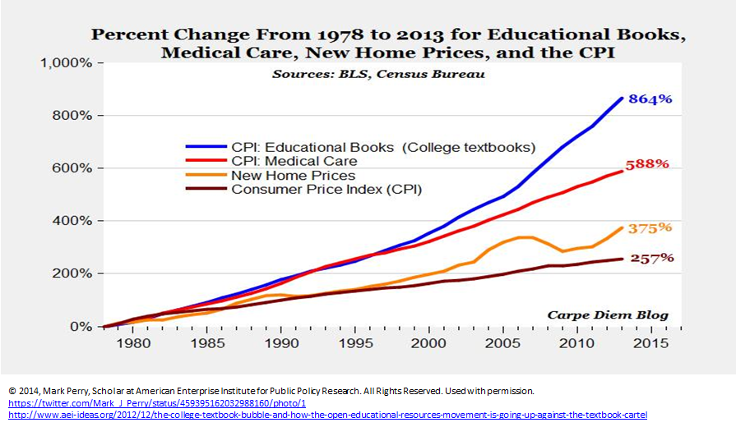
Author permission example
The permission granter may require a particular statement.
Citation is good scholarly practice.
ELMS

Slide 20
Mark
Mark 3rd party content within the document
  Creative Commons Example: © David Lenker Strawberry CC BY 2.0
  Public Domain Example: Poissons, Ecrevisses et Crabes (1719). Retrieved from: http://publicdomainreview.org/collections/images-from-the-earliest-known-colour-book-on-fish-1754 [Public domain]
Permission Example: © Mark Perry All Rights Reserved. Used with Permission
ELMS

Slide 21
Share
Share in your usual places:
In print
On your website
Share to avoid eventual broken links and so that others can find your work:
VTechWorks (VT’s instituional repository) https://vtechworks.lib.vt.edu (Google crawls)
Disciplinary repositories (contact your professional society)
Open repositories: OERCommons http://www.oercommons.org
      MERLOT https://www.merlot.org
  Open Textbook Library https://open.umn.edu/opentextbooks/Submit.aspx
More platforms for creating and sharing: http://hdl.handle.net/10919/76739
Tell people about your work:
Social media channels: Twitter, Facebook, Listservs
University communication channels & news services
Tell your colleagues: Face to face
ELMS

Slide 22
Best practices for creating & sharing OER
Evaluate
License
Mark
Share
ELMS
Public domain images: https://pixabay.com/en/tree-elm-elm-tree-leaf-green-1484370/

Slide 23
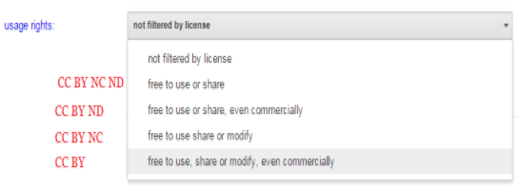
Finding OER, Creative Commons & Public Domain Resources
Google Advanced Search (“Usage Rights” filter)
Images, music, media & video: https://search.creativecommons.org
Open (OER) Textbooks: https://open.umn.edu/opentextbooks
Interactive Simulations: https://phet.colorado.edu
And more: http://guides.lib.vt.edu/oer

Slide 24
Services offered by the University Libraries
Consultations & Referrals: Where do I start? Who can help me?
Copyright, Creative Commons/Open Licensing consultations
Assistance locating & adapting openly licensed content
VTechWorks Institutional Repository
Open Textbook Publishing
Hosting of Open Journals and Open Conference Proceeding
Open Education Initiative Faculty Grants for development of openly licensed learning resources - https://researchinformatics.lib.vt.edu/oeig16-17
© Anita Walz. This presentation is licensed with a Creative Commons Attribution 4.0 license. Anyone may modify and redistribute this presentation with attribution. Required attribution: This presentation is adapted from © Anita Walz’s CC BY 4.0 licensed presentation “Creative Commons and OER in 30 minutes” available from: http://hdl.handle.net/10919/78393

Slide 25
Thank you and discussion

