Slide 1

Advancing the Human Condition
Emerging Questions
Photos are from the 2017 Taylor Wessing Portrait Prize series.
Notes:
A visual reflection on the purpose of the first Advancing the Human Condition symposium.
This month, the prestigious Taylor Wessing Photograpy Portrait Prize announced the winners for its 2017 competition.

Slide 2
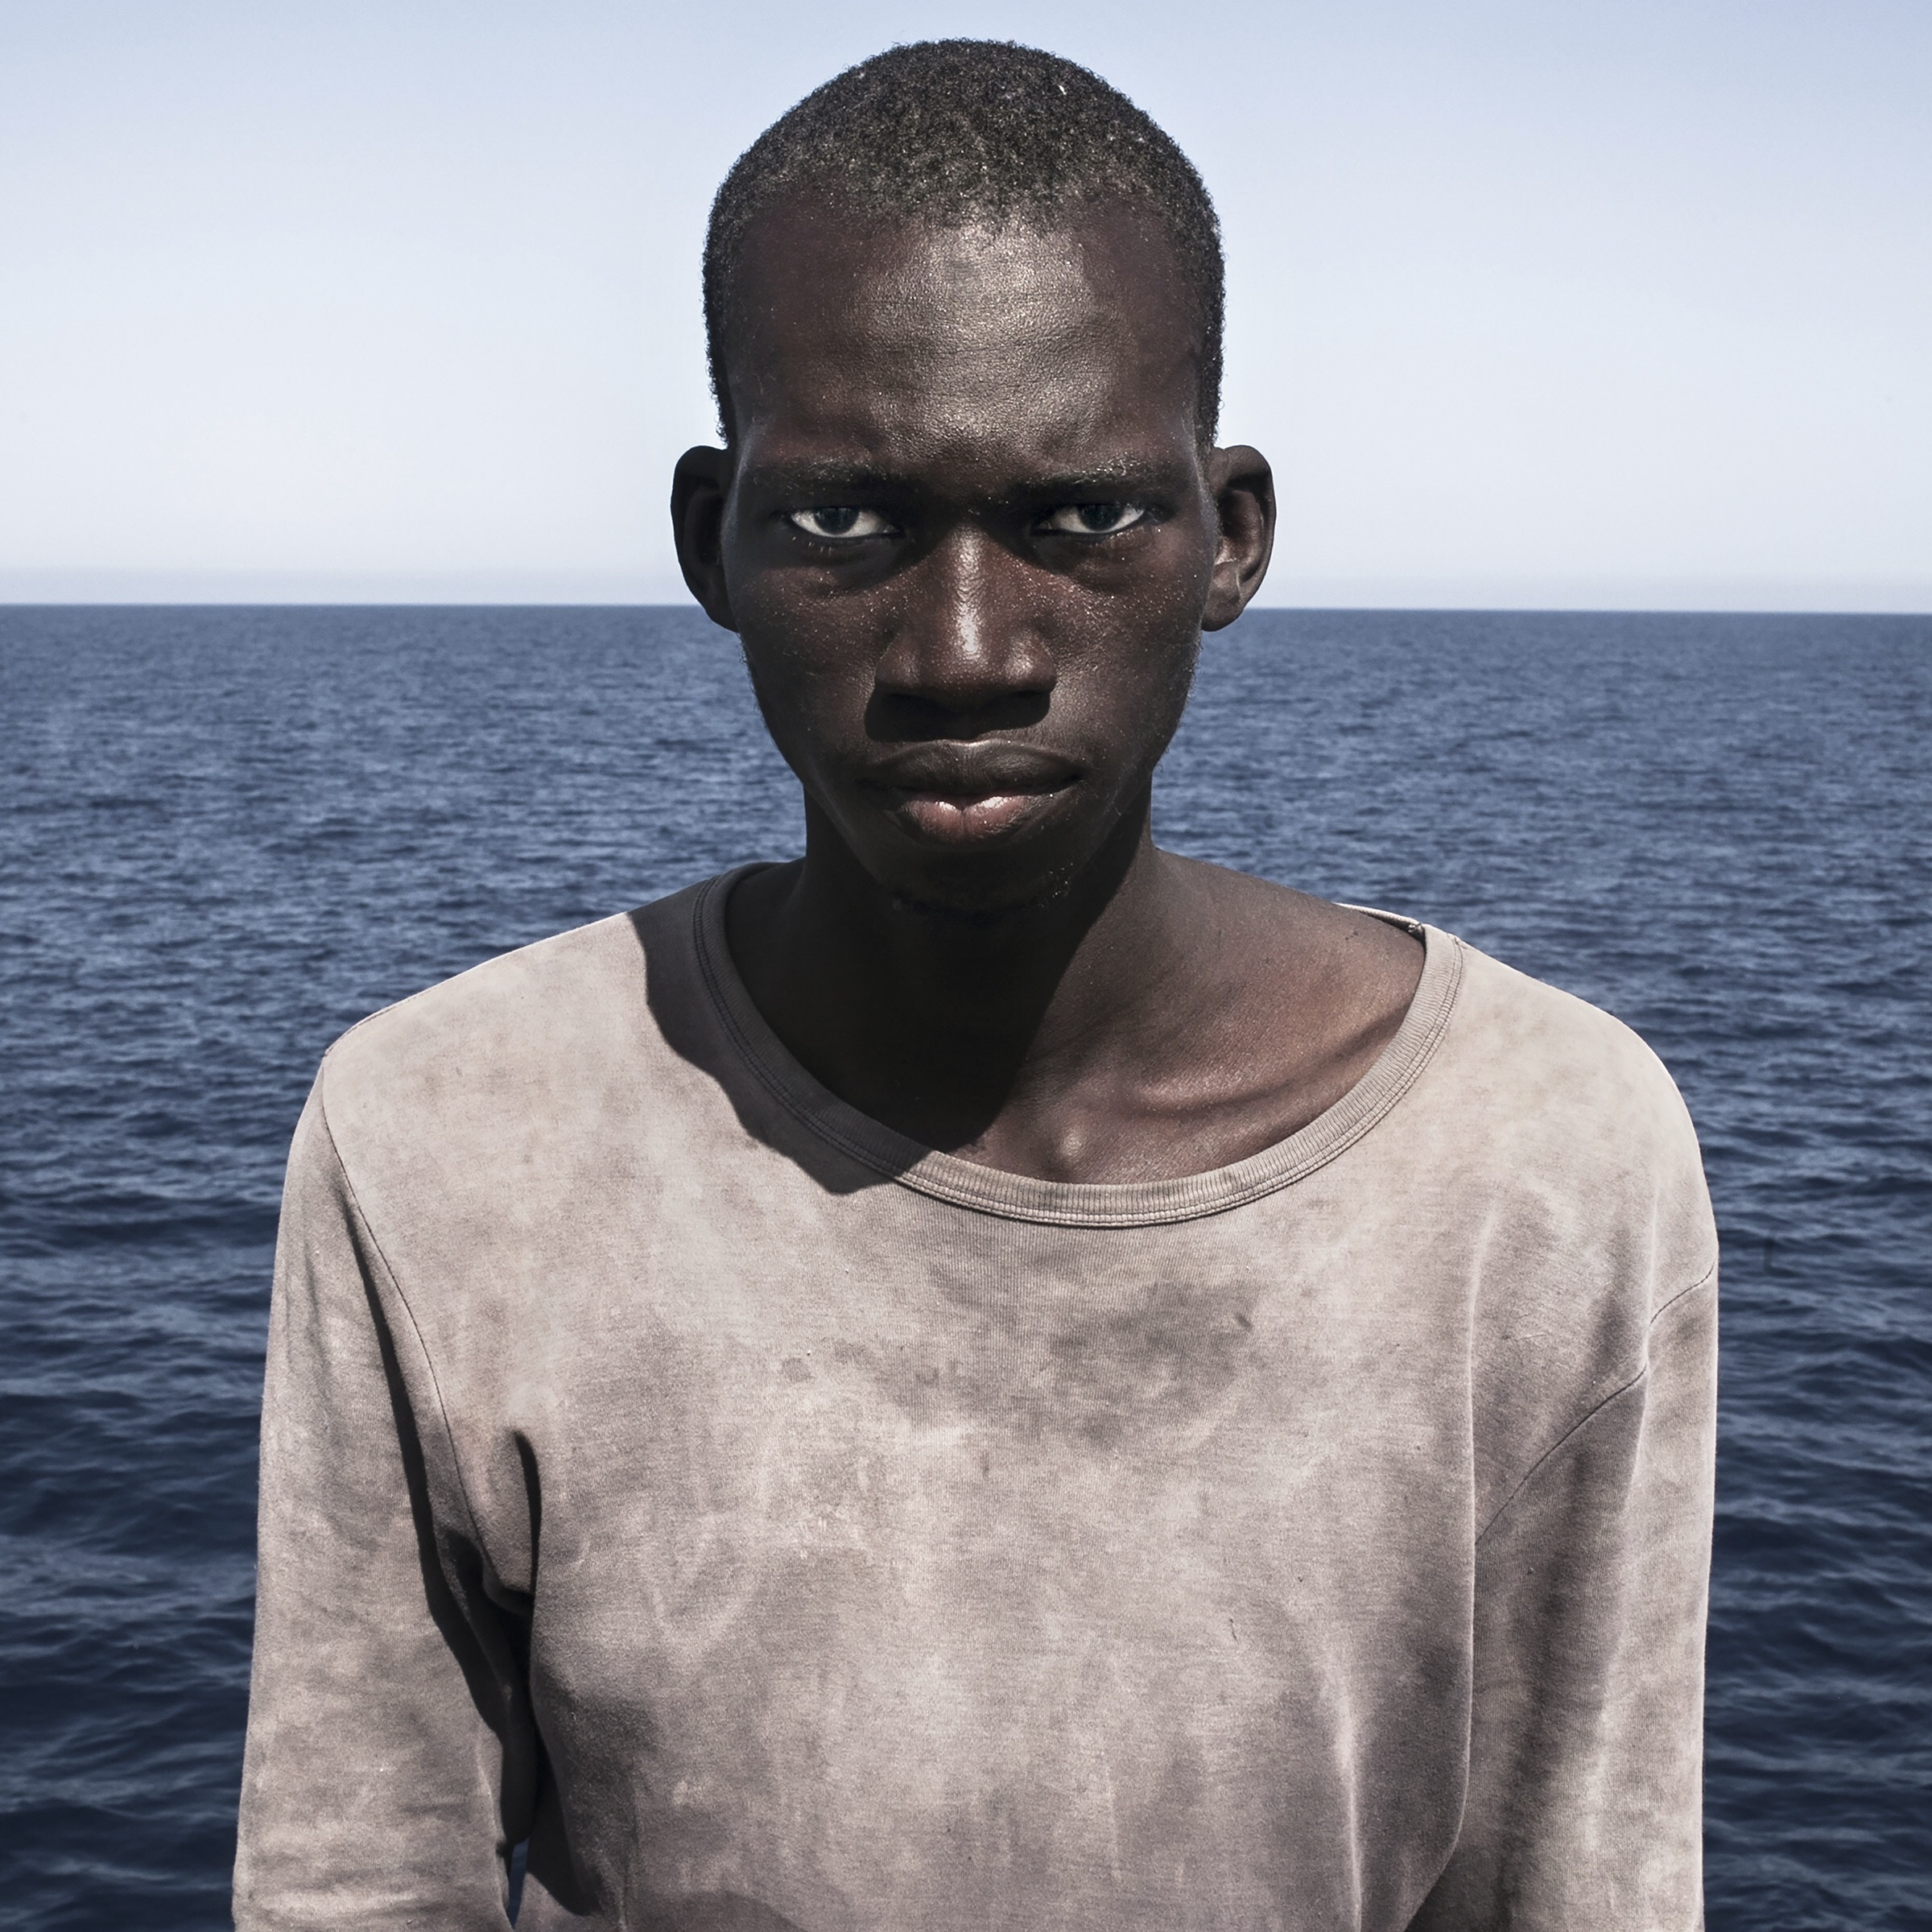
Who is not here from our communities?
Amadou Sumalia by Cesar Dezfuli
Notes:
The top prize was César Dezfuli’s portrait of Amadou Sumaila – a teenager rescued from the sea off the coast of Libya.
The face of Amadou demands attention to one of the most profound challenges facing the human condition in the 21st century: the mass displacement of people.
Whether it be precipitated by geopolitical conflict, ethnic cleansing, extreme poverty, natural disaster or human-facilitated environmental or resource crises, the number of people forced to migrate under dire circumstances is unprecedented.
What can an academic do? Our work in the areas of global systems, integrated security, policy, adaptive brain and behavior, data and decisions—all hold some part of the solution to the complex and protracted issue of forced migration and human displacement.
The face of Amadou confronts us “bare life”…

Slide 3

How is the academic language we use exclusionary insofar as it prevents some people from participating in the conversation?
One of them is a Human #1 by Maija Tammi
Notes:
Whereas the portrait of Erica, from Maija Tammi’s series, One of Them Is a Human, raises new questions—specifically, what does it mean to be alive?
Erica is an android created by scientists at Osaka University. Her inclusion in the contest—and the fact that her portrait garnered third prize—provoked controversy. Is Taylor Wessing breaking its own rules by allowing an image of something that is non human?
Or, does its inclusion require us to consider how innovations in robotics, artificial intelligence, and autonomous systems are altering the meaning of the human?
Robots and refugees—these are two of the faces of the human condition in 2017.

Slide 4
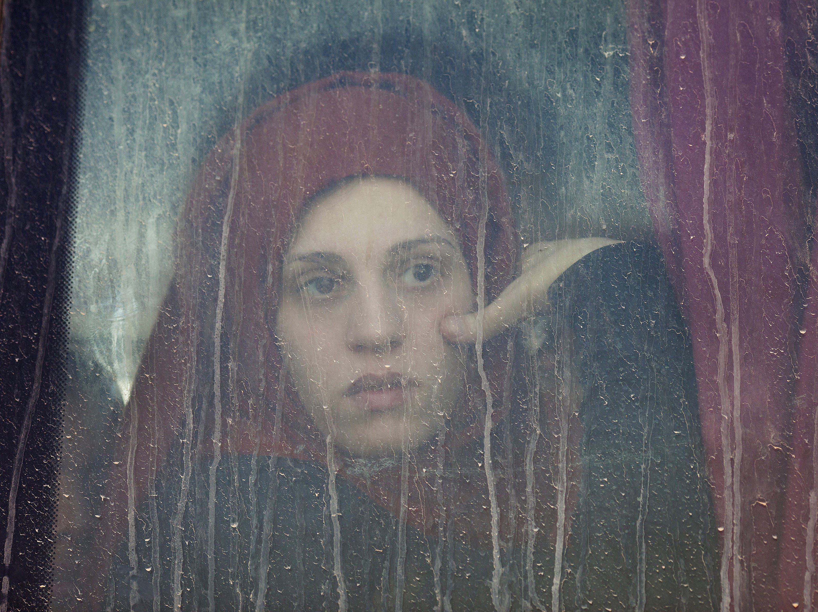
How can we extend these dialogues beyond campus so that they include the people who are the subjects of research and the people whose lives are directly impacted by the issues we explore?
Fleeing Mosul by Abbie Trayler-Smith
Notes:
However, while Amadu and Erica are named, the young woman fleeing Mosul who is the subject of the second prize photograph by Abbie Trayler-Smith is unnamed.
The image is personal, intimate. It is part of a series entitled Women in War: Life After Isis. It draws us closer to her lived experience. And yet, she remains separate from us—behind the window of the bus that brought her to the Hasan Sham camp in northern Iraq. We can only infer—her lived reality remains unknowable to us.
Without a name, do we render her voiceless under our gaze? The question of who tells the story and how it is told, of who determines what advances the human condition—these questions need to remain central to our collective work toward equity.
Thus, in addition to exploring the emerging theories and technologies of the human condition, we must also interrogate our methodologies to discern how they advance the human condition.

Slide 5
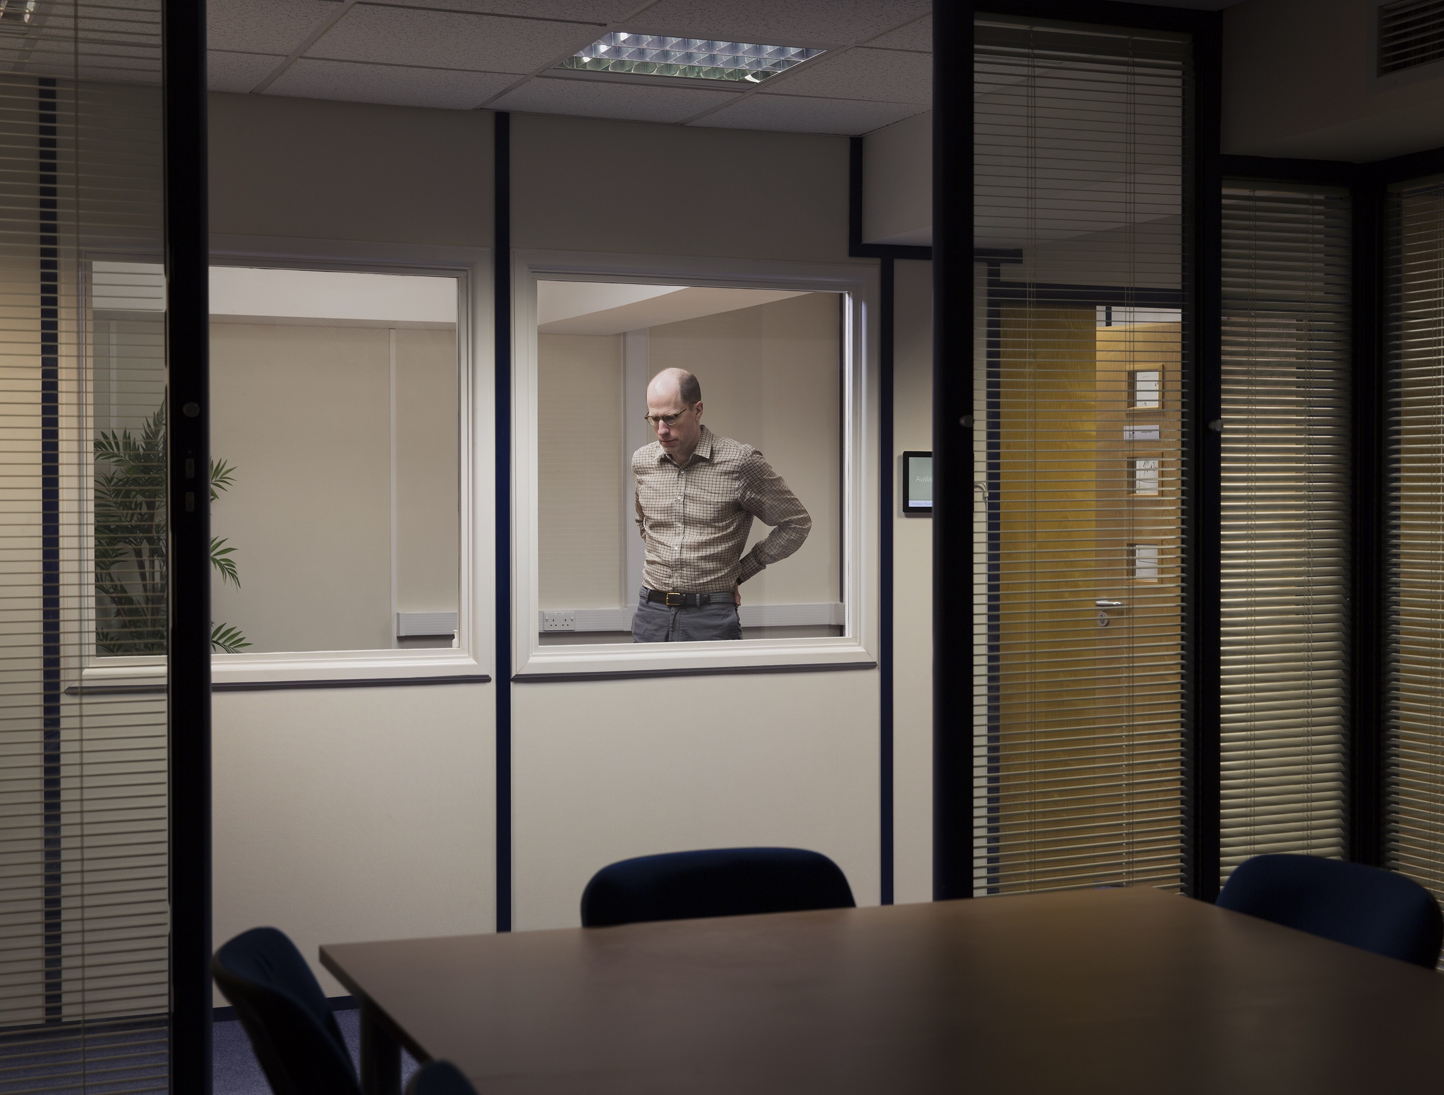
Sometimes I feel very alone at VT because some of the questions I want to ask are difficult.
How do we break out of this thing where we do what funding agencies want in order to speak up and ask the questions that need to be asked?
Nick Bostrom, The Future of Humanity Institute, Oxford. From the series Transhuman by David Vintiner
Notes:
The symposium explores multiple facts of advancing the human condition: theories, methodologies, pedagogies, technologies, communities.
(This photograph is of Nick Bostrom, founding director of the Future of Humanity Institute at the University of Oxford. The Institute brings the tools of mathematics, philosophy and social sciences to bear on big-picture questions about humanity and its prospects)
Similar to campuses across the globe, our approach is interdisciplinary.

Slide 6
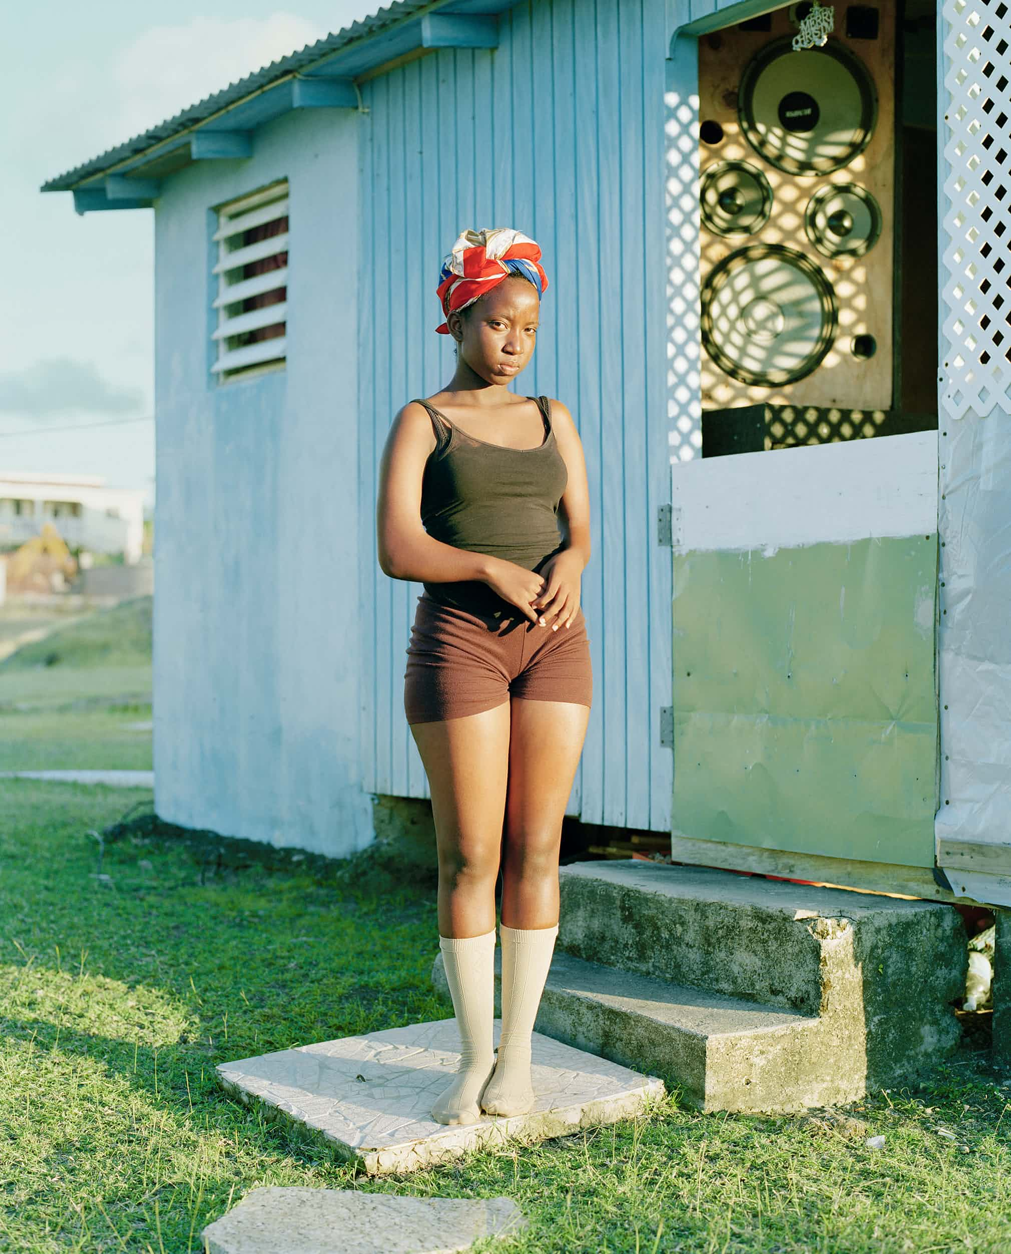
Can we counter the forces behind the economic interests in place now? How do we move beyond capitalism?
Maddens Wind Farm by Catherine Hyland
Notes:
Our symposium also explores human dimensions of the built environment,
And interconnected ecologies that are simultaneously local and global in scale,
And the intersections between social, economic, and environmental justice.

Slide 7
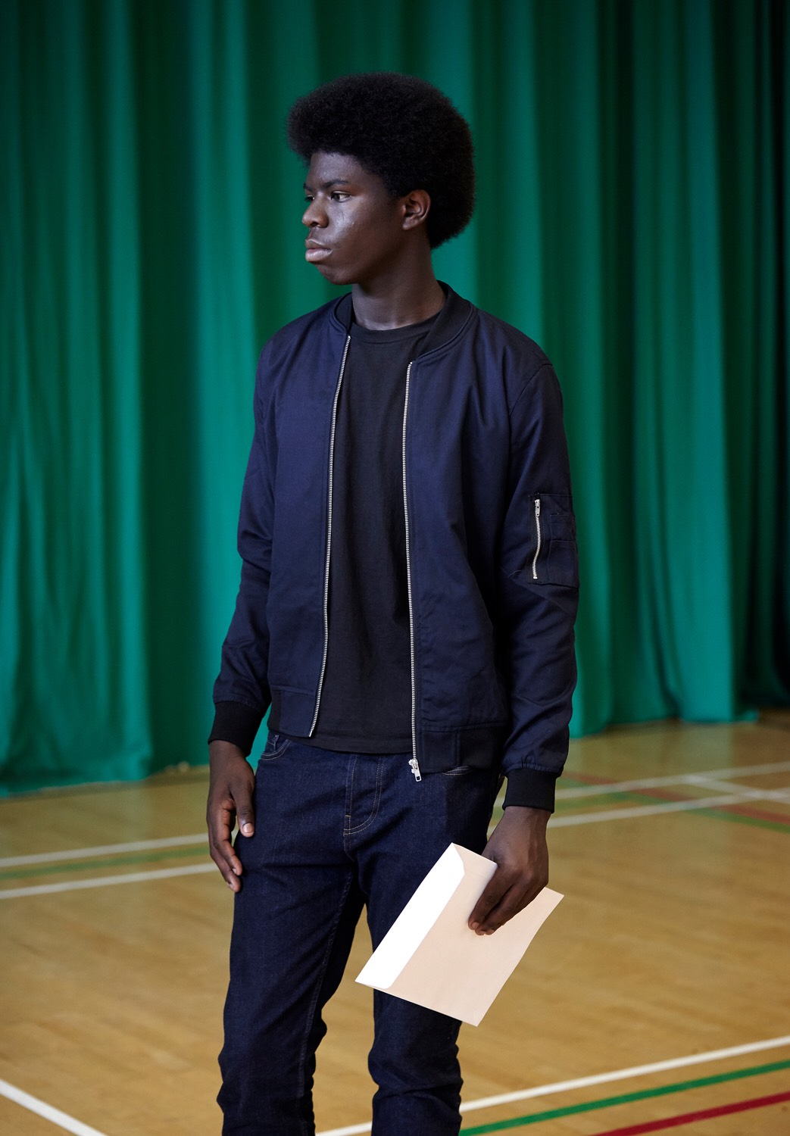
How do we imagine a future that looks beyond familiar systems. For example, what about democracy in indigenous systems?
What can be gained by looking at different historical models?
Notes:
The topics explored in this year’s symposium are wide ranging and include:
Social equity and inclusion in education policy
Learning experience that empower and build resilience.

Slide 8
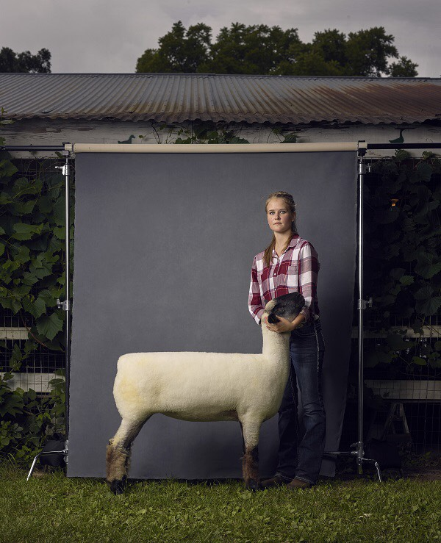
How can medical professionals, scientific researchers, and concerned citizens engage opioid-addicted patients and their families and encourage them to seek the help they need without guilt, recrimination, and threat of prosecution?
Anna and Helen, Blue Earth County Fair, Minnesota from the series The Unchosen Ones by RJ Kern
Notes:
Embracing one health through integrated dialogue around rural and underserved populations and human-animal interactions;
As well as producing ecological and equitable food systems,
And advancing food security through community leadership and vitality.

Slide 9
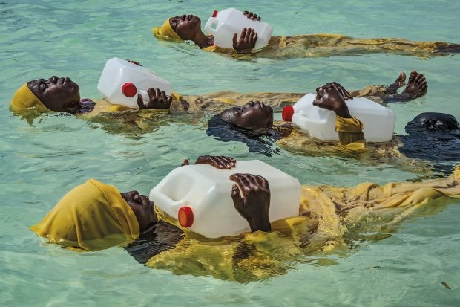
How can we encourage exchange of information, discourse, and collaboration between independent professionals and entities so that a coherent, unified voice about the dangers and treatment of opioid addiction is heard?
From the series Burkini Island by Anna Boyiazis
Notes:
All of us here add value to this common challenge of advancing the human condition.
Sometimes, the work requires the high level expertise evident in the sessions on biomedical and neuroscience research, in order better understand something like opioid addiction.
Other times, the solution is simpler—as we can see in this photo from the Burkini Island series by Anna Boylazis—where the design of modest swimwear made it possible for girls living along the Indian Ocean off Mnyuni, Zanzibar to learn to swim safely.

Slide 10
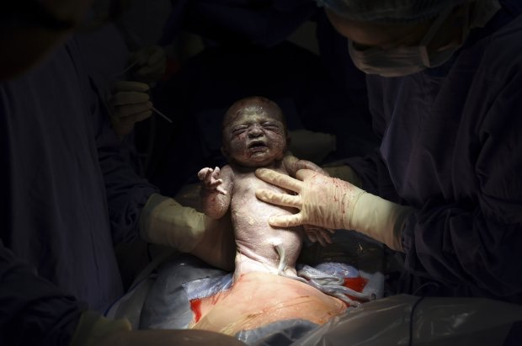
How can we continue the discourse and research surrounding the opioid epidemic and its consequences?
By Sean Smith
Notes:
Whatever we do, the concern for advancing equity and eliminating social disparity is fundamental to our research, scholarship, and praxis—
So that the human condition may flourish…

Slide 11
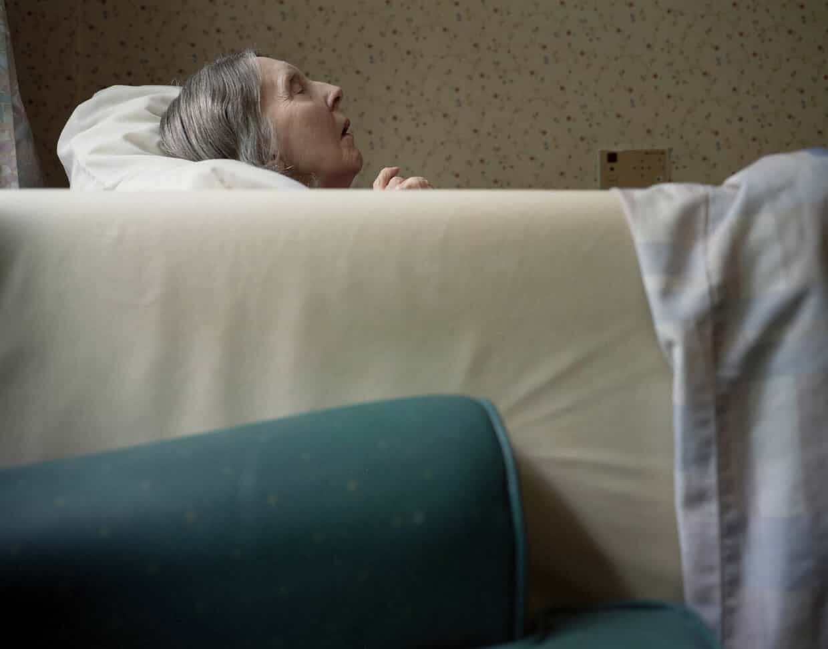
How can we empower the voices in academia that have been marginalized by the dominant culture?
By Matthew Finn, Portrait of his mother
Notes:
And be lived—and completed—with dignity.
Photographer: Matthew Finn

Slide 12
How can we redefine contribution and/or reward at Tech so that differing perspectives receive the respect they deserve?
Notes:
The top prize was César Dezfuli’s portrait of Amadou Sumaila – a teenager rescued from the sea off the coast of Libya.
The face of Amadou demands attention to one of the most profound challenges facing the human condition in the 21st century: the mass displacement of people.
Whether it be precipitated by geopolitical conflict, ethnic cleansing, extreme poverty, natural disaster or human-facilitated environmental or resource crises, the number of people forced to migrate under dire circumstances is unprecedented.
What can an academic do? Our work in the areas of global systems, integrated security, policy, adaptive brain and behavior, data and decisions—all hold some part of the solution to the complex and protracted issue of forced migration and human displacement.
The face of Amadou confronts us “bare life”…

Slide 13
How do we acknowledge that we are all situated within a particular life world that influences our choice of research pursuits?
Notes:
Whereas the portrait of Erica, from Maija Tammi’s series, One of Them Is a Human, raises new questions—specifically, what does it mean to be alive?
Erica is an android created by scientists at Osaka University. Her inclusion in the contest—and the fact that her portrait garnered third prize—provoked controversy. Is Taylor Wessing breaking its own rules by allowing an image of something that is non human?
Or, does its inclusion require us to consider how innovations in robotics, artificial intelligence, and autonomous systems are altering the meaning of the human?
Robots and refugees—these are two of the faces of the human condition in 2017.

Slide 14
Given that James Baldwin wrote “the human condition is uniquely personal,” how can we share our positionality with our students and those in our research in order to ensure that advancing the human condition is participatory and inclusive, even liberatory?
Notes:
However, while Amadu and Erica are named, the young woman fleeing Mosul who is the subject of the second prize photograph by Abbie Trayler-Smith is unnamed.
The image is personal, intimate. It is part of a series entitled Women in War: Life After Isis. It draws us closer to her lived experience. And yet, she remains separate from us—behind the window of the bus that brought her to the Hasan Sham camp in northern Iraq. We can only infer—her lived reality remains unknowable to us.
Without a name, do we render her voiceless under our gaze? The question of who tells the story and how it is told, of who determines what advances the human condition—these questions need to remain central to our collective work toward equity.
Thus, in addition to exploring the emerging theories and technologies of the human condition, we must also interrogate our methodologies to discern how they advance the human condition.

Slide 15
How do we articulate the benefits from a more flat and inclusive society (all the way down to communities and workplaces) and how do we equip students to understand and express the advantages and morality of such a non-hierarchical space in which everyone has a voice?
Notes:
The symposium explores multiple facts of advancing the human condition: theories, methodologies, pedagogies, technologies, communities.
(This photograph is of Nick Bostrom, founding director of the Future of Humanity Institute at the University of Oxford. The Institute brings the tools of mathematics, philosophy and social sciences to bear on big-picture questions about humanity and its prospects)
Similar to campuses across the globe, our approach is interdisciplinary.

Slide 16
How can we as researchers, scholars, and instructors subvert the neoliberal process that renders the personhood of certain groups as less than human and in need of improvement?
Notes:
Our symposium also explores human dimensions of the built environment,
And interconnected ecologies that are simultaneously local and global in scale,
And the intersections between social, economic, and environmental justice.

Slide 17
How can we instead imagine people as whole and full of alternative possibilities beyond the deficits seen through a neoliberal lens?
Or is this even possible?
Notes:
The topics explored in this year’s symposium are wide ranging and include:
Social equity and inclusion in education policy
Learning experience that empower and build resilience.

Slide 18
Story making emerges us in the sticky-ness of epistemological and ontological imaginaries.
How do the stories we tell help us change the way we think about change?
What are your stories of making change?
Notes:
Embracing one health through integrated dialogue around rural and underserved populations and human-animal interactions;
As well as producing ecological and equitable food systems,
And advancing food security through community leadership and vitality.

Slide 19
The allowance of silence is an ingredient for empathic receptivity. How to find the needed time and space to make new meaning together, through story, in the face of the urgency that comes with this work? Put another way, as an enduring question, is this useful enough?
Notes:
All of us here add value to this common challenge of advancing the human condition.
Sometimes, the work requires the high level expertise evident in the sessions on biomedical and neuroscience research, in order better understand something like opioid addiction.
Other times, the solution is simpler—as we can see in this photo from the Burkini Island series by Anna Boylazis—where the design of modest swimwear made it possible for girls living along the Indian Ocean off Mnyuni, Zanzibar to learn to swim safely.

Slide 20
The regaining of hope is far more elusive and difficult than is imagined.
What gives you hope?
What stories still need to be told to regain hope where it is needed most?
Notes:
Whatever we do, the concern for advancing equity and eliminating social disparity is fundamental to our research, scholarship, and praxis—
So that the human condition may flourish…

Slide 21
We are listening to questions and uncertainty—and staying in a place of uncertainty without jumping to an immediate answer. How do we cultivate the praxis of sitting with the questions, even when they terrify us?
Notes:
And be lived—and completed—with dignity.
Photographer: Matthew Finn

