Slide 1
Immersive Archaeology
Sam Williams, Enmu Liu
CS 4624 Multimedia, Hypertext and information Access
Instructor: Dr. Edward A. Fox
Client: Dr. Todd Ogle
Virginia Tech, Blacksburg VA 24061
12/14/2022

Slide 2

Outline
Project Description & Objectives
Project Design & Implementation
Service Diagram
Users & Clients
Project Deliverables
Project Goals & Future Work
OKR Status
Acknowledgement
Notes:
E

Slide 3

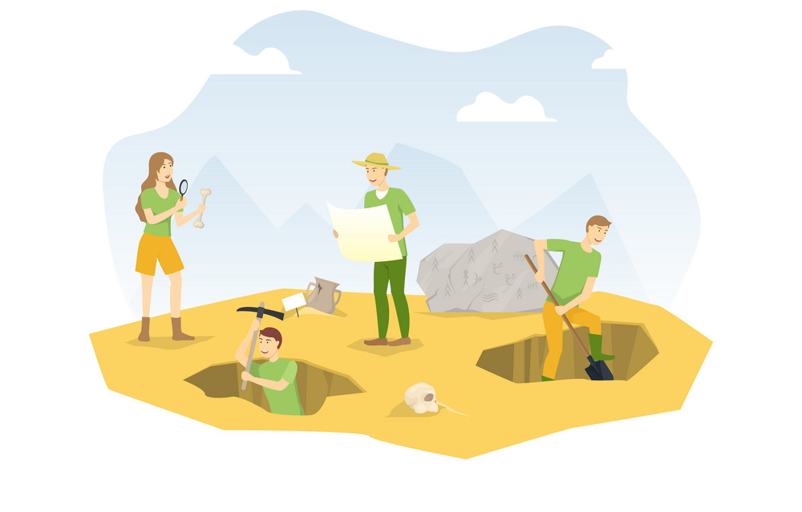
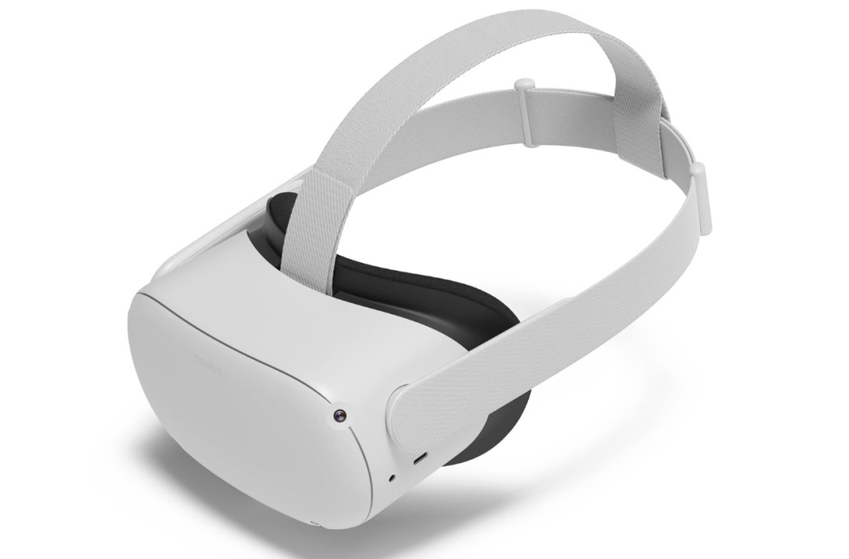
Project Description
To create a website that allows users to upload 3D scanning data from archaeological sites and artifacts found in a particular dig site for virtual analysis of corroborating evidence from the results of fieldwork.

Slide 4
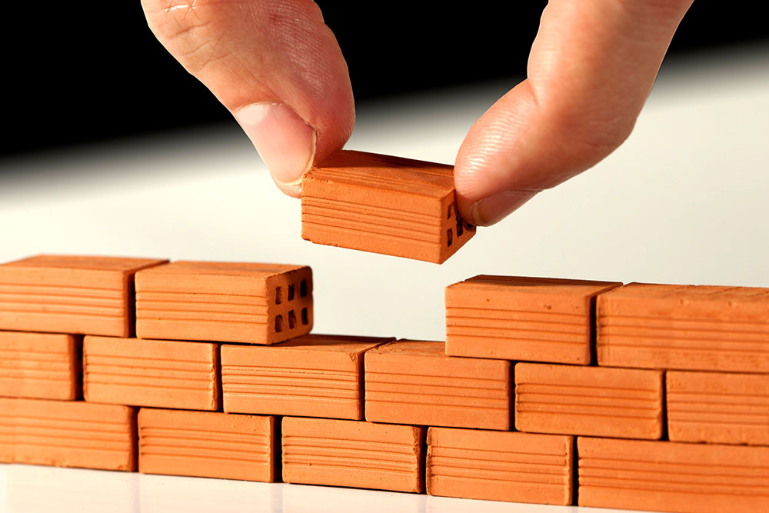
Project Description
For this semester, our goals were:
  Creating both a static and immersive one-user environment to interact with artifacts
  Providing interface for clients to upload dig sites and artifacts

Slide 5

Project Objectives
Create a:
  Working website that allows clients to upload artifacts and dig sites.
  Platform for users to comment on the artifact.
  2D display and 2D interaction with the dig sites and artifacts.
  VR/XR interaction with the dig sites and their artifacts.
    Time-brushing function.

Slide 6
Initial Project Design
Artifact
GITF (3D Model)
Metadata
Web Browser Interface
Upload Artifacts/Dig sites
Static Viewing
Interface
Upload Artifacts
User login
Static Viewing
Artifact
GITF
Metadata
XR
Web XR
Dig Site
GITF (3D Model)
Metadata
Museum
All artifacts display
Dig Site
Museum
All artifacts display
Dig Site
A
A
Storage (Database)
Website

Slide 7
Refined Project Design
Artifact
GITF (3D Model)
Metadata
Web browser Interface
Upload Artifacts/Dig sites
Static Viewing
Interface
Upload Artifacts
User login
Static Viewing
Artifact
GITF
Metadata
XR
Web XR
Dig Site
GITF (3D Model)
Metadata
Museum
All artifacts display
Dig Site
Museum
All artifacts display
Dig Site
A
A
Storage (Database)
Website

Slide 8
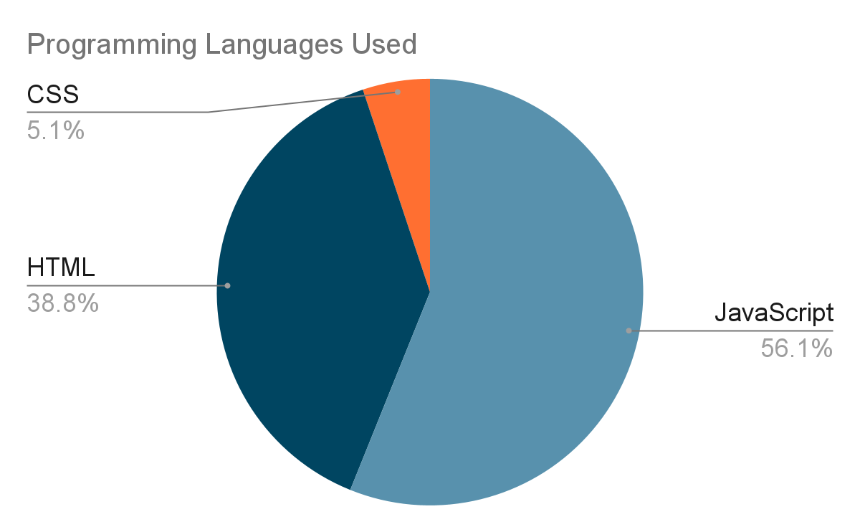
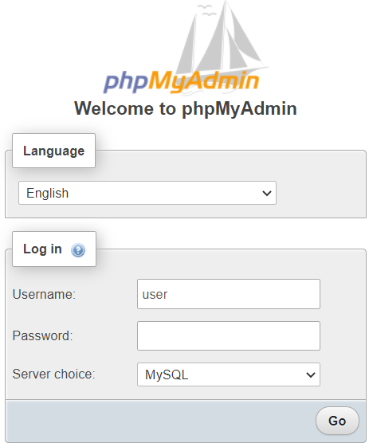

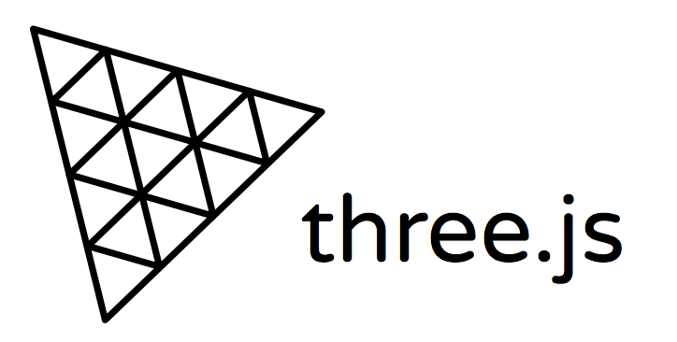
Project Implementation
AMP Stack (Apache, MySQL, PHP)
  Developed with WAMP
Publicly hosted on 000Webhost
XR -> Three.JS
Primarily JavaScript

Slide 9
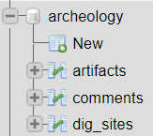
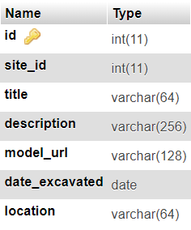
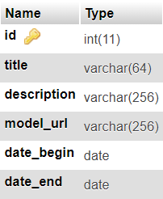
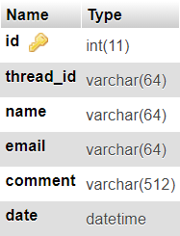
Database Implementation
Database
Artifacts
Dig Sites
Comments

Slide 10
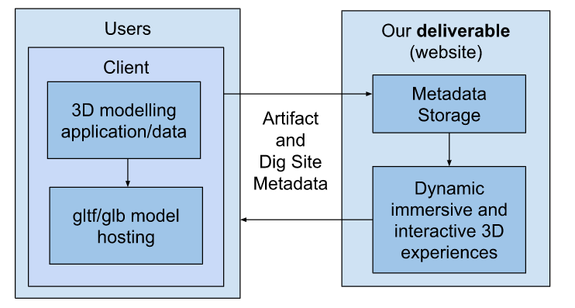
Service/Interaction Diagram

Slide 11

Users
Users can interact with
  Artifacts
  Dig Sites
  In Desktop web browsers or Oculus Headset
  Mobile and other headsets not officially supported
Users can leave comments (on static pages)

Slide 12

Clients
Not to be confused with our project client, Dr. Ogle.
Clients are a subset of users who have dig site and artifact metadata they would like to upload for other users and themselves to interact with.

Slide 13

Clients
Clients should be:
In possession of a 3D modeling program that allows them to export gltf/glb models, ideally that retain coordinate data.
Publicly hosting the corresponding models.
Aware of all artifact and dig site metadata that they wish to upload

Slide 14
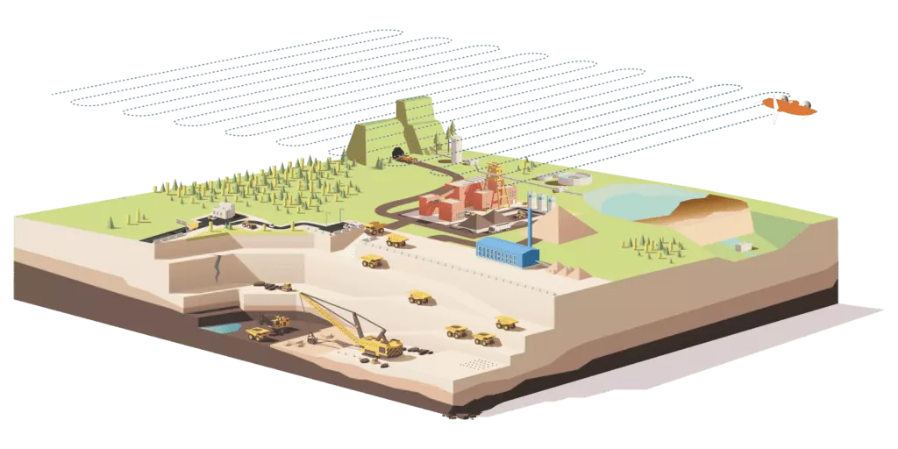
Client Criterion 1
Clients should be in possession of a 3D modeling program that exports dig sites and artifacts as gltf/glb files.
Dig site model data recorded via drones/lidar, stored as point clouds.
  If the location (coordinate) data of the dig site is retained, artifact coordinates can be copied into the artifact upload form.
  Otherwise, the client manually positions artifacts with dig site in app like Blender.

Slide 15

Client Criterion 2
Clients should publicly host the gltf/glb models.
Our website does not support storing the gltf/glb files, only links.
Free and easy way is via Github
  “Raw URL” can be used as the model URL.

Slide 16
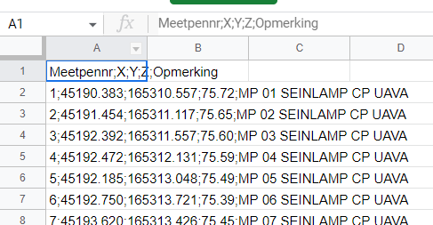
Client Criterion 3
Clients should be aware of the metadata of the artifacts and dig sites they wish to upload.
According to our client, clients will have artifact and dig site metadata stored in spreadsheet

Slide 17
Project Deliverables
Users can perform any of the three activities on our website:
  Interact with individual artifacts & dig sites on dynamic web pages.
  Interact with a particular dig site and all of its artifacts in an immersive WebXR environment:
    Navigate through
    Interact with by brushing artifacts by particular excavation dates.
    Either desktop web browser or an Oculus Quest.

Slide 18

Project Goals We did not Achieve
A search system for the artifact and dig site metadata.
Refined Website Style
User testing
Custom VT web hosting service and domain

Slide 19
Future Work
Teams in subsequent semesters can work on the following:
Improve site security & comprehensive error handling
  E.g. login feature
User-Artifact interaction in VR (Allows the user to pick and rotate the artifact)
Enable user to do the following without leaving the VR environment
  See high-resolution digital photos of the artifact
  Read the field archaeologist’s notes regarding the discovery of the artifact
User-User Interaction in VR
  Avatar, Voice discussion, pinpoint a detail on an object, etc.

Slide 20
Demo
Running live on: https://immersive-archeology.000webhostapp.com (A warning might be displayed but the website is safe to visit)

Slide 21
Acknowledgements
Thanks to Dr. Ogle and Dr. Fox for their assistance.

