Slide 1
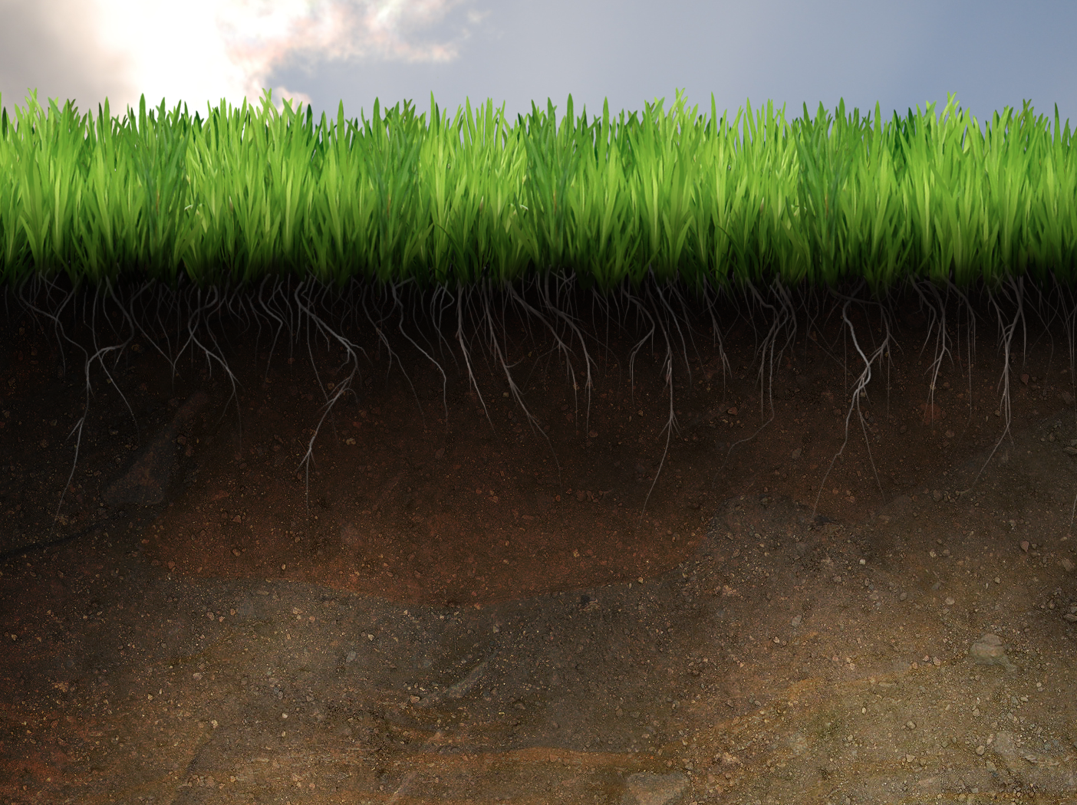
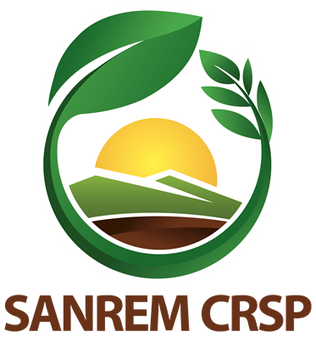
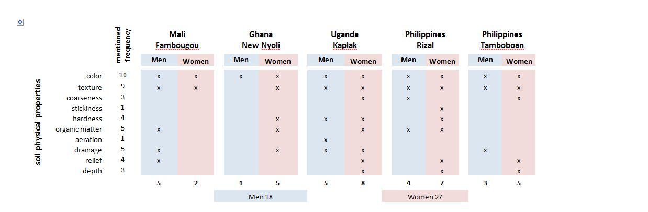
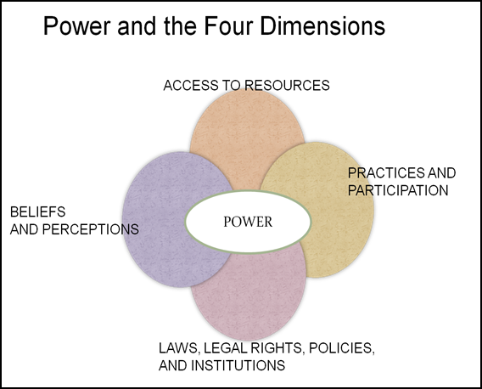
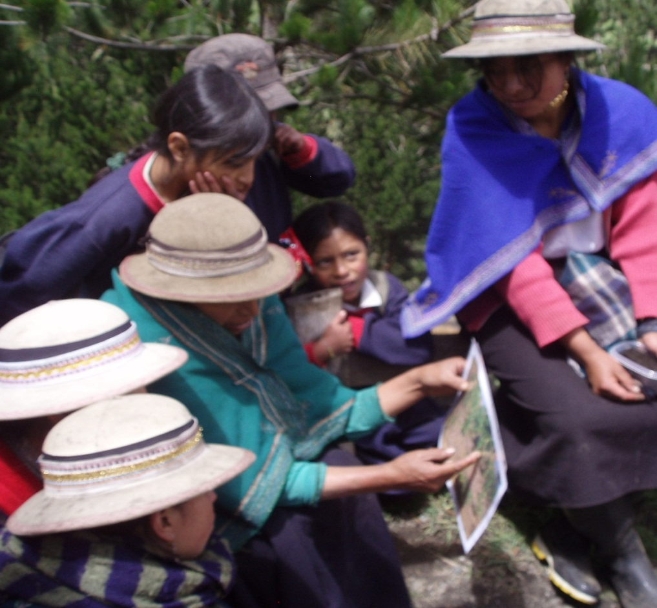
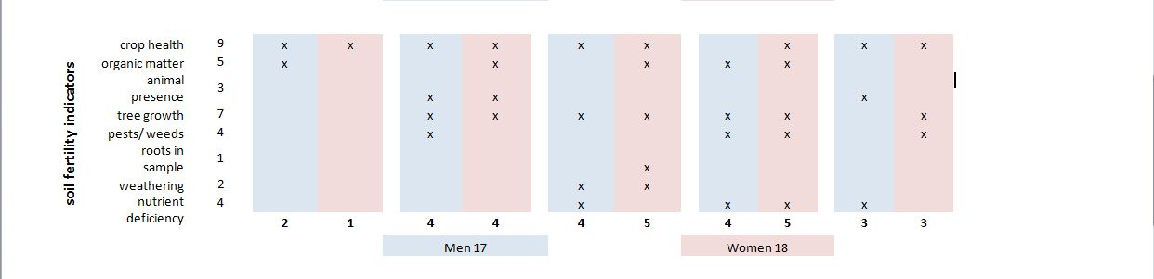
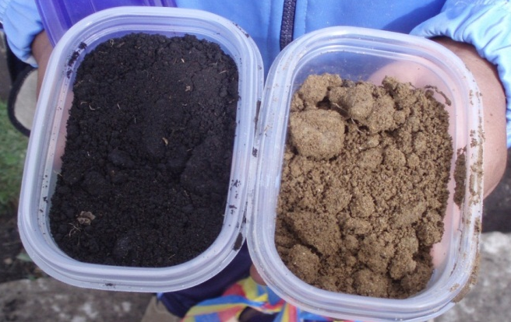
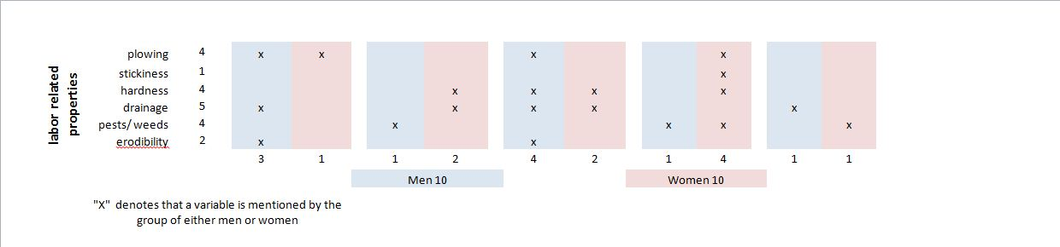
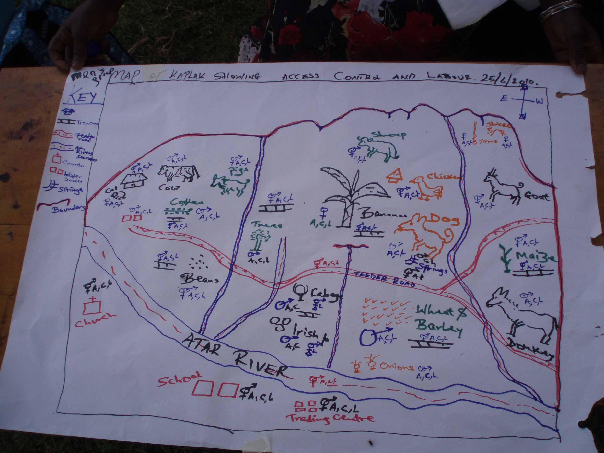
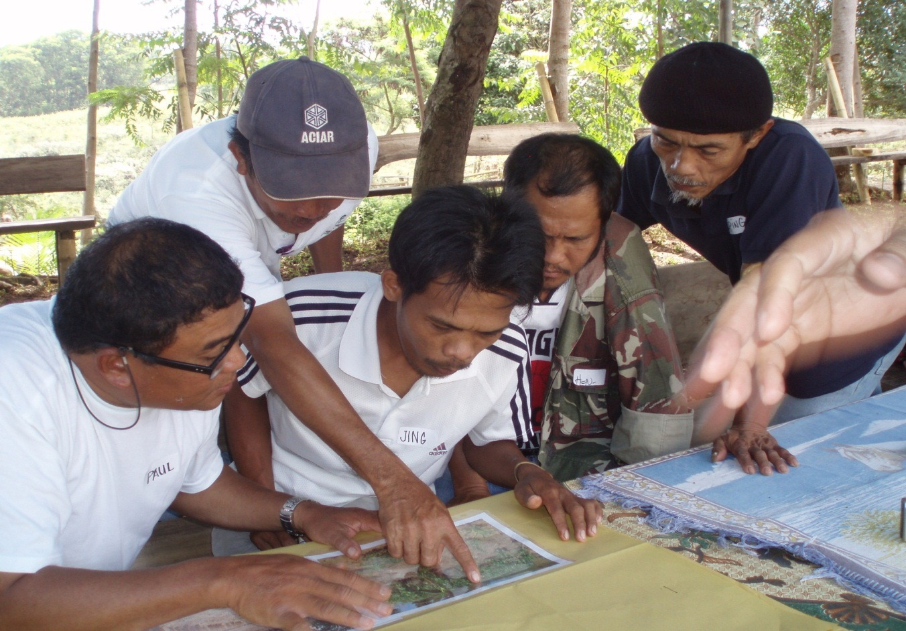
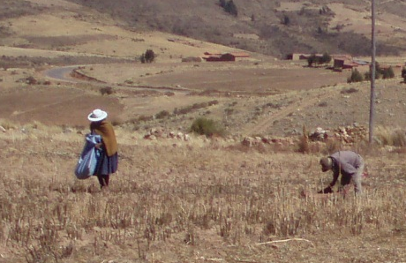


Gender Cross-Cutting Research Activity Gendered Perspectives for Conservation Agriculture: Local soil knowledge and crop-livestock interaction
Introduction
The Sustainable Agriculture and Natural
Resource Management Collaborative Research
Support Program (SANREM CRSP) is in its fourth phase of
using science to improve the livelihoods and food
security of small farmers in the developing world. The current
phase focuses on conservation agriculture production systems (CAPS), defined by the following components: year-round soil cover, no tillage,
and crop rotation. It includes the Gendered Perspectives for Conservation Agriculture cross-cutting research activity (CCRA), which addresses gender-related factors that contribute to the success or failure of CAPS. Socio-economic factors such as increased labor requirements—especially for women—are among the critical constraints to adoption of CAPS (Giller, 2009).
Dr. Maria Elisa Christie, Keri Agriesti, and Jess Martin
Research Data
From 2009 to 2010, focus group activities, including soil interpretation were conducted in: Mali, Ghana, Uganda, Ecuador, Kenya, and Philippines. Fieldwork begins in Bolivia and the Philippines in 2011, and India and Cambodia in 2012.
Research Objectives
Objective 1: Document differences in men and women’s knowledge, beliefs, and perceptions of soil fertility.
Objective 2: Document the gendered nature of crop-livestock interaction with respect to the conservation objective of maintaining crop residue cover on the soil.
Describe the quality of the soil.
Which one is better?
How do you know?
Gender Analysis
The Gender Dimensions Framework (GDF) facilitates a gender analysis of data collected. It incorporates four dimensions and the cross-cutting dimension of power (Rubin et al., 2009).
Hypothesis
Women will identify soil variables relating to fertility while men will identify variables related to field labor.
Indigenous women interpreting soil photographs (Illangama, Ecuador).
Methodology
Researchers use participatory, qualitative techniques, including: focus group discussions, socio-economic activity charts, participant observation, transect walks, structured and unstructured interviews, participatory mapping, and interpretation of photographs and soil samples. Gender disaggregated data is gathered by dividing men and women into different groups to carry out activities, and then coming back together to present as a whole.
Anticipated Products
Two MSc theses, peer-reviewed journal articles, methodological tools for future research and projects. Recommendations for building on women’s knowledge for promotion of CAPS.
Impediments Encountered
1. Understanding beliefs and perceptions requires ethnographic techniques and understanding
of local culture and language. 2. Researchers mistranslate and summarize indigenous and local knowledge into Western science constructs.
Gendered Knowledge, Beliefs, & Perceptions
Using qualitative, case study-based research, this project considers how gendered access to and control of land and livestock correlates with men and women’s knowledge, beliefs, and perceptions of soil fertility.
Practices and Participation
Who does what?
Map of Kaplak showing access, control, and labor (Kapchorwa, Uganda).
Men interpreting soil photographs (Claveria, Philippines).
Access to Resources
Using participatory methods to map gendered landscapes showing access, control and labor in relation to productive and reproductive activities—including gardening and raising small animals.
Men and women farming (Tiraque, Bolivia).
Acknowledgements
This publication/presentation was made possible by the United States Agency for International Development and the generous support of the American People for the Sustainable Agriculture and Natural Resources Management Collaborative Research Support Program under terms of Cooperative Agreement No. EPP-A-00-04-00013-00.
References
Giller, K. E. (2009). Conservation agriculture and smallholder farming in Africa: The heretics' view. Field crops research 114(1): 23.
Rubin, D., C. Manfre and K.N. Barrett. (2009). Promoting Gender Equitable Opportunities in Agricultural Value Chains [Handbook]. Greater Access to Trade Expansion (GATE) Project under the Women in Development IQC. USAID.
Notes:
Space, Place, Ethnopedology: Kosmos, Corpus, Praxis. Understanding local K of soils and land use patterns
“Land Moves and Behaves: Indigenous discourse on sustainable land management in Pichataro, Patzcuaro Basin, Mexico.” 2003
SKB: entered
Keywords: ethnopedology, indigenous people, local attitudes towards soil health, local land use systems, mountain landscapes, Mexico
The researchers documented farmer's perceptions that land is dynamic (as shown in the title quote) and soil is treated holistically as being integrated with climate, relief, and the water cycles. Traditional agriculture, which sees erosion and fertility losses as inevitable thus making land management imperative to human health and sustenance, does not lead to land degradation.
Research methods (carried out over 18 months) included a geopedological survey and ethnographic study comprised of participatory mapping, transect walks, ¿free listing¿ of soil terms, soil grouping, problem ranking, coallation of calendars, village history chronicling, discussions, household surveys, and interviews. Four principles of land management in this locality were land position, behavior, resilience, and quality.
Figure 2 show corresponding calendars of climate, agricultural activities, and religious events. Figure 4 shows activities that correspond to different lunar phases. There are 10 figures and tables that would be very informative for researchers interested in the specifics of Patzcuaro Basin, Mexico.
“Ethnopedology: a worldview on the soil knowledge of local people.”
The KCP model is also introduced, explaining the beliefs and symbolic associations (Kosmos), cognitive systems (Corpus) and methods of production (Praxis). Methodological approaches such as the ethnographic, comparative, and integrated approaches are explained and critiqued to help other researchers avoid the pitfalls of each. In the ethnographic approach, the EPS is not compared to scientific soil data as it is in the comparative approach, and thus more emphasis is placed on linguistic analysis and the local perspectives on land uses. Finally, the global spread of EPS is explained and regions that may have need for extended studies are identified. It is evident that much information is available for Mexico, Peru, Nigeria, India, and Nepal, but lacks for east Asia and the Pacific.
Methodology: ethnopedological methods that rely on geography → participatory mapping
Geography provides a way to understand the world through spatial relationships and unlimited variables. Regardless of training, all people develop and use mental maps and can explain relationships in their surroundings. Mapping can provide an interface for understanding relationships between local and scientific knowledge (LK and SK). Soil samples would be randomly collected by soil scientists, analyzed, and compiled into a GIS soil map. Without contaminating information, participatory mapping approaches would be used by an ethnographer. Maps can be created with community members using whatever variables are deemed most relevant to the research, and pathways, resources, access, labor, and control can all be spatially represented. Using the hand-drawn maps as a guide, the ethnographer should then go on a transect walk with a farmer and note-taker who speaks both languages. Transect walks are important because interactions with the environment are an expression of a person’s sense of place. GPS points should be taken along the walk whenever a boundary is crossed or a feature is reached. The note-taker will need to record what each point represents in order, as the points need to be identified in later stages when an annotated map is created. Afterwards, the researcher and farmer will each draw their own diagram of the transect walk as a cross-section that shows topography, resource, field and landscape features, etc. The GPS points and soil GIS will be combined to form a culturally informed spatial overlay for comparison with scientific knowledge. This map can then be annotated with the help of local farmers and given to them to use as a land management resource.
Surveys – both structured and formal and the informal conversations that arise from them – are a methodological tool that relies heavily on the understanding that any language barrier will be able to be breached by recording, translation, and transcription. An ethnopedological survey would be useful in determining basic soil types and subdivisions of categories, as a large number of people could be polled and contribute to the degrees of homo- or hetero-geneity. In an effort to better understand local cosmology, researchers may try asking about medicinal plants, asking who in the locality knows the most about them, and then interviewing that person more thoroughly to understand the local ideologies that tie existence to health to spirituality.
A household survey would be an extensive undertaking, but is necessary for baseline data. The heads of household will be asked to describe the soils that they own, use, or have access to, what the best soils are, how they rank soils, and what soil properties determine the land’s use.
When a language barrier exists, the cliché “a picture says a thousand words” becomes a matter of survival in successful communication. Pictures of soil types, land uses, and agricultural activities can be taken either during or after the transect walk, and then farmers can be asked to match pictures of soils with their uses.
Through these methodologies, and others used by local researchers, we hope to gather information on the location, soil properties, local name, ranking, uses, gender and status of users, and access, control, and labor associated with the land.
Briggs explains the binary tensions between indigenous knowledge and western science, the romanticisation of indigenous knowledge, and the problems that arise from taking it out of context. This article is important to keep on hand to remind us of the pitfalls of ethnographic study applied to development projects. Indigenous knowledge is especially limited as it is often conceptualized as separate from other knowledge that farmers possess, when, in reality, pragmatism primes a farmer for hybridizing and adapting at all times.

