Slide 1
Classification
CS5604 Information Storage and Retrieval - Fall 2016
Virginia Polytechnic Institute and State University
Blacksburg, Virginia 24061
Professor: E. Fox
Presenters:
Saurabh Chakravarty,
Eric Williamson
December 1, 2016

Slide 2
Table of contents
Problem Definition
High-Level Architecture
Data-Retrieval and Processing
Classification
Experimental Results
Conclusion and Future work

Slide 3
Problem Statement
Given the tweets in the GETAR and IDEAL collections and a set of real world events, determine which tweets belong to each real world event.

Slide 4
Problem Statement
Tweet Collection
Real world event
20: hurricane sandy
Hurricane Sandy
27: hurricane
Hurricane Arthur
188: #Arthur
Fairdale Tornado
182: #tornado
632: fairdale
Manhattan Explosion
174: #Manhattan

Slide 5


High level architecture
Classification pipeline

Slide 6
TRAINING PIPELINE
Training data

Slide 7
TRAINING PIPELINE
Pre-processing
(clean/lemmatize/remove stop words)
Training data
Notes:
Duplicate remove stop word

Slide 8
TRAINING PIPELINE
Pre-processing
(clean/lemmatize/remove stop words)
Training data
Train word vectors

Slide 9
TRAINING PIPELINE
Pre-processing
(clean/lemmatize/remove stop words)
Training data
Train word vectors
Word2Vec Model

Slide 10
TRAINING PIPELINE
Pre-processing
(clean/lemmatize/remove stop words)
Training data
Train word vectors
Word2Vec Model
Train Classifier

Slide 11
TRAINING PIPELINE
Pre-processing
(clean/lemmatize/remove stop words)
Training data
Train word vectors
Word2Vec Model
Classifier Model
Train Classifier

Slide 12
Prediction PIPELINE
Pre-processing
(clean/lemmatize/remove stop words)
<<table>>
ideal-cs5604f16
Word2Vec Model
Classifier Model

Slide 13
Prediction PIPELINE
Pre-processing
(clean/lemmatize/remove stop words)
<<table>>
ideal-cs5604f16
Load Word2Vec & Classifier model
Word2Vec Model
Classifier Model

Slide 14
Prediction PIPELINE
Pre-processing
(clean/lemmatize/remove stop words)
<<table>>
ideal-cs5604f16
Load Word2Vec & Classifier model
Word2Vec Model
Classifier Model
Predict Tweet Event

Slide 15
Prediction PIPELINE
Pre-processing
(clean/lemmatize/remove stop words)
<<table>>
ideal-cs5604f16
Load Word2Vec & Classifier model
Word2Vec Model
Classifier Model
Predict Tweet Event

Slide 16
Data Retrieval Challenges
Large amounts of data (1.5 billion tweets)
Have to avoid serial execution
Cannot fit into memory
Prevent reprocessing data unnecessarily

Slide 17
Data Retrieval from HBase
Retrieval Method | Description | Smaller collection performance | Larger collection performance
Spark HadoopRDD | Load data into driver and parallelize across the cluster. | Seamless reading from HBase. | Hangs and does not complete reading on collections > one million.
Batch Processing | Load one batch at a time onto the drive and parallelize across the cluster. | Slower reading due to batch overhead. | Allows classification or arbitrarily large collections.

Slide 18
Challenges With tweets
Abbreviations and Slang (u,omg)
Non English URLs and characters
Misspellings
RT: @AssociationsNow A Year After Texas Explosion Federal Repourt Outlines Progress on Fertilize... http://t.co/8fDbMu9asU #meetingprofs
Notes:
Put stuff as examples

Slide 19
Text-Preprocessing
Remove URLs
Remove the # characters
Lemmatization using StanfordNLP
Stopword removal

Slide 20
Cleaning Example
Raw:
RT: @AssociationsNow A Year After Texas Explosion Federal Report Outlines Progress on Fertilize... http://t.co/8fDbMu9asU #meetingprofs
Clean:
year texas explosion federal report outline progress fertilize meetingprof

Slide 21
Training Data Generation
Random samples of collections corresponding to real world events.
Tweet assigned a number with the class it belongs to most.
Hand Labeled 1000 Tweets

Slide 22
Class distribution for training and test data
Notes:
May want to put a pie chart instead?

Slide 23
Text Classification
Feature selection
Feature representation
Choice of classifier

Slide 24
A comparison of Feature selection techniques
Technique | Advantages | Disadvantages
Tf-idf | Superior for small feature. High term removal capability. | Accuracy suffers for large datasets.
Mutual information | Simple to implement. | Inferior accuracy performance.
Association rules | Fast execution. Very good accuracy for multi-class scenarios. Easy to interpret the rules | Prone to discovering too many rules or poorly understandable rules that hurt performance and interpretation.
Chi-square statistic | Robust accuracy and performance with large sample sets with fewer classes. | Difficulty in interpretation of when there are a large number of classes.
Within class popularity | Identifies words that are most discriminative. | Ignores the sequence of words.
Word2Vec | Captures relationships of a word with neighbors. | High computational complexity. Long training time for large sample size.

Slide 25
Common Feature representation techniques
One-hot encoding
Bag of words
Challenges
Large number of dimensions
Word relationships with neighbors are not captured

Slide 26
Word2Vec
A feature selection technique.
Captures the semantic context of a word’s relation with neighbors.
Notes:
Why? Because

Slide 27
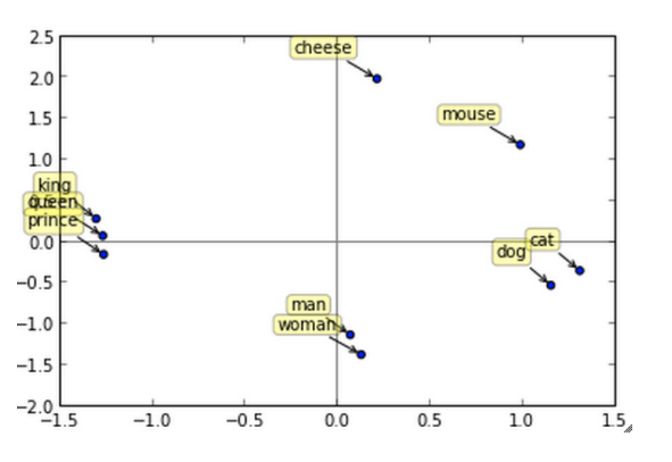
Word2vec
Similar words are grouped together and closer to one another.
Notes:
Similar words are grouped together

Slide 28
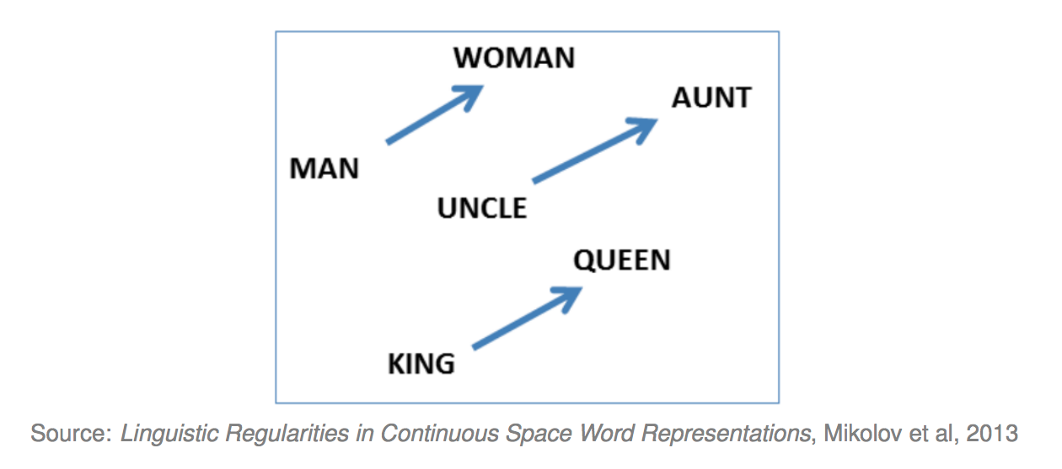
Word2vec
Word displacements are relationships between the words.
Notes:
Word relationships are displacements

Slide 29
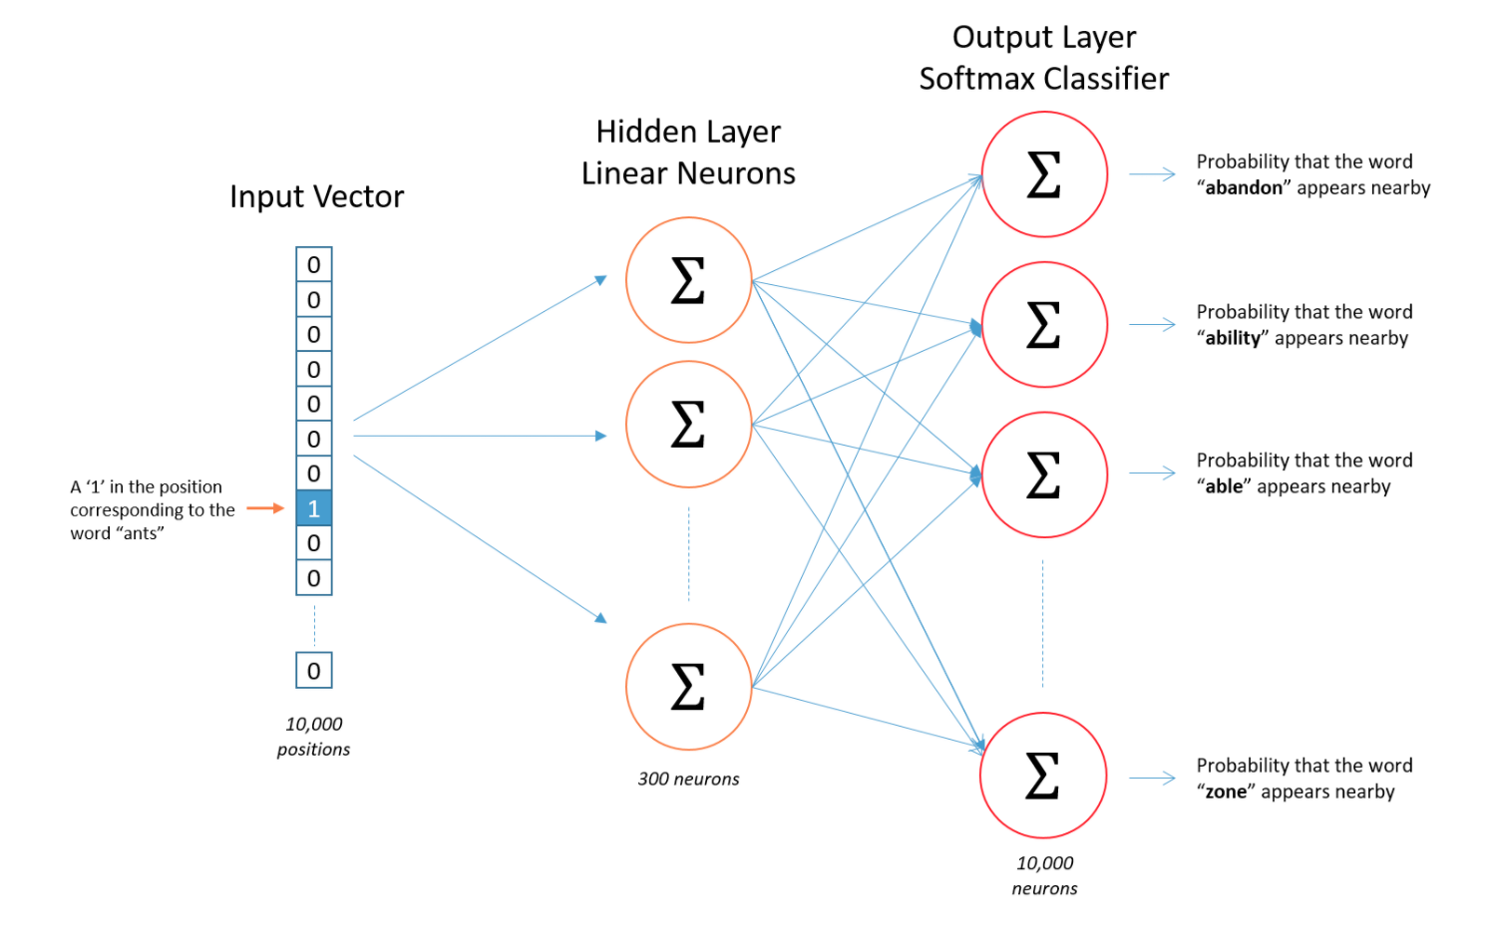
Word2vec
Slide courtesy - http://mccormickml.com/2016/04/19/word2vec-tutorial-the-skip-gram-model/
Notes:
We don’t care about the neural network and the output. We just need the hidden layer representation of the word vectors.

Slide 30
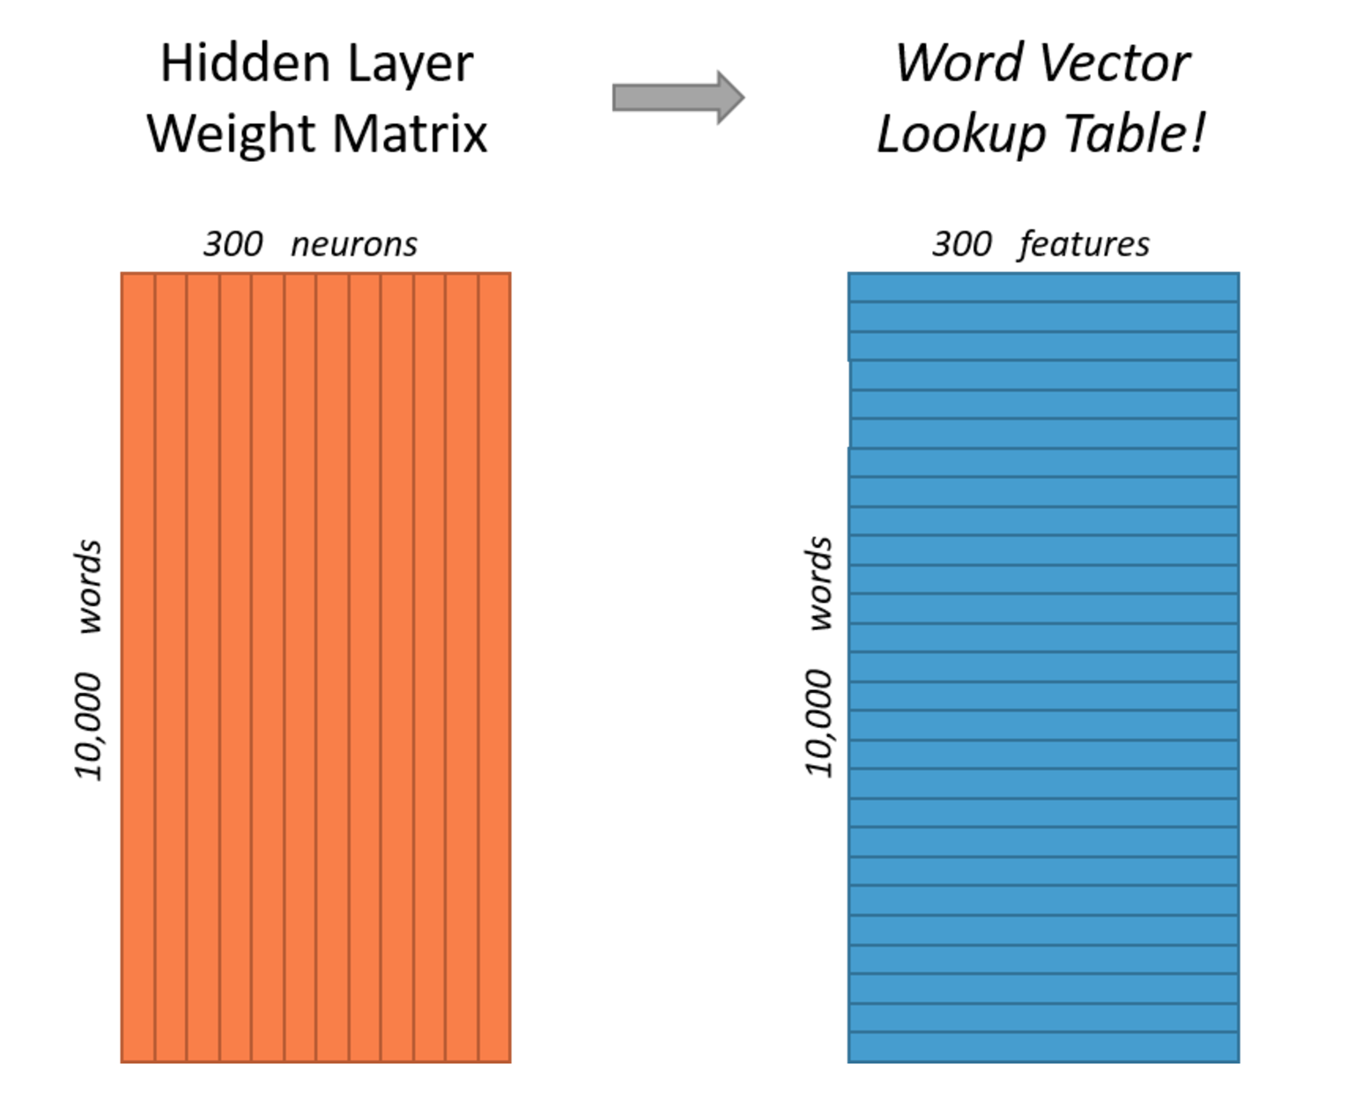
Word2vec
Slide courtesy - http://mccormickml.com/2016/04/19/word2vec-tutorial-the-skip-gram-model/
Notes:
We don’t care about the neural network and the output. We just need the hidden layer representation of the word vectors.

Slide 31
Classifier – Implementation details
A word feature is an average of the word vectors generated by the Word2Vec model.
We used a vector representation with a default of 100 values.
We chose the multi-class logistic regression in the Spark framework to perform classification.
The classifier labels the predicted class along with the normalized probabilities of the other classes.

Slide 32
Experiments
Effect of preprocessing
Accuracy performance
Runtime performance
Probability distribution
Class assignment

Slide 33
Cleaning Experiment
Determine how cleaning the data influences accuracy
Cleaning:
  Lemmatization
  Stopword removal
  Hashtag removal
Experimental setup:
  Split hand-labeled data:
    70% train
    30% test

Slide 34
Cleaning improves accuracy!
Word2Vec with logistic regression: 29% fewer misclassifications
Association Rules: 51% fewer misclassifications

Slide 35
Accuracy Experiment
Determine which classifier gives better results on labeled data
Experimental setup:
  Generate 10 different breakups of the labeled data
  Calculate metrics for each classifier on same breakup
  9 different classes

Slide 36
Accuracy Experimental Setup
Labeled Data
Divided into 10 sets
Training
Test
7 sets
3 sets
Rotate sets
Generate 10 different training and test sets

Slide 37
Word2vec outperforms association rules
Word2Vec with logistic regression had a 6.7% increase in F1 score over association rules.
Notes:
Only f1 reduced errors (Lr-ar)/(1-ar)

Slide 38
Classifier Runtime Performance
Need to be able to handle large collections efficiently to classify all of the tweets
Classify at a rate faster than the tweets coming in
Allow reruns as more classes are added to the training set

Slide 39
Classification Runtime Performance

Slide 40
Optimization
HBase Read
Partition and distribute
Broadcast models to each partition
Partition 1
Partition 2
Partition 3
Word2Vec Model
Clean
Clean
Clean
Logistic Regression Model
Classify
Classify
Classify
Write
Write
Write

Slide 41
Processing across partitions increases runtime performance!
57% faster than original Word2Vec
14% faster than Association Rules

Slide 42
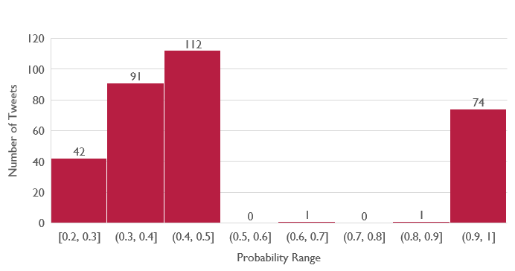
Probability Distribution for Test Data

Slide 43
MULTI-Class Assignment Distribution for Test Data

Slide 44
Conclusion
Reading data in blocks from HBase and then partitioning it into parallel tasks results in huge run time performance efficiency and predictability.
Cleaning text based on the English usage nuances in the Twitter universe results in better accuracy.
Feature selection methods like Word2Vec that capture richer word semantics and context result in better accuracy than traditional ones for text classification.
It is natural for a Tweet to be classified in multiple classes and the tradeoff between precision and recall is dependent on the user/product requirements.

Slide 45
Future work
The system can be retrained using a bigger corpus to generate a newer set of word vectors. Training on a text corpus like Google News can help generate word vectors that have richer word relationships encoded within. These can help improve the classification accuracy.
The Logistic Regression classifier can be retrained on new classes.
The system will be configured to run via a cron job periodically.
In addition to classifying a tweet, the system also emits probabilities of all the classes that could be saved in HBase and can be used by SOLR or the front-end team to use as a criterion for customizing the indexing or user experience.
Comparisons can be performed with the results of the developed classifier with the AR classifier or a few more classifiers and a inter-classifier agreement analysis can throw further light on the efficacy of the developed classifier.
Notes:
Bigger Corpus(Google News). Gives -> word vectors with richer relationships. Better word vectors -> Better classification accuracy.
The cron job would ensure that the new tweets are classified as they come in, of course, in batches.

Slide 46
Acknowledgements
We would like to acknowledge and thank the following for assisting and supporting us throughout this project.
Dr. Edward Fox, Dr. Denilson Alves Pereira
NSF grant IIS - 1619028, III: Small: Collaborative Research: Global Event and Trend Archive Research (GETAR)
NSF grant IIS - 1319578, III: Small: Integrated Digital Event Archiving and Library (IDEAL)
Digital Library Research Laboratory
Graduate Research Assistant – Sunshin Lee
Other teams in CS 5604

Slide 47


Slide 48
Appendix

Slide 49
Feature selection techniques
Technique | Advantages | Disadvantages
Tf-idf | Superior for small feature sets that have a large scatter of features among the classes. High term removal capability. | Accuracy suffers for large data sets where a term distribution alone does not suffice in class discrimination.
Mutual information | Simple to implement. | Inferior performance in estimation of probabilities because of bias.
Association rules | Fast execution. Very good accuracy for multi-class scenarios. Rule based classifier helps understand the classification decision easily. | Prone to discovering too many rules or poorly understandable rules that hurt performance and interpretation.
Chi-square statistic | Robust accuracy and performance with large sample sets with fewer classes. | Difficulty in interpretation of when there are a large number of classes.
Within class popularity | Identifies words that are most discriminative. | Ignores the sequence of words.
Word2Vec | Captures relationships of a word with neighbors. | High computation complexity. Long training time for large sample size.

Slide 50
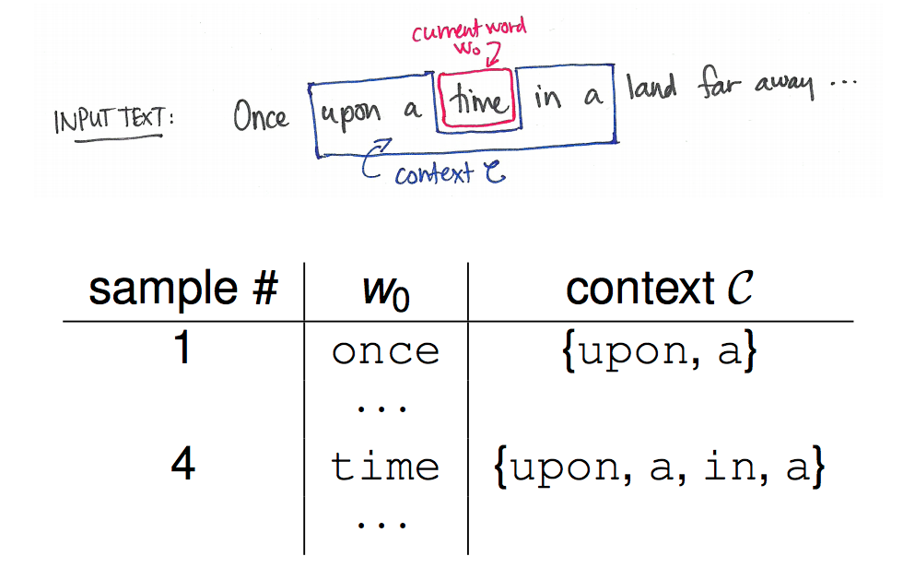
Word2Vec
Slide courtesy - http://files.meetup.com/12426342/5_An_overview_of_word2vec.pdf

Slide 51
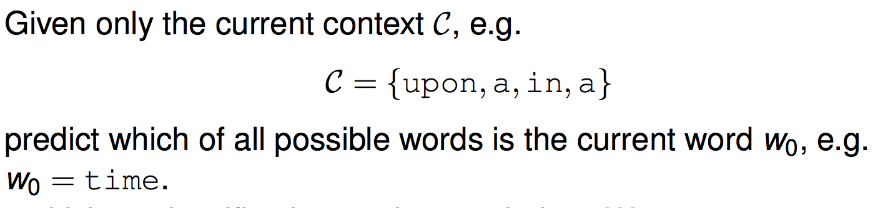
Word2vec
Can learn the word vectors via two forms.
CBOW
Predict the word, given the context.
Slide courtesy - http://files.meetup.com/12426342/5_An_overview_of_word2vec.pdf
Notes:
CBOW – Given a context, predict the word.
Skip-gram – Given a word, predict the neighbors

Slide 52
Word2vec
Skip-gram – Inverse objective of CBOW. Predict the context, given a word.
Slide courtesy - http://files.meetup.com/12426342/5_An_overview_of_word2vec.pdf
Notes:
CBOW – Given a context, predict the word.
Skip-gram – Given a word, predict the neighbors

Slide 53
Real World Events Used for Experiments
The real world event along with the amount of tweets labeled as that class for our experimental sets.
Hurricane Sandy (108 tweets) | Hurricane Isaac (83 tweets)
New York Firefighter Shooting (58 tweets) | Kentucky Accidental Child Shooting (16 tweets)
Newtown School Shooting (157 tweets) | Manhattan Building Explosion (189 tweets)
China Factory Explosion (178 tweets) | Texas Fertilizer Explosion (120 tweets)
Hurricane Arthur (169 tweets)

Slide 54
Real World Events Classified
The real world events classified along with some collections tweets of that event are found.
Real World Event | Collections | Real World Event | Collections
Hurricane Sandy | 23,27,375 | Hurricane Isaac | 27,28,375
New York Firefighter Shooting | 43,46 | Kentucky Accidental Child Shooting | 45,46
Newtown School Shooting | 41,42,46 | Manhattan Building Explosion | 173,174,399,400
China Factory Explosion | 231,232 | Texas Fertilizer Explosion | 77,381
Hurricane Arthur | 27,187,188,375 | Quebec Train Derailment | 96,98,381
Fairdale Tornado | 406,632 | Oklahoma Tornado | 406,84
Mississippi Tornado | 406,528 | Alabama Tornado | 406,407

