Slide 1

Connecting the Opens
Open Access
Open Education
Open Data
19 March 2018
Comments by:
Peter Potter, Director of Publishing Strategy
Anita Walz, Open Education, Copyright & Scholarly Communication Librarian
Panelists
Karen DePauw, Vice President & Dean for Graduate Education
Rajiv Jhangiani, Special Advisor to the Provost on Open Education, Kwantlen Polytechnic University
Mayra S. Artiles, Doctoral Candidate, Engineering Education
Monty Abbas, Professor, Department of Civil & Environmental Engineering
Jon Petters, Data Management Consultant, University Libraries
Philip Young, Institutional Repository Manager, University Libraries

Slide 2
Open Access
*

Slide 3
Open Access
Open Education
*

Slide 4
Open Access
Open Education
Open Data
*

Slide 5
Open Access
Open Education
Open Data
Open Source
*

Slide 6
Open Access
Open Education
Open Data
Open Source
Open Pedagogy
*

Slide 7
Open Access
Open Education
Open Data
Open Source
Open Pedagogy
Open Research
*

Slide 8
Open Access
Open Education
Open Data
Open Source
Open Pedagogy
Open Research
Open Infrastructure
. . .
*

Slide 9
Foundations of Open
The Open movement in scholarly communication & publishing began in the late 20th century
Not surprisingly, it paralleled the evolution and maturing of internet & digital technologies
Notes:
Extending the Principles and Promise of Scholarly Communication Reform: A Chronicle and Future Glimpse, Joyce L. Ogburn
Archived version from NCDOCKS Institutional Repository http://libres.uncg.edu/ir/asu/

Slide 10
Foundations of Open
Several early statements & declarations of principles established a foundation for planning, action, and changing behavior across the Academy
Much of the focus was on the perceived crisis of losing access to sustainable and affordable scholarship
Notes:
Extending the Principles and Promise of Scholarly Communication Reform: A Chronicle and Future Glimpse, Joyce L. Ogburn
Archived version from NCDOCKS Institutional Repository http://libres.uncg.edu/ir/asu/

Slide 11
Foundations of Open
Tempe Principles
(Principles for Emerging Systems of Scholarly Publishing), 2000
Nine principles designed to build consensus on an approach to transforming the scholarly publishing system—including cost, quality control, permanence, exploiting digital capabilities, equity of rights, etc.

Slide 12
Foundations of Open
Budapest Open Access Initiative (BOAI)
Budapest, 2002
“An old tradition and a new technology have converged to make possible an unprecedented public good.”

Slide 13
Foundations of Open
Budapest Open Access Initiative (BOAI)
Budapest, 2002
“An old tradition and a new technology have converged to make possible an unprecedented public good. The old tradition is the willingness of scientists and scholars to publish the fruits of their research in scholarly journals without payment, for the sake of inquiry and knowledge.”

Slide 14
Foundations of Open
Budapest Open Access Initiative (BOAI)
Budapest, 2002
“An old tradition and a new technology have converged to make possible an unprecedented public good. The old tradition is the willingness of scientists and scholars to publish the fruits of their research in scholarly journals without payment, for the sake of inquiry and knowledge. The new technology is the internet. The public good they make possible is the world-wide electronic distribution of the peer-reviewed journal literature and completely free and unrestricted access to it by all scientists, scholars, teachers, students, and other curious minds.”

Slide 15
Foundations of Open
Bethesda Statement on Open Access Publishing
Bethesda, 2002
“We encourage our faculty/grant recipients to publish their work according to the principles of the open access model, to maximize the access and benefit to scientists, scholars and the public throughout the world.”

Slide 16
Foundations of Open
Open Access Policies for Academic Institutions
Writing in 2008, Peter Suber proposed this vision:
Universities should provide open access to their research output
Universities should not limit the freedom of faculty to submit their work to the journals of their choice
Universities now pay most of the costs of peer review, through subscription fees and faculty salaries. They should continue to bear the costs of peer review, in order to assure its survival, while recognizing that the forms and venues of peer review are changing

Slide 17
What is Open Access?
The Budapest Open Access Initiative
“By ‘open access’ to this literature, we mean its free availability on the public internet, permitting any users to read, download, copy, distribute, print, search, or link to the full texts of these articles, crawl them for indexing, pass them as data to software, or use them for any other lawful purpose, without financial, legal, or technical barriers other than those inseparable from gaining access to the internet itself. The only constraint on reproduction and distribution, and the only role for copyright in this domain, should be to give authors control over the integrity of their work and the right to be properly acknowledged and cited.”

Slide 18
What is Open Access?
Open Access by Peter Suber (MIT Press, 2012)
“Open access (OA) literature is digital, online, free of charge, and free of most copyright and licensing restrictions.”

Slide 19
Expanding Visions of Open
A decade later…
Revised thinking on what constitutes a unit of communication in a future scholarly communication system
Datasets
Simulations
Software
Dynamic knowledge representations regardless of format or location

Slide 20
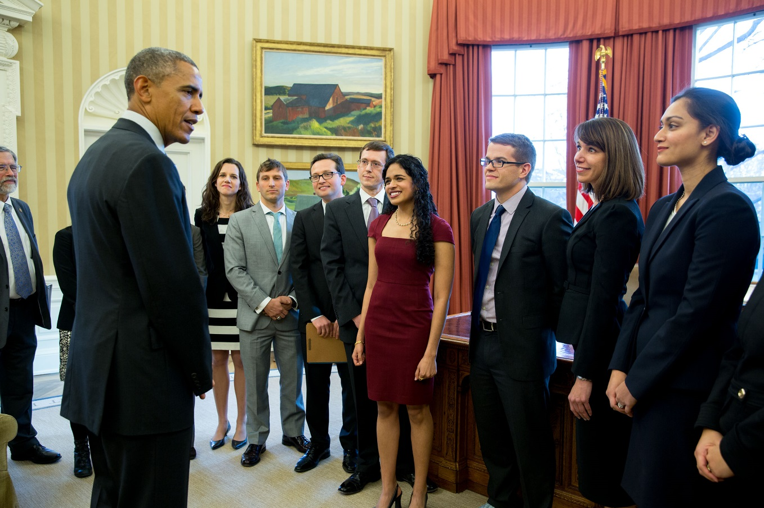
A Push from the Federal Government
In 2013 the White House Office of Science & Technology Policy (OSTP) directed federal agencies with more than $100M in R&D expenditures to develop plans to make the published results of federally funded research freely available to the public within one year of publication.
Notes:
Photo: President Barack Obama speaks with members of the Social and Behavioral Sciences Team in the Oval Office in January 2015.
Uploaded from https://www.whitehouse.gov/blog/2015/09/15/designing-federal-programs-american-people-mind

Slide 21






A Growing Infrastructure

Slide 22

A Growing Infrastructure
PubMed Central is a free full-text archive of biomedical and life sciences journal literature at the U.S. National Institutes of Health’s National Library of Medicine (NIH/NLM)

Slide 23
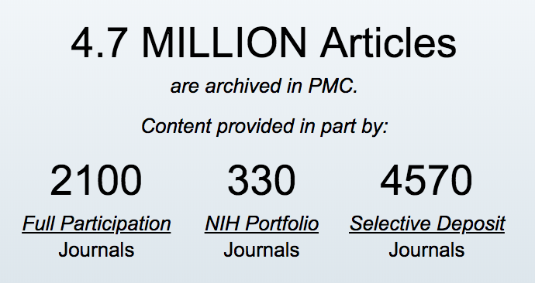
A Growing Infrastructure
PubMed Central

Slide 24
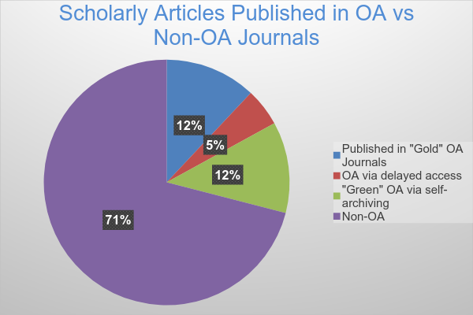
Still a Long Way to Go
Total OA market = $470M in 2016
4-9% of total market revenue
20-29% as percentage of total market volume
Notes:
Info source: Mabe & Ware, The STM Report (2015) http://www.markwareconsulting.com/the-stm-report/

Slide 25
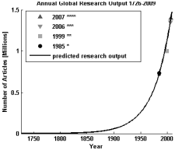
Still a Long Way to Go
7-9 million active researchers worldwide
Global spending on R&D more than doubled from 1996 to 2012 (NSF, 2012)
2.5 million articles published per yr
30,000+ journals
5,000+ publishers
$28 billion annual revenue ($11 billion of it journals)
80% of market controlled by 10 publishers
Estimated annual global research article output at 3% annual growth
Notes:
Source: Figure 2 from Arif E. Jinha (2010), “Article 50 Million: An Estimate of the Number of Scholarly Articles in Existence,” Learned Publishing, 23:258–263 doi:10.1087/20100308
Info source: Pippa Smart, “The Big Picture: Scholarly Publishing Trends 2014,” Sci Ed 2014; 1(2): 52-57. http://dx.doi.org/10.6087/kcse.2014.1.52
Mabe & Ware, The STM Report (2015) http://www.markwareconsulting.com/the-stm-report/

Slide 26
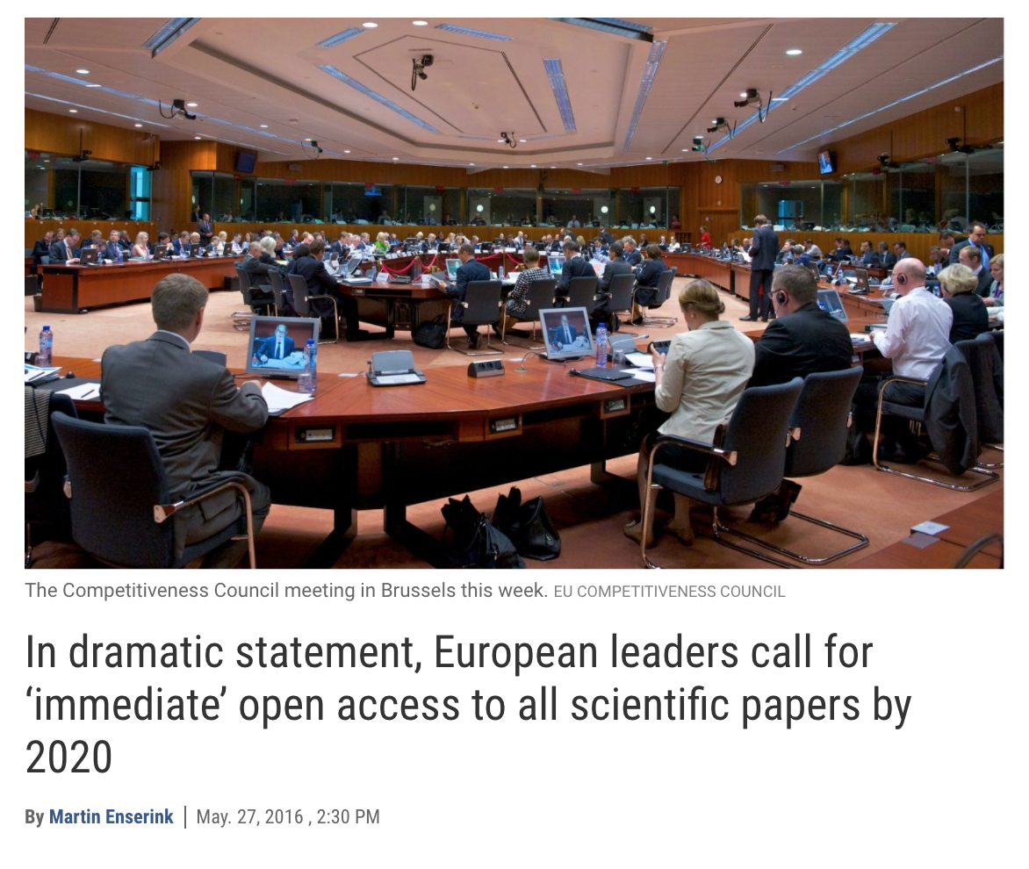

What Lies Ahead
Notes:
Info source: Mabe & Ware, The STM Report (2015) http://www.markwareconsulting.com/the-stm-report/

Slide 27
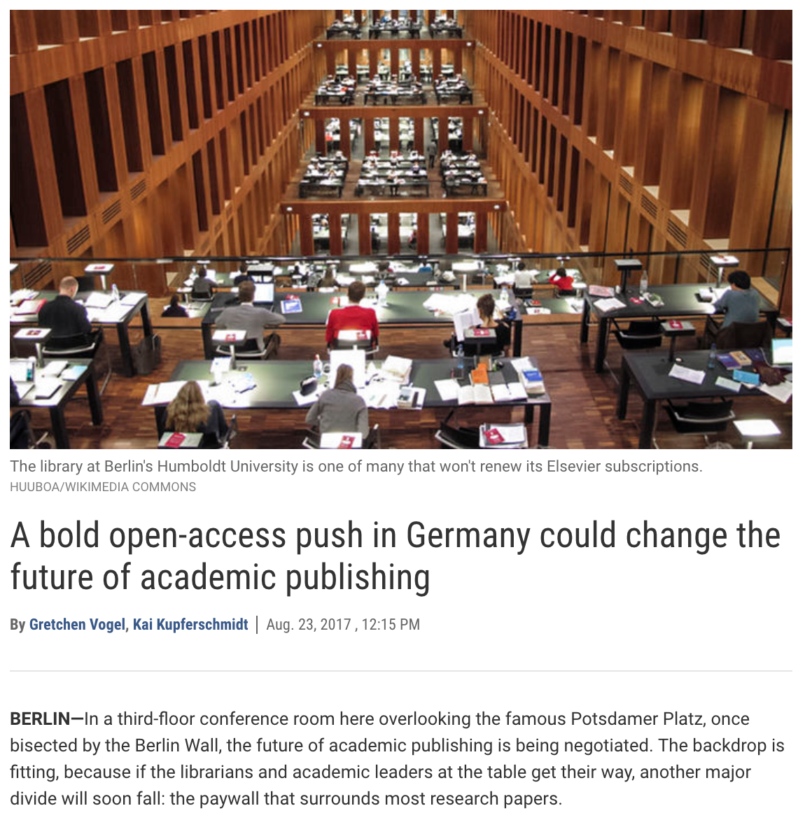
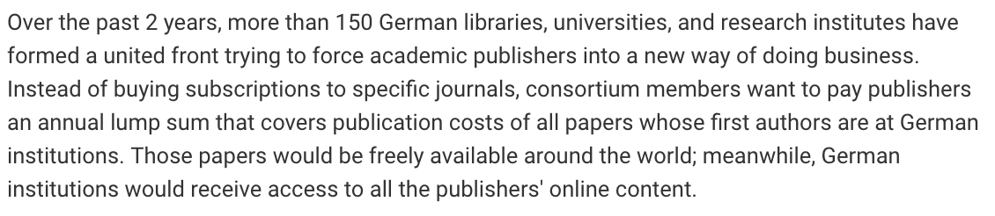
What Lies Ahead
Notes:
Info source: Mabe & Ware, The STM Report (2015) http://www.markwareconsulting.com/the-stm-report/

Slide 28
What Lies Ahead
Open infrastructure
Open Science/Open Scholarship
Commercial/Non-commercial showdown
Beyond the journal article & book?
New forms of peer review
Open Education
Notes:
Info source: Mabe & Ware, The STM Report (2015) http://www.markwareconsulting.com/the-stm-report/

Slide 29
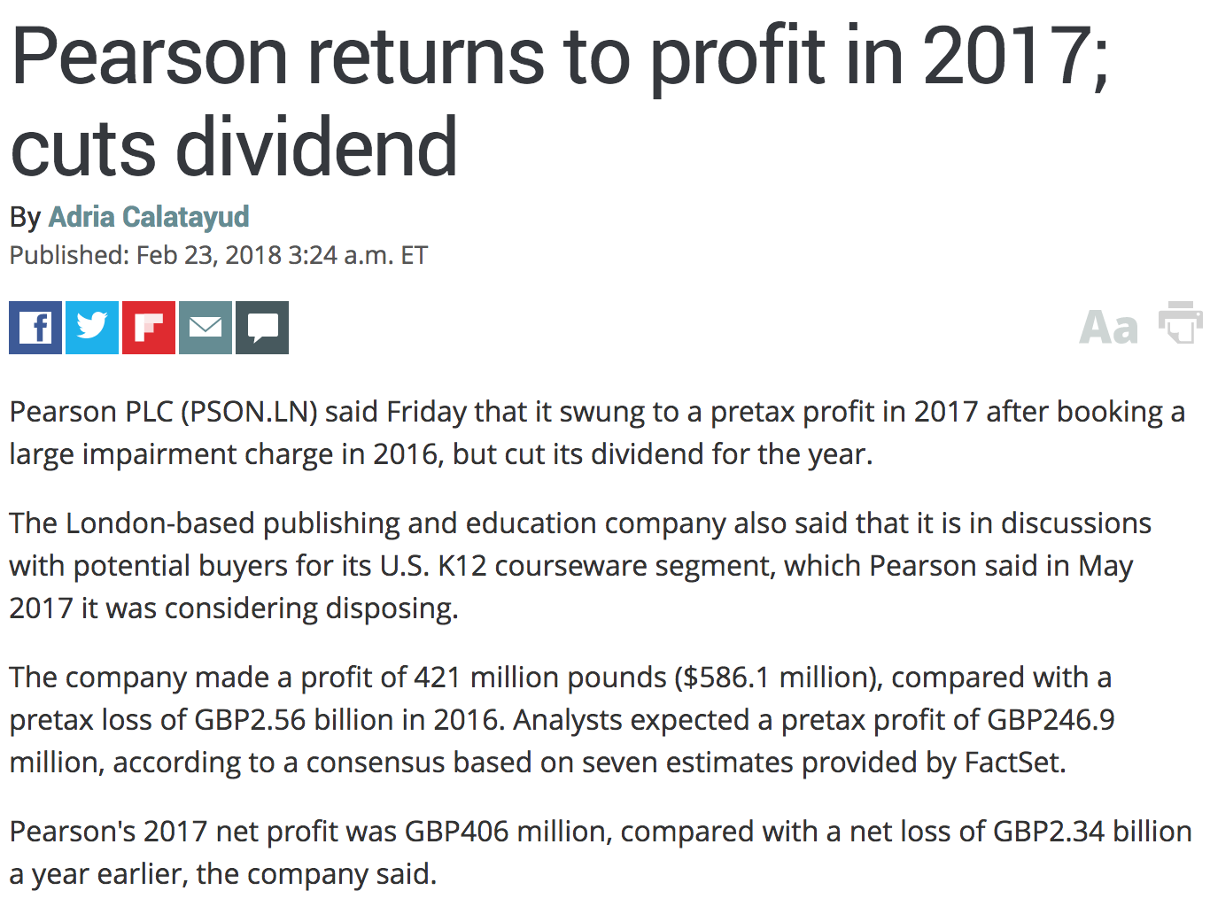

What Lies Ahead
Notes:
Info source: Mabe & Ware, The STM Report (2015) http://www.markwareconsulting.com/the-stm-report/

Slide 30
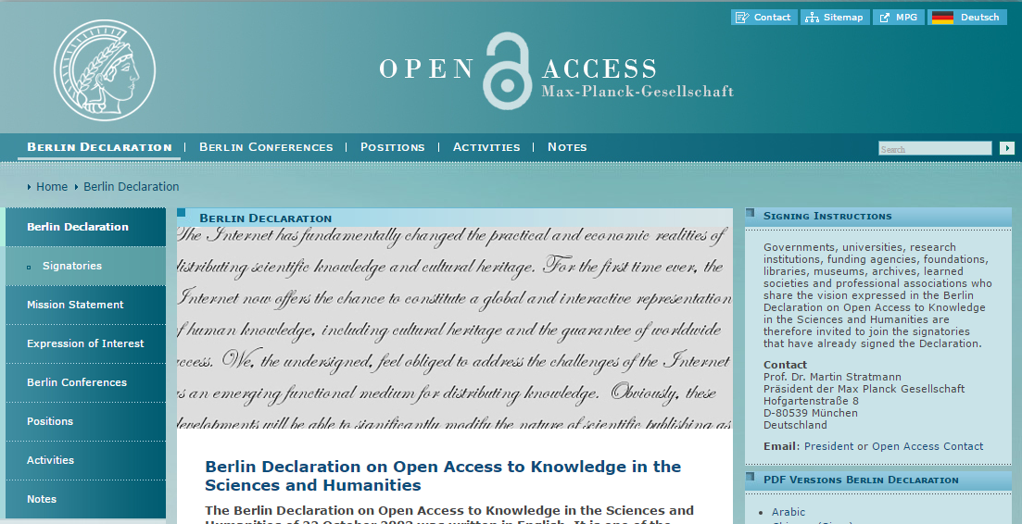
Connecting with other “opens”

Slide 31
Are OA and OER the same?
Are Open Access and OER (open educational resources) different names for roughly the same set of permissions?

Slide 32
Are OA and OER the same?
YES, if Open Access = CC BY
NO, if Open Access = free online & nothing more

Slide 33
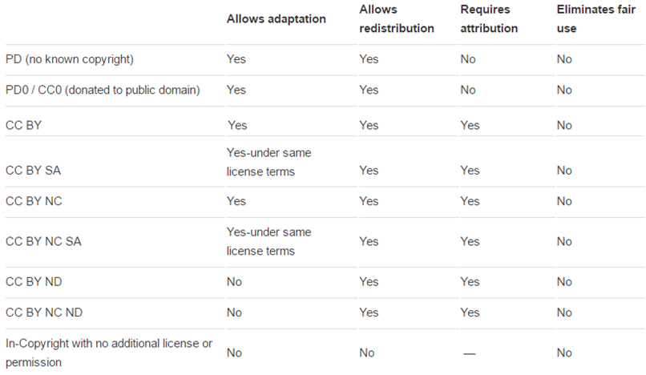
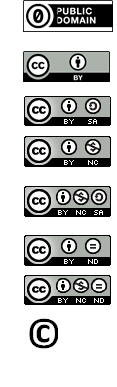

Slide 34

Creative Commons
Licenses
5 R permissions
Can anyone . . .
Retain it?
Reuse it?
Revise it?
Remix it?
Redistribute it?
http://opencontent.org/definition

Slide 35
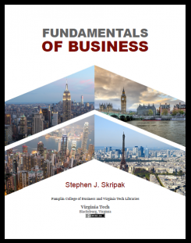
Published: August 2016
440+ pages Licensed: CC BY NC SA 3.0
~50% remixed content
Completely updated data, graphics, examples (currency)
Custom chapter order + chapters
(Fits the course learning objectives)
Philosophy: The course is more than a textbook
Several free downloadable file types (including editable)
Print on Demand (Lulu)
78,000+ downloads. 12 known “adoptions”

Slide 36
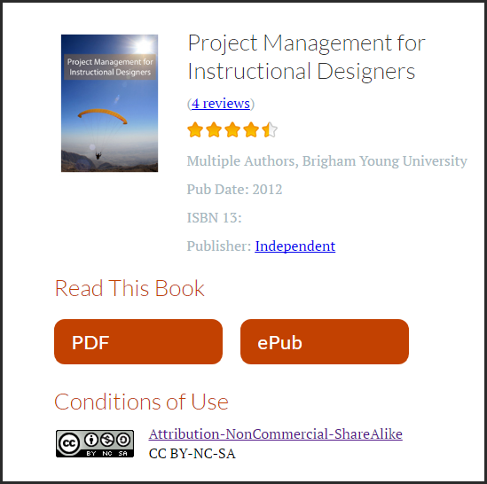

Slide 37
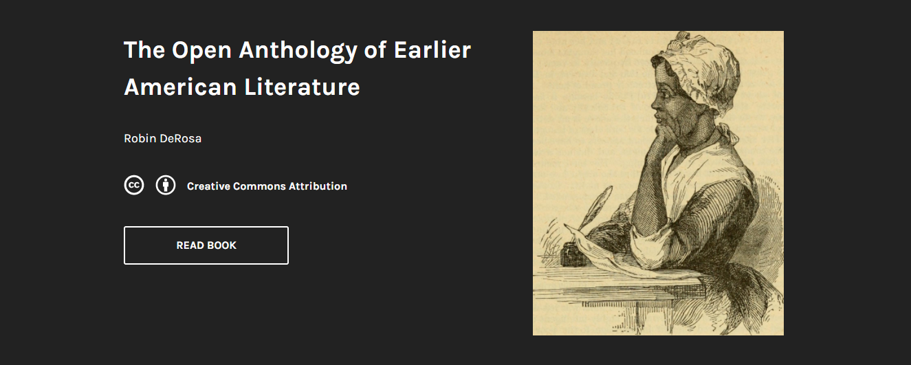
https://openamlit.pressbooks.com
http://robinderosa.net/uncategorized/my-open-textbook-pedagogy-and-practice

Slide 38
Going beyond OER
.

Slide 39

Non-disposable assignment
[public domain image]

Slide 40

Open Pedagogy
Leverages student agency
&
the real world
to produce:
Deeper learning approaches
More student engagement
Equity among students
Value for the real world
[public domain image]

Slide 41
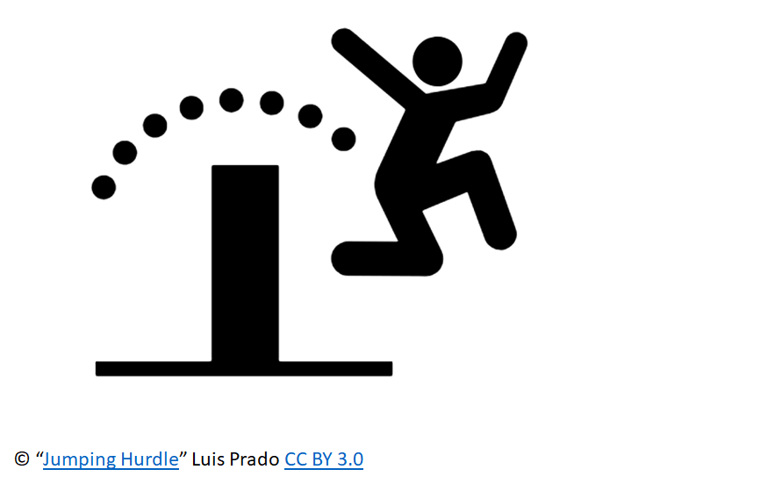
Open Education Is:
a movement
a philosophy
a broad, expanding set of value-driven practices.

Slide 42
Connecting the Opens
Open Access
Open Education
Open Data
19 March 2018
Comments by:
Peter Potter, Director of Publishing Strategy
Anita Walz, Open Education, Copyright & Scholarly Communication Librarian
Panelists
Karen DePauw, Vice President & Dean for Graduate Education
Rajiv Jhangiani, Special Advisor to the Provost on Open Education, Kwantlen Polytechnic University
Mayra S. Artiles, Doctoral Candidate, Engineering Education
Monty Abbas, Professor, Department of Civil & Environmental Engineering
Jon Petters, Data Management Consultant, University Libraries
Philip Young, Institutional Repository Manager, University Libraries

