Slide 1






On-station and on-farm experiments on Conservation Agriculture in slopping lands of Nepal
Presentation by
Dr. K.R. Pande, IAAS, T.U. Nepal
Sept. 2013
IAAS, T.U.

Slide 2
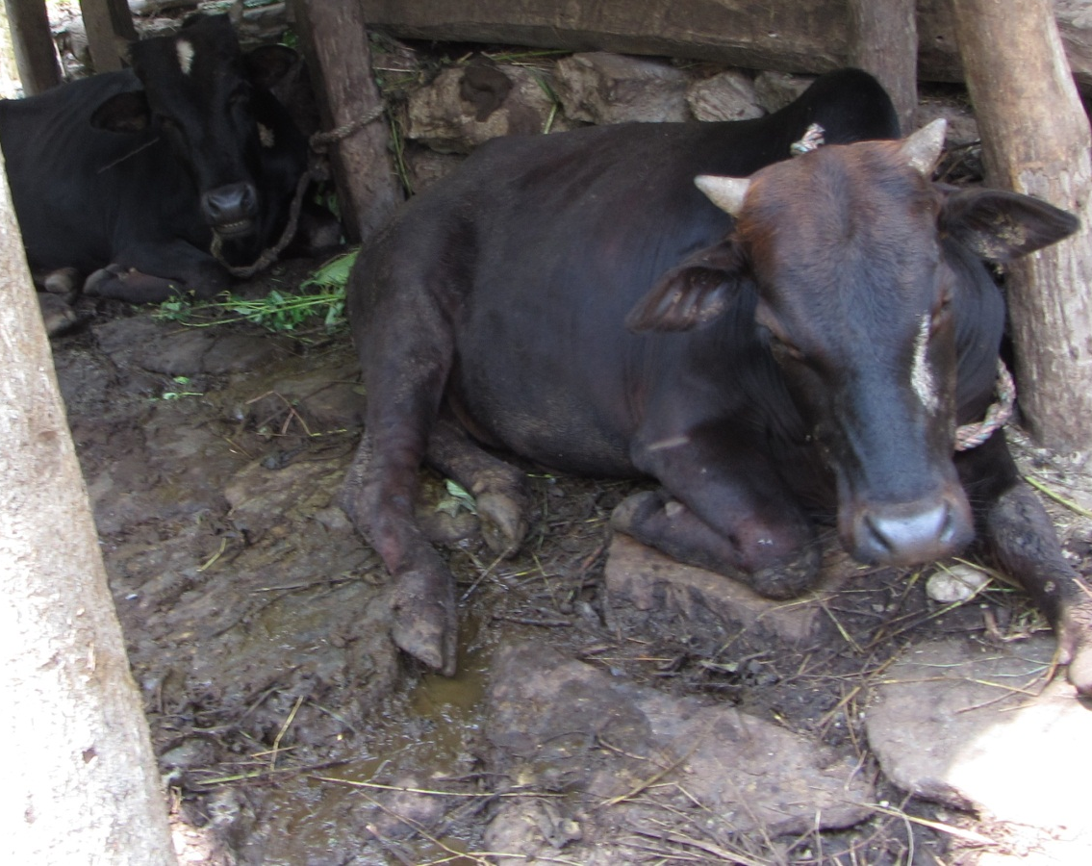
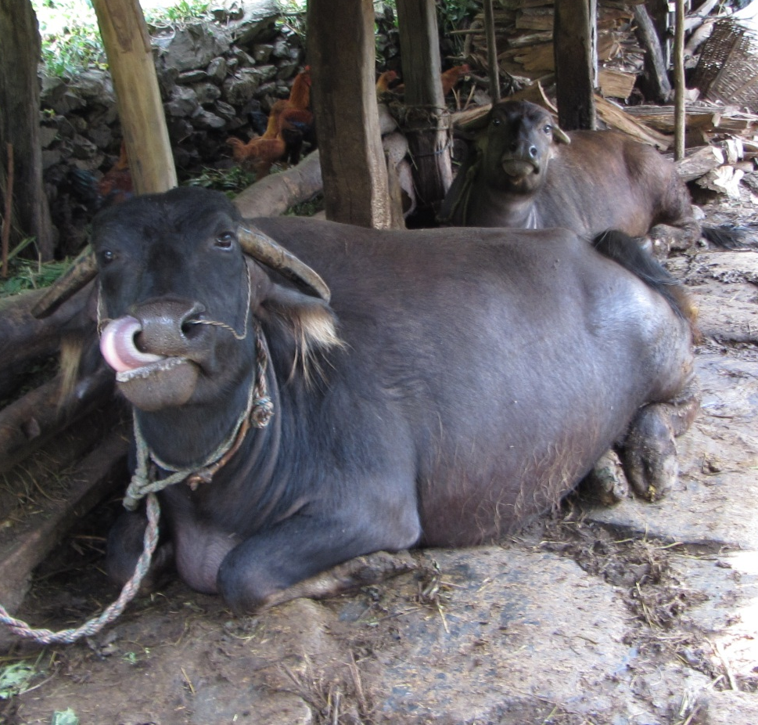
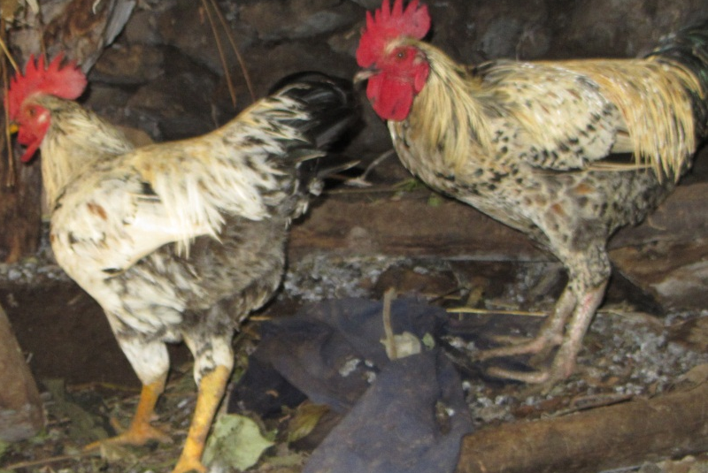
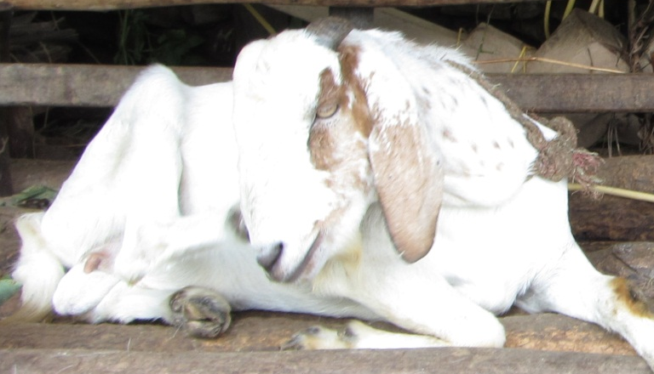

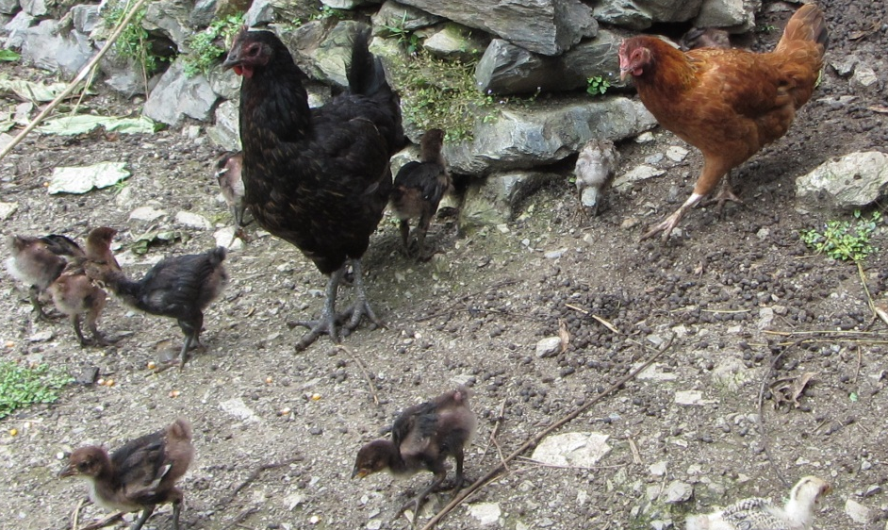
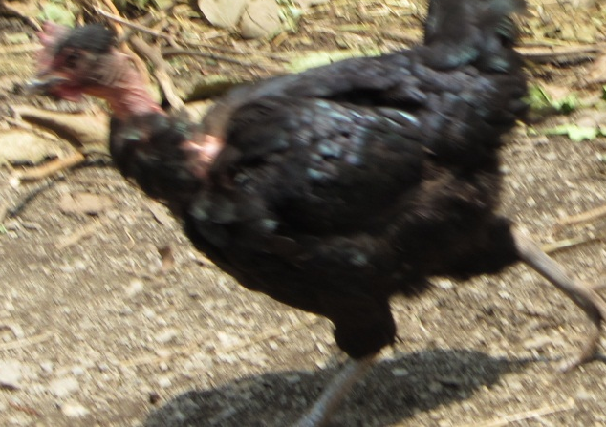
Farming slopping land

Slide 3
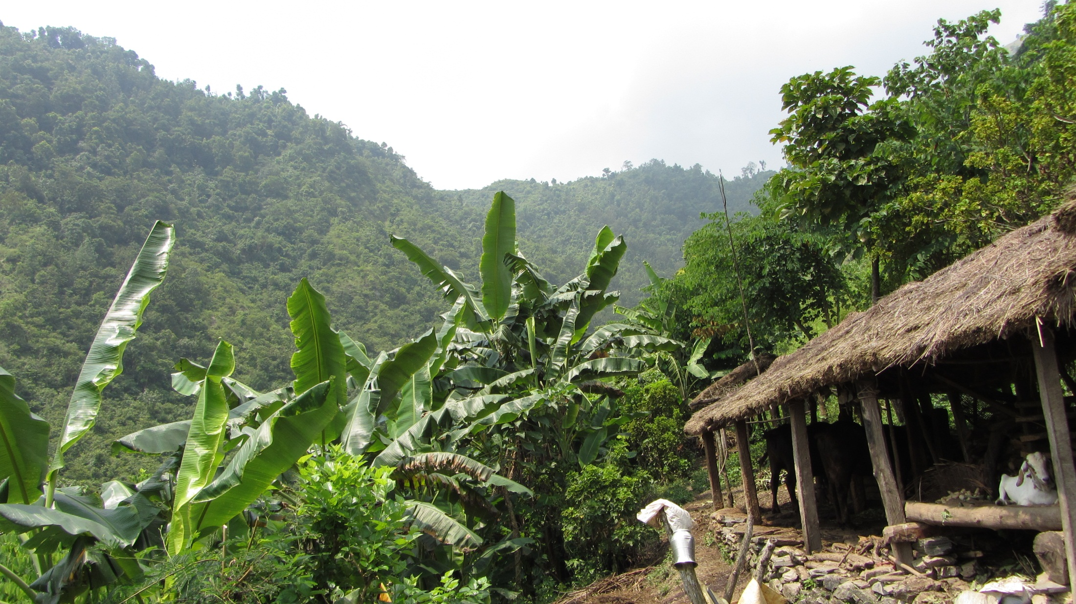
Animal shed
Banana
Manure

Slide 4
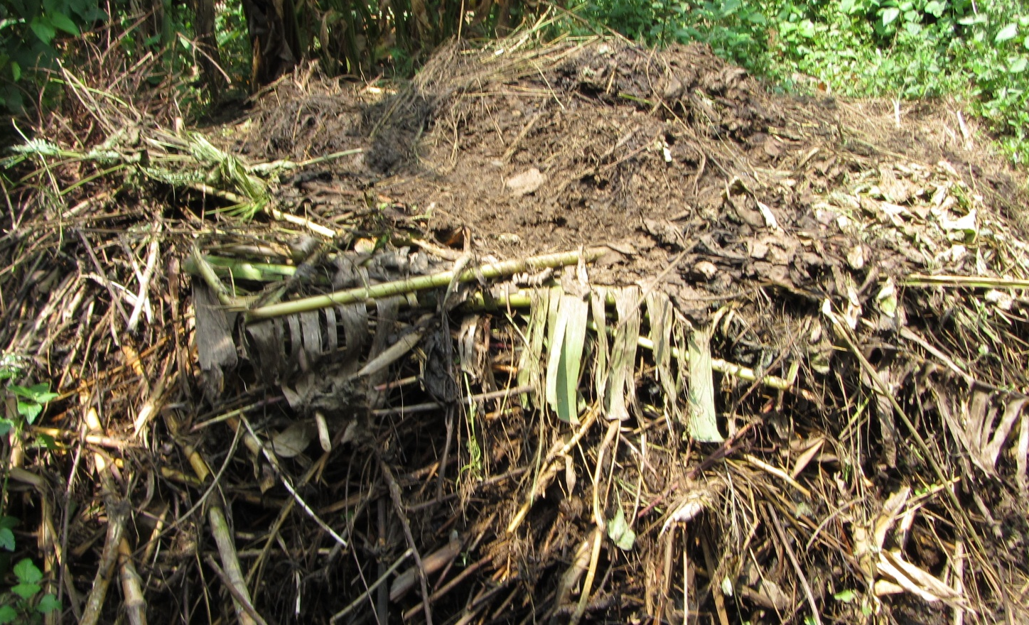
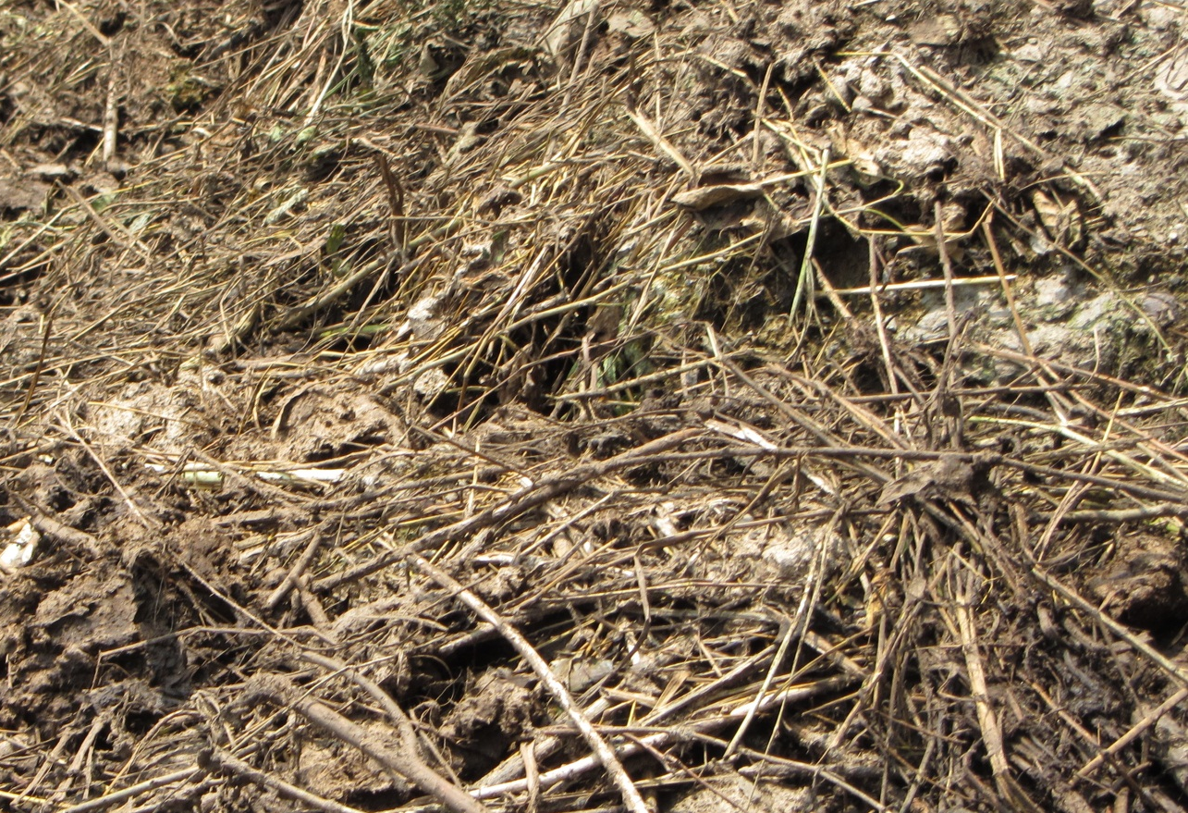
No roof
Direct solar radiation
Rainwater Entry
Need of Scientific manure management practices
Nutrient loss by
direct sunlight
Nutrient washed out
by rain water
Nutrient leaching and
pollution of aquatic system
Poor manure management

Slide 5
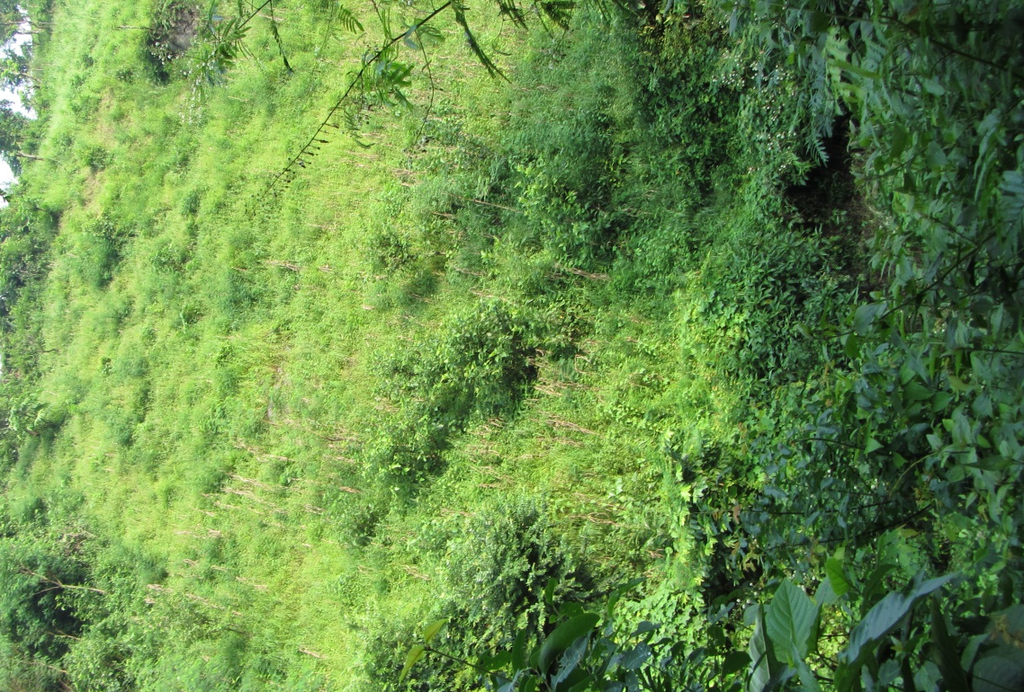
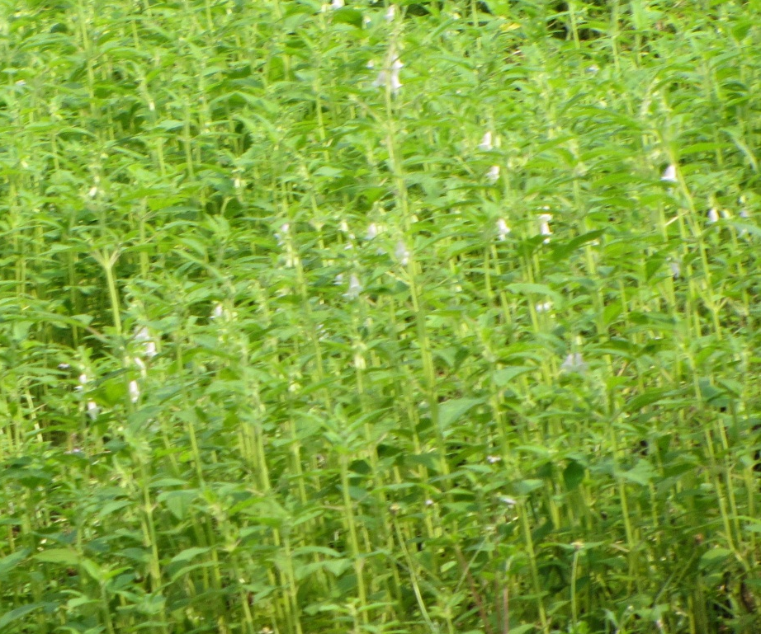
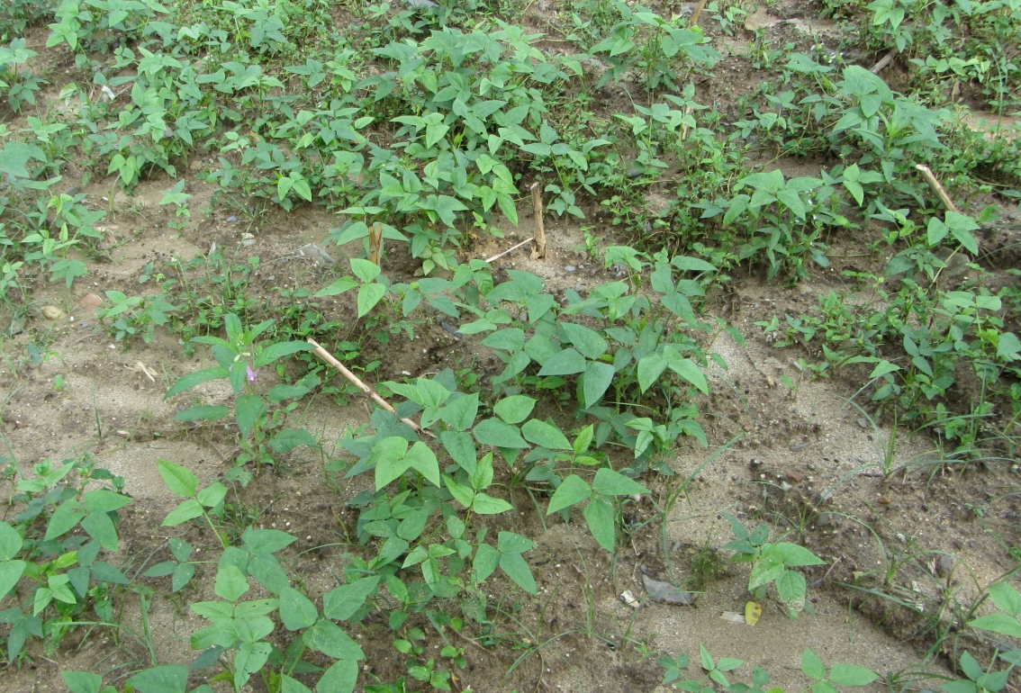
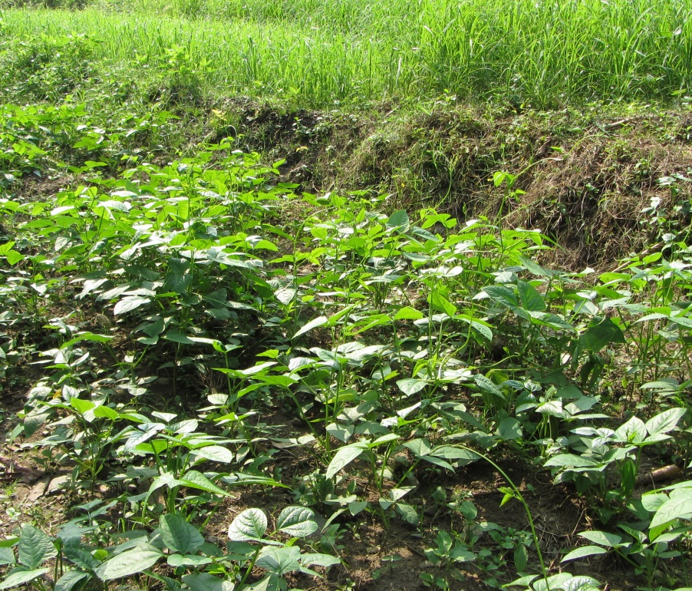
Maize stover at steep slope
Sessame (Til)
Millet under tillage
Blackgram under tillage
Cowpea under tillage
Farmers crops after maize for Autumn season

Slide 6
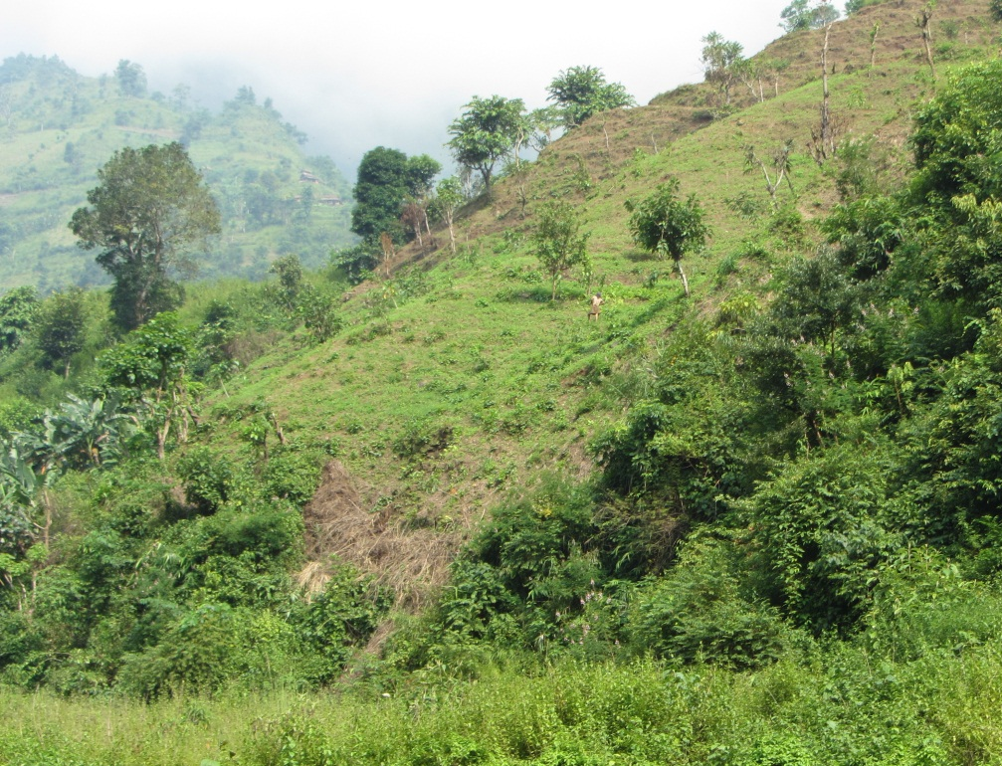
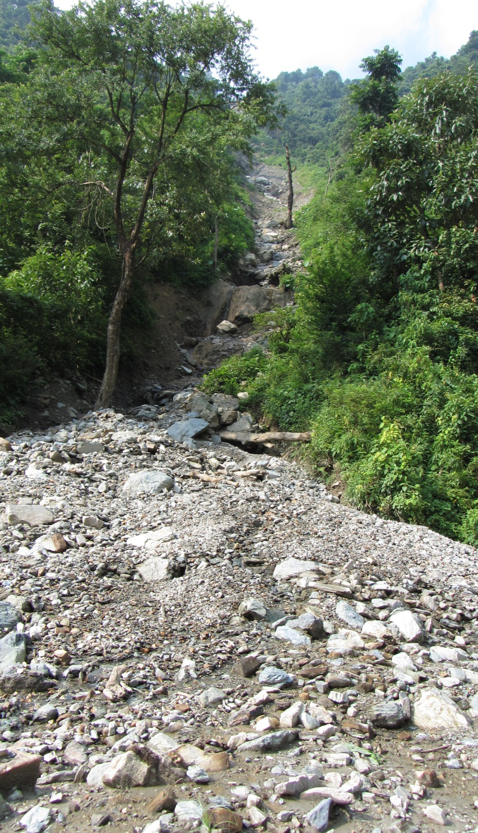
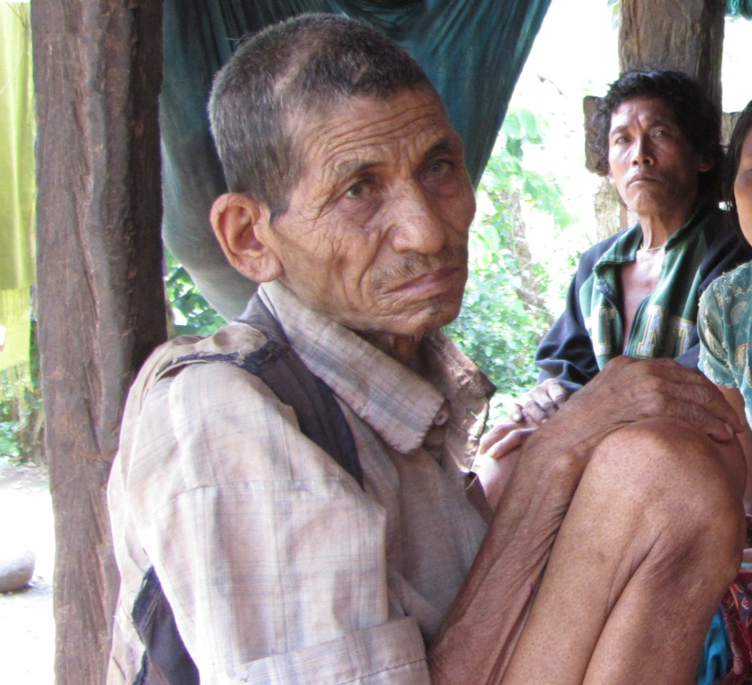

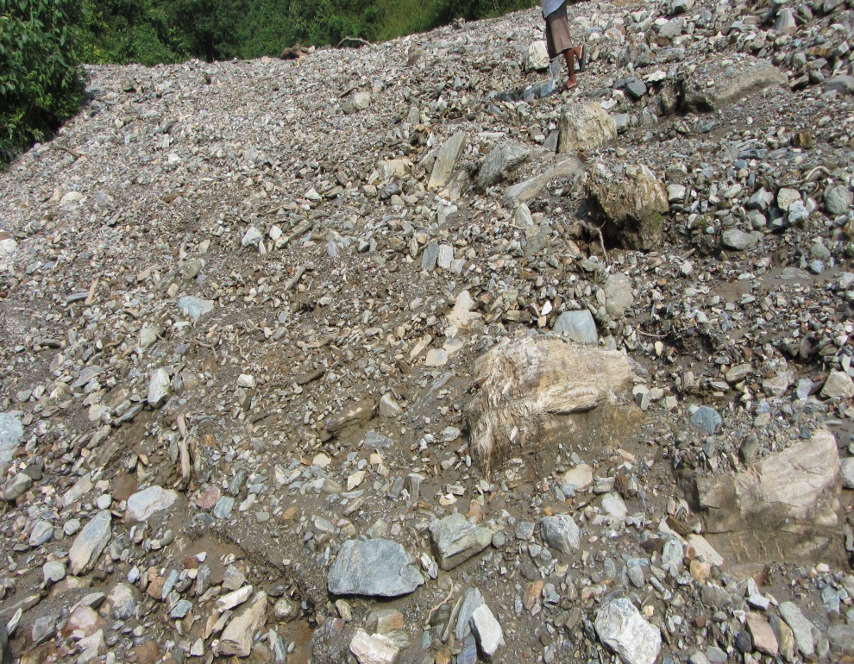
Slopping land agriculture
Multiple tillage
Low yielding crop varieties
Poor manure and land management
Lack of education
Lack of infrastructures
Lack of agri.inputs
Lack of modern production
technologies
Food crisis
Soil erosion
Nutrient erosion
N and P deficiency
Lower Production
Down stream pollution

Slide 7
Objectives
To improve soil and crop productivity of slopping land for long run by conservation agriculture in maize based cropping systems of Nepal.
Improve food security and livelihood of tribal people of slopping land.
Potential options
improve soil productivity by reducing tillage
Introduce legumes to improve soil productivity
Introduce different maize varieties to increase production and food security
Introduce different soyabean varieties in maize based cropping system of slopping land to improve food security and soil productivity
Evaluate the effects of different cover crops on maize production
Determine different crop management practices to introduce soyabean as intercropping with maize
Introduce and evaluate different high value perennial crops in slopping lands

Slide 8
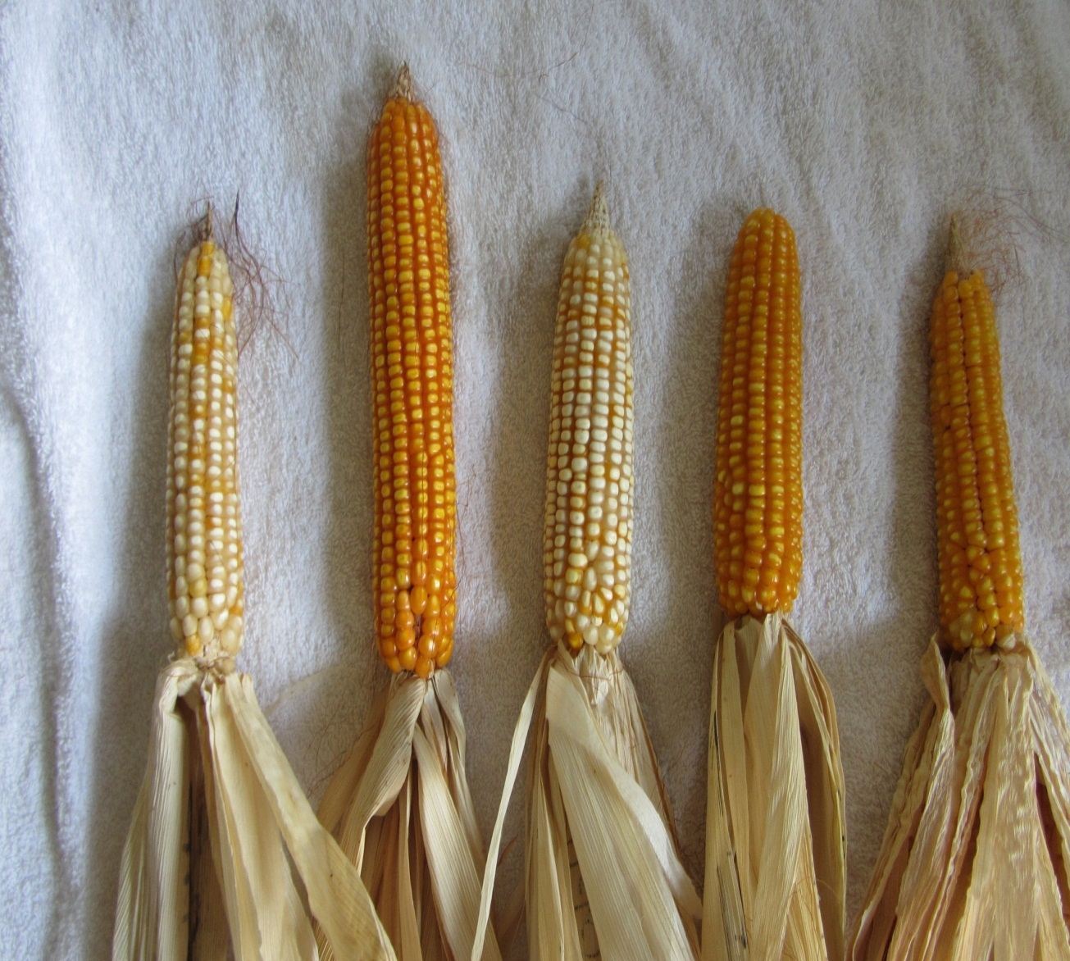
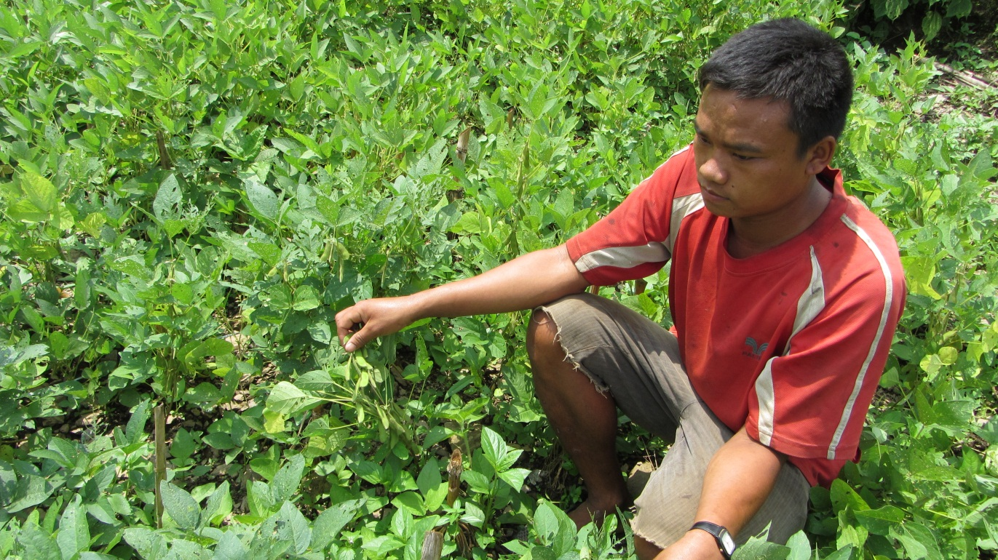
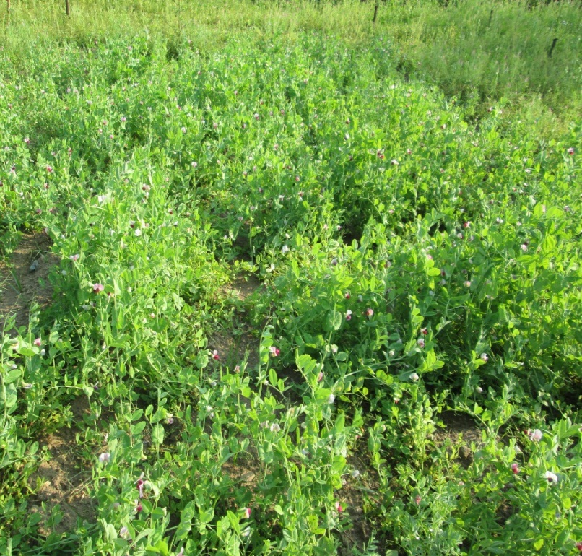
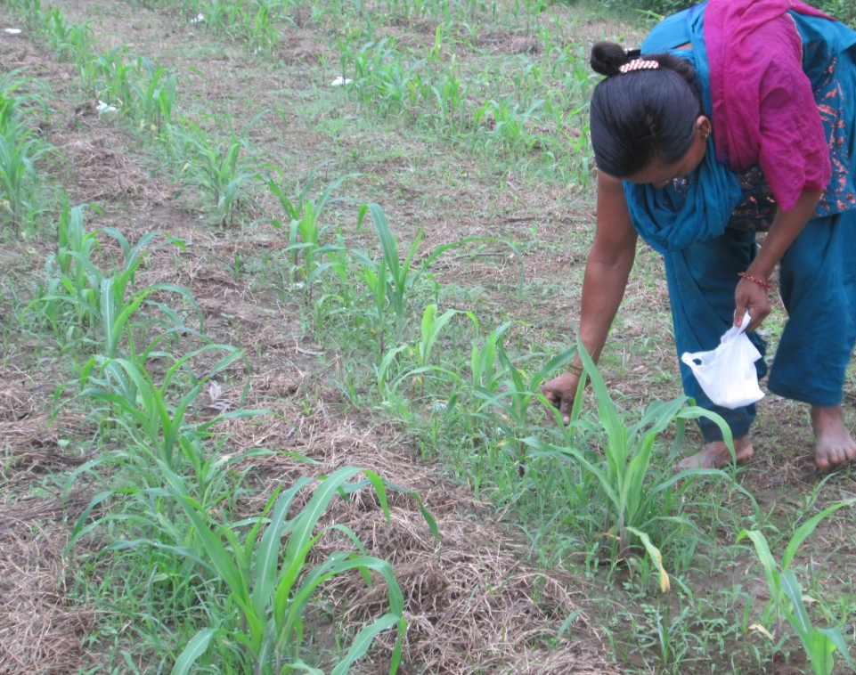
Maize varietal performance
Soyabean varietal trial
Expt. I: maize varieties at 3 sites with 5 reps, 013
Expt. II: soyabean varieties at 3 sites
Cover crops (Dec.-Apr.) -Maize (May-Aug./Sept)-Soyabean (June-Dec.)
Expt .III: cover crops, 2013
Expt. IV: Strip tilled maize
after cover crops

Slide 9
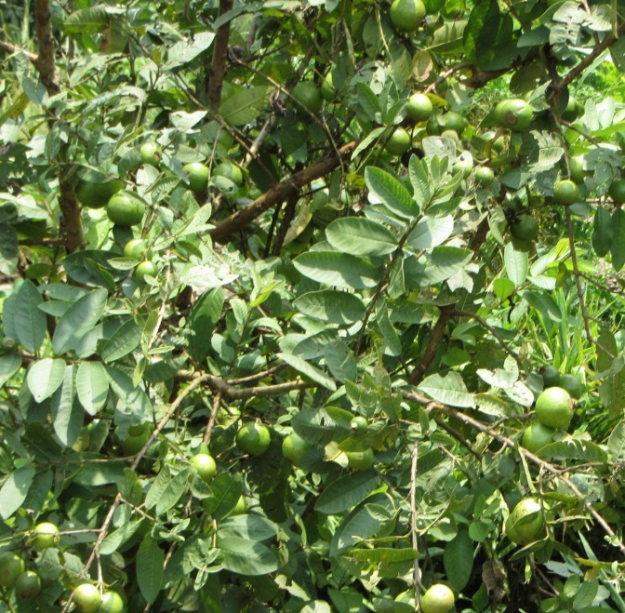
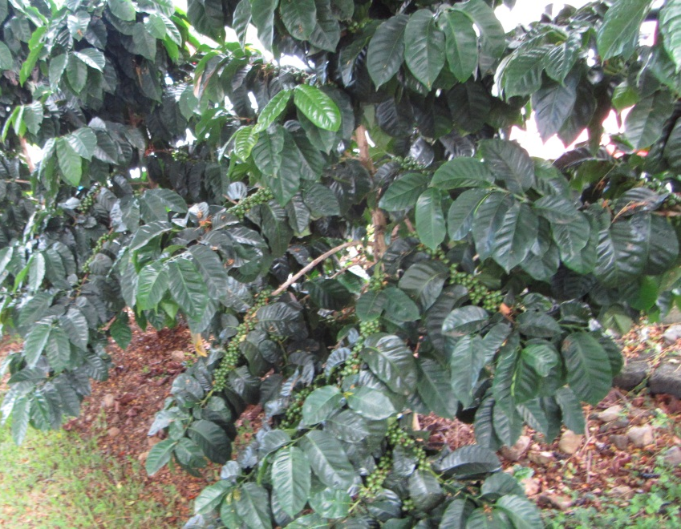
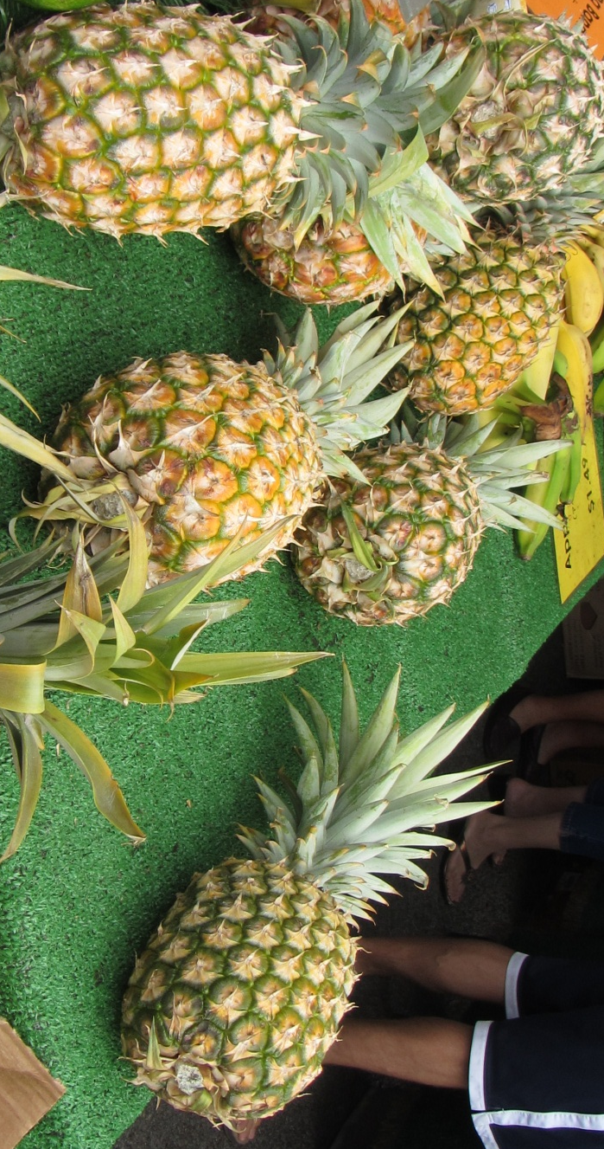
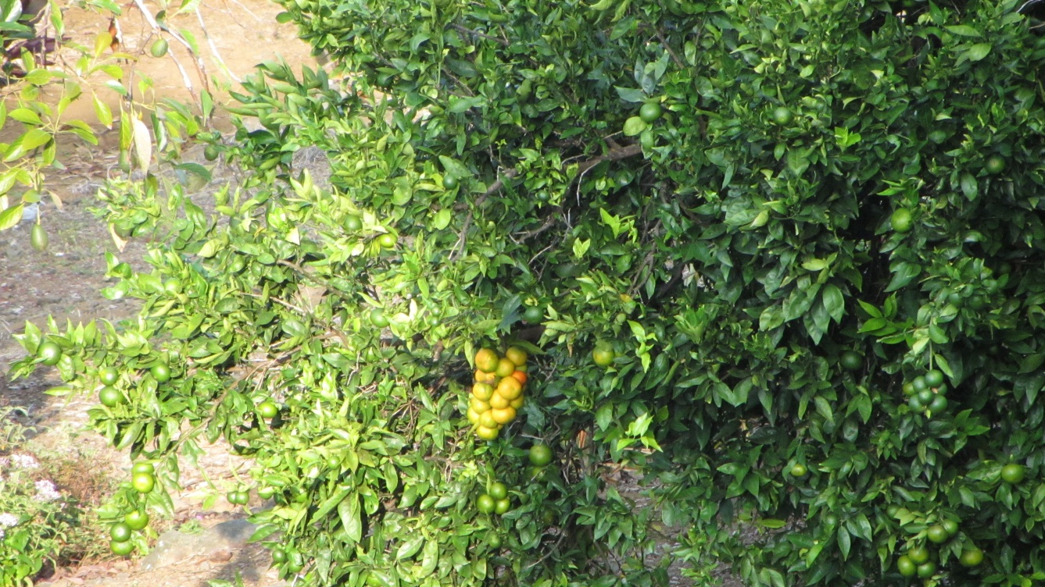
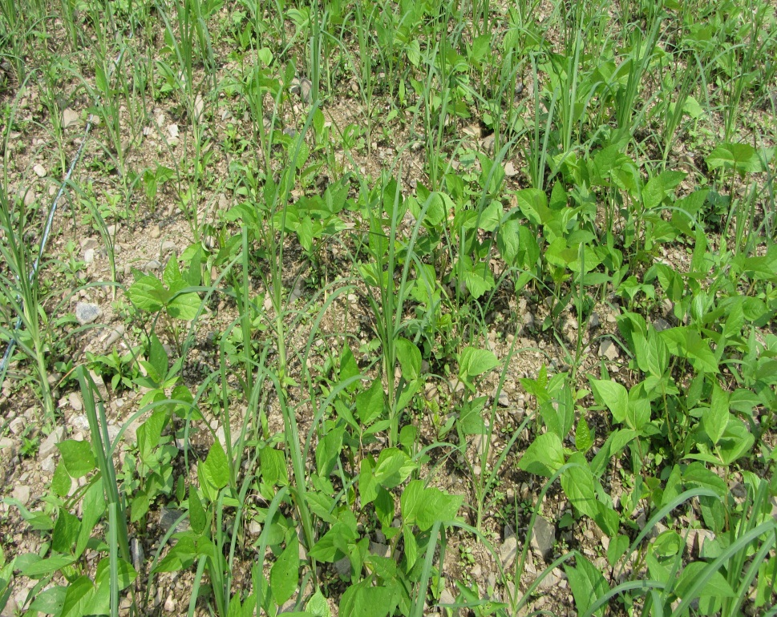
Potential crop Coffee
Potential crop Guava
Potential crop Pineapple
Potential crop Citrus
Potential crop millet+blackgram

Slide 10
Maize varietal Trial
Four improved maize varieties and one local (control) was planted as
farmers practice and preference was evaluated in Thumka, Hyakryang
and Kholagaun of Nepal (plot area: 20 m2 for each variety ).
Results
Grain yield of different varieties of maize at midhills of Nepal

Slide 11
Farmers’ perception
Most preferred characters of maize: Larger cob, more number of grains, more grain wt, taste and storability were.
Among the tested varieties Manakamana-4 and Manakamana-3 are preferred by the farmers
Farmers have been testing storability and will be reported

Slide 12
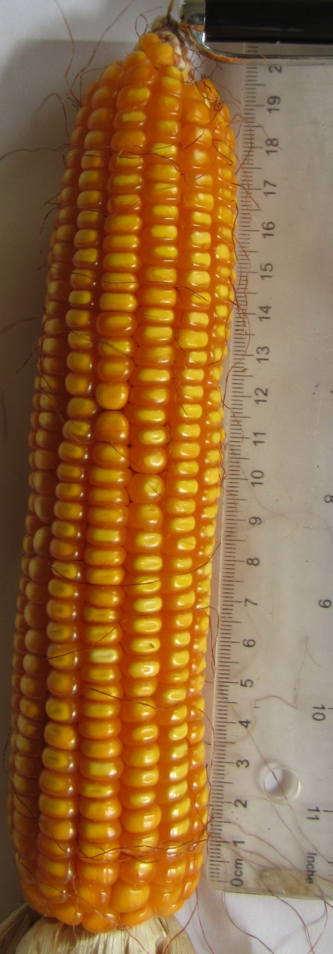
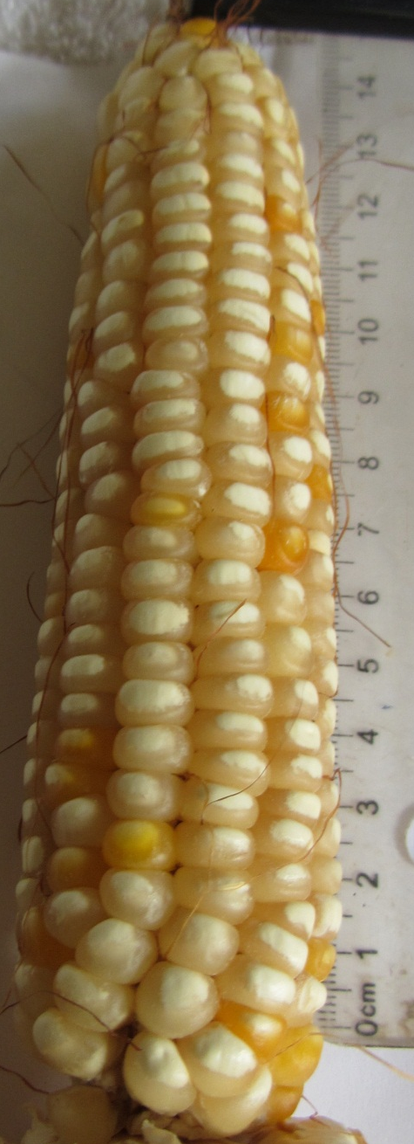
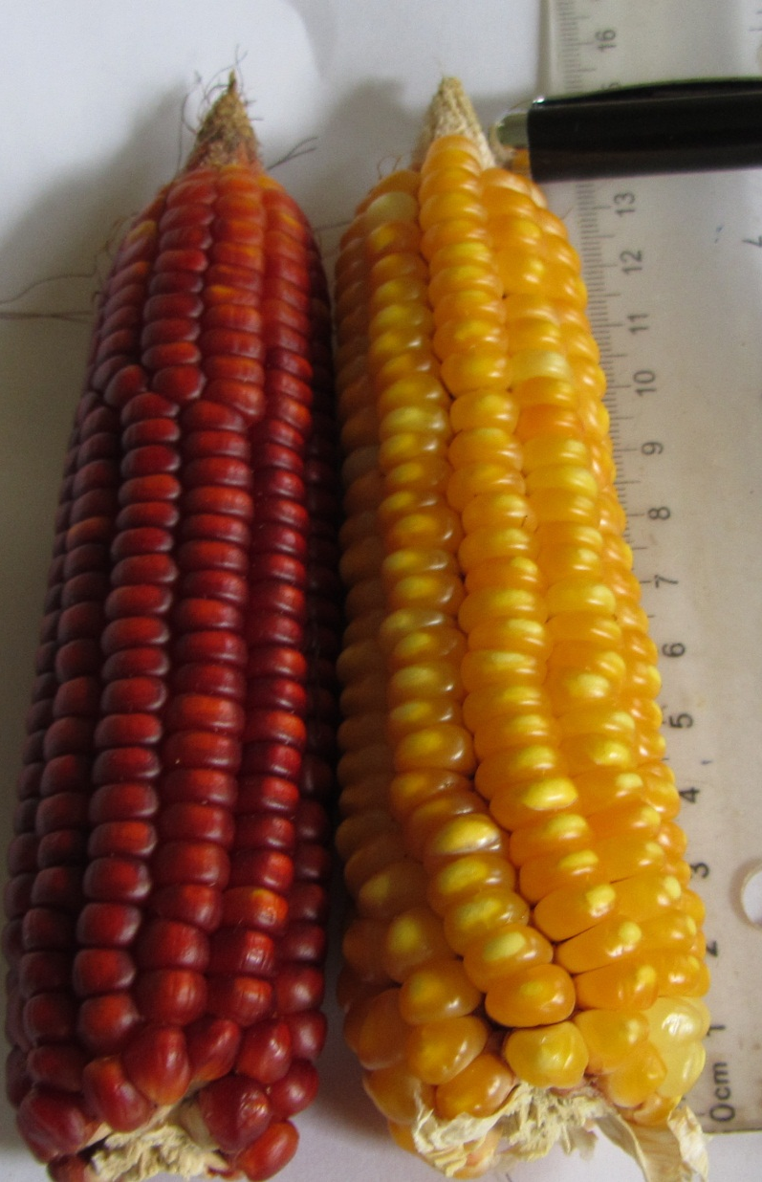
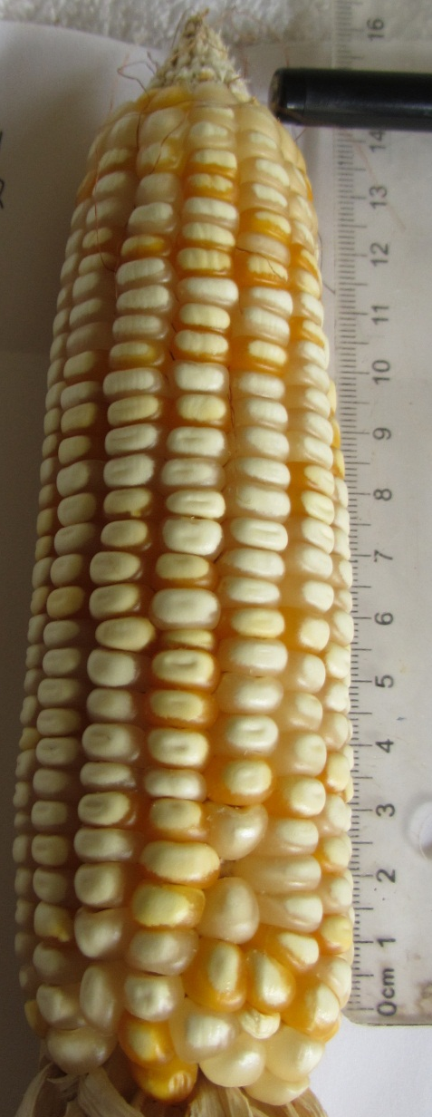
Manakamana-4
Local types
Manakamana-3

Slide 13
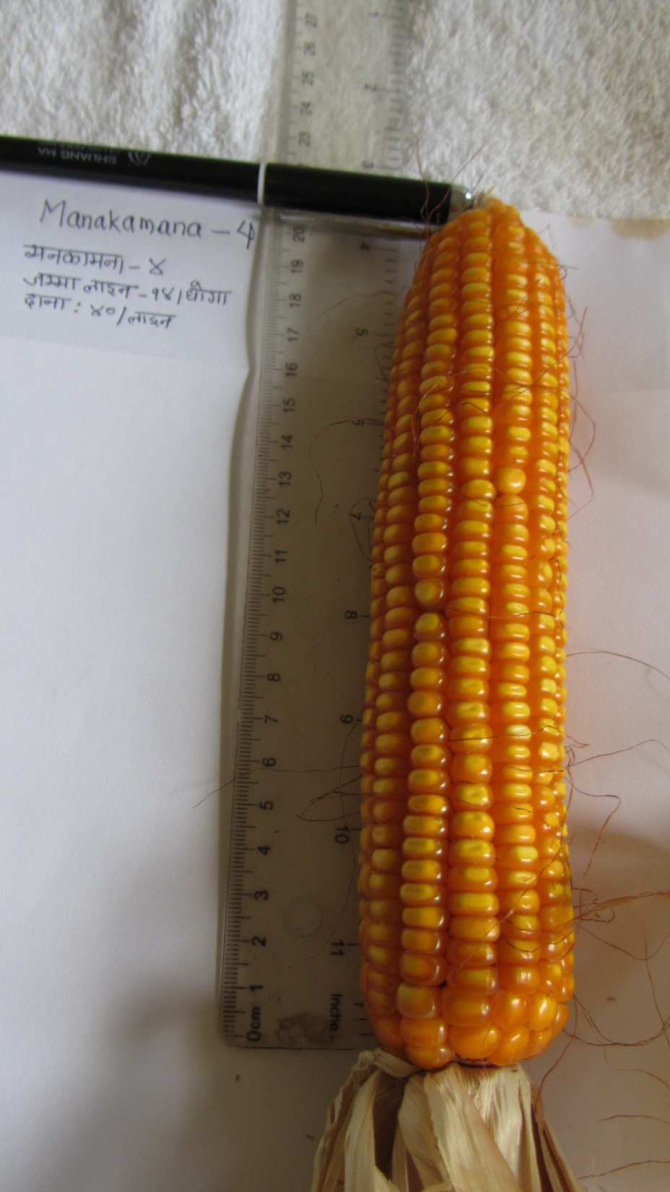
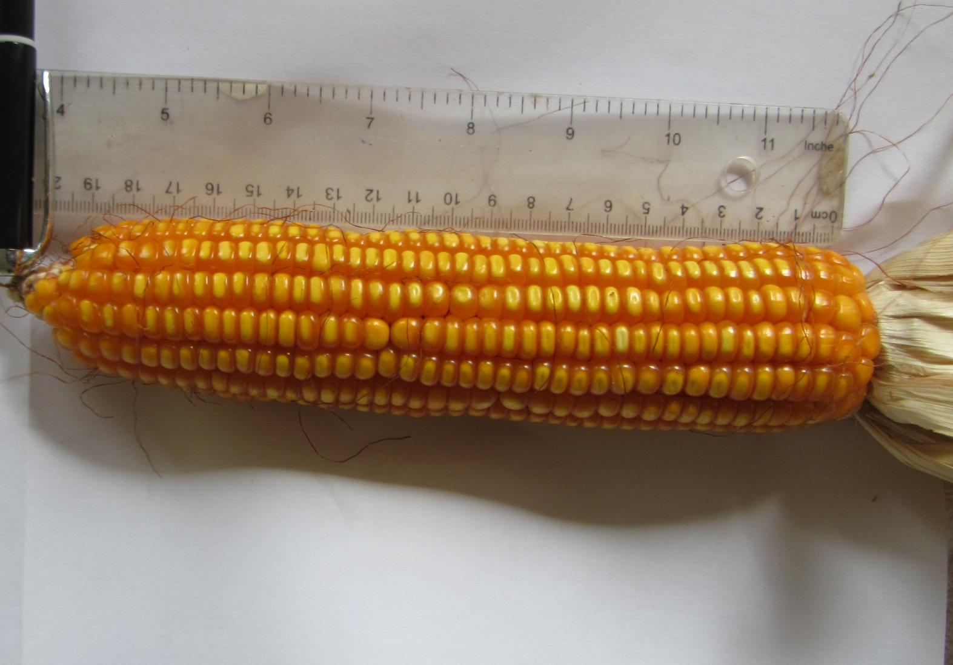


Slide 14
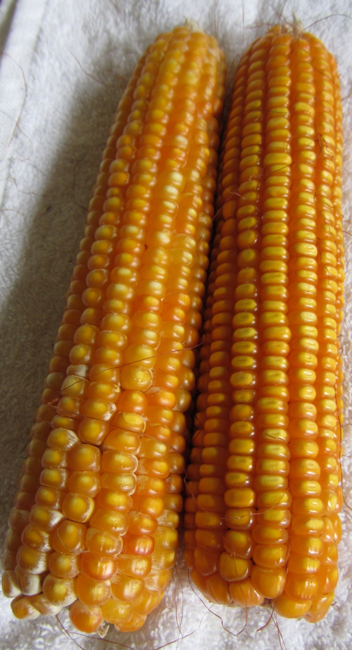
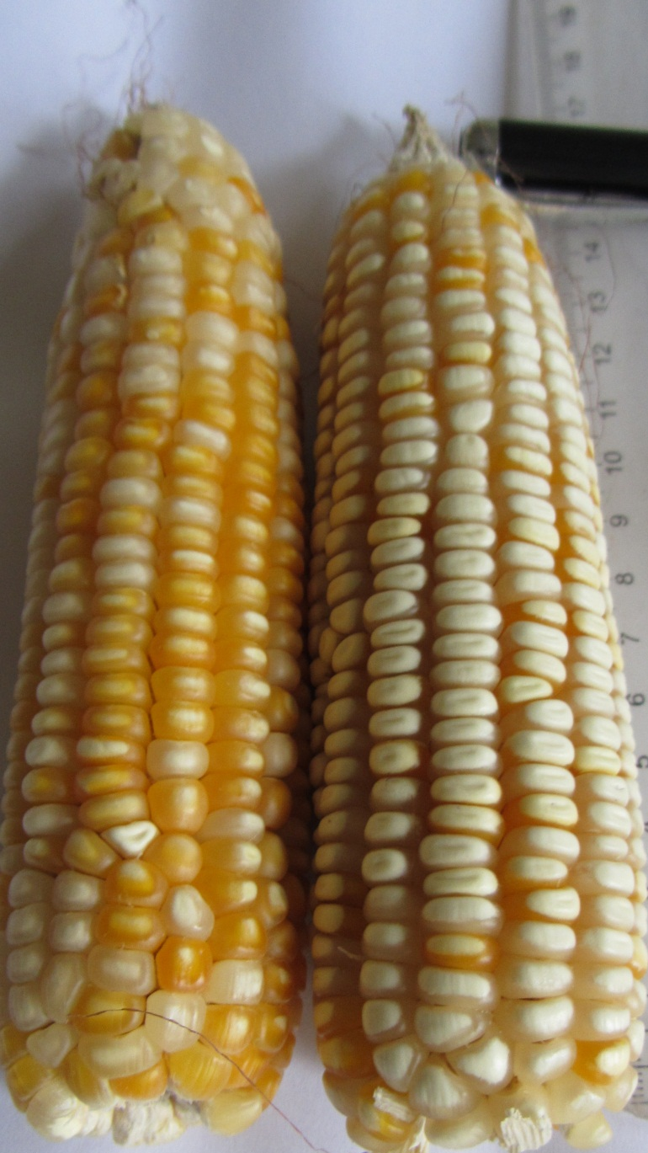

Cob length: 20cm
Cob length: 14.5cm
Cob length: 13.5cm
Manakamana-4
Manakamana-3
Local

Slide 15
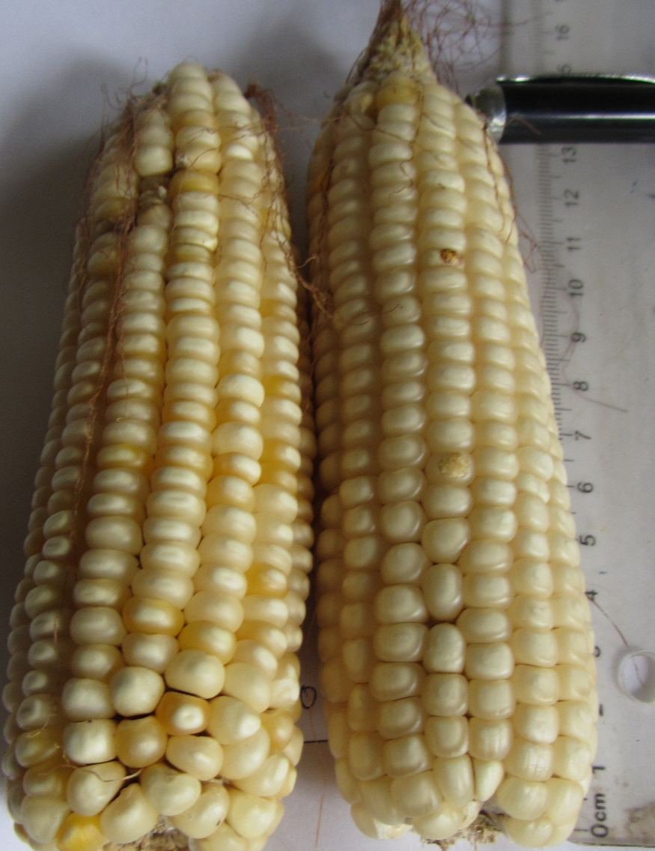
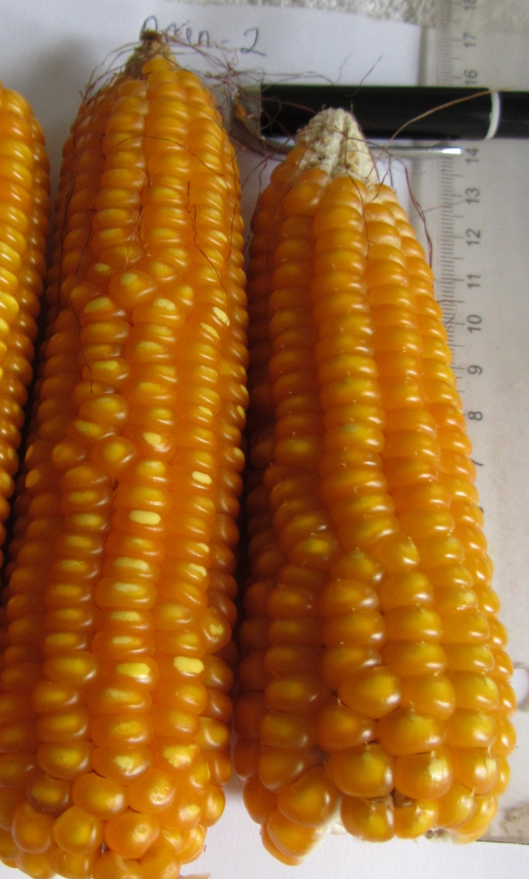
Cob length: 13.5cm
Cob length: 13.5cm
Cob length: 13.5cm
Local
Arun-2
Poshilo (QPM)

Slide 16


Slide 18
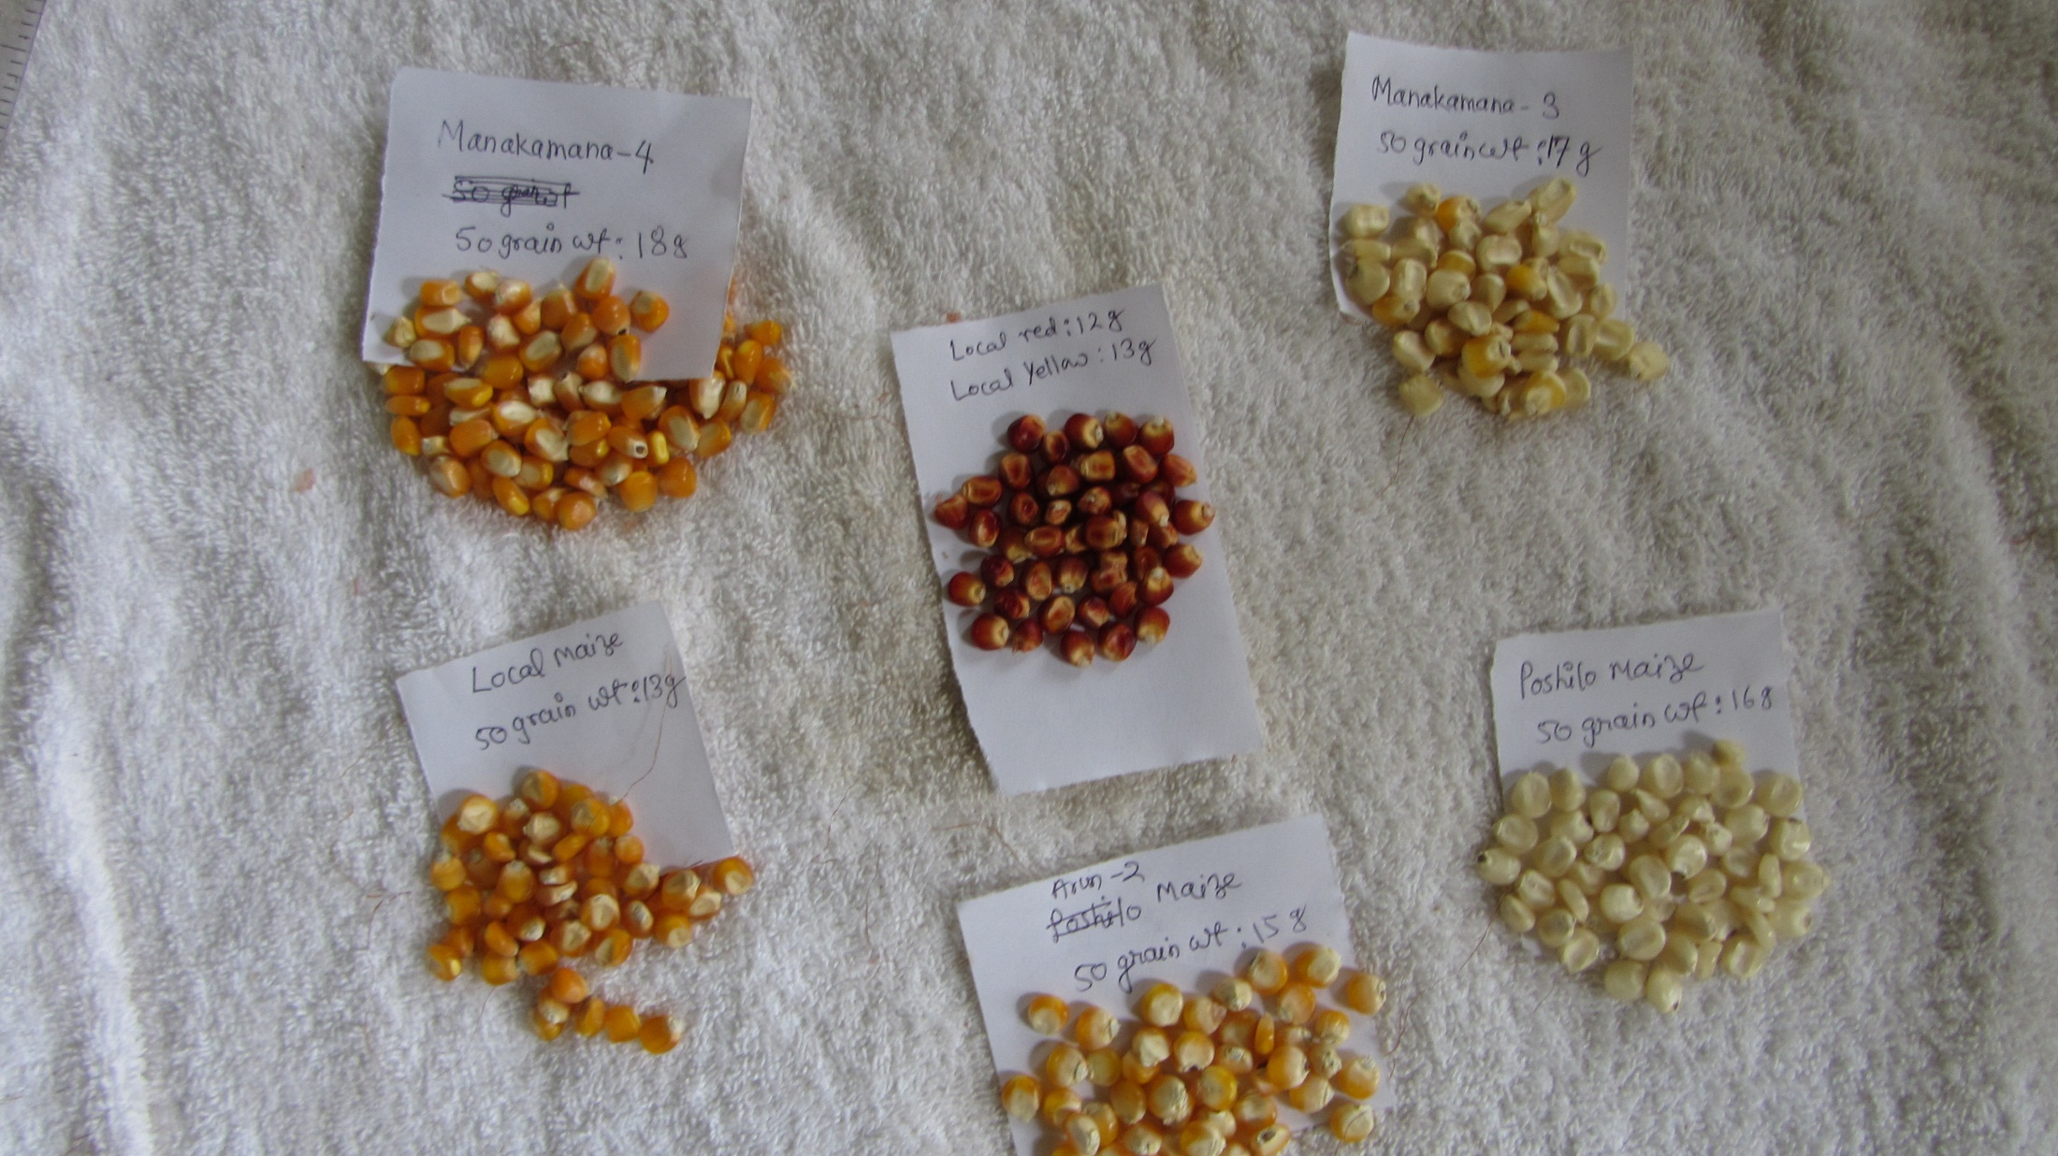
Grains of different maize varieties tested in farmers field at Kholagaun,
Thumka and Hyakryang, Nepal, 2013

Slide 19
Maize varietal performance
Soyabean varietal trial
Expt. I: maize varieties at 3 sites with 5 reps, 013
Expt. II: soyabean varieties at 3 sites
Expt .III: cover crops, 2013
Expt. IV: Strip tilled maize
after cover crops

Slide 20
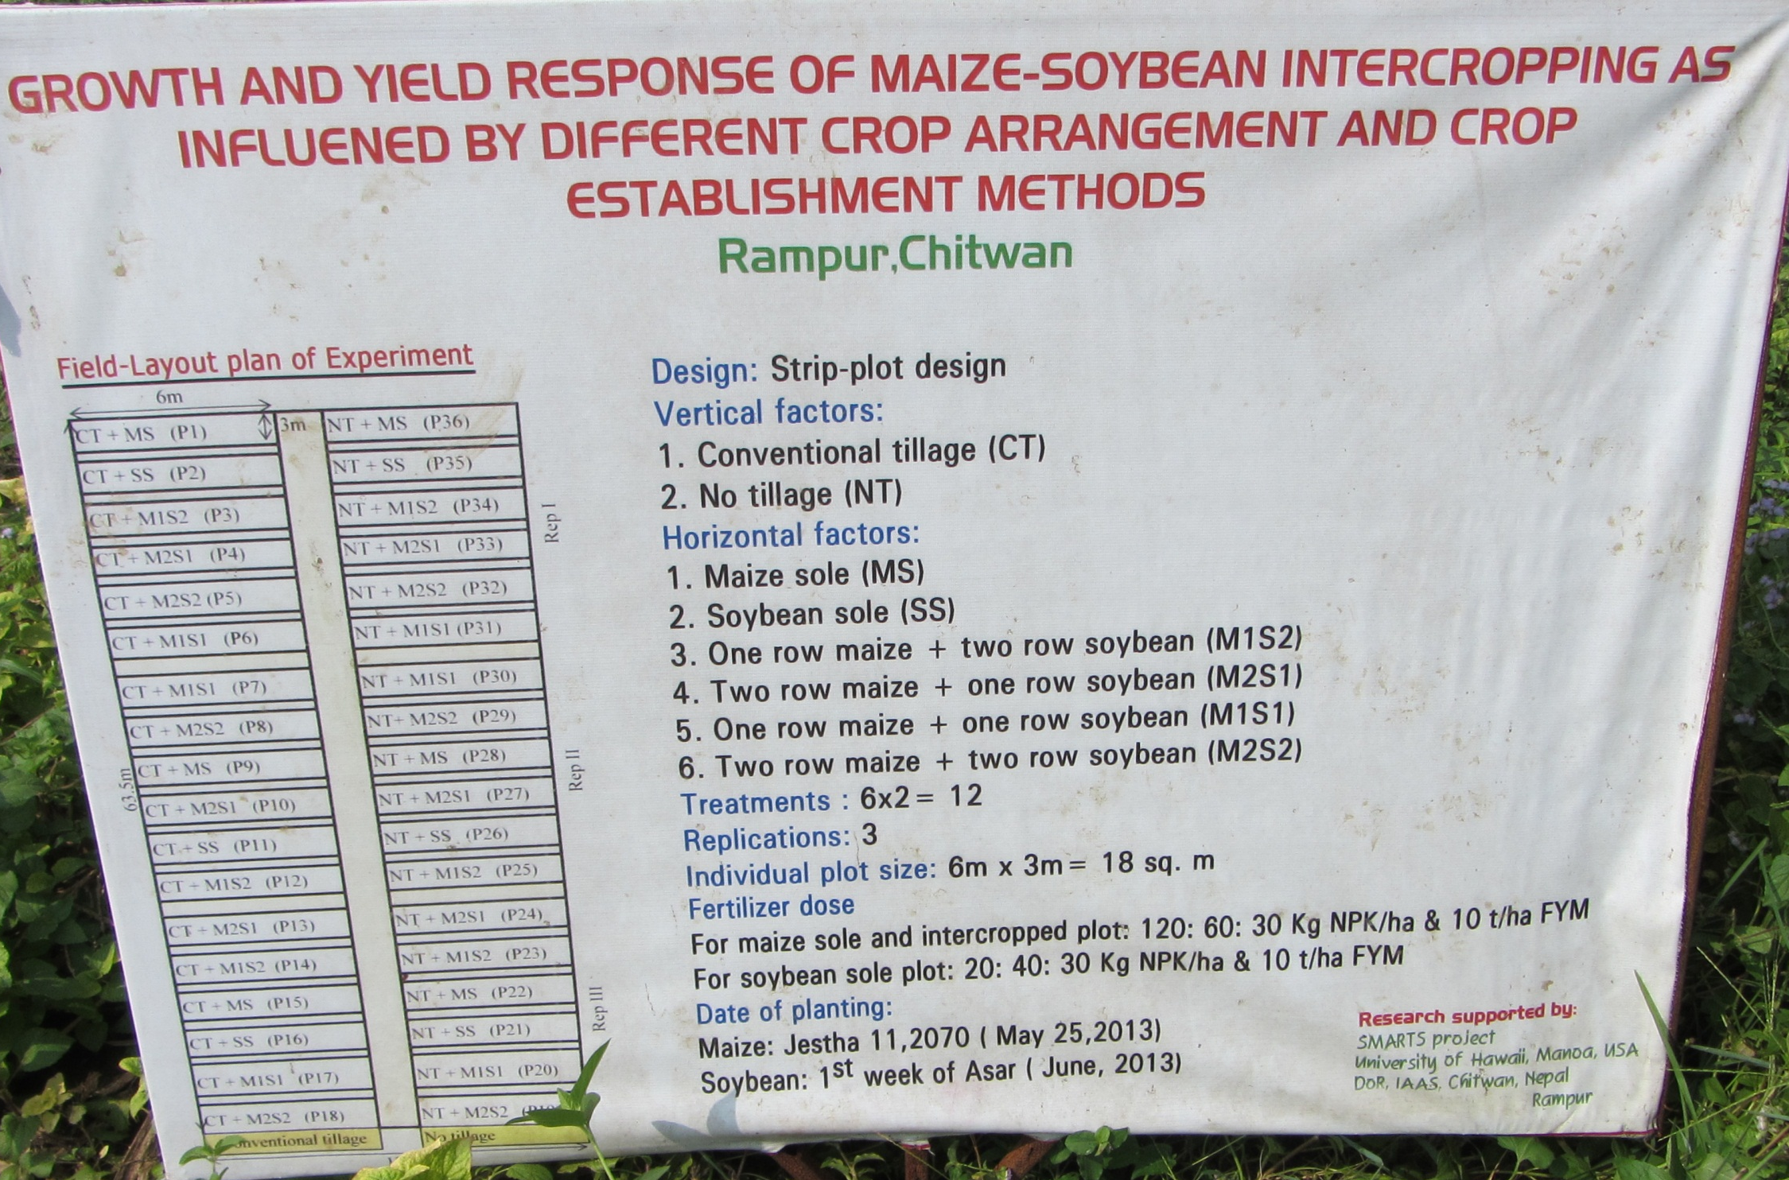
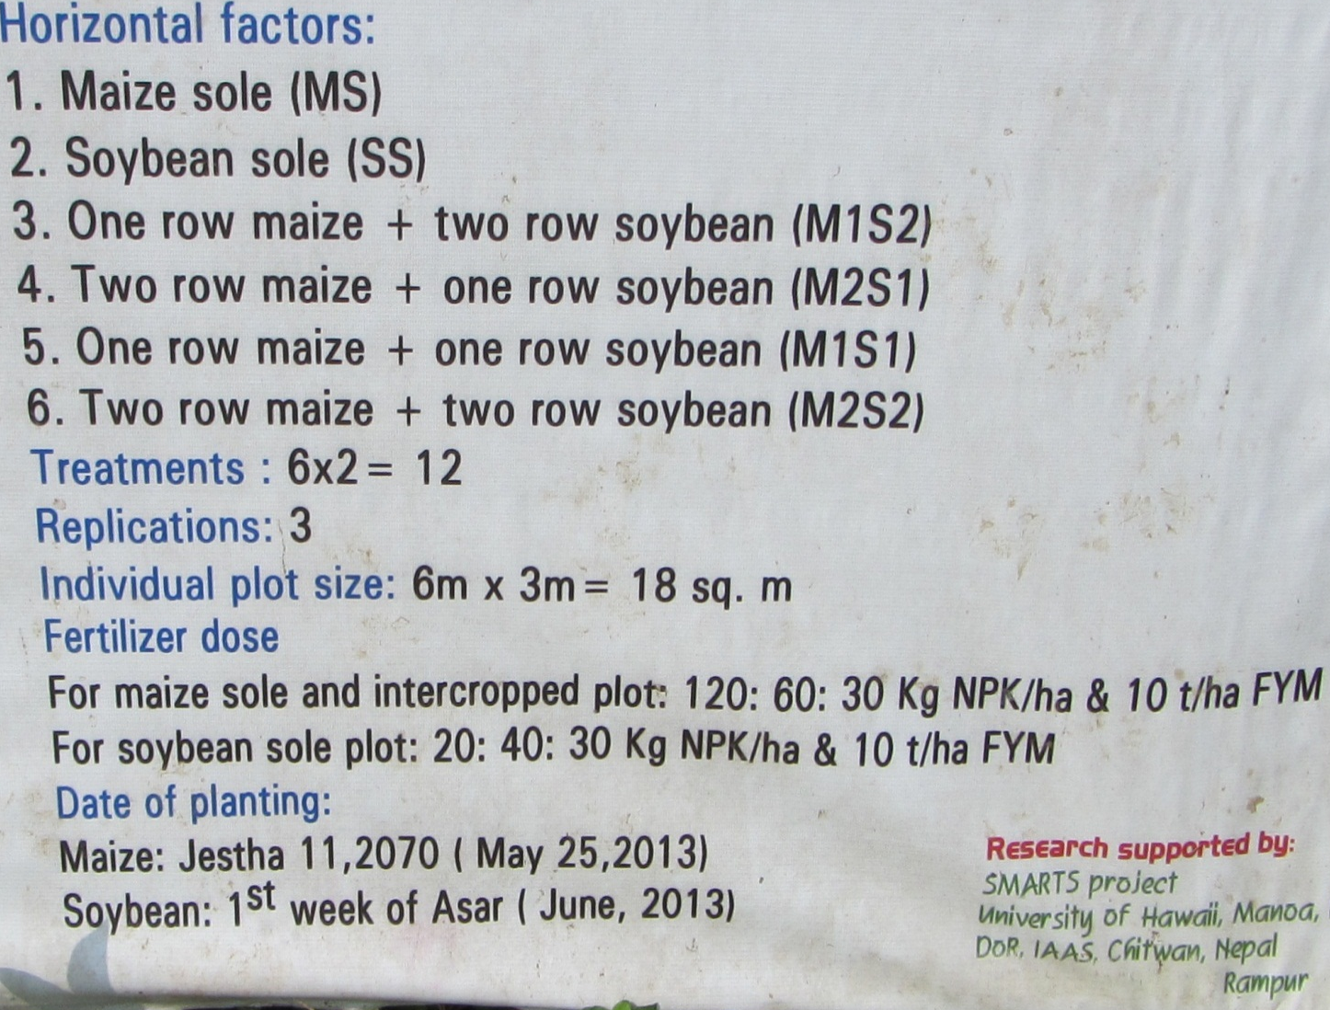
Maize- Soyabean inter cropping
Results:
+Maize harvested
+Soyabean in the field
+Waiting for full results

Slide 21
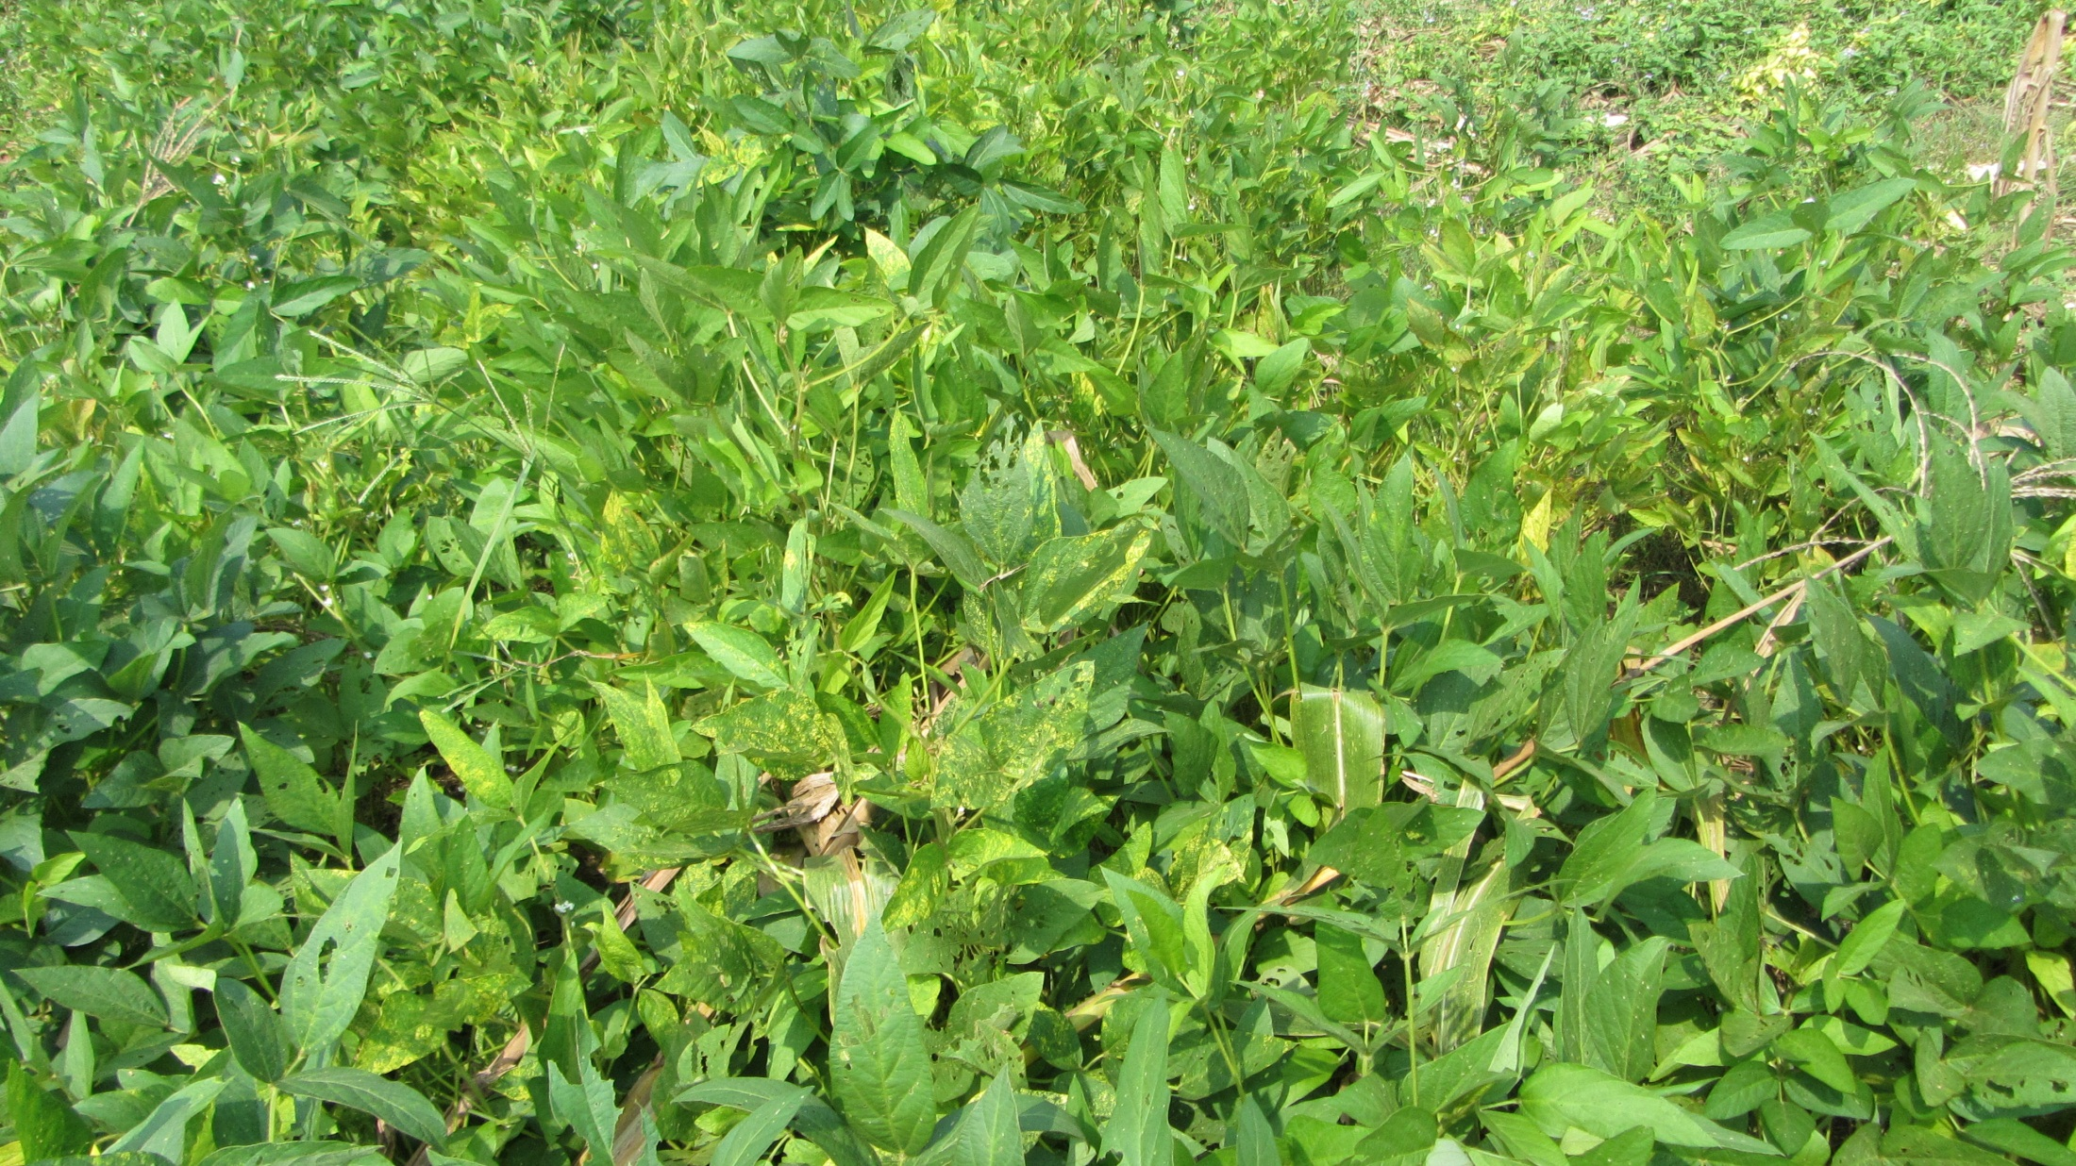
Soyabean varietal performance evaluation on farmers field
at Hyakryang, Kholagaun and Thumka of Nepal

Slide 22

Farmer showing varietal performance of soyabean at Kholagaun, Nepal, 2013
Result: waiting for yield performance and farmers perception

Slide 23
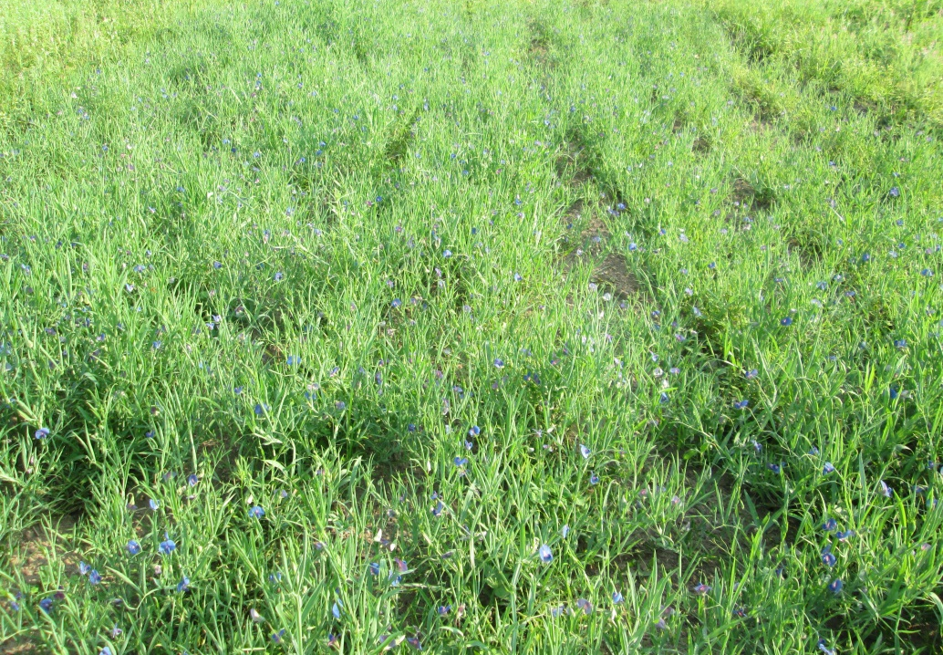
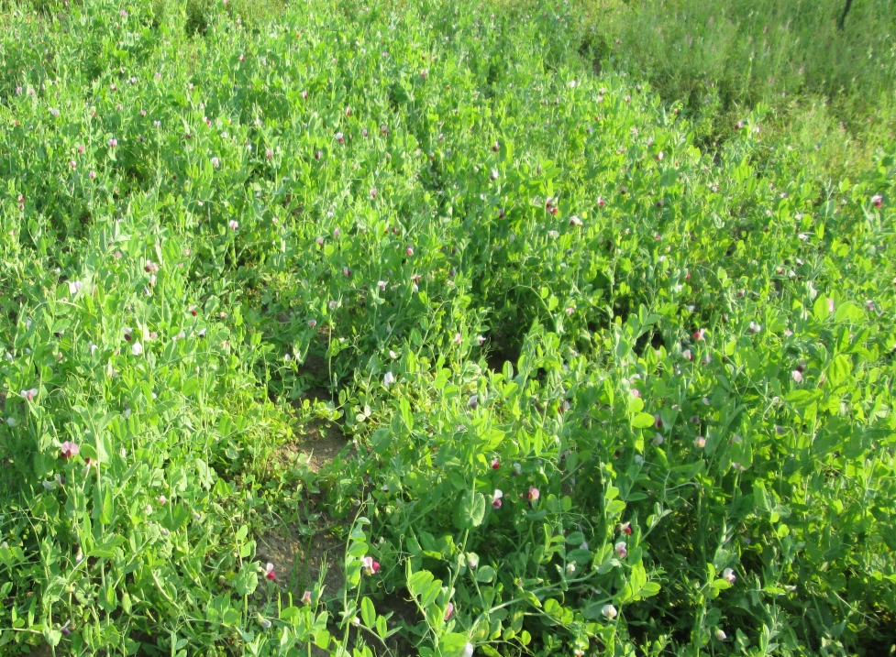
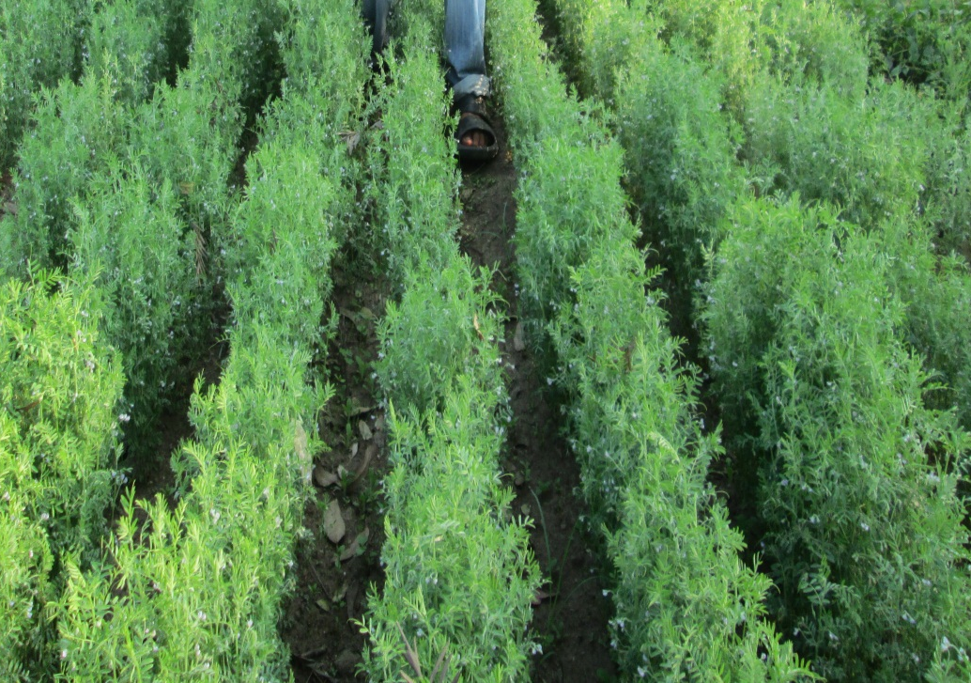
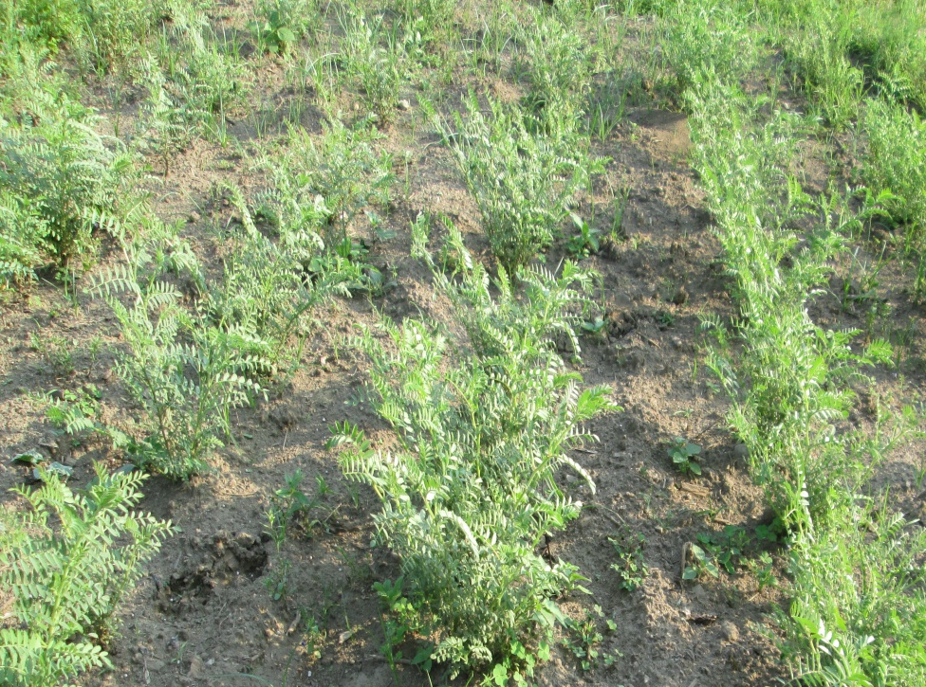
Effects of winter cover crops on succeeding maize
Cover crops sown on December 7. 2012
Lathyrus
Small pea
Cover crops (Dec.-Apr.) -Maize (May-Aug./Sept)-Soyabean (June-Dec.)
Lentil
Chickpea

Slide 24
Area coverage by cover crops during winter season, onstation experiment, Nepal, 2013

Slide 25
Residue was recycled and maize was grown under strip tillage
Maize is already harvested
108 Soil and 108 plant samples are under analysis
Maize growth and yield data are under processing
Soyabean has been intercropped under strip tillage
Soyabean is flowering and fruiting

Slide 26

Cover crops (Dec.-Apr.) -Maize (May-Aug./Sept)-Soyabean (June-Dec.)

Slide 27
Tillage effects on maize yield and soil properties
Field experiment was conducted at farmers field with three levels of tillage treatments (conventional: multiple tillage, dibbling, strip tillage) as main factor and different levels of FYM as 2Mg ha-1, 5 Mg ha-1, 10 Mg ha-1 and 20 Mg ha-1 as sub-factor, maize and soil productivity were evaluated.

Slide 28
Results
Effect of tillage and FYM on yield of maize, residual soil nutrients and nutrients uptake by maize at Kabilash, Chitwan, Nepal, 2012
Treatments | Crop yield (Mg ha⁻¹) |  | Residual soil nutrients |  |  |  | N-uptake (kg ha⁻¹) | P uptake (kgha-1)
 |  |  | % |  | (mg kg⁻¹)
 | Straw | Grain | OM | N | P | K
Tillage
Dibbling | 8.048 | 3.171 | 1.546 | 0.15ª | 22.30 | 80.57 | 134.670ª | 31.734
Strip tillage | 8.273 | 2.983 | 1.606 | 0.13ª | 21.72 | 80.30 | 134.670ª | 32.918
Convention tillage | 8.448 | 3.293 | 1.634 | 0.10^{b} | 21.12 | 87.70 | 134.670ª | 34.172
SEm | 0.222 | 0.126 | 0.075 | 0.01 | 2.12 | 5.07 | 134.670ª | 1.465
LSD | NS | NS | NS | 0.03* | NS | NS | 134.670ª | NS
FYM Levels
2 Mg ha⁻¹ | 6.793^{c} | 2.411^{c} | 1.418^{b} | 0.12^{b} | 16.40^{b} | 63.2^{b} | 78.313^{d} | 17.649^{d}
5 Mg ha⁻¹ | 7.619 ^{c} | 2.926^{bc} | 1.450 ^{b} | 0.12 ^{b} | 20.81^{ab} | 67.52 ^{b} | 101.783^{c} | 25.299^{c}
10 Mg ha⁻¹ | 8.739 ^{b} | 3.446^{ab} | 1.563 ^{b} | 0.11 ^{b} | 21.36^{ab} | 80.30^{b} | 131.972^{b} | 33.794^{b}
20 Mg ha⁻¹ | 9.874 ª | 3.814 ª | 1.950 ª | 0.16 ª | 28.28ª | 120.41ª | 174.712ª | 55.023ª
SEm | 0.256 | 0.145 | 0.087 | 0.011 | 2.451 | 5.854 | 5.201 | 1.692
LSD | 1.021** | 0.581** | 0.346** | 0.031* | 7.188* | 23.33** | 20.73** | 6.744**
CV% | 9.31 | 13.86 | 16.30 | 25.06 | 33.86 | 21.19 | 12.8 | 15.41

Slide 29
N concentration in maize during different growth period, Kabilash,
Nepal, 2012

Slide 30
P concentration in maize during different growth period, Kabilash,
Nepal, 2012

Slide 31
Effect of tillage and FYM on soil moisture at Chitwan, Nepal, 2012
Treatments | Soil Moisture %
 | 30 DAS | 60 DAS | 90 DAS
Tillage
Dibbling | 9.225ª | 17.247 ª | 17.282 ª
Strip tillage | 7.608 ^{b} | 15.658^{ab} | 14.848 ^{b}
Conventional tillage | 6.694 ^{c} | 14.015 ^{b} | 13.893 ^{b}
SEm | 0.139 | 0.425 | 0.355
LSD | 0.557** | 1.694** | 1.417**
FYM
2 Mg ha⁻¹ | 7.766 | 15.131 | 15.284
5 Mg ha⁻¹ | 7.807 | 15.162 | 14.820
10 Mg ha⁻¹ | 7.649 | 15.774 | 15.244
20 Mg ha⁻¹ | 8.149 | 16.491 | 16.016
SEm | 0.161 | 0.491 | 0.410
LSD | NS | NS | NS
CV% | 6.16% | 9.42% | 8.03%

Slide 32


Namaste, Aloha
Mahalo!! Thank you !!!

