Slide 1
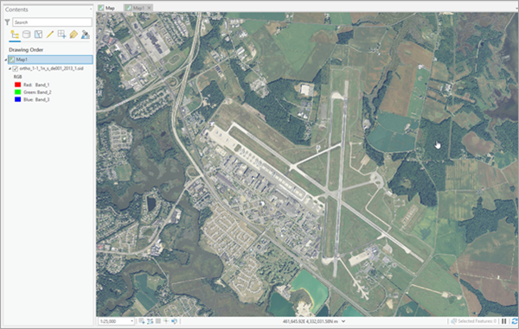
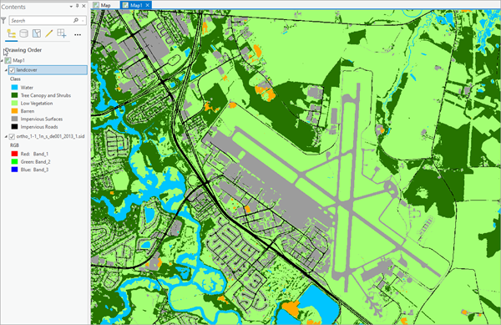
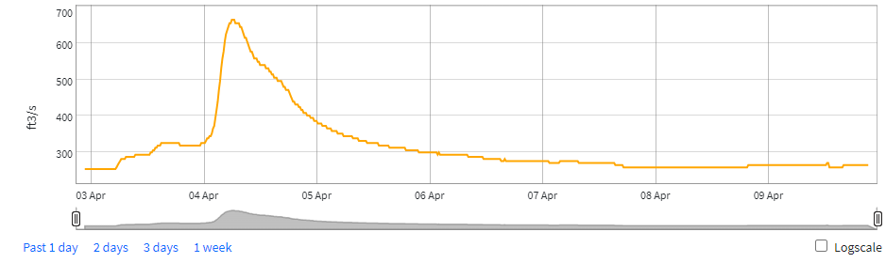
Using Deep Learning to Detect Land Cover Change and Correlate with Water Quality for the New River 2011-2021
Andrew Foy
Professor of Geospatial Science
Radford University

Slide 2
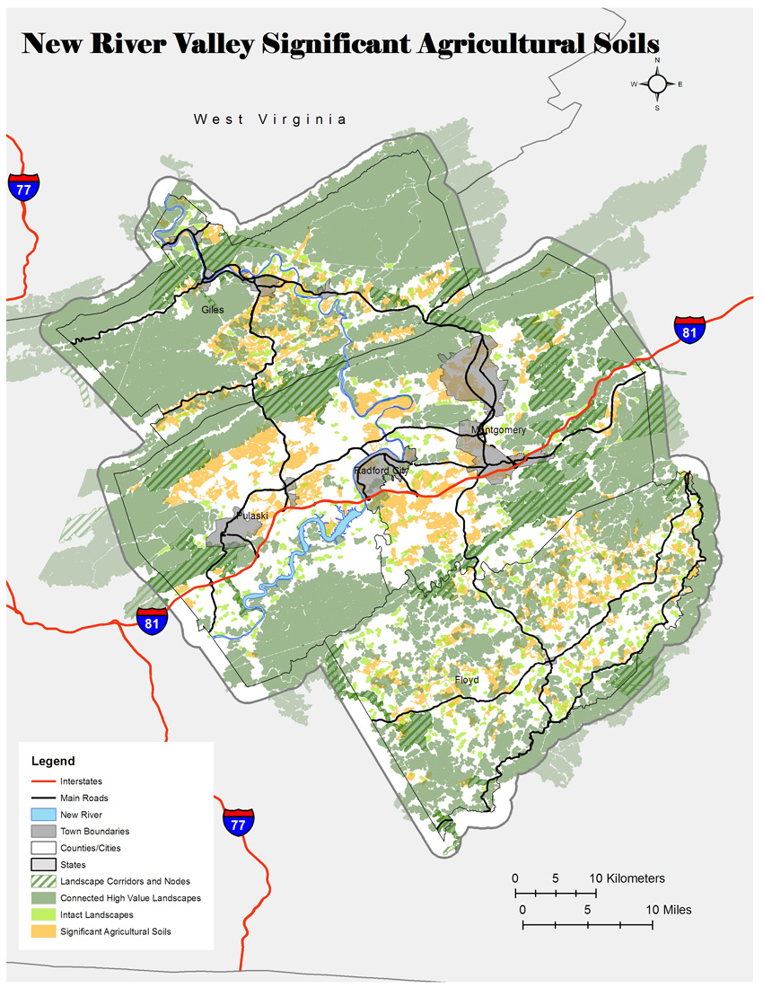
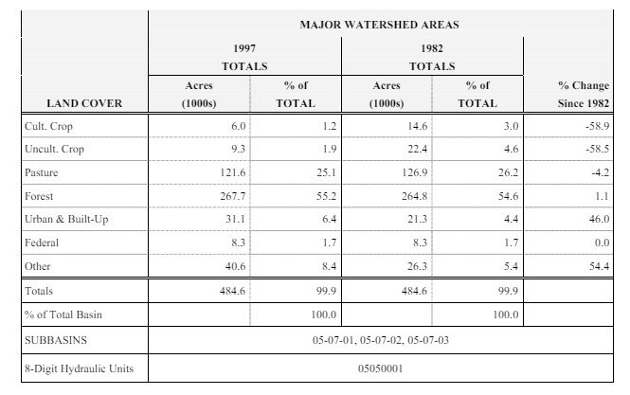
The land cover composition of a watershed is a critical multivariant factor that affects the water quality of a river system. There have been some studies on land cover change in the New River Basin, but most:
use low resolution satellite imagery
are not recent
and don’t directly correlate to water quality
https://files.nc.gov/ncdeq/Water%20Quality/Planning/BPU/BPU/New/New%20Plans/2005%20Plan/Appendix%20III%20Land%20Cover.pdf

Slide 3
Objectives:
Investigate landcover change in the New River-Peak Creek HUC10 (0505000115) from 2011-2021, using high resolution orthophotography and Deep Learning.
Demonstrate the applications for assessing the effects of landcover on water quality.
Review the observed benefits and limitations of using Deep Learning.

Slide 4
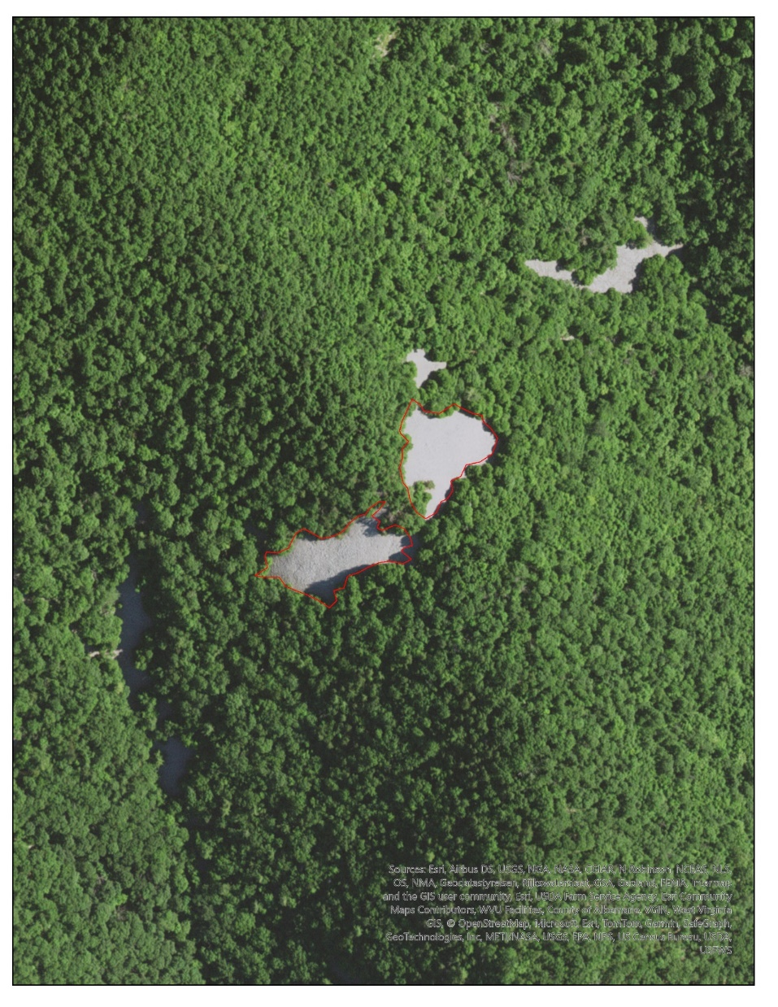
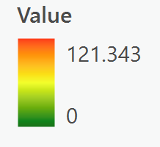
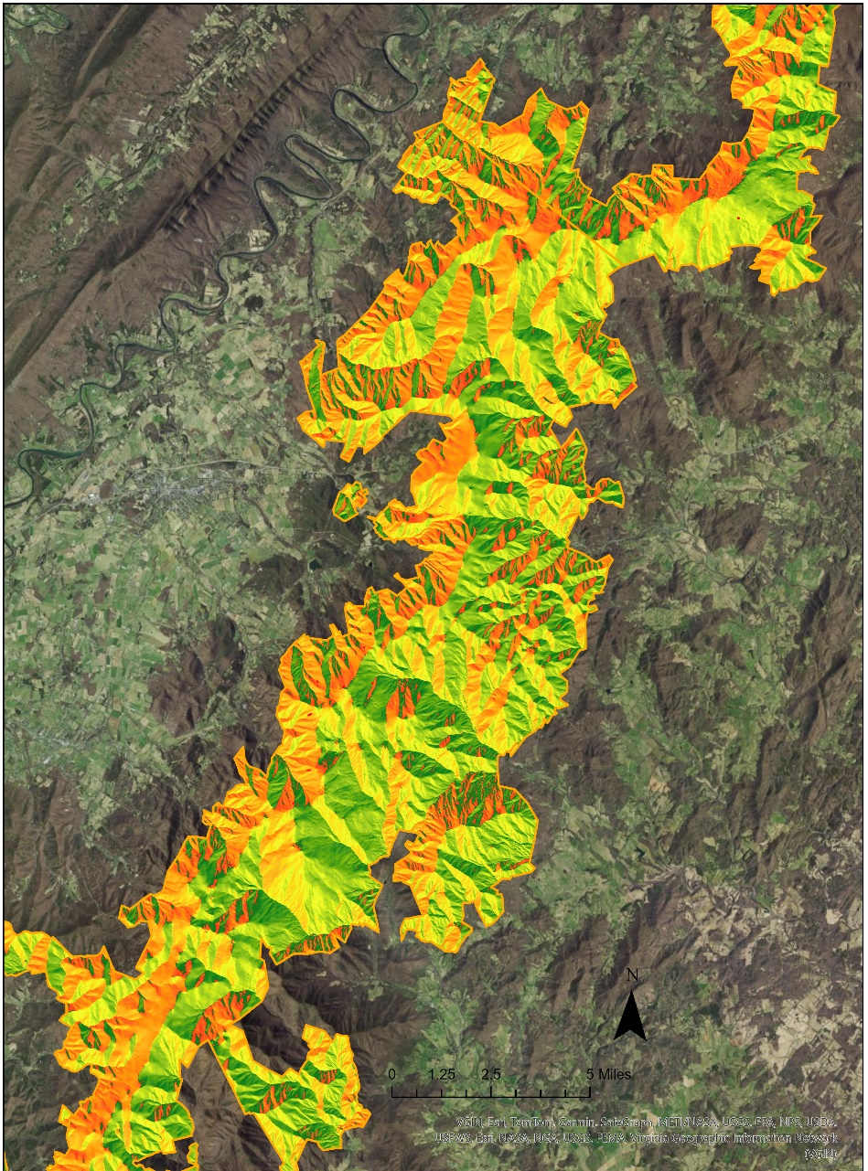
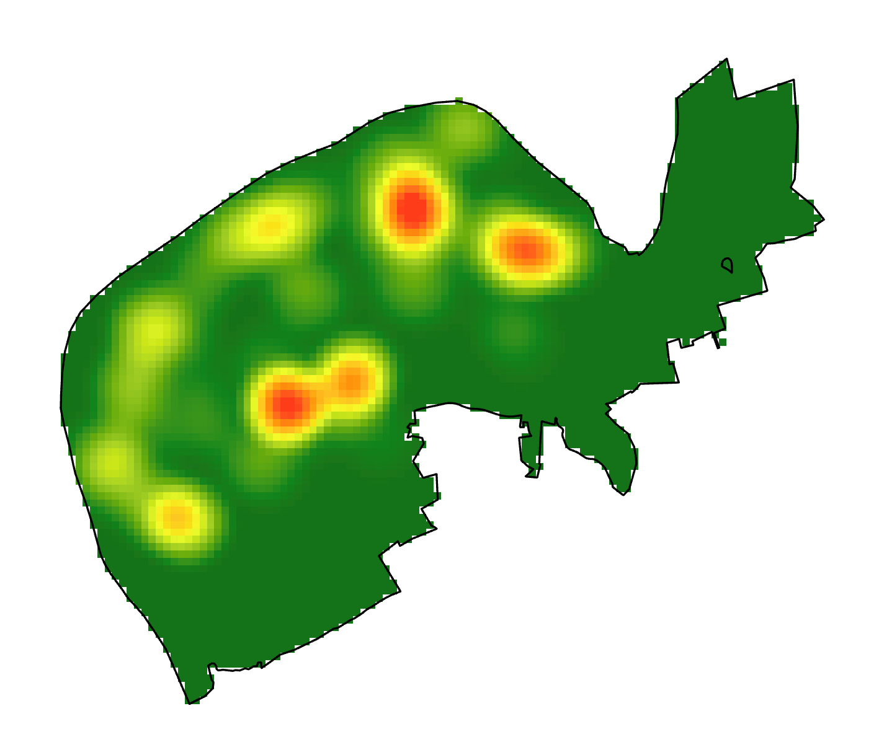
Why Deep Learning ?
DL & ML - Talus Slopes and Bat Abundance
ML - Retrospective Crime Prediction

Slide 5
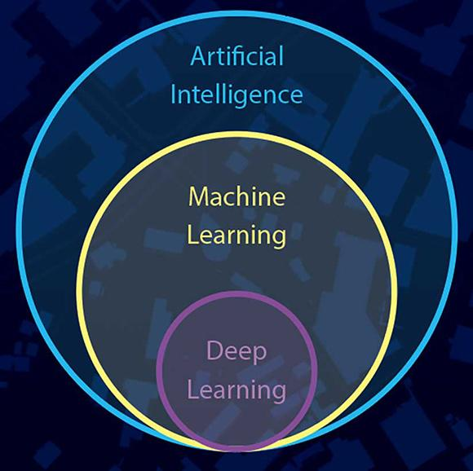
What is Deep Learning?
“Deep learning is a method in artificial intelligence (AI) that teaches computers to process data in a way that is inspired by the human brain” (AWS).
“ArcGIS pretrained deep learning models eliminate the need for huge volumes of training data, massive compute resources, and extensive artificial intelligence (AI) knowledge” (ESRI).
Segment Anything

Slide 6
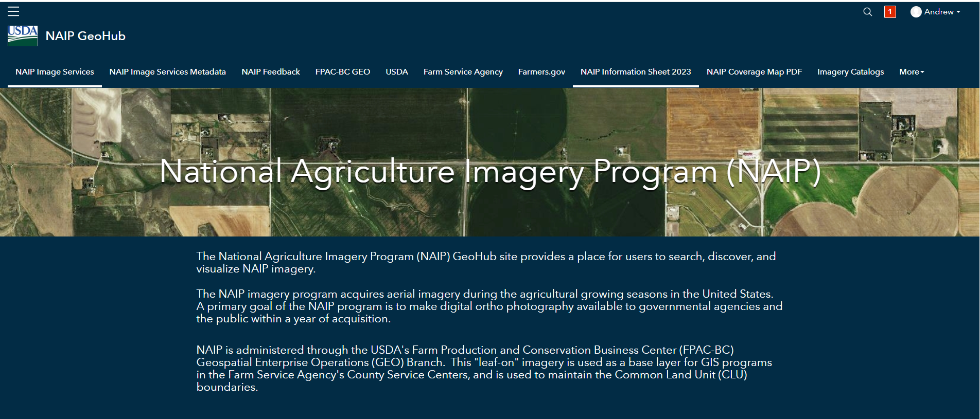
NAIP High Resolution Leaf-on Orthophotography
One meter resolution 2011; 0.6 meter resolution 2021
Two year intervals
Three or four bands – R, G, B and NIR

Slide 7
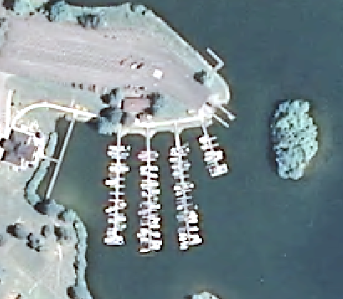
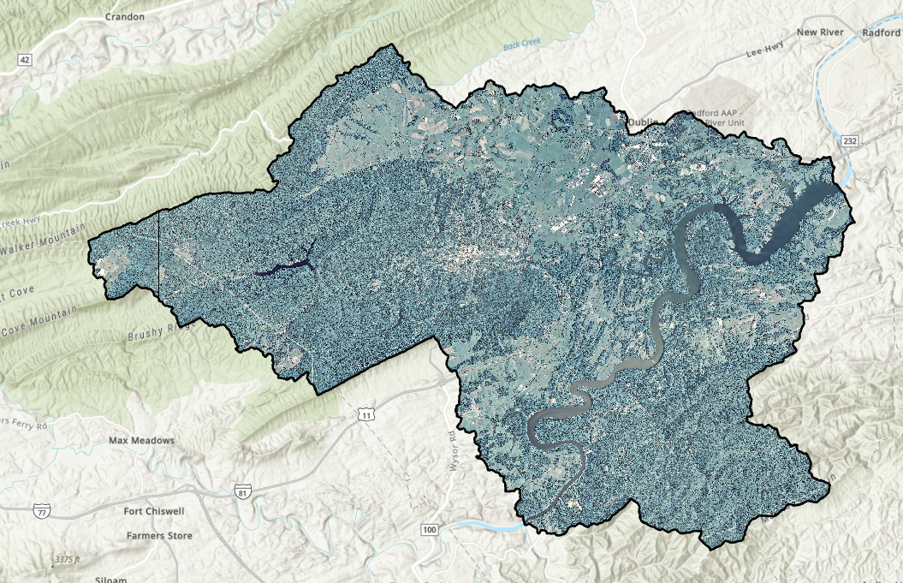
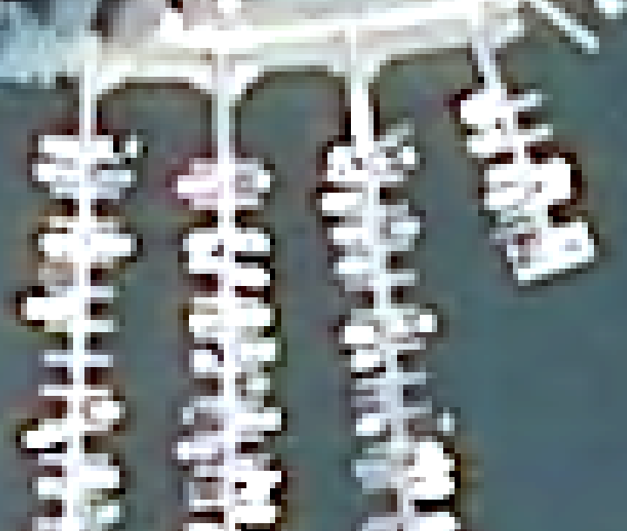
HUC 10 Surrounding Claytor Lake 2011

Slide 8
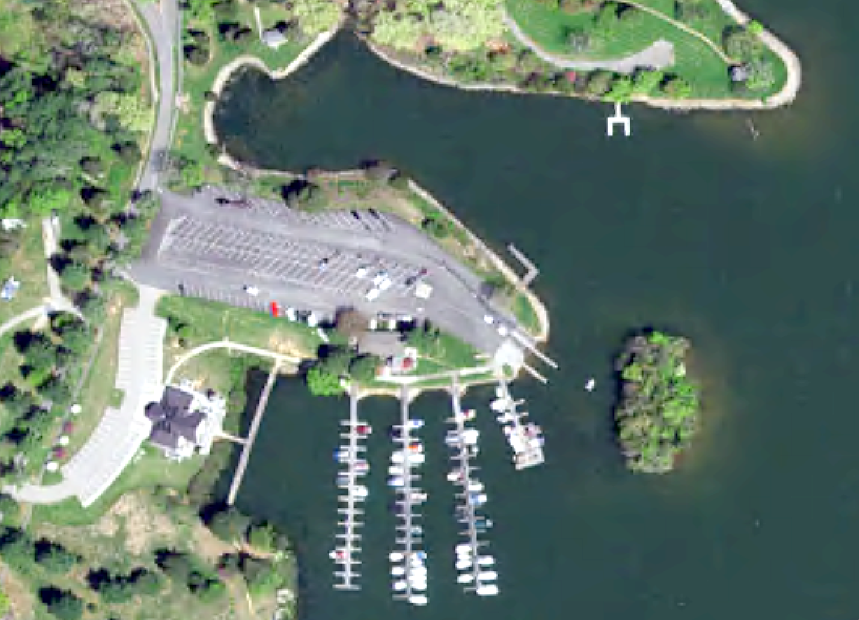
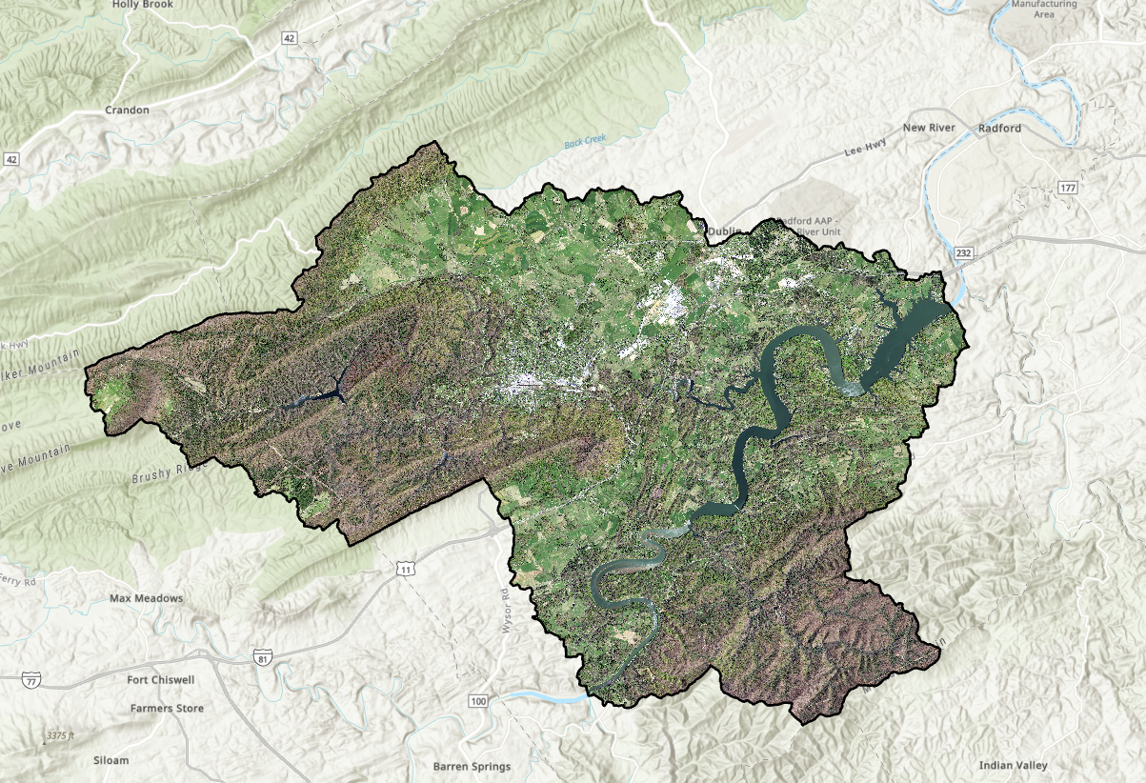
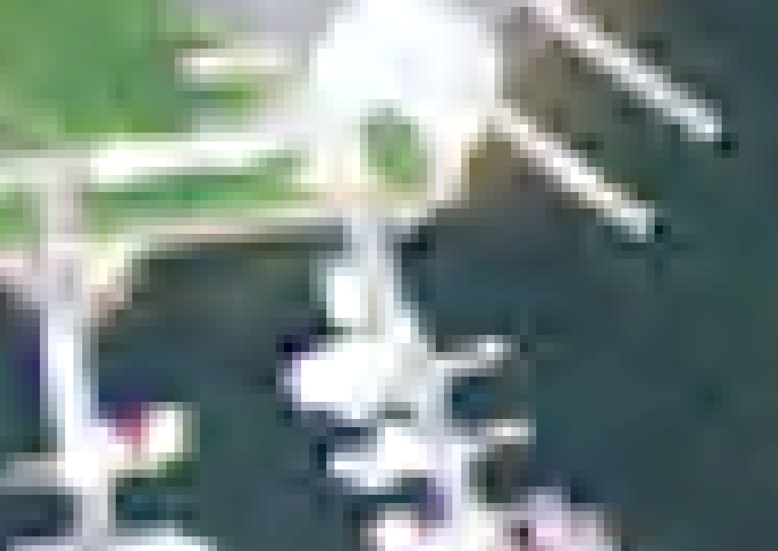
HUC 10 Surrounding Claytor Lake 2021

Slide 9
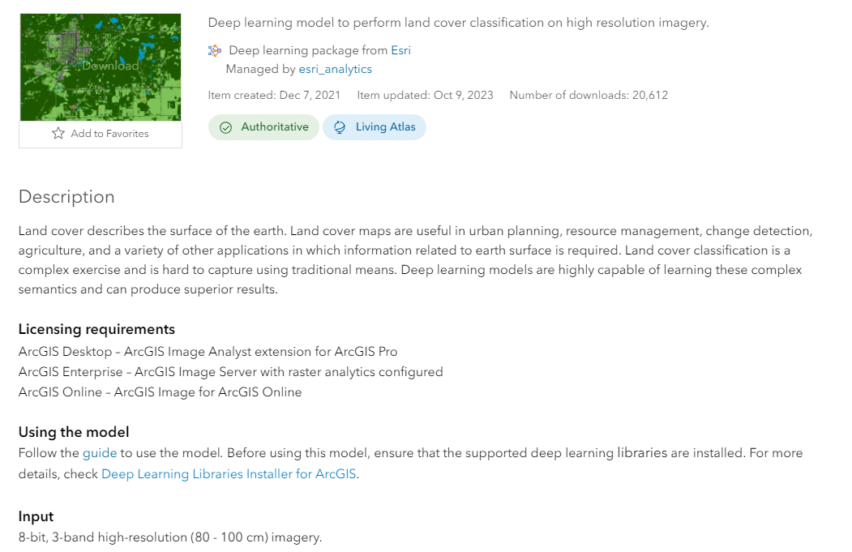
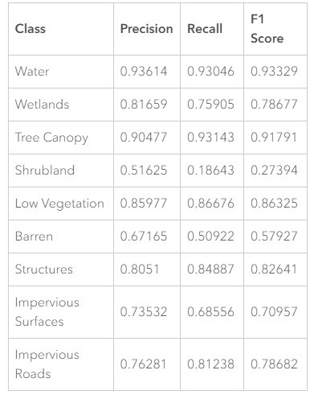
ESRI Deep Learning Pretrained High Resolution Land Cover Classification Model - USA
https://ru-geospatial.maps.arcgis.com/home/item.html?id=a10f46a8071a4318bcc085dae26d7ee4

Slide 10
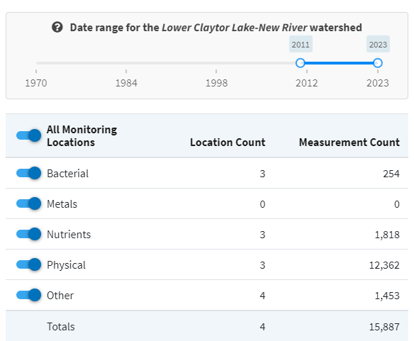
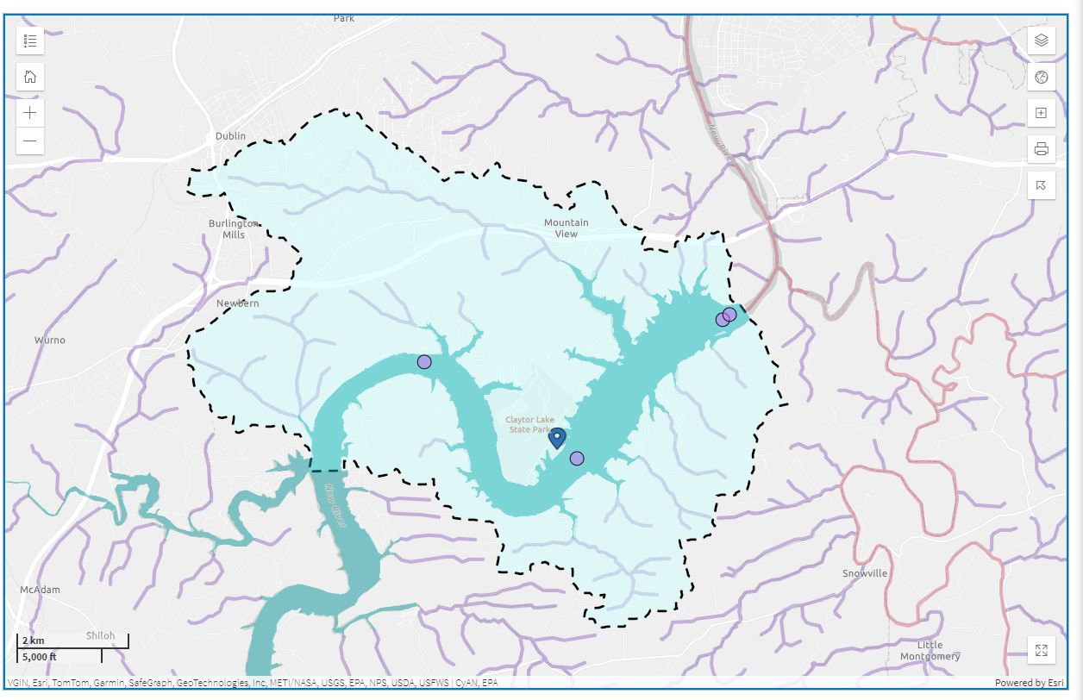
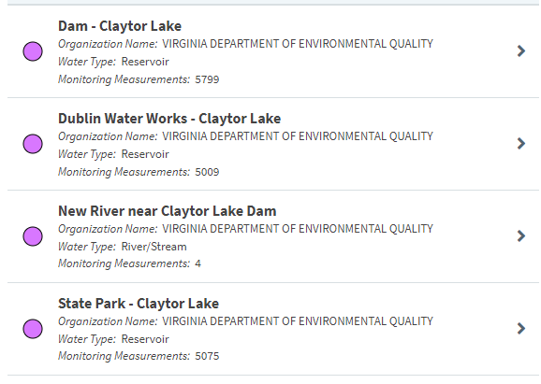
EPA – How’s My Waterway

Slide 11
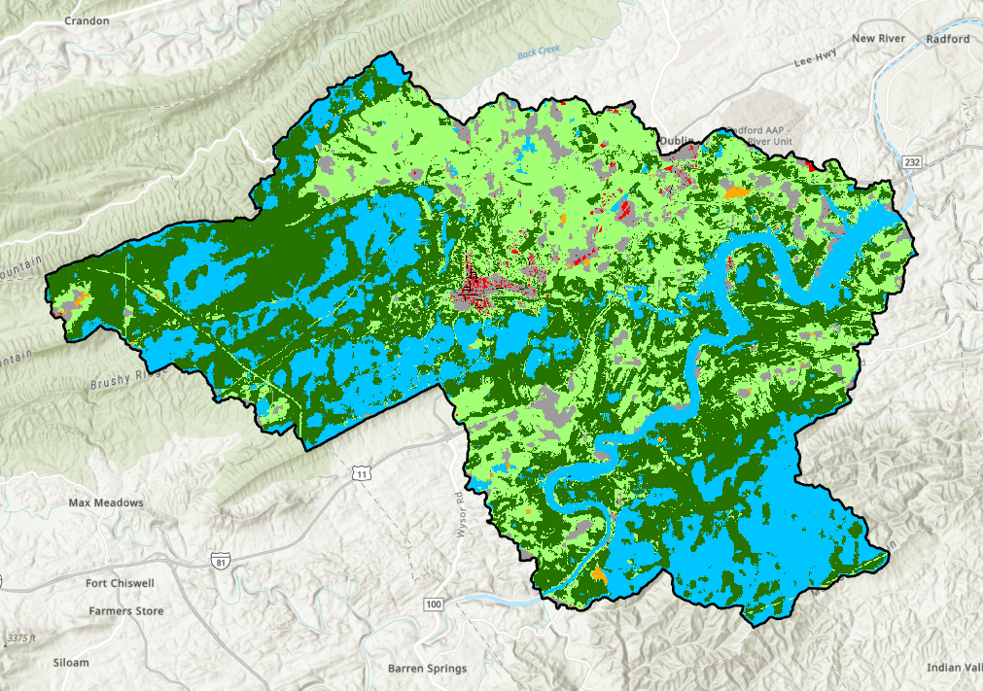
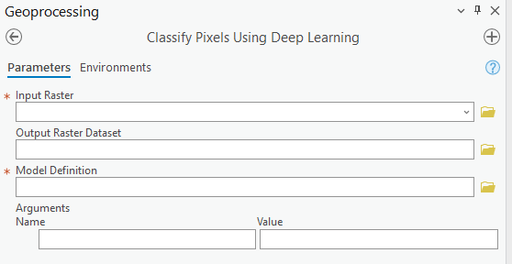
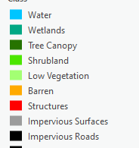
HUC 10 Land Cover Classification Failure - 2011
Why does this not meet model specs ?
  Resolution
  Topography
  Temporal
  Climate Change
  Randomness

Slide 12
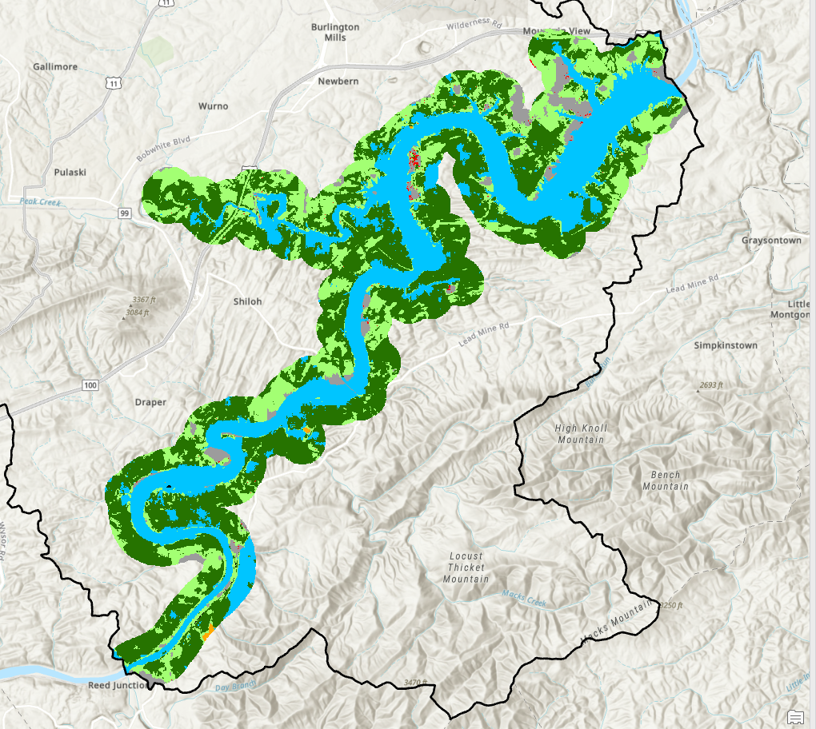
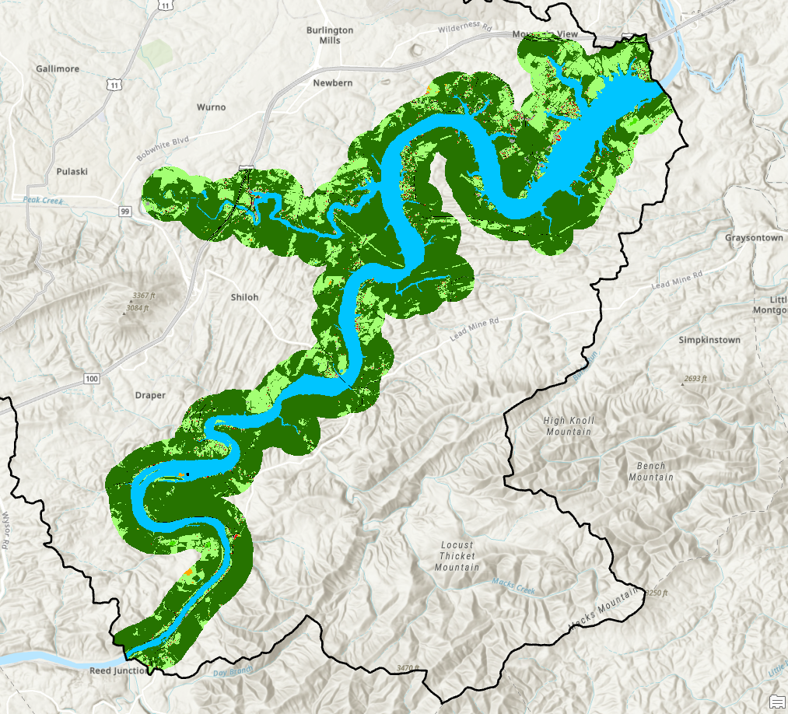
A visual comparison of Landcover 750 m. riparian zone 2011 - 2021
2011 - Over predicted water, indiscriminate of impervious surfaces
Meets or exceeds error metrics of the DL model (86.5% accuracy)

Slide 13
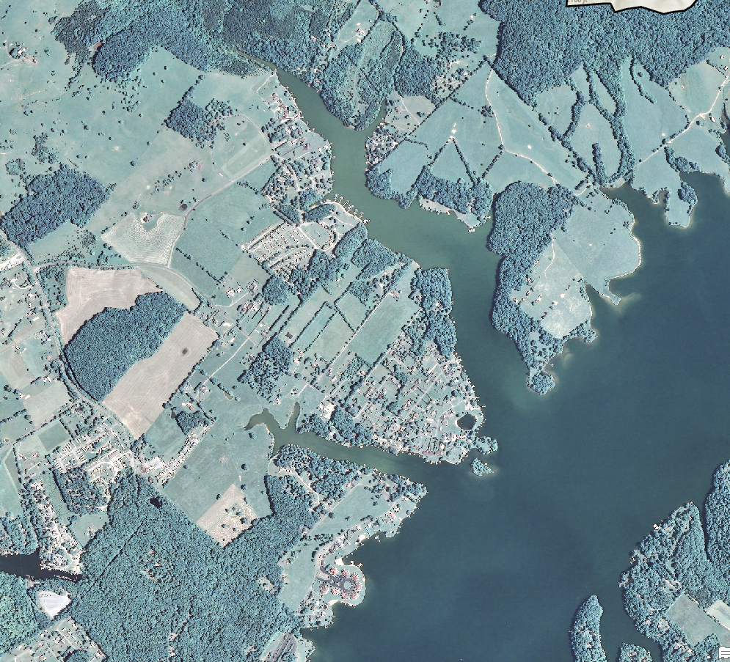
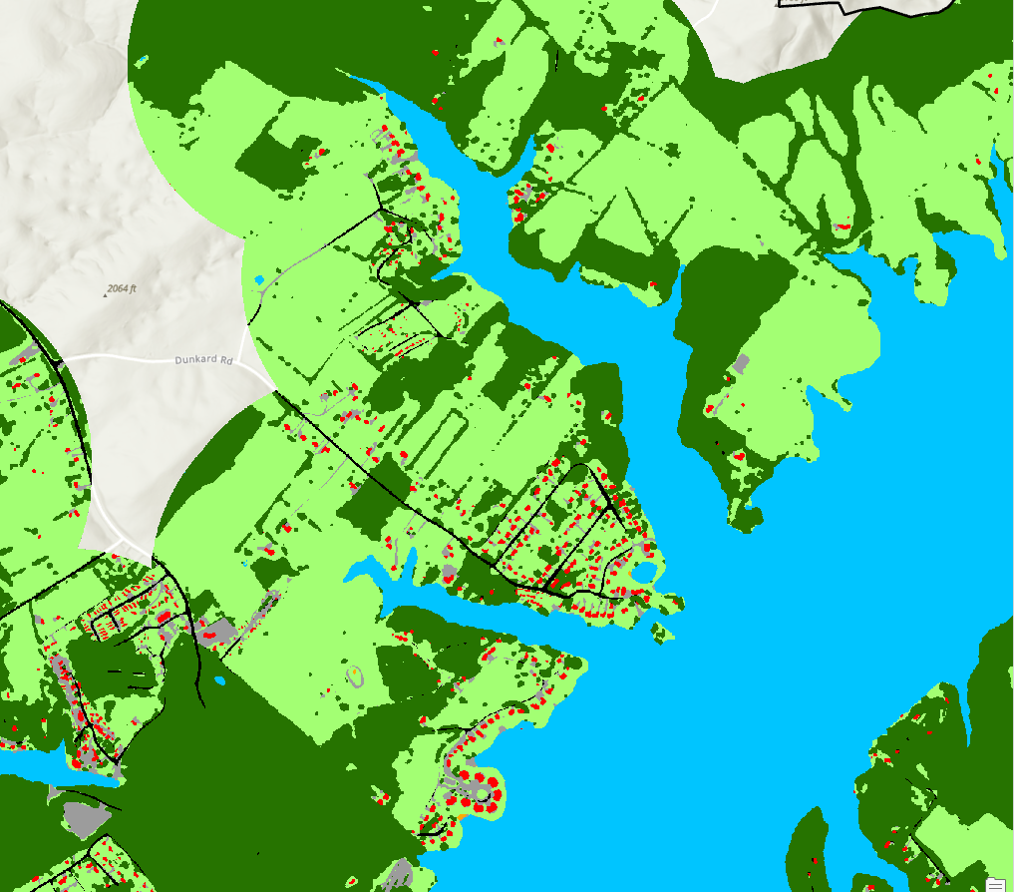
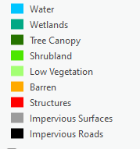
Example of the DL Pixel Classification results for Claytor Lake - 2021

Slide 14
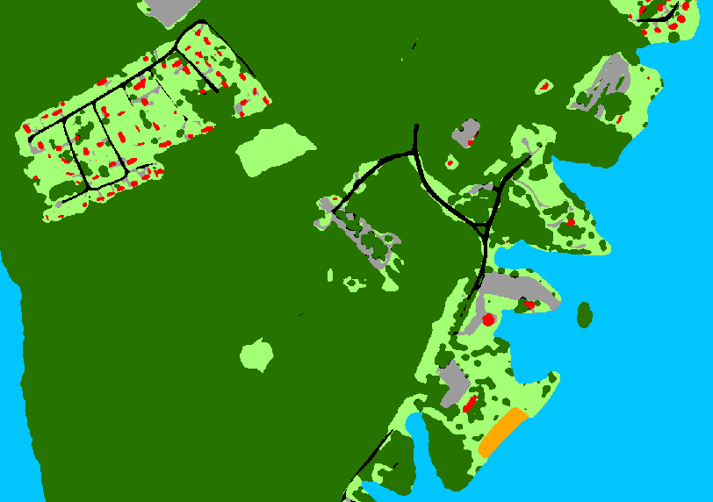
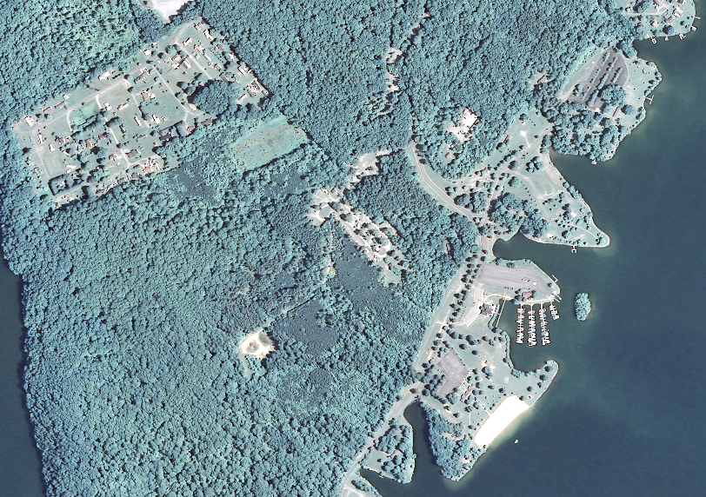
Example of the DL Pixel Classification results for Claytor Lake State Park- 2021

Slide 15
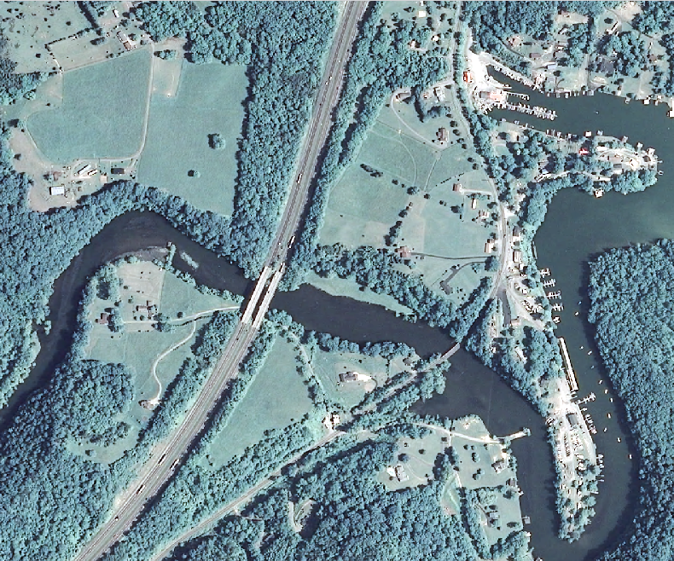
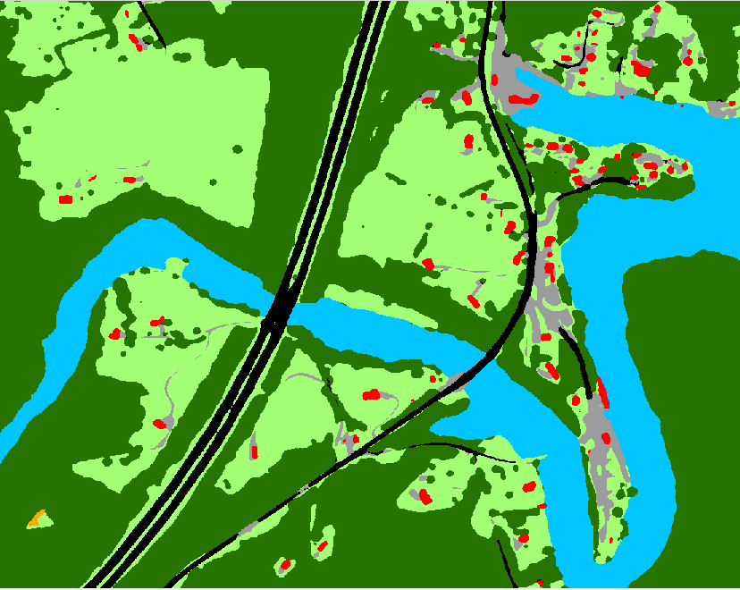
Example of the DL Pixel Classification results for Peak Creek - 2021

Slide 16
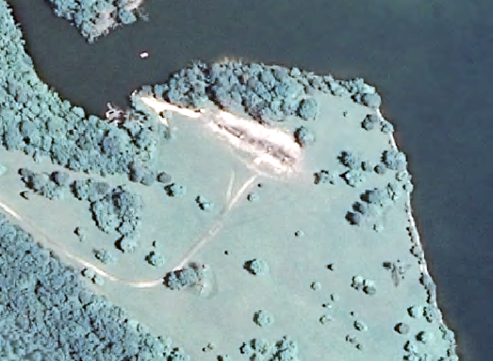
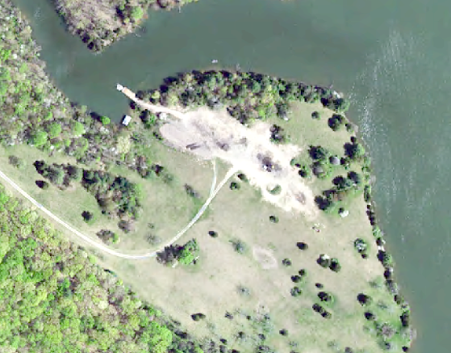
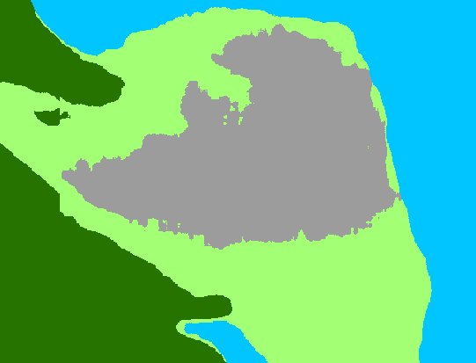
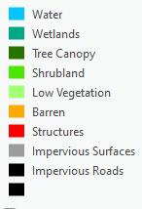
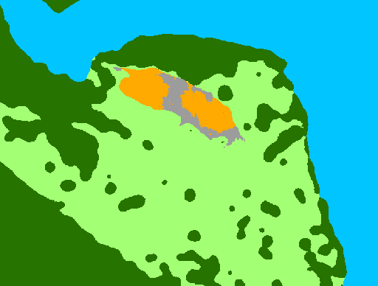
2011
2021

Slide 17
Land Cover Composition
Value | Class | 2011 Percent LC | 2021 Percent LC
1 | Water | 29.78 | 23.02
2 | Wetlands | NA | 0.00
3 | Tree Canopy | 42.86 | 56.09
4 | Shrubland | NA | 0.06
5 | Low Vegetation | 22.87 | 18.49
6 | Barren | 0.09 | 0.10
7 | Structures | 0.15 | 0.76
8 | Impervious Surfaces | 4.2 | 0.66
9 | Impervious Roads | 0.05 | 0.65

Slide 18
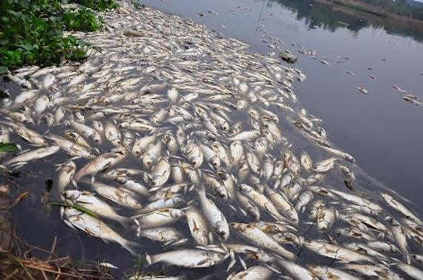
So, the land cover modeling is not suitable for change detection. Let’s explore the dynamics of water quality and explore future opportunities.
Ammonia is the only variable with a statistically significant difference (p<0.05) between sites. Let’s explore the data

Slide 19
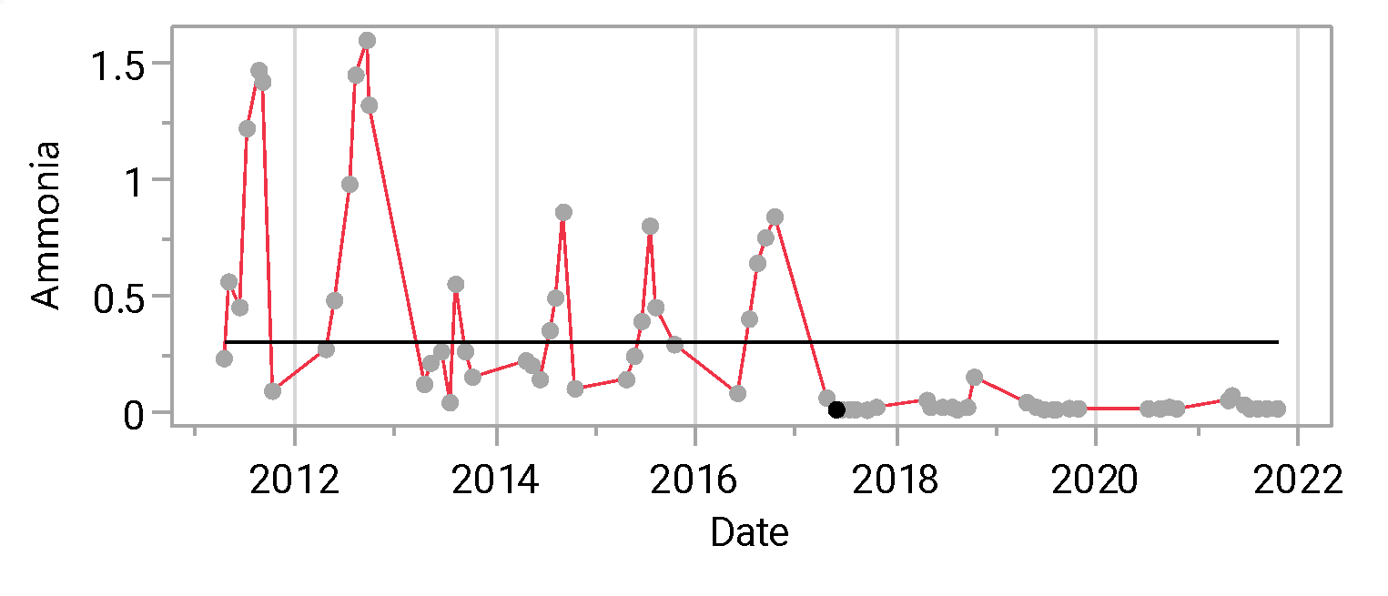
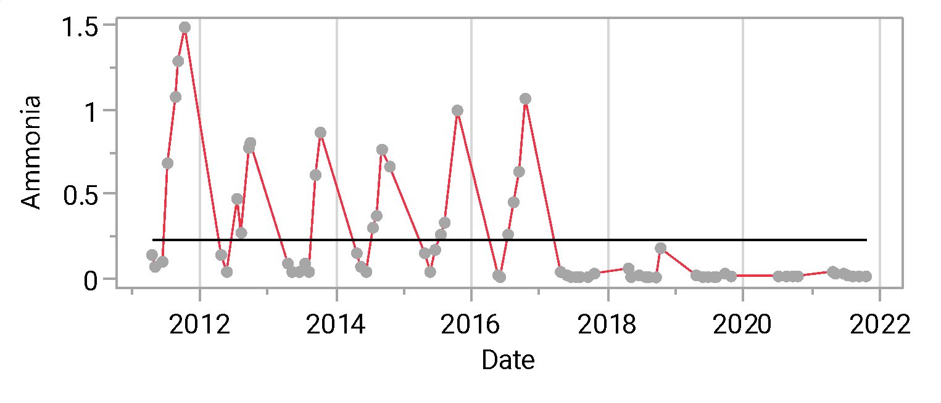
Ammonia mg/L 2011 - 2021
Peaks in September/October
Seasonal variation – stops in 2017
At elevated levels ammonia causes direct toxic effects on aquatic life

Slide 20
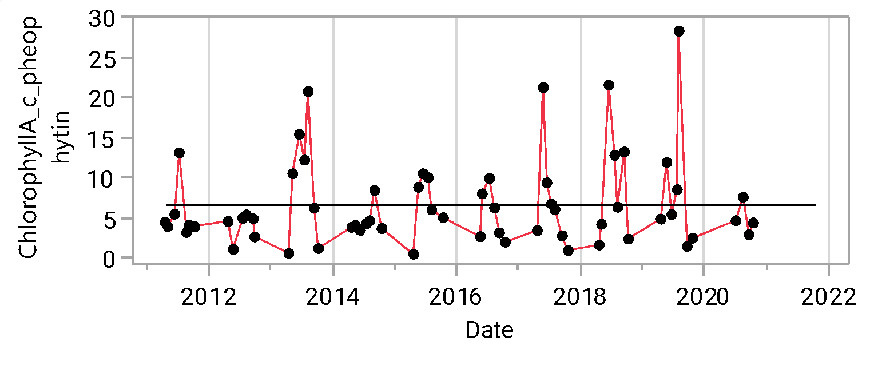
Chlorophyll A corrected for pheophytin

Slide 21
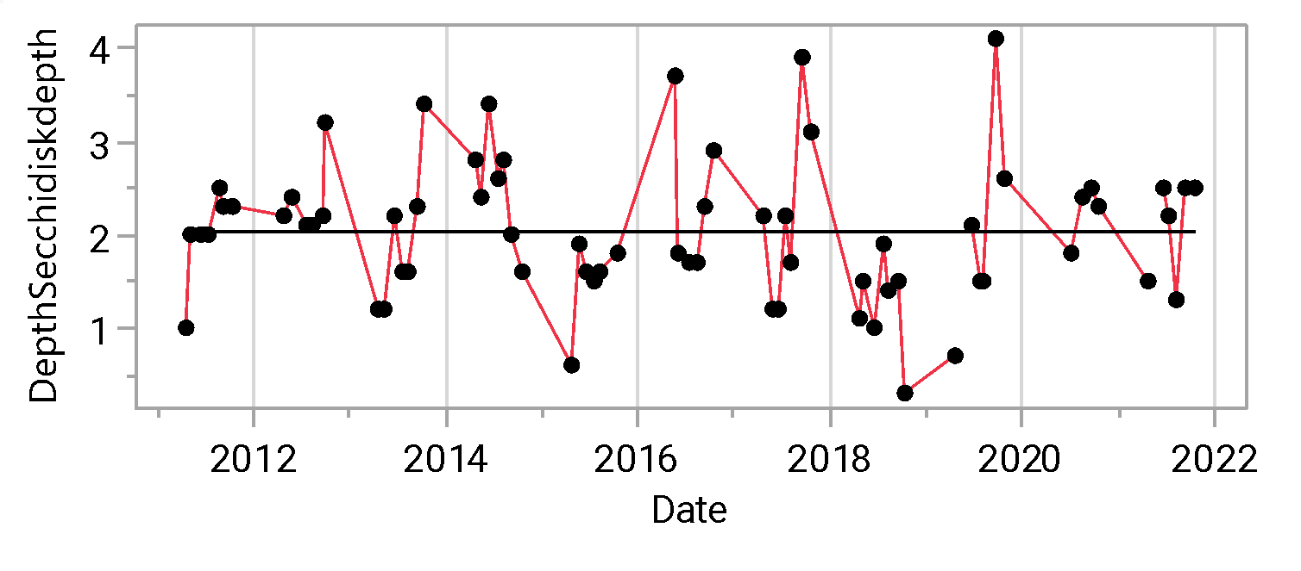
Secchi disk depth

Slide 22
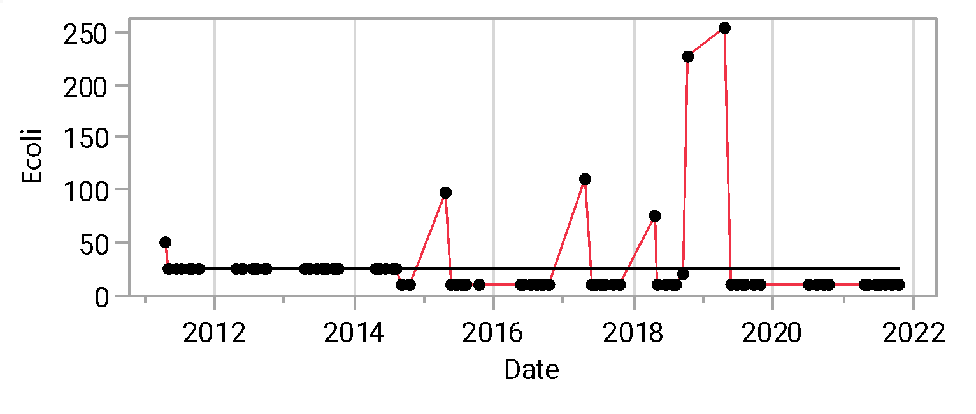
Escherichia coli

Slide 23
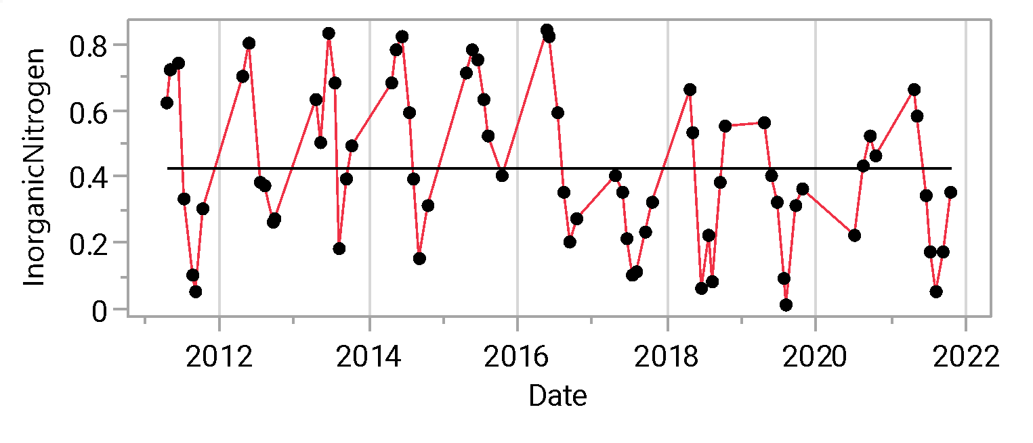
Inorganic Nitrogen

Slide 24
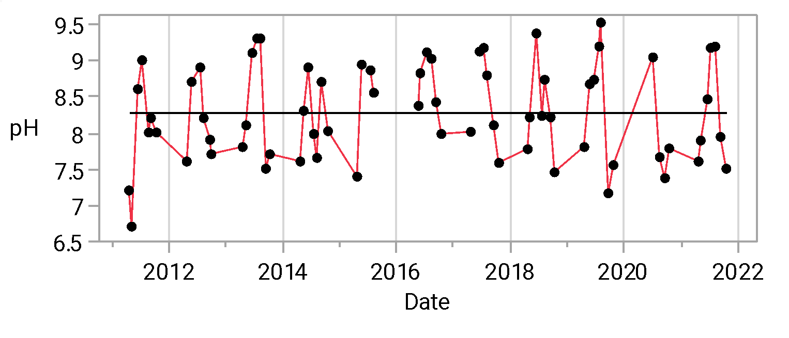
pH

Slide 25
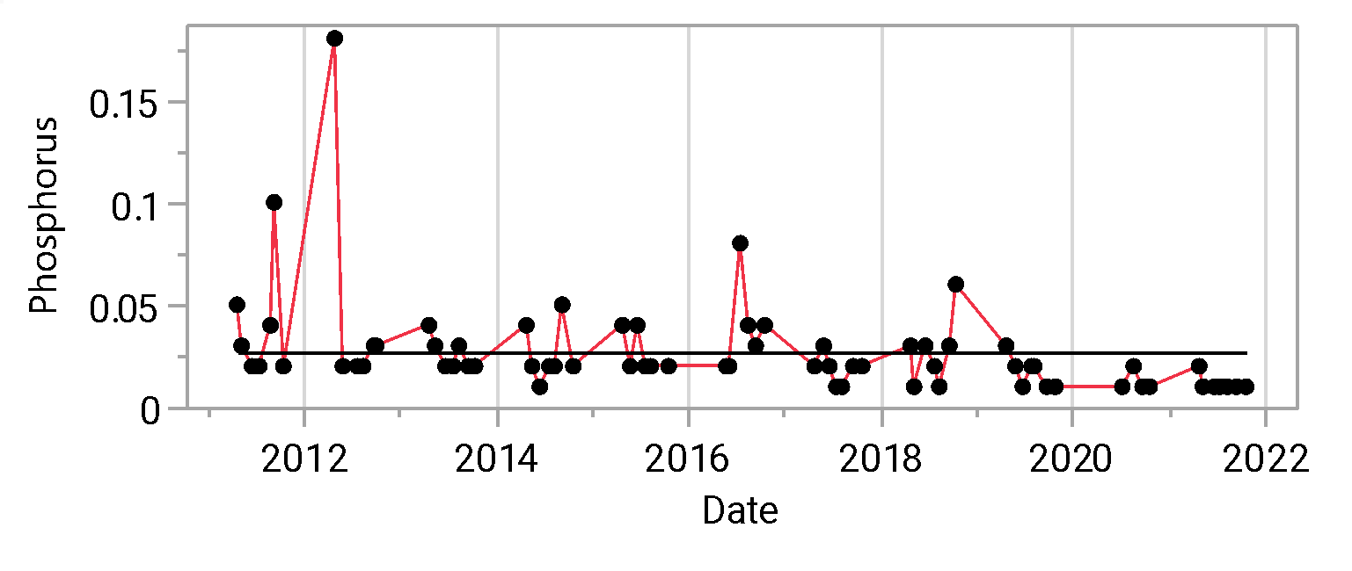
Phosphorus

Slide 26
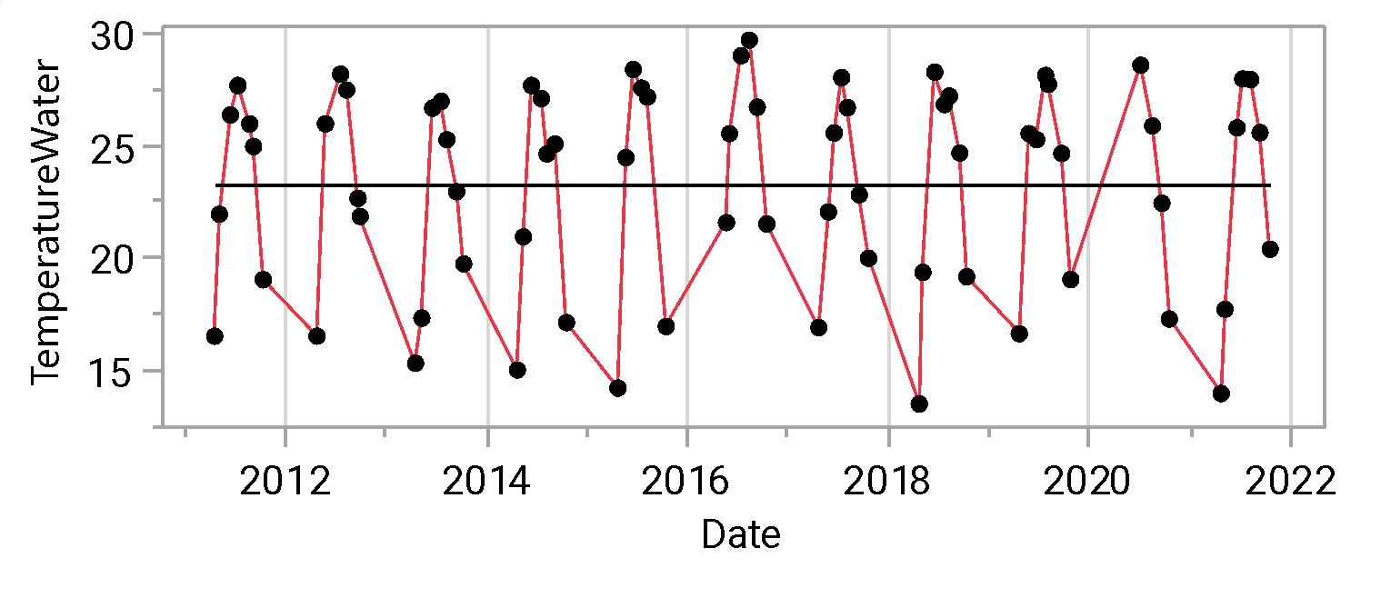
Temperature

Slide 27
Discussion
Deep learning has it challenges, but with good data and time it produces excellent remote sensing products
Due to lack of change detection results and relatively stable water quality it was not possible to do any quantitative analysis on the data
The water quality monitoring for this HUC is not great
Need to work together – citizen science – work with FCOL and others

