Slide 1
ETDseer
Final Term Term Project Presentation
Yufeng Ma, Tingting Jiang, Chandani Shrestha
CS 6604 - Digital Libraries
Virginia Tech, Blacksburg, VA, 24061
Professor Edward A. Fox
April 27, 2017

Slide 2
Overview
Problem Statements/Motivation
Related Works
      NDLTD
      CiteSeer
Stakeholder Overview
Architecture
Scenarios and Services
  Workflow example
Structured Data Extraction
ETD Segmentation
Table & Figure Extraction
Reference Extraction
Text Summarization
Network Visualization
Working On…

Slide 3
Background
Problem Statements
ETDs as international resource- extensive potential
Largely Untapped
Limitation in existing related tools
  Document length, Document accessibility (Full Text)
  Summarization, Visualization
Challenges working with ETDs
Need for enhanced usability
Motivation
Rich knowledge base - Single platform
Accessible to broader group of users
Network of institutional repositories

Slide 4

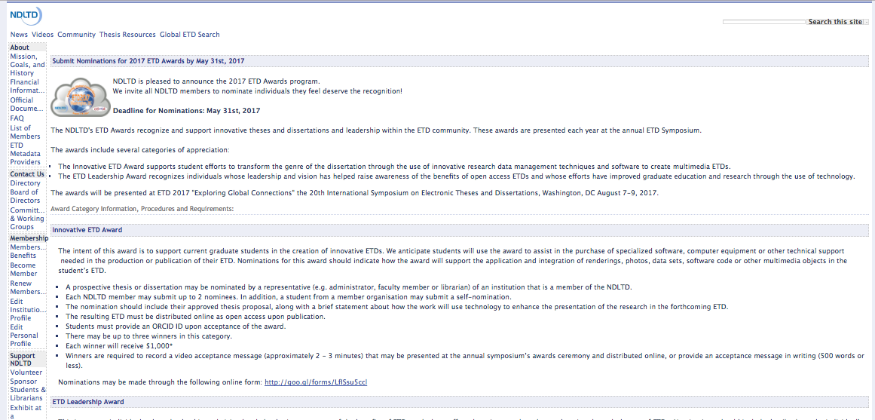
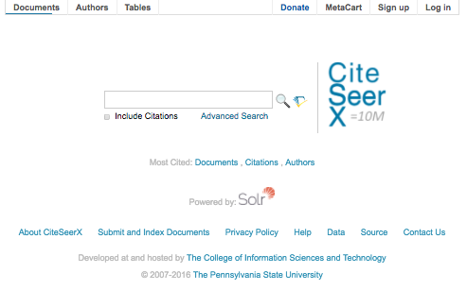
Related Works
NDLTD
VTechworks
CiteSeer
ContentMine
VTechWorks
NDLTD
CiteSeerX

Slide 5
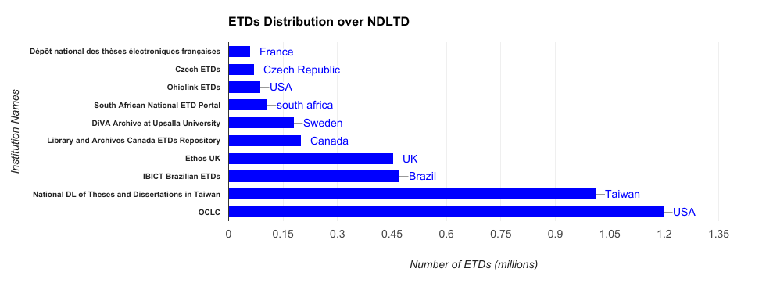
NDLTD
ETDs Statistics
Functional Limitations
  Categorization Missing
  No Full Text Access
Notes:
Statistics of ETDs from various disciplines
Lack of department facet
Histograms or
UML diagram

Slide 6
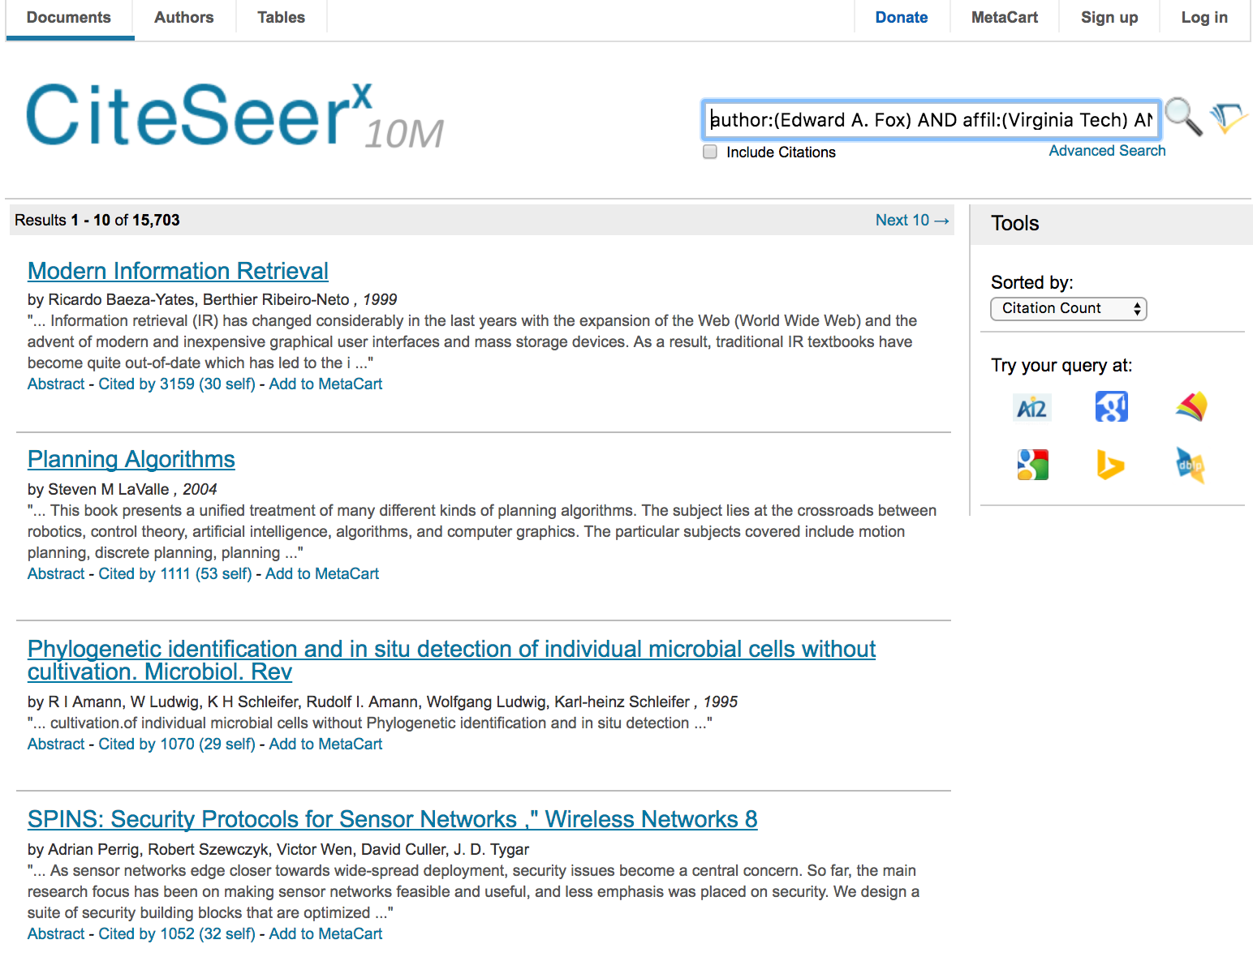
CiteSeerX
Data: Make use of Metadata
Technologies: SeerSuite tools
  Automatic citation indexing
  Automatic metadata extraction
  Reference linking
  Author disambiguation
  Related documents
  Full-text indexing

Slide 7
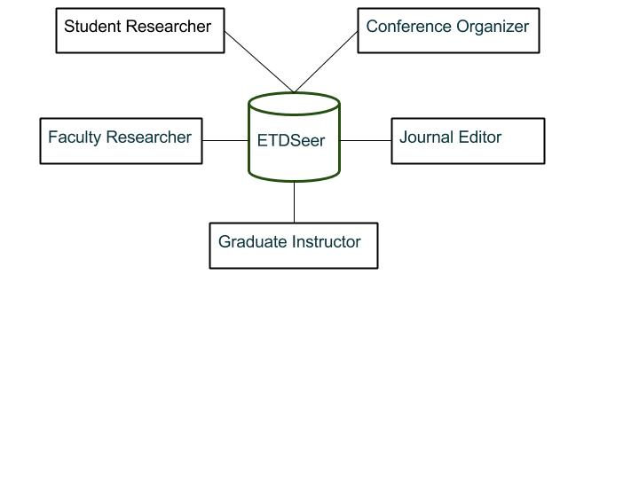
Stakeholders Overview

Slide 8
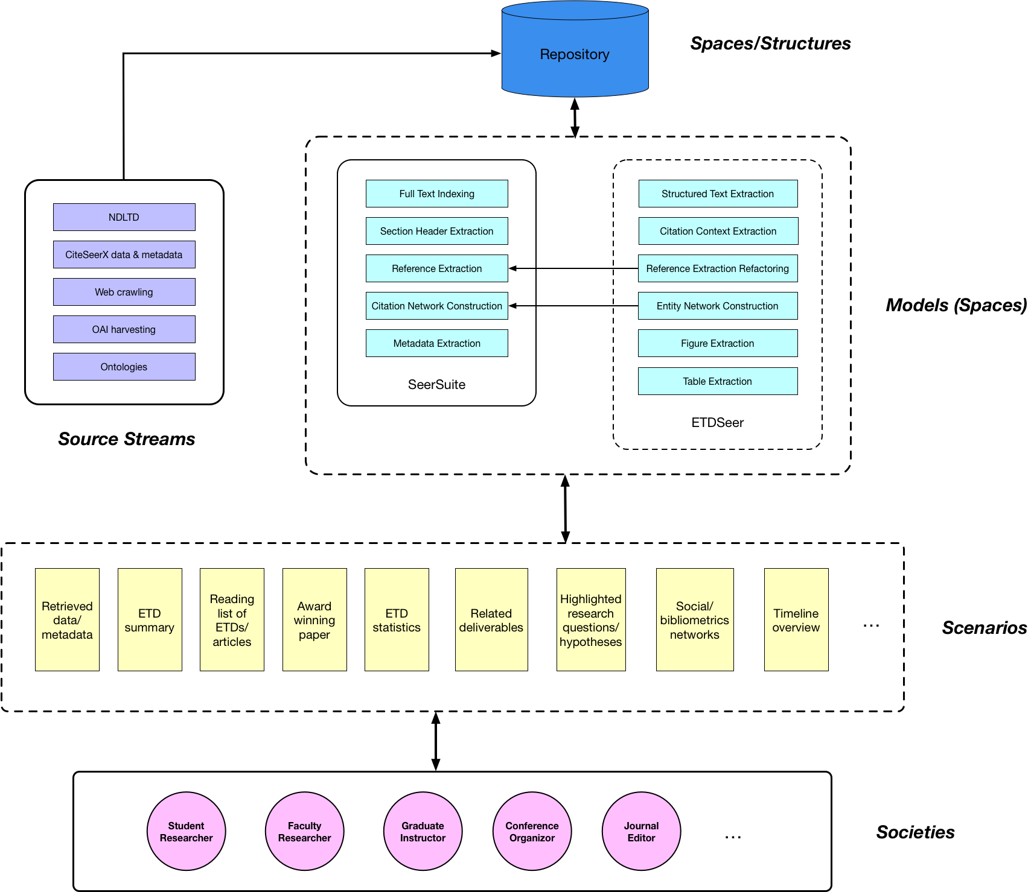
Architecture

Slide 9
Scenario 1 - Student Researcher
Requirements | Key techniques | Expected Outputs
Metadata-based search | SeerSuite | Specific ETDs within a date range Specific ETDs with an advisor name
Research interests discovery | Structured text extraction | Desired ETDs with quality scores Research questions/hypotheses highlighted
Reference extraction | Structured text extraction | Related ETDs/books/articles/papers Tabular/Canonical representations Downloadable package of related work Lists of journals/conferences
Linking of problems with methods | Text extraction | Different methods for a problem A site with detailed resources An award winning paper (outline/draft)
ETD analysis and study aids | Deep learning | ETD content summarizations Figures, tables and equations Key sections and list of related problems Visualizations (social/bibliometrics networks) Timeline overview of evolutionary work

Slide 10
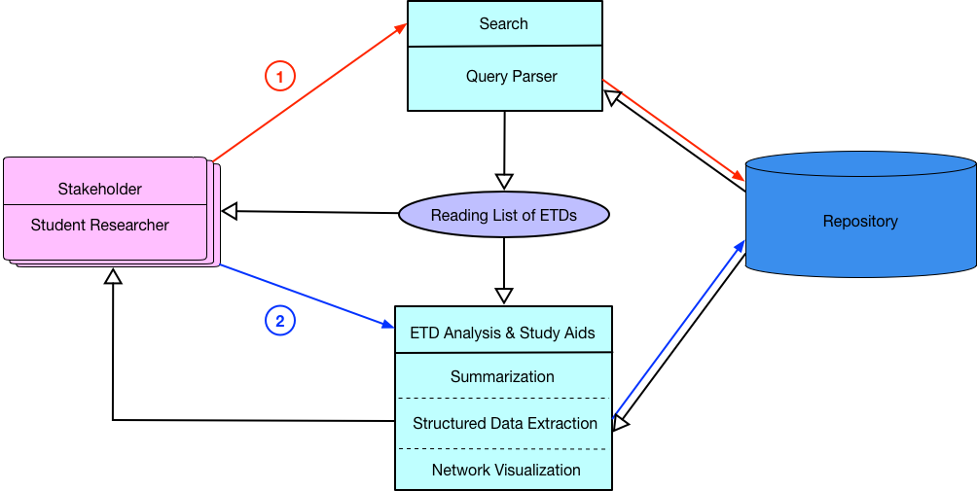
An Example Workflow

Slide 11
Other Scenarios
Stakeholder | Requirements | Expected Outputs
Faculty Researcher | Research problem exploration aid | Synthesis of related ETDs Proposed approaches/solutions Future works summarization
Graduate Instructor | Graduate course syllabus formulation | Draft with a hierarchical topical outline Link to each topical entry with a reading list
 | Advanced topic, lecture preparation | Slides cover research questions/problems Synthesis of provided potential solutions

Slide 12
Other Scenarios
Stakeholder | Requirements | Expected Outputs
Conference Organizer | TPC member identification | List of advisor research faculty names Ranking table of advisors
 | Potential participants identification | Subgraph of ETD-derived citation graph CSV file of author names, contact info.
Journal Editor | Peer-reviewer identification | Research interest-based reviewer list
 | Content originality check | Previous publications of the authors Estimated percentage of the new content/work

Slide 13
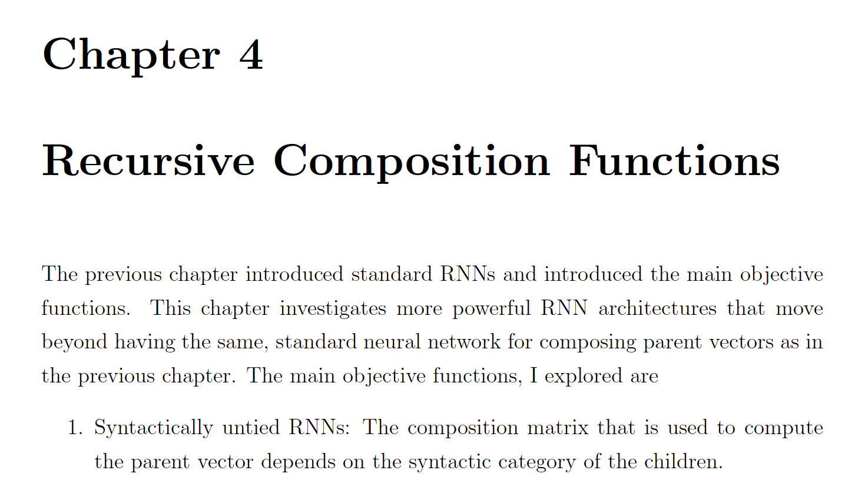
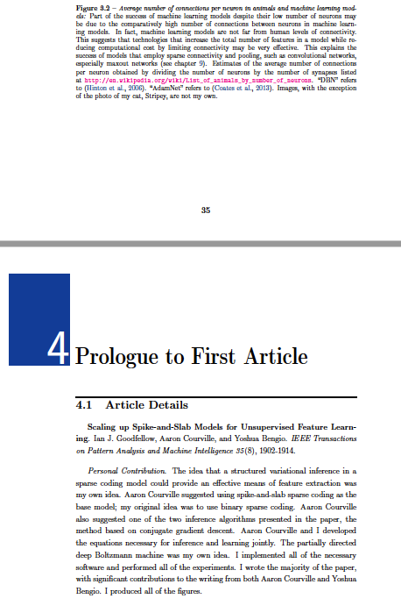
Structured Data Extraction:
ETD Segmentation
Heuristics-based strategy
  Start with ‘Chapter’ or ‘CHAPTER’
  Font size and style
Deep learning approaches
  Treat every two pages as one image
  Manually label each image - chapter breaking point or not
  Build a CNN model for classification

Slide 14
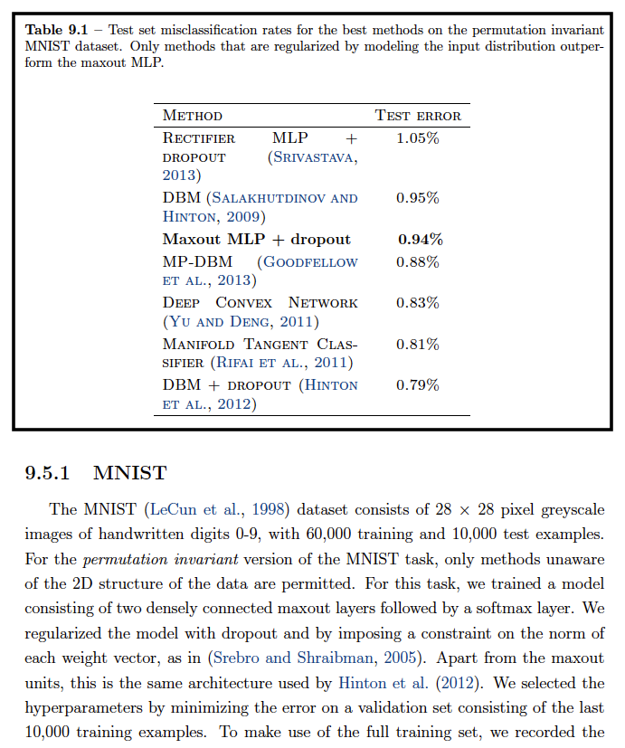
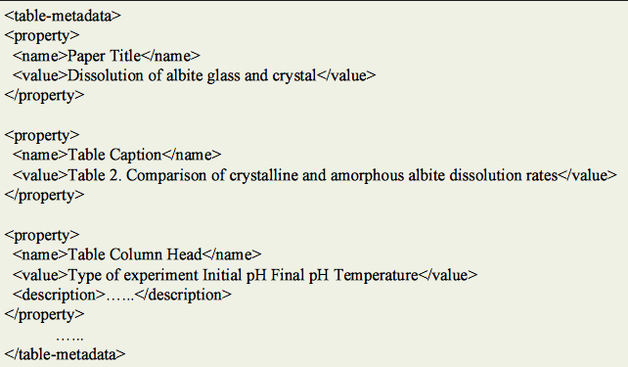
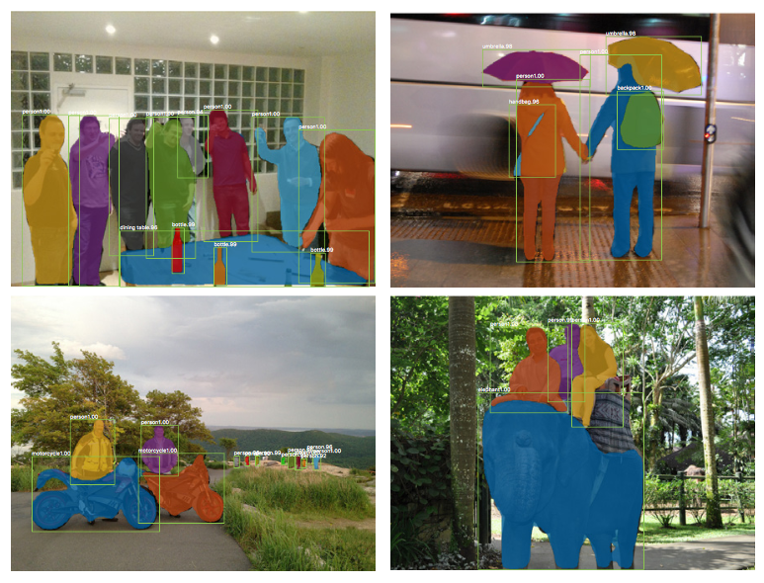
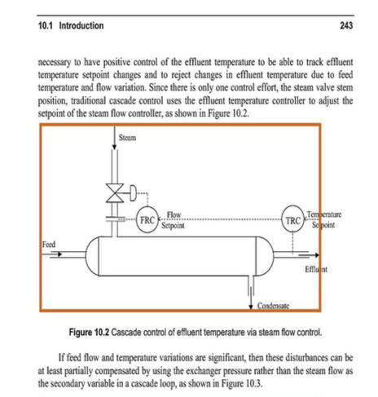
Structured Data Extraction:
Table & Figure Extraction
Extend work from TableSeer
  Table box detection
  Table metadata extraction
  Deal with styles of more disciplines
Figure Extraction
  Sagnik Ray Choudhury’s work
  CNN based approach - Mask R-CNN
  AMT for figure labeling
* K. He, et al., Mask R-CNN. arXiv, 2017.
* Y. Liu, et al., TableSeer, JCDL 2007.
* S. R. Choudhury, et al., An Architecture for information extraction from figures in DLs, WWW, 2015.

Slide 15

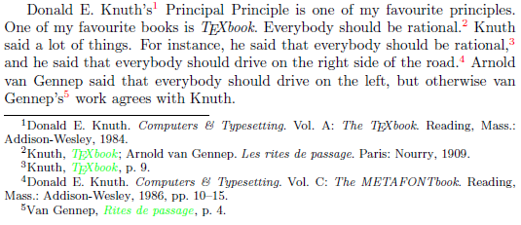
Structured Data Extraction:
Reference Extraction
References that appear at the end
  SeerSuite
References that appear anywhere like footnotes
  Deep learning for learning reference features
  Classifier will be trained
Represented in canonical format like BibTeX

Slide 16
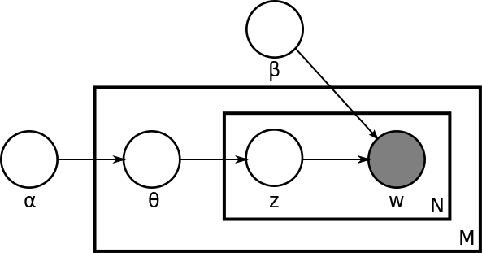
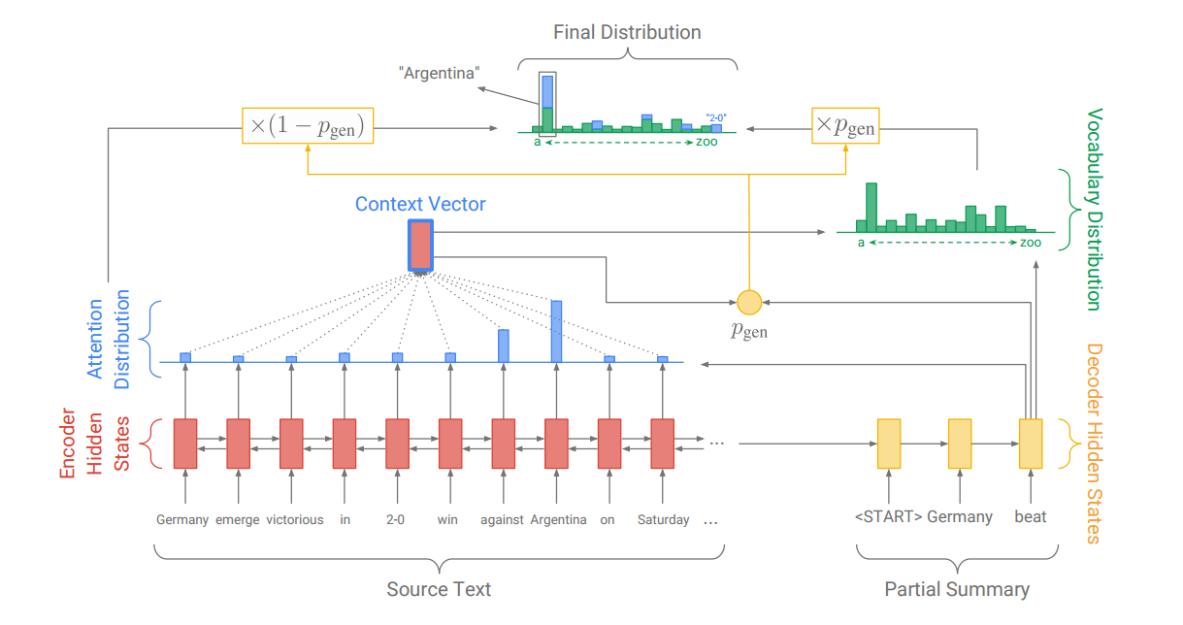
Text Summarization
Topic modeling based approach
  Extracted keyword or phrase
  Probabilistic graphical model
Deep learning approach
  Complete sentence
  Attention model
  Pointer & Generator

Slide 17
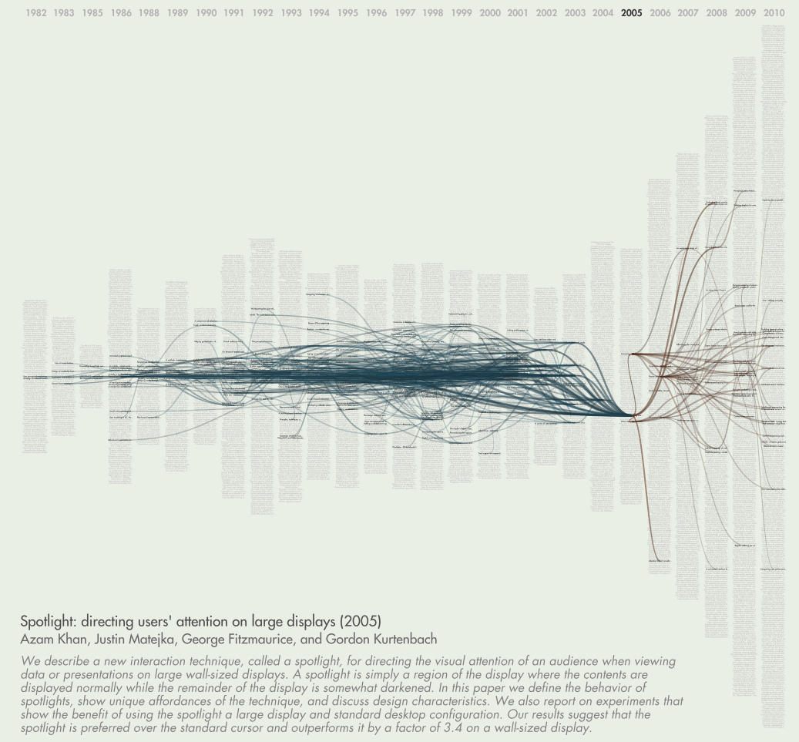
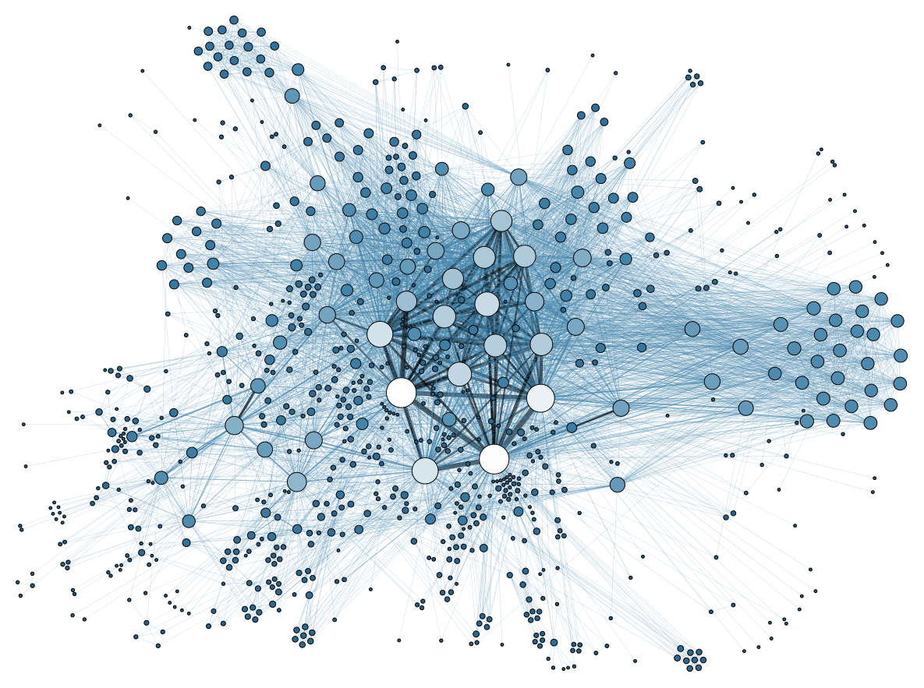
Network Visualization
Reference Network
  Given one ETD, citation relationship between papers and ETDs is visualized
Social Network
  Collaboration strength between research groups
  Author social network

Slide 18
Working on…..
User Study- based on the prospective Stakeholders
  Questionnaires to reach broader audience
  Interview (Focus group)
  Hands on use and feedback
Analysis of the collected data
Presentation/Discussion of the result based on the analysis

Slide 19
Reference
Sumit Bhatia, Cornelia Caragea, Hung-Hsuan Chen, Jian Wu, Pucktada Treeratpituk, Zhaohui Wu,
Madian Khabsa, Prasenjit Mitra, and C. Lee Giles. Specialized research datasets in the CiteSeerX
digital library. D-Lib Magazine, 18(7/8), 2012.
Cornelia Caragea, Jian Wu, Alina Ciobanu, Kyle Williams, Juan Fernandez-Ramirez,Hung-Hsuan
Chen, Zhaohui Wu, and Lee Giles. CiteSeerX: A Scholarly Big Dataset, pages 311–322. Springer International Publishing, Cham, 2014.
C. Lee Giles. The future of citeseer: Citeseerx. In Knowledge Discovery in Databases: PKDD 2006,
10th European Conference on Principles and Practice of Knowledge Discovery in Databases, Berlin,
Germany, September 18-22, 2006, Proceedings, page 2, 2006.
Complete list of references: https://goo.gl/QVgPQN

Slide 20

Thank you!!!

