Slide 1
Snagging Funds for Your Articles:
VT’s OPEN ACCESS
SUBVENTION FUND
Gail McMillan
Director, Digital Research & Scholarship Services
University Libraries, Virginia Tech
NLI, Oct. 22, 2013

Slide 2
Reputation Economy in Academia
Publishing models changing
Libraries respond to changes
  Hosting
  Publishing
  Subvention funds
Notes:
There are high expectations at academic institutions for faculty to publish in scholarly journals. The more prestigious journals are considered to have a high impact factor, and often have excessively high subscription rates for academic libraries. Libraries are balking at this strain on their budgets and responding in a variety of ways.
One way is by expanding their publishing operations, that is hosting electronic journals and, increasingly, hosting open source software that manages the editorial workflow (which we are talking about at another NLI session this afternoon).
Publishing models are changing in light of various factors, including the international open access movement and now the expanding federal mandates to make the results of government funded research available to the public.
Virginia Tech’s University Libraries established open access subvention fund to help faculty get their articles published in peer-reviewed scholarly journals that charge article processing fees.

Slide 3
Article Processing Fees
Open Access Subvention Funds
Support OA journals
  All articles are publicly available
Support hybrid journals
  Some OA articles
  Some subscription-only articles
Notes:
With the establishment of the Center for Digital Research and Scholarship have come new services and resources, including the Open Access Subvention Fund.
An increasing number of open access journals are supported through article processing charges. These are rigorously peer reviewed scholarly journals that are in the whole or in part funded by the authors of the articles.

Slide 4
Where do the $$$ come from?
Dean of University Libraries
Provost
Vice President for Research
2-year pilot project
$24,00/year
Notes:
$8,000 from each unit for two years. $24,000 per year. The program is administered by University Libraries and is under the guidance of the Faculty Senate’s University Library Committee.

Slide 5
Is there any money left?
For authors that do not have any other source of funding.
$1500.00 per article
  Max $3000.00 per author per year
  Prorated for multiple Virginia Tech co-authors
    $1500 distributed among the Virginia Tech co-authors
    3 authors of one article subsidized at $500 each
Notes:
Yes, but, authors must not have any other sources of funding. OASF is not available for articles resulting from research sponsored by agencies that allow allocations for open access fees like the NIH.
Support is limited to $1500.00 per article and $3000.00 per author per year. For papers with multiple Virginia Tech co-authors, the program would still subsidize the same total amount of up to $1,500 per article but it would be prorated among each of the authors for the purposes of calculating amounts towards the annual limit for individuals, for example, 3 Virginia Tech authors would be allocated $500 each.
Some sources of external funding for publication of research results include: Howard Hughes Medical Institute, Rockefeller Foundation, NIH, NSF

Slide 6
Who can you take advantage of OASF?
The Virginia Tech community
  Faculty
  Staff
  Graduate students
  Undergraduate students
Notes:
Everyone in the Virginia Tech community is eligible--all faculty, staff, graduate, and undergraduate students.
Faculty
R&T
AP
Staff
Graduate students and Post docs
Undergraduate students

Slide 7
Qualify
Author a scholarly peer-reviewed article accepted for publication in open access or hybrid journal
Publisher is a member of OASPA or complies with its code of conduct
Directory of Open Access Journals (DOAJ)
Hybrid journal publishers reduce institutional subscriptions
Funds allocated in order requests received
Notes:
How to qualify for funding
journal's publisher must be a member of the Open Access Scholarly Publishers Association (OASPA) or comply with OASPA's Code of Conduct.
reputable OA publisher (i.e., not on Beall’s list)
clear contact info
peer-review
editorial or governing board of recognized experts
clear about fees
markets appropriately
clear copyright license
clear instructions
website has high standards
has a means of reporting misconduct
For hybrid OA journals, the publishers must have reduced institutional subscription prices, or plan to reduce prices next year, based on the number of open access publications in the journals.

Slide 8
Apply
https://aqua.lib.vt.edu/oa-subvention.php
Name
PID
Department and college
Status
Article: title, journal, publisher
Publisher’s fee
Amount requested
Link to journal’s OA policy
No alternative sources of article support
Notes:
Status: faculty, undergraduate or graduate student, staff,

Slide 9
Review, vet, prioritize, notify
Applications reviewed by team of librarians
  Gail McMillan, fund manager
Funds
Eligibility
Guidelines
Email notification (10 days)
Notes:
The online application is sent to a team in University Libraries that reviews applications and vets and prioritizes them based on criteria for eligibility, guidelines, and available funding.

Slide 10
Last steps
How are APC paid?
  Notice to authors includes
    Where to have the invoice sent, or
    Proof of payment for reimbursement
Acknowledge VT OASF in published article
Also submit article to VTechWorks
Notes:
Payment
After the OASF application is received and the author is sent notification of approval, the author informs the journal to send University Libraries an invoice. Or, the author can send proof of payment and University Libraries will reimburse the department, for example if it paid the Article Processing Charges..

Slide 11
Who has used the VT OASF?
FY2013: 29 requests
  22 articles supported
  55 VT authors
  $24,209.15
FY2014 16 requests as of Oct. 19
  15 articles supported
  43 VT authors
  $18,020.50

Slide 12
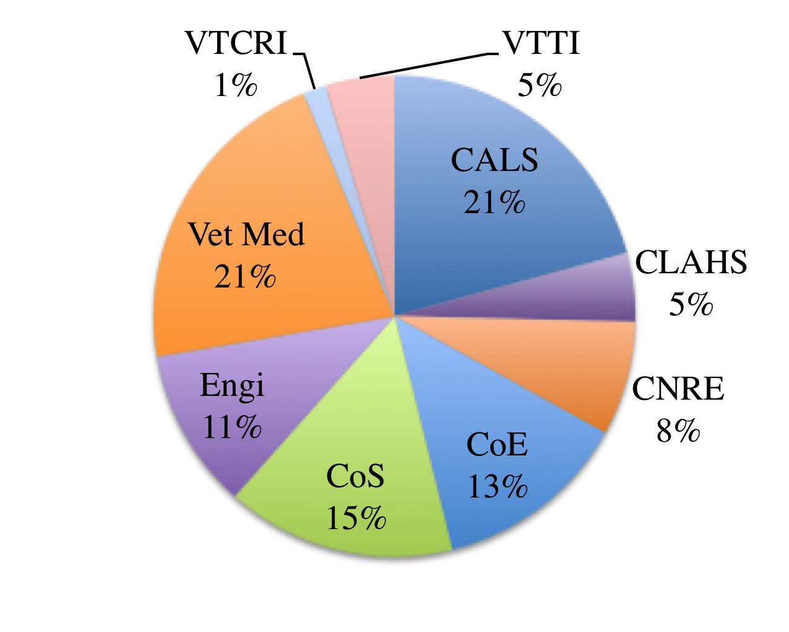
Articles VT OASF supported to-date

Slide 13
Journals VT OASF has supported
Acta Crystallographica Section E
Analytical and Bioanalytical Chemistry
Applied Physics Letters
BioMed Central Microbiology
BioMed Central Public Health
BioMed Central Research Notes
BioMed Central Systems Biology
BioMed Central Veterinary Research
Cancer Prevention Research
Frontiers in Antimicrobials, Resistance, and Chemotherapy
Health
IEEE Transactions on Dependable and Secure Computing
International Breastfeeding Journal
International Journal of Behavioral Nutrition and Physical Activity
International Journal of Environmental Research and Public Health
International Journal of Reconfigurable Computing
International Mathematical Forum
Journal of Dairy Science
Journal of Medical Internet Research - Research Protocols
Journal of STEM Education: Innovations and Research
Micromachines
Nucleic Acids Research
Optics Express
Public Library of Science One
Remote Access
VISAAUG2013BLB
Wetlands

Slide 14
VT Open Access Subvention Fund
Open access subvention fund
  http://www.lib.vt.edu/openaccess/fund/
Gail McMillan
  gailmac@vt.edu
Notes:
Announcements
Announced on the library website, Aug. 18, 2012; VTNews Sept. 28
Continuously available from the library’s website
New Fund Opens Access to Virginia Tech research
http://www.vtnews.vt.edu/articles/2012/09/092812-univlib-openaccessfund.html
Faculty Week: Publishing support from the University Libraries
https://www.lib.vt.edu/libnews/2013/2013-08-18.html
Open access subvention fund
http://www.lib.vt.edu/openaccess/fund/
Gail’s further research bibliography:
http://www.openaccesspublishing.org/

