Slide 1
ProjFocusedCrawler
CS5604 Information Storage and Retrieval, Fall 2012
Virginia Tech
December 4, 2012
Mohamed M. G. Farag
Mohammed Saquib Khan
Prasad Krishnamurthi Ganesh
Gaurav Mishra

Slide 2
Outline
Project description
Deliverables
Architecture
Roles
Progress
Milestones
Problems and challenges

Slide 3
Project Description
(from course Scholar webpage)
CTRnet uses Heritrix
  Quality of the seeds, and configuration details
Focused crawlers
  use topic information (which links to follow)
  reduce noise, and increase precision
  may reduce recall
Goal
  improve upon existing solutions
  demonstrate effectiveness w.r.t. CTRnet efforts

Slide 4
Deliverables
(from course Scholar webpage)
Design and implementation of a prototype focused crawler
New collection for CTRnet built using crawler
Software, data, report, and future plans
Publication about this research, and content for NSF proposal

Slide 5
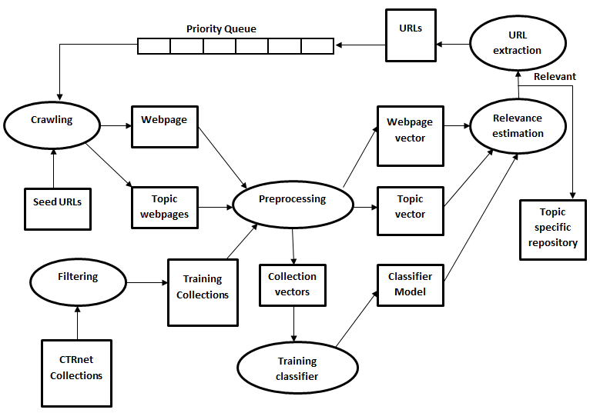
Architecture

Slide 6
Roles
Mohamed M. G. Farag:
  Building classifier
  Preparing training data (lead)
  Integrating different components
Mohamed Saquib Khan:
  Building classifier (lead)
  Preparing training data
  Comparing different classifiers

Slide 7
Roles (cont’d)
Prasad Krishnamurthi Ganesh:
  Preprocessing (lead)
  Preparing training data
  Evaluation
Guarav:
  Preprocessing
  Preparing training data
  Building documents TF-IDF vectors (lead)

Slide 8
Preparing training data
Warc files extraction
Sikkim earthquake collection
  19 seed URLs
  ~2000 HTML files out of 9000 files
Filtering
  Keywords, selected manually
  Relevance -> k or more words from keywords
  K = 1 → ~50% relevance (high recall, low precision)
  We used k = 5

Slide 9
Problems faced
Warc extraction
  Files saved on disk, original URL, wayback machine URL
  Encoding problems of saved on disk files
  Original URLs, not working (page not found)
  Wayback machine URLs, webpages have extra content that needs to be parsed and removed

Slide 10
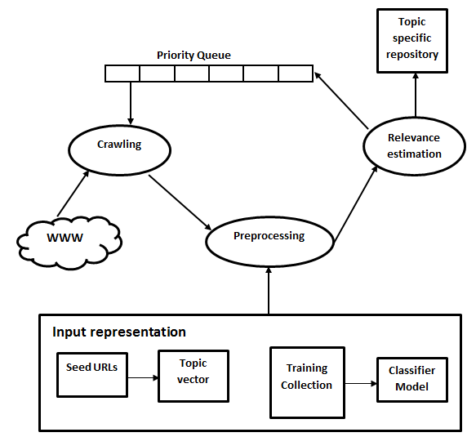
Modular design

Slide 11
Input representation
Seed pages
  Vector space model
  Normalized TF weighting scheme
    Problem of using IDF of relevant documents only
Training and testing data set
  Features, vector space model
  TF-IDF weighting scheme

Slide 12
Crawling
Get a URL from priority queue
Check if URL is:
  Visited (i.e., its webpage is already downloaded)
  In Queue (i.e., no need to put it again in queue)
Download
Extract text and URLs
Estimate relevance
Put URLs in priority queue
Stop if queue is empty or reach pages limit

Slide 13
Text extraction problems
Extract visual text of a webpage
Heuristic approaches
Scripts and comments tags remain after extraction (need explicit manipulation)
Invalid HTML tags (missing closing brackets)

Slide 14
How to Crawl
Three ways:
  URLs only: anchor text and address (doesn’t describe the topic of target webpage)
  Webpage text only: time and space, all URLs get same score, many non relevant URLs
  Hybrid: if webpage is relevant, use relevant URLs only

Slide 15
Relevance estimation
TF-IDF/cosine similarity score
  Assumed relevant if score more than threshold
Classifier
  Naïve Bayes
  Support Vector Machine (SVM)

Slide 16
Evaluation
Precision
  Number of downloaded webpages that are relevant
Classifier evaluation
  Performance on test data
  Cross validation, parameters best values
Performance
  Ordering of URLs in priority queue

Slide 17
Results
Egyptian revolution, threshold = 0.1
Precision = 633/1208 = 0.52
URL | Score
http://botw.org/top/Regional/Africa/Egypt/Society_and_Culture/Politics/Protests_2011/ | 1
http://live.reuters.com/Event/Unrest_in_Egypt?Page=0 | 1
http://www.aljazeera.com/indepth/spotlight/anger-in-egypt/ | 1
http://www.guardian.co.uk/world/series/egypt-protests | 1
http://www.huffingtonpost.com/2012/06/24/egypt-uprising-election-timeline_n_1622773.html | 1
http://www.washingtonpost.com/wp-srv/world/special/egypt-transition-timeline/index.html | 1
http://www.guardian.co.uk/news/blog/2011/feb/09/egypt-protests-live-updates-9-february | 0.52428340
http://www.guardian.co.uk/world/blog/2011/feb/05/egypt-protests | 0.50552904
http://www.guardian.co.uk/world/blog/2011/feb/11/egypt-protests-mubarak | 0.50212776
http://www.guardian.co.uk/news/blog/2011/feb/08/egypt-protests-live-updates | 0.47775149

Slide 18
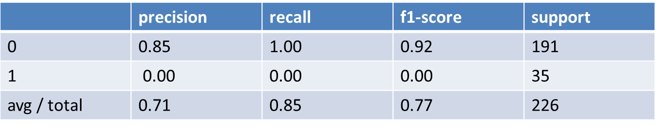
SVM
Without feature selection, k = 5 for filtering
Accuracy = 0.845132743363

Slide 19
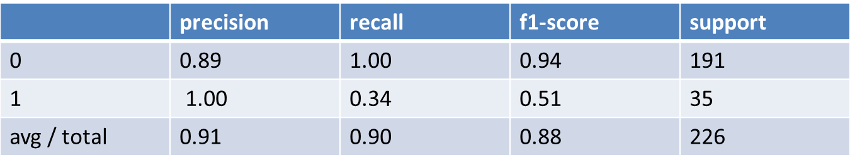
SVM
With feature selection (Chi-square) and k = 5 for filtering
Accuracy = 0.898230088496

Slide 20
Naïve Bayes
Same result for using/not using feature selection and k = 5 for filtering
Accuracy = 0.845132743363

Slide 21
Future work
Domain ontology
  Tunneling
    Non-relevant webpage can lead to relevant ones
  Ontology-based relevance estimation
    Concepts comparison

Slide 22
Milestones
Milestone | Date
Preparing training data | (Oct. 15)
Building general crawler | (Oct. 30)
Building classifiers | (Nov. 15)
Integrating components | (Nov. 30)
Testing and evaluation | (Dec. 5)
Completing report and prototype | (Dec. 11)

Slide 23
Thank you!
Questions ?

