Slide 1
Meta-models of Confidentiality
Dennis Kafura

Slide 2

Overview
Introduction
  Confidentiality
  Access control
  Information flow control
Meta-models
  Motivation
  Access control
  Information flow control
Comparisons & Observations
Future Work
Acknowledgements

Slide 3
Security: goals and attacks
Information security
  Confidentiality
    Goal: insuring information is seen by the “right” people
    Attacks: identity/credential theft, avoiding/subverting authentication mechanisms
  Integrity
    Goal: insuring the “right” information is seen
    Attacks: misdirection (e.g., DNS attacks), spoofing, data corruption
  Availability
    Goal: insuring information can be seen
    Attacks: denial of service

Slide 4
Insuring Confidentiality
Access Control
  What information can you access? And how?
  Is principal p allowed to perform action a on resource r ?
  Widely used
    File systems (e.g., Unix permissions, ACLs)
    Web page access (e.g., .htaccess)
    Cryptography-based methods (e.g., TLS)
    Many, many, many models incorporating
      roles, context, time, status, obligations, teams,…
Information Flow Control
  What can you do with information you have accessed?
  Is information allowed to flow from a given source to a given destination?

Slide 5
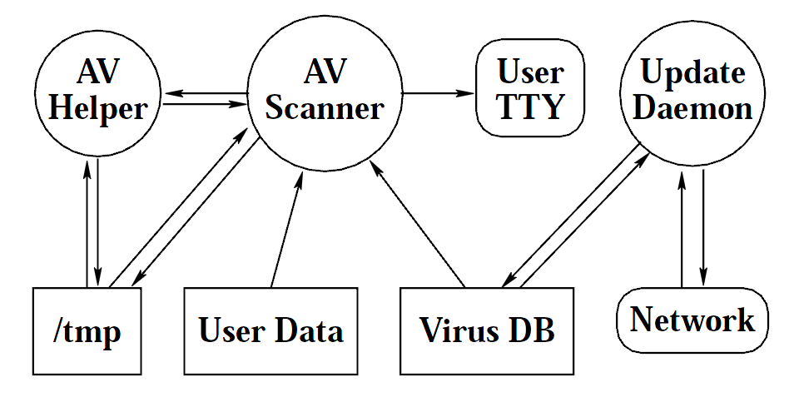
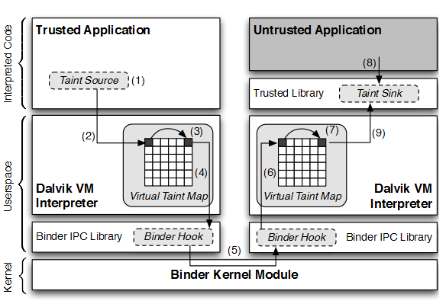
Information Flow Examples
HiStar: guarantee that the anti-virus (AV) scanner cannot leak to the network any data found in its scan of user files
TaintDroid: tracking privacy sensitive data through third party applications on Android devices

Slide 6
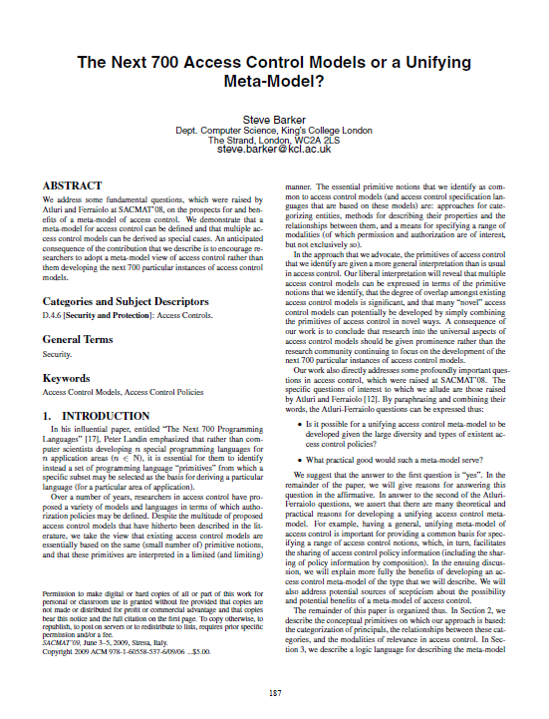
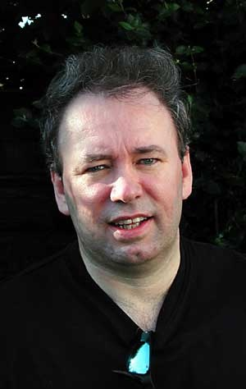
Motivation for an AC meta-model
“Existing access control models are essentially based on the same (small number) of primitive notions…Research into the universal aspects of access control models should be given prominence rather than…continuing to focus on the next 700 particular instances of access control models.”
Steve Barker
King’s College London
(Deceased: Jan 2012)
Homage to: P.J. Landin, “Next 700 Programming Languages” Aug. 1965
SACMAT, 2009

Slide 7
Meta-models
Motivations
  Explicates the fundamental principles of access control
  Provides a common basis for
    Precisely specifying access control and
    Understanding relationship among access control models
  Facilitates sharing of access control policy information
    Across models
    Among applications
  Aids policy administrators/authors
    Via specialization of general axioms
    Rapid prototyping of access control policies
  Is the basis for developing policy languages with solid semantic foundation
    Various syntaxes built on precise semantics
    E.g., can be represented in RuleML

Slide 8
Fundamental Concepts
Elements (all countable sets)
  Categories, C, denoted c_{o}, c₁, …
  Principals, P, denoted p_{o}, p₁, …
  Actions, A, denoted a_{o}, a₁, …
  Resource identifiers, R, denoted r_{o}, r₁, …
Meaning
  Categories represent groups or classes sharing, for example, a common attribute, a similar level of trust, or the same security clearance.
  Principals are individuals or agents
  Actions are operations that can be performed on Resources

Slide 9
Fundamental Concepts
Meta-model, M
  core axiom:
  By choosing different definitions of pca, contains, and arca the model M can be specialized to define different access control models
(p)
PCA
(a,r): permission
(p,a,r)
C
(p,a,r): authorization
C’
(a,r)
ARCA

Slide 10




Fundamental Concepts
Relations

Slide 11
Example
File Sharing example
C₀
Bob
C₄
Alice
C₁
C₂
C₃
(read C)
(write, A)
(read, A)
Craig
(read, B)

Slide 12
An information flow control meta-model
All of same motivation given by Barker, and…
…in addition:
  Assess whether Barker’s approach is adequate for meta-modeling of information flow control.
  Compare fundamental differences between access control and information flow control.
  Explore possible combinations of access control and information flow control.

Slide 13
Information Flow Control: requirements
Policy: Bob can only access public information.
Alice can access public and private information.
public
A
B
C
private
Dynamic determination of accessibility
A labeling of the states of P and R
Labels for P and R:
[level, clearance]
Alice
Bob

Slide 14
IFC meta-model structure
core axiom
history
meta-model
policy
levels & clearances
initialization

Slide 15
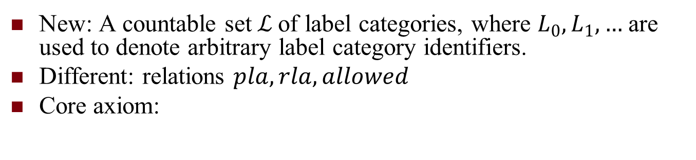
IFC: core axiom
New: A countable set$ℒ$ of label categories, where $L_{0}, L_{1}, …$ are used to denote arbitrary label category identifiers.
Different: relations $pla, rla, allowed$
Core axiom:
$$par(P,A,R)←pla\left(P,L_{P}\right), rla\left(R,L_{R}\right), allowed(L_{P}, A, L_{R})$$
P
A
R
allowed
L_{R}
L_{P}

Slide 16



IFC history
Modeling the dynamically changing labels in a computational logic framework – a history of what happens over time.
$$granted\left(P,L_{S},A, R, L_{R}\right)$$
$$granted\left(Q,L_{Q},A, R, L_{R}\right)$$
$$granted\left(P,L_{T},A, F, L_{F}\right)$$
T₂
T₃
T
T₁
What is the label for P at T?

Slide 17
IFC: history
Labels are time (state) dependent
Current label results from must recently granted operation
Similarly for resource labels

Slide 18

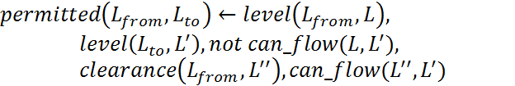

IFC: labels and clearances
Defining allowable flows

Slide 19
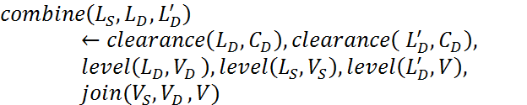
IFC: levels and clearances
What is the result when the source (S) and destination (D) have different labels?

Slide 20
Model Structure
par
core axiom
pla
rla
allowed
history
current_time
happens
last
plat, rlat
levels & clearances
combine
permitted
initial
mutate
inspect
initialization
(policy definition)
join
level
clearance
can_flow

Slide 21
Example: file sharing
Categories
Actions
Valid Flows
Combining Flows

Slide 22
Example: File Sharing
Labels
Levels & Clearances

Slide 23
Comparisons: observation
Barker’s framework is adequate to define an information flow control meta-model
Explicit vs. implicit permissions
  AC provides explicit permissions ( (a,r) )
  IFC provides implicit permissions derived from flow rules
Action granularity
  AC differentiates actions (e.g., write vs. append)
  IFC only cares about the direction of the flow
Complexity
  IFC meta-model is more complex than AC meta-model
History
  Required for IFC but not for AC

Slide 24
Comparisons: hypothesis
core axiom
AC = IFC
IFC + history(R)
AC + history(P)
SBAC
???
???
AC + history(R)
IFC
IFC + history(P)
+ history(R)

Slide 25




Comparison: new design spaces
Given:
What about:

Slide 26
Future Work
Develop specializations for additional information flow control policies/systems to assess adequacy and minimalism of meta-model.
Develop extensions to meta-model to incorporate other features and concepts (e.g., community-oriented control).
Continue comparison of access control and information flow control to better understand spectrum of confidentiality mechanisms.
Explore design space of combined access control and information flow control to discover novel and useful approaches to insuring confidentiality.
Develop computational realizations of the meta-models to
  Explore properties of policies/systems
  Prototype new policies/systems
Use meta-model to guide continuing project on community privacy.

Slide 27





Collaborators/References
Tom DeHart
Andrea Kavanaugh
Sherley Codio
Denis Gracanin
Manuel
Perez-Quinones
Dennis Kafura and Denis Gracanin, “An Information Flow Control Meta-Model”, 18th ACM Symposium on Access Control Models and Technologies (SACMAT), June 12-14, 2013, Amsterdam, The Netherlands.
Sherley Codio, Dennis Kafura, Manuel Perez-Quinones, Dennis Gracanin, Andrea Kavanaugh, “A Case Study of Community Privacy,” 2012 ASE International Conference on Social Informatics, December 14-16, 2012, Washington, D.C.
Sherley Codio, Dennis Kafura, Manuel Perez-Quinones, Andrea Kavanaugh, Denis Gracanin, “Identifying Critical Factors of Community Privacy,” 2012 ASE International Conference on Privacy, Security, Risk and Trust (PASSAT’12), September 3-5, 2012, Amsterdam, The Netherlands.
Dennis Kafura, Denis Gracanin, Manuel Perez, Tom DeHart, “An Approach to Community-Oriented Email Privacy,” Third IEEE International Conference on Information privacy, Security, Risk and Turst (PASSAT 2011), MIT, Boston, MA, October 9-11, 2011.

Slide 28
Questions
Where’s the
signup sheet?

