Slide 1





Highlighting mental perception gaps between professional and farmer of three conservation agricultural treatments: a focus on tribal villages of Kendjuhar, India and the Himalayan foothills of Nepal
Presenter: Dr. Catherine Chan- Halbrendt
Lai, C^{1,*}, Chan-Halbrendt, C¹, Halbrendt, J¹, Reed, B¹, Dibakair, N², Chittanranjan, R³
¹Dept. of Natural Resources and Environmental Management, University of Hawaii at Manoa, Honolulu, USA
²College of Agriculture, Orissa University of Agricult ural Technology, Bhubaneswar, India
³Water Resources Research Center, University of Hawaii, Honolulu, USA

Slide 2
1. Introduction
Increasing global pressures of population, limited natural resources and climate change, marginal land conditions → increasing impact on agricultural productivity.
Dissemination of information from professional to farmer regarding new and innovative agricultural practices has never been so important.
Millions of dollars allocated to support smallholder farmers towards agricultural sustainability → professionals work alongside farmers to develop new technologies
BUT … Only 20% of technology generated in agricultural research is actually adopted by farmers (Chambers, 1991; Feder et al. 1985).
Objective: highlight mental perception gaps between farmers and professionals to better understand why farmers do not adopt

Slide 3
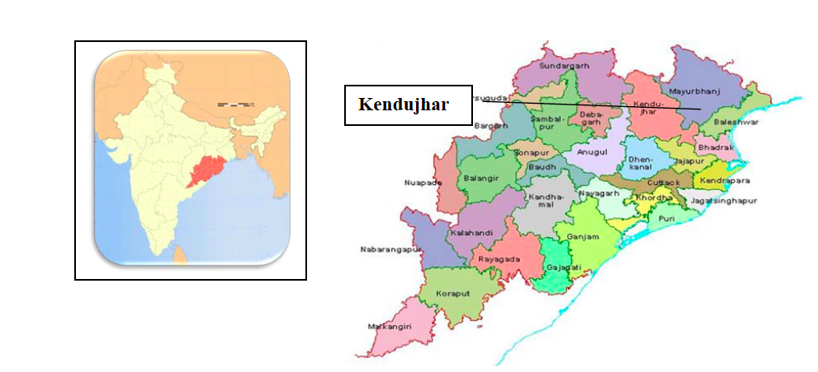
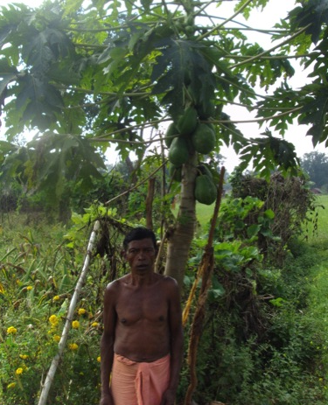
2. Case Studies: Area Profiles, India
INDIA: District of Kendujhar, Odisha
One of the poorest districts: economic and environmental resources
North-Central Plateau region
Villages (Tentuli, Saharpur, Gopinathpur): 30 – 100 households
Subsistence agriculture: Conventional tillage
Main crops: Maize, Mustard
Farm size: < 2 hectares
Annual income: $420 USD

Slide 4
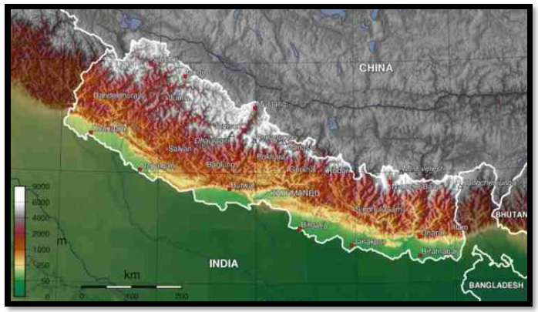
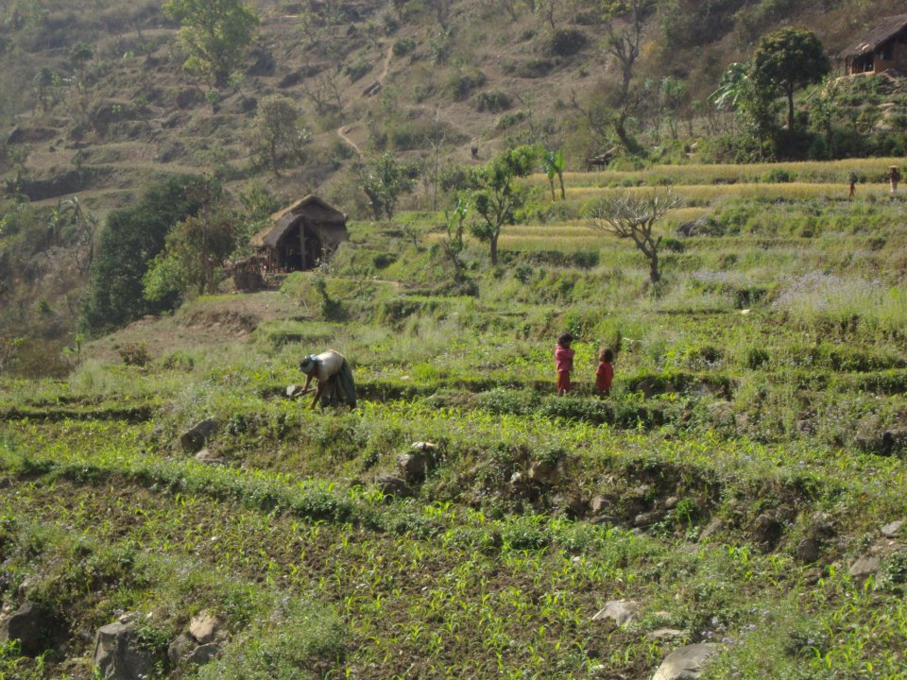
2. Case Studies: Area Profiles, Nepal
NEPAL: Himalayan Mid-hills
9% of the population is considered moderately to severely food insecure; 74 percent represent agricultural households (majority smallholder farmers)
Mid-hills region, highly sloping lands
Villages (Thumka, Hykrang, Khola-Gaun)
Subsistence agriculture: Conventional tillage
Main crops: Maize, Millet
Farm size: < 0.6 hectares
Annual income: $601 USD

Slide 5
3. Methodology
Partnership: Development of CAPS
  SMARTS: U.S.A. Institution (UHM), Local Counterparts (OUAT, LI-BIRD)
  Villages:
    India (Tentuli, Saharpur, Gopinathpur)
    Nepal (Thumka, Hyrkrang, Khola-Gaun
Baseline Surveys, focus group discussions
  Village profiles
  Criteria: Profit, Soil Environmental Benefit, Labor Saving, Yield
Analytical Hierarchy Process:
  Farmer vs. Professional preferences
  Lai et al. 2011; Reed et al. 2012
Country Comparison
  Farmers vs. Professionals
  Preferences across and within India and Nepal

Slide 6
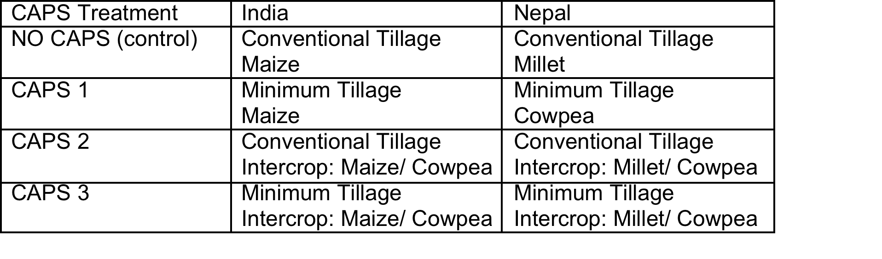
4. CAPS
Sustainable Management of Agroecological Resources of Tribal Societies (SMARTS) → Conservation Agricultural Production Systems (CAPS)
Introduction of new innovative practices
Professionals → Farmers
Table 1. List of CAPS introduced in India and Nepal by the SMARTS Project (Lai et al., 2011; Reed et al., 2012)

Slide 7
5. Results
Figure 2 and 3. Comparison of preferences of selected criteria between case studies of professionals (above) and farmers (below) with respect to the goal of improved income (Lai et al. 2011; Reed et al. 2012)
Notes:
Professionals from Nepal are more environmentally resource driven towards the goal of improved income, farmers are the same way
Professional and farmer 1) Soil health →2) Yield → 3) Profit
Professionals from India are more economically driven towards the goal of improved income, farmers are the same way
Professional 1)Profit, but 2) soil health → 3) Yield
Farmer 1) Profit ← 2) Yield ←3) Soil health

Slide 8
5. Results
Figure 4 and 5. Comparison of preferences of CAPS treatments between case studies of professionals (above) and farmers (below) with respect to the goal of improved income (Lai et al. 2011; Reed et al. 2012)
Notes:
Professionals from Nepal and India promote CAPS 3 (most environmentally beneficial)
CAPS 1 and 2 professionals see as equal as each only introduces one new practice but while nepal prefers CAPS 1 because they rather minimum tillage than cowpea because of the negative association (cowpea shadows millet in intercrop) and not as commonly produced as opposed to India professionals next option is CAPS 2 with intercropping of cowpea because leguminous and high value in market.
Farmers from Nepal choose CAPS 1 with least risk and most similar to current practices (isolation, midhill regions, limited resources and access to markets)
Farmers from India are more flexible with their plateau region and access to resources and off-farm employment of mining so can select CAPS 2 and 3 as preferences
All farmers agree that current practices are unsustainable and as such this is good opportunity for information sharing and introducing other alternatives
Farmers learned from the CAPS workshops as they all had higher weights for CAPS 3 and as such have learned the environmental benefits of CAPS .

Slide 9
6. Conclusion
Professionals are trained to be analytical and apply a systematic scientific method, whereas farmers are looking for what works depending on a dynamic environment (Carr and Wilkinson 2005).
Farmers:
  Preferences: Yield, profit soil environmental benefit
  GAPS:
    Logical understanding of environmental change, do not fully understand impacts/ effects
    Will select CAPS based on country specific factors: ease of application (Nepal- less risk); and options of alternative resources (India, off-farm employment, greater access to resources).
Professionals:
  Preferences: Soil environmental benefit, Profit, Yield
  GAPS:
    Academic and background knowledge, limited on-the-ground knowledge of application
    Will select CAPS based on environmental benefit/ sustainability as that is their research objective
  Professionals need to continue information workshops/ seminars to further educate farmers → develop CAPS/ technological approaches together (professional in the field) → increase adoption rate as farmers agree that current practices are not sustainable
  CAPS must be adapted to each area as country specific factors prevent adoption of similar/ matching CAPS

