Slide 1
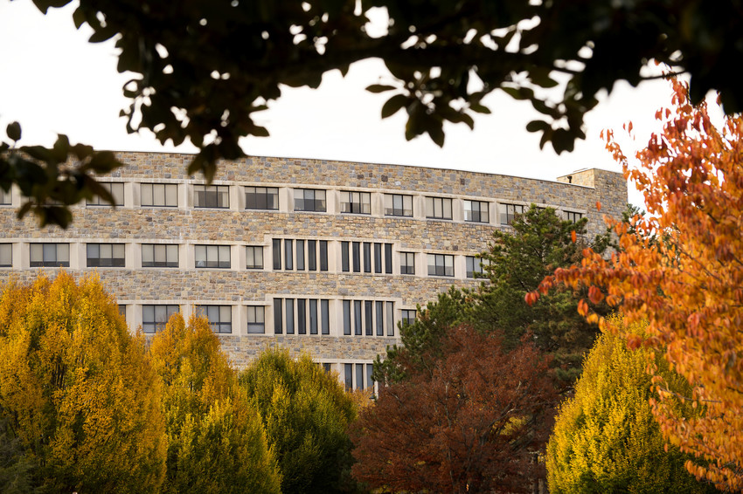


(Initial) Assessment of Research Data Services Through Client Interaction Records
Jonathan Petters
Assistant Director, Data Management and Curation Services
Virginia Tech University Libraries

Slide 2
Outline
Why a research data services assessment?
Overview of client records
What can be learned from these client records
Managing records post-assessment
Updating this assessment (or not)
Article published in JLSC August 2022
An Assessment of Research Data Services Through Client Interaction Records

Slide 3
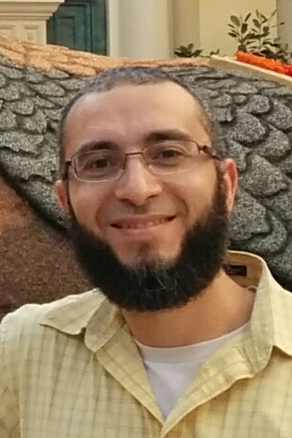
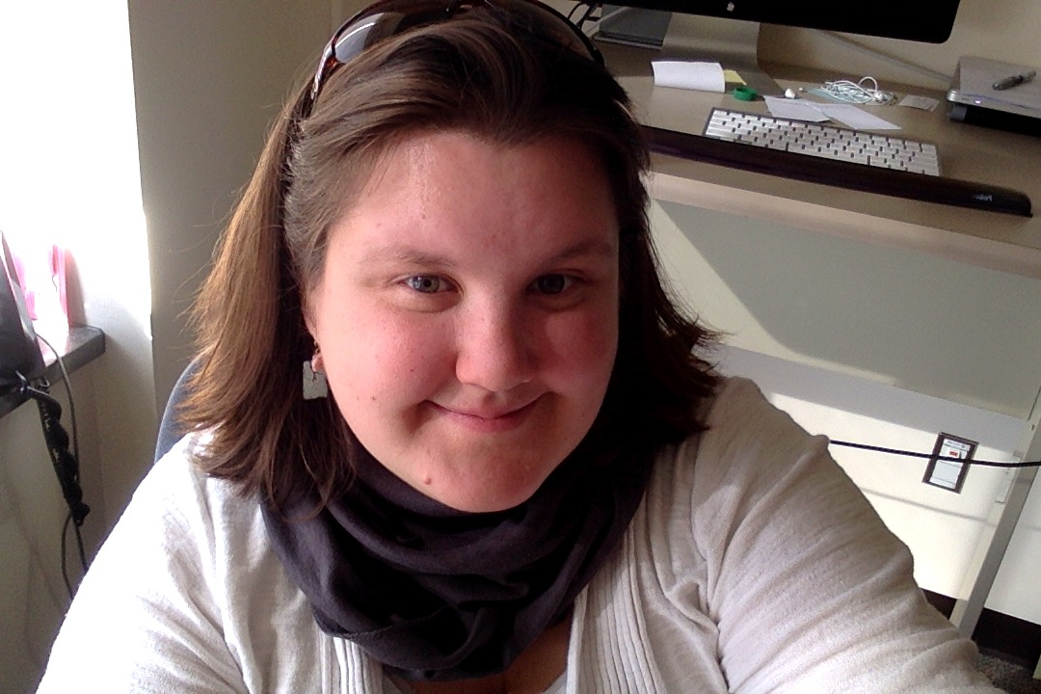
Co-Authors
Amr Hilal
Head, Informatics Lab &
Data Services Project Coordinator
Andi Ogier
Assistant Dean & Director,
Data Services

Slide 4
Acknowledgements
In VT Data Services
Chreston Miller (input, review)
Nathaniel Porter (input, review)
Michael Stamper (input, figures)
Outside of VT
Heather Coates (input)

Slide 5
Why service assessment?
Virginia Tech Data Services tracking client interactions since 2016
What can we learn about our services? Should we make service alterations?
Research data needs assessments plentiful in literature (Goben and Griffin 2019)
Formative*/summative assessments less so (e.g. Coates et al 2018)

Slide 6
What have we learned?
“Rather than prioritizing services that are useful to the largest number of researchers, we could (and perhaps should) prioritize engagement with researchers and research communities for whom our assistance can make the largest positive impact on their projects”

Slide 7
Virginia Tech Data Services 2016-2020
Services designed to “boost the value and impact of research data created by researchers at Virginia Tech. Our expertise creates efficiencies for researchers across the research lifecycle”

Slide 8

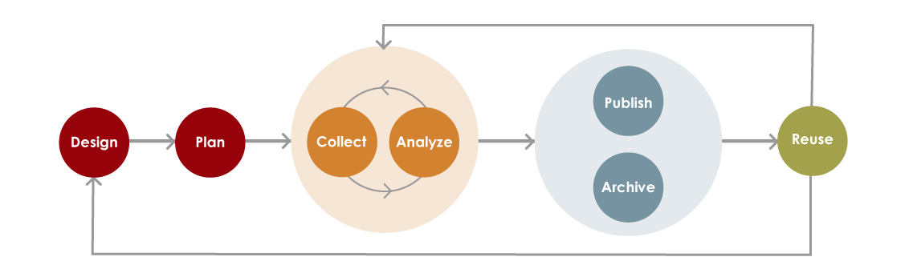
Virginia Tech Data Services 2016-2020
One Director
Three personnel in data management and curation services
Four to six data and informatics consultants
Two consultants added in 2017 and 2018

Slide 9
Interaction - the cumulative set of actions and responses to a particular inquiry or request from a client

Slide 10
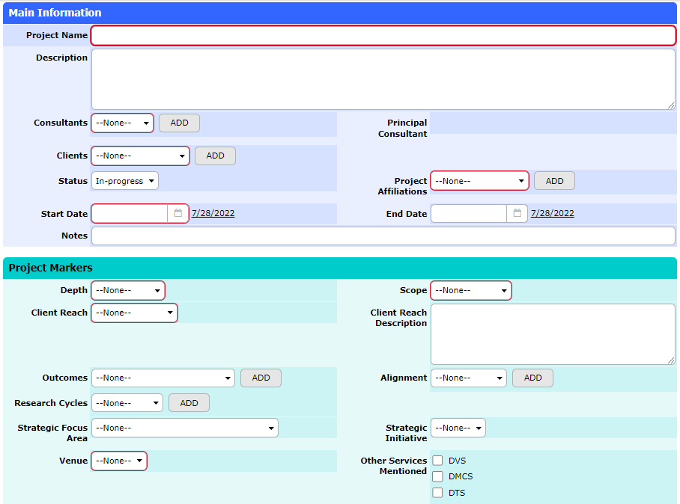
Client records

Slide 11
Client records

Slide 12
Client records

Slide 13
Cleaning Client Records
Inconsistency in client record entry across a group is hard to avoid
Data Services had more than one meeting as a group to talk through data entry
Amr and I had several discussions about collapsing categories, asking our colleagues for edits to the data - this took a lot of time and effort!
De-identified data available online

Slide 14
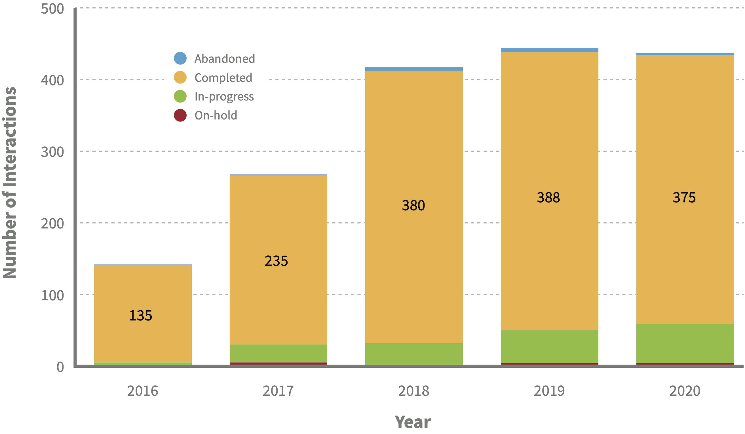
Interactions by Year

Slide 15
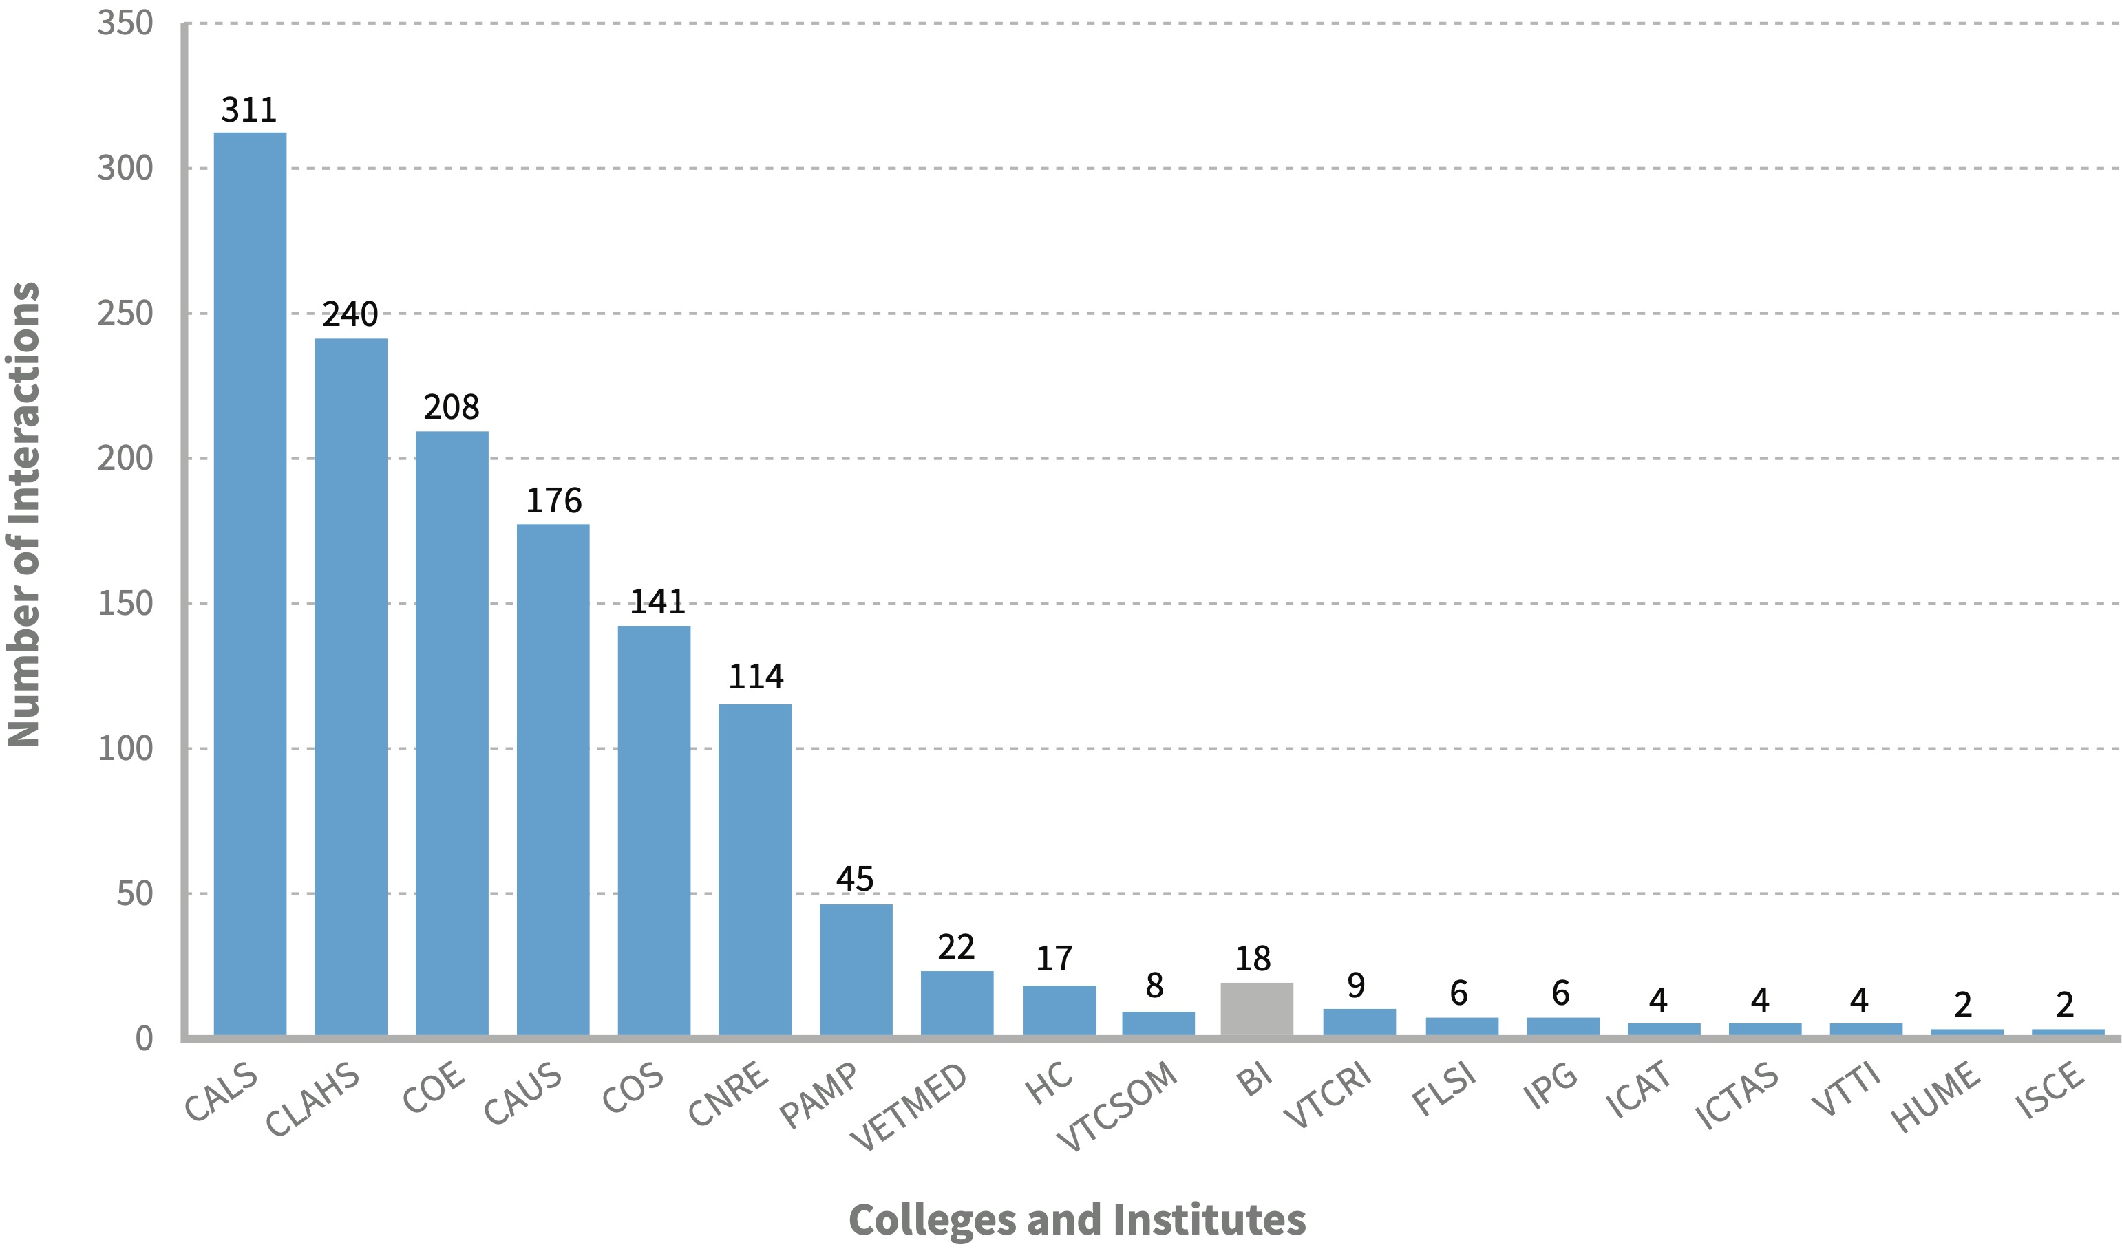
Total Interactions by
Colleges || Institutes

Slide 16
Total Interactions by College
# of faculty/ college
CALS 1144
CLAHS 705
COE 819
CAUS 254
COS 572
CNRE 225
PAMP 282
VETMED 404
HC ??
VTCSOM 68

Slide 17
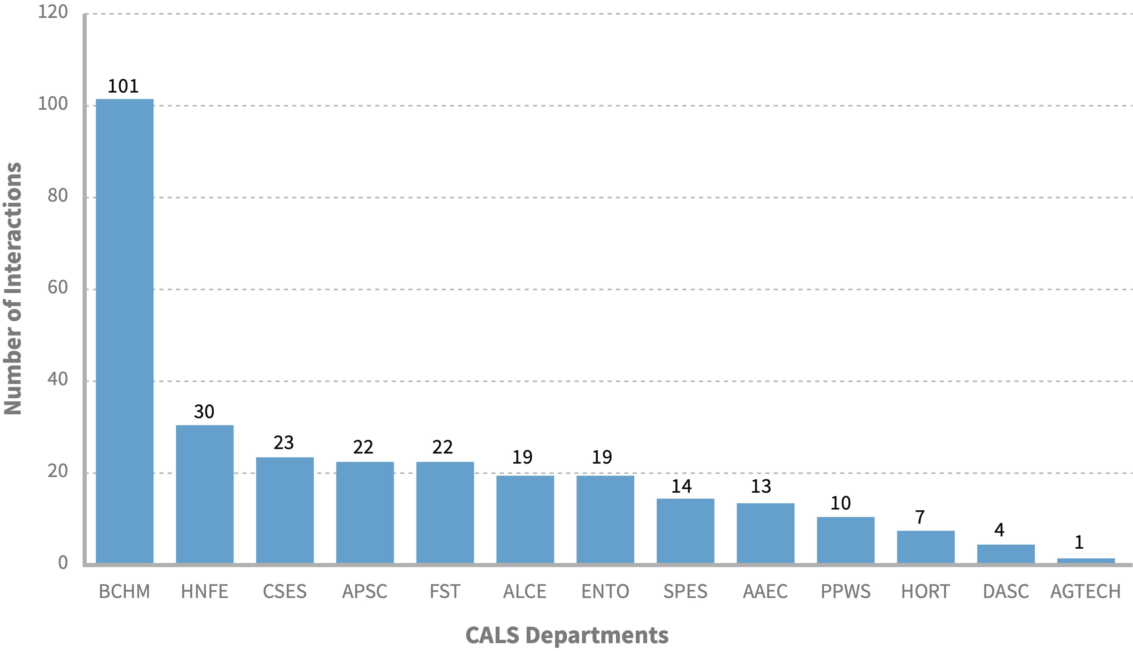
Interactions with CALS by Department

Slide 18
Client Reach Categories
Category | Definition
Event | Event or event series about research data topics, promoting services
External Referral | Previous client or another campus unit referring new client
In Person | Client is in direct contact to consultant or referred by a direct contact
Library Referral | Referral by any colleague who works in the Libraries
Online | Client found us through our online presence
Recurring | Former client coming back for assistance with a different issue

Slide 19
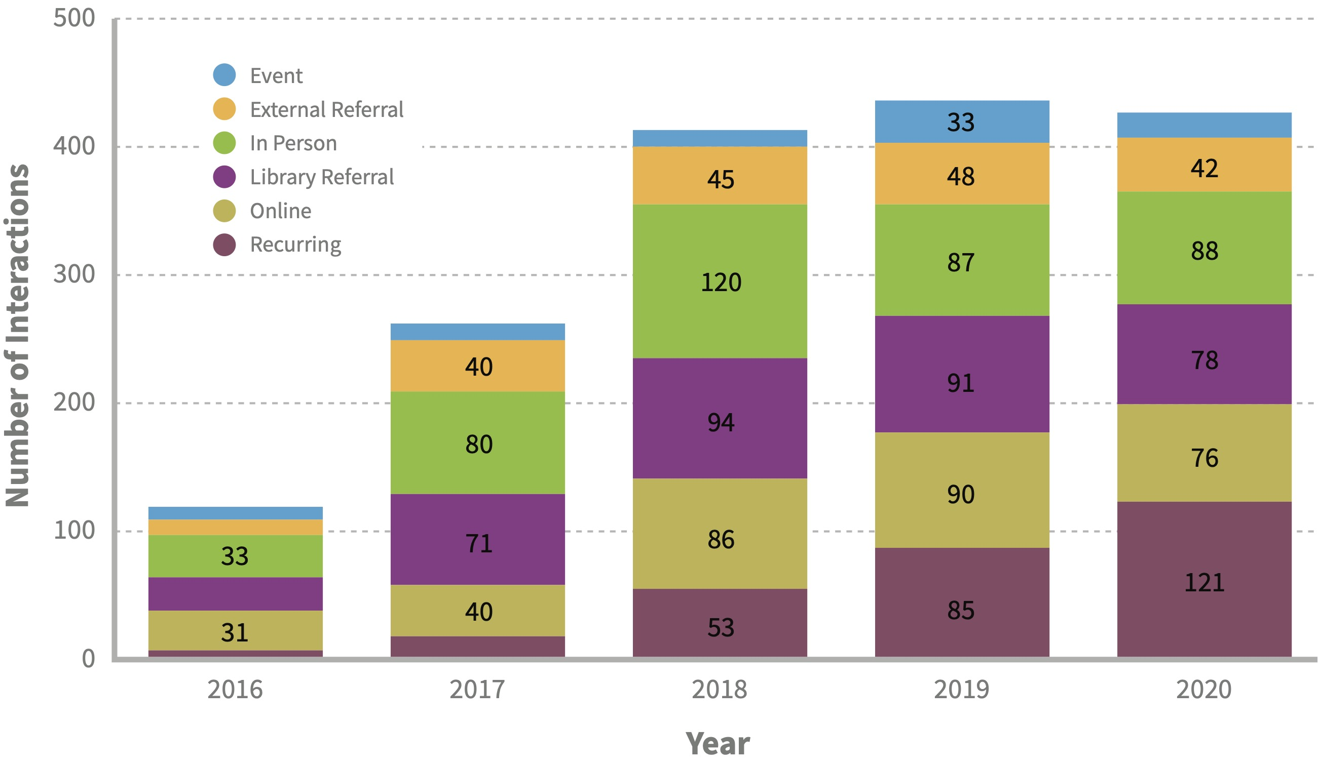
Interactions by Year and Client Reach

Slide 20
Short(<180 days) and Long Interactions
Year | # Short | # Long | # Short/# Long
2016 | 62 | 23 | 2.7
2017 | 112 | 26 | 4.3
2018 | 139 | 38 | 3.7
2019 | 201 | 37 | 5.4
2020 | 220 | 56 | 3.9
Since 2018, 4.3 short interactions for every long interaction

Slide 21
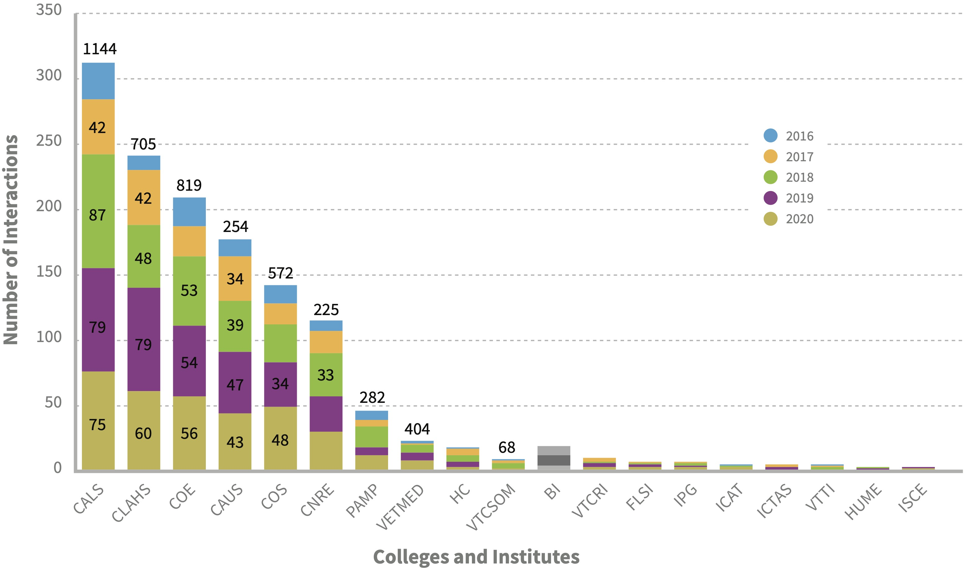
Interactions by Year and College/Institute

Slide 22
Total Interactions by College
# of faculty/ college
CALS* 1144
CLAHS* 705
COE 819
CAUS 254
COS 572
CNRE 225
PAMP 282
VETMED 404
HC
VTCSOM 68
*
*

Slide 23
What have we learned?
“Rather than prioritizing services that are useful to the largest number of researchers, we could (and perhaps should) prioritize engagement with researchers and research communities for whom our assistance can make the largest positive impact on their projects”
Lazy outreach -> best return on investment?

Slide 24
Disposition of client records
Need to retain for some amount of time – how long?
Records currently stored privately
Could de-identify after specified amount of time
Policies/procedures for the retention of client/consulting records not yet done
Data Analyst currently working on standardizing Libraries-wide records for ARL reports

Slide 25
Will we update this service assessment?
Libraries moved client interaction recording to LibConnect in 2021
Emphasis on recording most basic information only (lowest common denominator across Libraries)
Increasing detail of Data Services record keeping now could be overtaken in the future (again)
Future service assessments will not be as rich and will be more labor-intensive

Slide 26
jpetters@vt.edu
@jon_petters
Thanks!
Questions?

Slide 27
Outcome Categories
Category | Definition
Dataset Operation | Dataset discovery, transformation, extraction, creation, or deposit/archiving
Grant Development | Providing support on a grant (e.g. data management plan support) or collaborating on a grant
Guidance | To-the-point research data assistance, either once or in series (e.g. troubleshooting a software bug)
Instruction | Invited talk, guest lecture, either once or in series
Learning Support | Producing learning objects of another instructor's use, running a class or assisting on such
Planning | Meeting to coordinate future cooperation on a research project
Publication Development | Peer review of a publication, Creation of a publication in whole or part
Visualization | Creating a visualization or graphic for proposals, presentations, publications etc.
Web Design or Special Tool | Providing a tool customized to solver a problem, website support

Slide 28
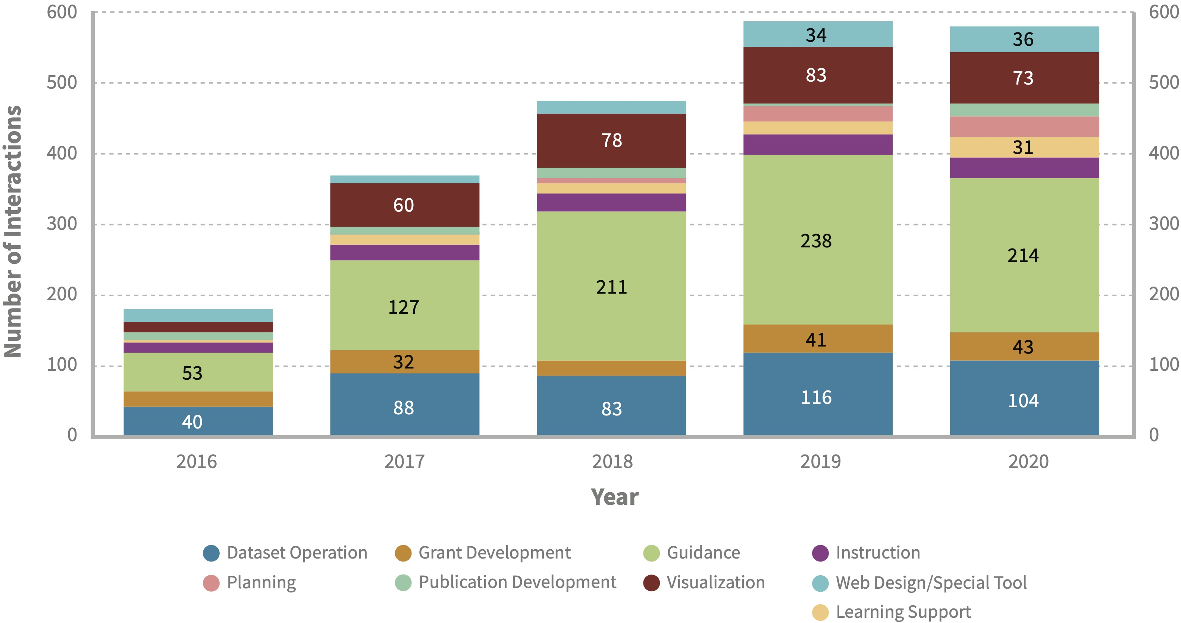
Outcomes by Calendar Year

