Slide 1

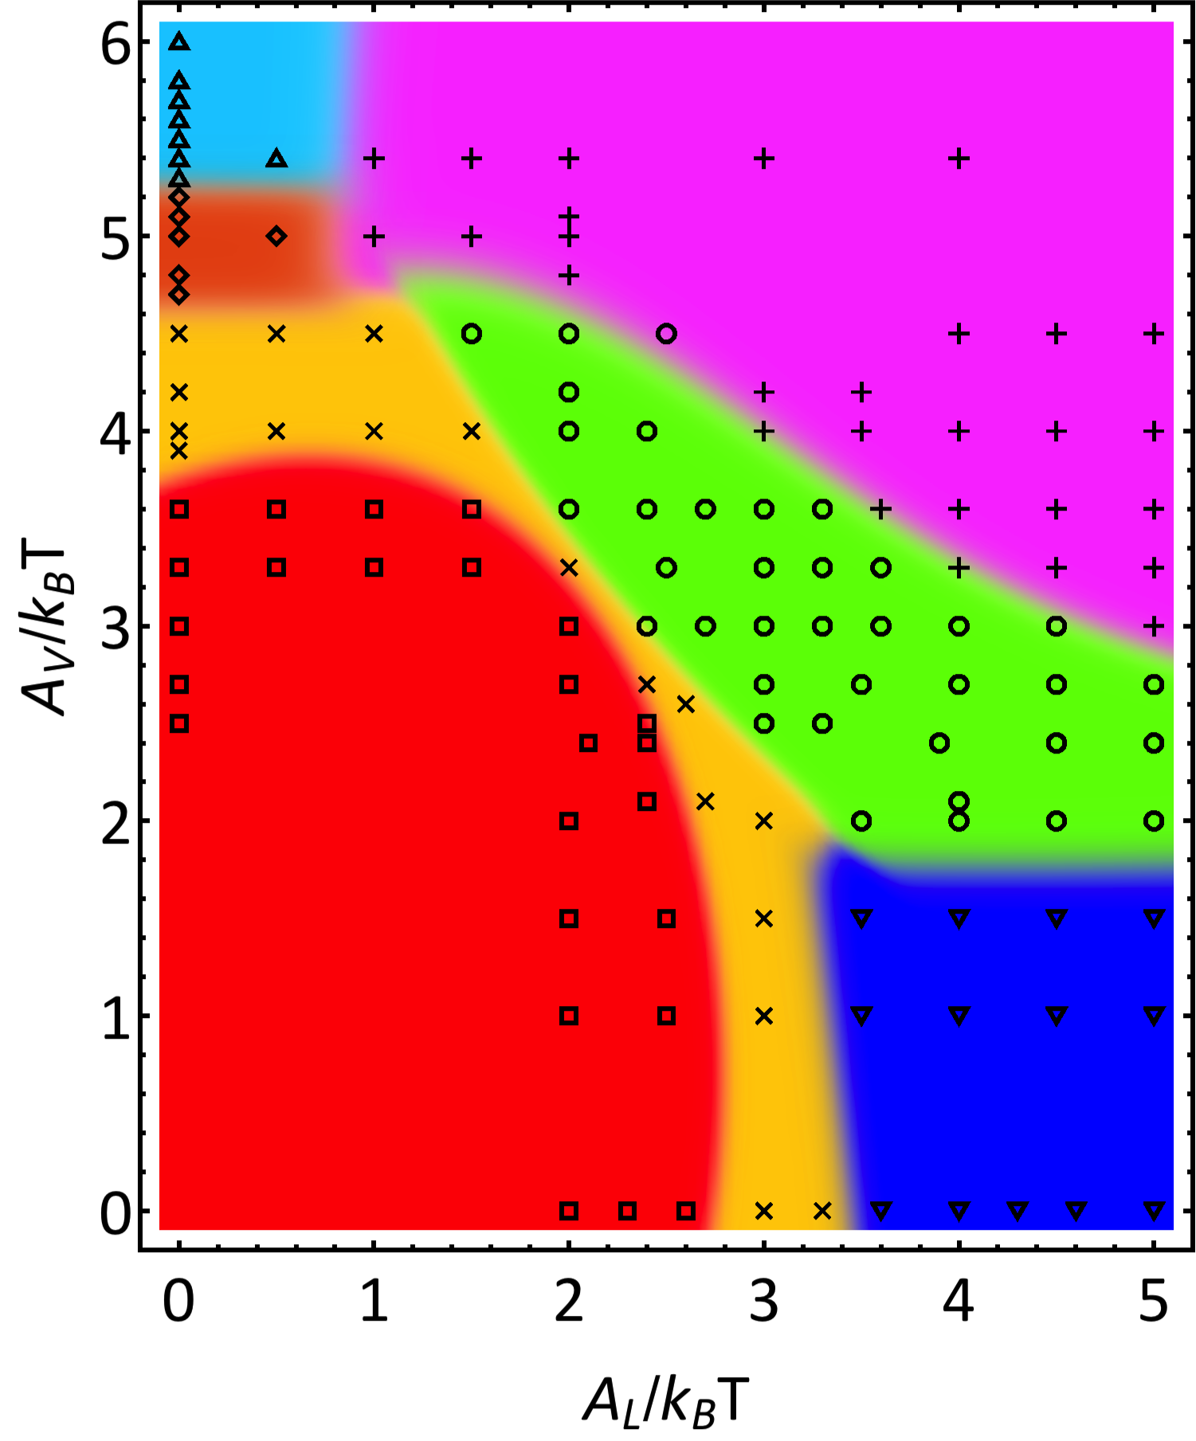
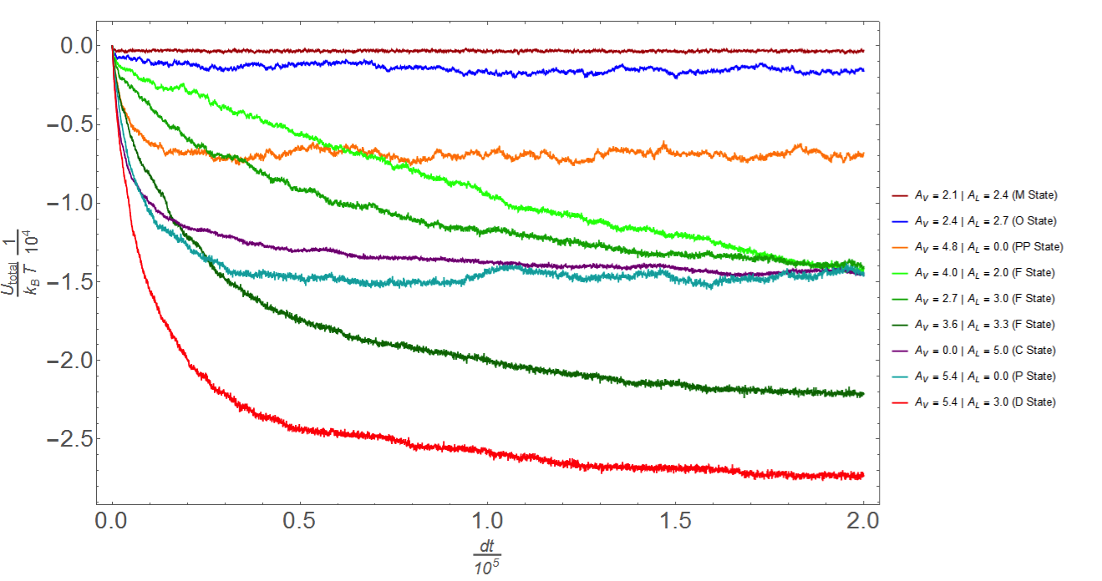
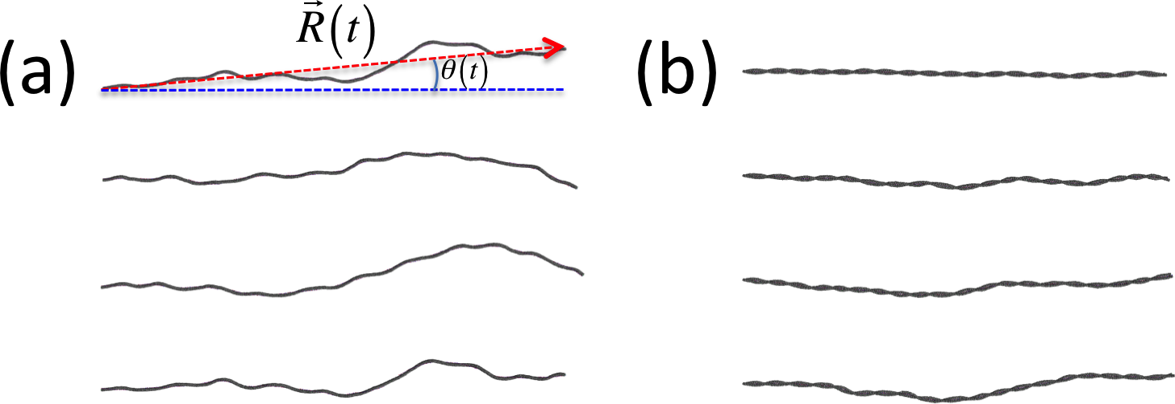
Self-Assembly of Artificial Actin Filaments
C. Ryan Grosenick, Shreya Dayal, and Shengfeng Cheng
Macromolecules Innovation Institute
Department of Physics
Virginia Tech, Blacksburg, VA 24061
Motivation
Actin filaments, or microfilaments, are long (~ several μm), double-stranded, helical filaments that span the cytoplasm of cells.
Typical diameter only ~6 nm across, but have a pitch length (distance for one full “twist” of double helix) of ~72 nm.¹
Important for cell mobility and cell division, but assembly mechanism still not well understood.
How do we make double-stranded helical structures that mimic microfilaments such that we can study the self-assembly process?
Self-assembly structural diagram and assembly kinetics
Model to replicate F-actin geometry
Rigid bent-rod monomers (core sites + attractive sites)
Vertical bonding builds protofilaments while staggered lateral bonding links helices together
Protofilaments have 12 monomers (n=12) per pitch; ideal filament/protofilament has at least 1 full pitch
Bonding interactions only between attractive sites in the same color using soft cosine potential² – varying binding strength A leads to various structures
Double-stranded actin-like filaments are formed when A_{V} and A_{L} are in the appropriate range (green zone in the structural diagram). Self-assembly
mainly proceeds via an addition polymerization scheme: one monomer is added at a time. However, we also find oligomer addition and filament merging, though rarely.
Building block
Filaments
Why are actin filaments double-stranded ?
We model single- and double-stranded filaments built with bent-rod monomers. One end of each filament is fixed. The length and orientational fluctuations of the filaments are followed. Results (see the Table) show that the double-stranded filaments are more rigid structurally and exhibit much less fluctuations.
Single-stranded filaments
Double-stranded filaments
 | A_{L} (k_{B}T) | A_{V} (k_{B}T) | <R> (σ) | ΔR (σ) | Δθ (°)
Single-stranded | 0 | 7.5 | 391.76 | 29.19 | 1.82
 | 0 | 10.0 | 447.78 | 48.98 | 6.59
 | 0 | 15.0 | 455.37 | 25.62 | 5.47
Double-stranded | 2.0 | 4.0 | 400.41 | 11.09 | 0.99
 | 2.7 | 3.6 | 435.36 | 14.89 | 1.33
 | 5.0 | 7.5 | 461.68 | 8.61 | 2.72
Various self-assembled structures
Why do actin filaments seem to have A_{V} > A_{L} ?
M State
O State
PP State
Fraction of defected filaments
P State
F State
Double-stranded helical filaments
Three types of defects are observed for double-stranded actin-like filaments. The fraction of defected filaments starts to grow rapidly once A_{L} > A_{V}, which indicates that a high yield of actin filaments with a well-defined structure requires A_{V} > A_{L} .¹
References
C State
D State
O. N. Yogurtcu, J. S. Kim, and S. X. Sun, "A mechanochemical model of actin filaments“, Biophysical Journal 104 (3), pp 737-738 (2013).
S. Cheng. A. Aggarwal, and M. J. Stevens, “Self-assembly of artificial microtubules”, Soft Matter 8, pp 5666-5678 (2012).
Various structures are
obtained by varying A_{L} and A_{V}
Acknowledgments
This works is supported by the Jeffress Trust Awards Program in Interdisciplinary Research. We gratefully acknowledge the support of NVIDIA Corporation with the donation of the Tesla K40 GPU used for this research.

