Slide 1
Crisis Events Webpages Archiving
Jeff Chen, Matthew Averyt, Nihal Mitta, Merna Khamis, Justin Lee
CS 4624: Multimedia, Hypertext, and Information Access
Mohamed Farag
Virginia Tech, Blacksburg VA 24061
4/20/23
Notes:
18pt font or larger

Slide 2
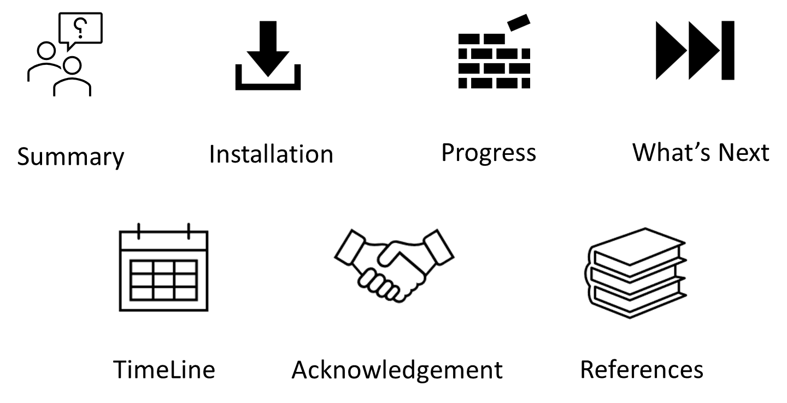
Outline

Slide 3


Summary
Web pages disappear quickly, so it is important to archive them
To help with archival, we created an application to record/replay web pages
  Python/Flask backend
  React frontend
Current solutions aren’t fit for mass archival and can be cumbersome to use

Slide 4
Installation
Software:
Python 3.9.X
Node.js
npm
Git bash
Windows
Installation Instructions:
Git clone https://git.cs.vt.edu/jklee00/webarchive.git
Open git bash and enter the following:
  pip install warcio
  pip install requests
  pip install psutil
  pip install pywb
  pip install requests
Navigate to “webarchive\Backend\src” and open git bash./

Slide 5
Installation
Enter into git bash:
  python -m venv venv
  "venv/Scripts/activate" with quotations.
  pip install flask
  pip install psutil
  pip install flask_cors
  pip install requests
  pip install warcio
To run the program, both Front-end and Back-end need to be run concurrently:
Front-end: navigate to “webarchive\Frontend\src”, open git bash, then enter “npm start” without quotations.
Back-end: navigate to “webarchive\Backend\src”, open git bash, enter “venv/Scripts/Activate” with quotations, then “python flask-app” without quotations.

Slide 6
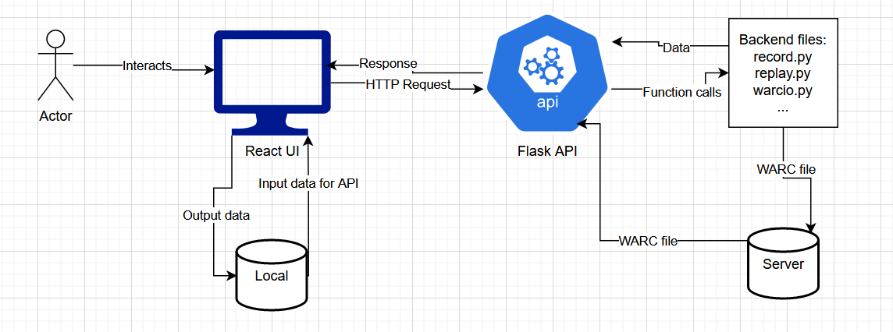
System Overview

Slide 7
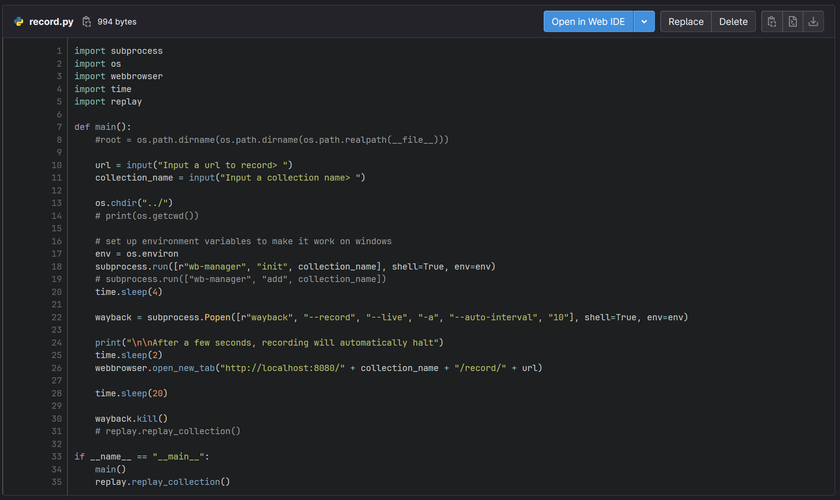
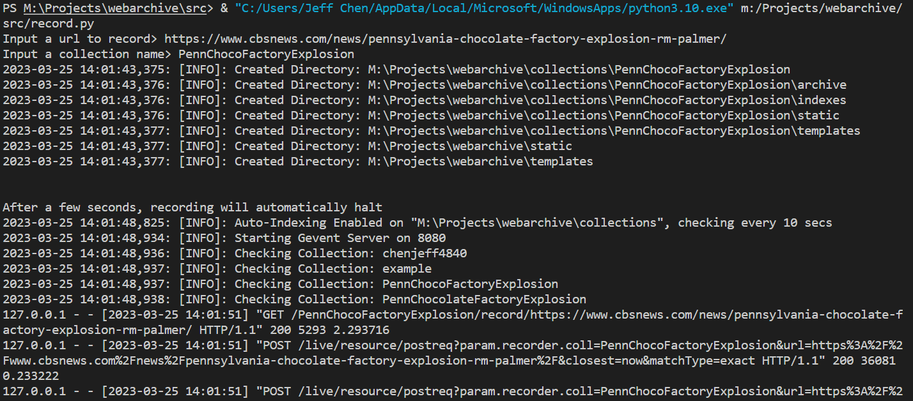
Current Progress - Recording
Notes:
Record.py

Slide 8
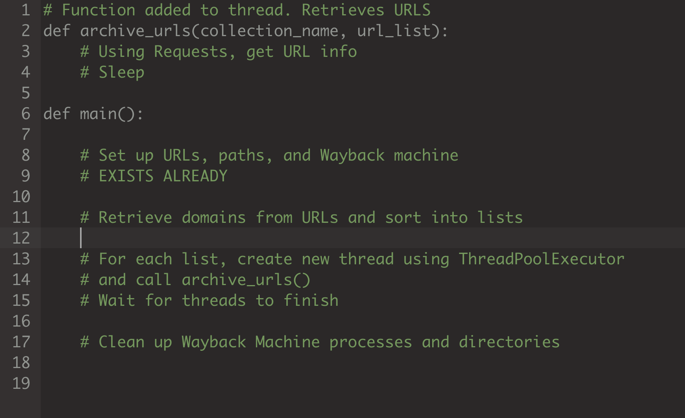
Current Progress -
Multithreading
Notes:
Testing needed using large url sets
ThreadPoolExecutor
NIHAL

Slide 9
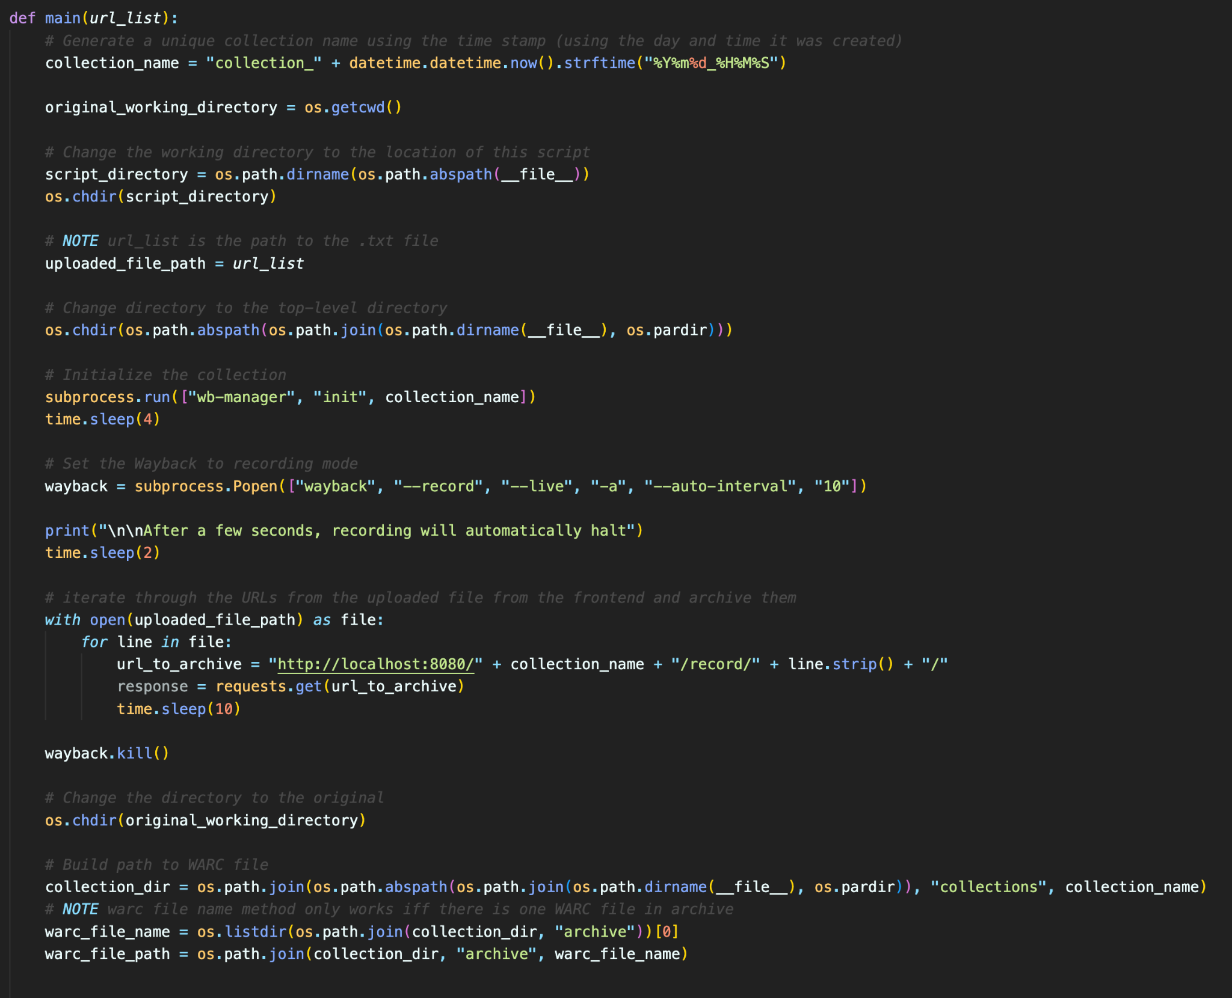
Current Progress - Full Backend

Slide 10
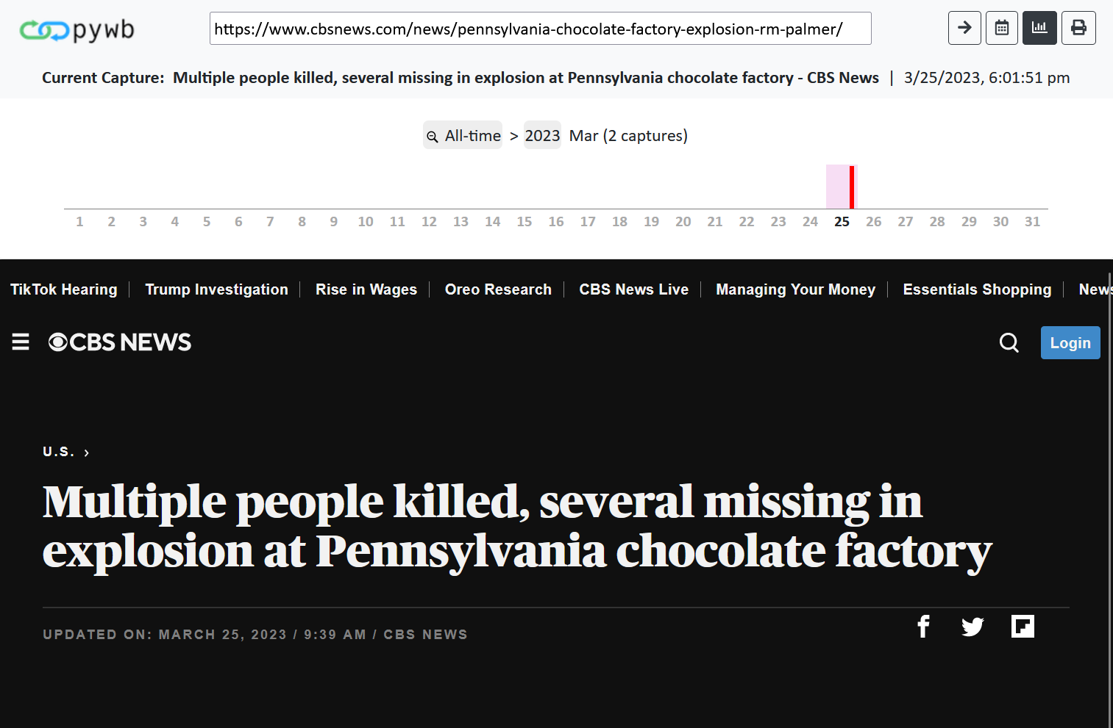
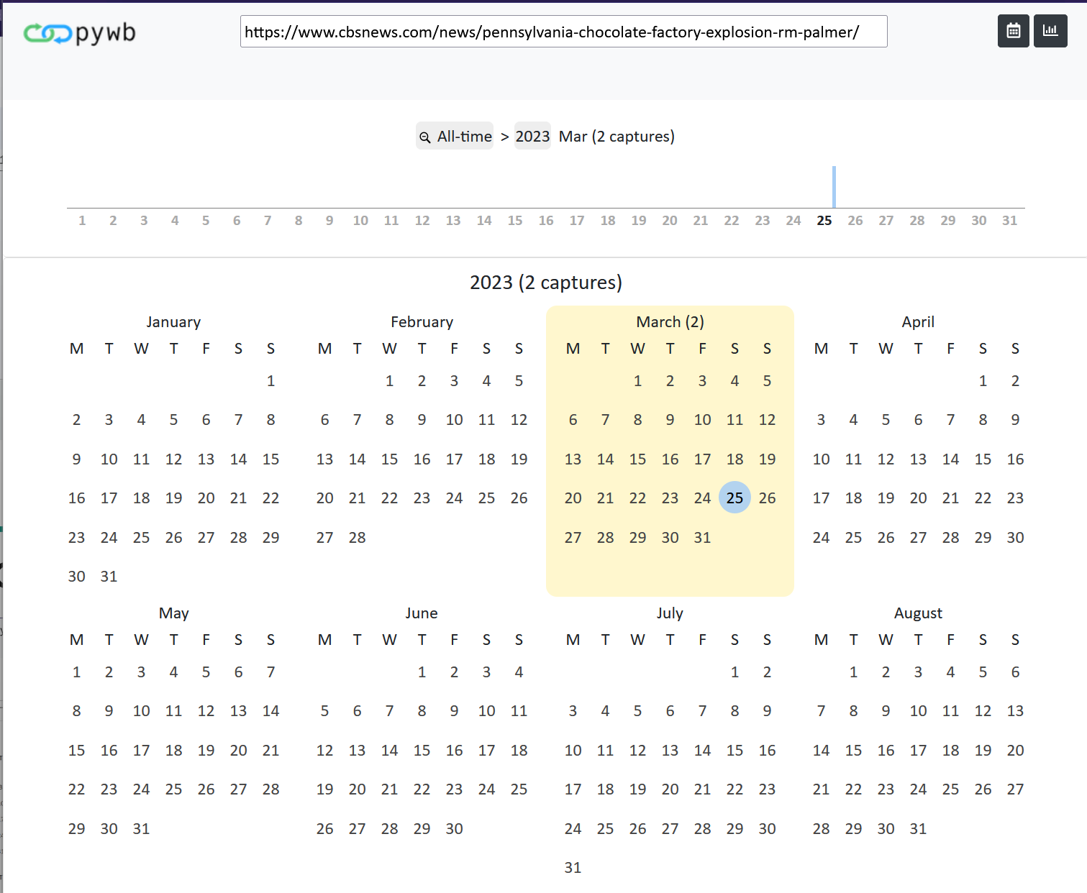
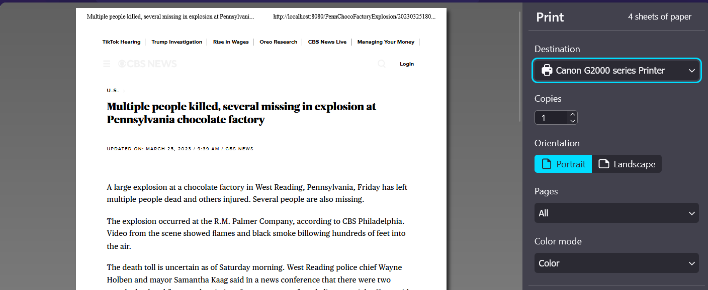
Current Progress - Replay
Notes:
Replay uses complete URL of archived web page.
Replay functionality unchanged from last presentation besides some extra code to aid with linking with the api
To recap: replay
Opens a replay browser as seen on the left
User selects a collection and inputs a url
Brought to calendar view were user selects a date of snapshot of a url
The snapshot is then shown to the user which the user can then go back to calender view, view snapshot captures for the month, and print the snapshot

Slide 11
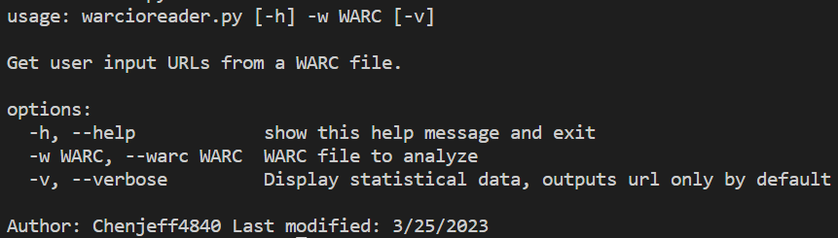
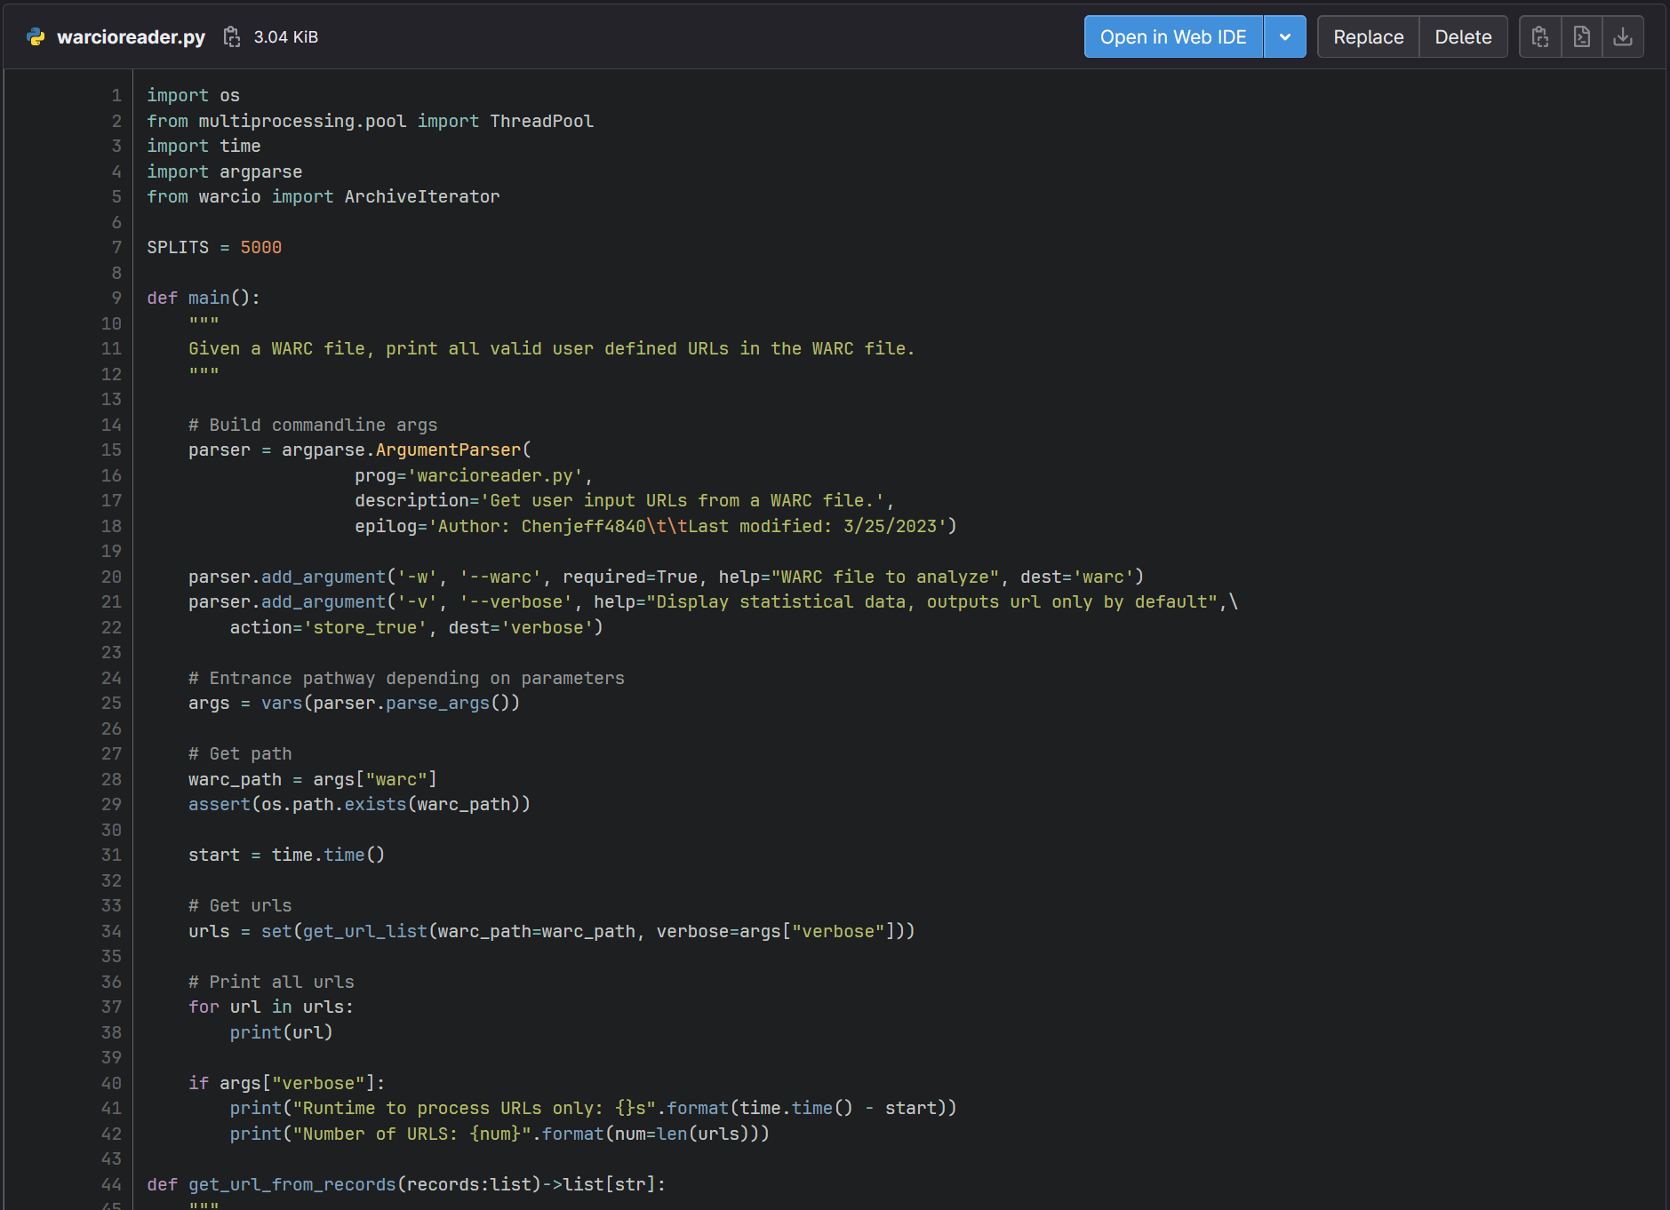
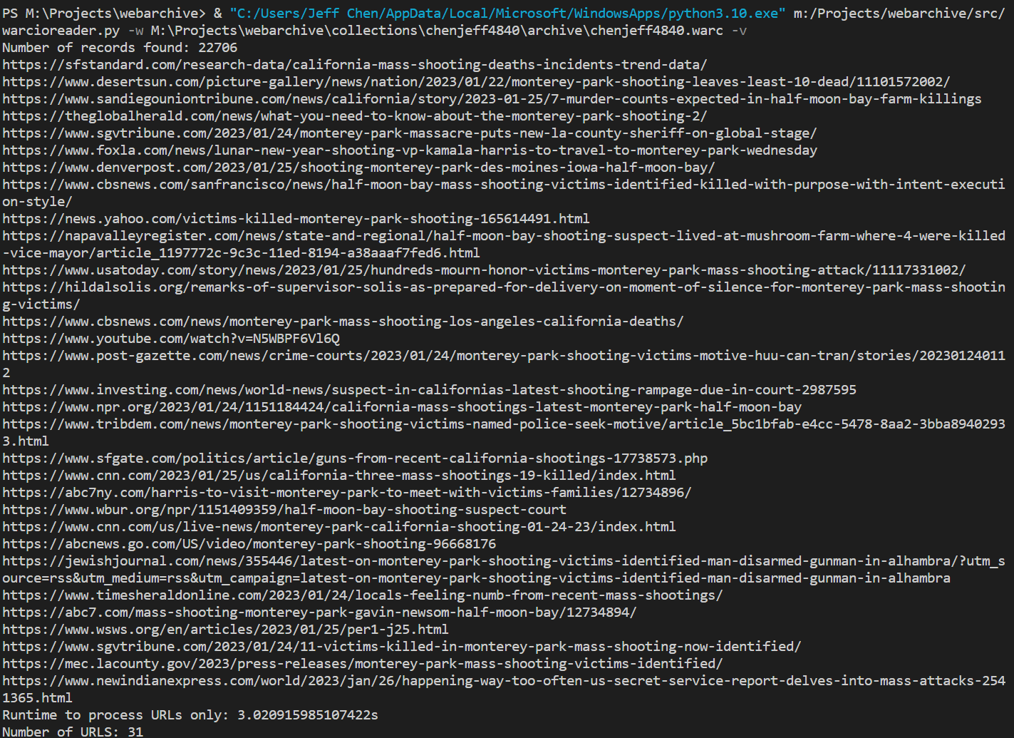
Current Progress - Replay
Notes:
Script to get all user input urls from a WARC file is unchanged, it hasn’t been linked up with the api yet and we are looking for alternatives such as looking at WARC index files which may speed up the speed needed to get all user input urls from a WARC file.

Slide 12
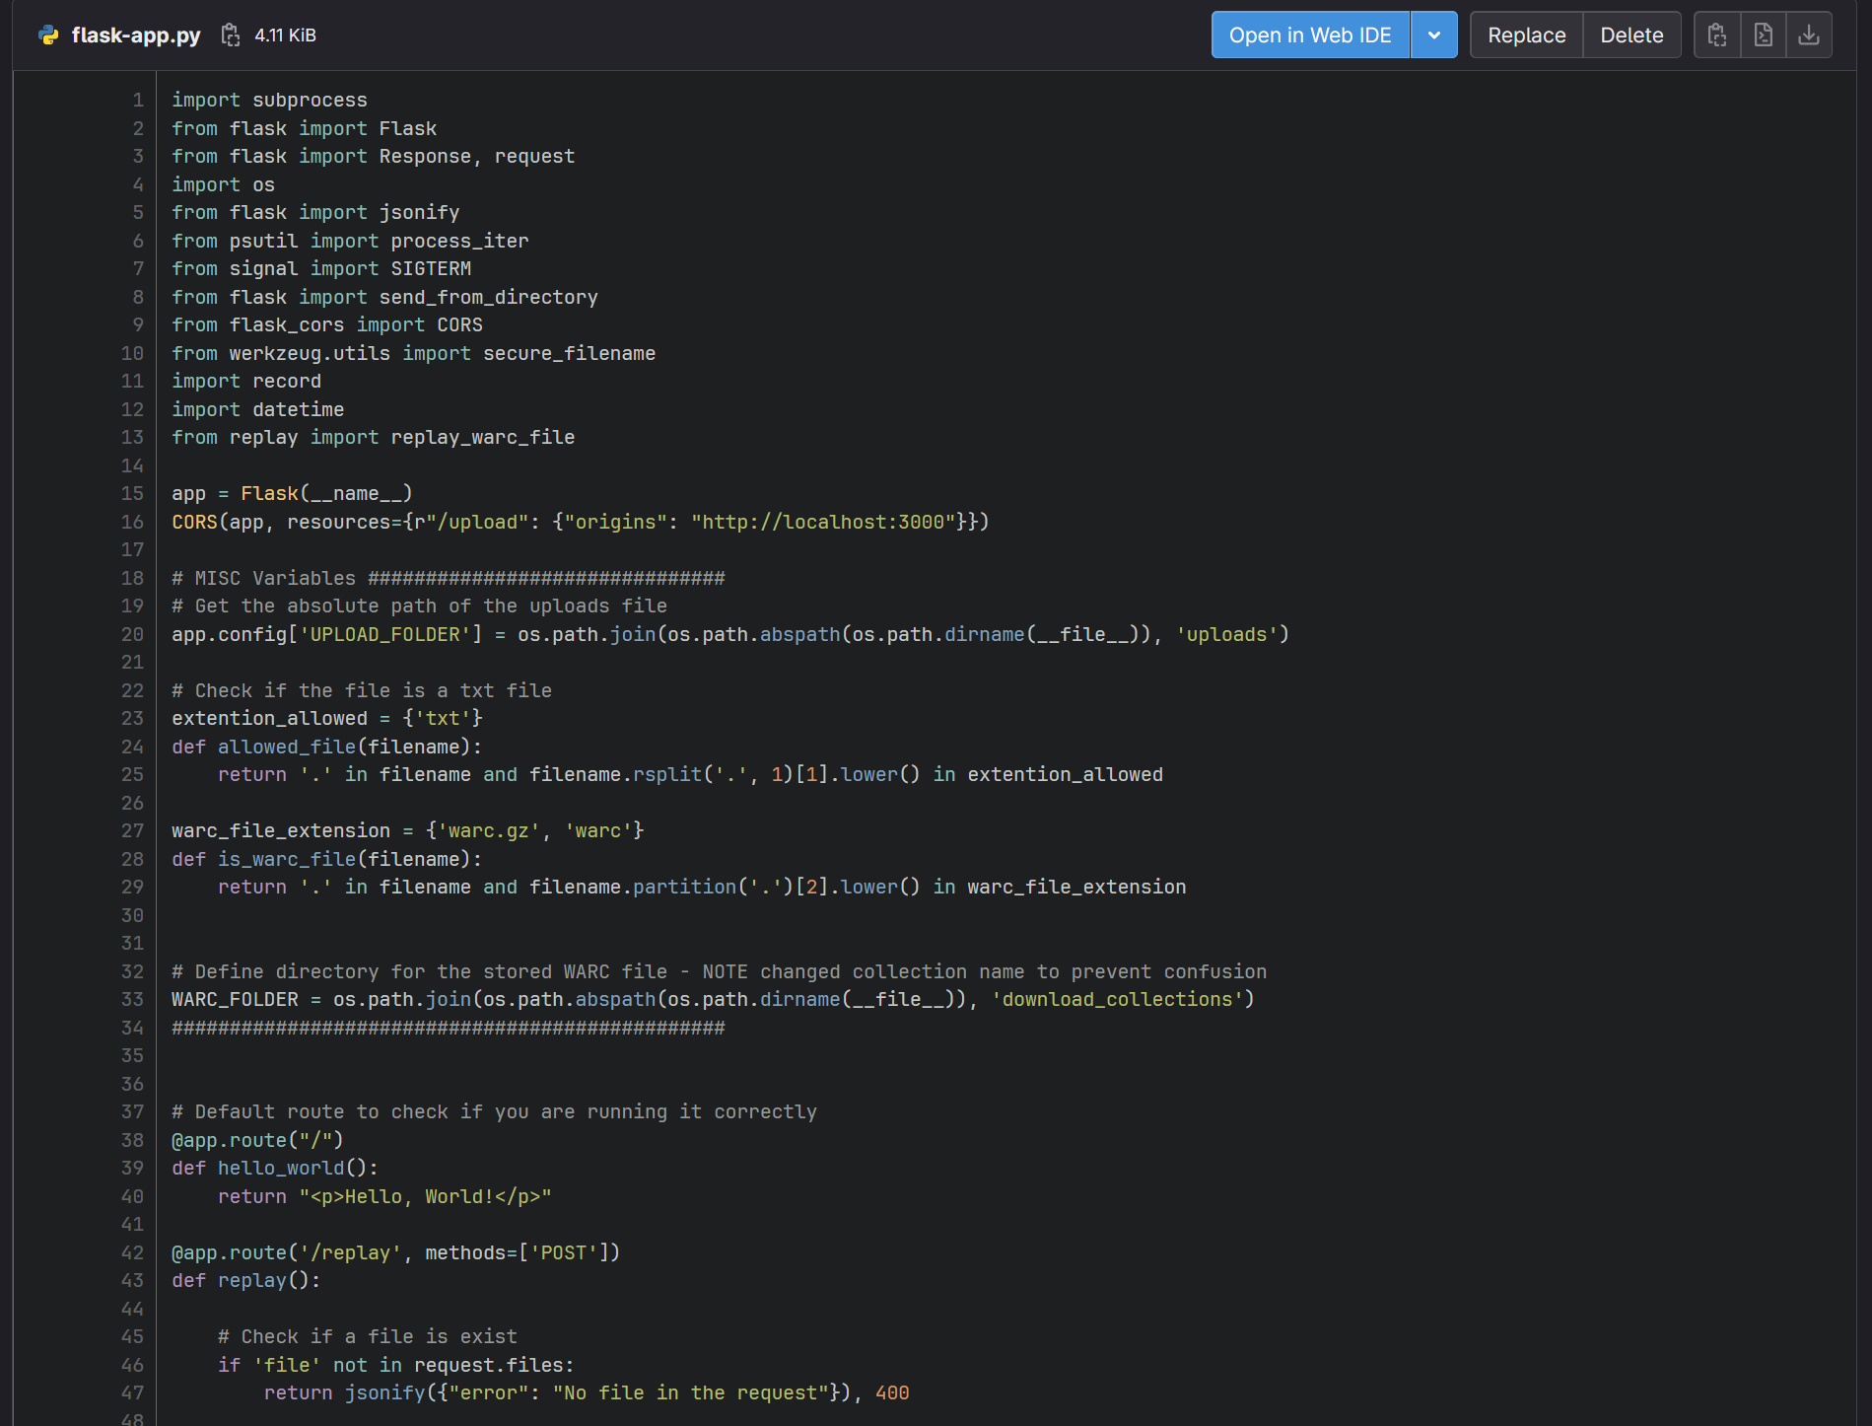
Current Progress - Flask Backend
Notes:
Flask script functionality was consolidated to make it easier to for the front end to access the backend. Two main routes which will record all urls given a list of urls in the form of an uploaded text file and replay a WARC file given a uploaded WARC file.

Slide 13


Work Done - Frontend
React Web Application
  Upload text file with URLs to archive.
  Upload WARC file to replay.
Connected to the backend using Flask.
New UI with routes.
Applied most of the new UI to our application.
Notes:
Merna

Slide 14
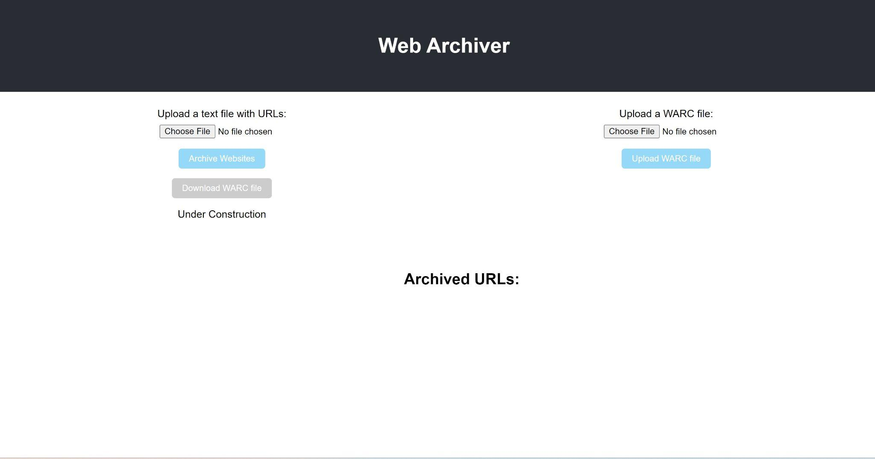
Home Page
Notes:
Merna

Slide 15
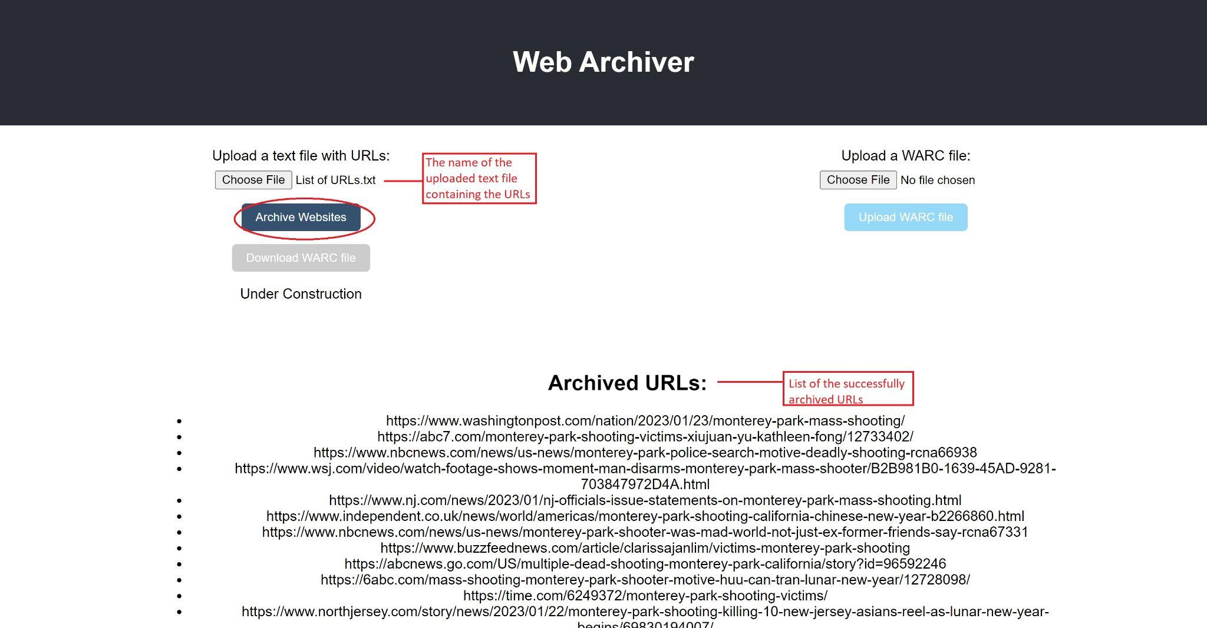
Notes:
Merna

Slide 16
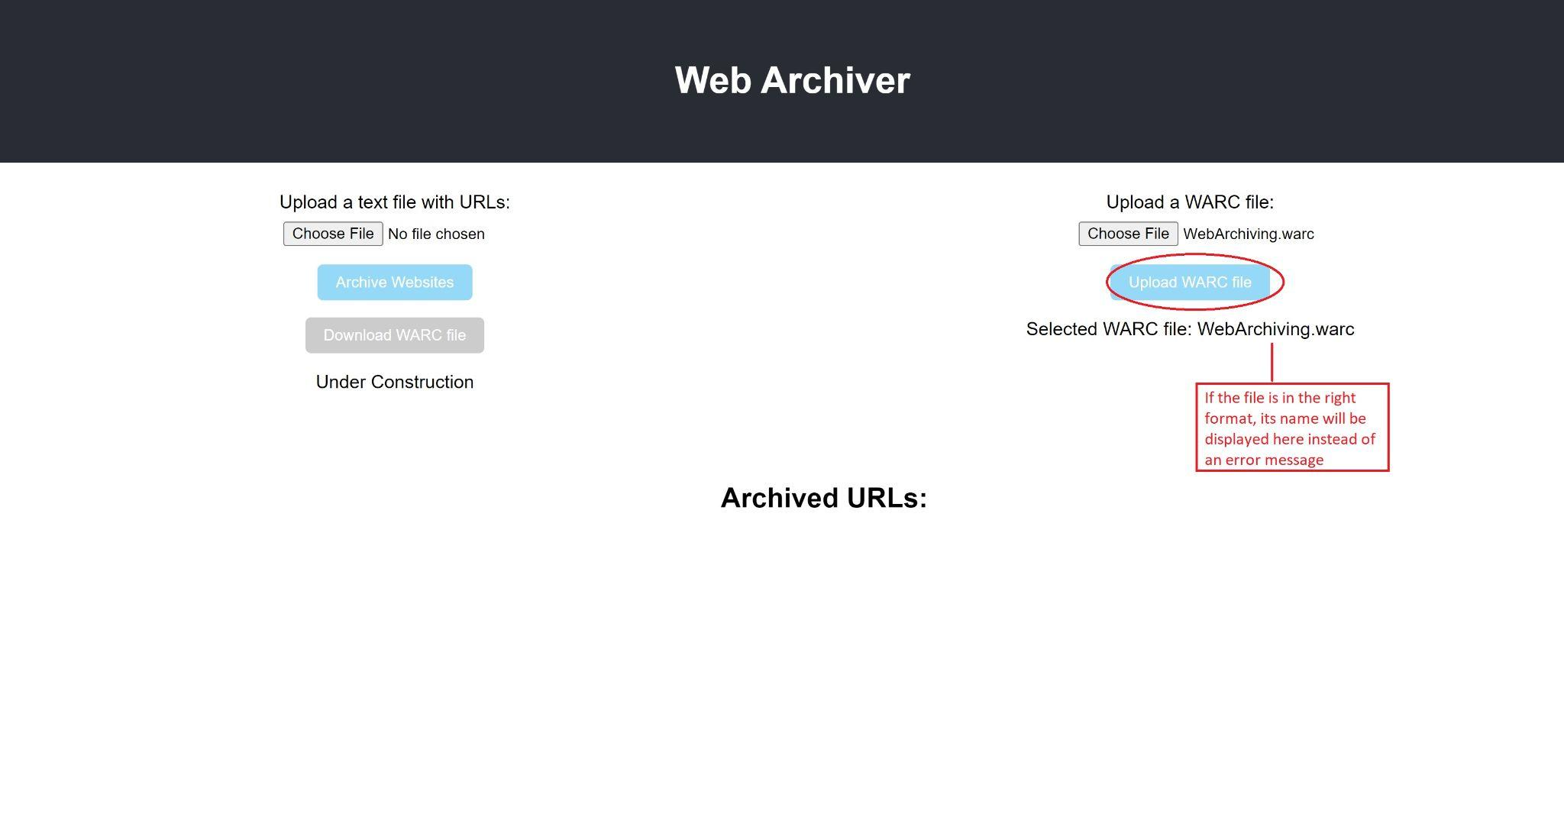
Notes:
Merna

Slide 17
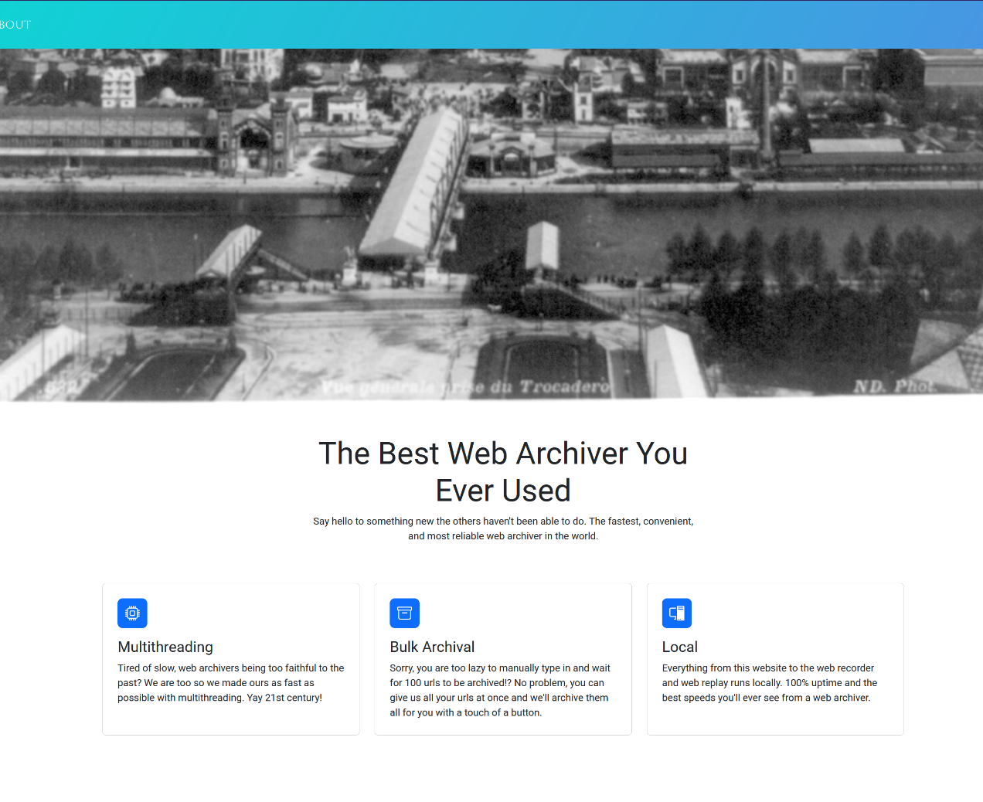
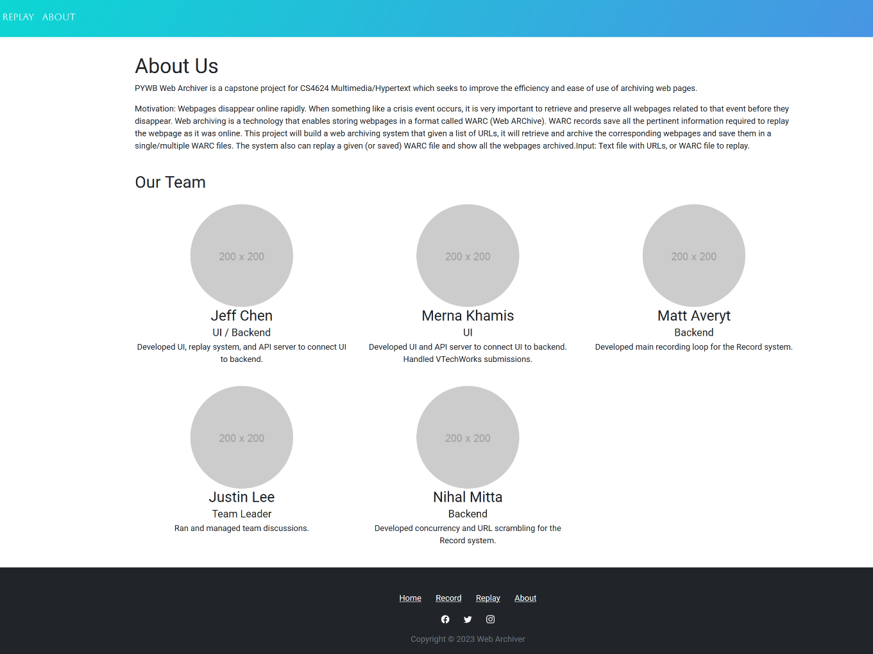
What’s Done: Current UI

Slide 18
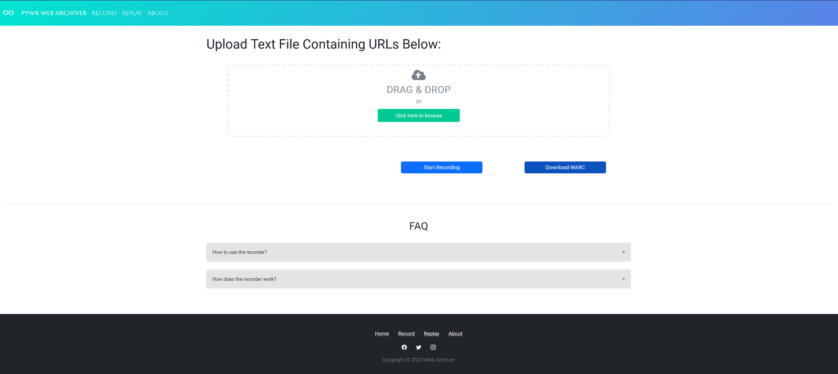

Slide 19
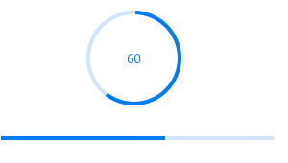
What’s Next
Progress bar for the URL archival
  Allows user to see current progress
Path specification for archiving
Mac and Linux Compatibility
Quickness and efficiency
Refine current UI
Download WARC File after archiving is done
List of URLs in WARC file instead of searching
Notes:
Nihal

Slide 20
Lessons Learned
Web archival
  Importance and tools
Flask
  Frontend & Backend integration
Python libraries
  Pywb, Warcio
Teamwork & Communication
  Essential as a group
Time management
  Meet deadlines
Meetings
  Help get everyone up to speed

Slide 21

Timeline/Milestones
Presentation 2: 3/28
All coding completed: 4/9-16
User/Developer Manuals: 4/9-16
Final Presentation: 4/20
Final Report: 4/27
Notes:
Justin
Something about archiving, and then replaying; maybe there is no need for dates

Slide 22
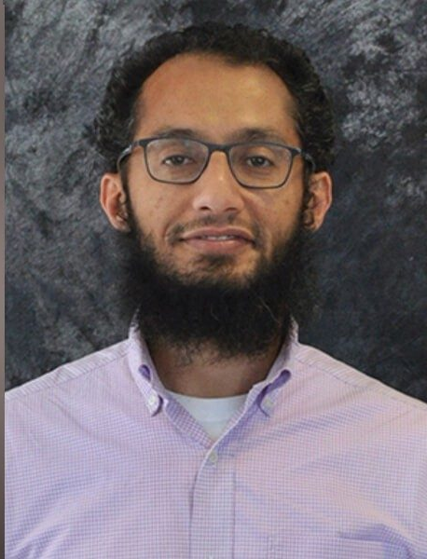

Acknowledgement
Dr. Mohamed Farag
Research Associate of the Center of Sustainable
Mobility VT, Transportation Institute.
We would thank our client, Dr. Farag, for allowing us to work on this project and working with us by giving us advice and guiding us through the entire process.
Notes:
Merna

Slide 23

References
[1] https://webrecorder.net/
[2] https://www.selenium.dev/
[3] https://pywb.readthedocs.io/en/latest/
[4] https://github.com/internetarchive/heritrix3
[5] https://github.com/webrecorder/browsertrix-crawler
[6] https://legacy.reactjs.org/docs/getting-started.html
Notes:
Maybe change references to be more “formal” like ieee or something

Slide 24
Thank you!

Slide 25

DEMO TIME
Notes:
Maybe change references to be more “formal” like ieee or something

