Slide 1
Giles County Animal Rescue
Virginia Tech, CS4624 Spring 2013, 5/6/2013
Amber Parsons
Greg Myrick
Blacksburg, VA
Client:
Christine Link-Owens

Slide 2
Overview
Project goals
Timeline
Work accomplished:
Mockups
Development
User Testing/Bug Fixes
Release
Demo

Slide 3
Project Goals
Redesign/fix the Giles County Animal Rescue website.
Broken features
Redundancies
Hard to use/navigate
Add new features
Newsletter functionality
Expanded animal statuses
Train users to add content and maintain the new website

Slide 4
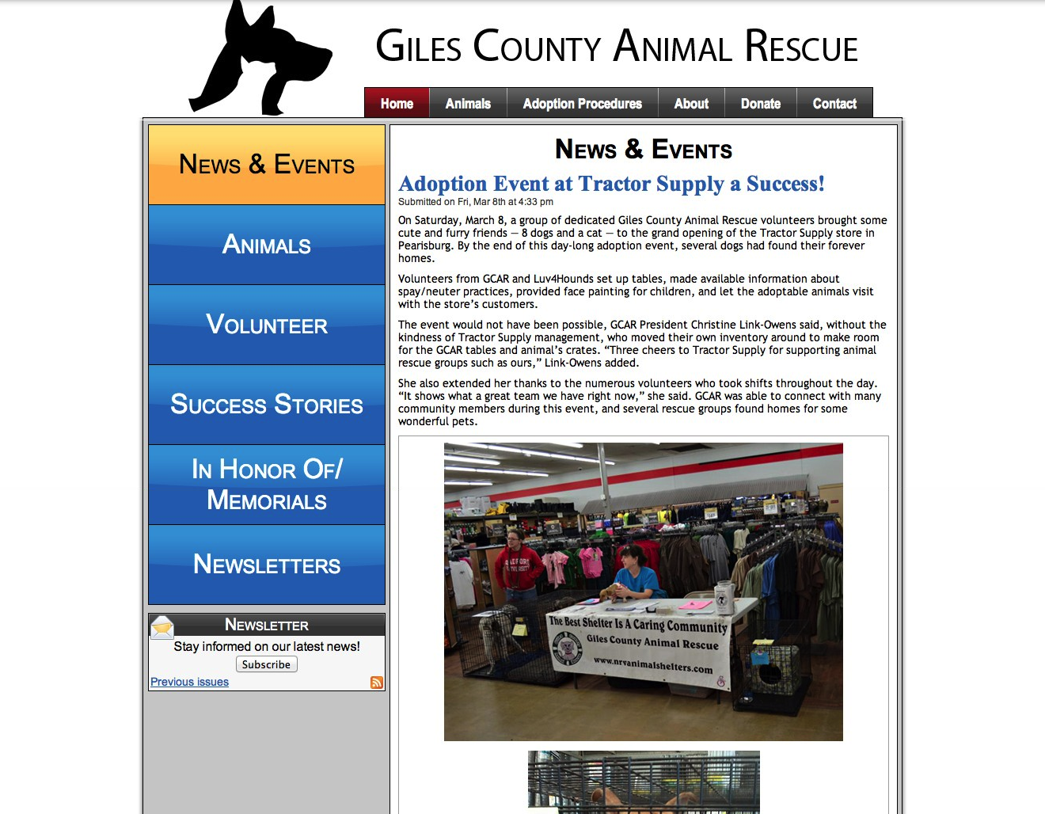
Giles County Animal Rescue - Before Redesign

Slide 5
Timeline
February 8th: Meet with the client
February 15th: Submit plan and mockups for proposed interfaces/functionality
March 15th: Give update of development status
March 30th: Submit all implemented functionality as prototype for evaluation
April: 10th: Finish initial development
April 15th: Wrap up testing, bug fixes, begin user testing
April: 30th: Finish user testing, last bug fixes, release website

Slide 6
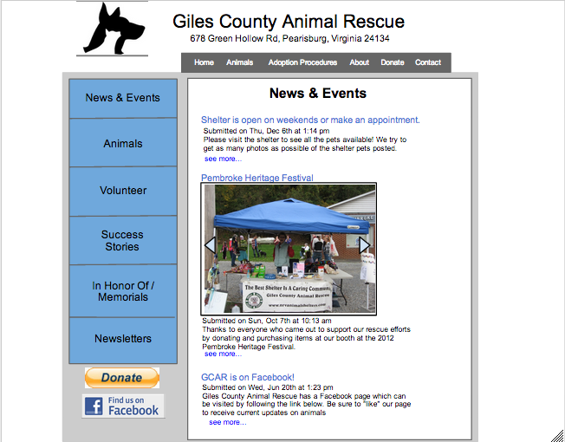
Mockups
Created mockups using Google draw

Slide 7
Development
Began with fixing bugs
Quickly realized that many things were beyond repair
Many of the layout files were full of hacks and quick fixes
2 options:
Find workarounds
Restart and design from scratch
We chose to start from scratch

Slide 8
Development
We needed to recreate the website
Recreated views
Added in content types
Installed necessary modules
Migrated data
Once that was finished, we needed to add any new functionality

Slide 9
User Testing/Bug Fixes
Users had several issues with our design:
Difficult to find some pages
Requests for additional functionality
Adding new animal statuses
Adoptable - Foster Care, At Risk
Lost, Found
Saved - Adopted, Rescued, Owner Found
Hidden, Hidden - Euthanized
Changing site layout
Modification of logo to include address
A text address was added to the existing logo using GIMP by the students
A few small bug fixes
Animal statuses not changing
Contact page not sending emails

Slide 10
Release
We are currently working on making the website live
Administrators will receive documentation on how to use the site
Video documentation for editing the site
User's manual

Slide 11
Questions?

