Slide 1

A Framework Tasting
Trying Out a New Vintage in Info Lit
Virginia Pannabecker
Life Science & Scholarly Communications Librarian Virginia Tech
“wine, cheers, red, lounge, restaurant,” by Skitterphoto, CC0, via Pixabay http://pixabay.com/en/wine-cheers-red-lounge-restaurant-622116/
This presentation is licensed CC BY-SA 4.0
Notes:
Welcome to this conversation starter, “A Framework Tasting.” We’ll start with a short overview of the new Framework for Information Literacy for Higher Education, with the majority of our time being a discussion of the Framework.

Slide 2
Post-Presentation Follow-Up
Slides, handouts, and TILC group discussion summary available at
http://tinyurl.com/TILCFrameworkTasting
TILC Group Discussion Summary:
also recorded below on slides 15-17.

Slide 3
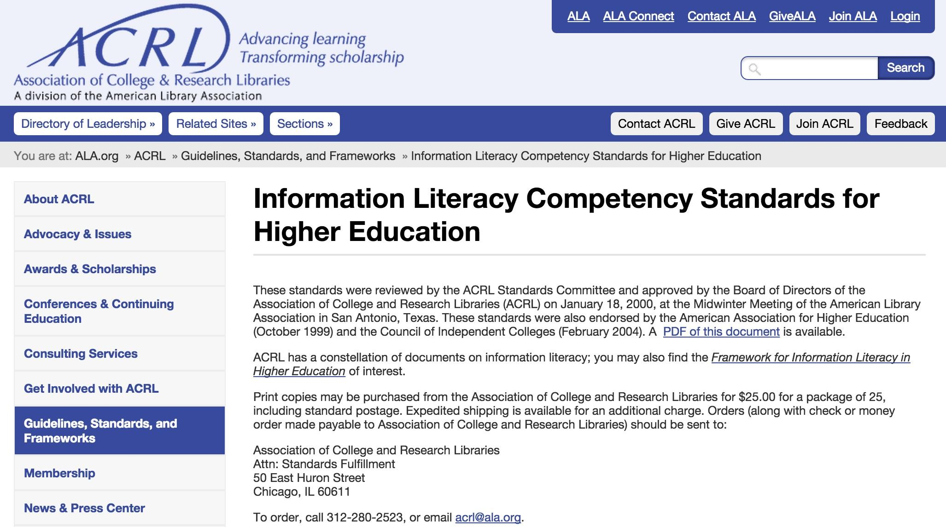
http://www.ala.org/acrl/standards/informationliteracycompetency
Notes:
We’ve all become used to integrating the Information Literacy Competency Standards for Higher Education into instruction and curriculum support. Many of us also use disciplinary adaptations of these standards, such as those for Nursing and Visual Literacy.

Slide 4
A new approach
“It is time for a fresh look at information literacy, especially in light of changes in higher education, coupled with increasingly complex information ecosystems.”
~Framework for Information Literacy Appendices, Appendix 1, Creating a Framework

Slide 5
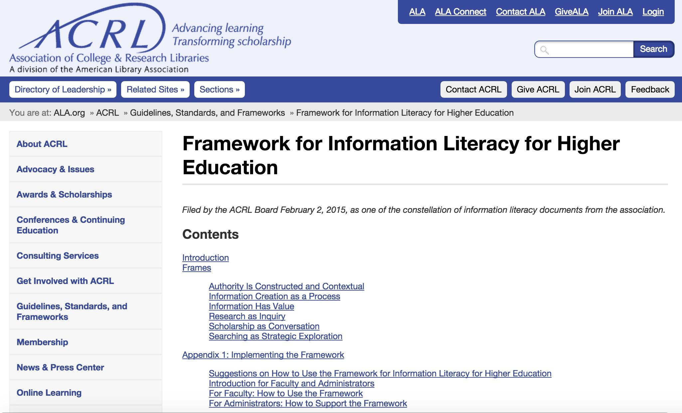
http://www.ala.org/acrl/standards/ilframework
Notes:
To address challenges we all encounter within current complex information ecosystems, ACRL designated a task force who developed this new Framework for Information Literacy for Higher Education.

Slide 6
Threshold concepts
“Threshold concepts² are those ideas in any discipline that are passageways or portals to enlarged understanding or ways of thinking and practicing within that discipline.”
Metaliteracy
“...this Framework draws significantly upon the concept of metaliteracy,⁷ which offers a renewed vision of information literacy as an overarching set of abilities in which students are consumers and creators of information who can participate successfully in collaborative spaces.”
~ACRL Framework for Information Literacy for Higher Education, Introduction
2 Grant Wiggins and Jay McTighe. Understanding by Design. (Alexandria, VA: Association for Supervision and Curriculum Development, 2004)
7 Thomas P. Mackey and Trudi E. Jacobson. Metaliteracy: Reinventing Information Literacy to Empower Learners.(Chicago: Neal-Schuman, 2014)
Notes:
The framework is built with consideration of ‘Threshold Concepts,’ from Wiggins and McTighe’s Understanding by Design - encouraging instructors and learners to explore key concepts in interacting with information. The Framework also makes use of Metaliteracy from Mackey and Jacboson in frame descriptions and in suggested Knowledge Practices that follow each frame as examples of abilities that learners engaging with each frame may demonstrate.

Slide 7
Frames
“The Framework is developed around a set of “frames,” which are those gateway or portal concepts through which students must pass to develop genuine expertise within a discipline, profession, or knowledge domain.”
~Framework for Information Literacy Appendices, Appendix 1, Creating a Framework
Notes:
What seems especially exciting about the Framework is its use of these portal concepts, where, standing at a starting point we, learners, instructors, may depart in any number of directions and explore these crucial concepts in ways and at levels that fit our current and aspirational learning goals.

Slide 8
6 Frames
Authority Is Constructed and Contextual
Information Creation as a Process
Information Has Value
Research as Inquiry
Scholarship as Conversation
Searching as Strategic Exploration
Notes:
Theses are the six frames in the new framework. The framework’s description points out that their order is alphabetical, which is intended to prevent any ranking of one over another.

Slide 9
Knowledge Practices
“Each frame includes a knowledge practices section used to demonstrate how the mastery of the concept leads to application in new situations and knowledge generation.”
Dispositions
“Each frame also includes a set of dispositions that address the affective areas of learning”
~Framework for Information Literacy Appendices, Appendix 1, Creating a Framework

Slide 10
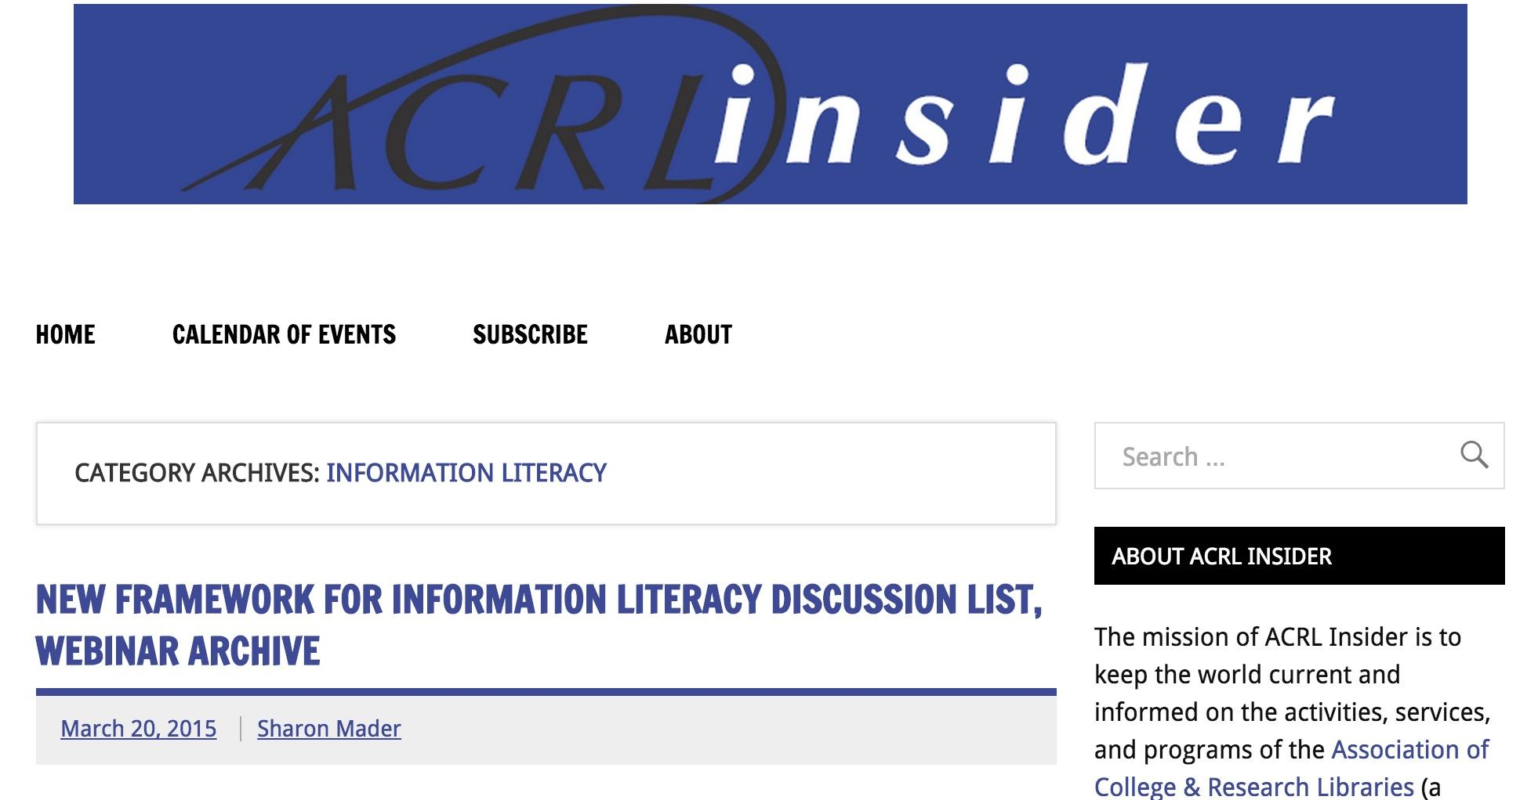
Discussion List & Webinar Archive
http://www.acrl.ala.org/acrlinsider/archives/category/information-literacy

Slide 11
How will we use the Framework?
Authority Is Constructed and Contextual
Information Creation as a Process
Information Has Value
Research as Inquiry
Scholarship as Conversation
Searching as Strategic Exploration
Notes:
Now, we’ll move on to our discussion activity.

Slide 12
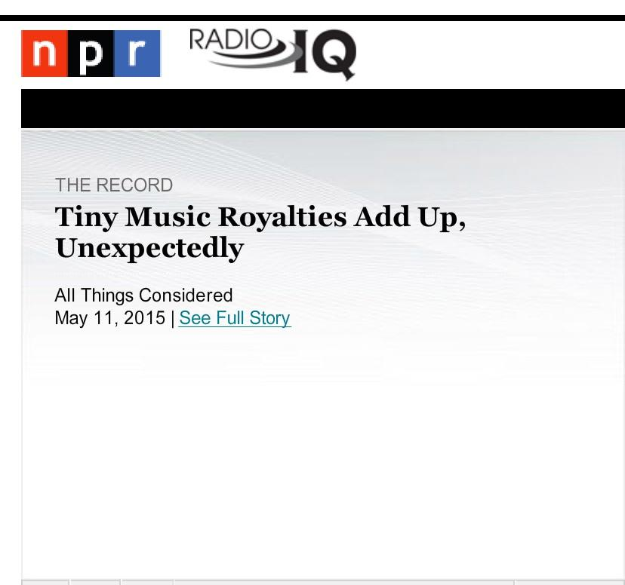
http://www.npr.org/blogs/therecord/2015/05/11/404485444/tiny-music-royalties-add-up-unexpectedly
Notes:
To kick off our discussion, let’s listen to this news story on micro-licensing for music, which is relevant to most if not all 6 frames in the new framework. This story covers copyright and intellectual property, joint creator rights, student creator rights, use of music for commercial, business, and personal multimedia creations, and more.

Slide 13
References
Images: all images used in this presentation are: in the public domain, or are screenshots taken by Virginia Pannabecker with the Mac Grab utility application.
These slides and accompanying discussion group handouts available at: http://tinyurl.com/TILCFrameworkTasting
TILC Group Discussion Summary: recorded below on slides 15-17.
ACRL Information Literacy Competency Standards for Higher Education, 2000. http://www.ala.org/acrl/standards/informationliteracycompetency
ACRL Framework for Information Literacy for Higher Education, 2015. http://www.ala.org/acrl/standards/ilframework
ACRL Framework for Information Literacy Appendices, Appendix 1, Creating a Framework, 2015. http://www.ala.org/acrl/standards/ilframeworkapps
Grant Wiggins and Jay McTighe. Understanding by Design. (Alexandria, VA: Association for Supervision and Curriculum Development, 2004)
Thomas P. Mackey and Trudi E. Jacobson. Metaliteracy: Reinventing Information Literacy to Empower Learners. (Chicago: Neal-Schuman, 2014)
Sharon Mader, “New Framework for Information Literacy Discussion List, Webinar Archive,” ACRL Insider, March 20, 2015. http://www.acrl.ala.org/acrlinsider/archives/category/information-literacy
Laura Sydell, “Tiny Music Royalties Add Up, Unexpectedly,” All Things Considered, National Public Radio (NPR) program, May 11, 2015. http://www.npr.org/blogs/therecord/2015/05/11/404485444/tiny-music-royalties-add-up-unexpectedly

Slide 14
Discussion
Small Groups - 1 frame each
Report Back & Full Group
Wrap-Up

Slide 15
How will we use the Framework?
“The Framework opens the way for librarians, faculty, and other institutional partners to:
redesign instruction sessions, assignments, courses, and even curricula;
connect information literacy with student success initiatives;
collaborate on pedagogical research and
involve students themselves in that research; and
to create wider conversations about student learning, the scholarship of teaching and learning, and the assessment of learning on local campuses and beyond.”
~ACRL Framework for Information Literacy, Introduction

Slide 16
Discussion Summary - Engaging with the Framework
Questions considered:
What does this frame mean to you?
How do your current instructional practices support:
What else would you like to try to engage with and support:
Authority Is Constructed and Contextual
An example provided by the Frame 1 group to engage with the frame: A faculty from a Social Psychology course approached a librarian in the group about frame 1 as it related directly to what they were teaching in their course - examining construction of authority. As an activity, the instructor and librarian divided the class into groups. Each group (was given, or found?) a journal article about a topic in Social Psychology. They were asked to read the article. Then, they were asked to research the article’s author/s and prepare an introduction of the author/s as though they would be introducing the author/s as a speaker. They were asked to address the author’s / authors’ work, qualifications, and to use the following question to frame their intro: Why would this author be worth listening to?
Information Creation as a Process
The group saw this frame as promoting opportunities to investigate the process behind information one uses, and the processes one uses oneself. One example provided: ask students, “Where does information come from?”, then discuss responses. When encountering information sources, ask, “Where does this information come from?” - for example, whether looking at a Twitter, Facebook, or Instagram post, an article from an academic journal, a post on an organization’s website, etc. Follow up with a discussion on how else such information might be published/distributed.
Notes:
Welcome to this conversation starter, “A Framework Tasting.” We’ll start with a short overview of the new Framework for Information Literacy for Higher Education, with the majority of our time being a discussion of the Framework.

Slide 17
Discussion Summary - Engaging with the Framework
Questions considered:
What does this frame mean to you?
How do your current instructional practices support:
What else would you like to try to engage with and support:
Information Has Value
The group saw this theme as tying into the theme Scholarship as Conversation. Their discussion considered options such as a year long or semester long class that would engage with both of these frames and address topics such as citation, information privilege, and a balance between flexibility and precision in methods for valuing information. They also noted that they would add discussions of consequence when addressing this frame - consequences of valuing information using standardized practices, and of not taking time/effort to do so (lack of attribution).
Research as Inquiry
The group saw this frame’s importance as emphasizing ways to support students in the full process of inquiry, and in facilitating activities, time, and spaces in which they are supported in inquiry as a true exploration, idea generation, and question formulation → both prior to, and mixed in with frame 6, which focuses on Searching as Strategic Exploration. One example from this group is a course where the librarian and instructor support students in exploring and acquiring many sources of information, so closer to 10 minimum, rather than a more standard 2-5 for intro research courses. The idea being to really explore the topic and then develop their questions and target their subsequent searches based on what they learn and think about after reading and evaluating the first large group of sources.

Slide 18
Discussion Summary - Engaging with the Framework
Questions considered:
What does this frame mean to you?
How do your current instructional practices support:
What else would you like to try to engage with and support:
Scholarship as Conversation
The group saw this frame as a way to encourage students to think of their role as a participant in the scholarly conversation. Some methods the group suggested were to encourage students to: build on others’ ideas, be open to new and different ideas, provide evidence from other works as part of their work to show that they are part of the larger conversation on a topic, and experience the conversation as ongoing without an endpoint. The group emphasized discussing different outputs for scholarship and the role they play in shaping the scholarly conversation. They also suggested assigning useful outputs, such as grant proposals rather than research papers to build similar skills and work with a useful experience for later scholarly work.
Searching as Strategic Exploration
This group saw this frame as a common role for librarians in supporting faculty teaching and student research. They suggested the following ways to engage with this frame: discussing uses of discovery tools versus/in addition to distinct resources; discussing ways to approach searching - as tactical, as question driven; work with students to break down the process of searching; and encourage students to consider first what they already know, and what methods they already use to gather information - encourage them to think through when, how, and why they use different methods to find different information. The group also promoted training for faculty on information literacy and forming partnerships to integrate this frame with course assignments, such as students receiving points for creating research logs.

Slide 19
Additional
Questions
(if time allows)

Slide 20
Connecting with Colleagues
How would you introduce the framework to colleagues in your institution or community outside of the library?

Slide 21
Disciplinary Adaptations
The previous standards have been adapted to discipline-specific contexts by librarians specializing in related subject areas.
Do you specialize in a subject area and/or use any of the disciplinary standards?
How will you use the new Framework with your discipline - will it need disciplinary adaptations?

Slide 22
Critical Librarianship
Are you familiar with the emerging term ‘Critical Librarianship’?
Will using the new Framework support changing approaches to librarianship and library instruction?

